Slide 1
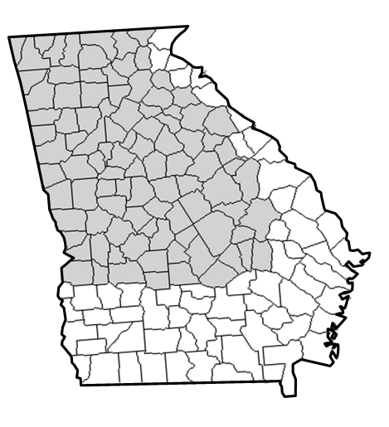
National Weather Service
Disclaimer: The information contained in this briefing is time sensitive which should be taken into consideration while viewing.
Weekly Weather Briefing
NWS Atlanta/Peachtree City
For the Week Starting July 24, 2025
Notes:
Good morning, I’m Sam Marlow, a meteorologist with the National Weather Service here in Peachtree City GA. This is your weekly weather briefing starting today, October 26th 2023, through next Wednesday, November 1st.

Slide 2
The Week Ahead
For the Period Thursday (July 24) through Wednesday (July 30)
Risk/Impact Levels:
1
2
3
4
5
Today (7/24)
Friday
Saturday
Sunday
Monday
Tuesday
Wednesday
1
2
2
3
4
4
3
Heat Index values 95-105F
Widely scattered (15-30%) mainly aftn/eve storms
Heat Index values 98-110F
Isolated (10-20%) storms mainly far north GA
Heat Index values 98-112F
Heat Index values 100-115F Isolated (10-20%) aftn/eve storms
Heat Index values 100-115F Widely scattered (15-30%) storms
Heat Index values 98-112F Scattered (25-45%) storms
The HEAT will continue to be the primary concern through the next 5-7 days, with dangerously high Heat Index values expected Saturday through next Wednesday.
The storm threat will diminish over the next few days, but any storms that do develop will be capable of locally heavy rain, lightning and brief gusty winds.
Weather
Highlights

Slide 3
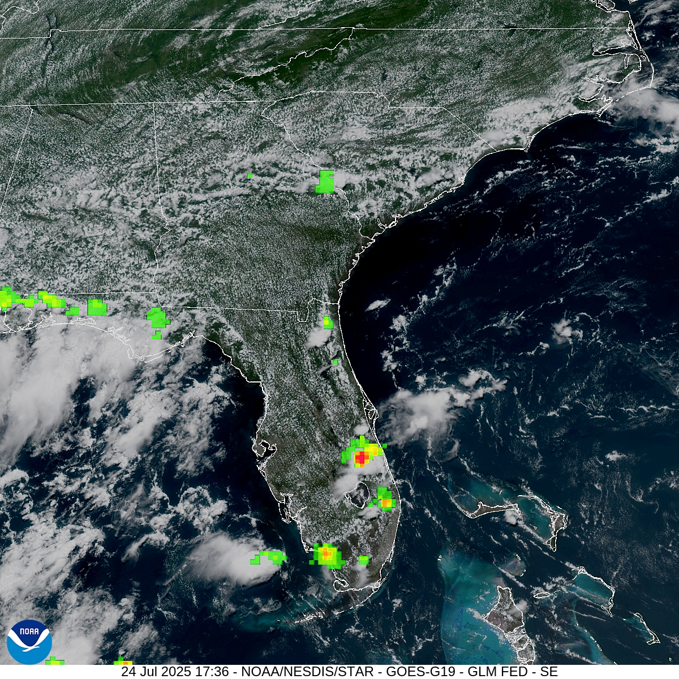
Satellite - Southeast
Loop = ~8a-12p Thursday (7/24)
An easterly flow off the Atlantic is maintaining decent moisture across the region. A few afternoon and evening showers & storms are possible as daytime heating occurs.
Primary storm threats:
Locally heavy rain
Lightning
Brief wind gusts (to 40 MPH)

Slide 4
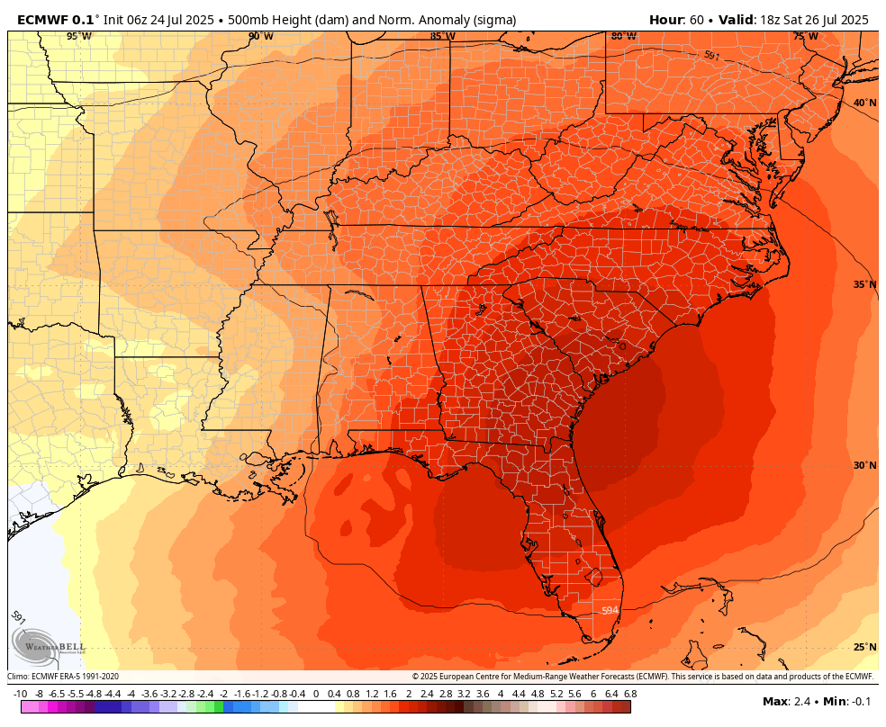
Why is it unusually HOT?
Upper level pattern (Sunday through early Tuesday)
Upper level HIGH pressure (i.e. “ridge”) can suppress thunderstorm development but can also result in very warm conditions
The pattern over the next 5-7 days shows an unusually warm “upper level ridge” setting up across the SE Region
The orange to darker red colors in the graphic shows upper level “heights” that are 1.5 to 3 times above where they typically would be for late July (our warmest time of the year)

Slide 5
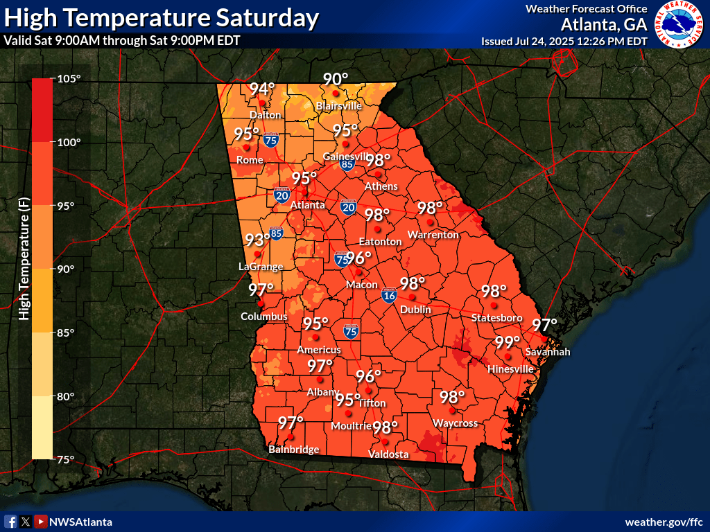
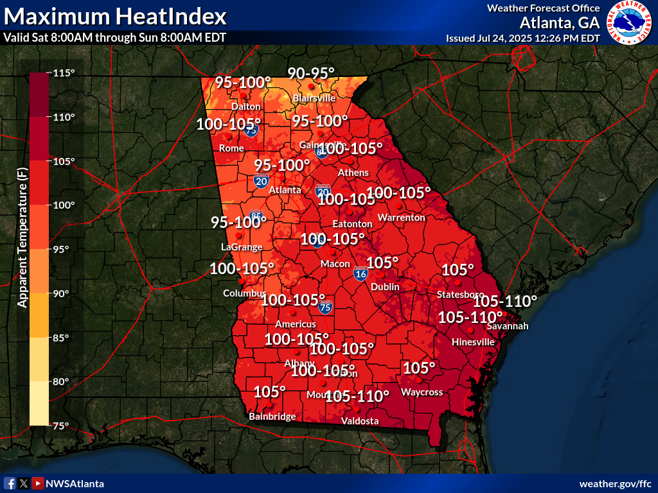
High Temps + Heat Index (Max)
Saturday (July 26)
Heat ADVISORY criteria likely across a portion of the area ≥ 105F (Heat Index).
Notes:
Taking a further look at the conditions expected today. Highs will be in the upper 70s to low 80s for much of Georgia. No precipitation is expected for today. So enjoy the sunshine and beautiful weather if you can!

Slide 6
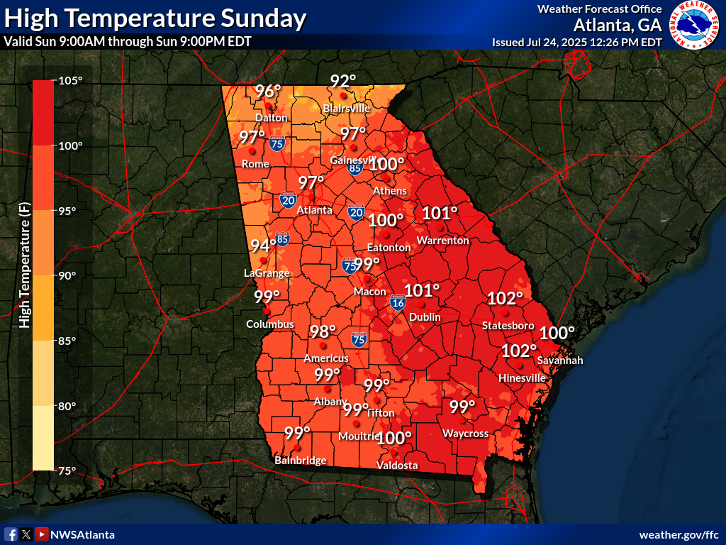
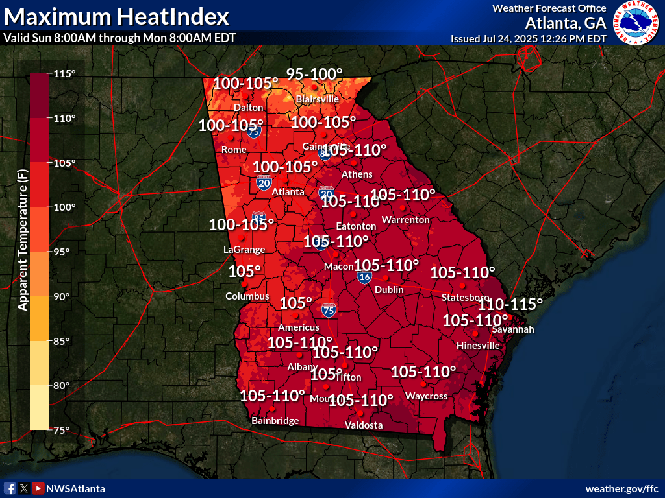
High Temps + Heat Index (Max)
Sunday (July 27)
Heat ADVISORY criteria likely across a portion of the area ≥ 105F (Heat Index).
Notes:
Taking a further look at the conditions expected today. Highs will be in the upper 70s to low 80s for much of Georgia. No precipitation is expected for today. So enjoy the sunshine and beautiful weather if you can!

Slide 7
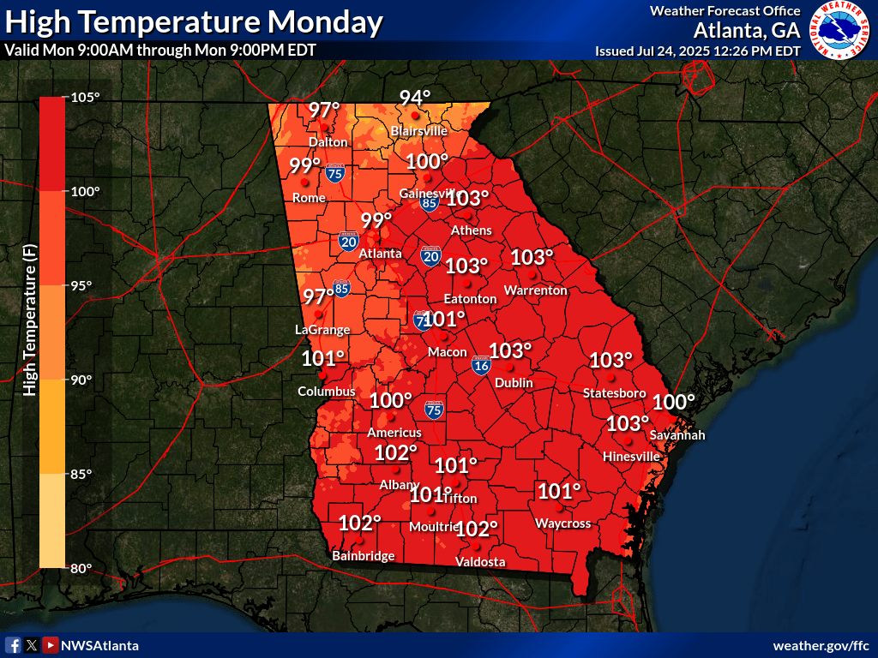
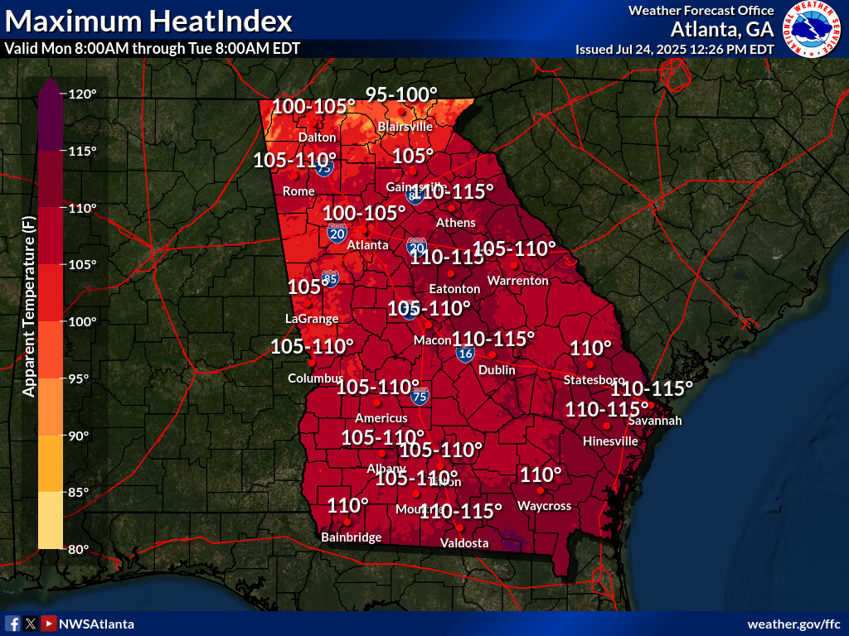
High Temps + Heat Index (Max)
Monday (July 28)
Heat ADVISORY criteria likely across a portion of the area ≥ 105F (Heat Index).
Extreme Heat WATCH or WARNING possible; areas ≥ 110F (Heat Index)
Notes:
Taking a further look at the conditions expected today. Highs will be in the upper 70s to low 80s for much of Georgia. No precipitation is expected for today. So enjoy the sunshine and beautiful weather if you can!

Slide 8
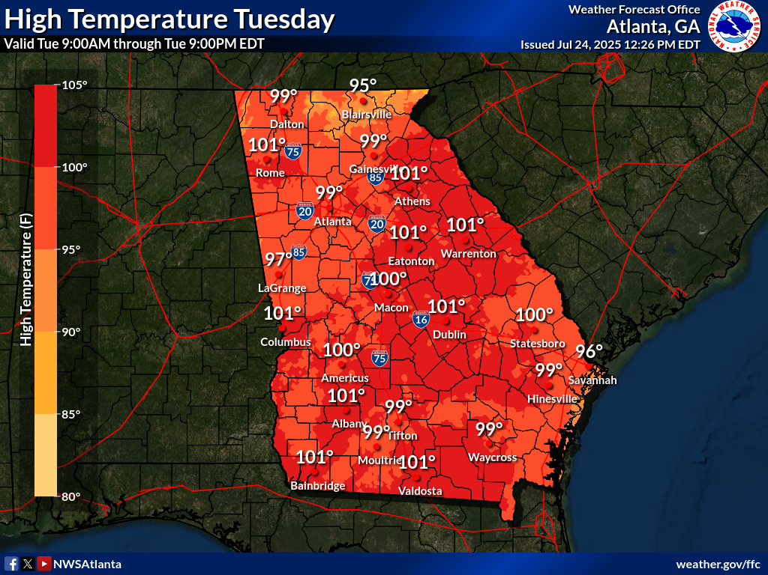
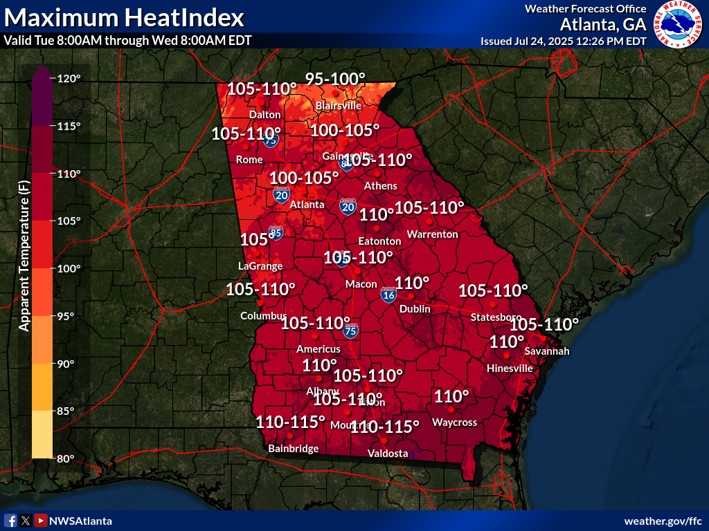
High Temps + Heat Index (Max)
Tuesday (July 29)
Heat ADVISORY criteria likely across a portion of the area ≥ 105F (Heat Index).
Extreme Heat WATCH or WARNING possible; areas ≥ 110F (Heat Index)
Notes:
Taking a further look at the conditions expected today. Highs will be in the upper 70s to low 80s for much of Georgia. No precipitation is expected for today. So enjoy the sunshine and beautiful weather if you can!

Slide 9
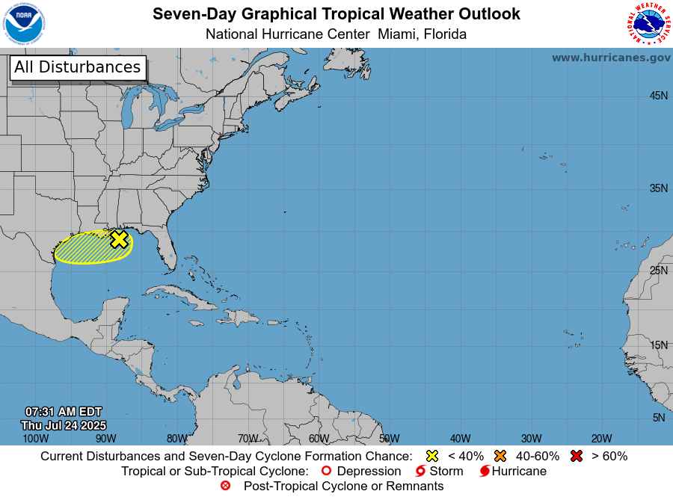
Keeping An Eye On The Tropics
Overview:
A weak disturbance over the northern Gulf is expected to drift west through the weekend and have little impact on our weather.
Chances of this disturbance becoming an organized tropical system is VERY LOW at this time (~10%).
9
NATIONAL WEATHER SERVICE ATLANTA
weather.gov/Atlanta
Follow:
@NWSAtlanta
Updated: Thu Jul 24, 2025 12:08 PM

Slide 10
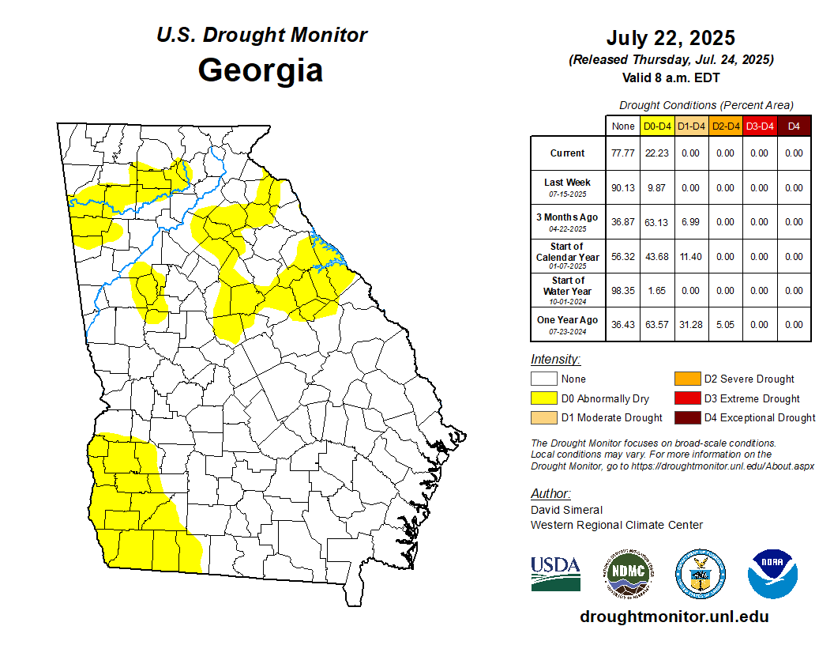
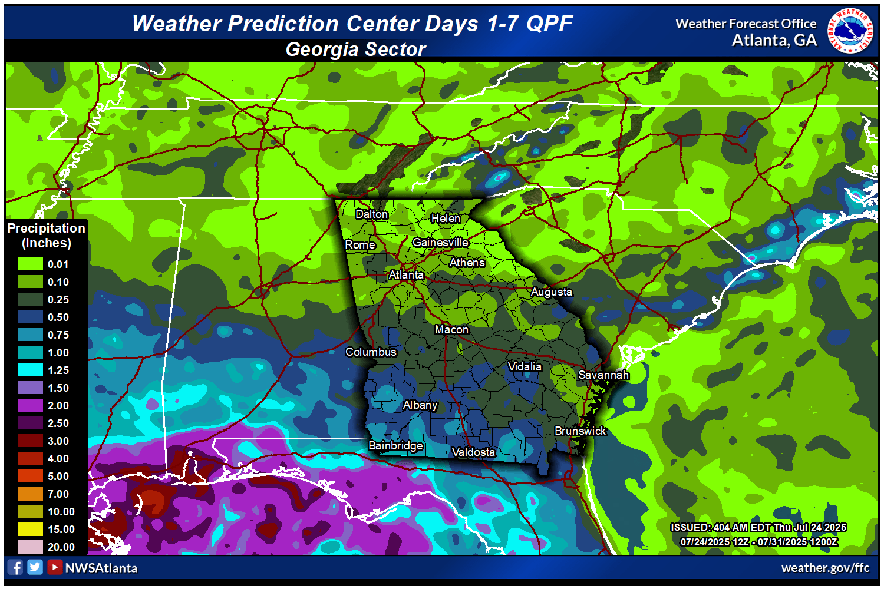
Latest Drought Conditions

Slide 11
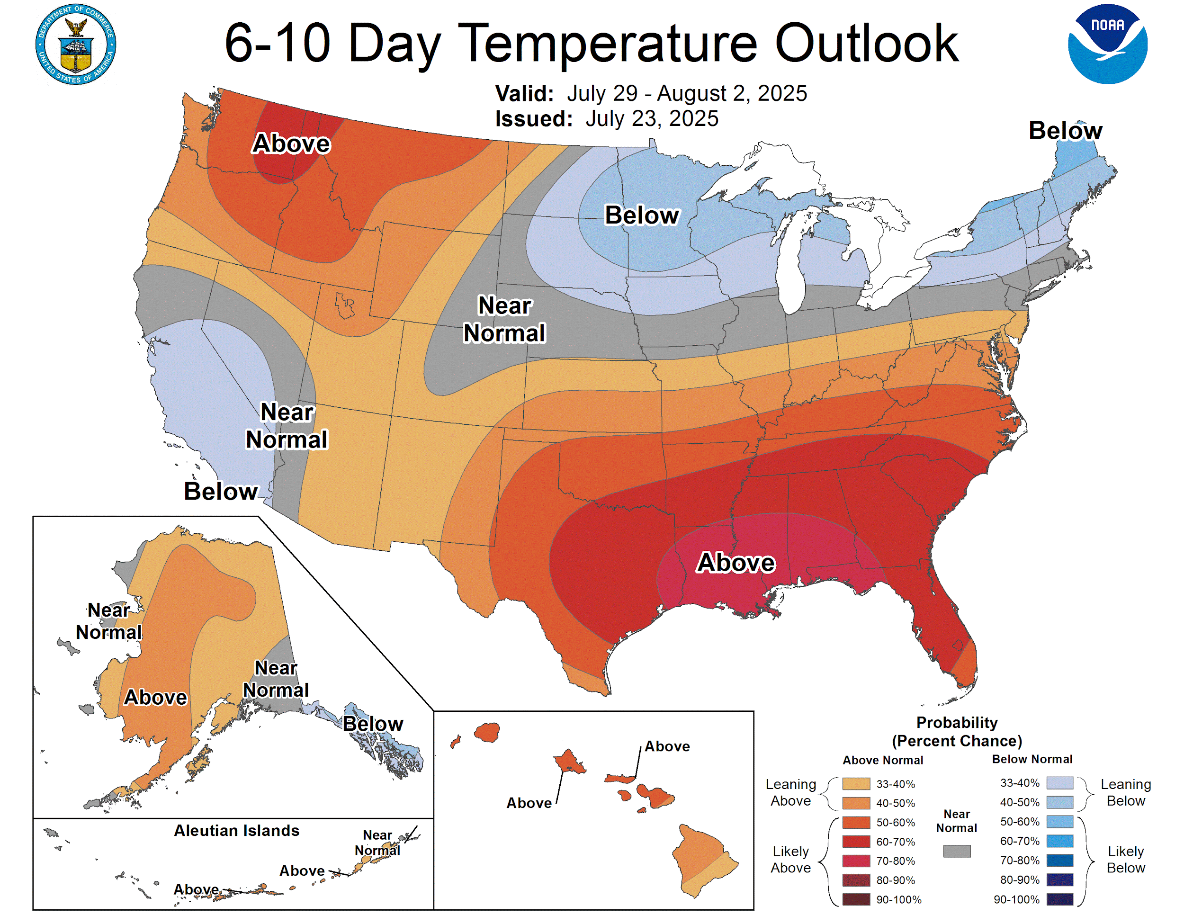
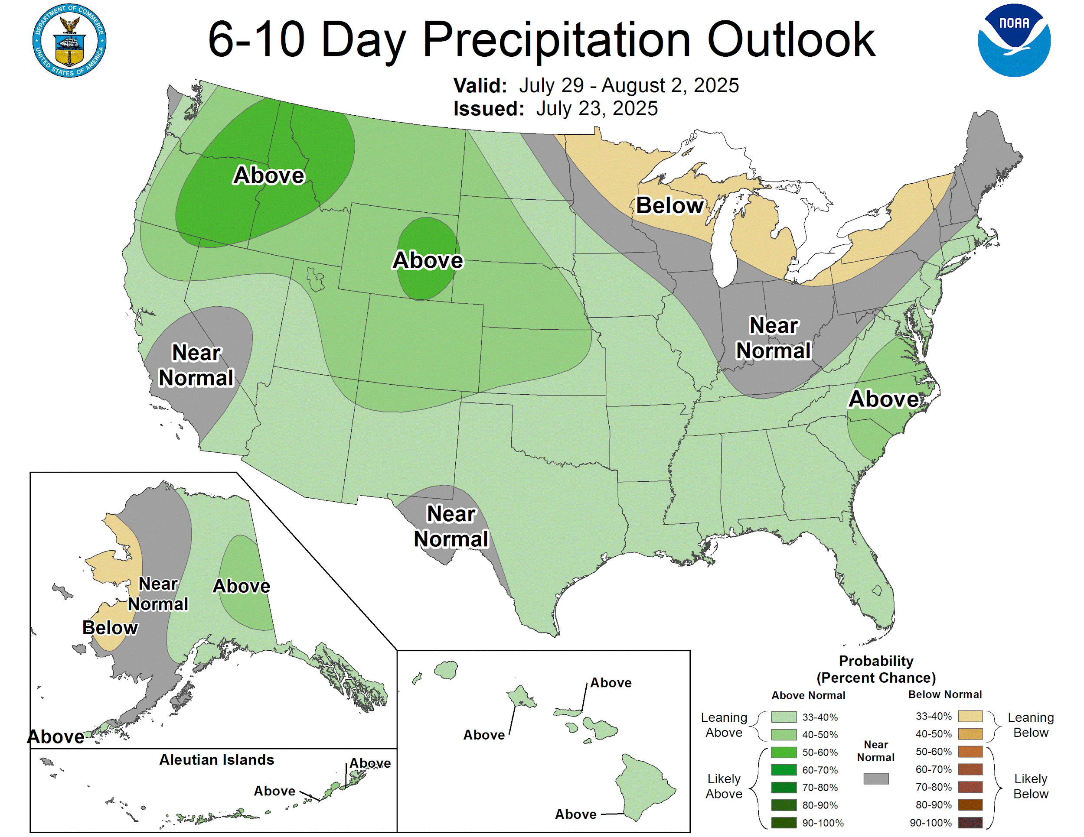
Peachtree City, GA Climate Outlook
For the period: July 29-August 2, 2025
Notes:
Starting off by taking a look at the Climate Prediction Center’s 6-10 day outlook, conditions starting mid next week will see temperatures below normal for this time of the year. Sadly, we are also anticipating drier than normal conditions as well, meaning no help with the drought is currently in sight.

Slide 12
The Week Ahead
For the Period Thursday (July 24) through Wednesday (July 30)
Risk/Impact Levels:
1
2
3
4
5
Today (7/24)
Friday
Saturday
Sunday
Monday
Tuesday
Wednesday
1
2
2
3
4
4
3
Heat Index values 95-105F
Widely scattered (15-30%) mainly aftn/eve storms
Heat Index values 98-110F
Isolated (10-20%) storms mainly far north GA
Heat Index values 98-112F
Heat Index values 100-115F Isolated (10-20%) aftn/eve storms
Heat Index values 100-115F Widely scattered (15-30%) storms
Heat Index values 98-112F Scattered (25-45%) storms
The HEAT will continue to be the primary concern through the next 5-7 days, with dangerous Heat Index values expected Saturday through next Wednesday.
The storm threat will diminish over the next few days, but any storms that do develop will be capable of locally heavy rain, lightning and brief gusty winds.
Weather
Highlights

Slide 13
Contact and Next Briefing Information
July 24, 2025
12:08 PM
By Phone
770-486-1133
Twitter
@NWSAtlanta
Via Email
sr-ffc.webmaster@noaa.gov
Instagram
nwsatlanta
Online
weather.gov/atlanta
weather.gov/ffc/briefings
Facebook
NWSAtlanta
NWS Chat
EMs, Media, and approved partners
YouTube
@NWSPeachtreeCity
Decision Support
weather.gov/ffc/dss
National Weather Service
National Weather Service
Peachtree City, GA

