Slide 1
Impact-based Decision Support Services (IDSS)
NWS Peachtree City / Atlanta
2017 North & Central Georgia Partners Workshop / Integrated Warning Team
December 5, 2017
David Nadler & Jason Deese / NWS Peachtree City

Slide 2
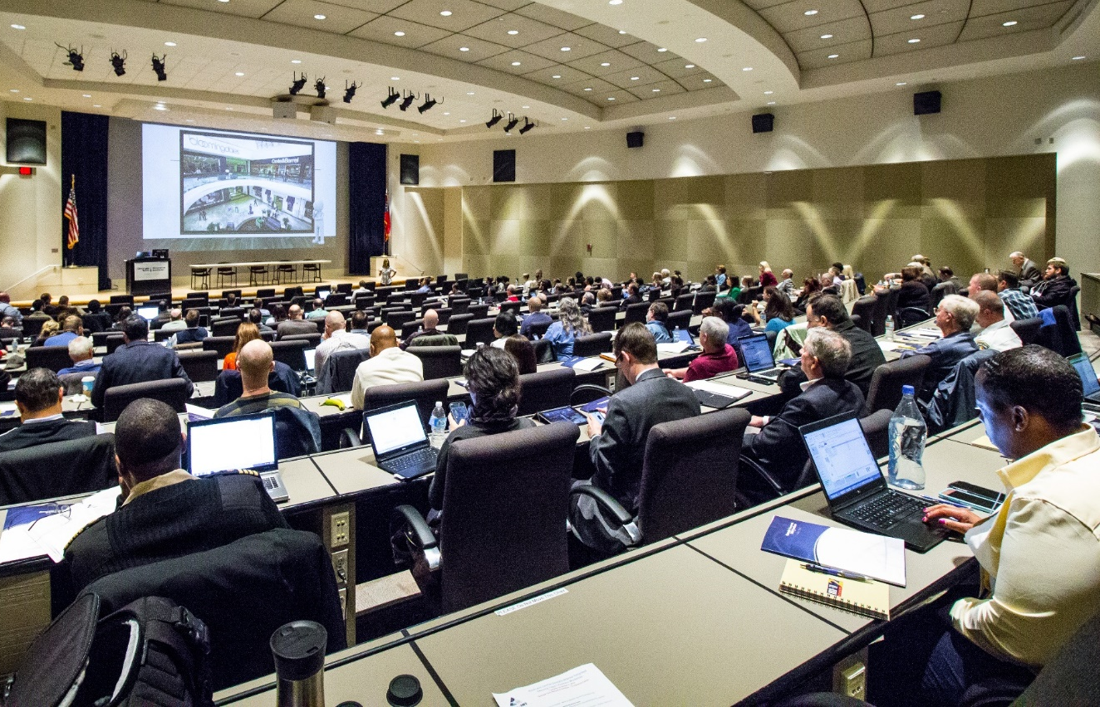
Adjusting To Meet Expanding Partner Needs
Schedule Modifications --
  One objective: DSS meteorologists have more time to interact w/ customers
Training --
  Get all FFC meteorologists on “same level”
  with support (routine & higher-impact)
Briefing/Notification Capabilities:
  Fine-tune “what works”
  Experiment w/ new ideas & technologies
Integrated Warning Team Workshop – December 2016

Slide 3
Defining Decision Support Services – DSS
FEMA Support (Region IV-Atlanta)
GEMA / State Operations Center
Large Public Event with EMA
Multi-day Event (dedicated IDSS Met)
On-Site
Email briefs / updates
Webinar briefings
Site-specific (spot) Forecasts
Interviews (higher impact events)
NWEM (via GFE)
Remote
(Routine – enhanced)
Routine Forecasts / Updates
Social Media + Web graphics
Phone calls / media requests
NWSChat
Routine

Slide 4
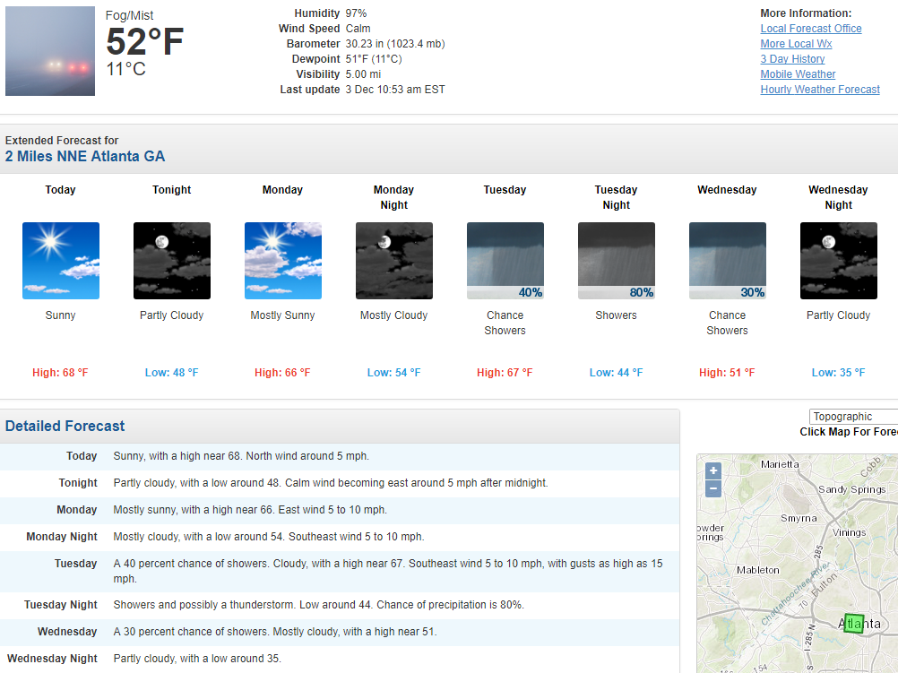
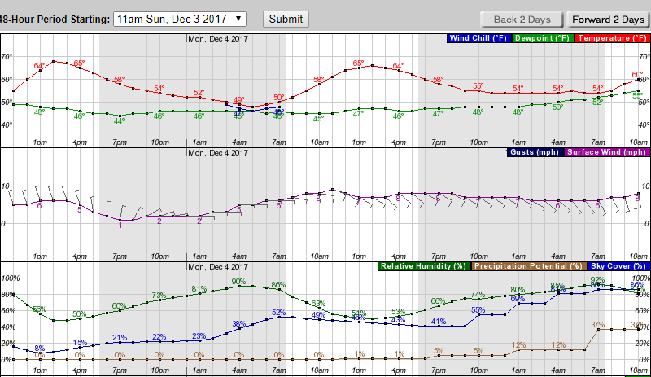
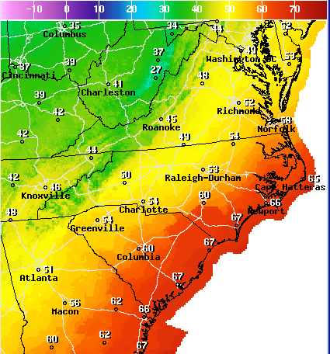

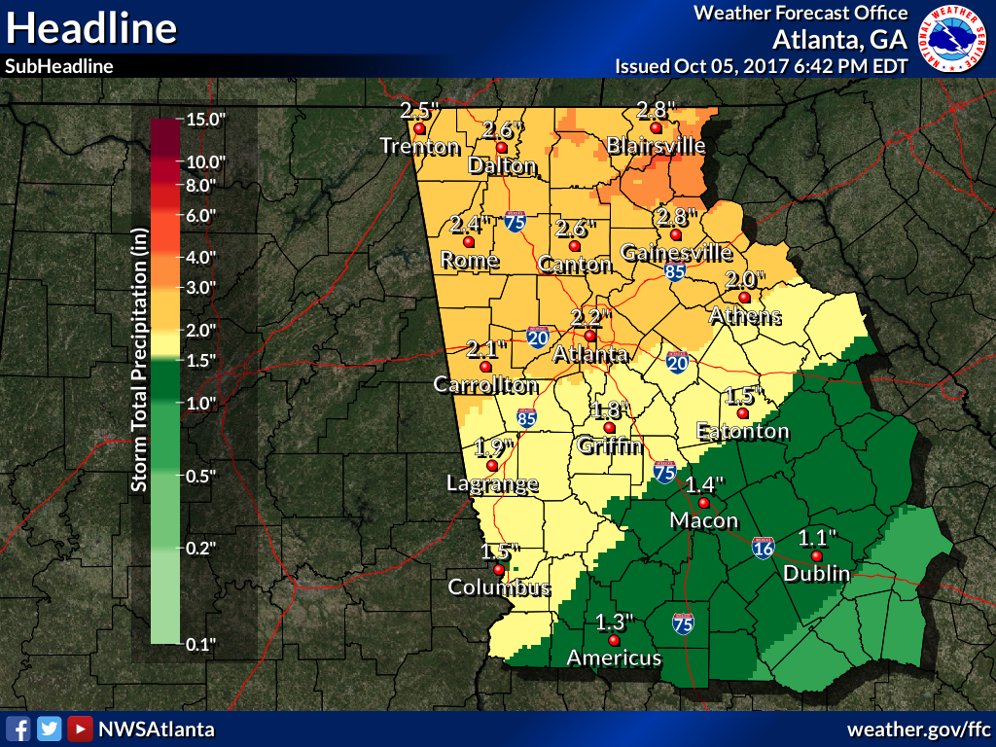
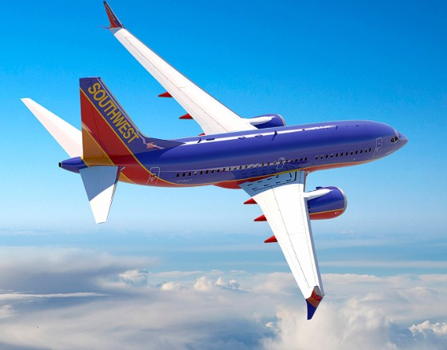
Routine IDSS / Weather Support
On-Site
Definition: day-to-day weather support (24/7)
7-day (Public) forecast
  NDFD / Point & click / Hourly Wx Graphs
Specific forecasts (i.e. Fire weather / Aviation)
Graphical generation via Web & Social media (FB/Twitter)
  www.weather.gov/ffc // @NWSAtlanta
NWSChat
Response to daily inquires (i.e. climate)
Remote
Routine

Slide 5
Routine-Enhanced (Remote) IDSS
On-Site
Designed for “non-routine” / elevated impacts
Level of support dependent on potential severity & coverage of impacts / threat to life and property
Examples of support:
  Outlooks (Special Weather Statements / Sig Wx Advisories)
  Email briefs / updates
  Webinar briefings
  Site-specific (spot) Forecasts (HAZMAT / Wildfire/ Etc.)
  Dedicated PIO/Forecaster at WFO (interviews)
Remote
Routine

Slide 6
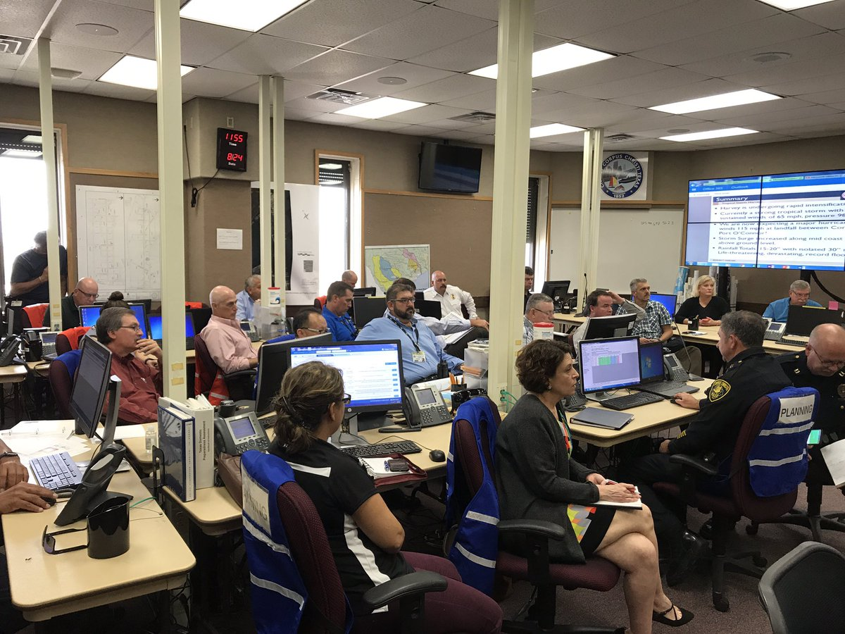
On-site Support / IDSS
On-Site
Least frequent support BUT (at times) most involved / planning & participation
Qualified/trained meteorologist to be deployed “on-site” in conjunction with local (county), state or federal EMA or core partner
Contingent on NWS staffing/resources
Remote
Routine

Slide 7
Examples of On-Site Support
On-Site
Situations where NWS Peachtree City (FFC) can be requested for on-site deployment:
  GEMA / State Operations Center (SOC) for high-impact weather event (i.e. hurricane/ice storm)
  Large Public/Outdoor Event
    Sporting events (CFP/Super Bowl/Final Four/NASCAR)
    Outdoor Festivals/Concerts/Fairs, etc. (attendance > 10K people)
  ICC/JIC for Multi-day HAZMAT or high-impact weather event (county-level)
  FEMA-Region IV support (working w/ SR-ROC and NWS Liaison Team-IMAT)
  Exercises / Training
Remote
Routine

Slide 8
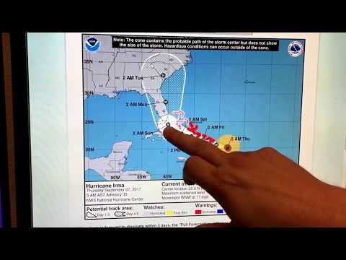
FFC - IDSS examples/capabilities
What are we exploring with in 2018?
  More real-time (short) video updates in operations
This offers us and you some nice advantages…
Huge time savings on our end from a formal briefing
This enables us to do these more often as conditions warrant.
Can be as simple as a 30 sec snippet showing where the freezing line has progressed.

Slide 9
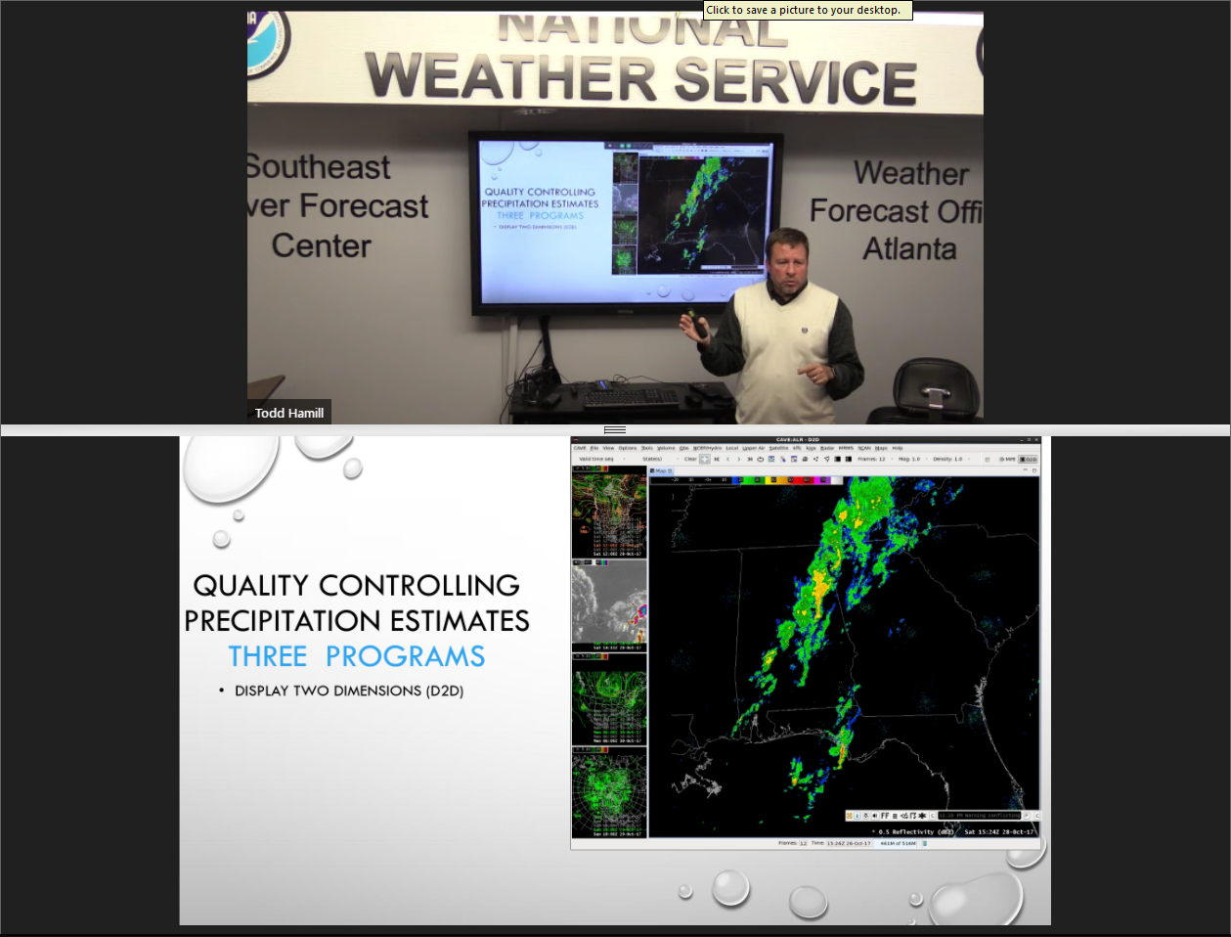
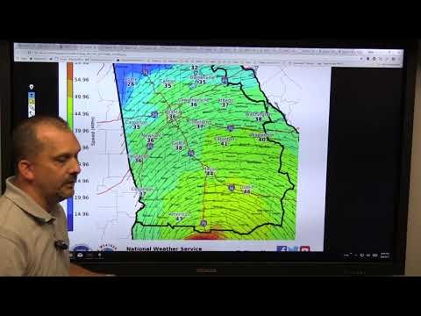
FFC - IDSS examples/capabilities
What are we exploring with in 2018?
  Expanded utilization of conference room technology

Slide 10
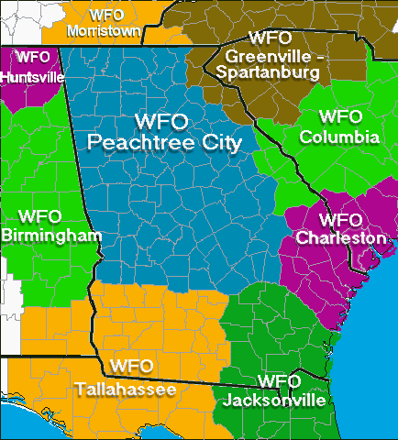
Our Vision For Future of IDSS
Daily briefings to a variety of partners on significant events
The challenge is we have 96 counties with some of those counties having hundreds of significant events within them.
How do satisfy these emerging needs with the same amount of resources we have always had?
Automation will be the key with forecaster input adding in the important details

Slide 11
NWS Peachtree IDSS Example
Forecaster arrives on IDSS shift to see what significant events are on tap this week (likely a catalog of events we create).
Forecaster sees there are two big events coming up…
  Cherry Blossom Festival in Macon
  The Georgia Marathon in Atlanta
  Plus 5 to 6 smaller events including local Fairs
We are going to need some help on this one…
Let’s Try The Fictional NWS Peachtree City IDSS Forecast Generator

Slide 12
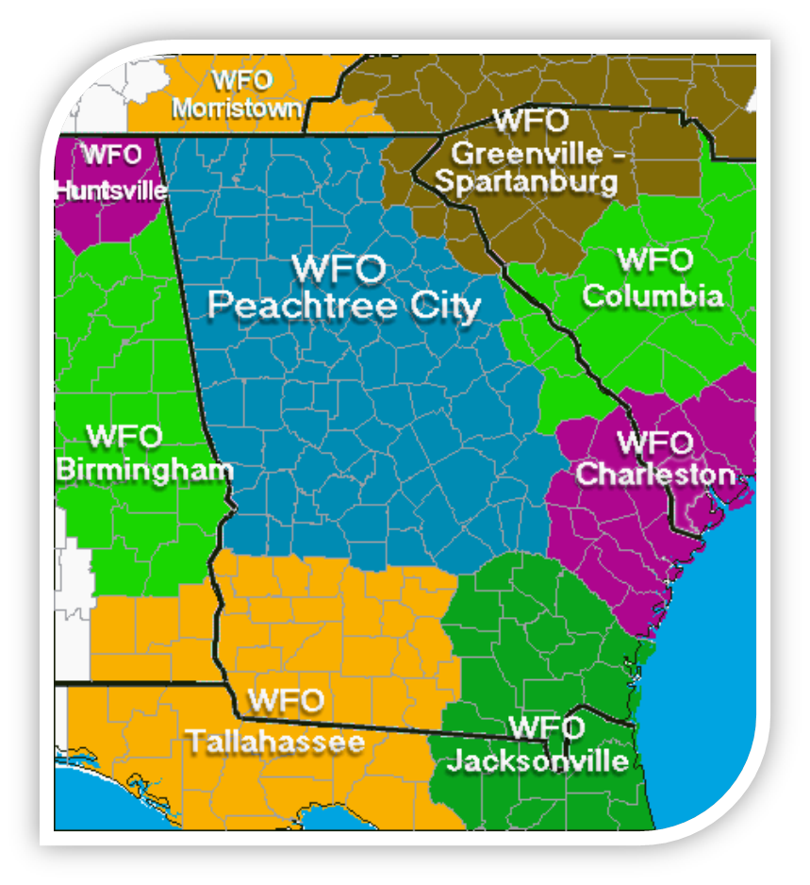
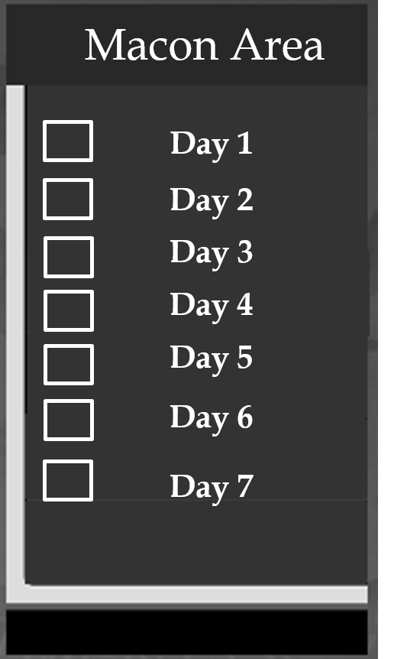

NWS Peachtree City IDSS Forecast Generator
Forecaster selects the areas of interest
This brings up next menu that allows forecaster to select time period of interest and parameters.

Slide 13
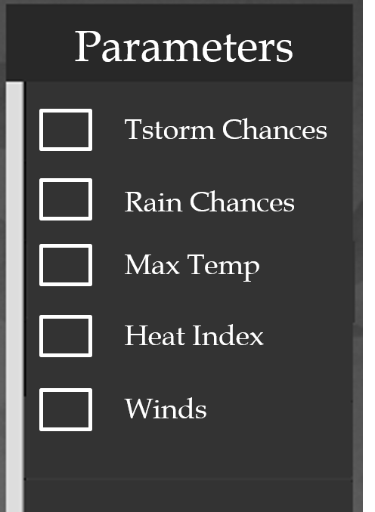
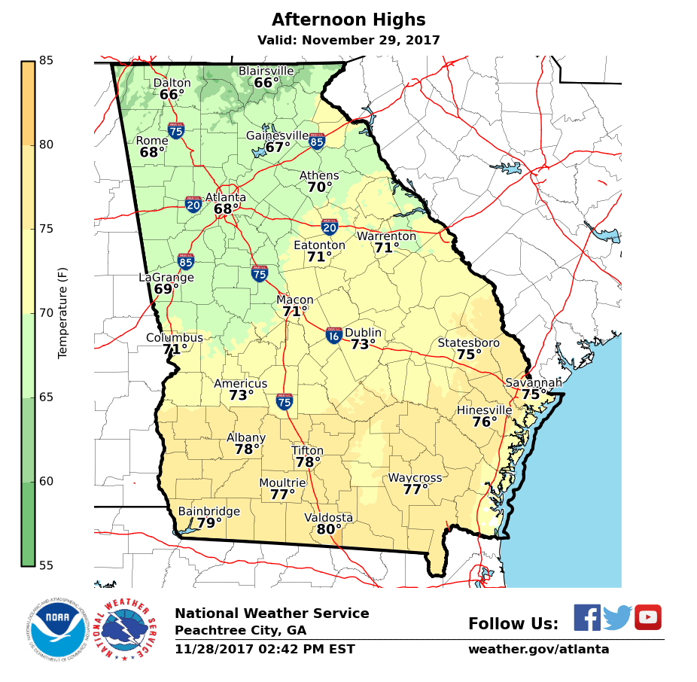
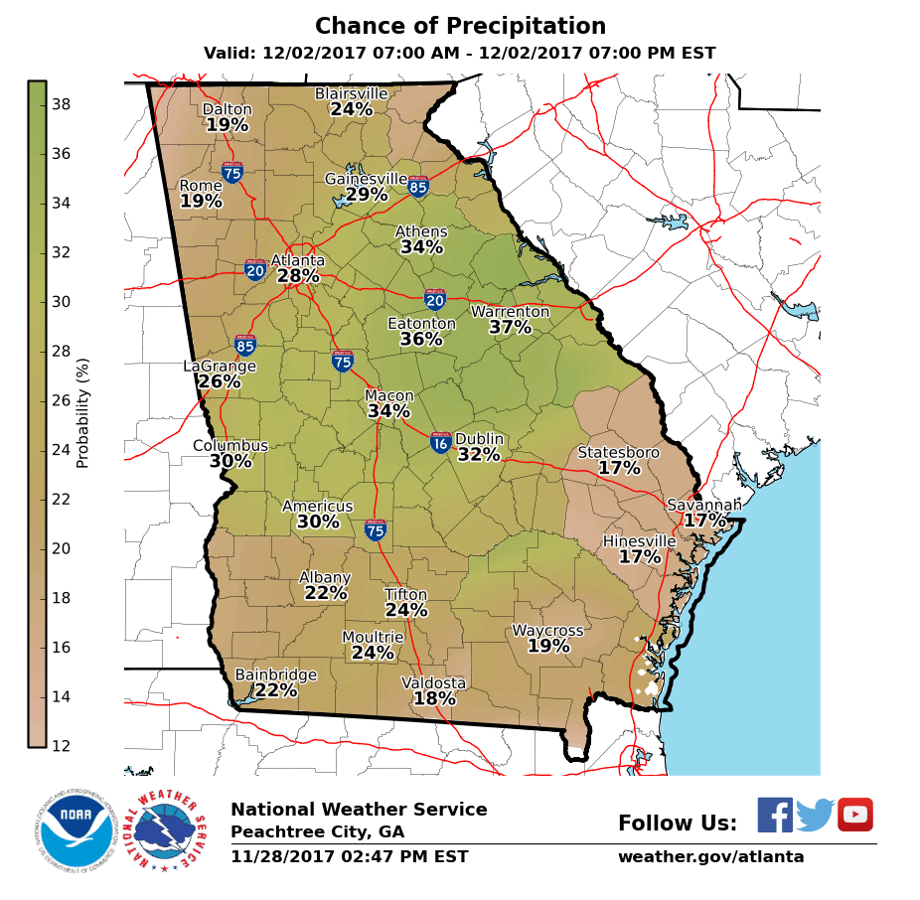
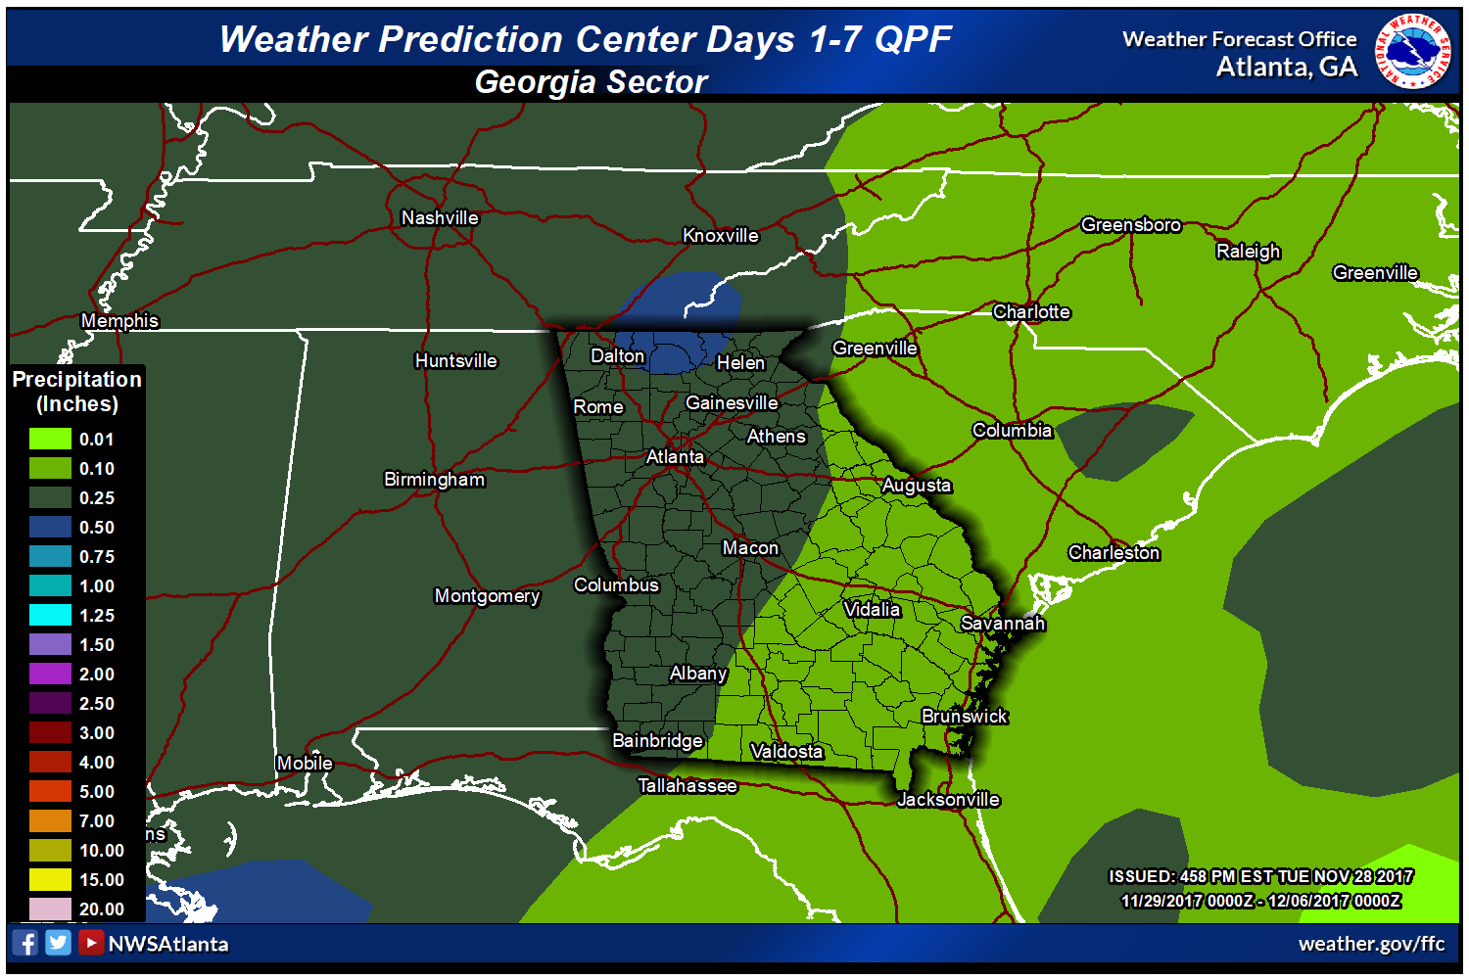

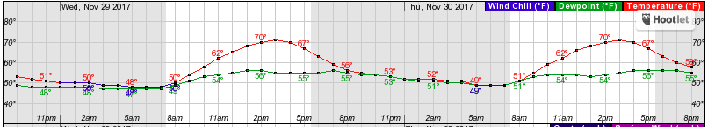
NWS Peachtree City IDSS Forecast Generator
Forecaster Discussion

Slide 14
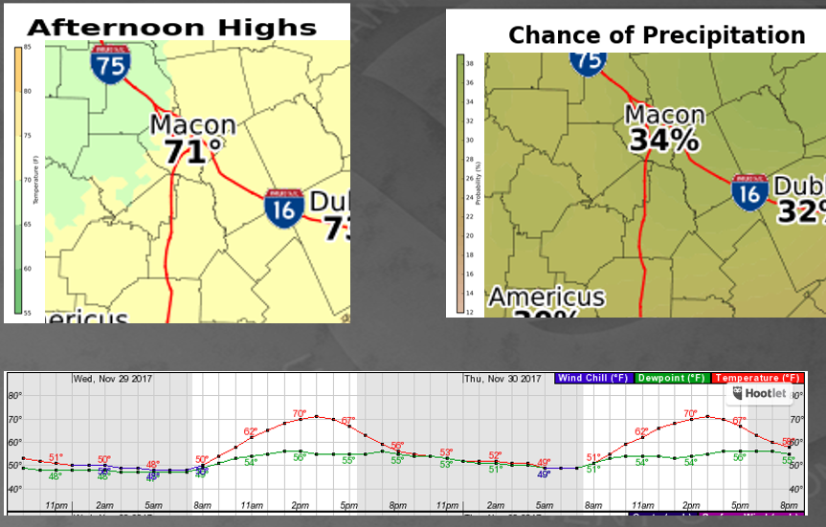


NWS Peachtree City IDSS Forecast Generator
Forecaster Discussion
Emergency Managers
County Officials
City Officials
Superintendents

Slide 15

Any Questions?

