Slide 1
2018 (NWS) Initiatives
A look ahead to 2018 and beyond at NWS operations & services
Break-out session #3
Ryan Willis & Dave Nadler / NWS Peachtree City
North & Central Georgia Partners Workshop
#IWT2017

Slide 2
Topics
Communication Tools & Resources
  Communicating Threats
  Submit-A-Storm-Report (new look)
  NWSChat (via mobile device)
2017-18 Probabilistic Snow/Ice Program
HazSimp (Winter)
A review of Impact-Based Warnings (IBW)

Slide 3
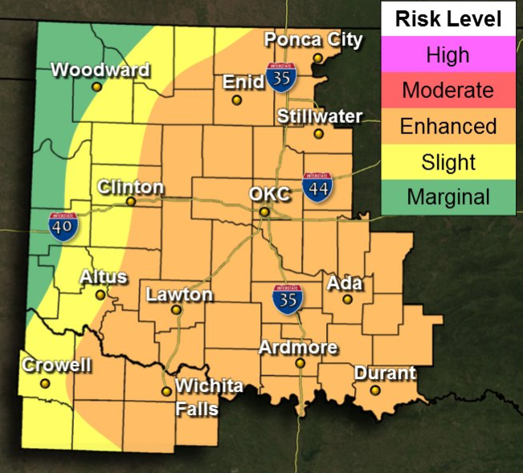
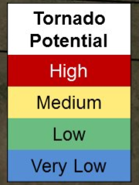
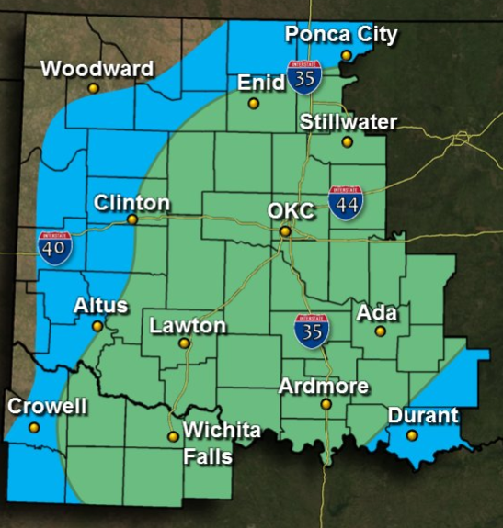
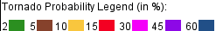
Communicating Threats
What?
  Experimenting how we can emphasize short-term (Day 1) severe weather threats (see examples) →
Why?
  Probabilities (%) can be confusing & misinterpreted
Colors and threat wording are pending
*

Slide 4
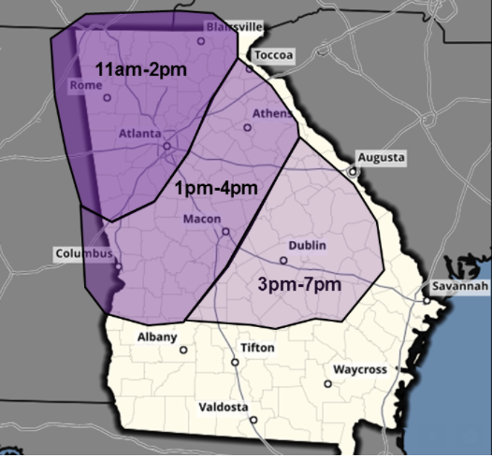
FFC Threat Graphics
Severe Weather Example
Damaging Wind
LOW
MODERATE
HIGH
Tornadoes
LOW
MODERATE
HIGH
Large Hail (≥ 1 inch)
LOW
MODERATE
HIGH
Flash Flooding
LOW
MODERATE
HIGH

Slide 5
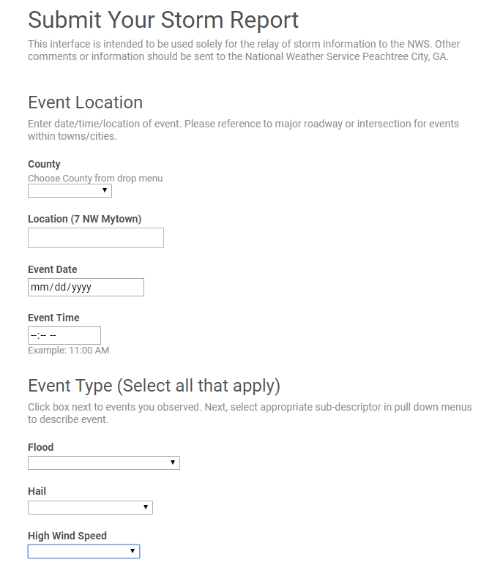
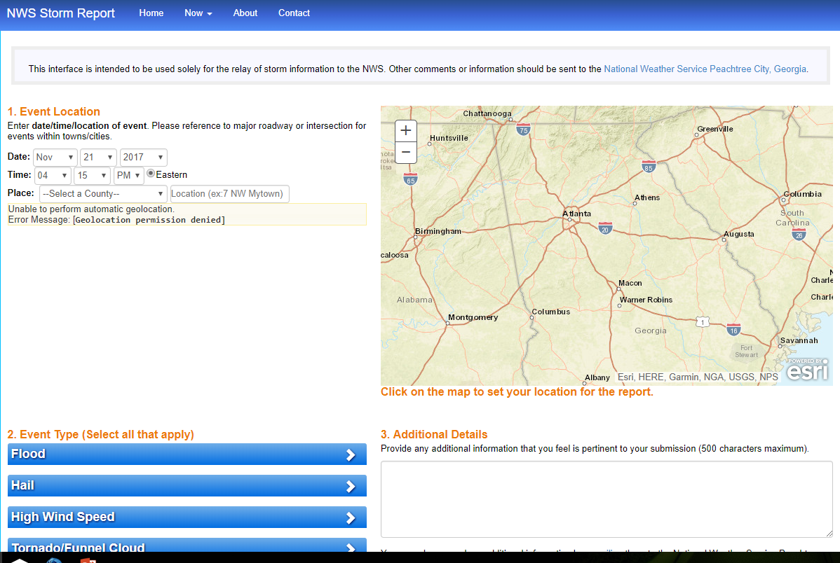
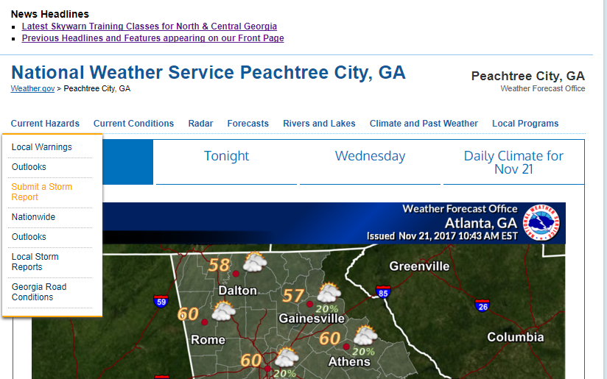
Sending Storm Information (via Web)
Minor changes to “Submit-A-Storm-Report” page
** New look (temporary) **
** Old look to page **

Slide 6
NWSChat – mobile!
https://nwschat.weather.gov
Older apps are not compatible with newer phones
  Talkonaut still works with older phones
Suggested newer apps:
“Monal” for iPhone
“Xabber” for Android
Instructions for each will be on the Atlanta IWT web page

Slide 7
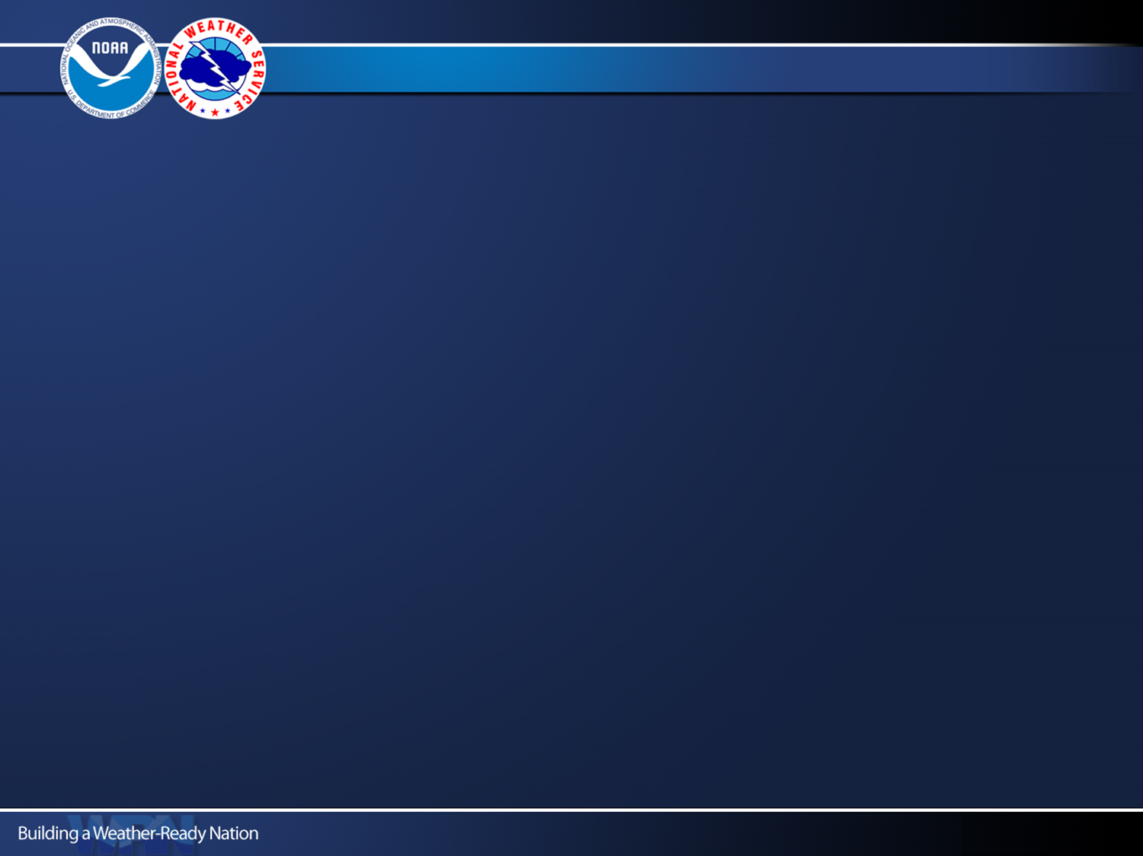



NWS Probabilistic Snowfall Forecast
Title
2017 North & Central Georgia Partners Workshop
Notes:
Intro Slide

Slide 8
Probabilistic Snowfall Program Details
Purpose:
To provide partners a range of snowfall possibilities to better communicate forecast uncertainties during winter weather events.
What’s New for 2017-2018:
Ice Accumulation Forecasts (official from NWS) will be available
  NWS Atlanta (FFC) and Greenville-Spartanburg (GSP) will experiment with ice accumulation probabilities internally
Model Enhancements: Upgrade to higher resolution ensemble members
(46 model members on 5 km grid)
NWS Columbia and Charleston SC will join NWS Atlanta and Greenville-Spartanburg in the experiment
Graphic Headlines/Titles Adjusted to make better sense of “range of possibilities”
Title
Notes:
Intro Slide

Slide 9
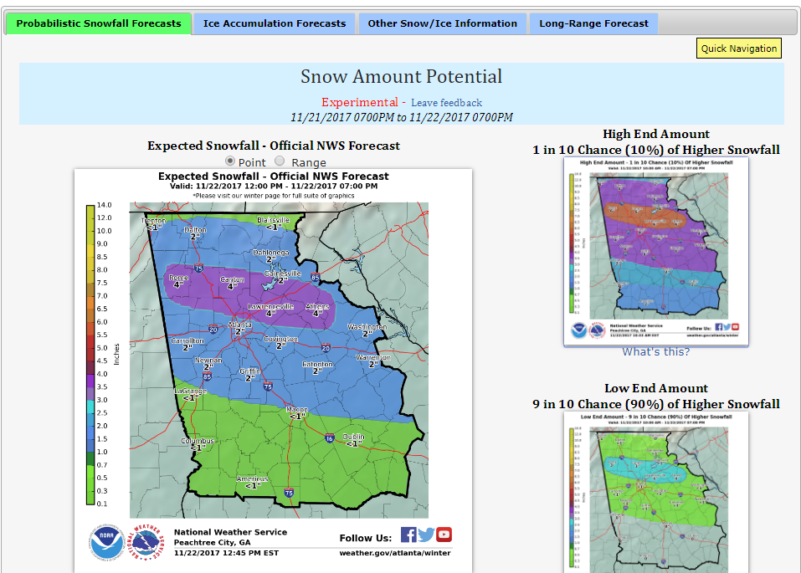
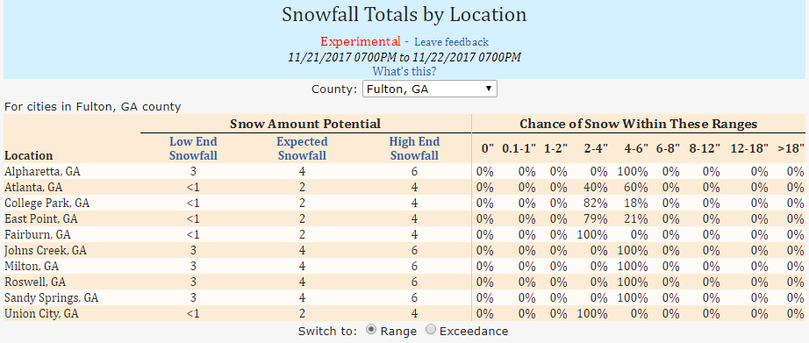
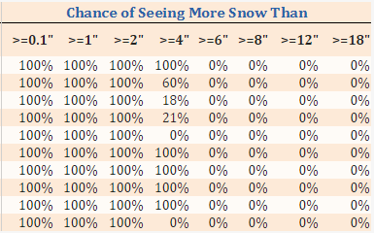
Page Layout – www.weather.gov/ffc/winter
Title
Notes:
Intro Slide

Slide 10
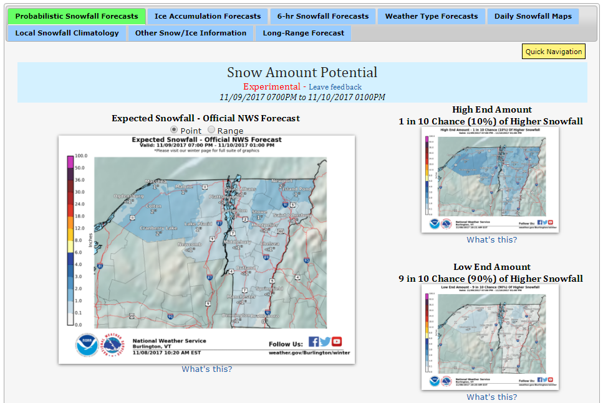
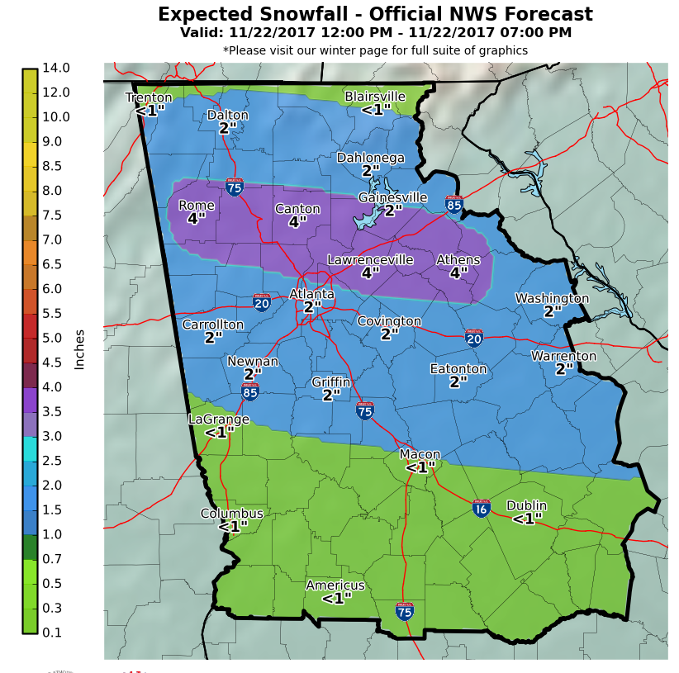
Snow Amount Potential
Title
Expected Snowfall:
Official NWS snow forecast
This is the most likely scenario you should plan for
Notes:
Intro Slide

Slide 11
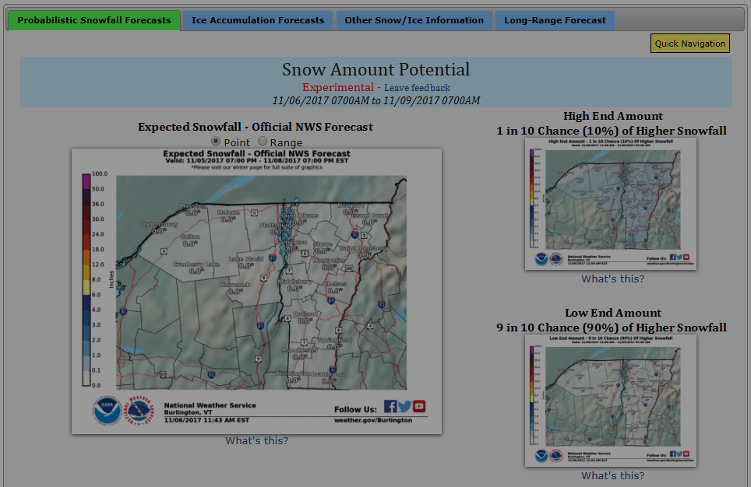
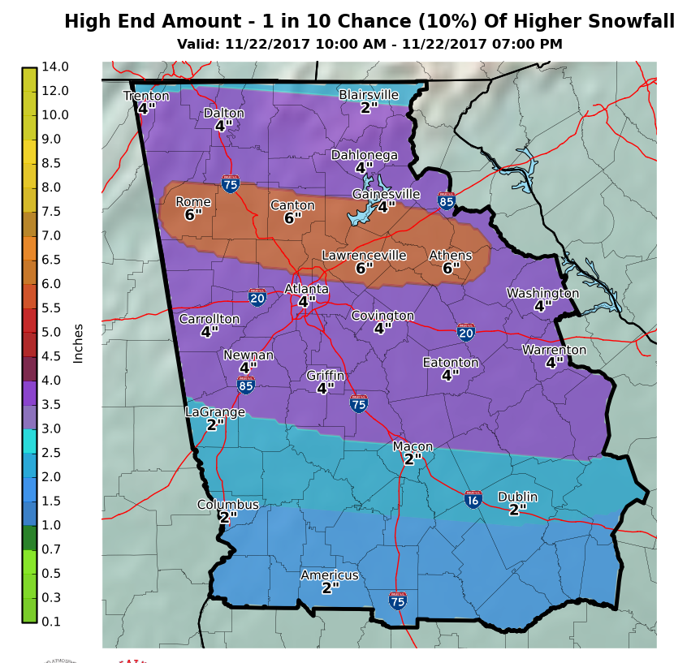
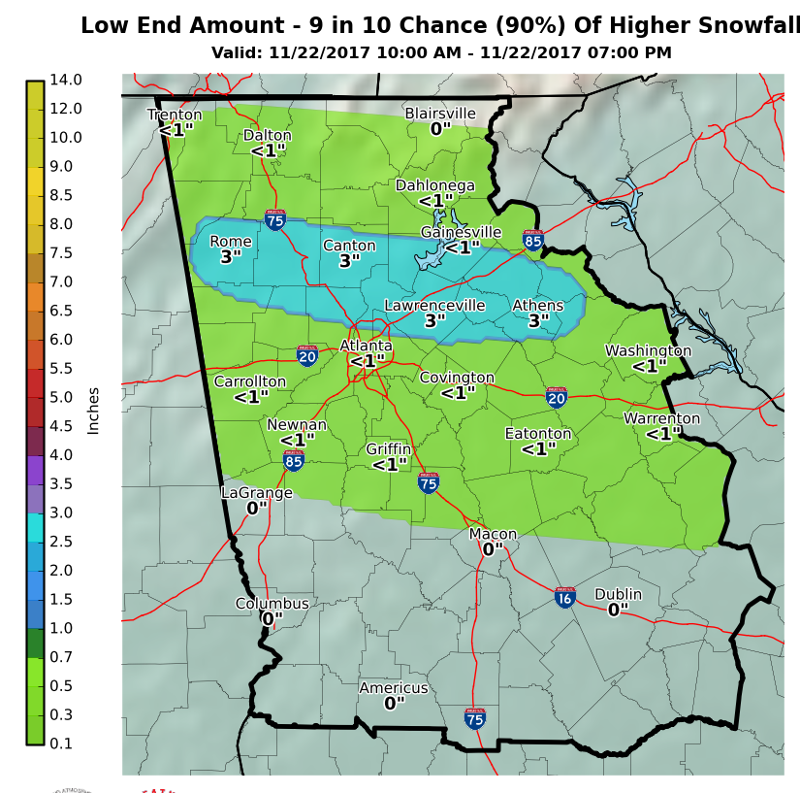
Snow Amount Potential
High End and Low End Amounts take into account variability in the models (track of storm, timing, etc.) to provide a possible range of outcomes
Title
Notes:
Intro Slide

Slide 12
Snow Amount Potential – High End Range
Title
High End Amount (meaning):
Most plausible worst-case scenario
Only 10% of the models (~5 of 46) used in the experiment have snow amounts higher than what is shown
Other benefits?
  Removes model “outliers” that can unintentionally hype up an event days before actual occurrence.
Notes:
Intro Slide

Slide 13
Snow Amount Potential – Low End Range
Title
Low End Amount (meaning):
Most plausible best-case scenario
Only 10% of the models (~5 of 46) used in the experiment have snow amounts lower than what is shown
90% chance of seeing at least this much snow
Keep in mind Georgia Snowfall Climatology (see next slide)
Notes:
Intro Slide

Slide 14
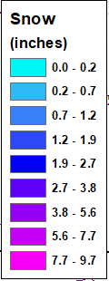
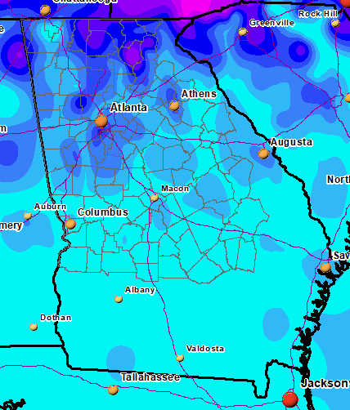
Snow Amount Potential – Low End Range
2-6”
Average Yearly Snowfall (past 30 years)
Title
1-3”
<1”
Low End Amount (things to consider):
Georgia Snowfall Climatology –
  Low-end Amounts from model output will typically show 0” (zero) for many of our snow events.
<1”
Notes:
Intro Slide

Slide 15
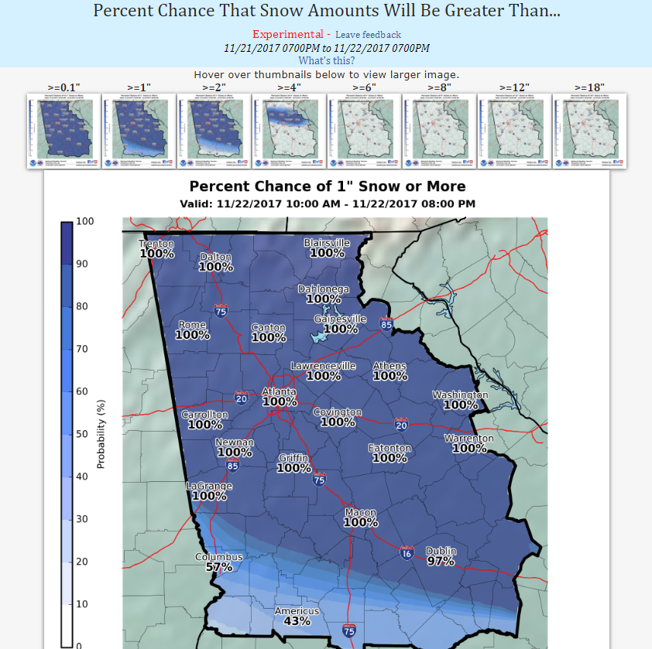
Snowfall Probabilities
Title
What does this tell us?
Chance (0-100%) of seeing at least this much snow
Notes:
Intro Slide

Slide 16
Probability Snow Amounts Greater Than…
Title
Click (or hover over) any of the thumbnails to get larger image/graphic
Notes:
Intro Slide

Slide 17
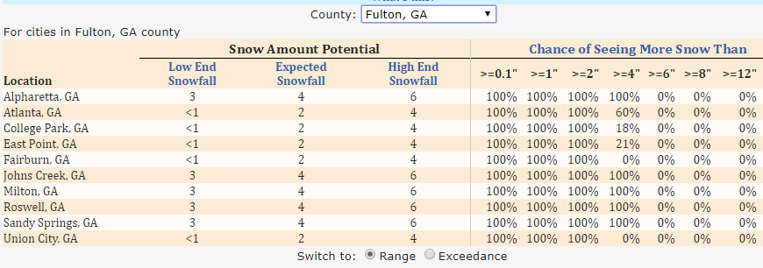
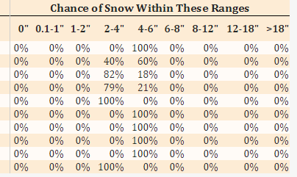
Table of Range/Exceedance Probabilities
Title
County “pull-down” menu
Cities (pre-defined for each county)
Range vs. Exceedance?
  Range = % chance of snowfall in a range (i.e. 1-2”)
  Exceedance = % chance of seeing ≥ amount in table
Notes:
Intro Slide

Slide 18
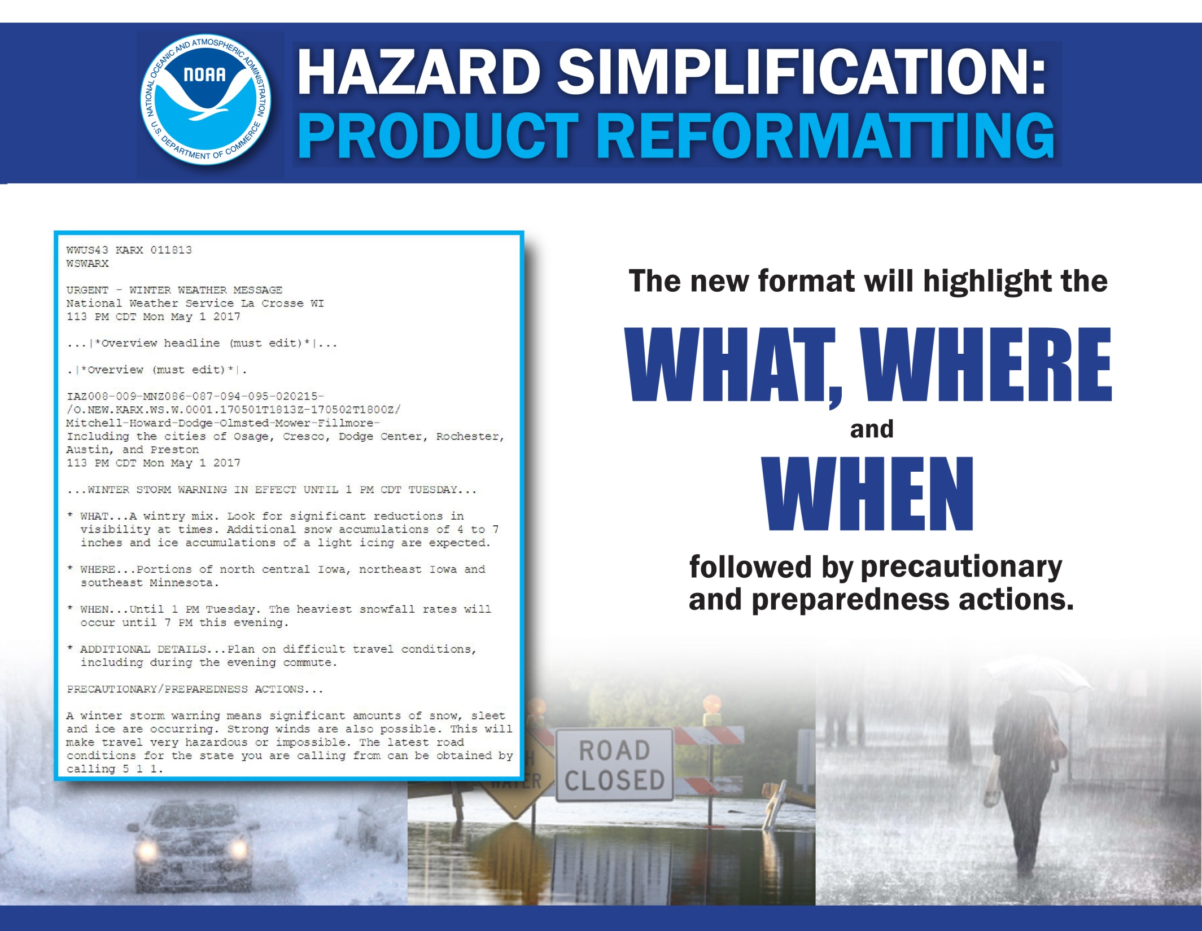

Slide 19
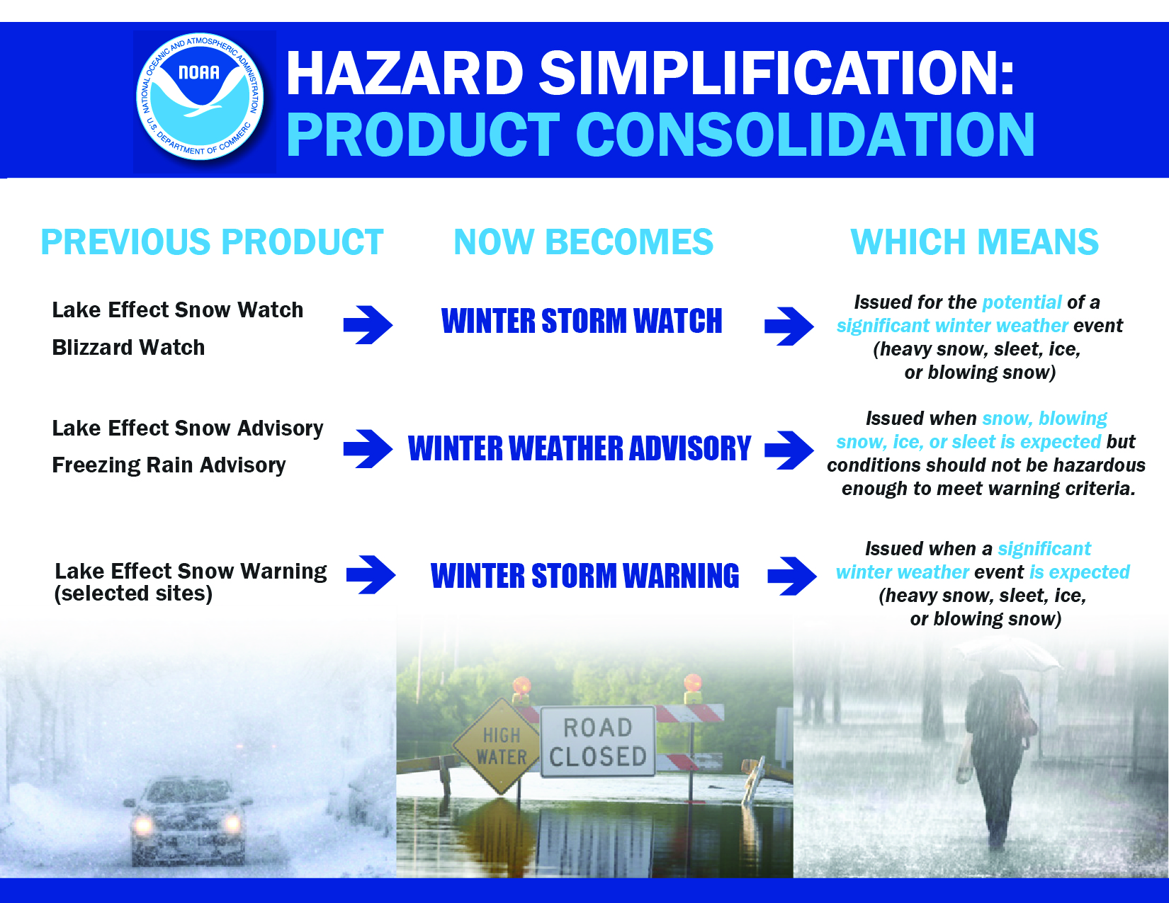
Unchanged:
BLIZZARD WARNING
ICE STORM WARNING

Slide 20


Example of Previous WSW Format
...WINTER STORM WARNING REMAINS IN EFFECT UNTIL 1 PM EST SATURDAY...
* LOCATIONS...THE FAR NORTHERN PIEDMONT AND FOOTHILLS OF SOUTH
CAROLINA AND UNION COUNTY IN NORTH CAROLINA.
* HAZARDS...ACCUMULATING SNOWFALL.
* TIMING...A MIX OF RAIN...SNOW AND SLEET WILL CHANGE TO ALL SNOW
WITHIN AN HOUR OR TWO OF MIDNIGHT. SNOW WILL CONTINUE OVERNIGHT
AND TAPER OFF SATURDAY MORNING.
* ACCUMULATIONS...3 TO 6 INCHES, WITH THE HIGHEST TOTALS
OCCURRING ALONG AND NORTH OF THE NORTH CAROLINA STATE LINE.
* IMPACTS...THE HEAVY SNOW WILL CREATE SNOW COVERED ROADS AND
PRODUCE SCATTERED POWER OUTAGES.
* TEMPERATURES...LOWS TONIGHT IN THE UPPER 20S. HIGHS SATURDAY IN
THE LOWER TO MID 30S.
* WINDS...NORTHEAST 10 TO 15 MPH WITH GUSTS UP TO 25 MPH.
* VISIBILITY...LESS THAN ONE MILE AT TIMES EARLY SATURDAY
MORNING.
PRECAUTIONARY/PREPAREDNESS ACTIONS...
A WINTER STORM WARNING FOR HEAVY SNOW MEANS SEVERE WINTER WEATHER CONDITIONS ARE EXPECTED OR OCCURRING. SIGNIFICANT AMOUNTS OF SNOW ARE FORECAST THAT WILL MAKE TRAVEL DANGEROUS. ONLY TRAVEL IN AN EMERGENCY. IF YOU MUST TRAVEL...KEEP AN EXTRA FLASHLIGHT...FOOD...AND WATER IN YOUR VEHICLE IN CASE OF AN EMERGENCY.

Slide 21


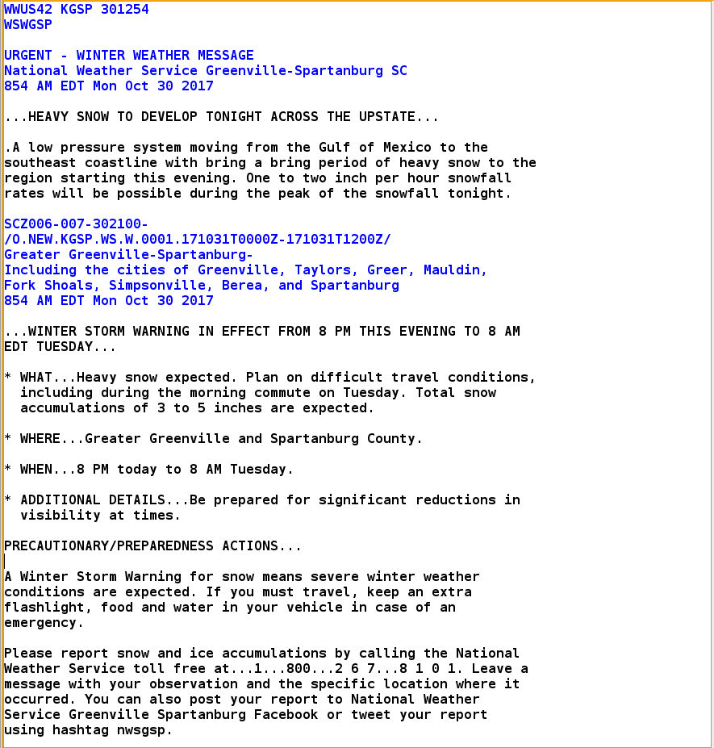
Example of the New WSW Format
Consolidate multiple points into “What” “Where” “When”
Use “Additional Details” to relay other critical information (i.e. travel conditions, visibilities, gusty winds, etc.)

Slide 22
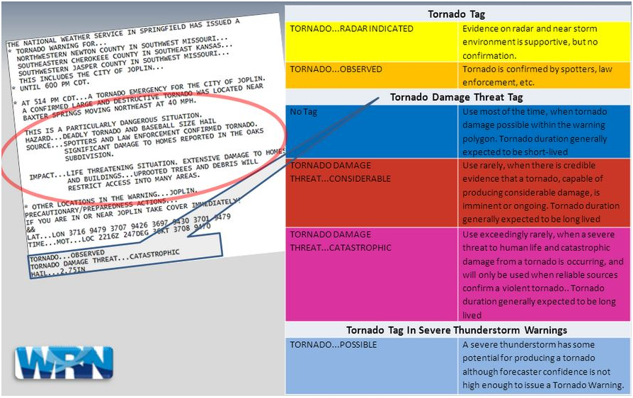
Impact-Based Warnings (Year 3)

Slide 23
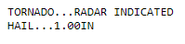
Impact-Based Warnings (Year 3)
Review of Warnings (Tornado):
“Base” Tornado Warning
  Reason for Warning? “radar indicated rotation”
    Also known as the “Source” triggering the Warning (3rd bullet)
  Tag (bottom of warning)? “Tornado…Radar Indicated”
    Tornado Damage Threat Tag? N/A
Example?

Slide 24
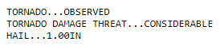
Impact-Based Warnings (Year 3)
Review of Warnings (Tornado):
“Observed” Tornado Warning – Considerable
  Reason for Warning? Tornado is confirmed by any of the following:
    Radar (Tornado Debris Signature) / TDS)
    Trained spotter, law enforcement, EMA, etc.
  Tornado Tag (bottom of warning)? Tornado…Observed
  Tornado Damage Threat Tag? …“Considerable”
    Unconfirmed EF-2 to EF-3 damage (TDS research)
Example?

Slide 25
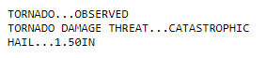
Impact-Based Warnings (Year 3)
Review of Warnings (Tornado):
“Observed” Tornado Warning – Catastrophic
**TORNADO EMERGENCY** (default)
  Reason for Warning? Tornado is confirmed by any of the following:
    Radar (Tornado Debris Signature) / TDS)
    Trained spotter, law enforcement, EMA, etc.
  Tornado Tag (bottom of warning)? Tornado…Observed
  Tornado Damage Threat Tag? …“Catastrophic”
    Unconfirmed EF-4 to EF-5 damage (based on visual evidence)
Example?

Slide 26
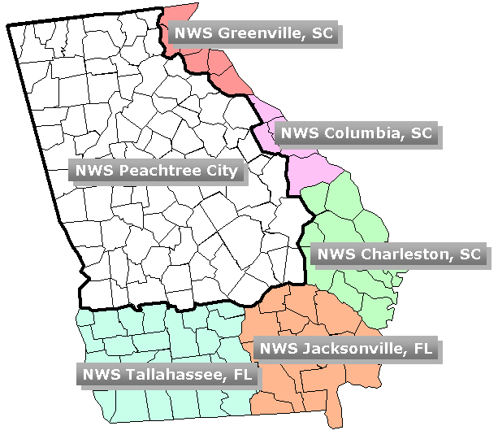
Questions?
Title
Probabilistic Snowfall Forecast Experiment available at:
NWS Peachtree City/Atlanta: weather.gov/ffc/winter
NWS Greenville-Spartanburg: weather.gov/gsp/winter
NWS Columbia: weather.gov/cae/winter
Notes:
Intro Slide

