Slide 1
NWSChat
For iPhones

Slide 2
NWS Chat for Mobile Devices- Apple
Some mobile apps can access NWSChat, like “Monal”
Search for “Monal” in Apple APP Store

Slide 3
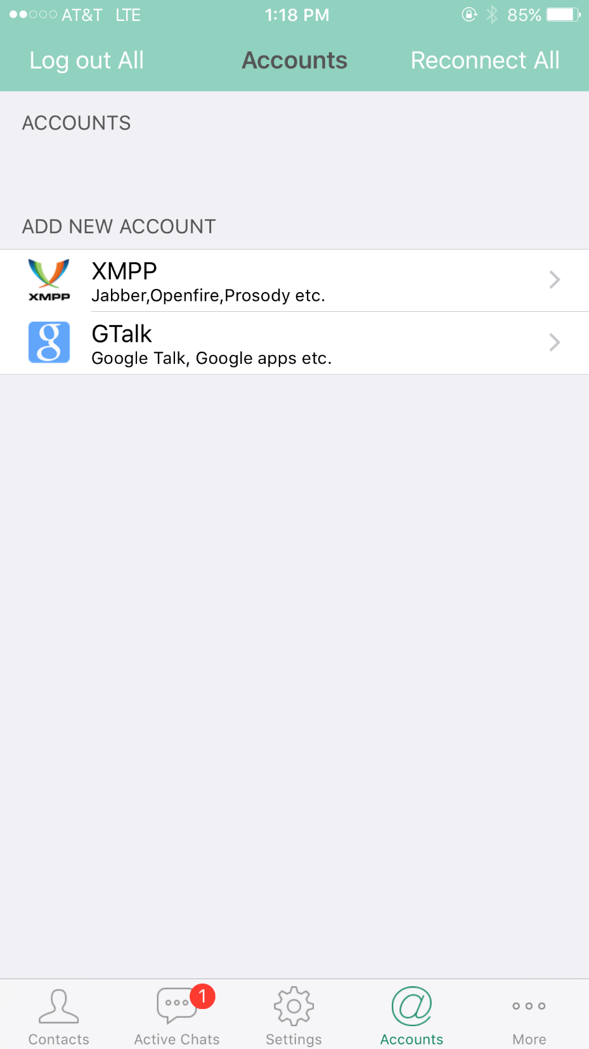
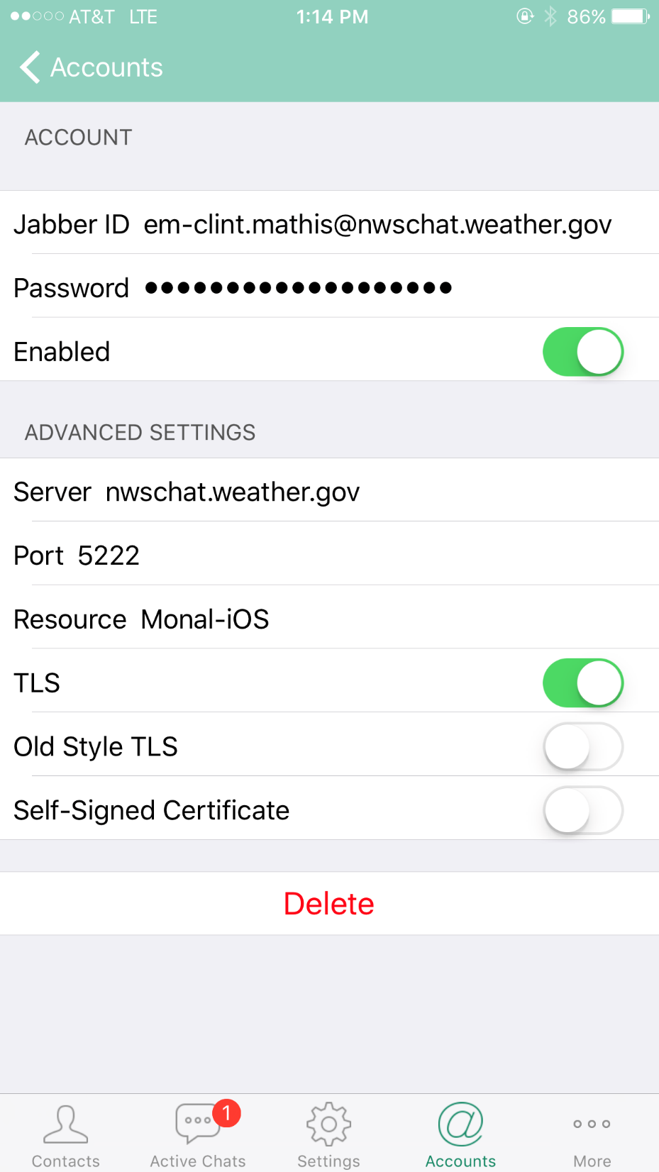
3
2
Fill out as shown here!
1

Slide 4
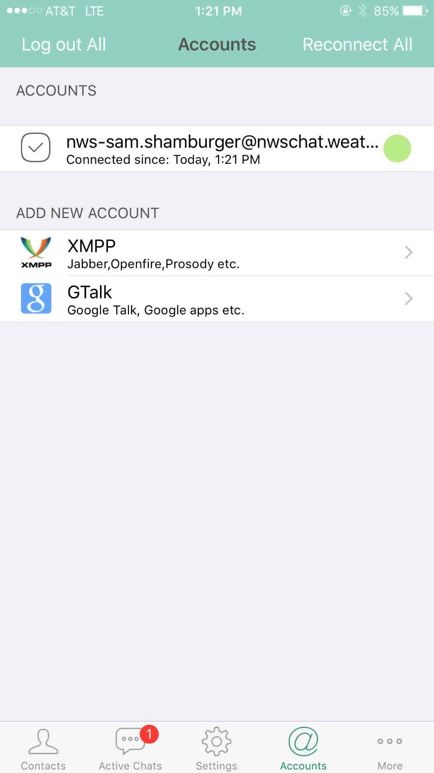
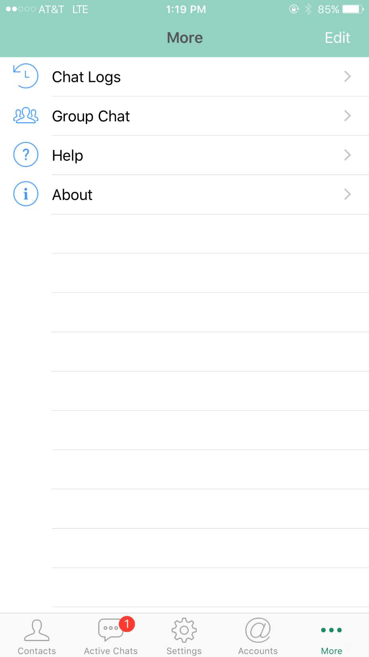
6
Account created – hooray!
4
5

Slide 5
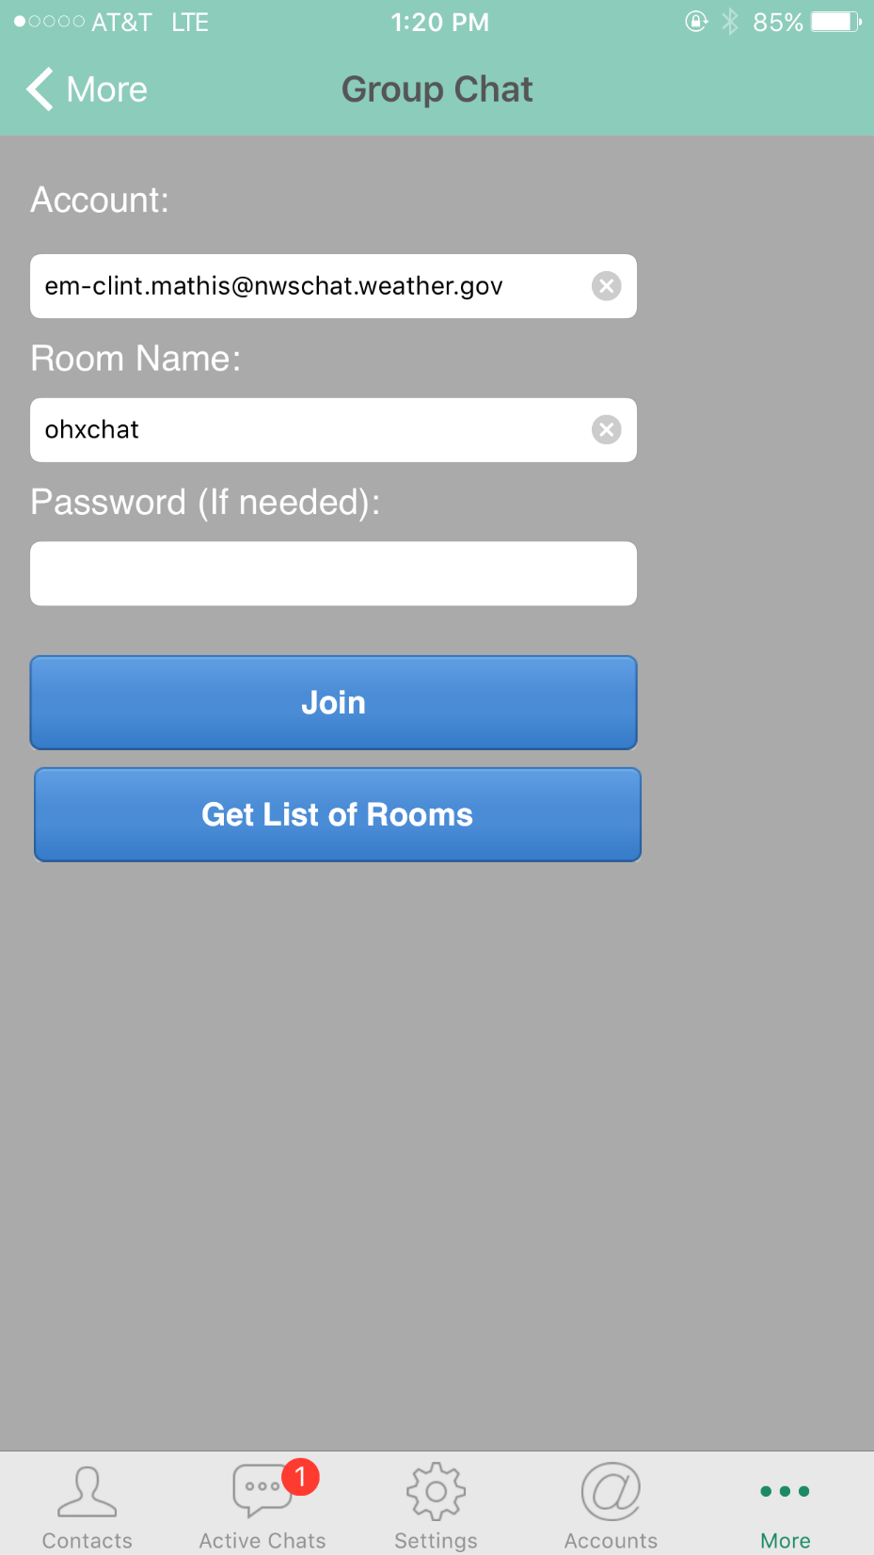
Account automatically filled out
hunchat
7) Type “hunchat” for Room Name
8) Leave Password blank then hit Join!

Slide 6
hunchat@conferences.nwschat.weather.gov
10) Click on hunchat to join
NWS Huntsville chatroom
9

Slide 7
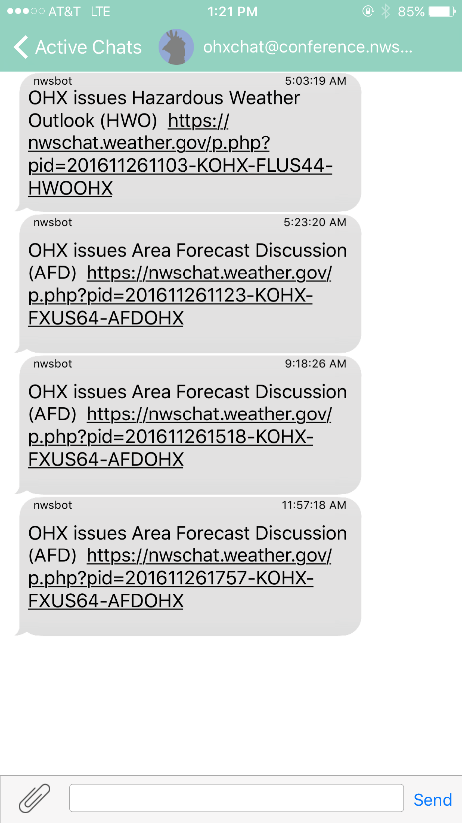
You’re in!
Enjoy!

