Slide 1
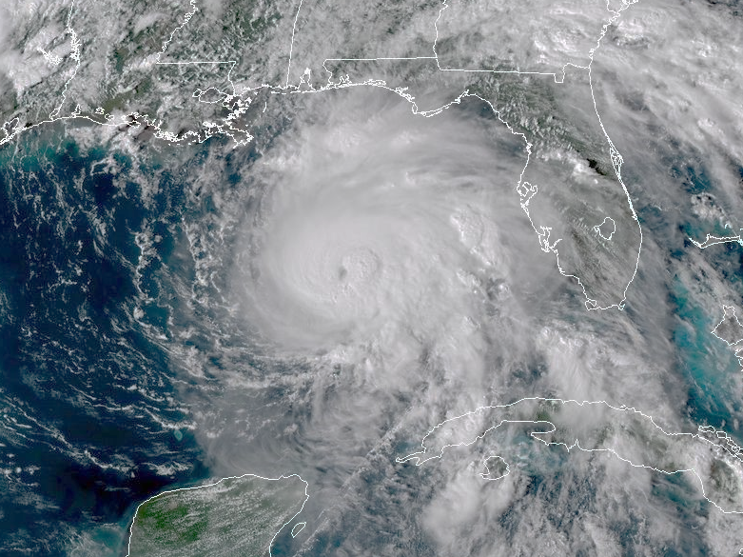
Exercise Two
A Multi-Hazard Scenario

Slide 2
Rules of Play
Format
Three ‘modules’ or decision points during a Tropical Weather Scenario
Related questions will be presented following each module to facilitate discussion
Participation
Your role is to be YOU
Everyone is encouraged to speak up and provide thoughts and ideas
Remember, this is an exercise, not a test. Let’s keep it fun and positive.

Slide 3
Module One
72-hours before landfall

Slide 4
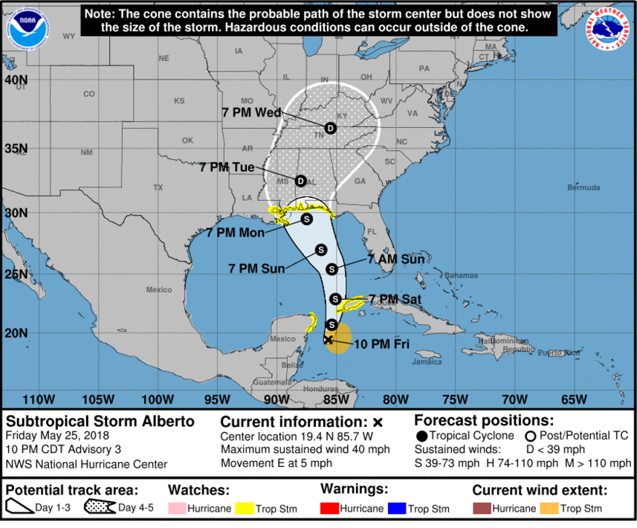
Module One - Briefing
Today is Friday, Sep 14.
Just before bed you decide to check your phone.
The meteorologists have been talking about a potential tropical system expected to impact the southern U.S. early next week, and it looks like it’s really starting to pan out.
S
H
H
H
S
S
Tropical Storm Miles
Friday, Sep 14, 2018

Slide 5
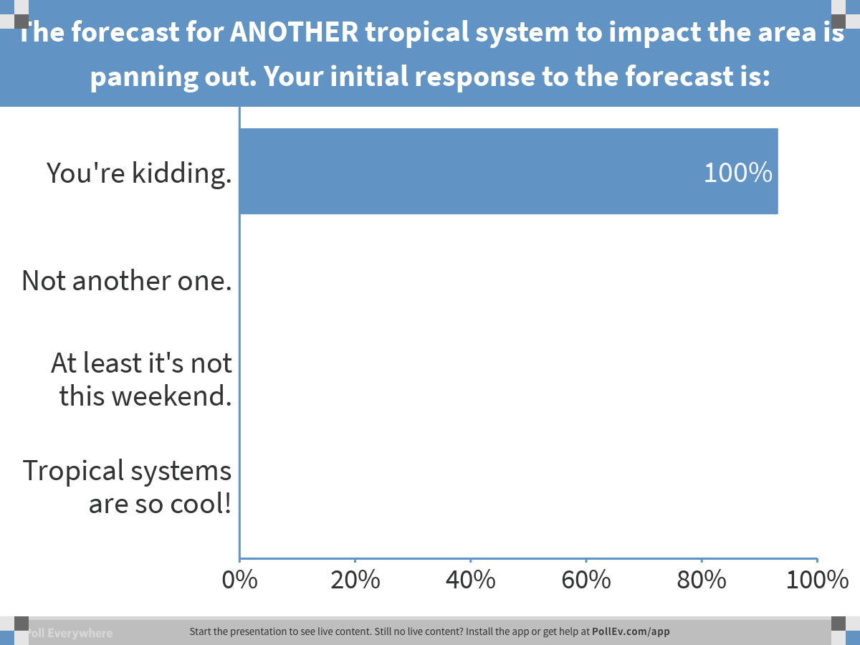
Notes:
Poll Title: The forecast for ANOTHER tropical system to impact the area is panning out. Your initial response to the forecast is: https://www.polleverywhere.com/multiple_choice_polls/WG20KjRzfyBL5th

Slide 6
Module One - Briefing
The NHC has updated their forecast for newly named Tropical Storm Miles, now expected to make landfall Monday evening along the Florida Panhandle.
Current winds: 40 mph
Winds at landfall: 105 mph
S
Category 2
H
H
H
You check the evening news broadcast. It’s not quite the leading story, but they’re certainly talking about it.
S
S
Tropical Storm Miles
Friday, Sep 14, 2018

Slide 7
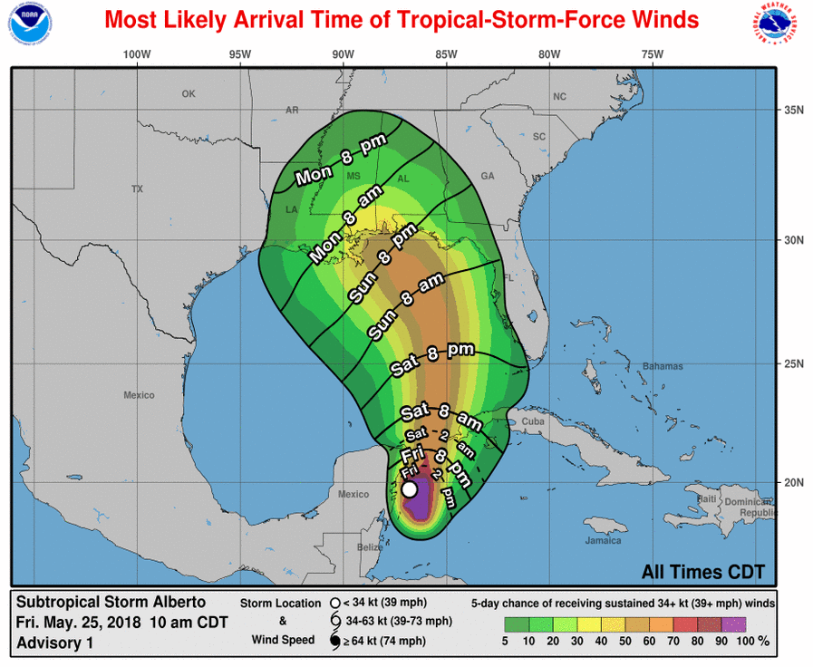
Module One - Briefing
Scrolling through your social media, you see the NWS Atlanta office is posting graphics about the potential issues.

Slide 8
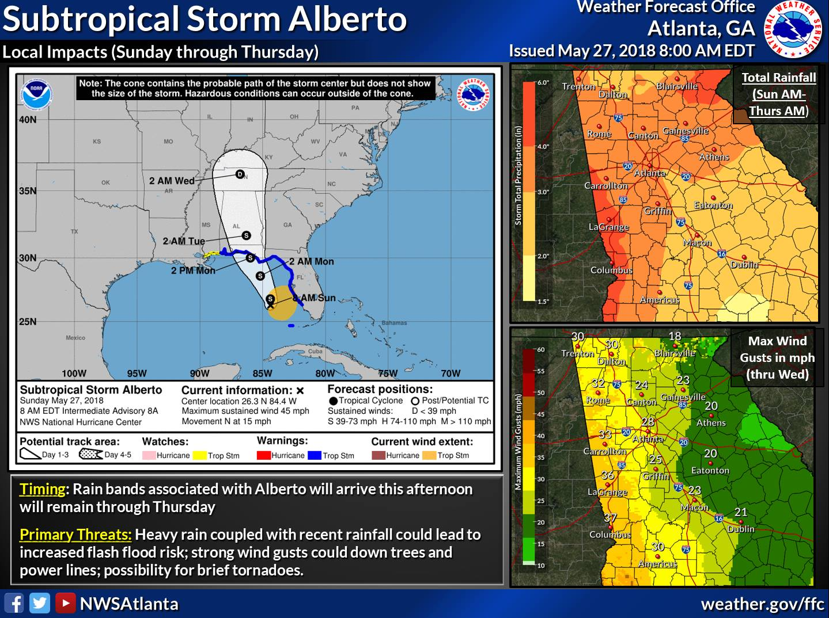
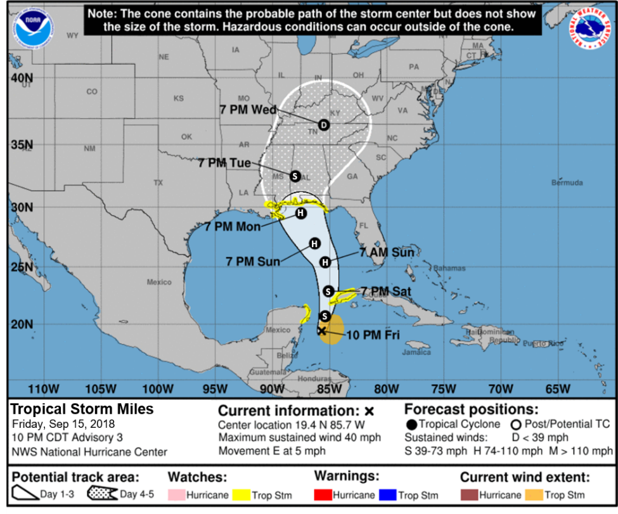
Module One - Briefing
Yikes! It’s been a wet few weeks, and this is the last thing we need!
Total Rainfall (Sun-Tue)
Max Gusts (Mon–Tue)
Timing: Rain bands associated with Miles will arrive Sunday afternoon, and remain high through Tuesday.
Primary Threats: Heavy rain coupled with recent rainfall could lead to increased flash flood risk; strong wind gusts could down trees and powerlines; possibility for brief tornadoes.

Slide 9
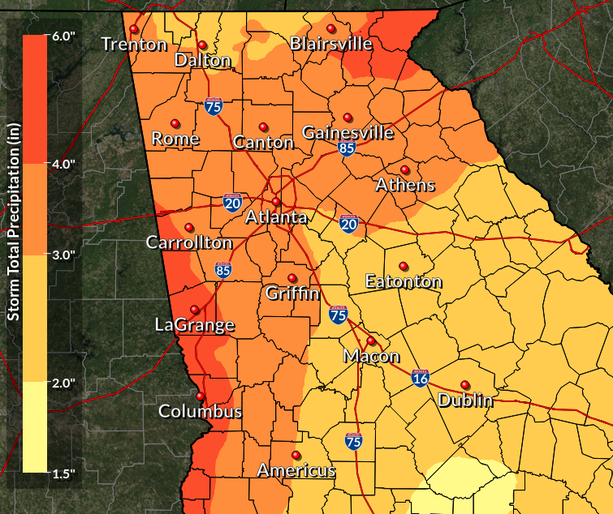
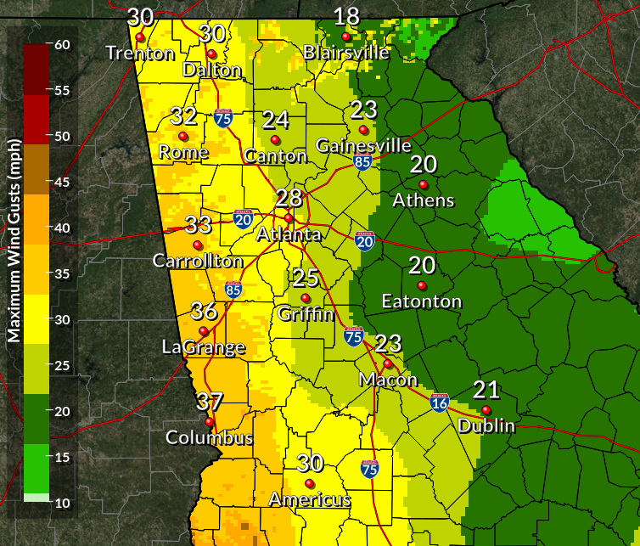
Module One - Briefing
Sunday – Tuesday Total Rainfall
Monday and Tuesday Max Winds
3-4
inches
4-6 inches
2-3
inches
35-40mph
Initial rainfall estimates are showing 4-6” possible over far western Georgia, with 3-4 inches over the metro Atlanta area.
We’ve been in a wet period and these amounts could really increase the flash flood risk.

Slide 10
Module One - Briefing
Sunday – Tuesday Total Rainfall
Monday and Tuesday Max Winds
3-4
inches
4-6 inches
2-3
inches
35-40mph
Wind speeds are expected to peak at 35-40 mph over western Georgia, with 25-30 in the Atlanta area.
Saturated soils could allow trees to topple easily at these speeds.

Slide 11
Module One - Briefing
NWS Atlanta will begin special briefings for Tropical Storm Miles Saturday, and will follow the schedule below.
Saturday | Sunday | Monday (as needed)
6 AM (email) | 6 AM (email) | 6 AM (email)
12 PM (webinar) | 12 PM (webinar) | 12 PM (webinar)
6 PM (email) | 6 PM (email) | 6 PM (email)

Slide 12
Module One - Briefing
Luckily, weather Saturday and Sunday looks to be sunny and dry. Highs in the 70s.

Slide 13
Notes:
Poll Title: It's Friday night. Landfall is expected late Monday. Have you started preparing? https://www.polleverywhere.com/multiple_choice_polls/G2DxvSpSmG4EK58

Slide 14
Notes:
Poll Title: Given this information, what's your biggest weather concern? https://www.polleverywhere.com/multiple_choice_polls/0fLTkuOgpNtnqQB

Slide 15
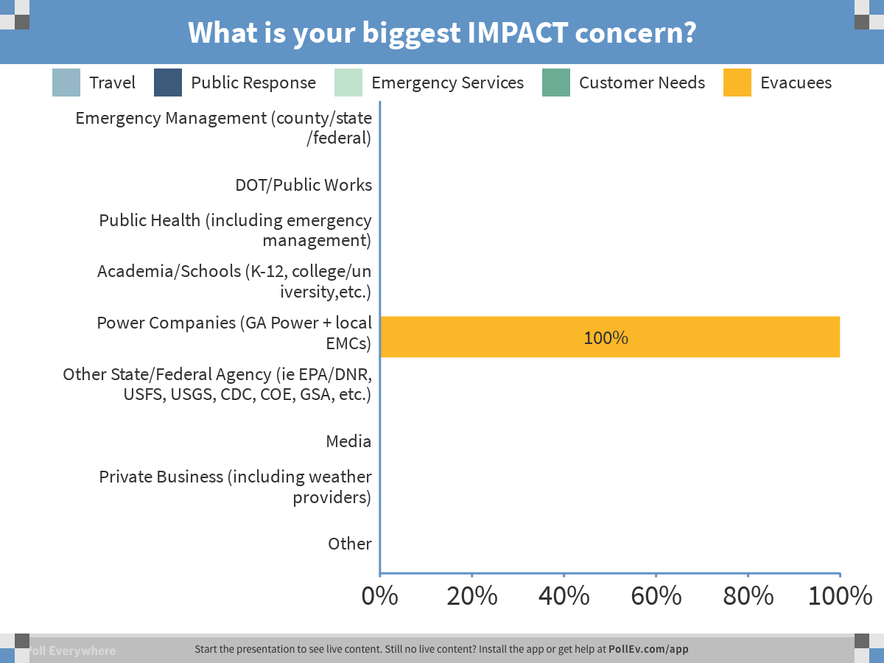
Notes:
Poll Title: What is your biggest IMPACT concern? https://www.polleverywhere.com/multiple_choice_polls/ovJweG9dtfqMc2I

Slide 16
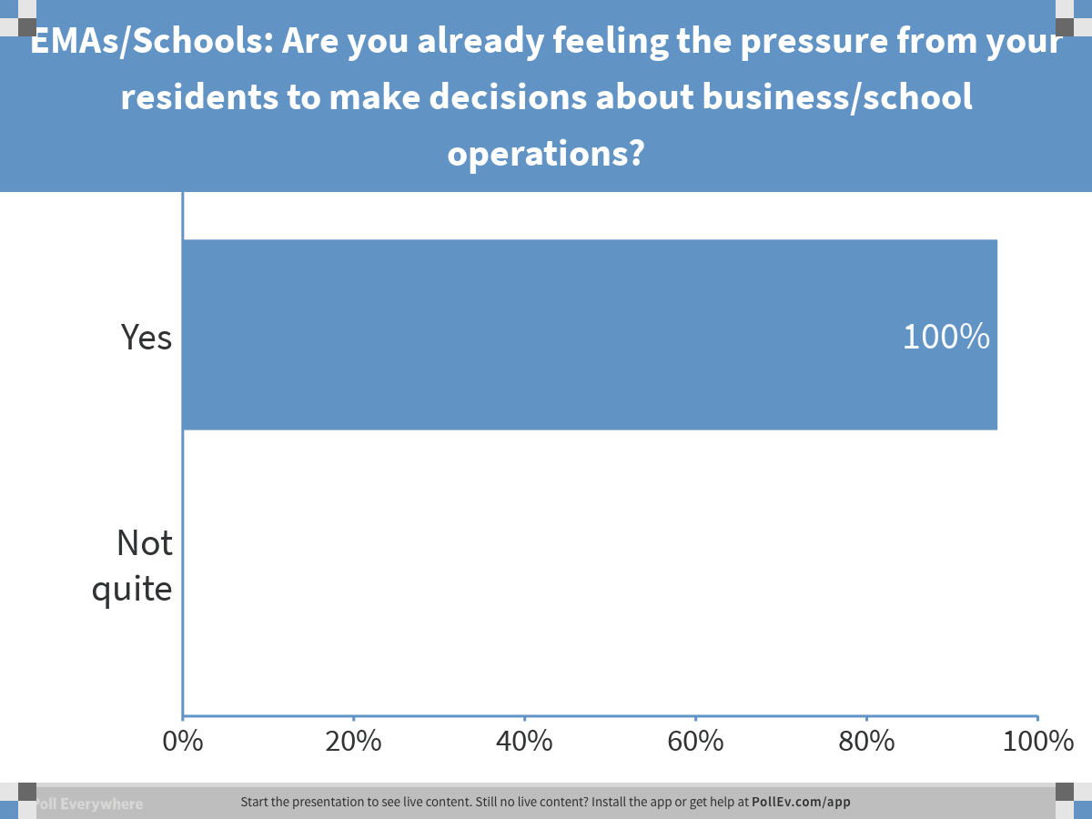
Notes:
Poll Title: EMAs/Schools: Are you already feeling the pressure from your residents to make decisions about business/school operations? https://www.polleverywhere.com/multiple_choice_polls/RGFkUlfxjZ5c2d2

Slide 17
Notes:
Poll Title: Private Groups: How are you addressing the concerns of your customers? https://www.polleverywhere.com/free_text_polls/Ri9qiHsBFimmWIp

Slide 18
Notes:
Poll Title: Even this early, is there additional information you would have found useful? If so, what? https://www.polleverywhere.com/free_text_polls/8RJNK8Cn4e1Q7De

Slide 19
Module Two
12-hours before landfall

Slide 20
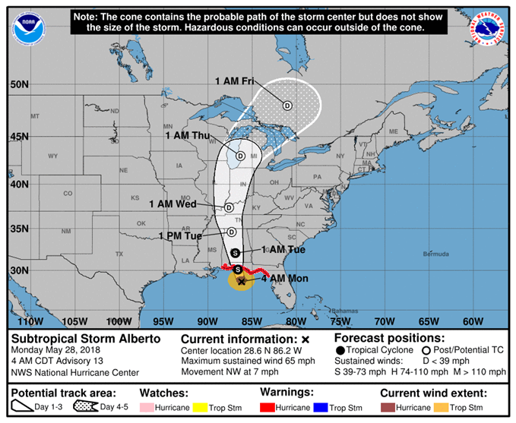
Module Two - Briefing
It’s now late Sunday, and about 12 hours until landfall.
Hurricane Miles is a strong Category 2 Hurricane, and some additional strengthening is possible overnight. It is expected to make landfall as a Category 3 Major Hurricane around 11 AM Monday.
D
S
H
M
11
Hurricane Miles
Monday, Sep 17, 2018
11 PM EDT Advisory 14
110 mph

Slide 21
Notes:
Poll Title: The track has shifted west, and we're outside the error cone. Are we in the clear? https://www.polleverywhere.com/multiple_choice_polls/HmnCqYfrOz3ZcKG

Slide 22
Module Two - Briefing
The NWS Atlanta email briefing tonight is showing increasing confidence that the area has a high risk of heavy rainfall/ flooding, and a moderate risk of damaging winds.
Timing of Threats:
Winds
Mon 8am - Tue 12pm
Rainfall
Mon 8am – Tue 10pm

Slide 23
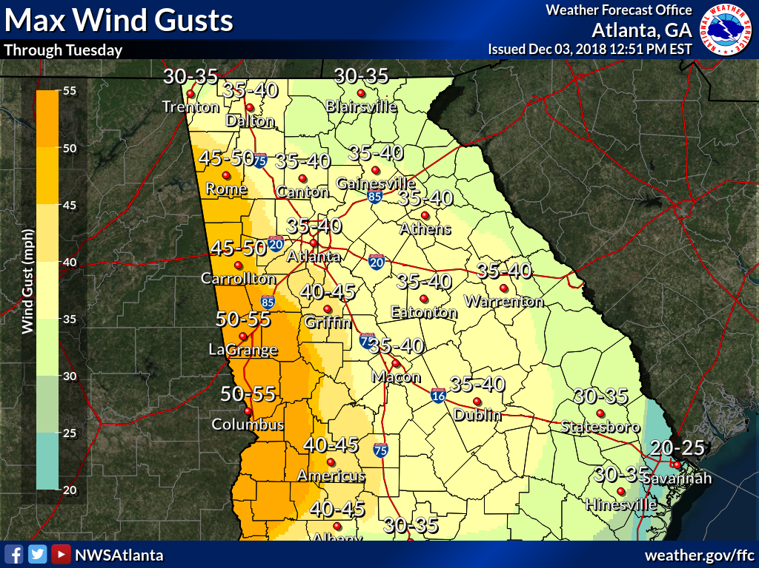
Module Two - Briefing
Sunday – Tuesday Total Rainfall
Monday and Tuesday Max Winds
3-4
inches
4-6 inches
2-3
inches
35-40mph
The updated forecast has increased rainfall estimates over western Georgia, and a large area can expect 4-6 inches.
Forecast wind speeds have not changed much over the last few days, and the majority of the area should remain below Tropical-Storm Force.

Slide 24
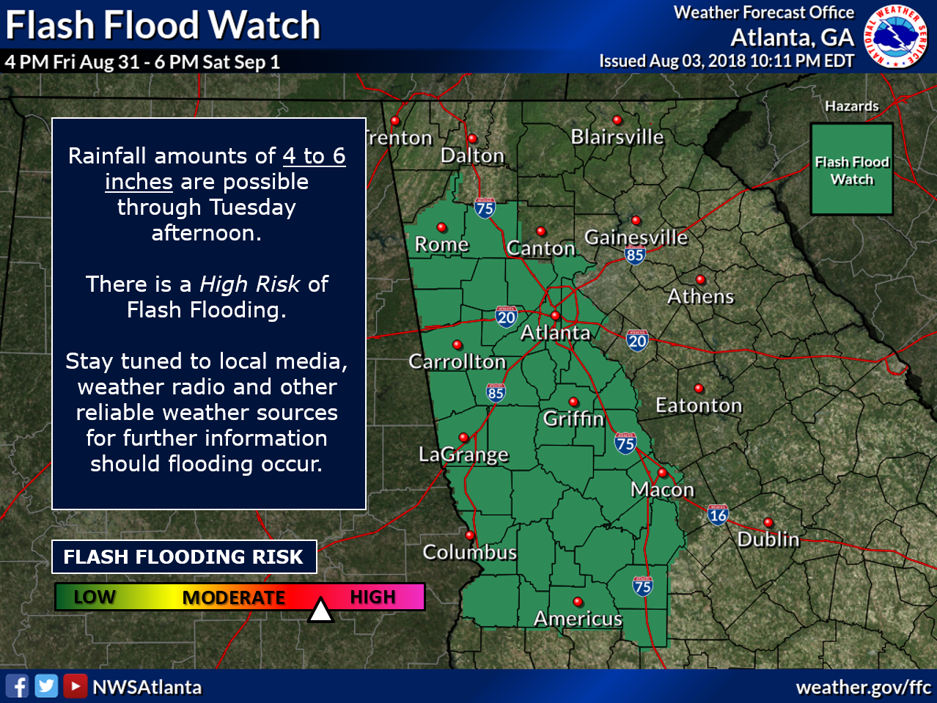
Module Two - Briefing
A Flash Flood Watch is in effect from midnight tonight through 10 PM Tuesday as the rain bands impact the area.
12 AM Mon Sep 17 – 10 PM Tue Sep 18
Notes:
Expand the watch area.

Slide 25
Module Two - Briefing
Tropical Storm Warning and
Tropical Storm Watch products have been issued for portions of western Georgia through Tuesday due to potential for Tropical Storm conditions.

Slide 26
Notes:
Poll Title: Do your response plans change now that NWS products have been issued? https://www.polleverywhere.com/multiple_choice_polls/kyD5mD2zGb46NOF

Slide 27
Notes:
Poll Title: If you were in Columbus, what category storm are you preparing for at this point? https://www.polleverywhere.com/multiple_choice_polls/LqVdpljsLoCfbWn

Slide 28
Notes:
Poll Title: Now that the storm has intensified, does your primary weather concern change? https://www.polleverywhere.com/multiple_choice_polls/in8IuDIJoeAhAwk

Slide 29
Module Three
24-hours after landfall, 11AM Tuesday

Slide 30
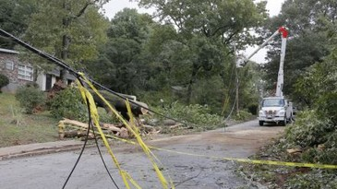
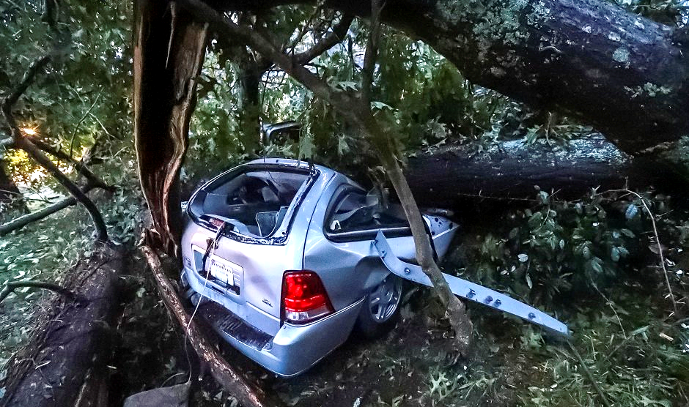
Module Three - Briefing
Hurricane Miles made landfall at 10:42 AM Monday morning as a Category 3 Storm, with 112 mph maximum winds.
It quickly weakened as it moved northward through Alabama, with several bands pounding Georgia with heavy rainfall and damaging winds.
The initial clean up of downed trees and power lines has begun, but flooding continues to be a major threat.

Slide 31
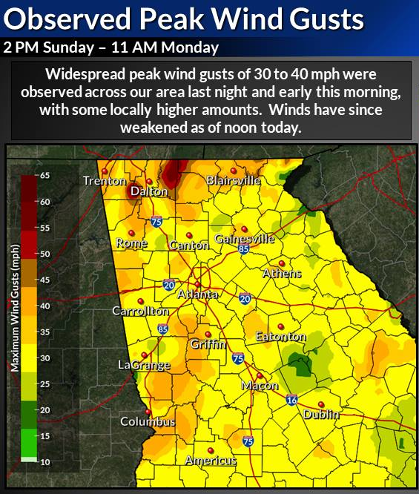
Module Three - Briefing
Hundreds of trees were downed by the winds over western and north Georgia, and 300,000 customers are without power.
Two NOAA Weather Radio transmitters were briefly off the air in far north Georgia due to communication/power failure.
12 AM Mon Sep 17 – 10 AM Tue Sep 18
Widespread observed wind gusts of 30 to 40 mph were observed across the area yesterday through this morning from Hurricane Miles. Higher speeds were observed in the higher elevations of north Georgia. Winds have begun to subside, and will continue to weaken through the afternoon.

Slide 32
Notes:
Poll Title: Do you think that we missed a warning for north Georgia given the observed wind gusts? https://www.polleverywhere.com/multiple_choice_polls/SYzVmgBYXWfHLya

Slide 33
Notes:
Poll Title: Power/Energy Groups: What could keep you from restoring power quickly? https://www.polleverywhere.com/free_text_polls/KVjeKqTZPksUs8o

Slide 34
Notes:
Poll Title: How are communicating weather hazards to your stakeholders, especially if there is a comms failure? https://www.polleverywhere.com/free_text_polls/y9P4xTYIDgkmbru

Slide 35
Module Three - Briefing
A large area of 4 to 5.5 inches of rain occurred from late Sunday through this morning, with locally higher amounts.
Although only light rain remains, rivers remain high, and continue to rise due to the increased runoff.

Slide 36
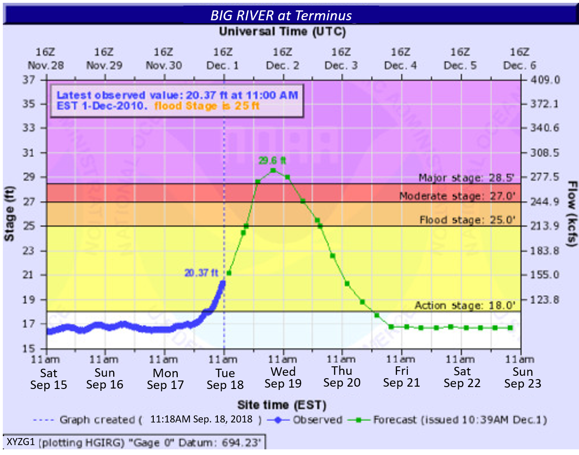
Module Three - Briefing
In addition to numerous road closures in your area, the main-stem river in your county, the Big River, is currently at action stage and is continuing to rise. The latest projection has it cresting at Major Flood Stage tomorrow morning, Wednesday, at 11AM.

Slide 37
Module Three - Briefing
Minor Flood Stage
Water begins to inundate the Big River Recreational Area, and some portions may be closed. Portions of the YMCA Campground off Forest Road begin to flood.

Slide 38
Module Three - Briefing
Minor Flood Stage
Water begins to inundate the Big River Recreational Area, and some portions may be closed. Portions of the YMCA Campground off Forest Road begin to flood.
Moderate Flood Stage
Backyards of homes off River Lane and Water Court are under two feet of water, in addition to portions of the 8th and 12th fairways of the Big River Golf Course. The Big River Recreational Area will be under 2-4 feet of water, and the public restrooms will begin to inundate. Water will be approaching the bottom of the Main Street/GA Hwy 12 bridge.

Slide 39
Module Three - Briefing
Minor Flood Stage
Water begins to inundate the Big River Recreational Area, and some portions may be closed. Portions of the YMCA Campground off Forest Road begin to flood.
Moderate Flood Stage
Backyards of homes off River Lane and Water Court are under two feet of water, in addition to portions of the 8th and 12th fairways of the Big River Golf Course. The Big River Recreational Area will be under 2-4 feet of water, and the public restrooms will begin to inundate. Water will be approaching the bottom of the Main Street/GA Hwy 12 bridge.
Major Flood Stage
Water begins to enter a dozen homes off River Lane and Water Court, and the entrance to the neighborhood will be cut off. Widespread inundation of the Big River Golf Course occurs, and water hit the bottom of the Main Street/GA Hwy 12 bridge, acting like an obstacle and causing some backwater and erosion to the sides of the bridge.

Slide 40
Notes:
Poll Title: If the river gauge stops working, how do you get level or flow information? https://www.polleverywhere.com/free_text_polls/8iMmLHQqBzUIUzP

Slide 41
Notes:
Poll Title: Which agencies/organizations would you contact to help with ongoing flooding? https://www.polleverywhere.com/free_text_polls/xynPcjIPRhSRC6z

Slide 42
Notes:
Poll Title: Private Groups: What is your primary role as an event winds down, or after the storm? https://www.polleverywhere.com/free_text_polls/9DUGahb2lLRiWQv

Slide 43
Notes:
Poll Title: What expectations do you have for the NWS post-event? https://www.polleverywhere.com/free_text_polls/g6ME0oizEiWNoqI

