Slide 1
Winter Outlook + Tools & Resources
Title
North & Central GA Partners Workshop (IWT)
December 4, 2018
Notes:
Intro Slide

Slide 2
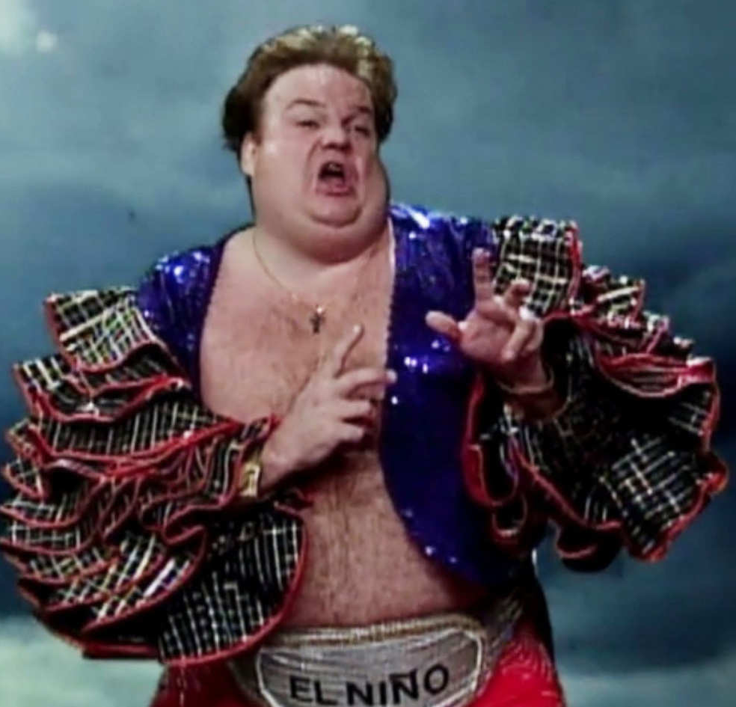
2018-19 Winter Outlook
DISCLAIMER: Long-range (> 14 days) outlooks are just that – outlooks. They are intended to provide a big picture - probabilistic view of potential long-wave patterns that could impact temperatures and precipitation across different regions of the world.
What it is NOT designed for:
How many snow/ice storms will we see
this winter?
Will it snow 3” on Christmas day?
Record cold temperatures in February?
Early Spring?
Notes:
Intro Slide

Slide 3
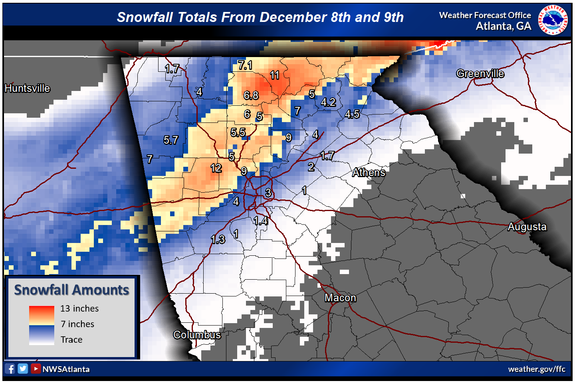
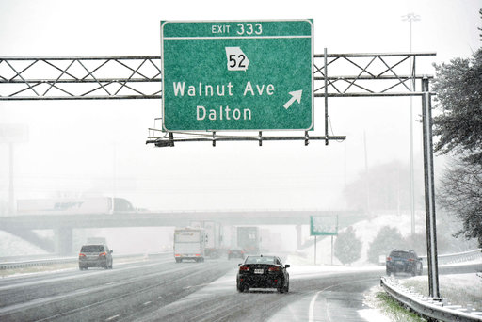
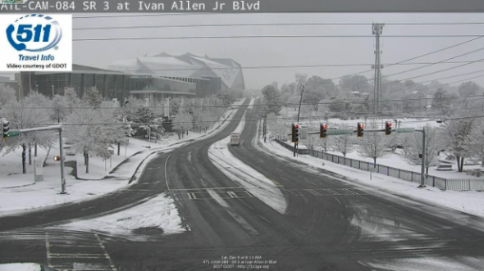
Regardless of Outlooks…
…it only takes one event!
Notes:
Intro Slide

Slide 4
NOAA Winter Outlook – Precipitation
50+%
40-50%
40-50%
“Equal chances” = ???
Notes:
Intro Slide

Slide 5
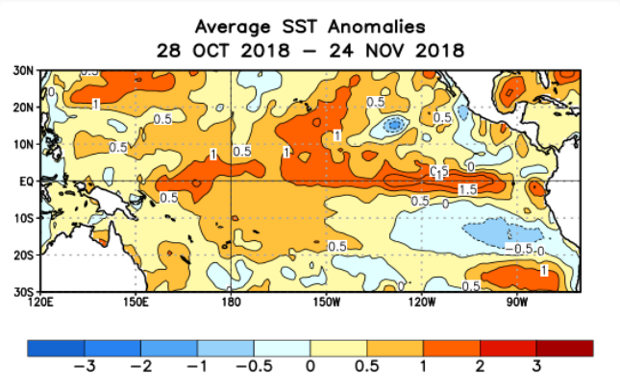
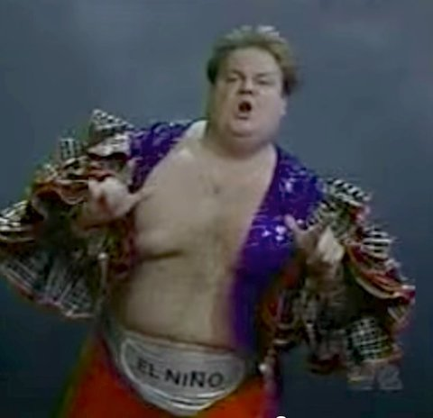
La Nina / El Nino – What is that again??
Sea-surface Temp (SST) measured at various “regions” of the equatorial Pacific
Warmer than normal = El Nino
Colder than normal = La Nina
“Weak” event = +/- 0.5 to 0.9C
“Moderate” event = +/- 1.0 to 1.4C
“Strong” event = ≥ +/- 1.5C
as of November 26
Notes:
Intro Slide

Slide 6
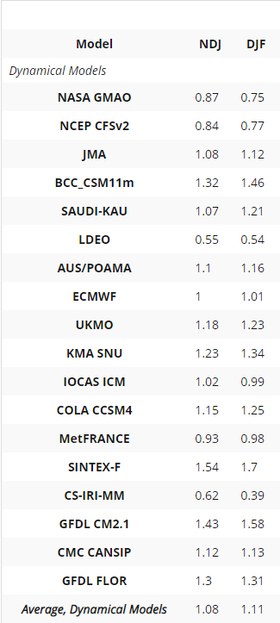
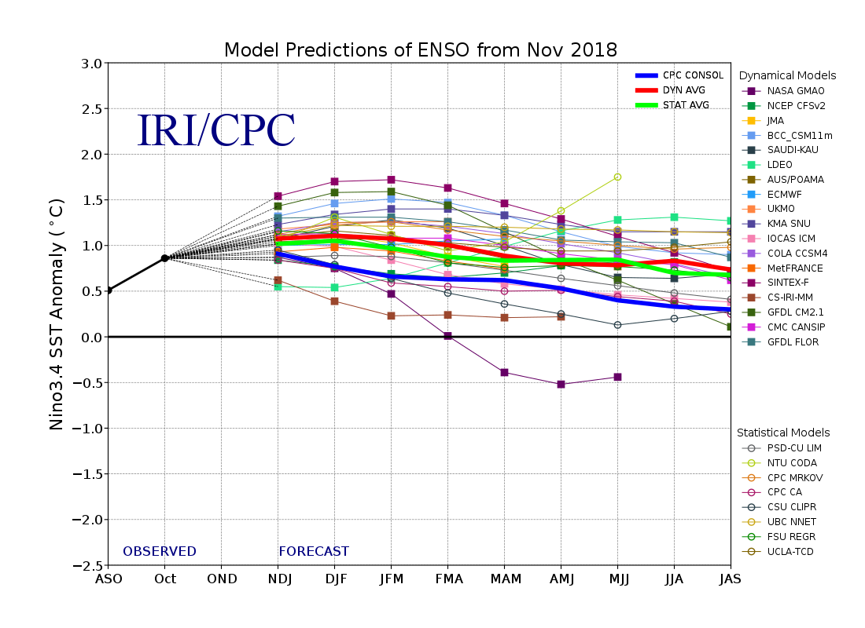
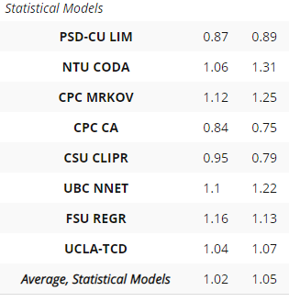
Latest ENSO Model Forecast
Weak to Moderate El Nino (SST +0.5 to 1.4°C) expected
SST Anomalies
SST Anomalies
** Take-away? All models showing El Nino conditions through at least February
Notes:
Intro Slide

Slide 7
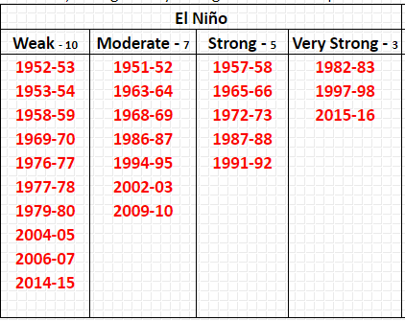
Latest ENSO Forecast
Weak to Moderate El Nino (SST +0.5 to 1.4°C) expected through Winter season (80%)
Next few slides compare several previous Fall seasons heading into “El Nino winters” to what’s currently happening (Fall 2018)
Temperature Outlook Only
Notes:
Intro Slide

Slide 8
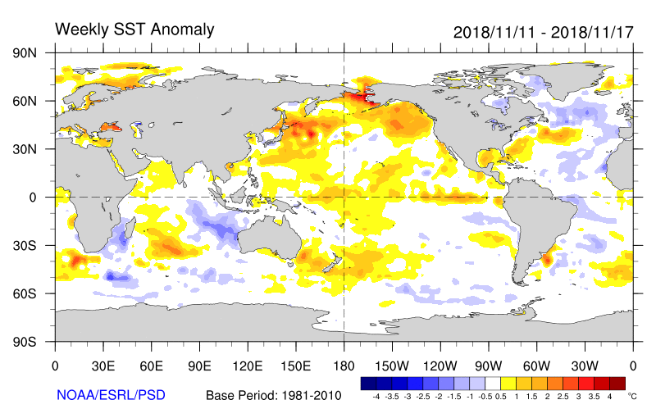
2018-19 Winter Outlook
Favors Colder Winter →
Source: WDT
Notes:
Intro Slide

Slide 9
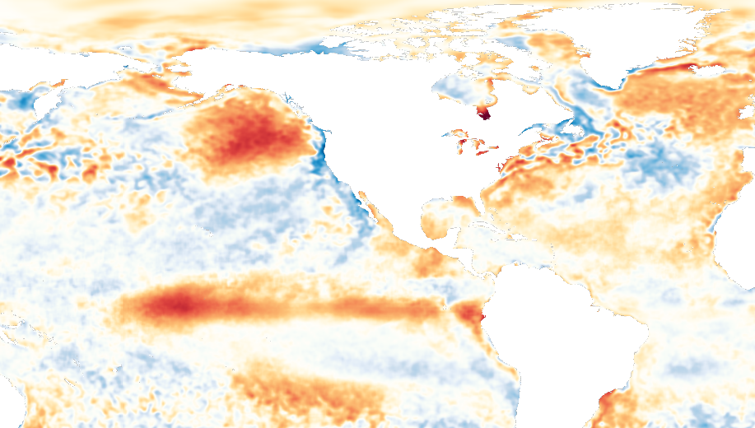
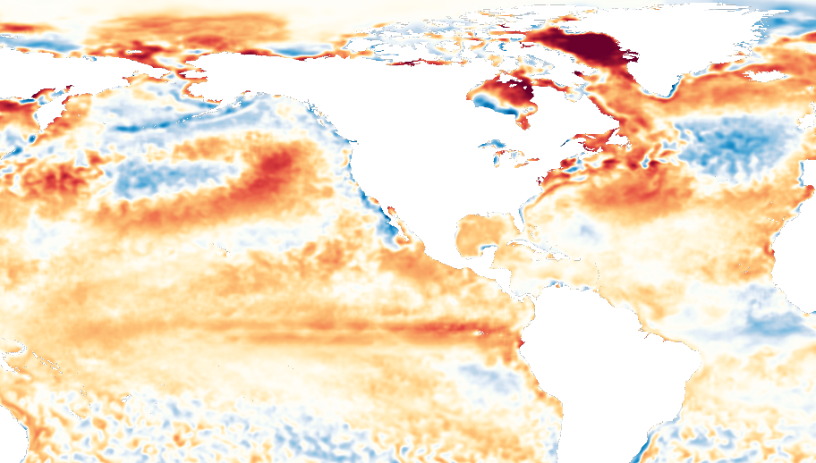
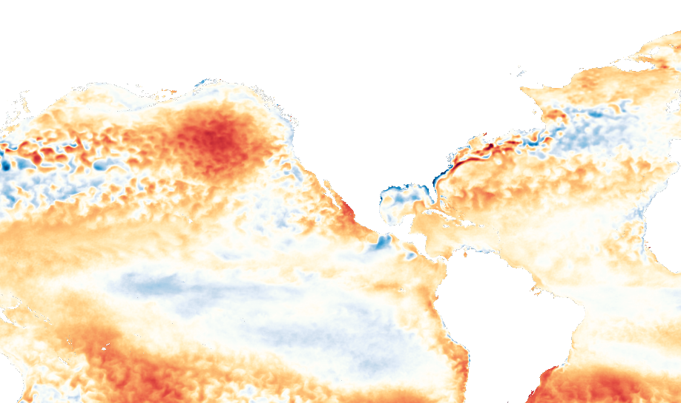
(Colder) analog years going into El Nino:
2002-03, 2009-10, 2014-15
Fall SST Anomalies in those years
Fall 2002
Fall 2009
Fall 2014
Current:
Fall 2018
Notes:
Intro Slide

Slide 10
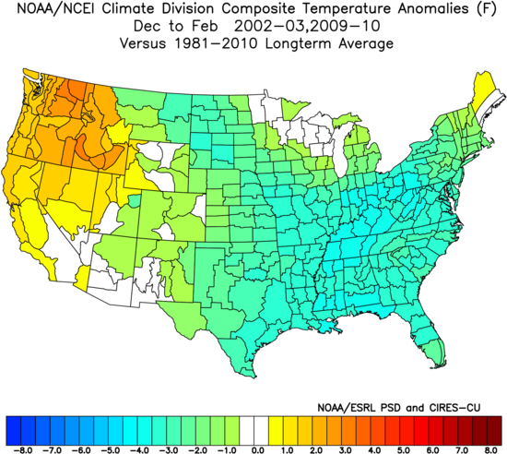
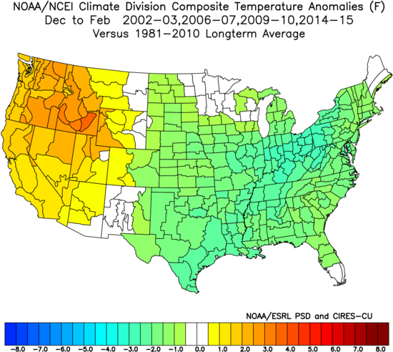
2018-19 Winter Outlook
Dec/Jan/Feb Temperature Anomalies during recent El Nino Winters
Much below average
Slightly below average
-3 to -5C below
-1 to -3C below
Notes:
Intro Slide

Slide 11
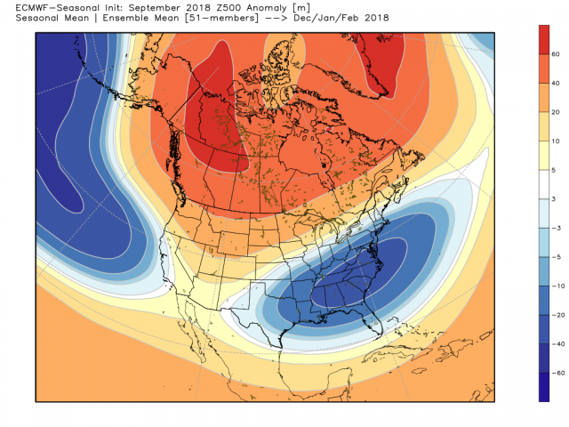
2018-19 Winter Outlook
European Model “Ensemble” (500mb heights) Winter Season (D/J/F) Outlook
Showing lower anomalies = potential to see deeper / more persistent troughs (colder air)
Notes:
Intro Slide

Slide 12
Private Sector (WDT) Outlook… SNOW!
130-150% above normal
Notes:
Intro Slide

Slide 13
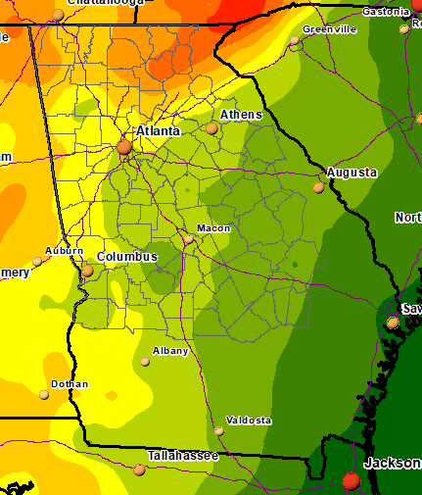
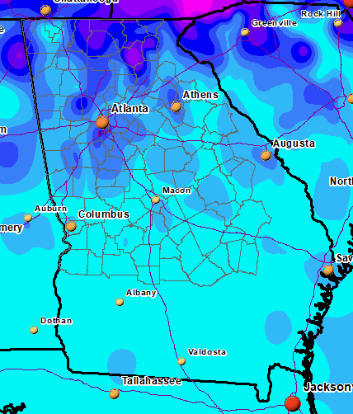
Winter precip/snowfall averages
Dec - Feb / 30-year Averages
Precipitation
Snowfall
15-20”
3-6”
12-15”
1-3”
<1”
<1”
9-12”
Notes:
Intro Slide

Slide 14
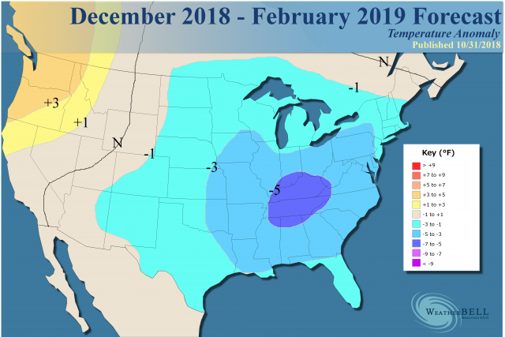
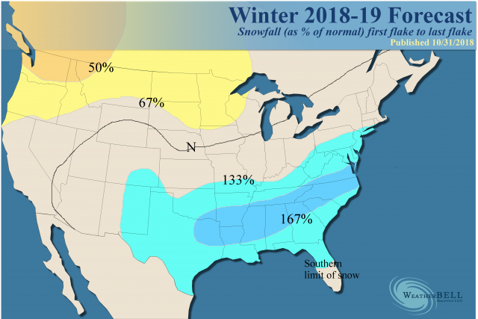
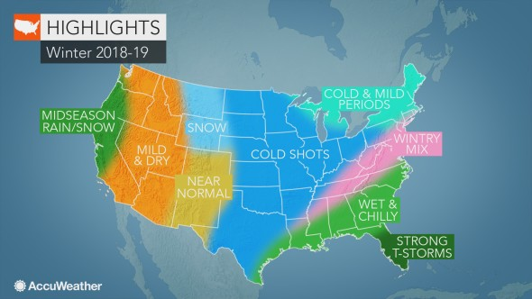
Other Private Sector Winter Outlooks
WeatherBell (right side) continues to focus on the eastern half of the country as colder and snowier for reasons mentioned earlier.
Forecast updated on 10/31/2018
Accuweather (below) calling for an active southern storm track with more chances for snow/ice
Notes:
Intro Slide

Slide 15
Product Review / Tools & Resources
Title
North & Central GA Partners Workshop (IWT)
December 4, 2018
Notes:
Intro Slide

Slide 16
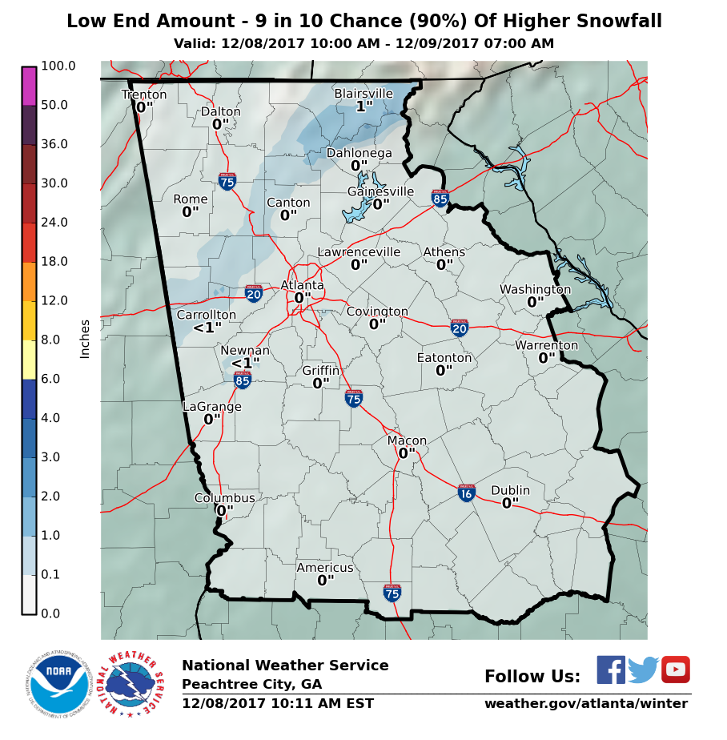
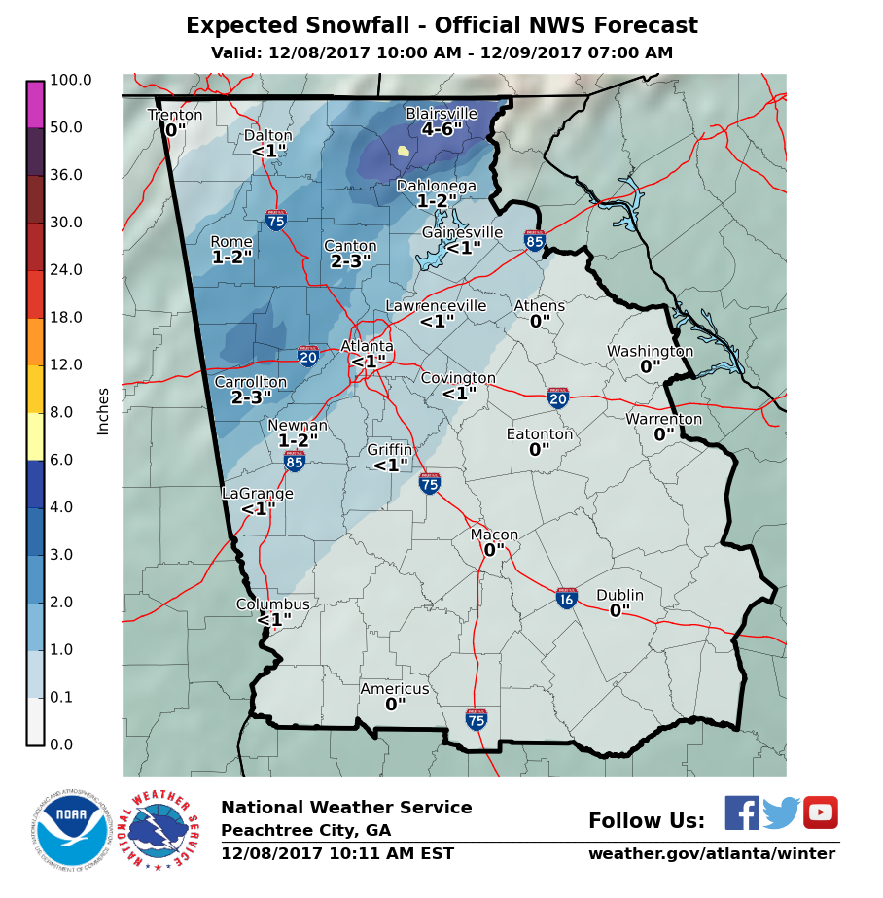
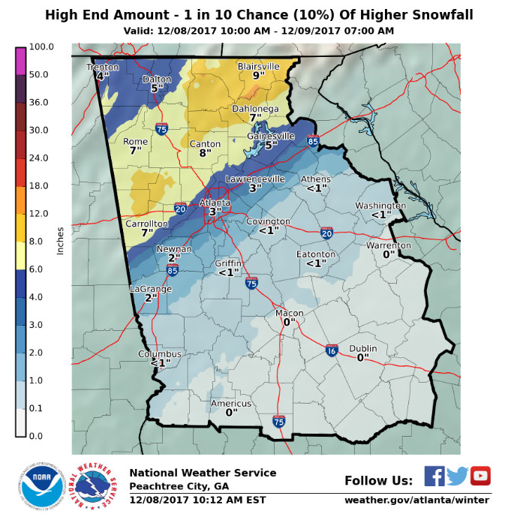
Winter Snow/Ice Probabilistic Forecasts
www.weather.gov/ffc/winter
Title
3rd year of “experiment” at FFC
Create a cumulative probability distribution function with the official NWS snowfall forecast as the mode of the distribution (not a worst case model forecast)
The 10th and 90th percentile values are communicated as the minimum (expect at least this much) and maximum (potential for this much) snowfall, respectively, while the official (e.g., NDFD) NWS WFO snowfall is communicated as the most likely snowfall amount
Generated from an ensemble of Numerical Weather Prediction (NWP) snowfall forecasts
Notes:
Intro Slide

Slide 17
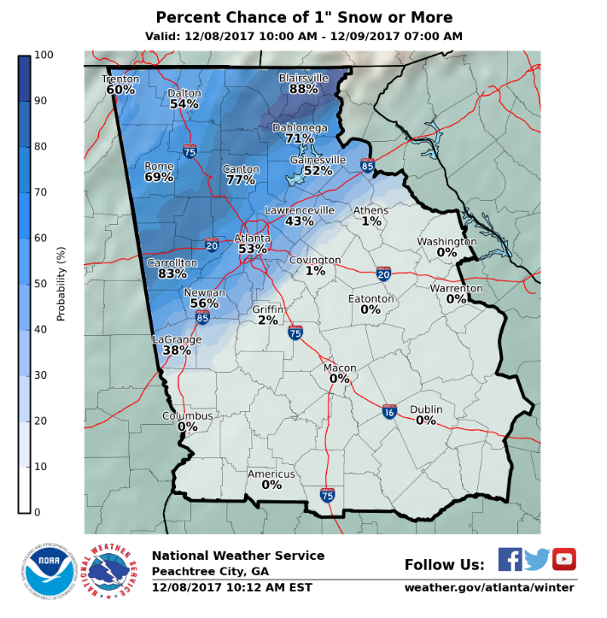
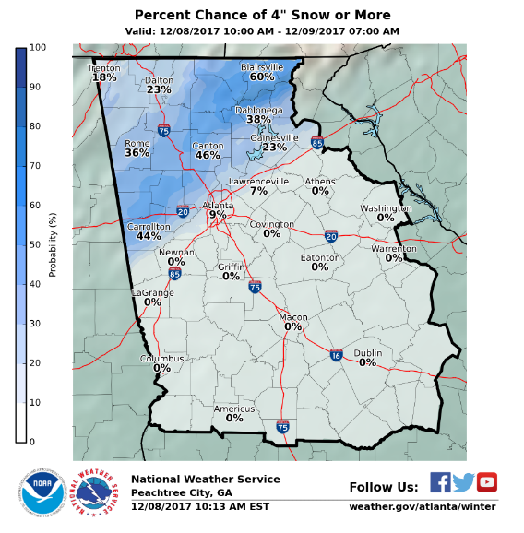
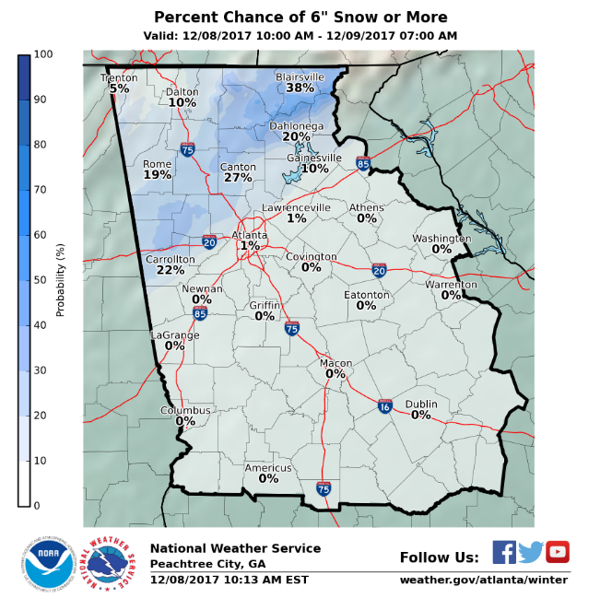
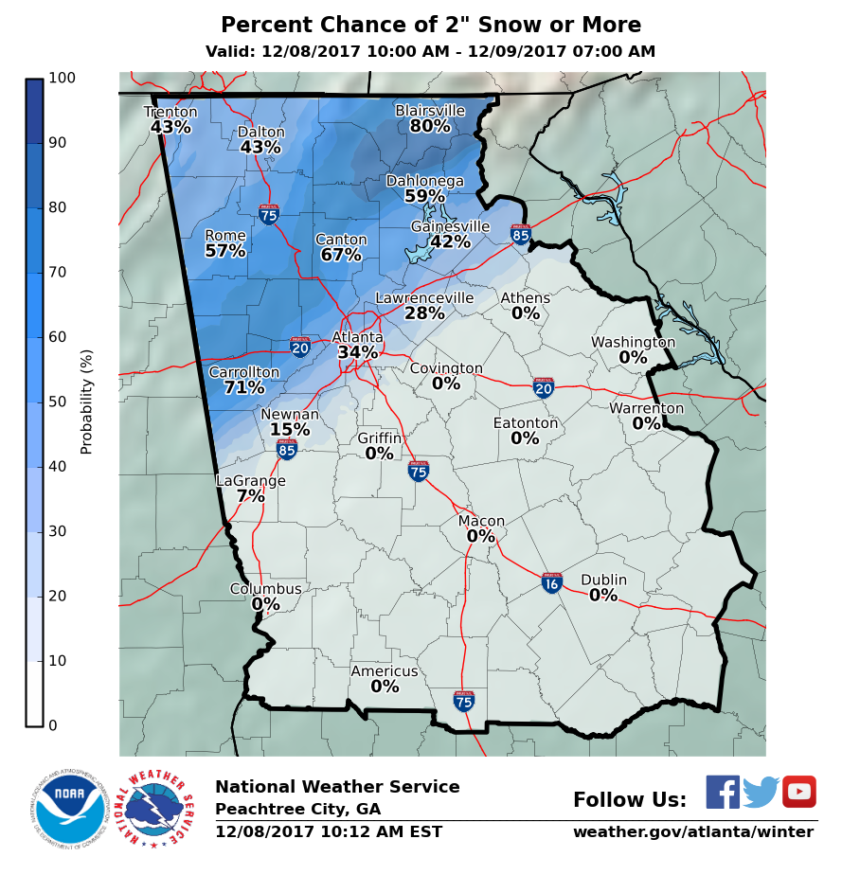
Winter Snow/Ice Probabilistic Forecasts
www.weather.gov/ffc/winter
Title
Graphically displays probability (% chance) of seeing a certain amount of snow (i.e. 1”, 2”, 4”… etc.)
This is also shown in tabular format – can select county to get list of towns/cities
Show example on web?
Notes:
Intro Slide

Slide 18
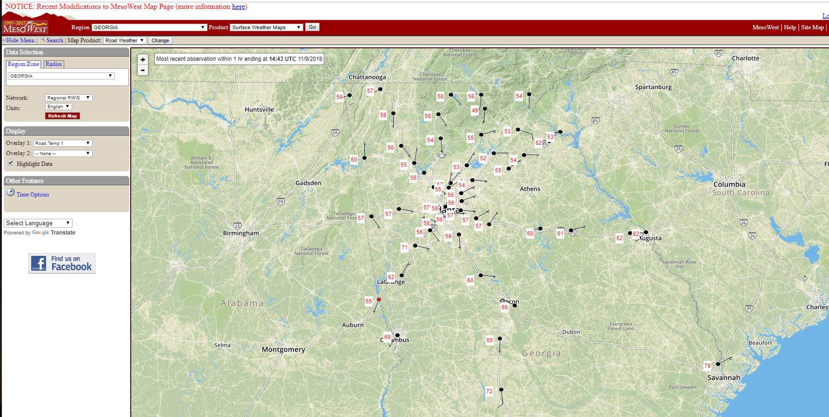
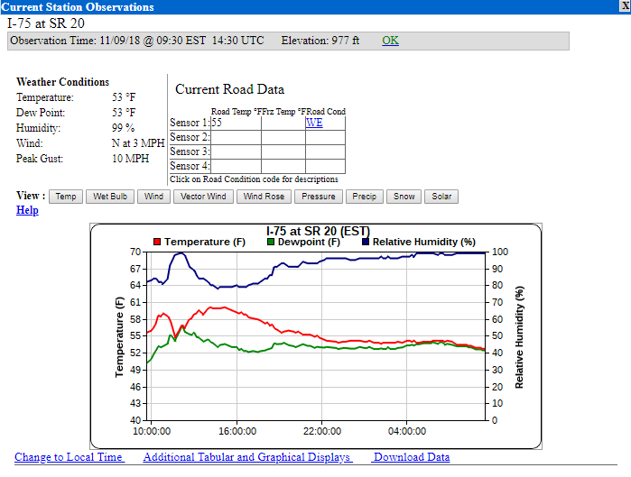
Real-time Weather Observations
https://mesowest.utah.edu
Title
Notes:
Intro Slide

Slide 19
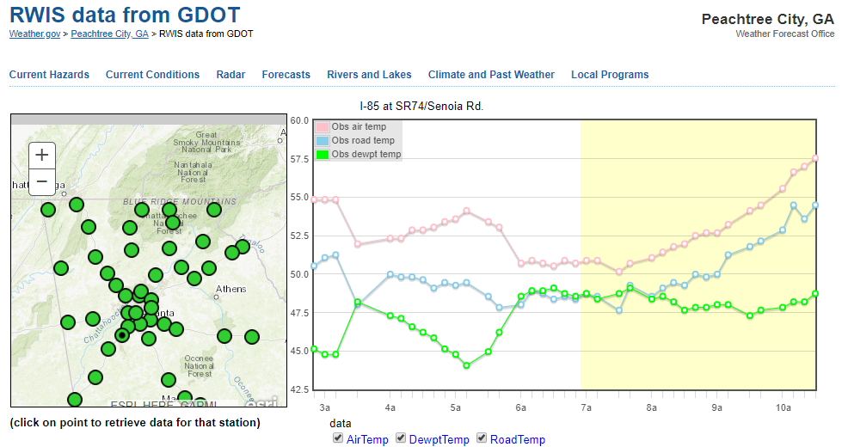
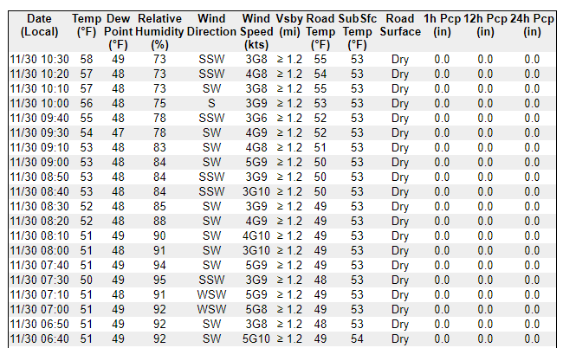
Real-time Weather Observations
GDOT Road Weather Sensors – www.weather.gov/ffc/gdot_rwis
Title
Notes:
Intro Slide

Slide 20
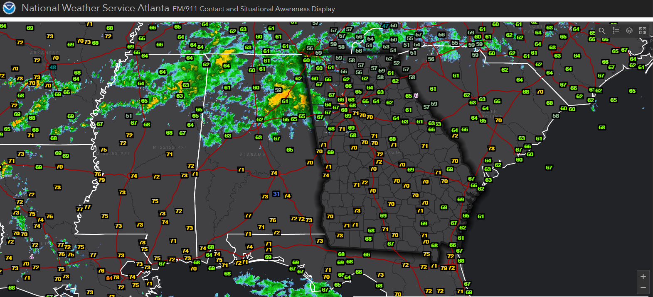
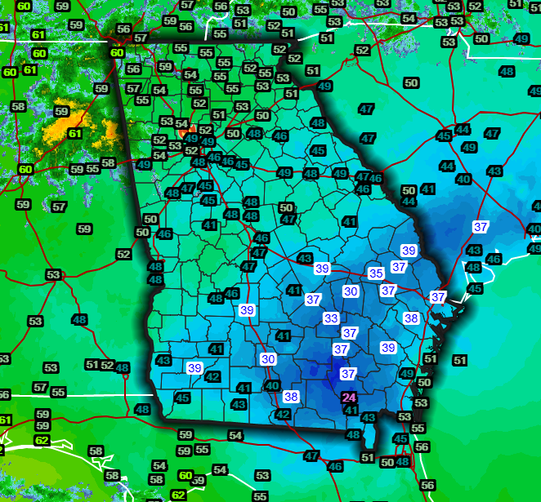
Real-time Weather Observations
Title
Reference 1-pager w/ links
Notes:
Intro Slide

Slide 21
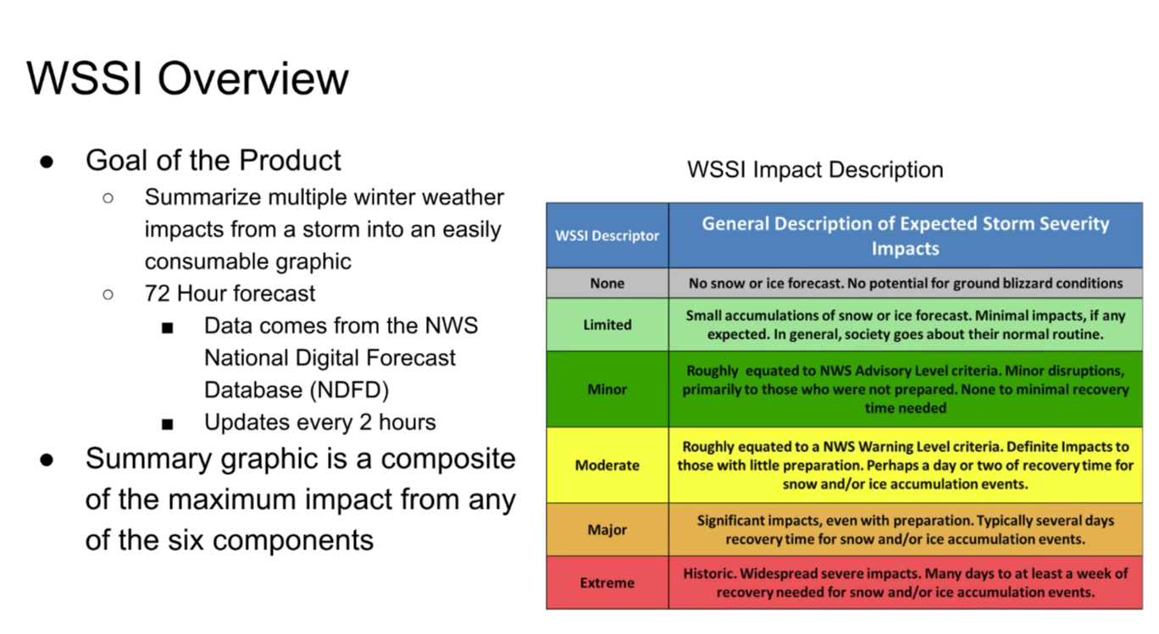
WSSI – Winter Storm Severity Index
Title
Notes:
Intro Slide

Slide 22
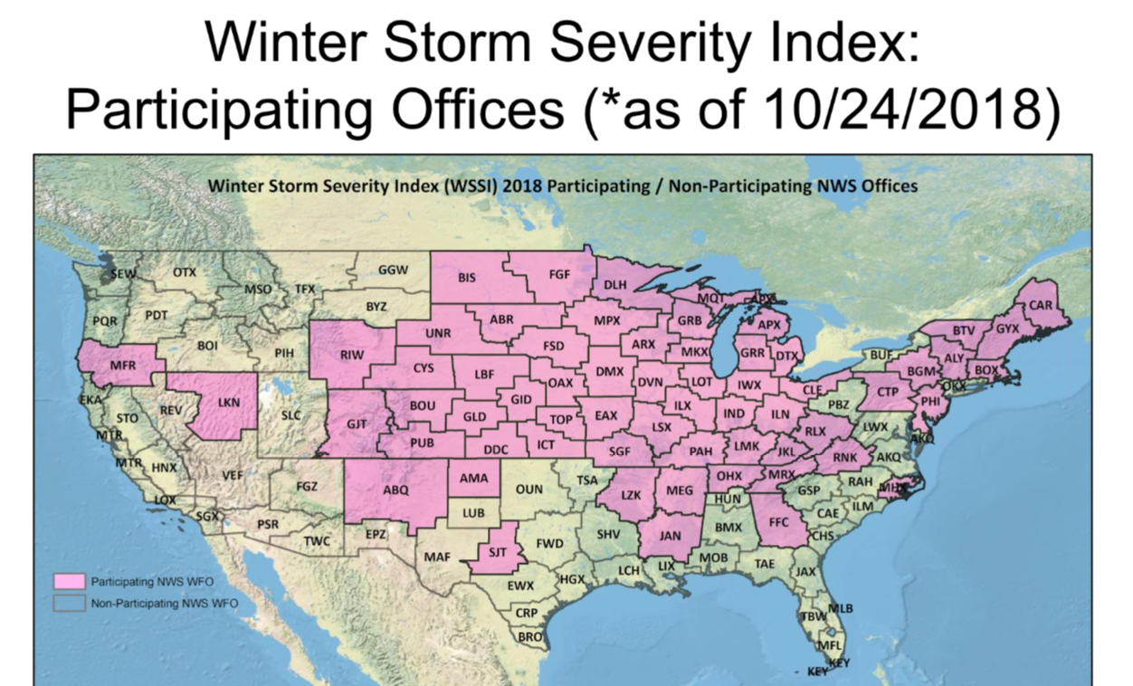
WSSI – Winter Storm Severity Index
Title
Notes:
Intro Slide

Slide 23
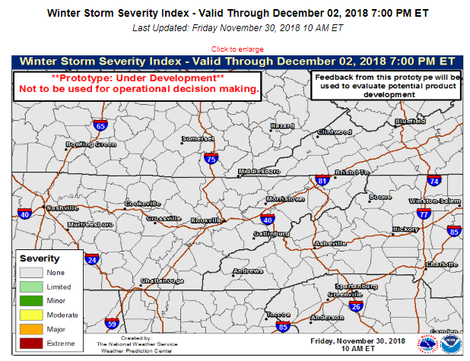
Winter Storm Severity Index (WSSI)
https://www.wpc.ncep.noaa.gov/wwd/wssi/wssi.php
Title
Identifies / rates 6 components
snow amount
snow load
ice accumulations
flash freeze
blowing snow
ground blizzard
Helps create an all-inclusive Winter Storm Severity Index
Notes:
Intro Slide

Slide 24
Winter Storm Severity Index (WSSI)
https://www.wpc.ncep.noaa.gov/wwd/wssi/wssi.php
Title
Include Dec 8, 2017 event
Notes:
Intro Slide

Slide 28
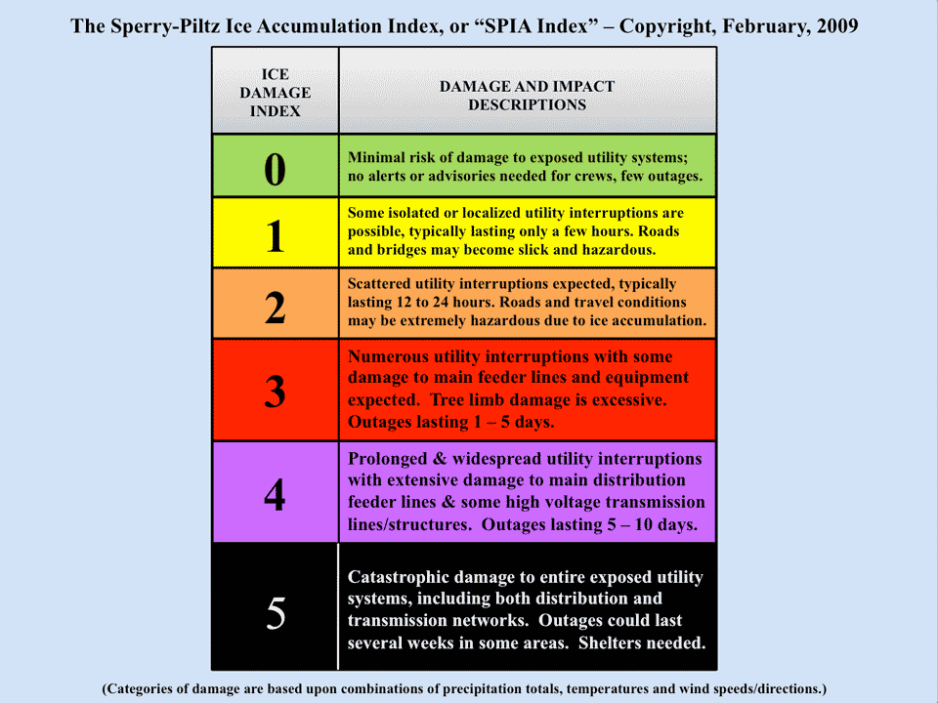
SPIA Index (http://www.spia-index.com/index.php)
Forward-looking ice storm damage index
*Impact-based* geared toward utility industry
Several NWS test sites:
For more information, contact: SidSperry@gmail.com

Slide 29
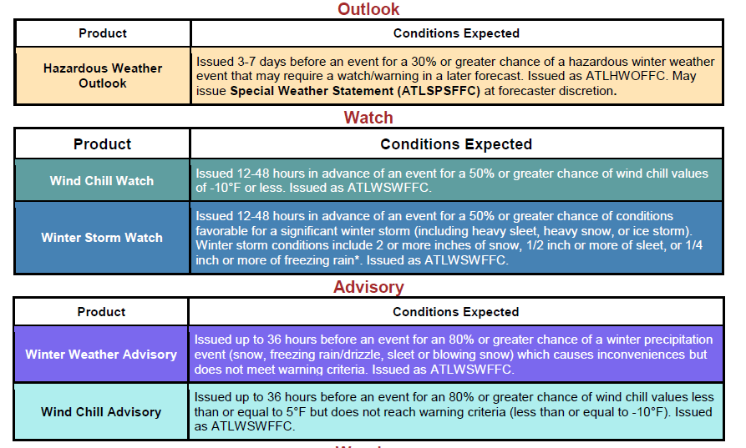
NWS Winter Products and Timelines
Title
*Criteria based on NWS Atlanta Forecast Area Thresholds
Notes:
Intro Slide

Slide 30
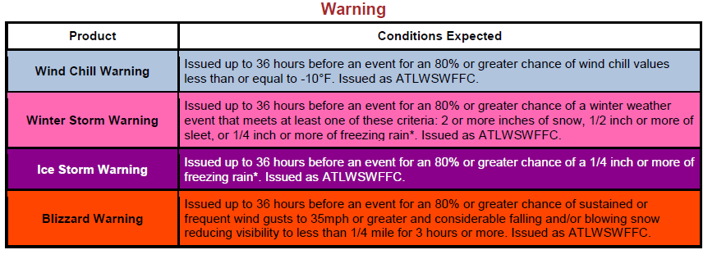
NWS Winter Products / Timeline
Title
IMPACTS strongly considered
*Criteria based on NWS Atlanta values
Notes:
Intro Slide

Slide 31
Questions?
Title
Notes:
Intro Slide

