Slide 1
Requesting Spot Forecasts:
Training for New Webpage
NWS Spot - Version 2

Slide 2
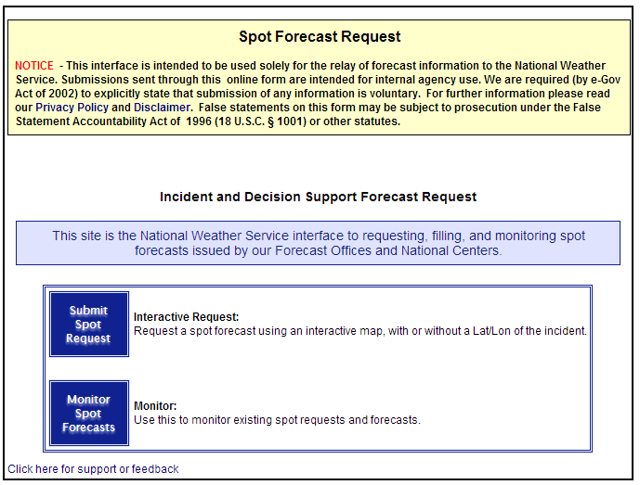
New front page: NWS Spot 2.0 http://www.weather.gov/spot/

Slide 3
Front Page Notes:
Enter requests through one national page.
Previous Spot system used 122+ start pages, one for each NWS Office.
Goal of new Spot Page is to get the request to the right Forecast Office.
Another goal: allow users to monitor a user defined area that can cover multiple forecast office areas.

Slide 4
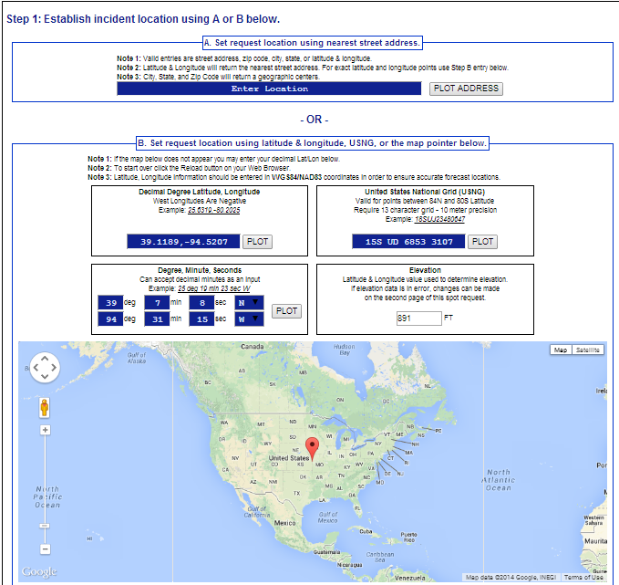
New Submit Spot Request

Slide 5
Submit Spot Request Notes:
More ways to enter in a location:
  Enter an address.
  Enter Latitude/Longitude coordinates.
  Enter in U.S. National Grid coord.
  Move a map pointer to desired location.
  Once location entered in, map will zoom, allowing location to be validated and adjusted further.
  Once location is selected/finalized, scroll down to choose incident type

Slide 6
Submit Spot Request Notes:
Important for user to get location right, so correct forecast office receives the spot forecast request.
Web page automatically determines which forecast office is responsible for the request.
Fire Weather AOR areas are used for fire users.
County warning areas for other users.

Slide 7
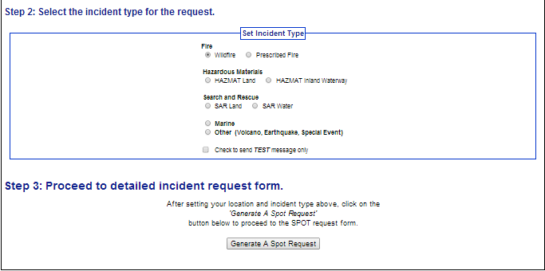
New Submit Spot Request

Slide 8
Submit Spot Request Notes:
New step: select incident type; for example, “wildfire” or “land hazmat”.
Selection determines which weather elements user may select on the next request form.
Once the incident type is selected, click on “Generate a Spot Request” to continue to page 2.

Slide 9
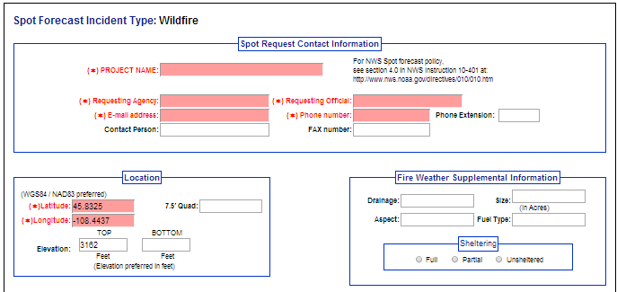
Submit Spot Request - Page 2

Slide 10
Submit Spot Request Notes:
When the “Generate a Spot Request” button is pressed, page 2 appears.
This form is tailored for the forecast office and requested incident type.
New pages adds field for email address.
Fire Weather Supplemental Information will disappear for non-fire requests.
Fill out required sections (red). Scroll down once top section is complete.

Slide 11
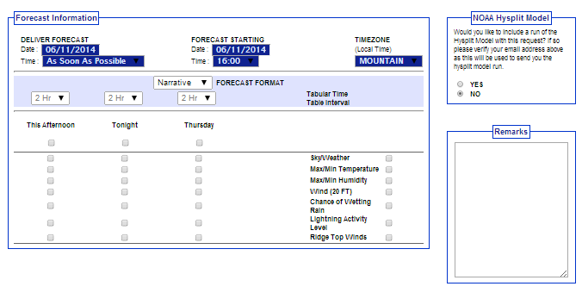
Submit Spot Request - Page 2

Slide 12
Submit Spot Request Notes:
“Forecast Information” section was revamped from “Primary Forecast Elements” section on old page.
Forecast Deliver date/time was added. Users can get forecasts ASAP or enter in when the forecast is needed.
Ignition date/time replaced by Forecast Start date/time; time tied to computer
The forecast periods are dynamic and based on the Forecast Start date/time.

Slide 13
Submit Spot Request Notes:
The first forecast period is based on Forecast Start Time. For example “today”, “tonight”, “this afternoon”.
The user can now select the forecast format they want: Narrative only, both Narrative and Tabular, and Tabular only.
User can set the “tabular table time interval” for each period.

Slide 14
Submit Spot Request Notes:
Easier to select/deselect weather elements by period and by weather element.
Added ability to request the Hysplit model output (for toxic smoke and/or chemical plumes).
Once the selections are made in this section, continue scrolling down.

Slide 15
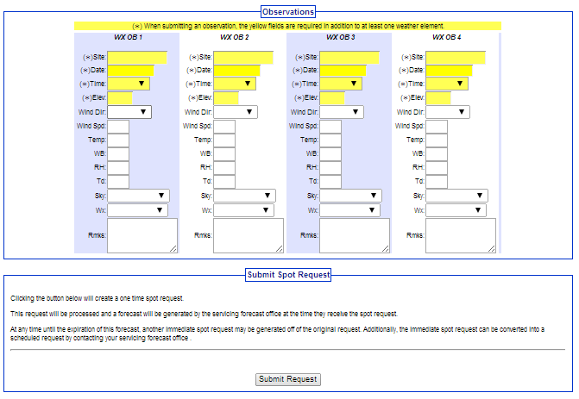
Submit Spot Request - Page 2

Slide 16
Submit Spot Request Notes:
Observation entry is more standardized with the use of dropdown menus.
Pressing the submit button will send a STQ notification message to the WFO just like the old web page did.
Inputting a weather observation is not required; but, an observation may help forecast accuracy.
Click “Submit Request” to continue.

Slide 17
New Spot Monitor

Slide 18
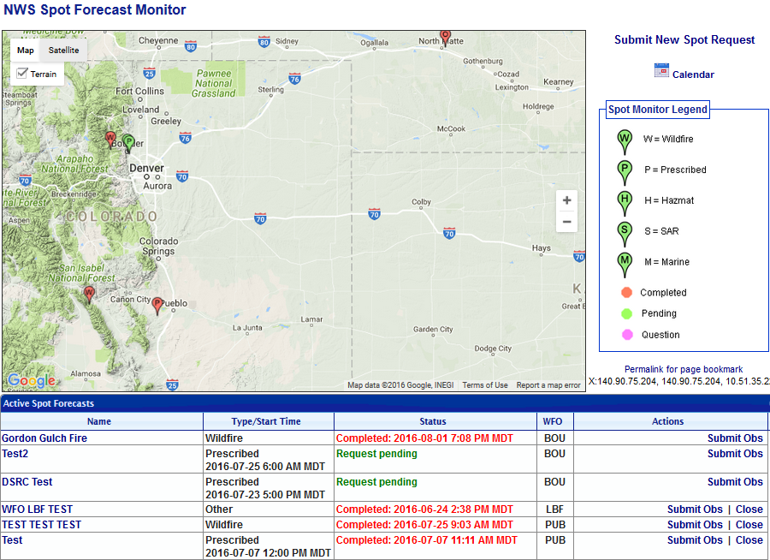
New Spot Monitor

Slide 19
Spot Monitor Notes:
Significant redesign of this page.
Previously, every Forecast Office had their own page.
Each user can now choose the area wanted for monitoring on a map. The selected area can span multiple Forecast Office domains.
To view an incident, click on the incident name in the “Name” column.

Slide 20
Spot Monitor Notes:
Old web page listed requests for one calendar day at a time.
New web page has all active incidents on one page.
When incident is finished, the incident is closed by the forecast office. Closing the incident moves all information and forecasts into an archive.

Slide 21
Spot Monitor Notes:
On old website, users requesting multiple forecasts during a day would lead to a display with multiple lines.
On new website, there will only be one line per incident. Only the latest forecast will be available.
Requests can be corrected from the Spot Monitor: “Change Request”

Slide 22
Spot Monitor Notes:
New webpage includes a “Submit Obs” link for each incident.
This allows users to enter observations for the incident without needing to submit a new request.
All observations for the incident will be databased and available to forecasters.
To submit a new observation, click on “Submit Obs” on right side of the page

Slide 23
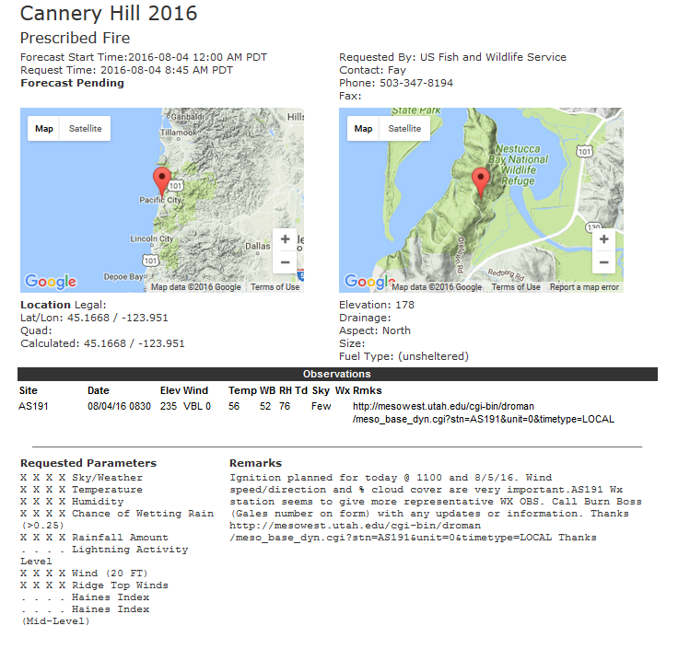
Forecast Page Notes:
All observations submitted for a particular incident will be listed on this incident page.

Slide 24
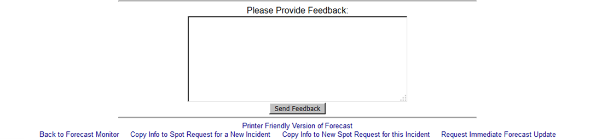
New Forecast Page
New Action: Request Immediate Forecast Update
If user or NWS forecaster realizes the forecast is off, then user/forecaster clicks link to get updated forecast.

Slide 25
Forecast Page Notes:
The customer, nor the NWS forecaster, will be allowed to edit the information related to the request.
There is an opportunity to enter in new observations. If the user realizes that the forecast is off, an observation could be submitted to help the NWS create a new forecast (although this is not always necessary).

Slide 26
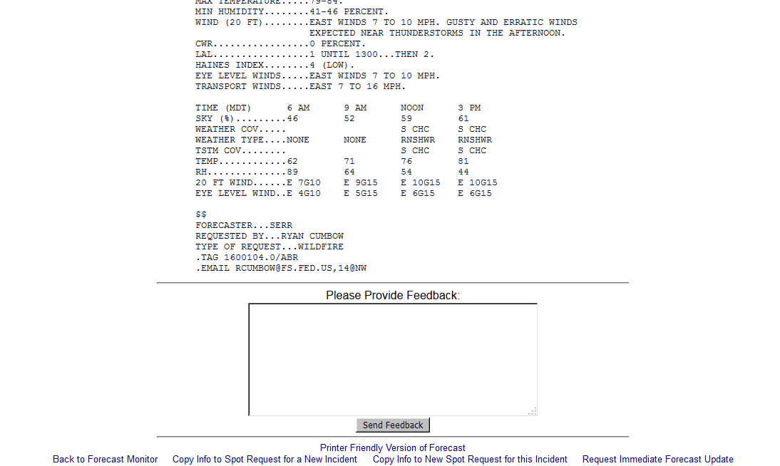
New Forecast Page

Slide 27
Forecast Page Notes:
New Action: Copy Info to New Spot Request for this Incident.
The user may use this link to get another forecast for an incident.
Unlike “Request Immediate Forecast Update”, the user is sent to Page 2 of the request process. Weather elements desired may be adjusted and the forecast delivery date/time may be changed, etc.

Slide 28
Forecast Page Notes:
Allows users to easily schedule the next needed forecast for an incident without having re-entering the information.
Allows new observations submitted to remain with the request.
However, lat/lon of the incident cannot be changed.

