Slide 1
NWSChat
&
Social Media
Neil Dixon
NWS WFO Greenville-Spartanburg, SC
Email: Neil.Dixon@noaa.gov

Slide 2
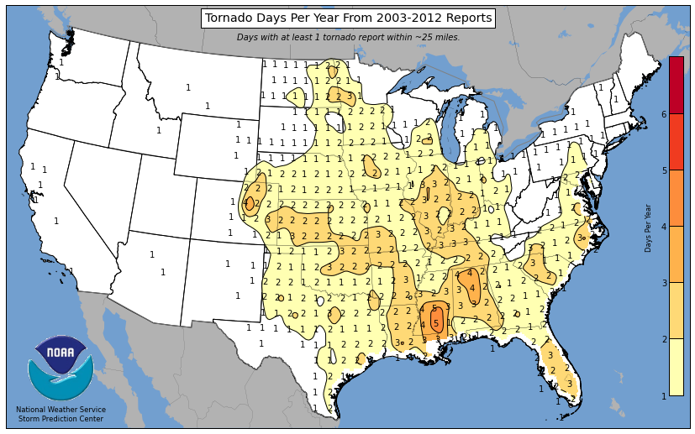
Tornado Days Per Year (2003-2012)

Slide 3
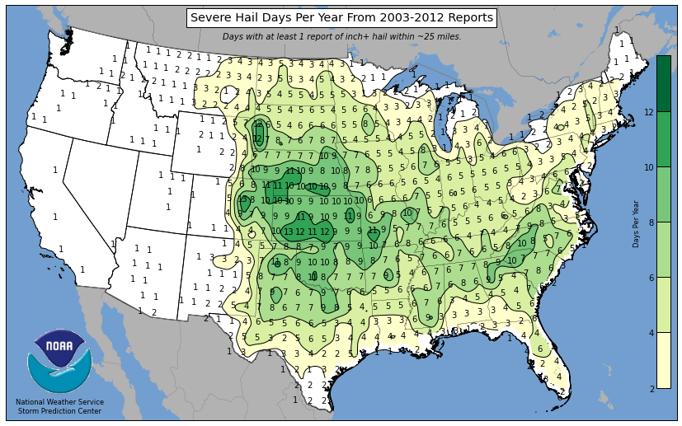
Severe Hail Days Per Year (2003-2012)

Slide 4
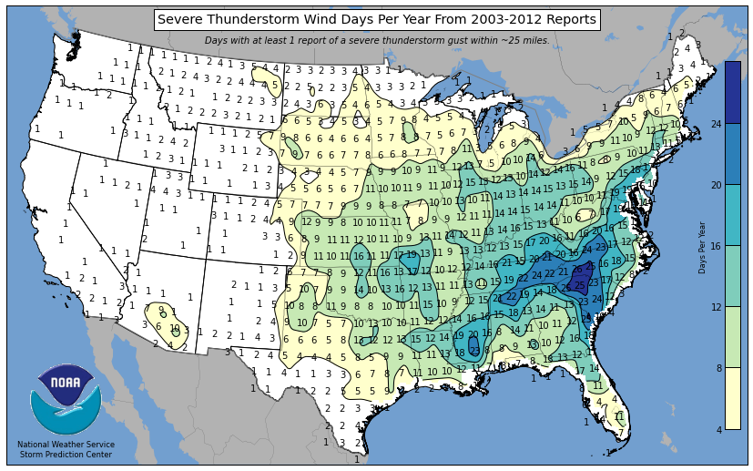
Severe Thunderstorm Days Per Year (2003-2012)

Slide 5
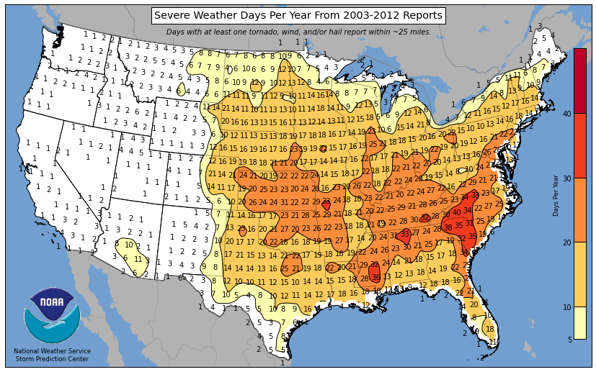
Severe Weather Reports Per Year (2003-2012)

Slide 6
NWSChat Background
The purpose of the NWSChat is to exchange information, including storm reports, or provide clarification on the forecast between the NWS forecasters and the chat participates.
NWS GSP began using NWSChat and assigning accounts in January 2008.
NWS GSP has assigned 150 accounts
47 – Media
39 – Amateur Radio
36 – Emergency Manager
18 – NWS
10 – Fire Department Personnel

Slide 7
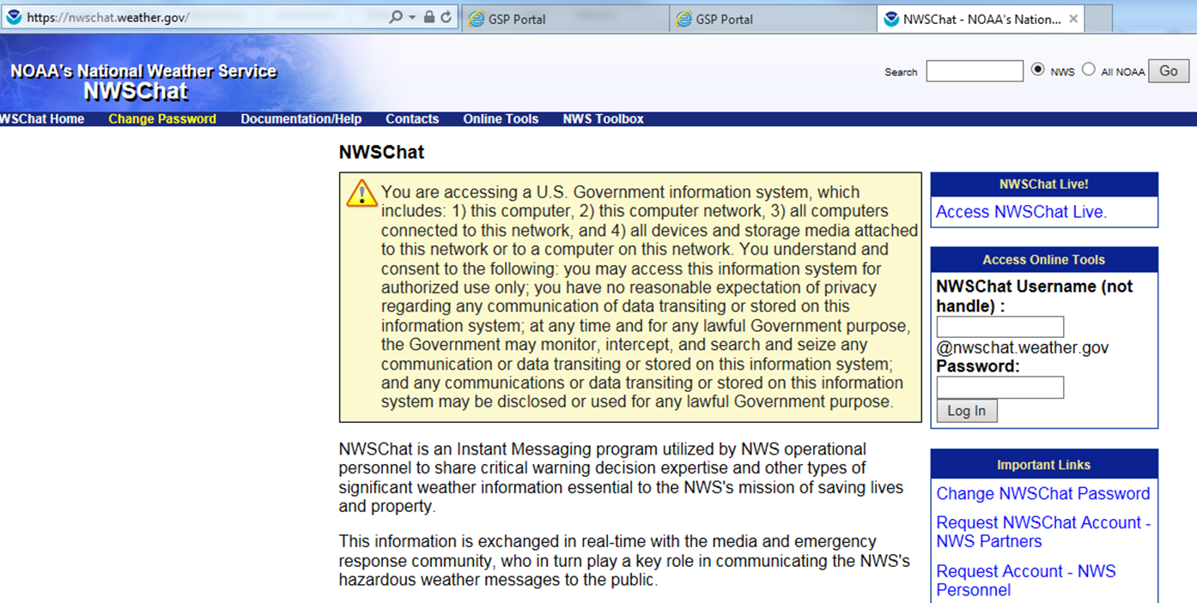
How to Request a NWSChat Account
https://nwschat.weather.gov
Media
Government Agencies
County/State EM
Skywarn Net Control

Slide 8
How to Access NWSChat
https://nwschat.weather.gov

Slide 9
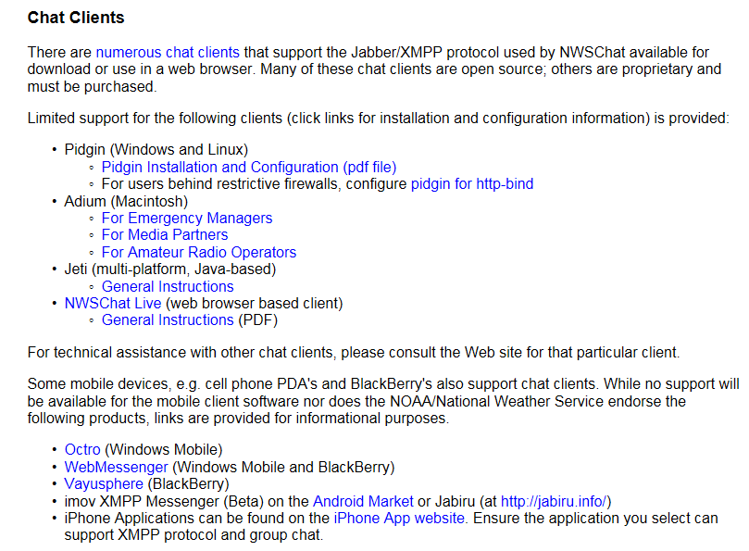
How to Access NWSChat

Slide 10
NWSChat bot
The NWSChat bot will automatically post the following products to the “gspchat” chatroom:
SPC Mesoscale Discussion and Watches
Record Event Report
Radar Status Messages for Greer and Charlotte
Local Storm Report
Area Forecast Discussion
Short Fuse Warnings: Severe, Tornado, Flash Flood, and Airport Weather Warnings
Long Fuse Warning: Winter Storm Watches/Warnings, Flood Watches/Warning, High Wind Watches/Warnings

Slide 11
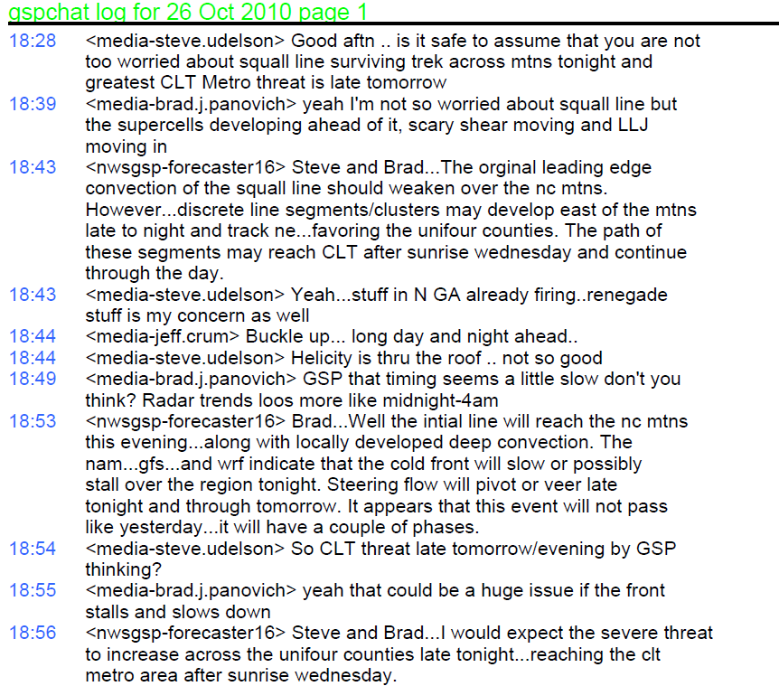
NWSChat Example – October 26, 2010

Slide 12
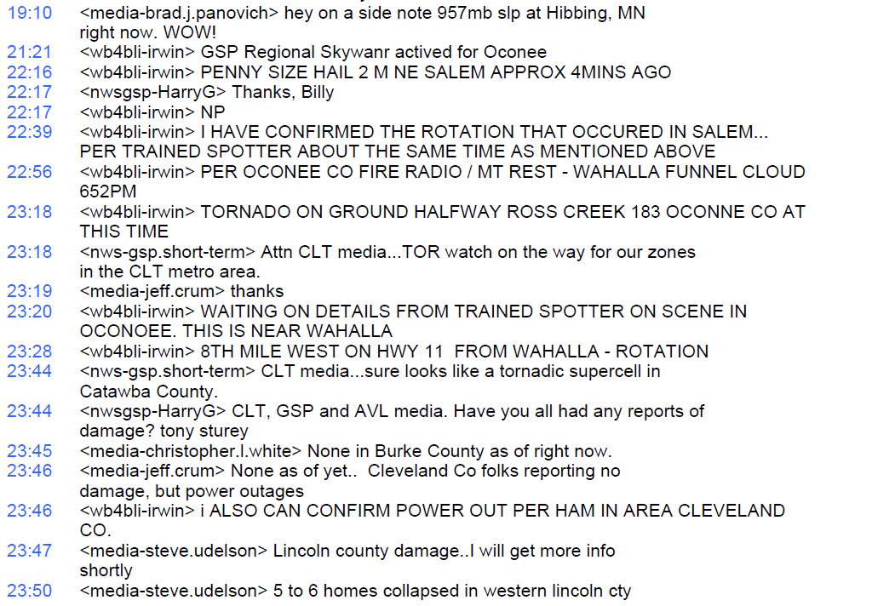
NWSChat Example – October 26, 2010

Slide 13
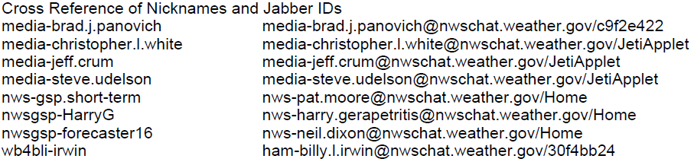
NWSChat Example – October 26, 2010

Slide 14




Social Media @ NWSGSP
@NWSGSP
@NWSGreer
@NWSGSP
@NWSGSP

Slide 15
Lexicon
Hootsuite – A popular 3rd party application to post and monitor on social media channels, including Twitter and Facebook. Widespread use within the National Weather Service (free version).
TweetDeck – An application acquired by Twitter to post and monitor only Twitter posts. Some use within the National Weather Service.

Slide 16
What is the Social Media Dashboard (SMD)?
Purpose I. A tool that allows an unlimited users to manage Twitter and Facebook accounts.
Purpose II. A Situational Awareness Display / Verification Resource
The SMD is customized by NWS offices for their forecast area
A tool utilized by 70 NWS offices & centers across 5 NWS regions

Slide 17
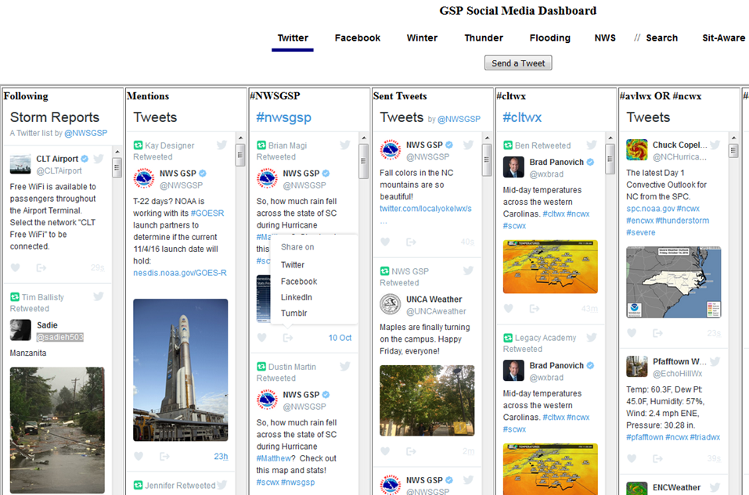
For Twitter: The SMD will emulate many of the same features of Hootsuite and TweetDeck. Organized into tabs.
Four Menu Sections
for Twitter
Share tweets on four social media platforms
4

Slide 18

Facebook
  Television media and weather interest groups supply us with an extremely rich source of weather testimonies, photos, and videos.
  Charlotte Market GSP & AVL Market Triad Market
  Station FB Likes Station FB Likes Station FB Likes
  WSOC 514K WHNS 429K FOX8 548K
  WCNC/BP 504K WYFF 257K WFMY 187K
  WBTV 346K WLOS 245K Ft. Hills Wx 42K
  FOX46 106K WSPA 217K Avery Rds/Wx 5.1K
  Total ~1.5M ~ 1.2M ~782K
Ray's Weather 30K
Greenville News 40K
Total CWA FB ~3.5 Million
NWS GSP has ~6,700 trained spotters and “other contacts”

Slide 19
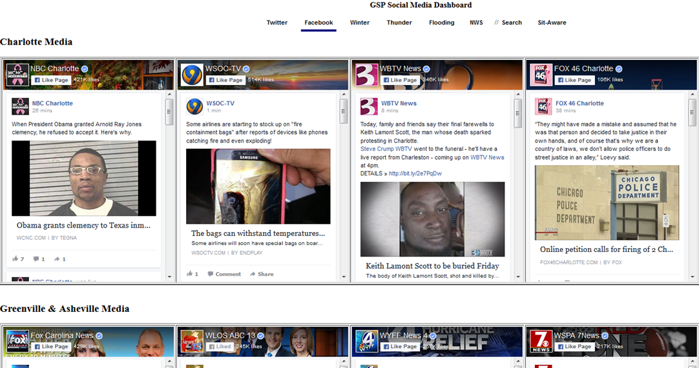
For Facebook: The SMD will display all key Facebook pages on one page.

Slide 20
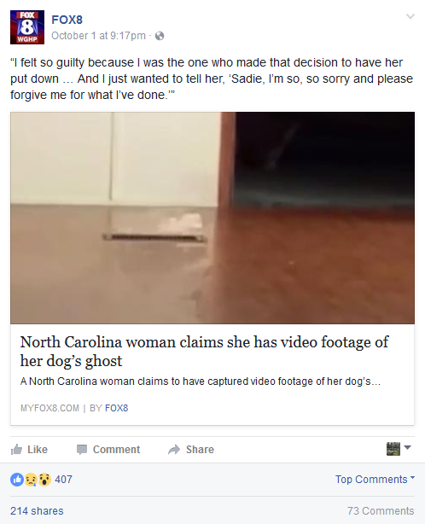
Facebook

Slide 21
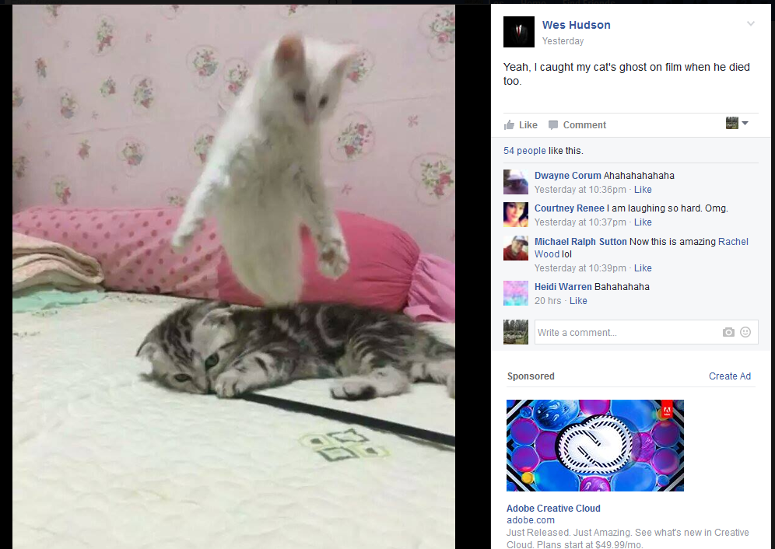
Facebook

Slide 22
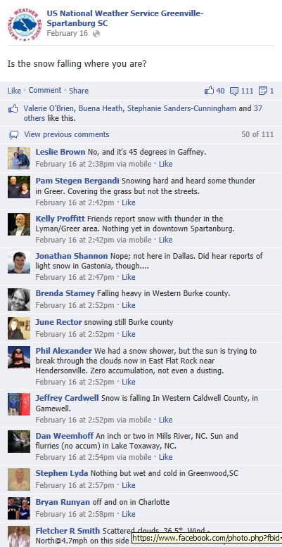
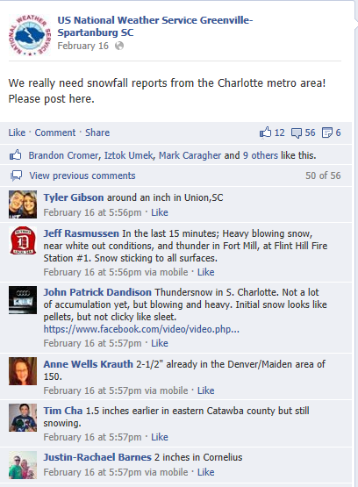

Slide 23
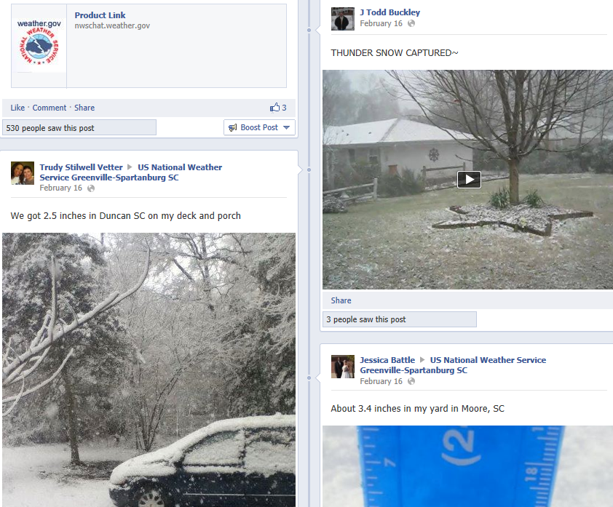
February 15-17, 2013

Slide 24
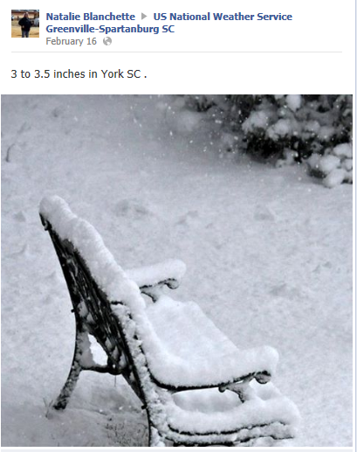
February 15-17, 2013

Slide 25
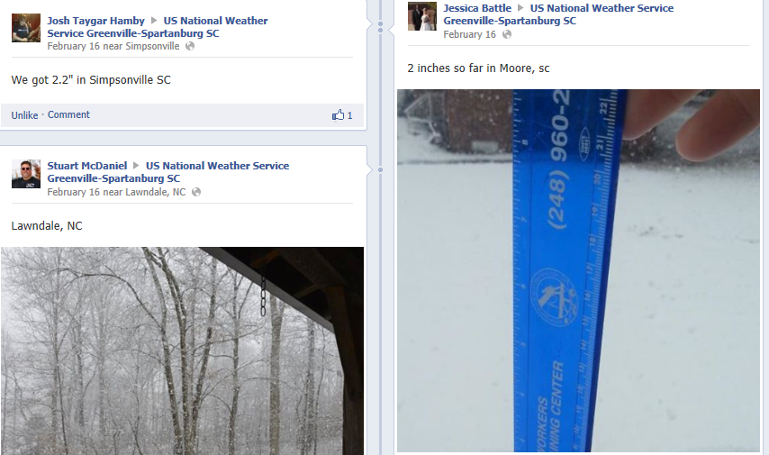
February 15-17, 2013

Slide 26
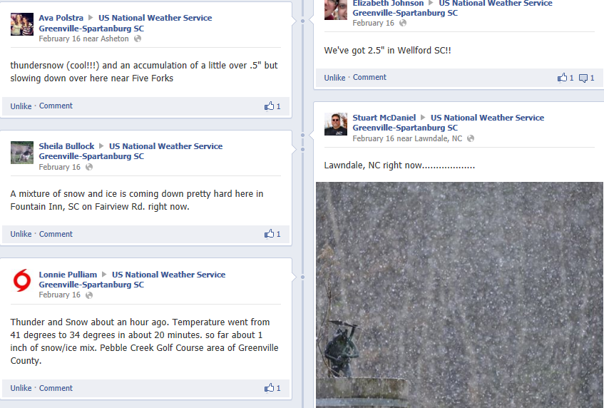
February 15-17, 2013

Slide 27
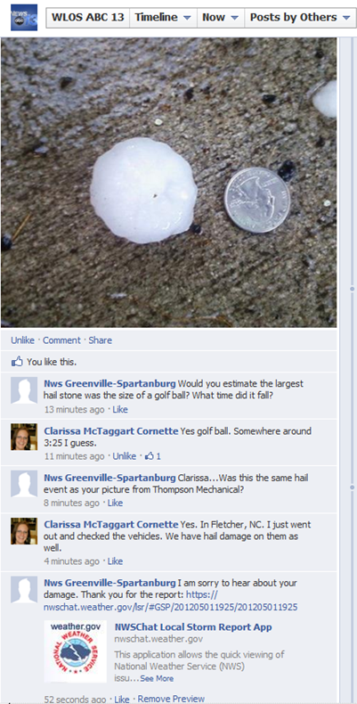

Slide 28
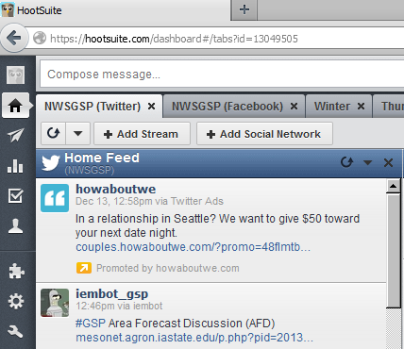
5 Advantages of the Social Media Dashboard
Advantage #5: No Advertising

Slide 29
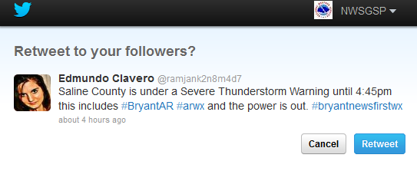
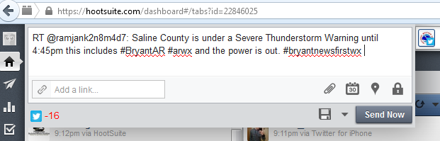
5 Advantages of the Social Media Dashboard
Advantage #4: Better Retweets
Hootsuite (Editing of 16 characters needed) Vs. SMD (Twitter) No Editing

Slide 30
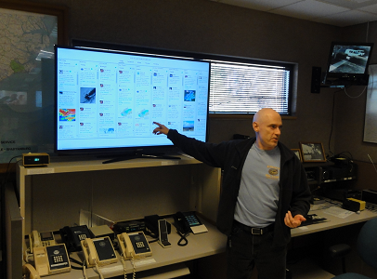
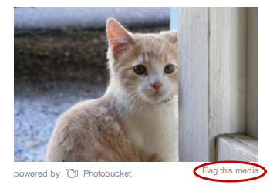
5 Advantages of the Social Media Dashboard
Advantage #3: No profanity or “Not-Safe-For-Work” content
in tweets (option in setup)
Source: https://support.twitter.com/articles/20169200#

Slide 31
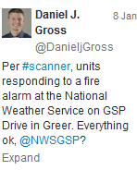

5 Advantages of the Social Media Dashboard
Advantage # 2: The SMD Twitter streams are fast
The SMD delivers Tweets faster than Hootsuite. The default
refresh rate for Hootsuite is 10 minutes (potentially 60 tweets).
Social Media Dashboard
The SMD is 8.5 to 0.5 minutes faster than HootSuite
Hootsuite

Slide 32
5 Advantages of the Social Media Dashboard
Advantage #1: Unlimited number of SMD users
Hootsuite (free & Pro accounts) has a limit of only 2 free users
Hootsuite Pro & Enterprise
3rd user = $250/year
10 users = $1,800/year
11 users = “eye watering” $18,000/year
Source: http://iag.me/socialmedia/reviews/7-reasons-not-to-use-hootsuite/

Slide 33









A Situational Awareness Display / Verification Resource
Social Media
Twitter
Facebook
YouTube
CoCoRaHS
Police, Fire, and County Scanners
Highway Patrol Reports
Power Outage Maps
Web cams
On-line Resource

Slide 34
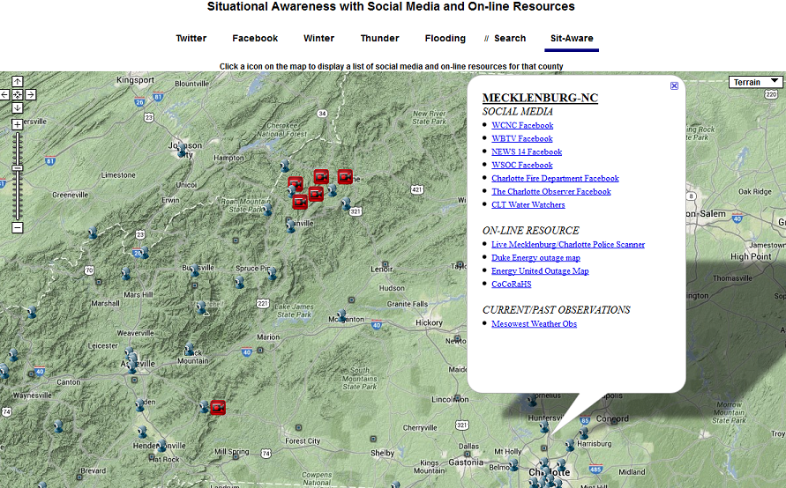
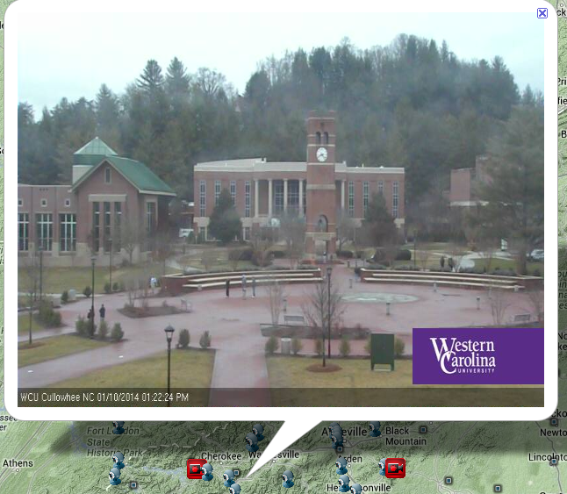
A Situational Awareness Display / Verification Resource

Slide 35
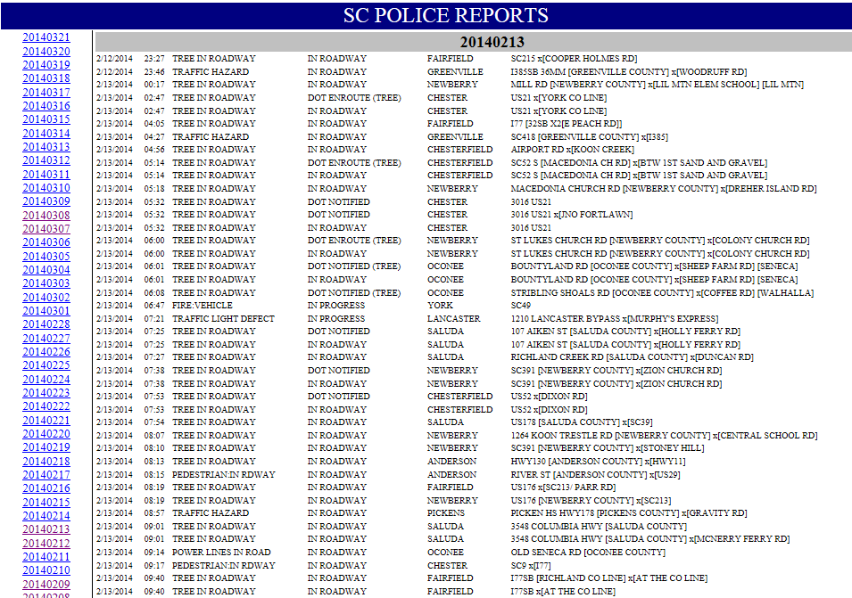

Slide 36
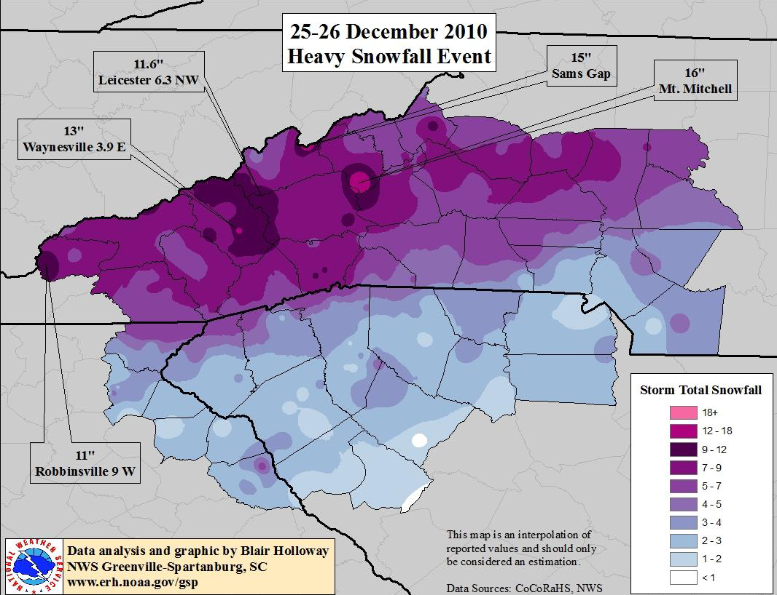
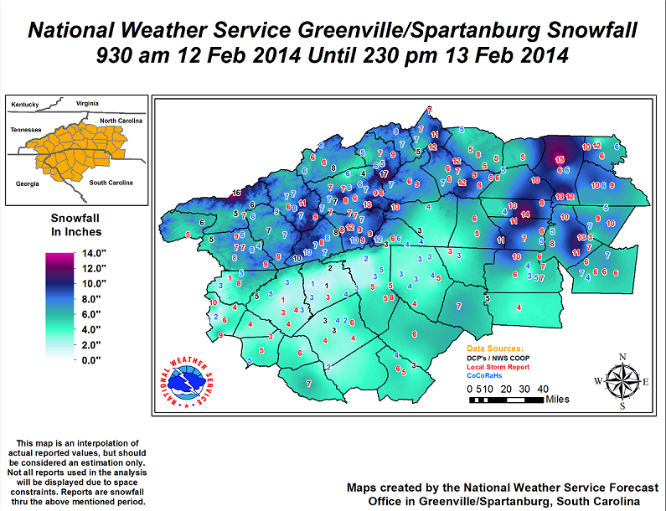
A Situational Awareness Display / Verification Resource
Christmas 25-26, 2010:
200 Snowfall Reports
February 12-13, 2014:
435 Snowfall Reports

Slide 37
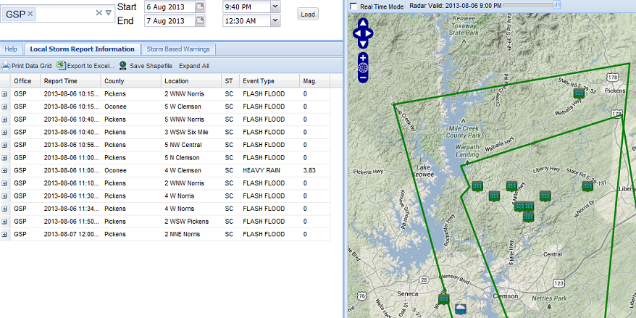
A Situational Awareness Display / Verification Resource
19

Slide 38
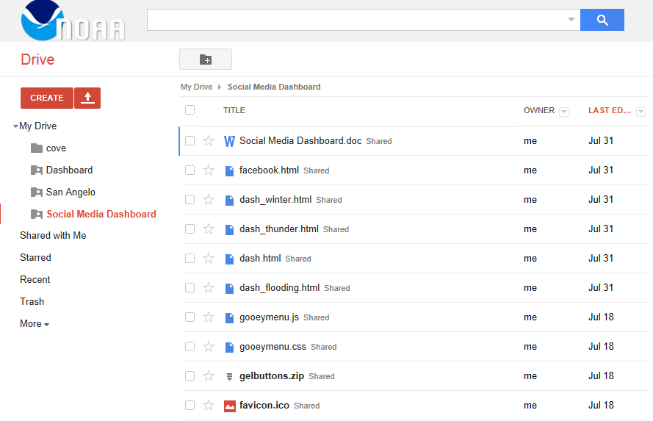
Sharing the Social Media Dashboard
SMD (code & instructions provided)
Email Neil.Dixon@noaa.gov for access to Google Drive

Slide 39
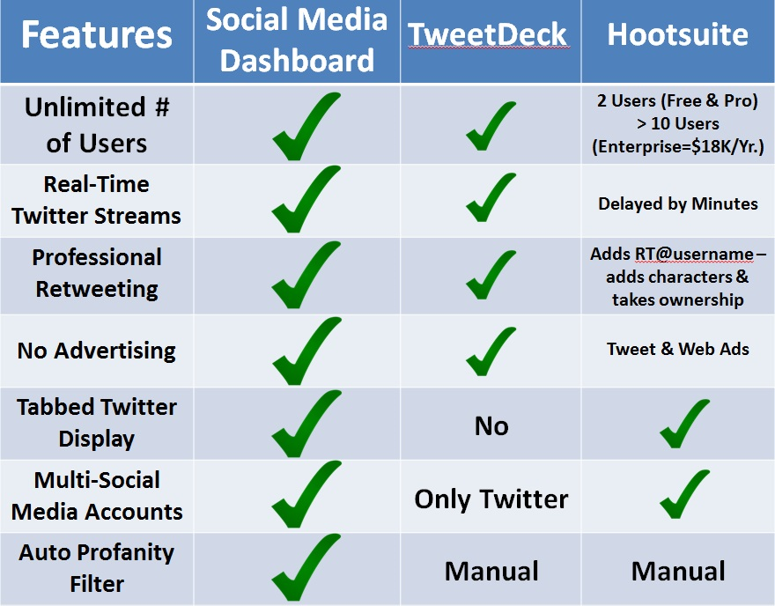
Social Media Dashboard // Summary
NWS Social Media Dashboard Vs. 3rd Party Applications

Slide 40
NWSChat // Summary
NWSChat is an Instant Messaging program used to share significant weather information.
NWSChat is intended to be used by:
Free NWSChat accounts are requested from nwschat.weather.gov
Media
Government Agencies
County/State EM
Skywarn Net Control

Slide 41

Social Media Dashboard
A Locally Developed Application
Comments or Questions?
Email: Neil.Dixon@noaa.gov

