Slide 1



Scenario
Greenville/Spartanburg
It’s Sunday, July 3rd
Based upon the information presented
- County/City EM’s should consider actions taken in support of a medium-sized or large outdoor event (preferably a real one that you support on July 4th weekend)
- Media partners should consider the type of
message (not just on the air, but also via Social
Media) that you plan to convey to your viewers/
followers as the scenario unfolds
- All other participants

Slide 2
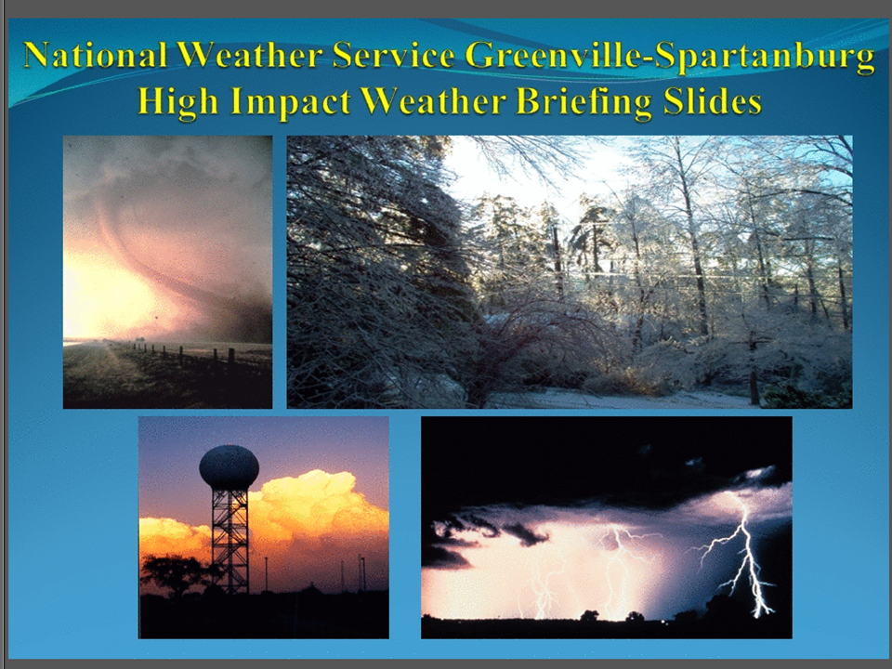

Slide 3
Near Term Extreme Heat and Convective Potential
Greenville/Spartanburg
Sunday, July 3rd
6:30 AM EDT

Slide 4
Talking Points
Greenville/Spartanburg
A strong ridge of upper level high pressure centered over the Mississippi Valley will maintain very hot and humid conditions across our area.
Heat advisories/Excessive heat warnings are in effect for much of the area
In addition to the heat, scattered thunderstorms are expected to develop across the area this afternoon into the evening. Some could produce locally intense microbursts
We will also have to watch the Ohio and Tennessee Valleys for the potential for organized thunderstorm development this afternoon, which could move quickly southeast and impact far western NC with an enhanced threat for damaging winds this evening
Although today is expected to be the hottest day, above normal levels of heat and humidity are expected to continue into the early part of the work week.
The situation regarding the severe weather threat could change significantly with short notice this afternoon into the evening. Keep abreast of the latest forecast information.

Slide 5
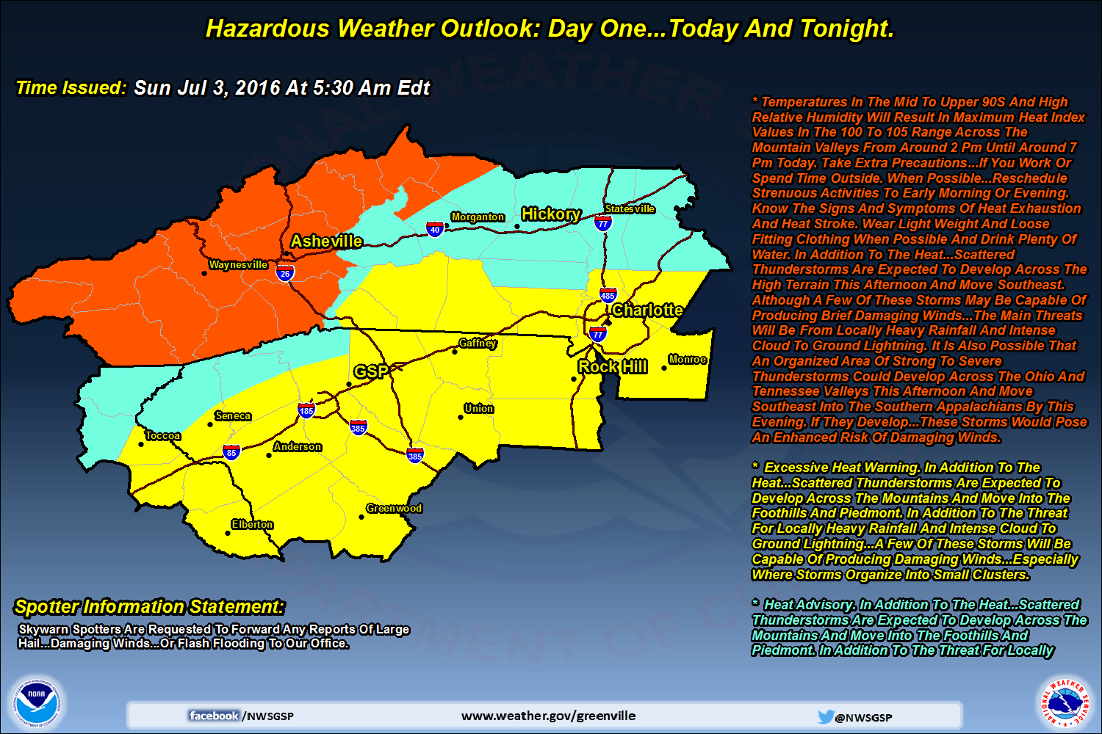
Hazardous Weather Outlook
Greenville/Spartanburg

Slide 6
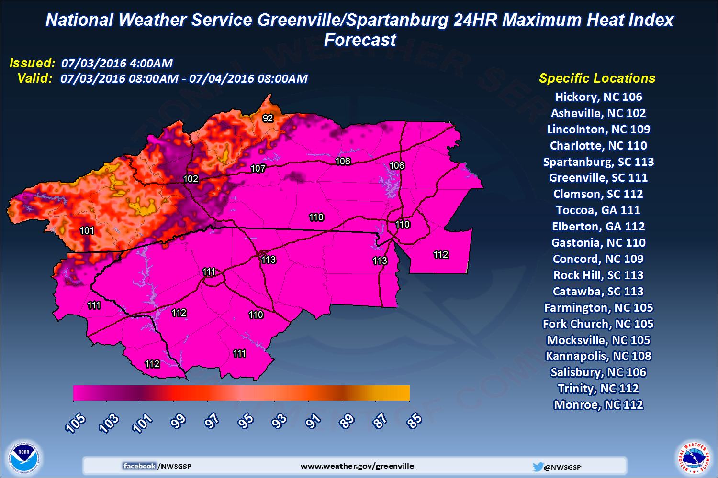
Heat Index For Today
Greenville/Spartanburg

Slide 7
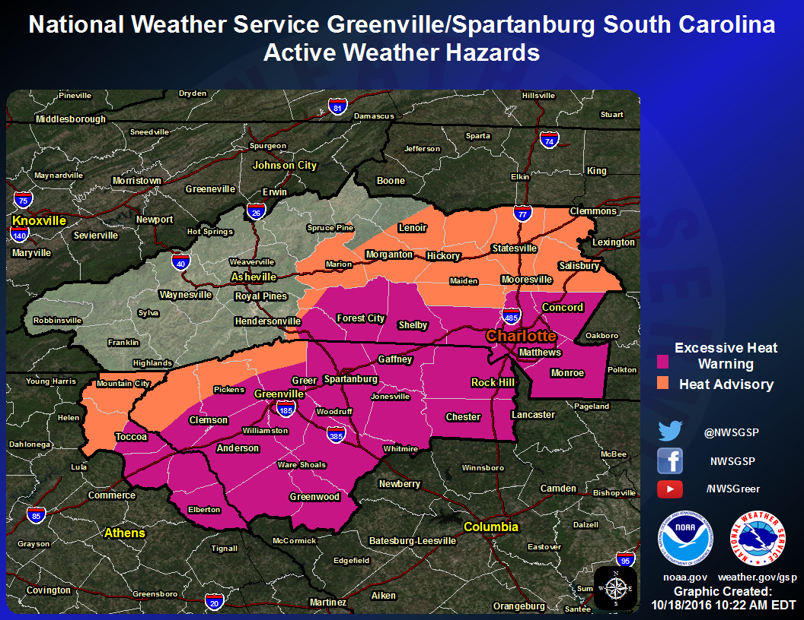
Active Warnings/Advisories
Greenville/Spartanburg

Slide 8
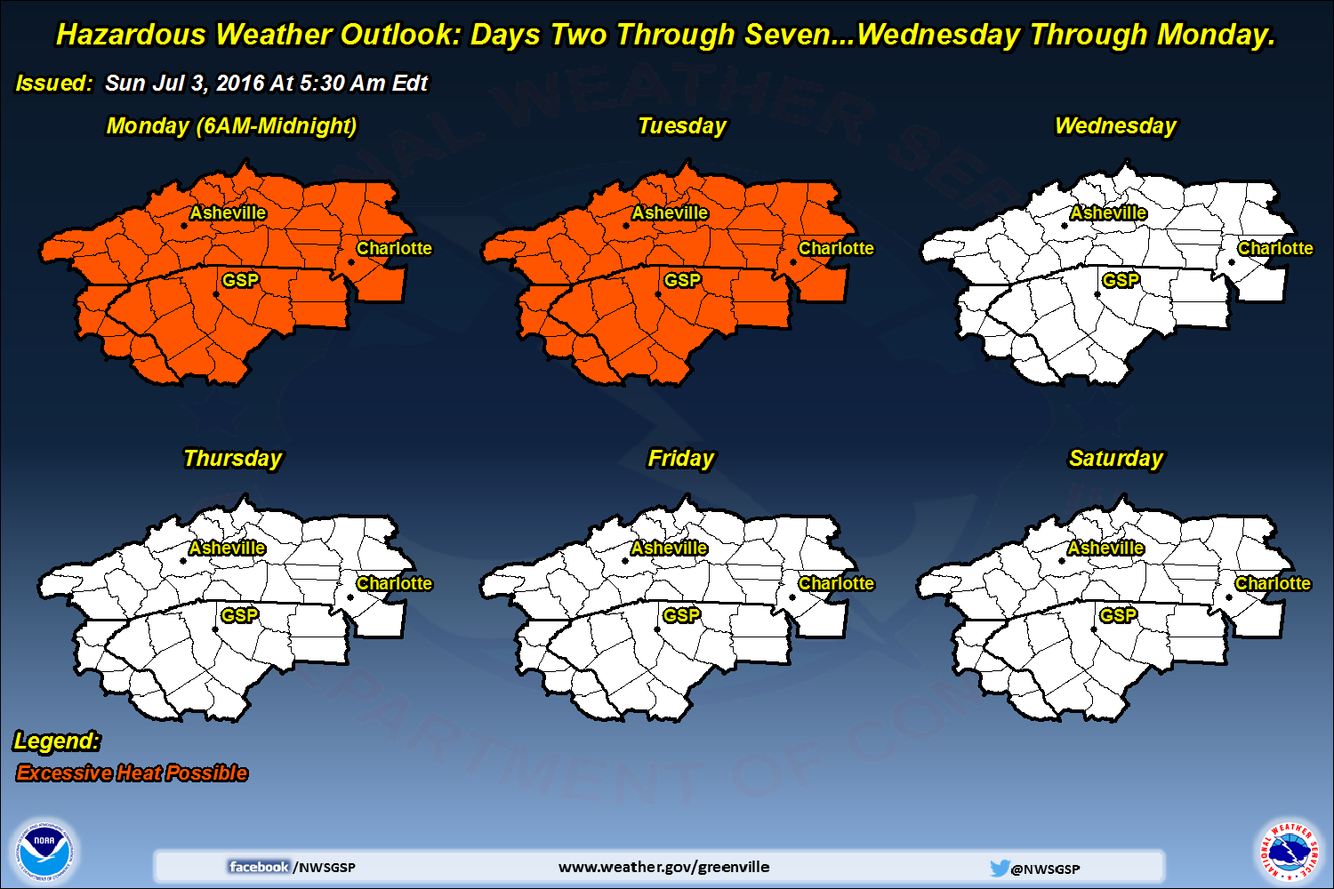
Extended Hazardous Wx Outlook
Greenville/Spartanburg

Slide 9
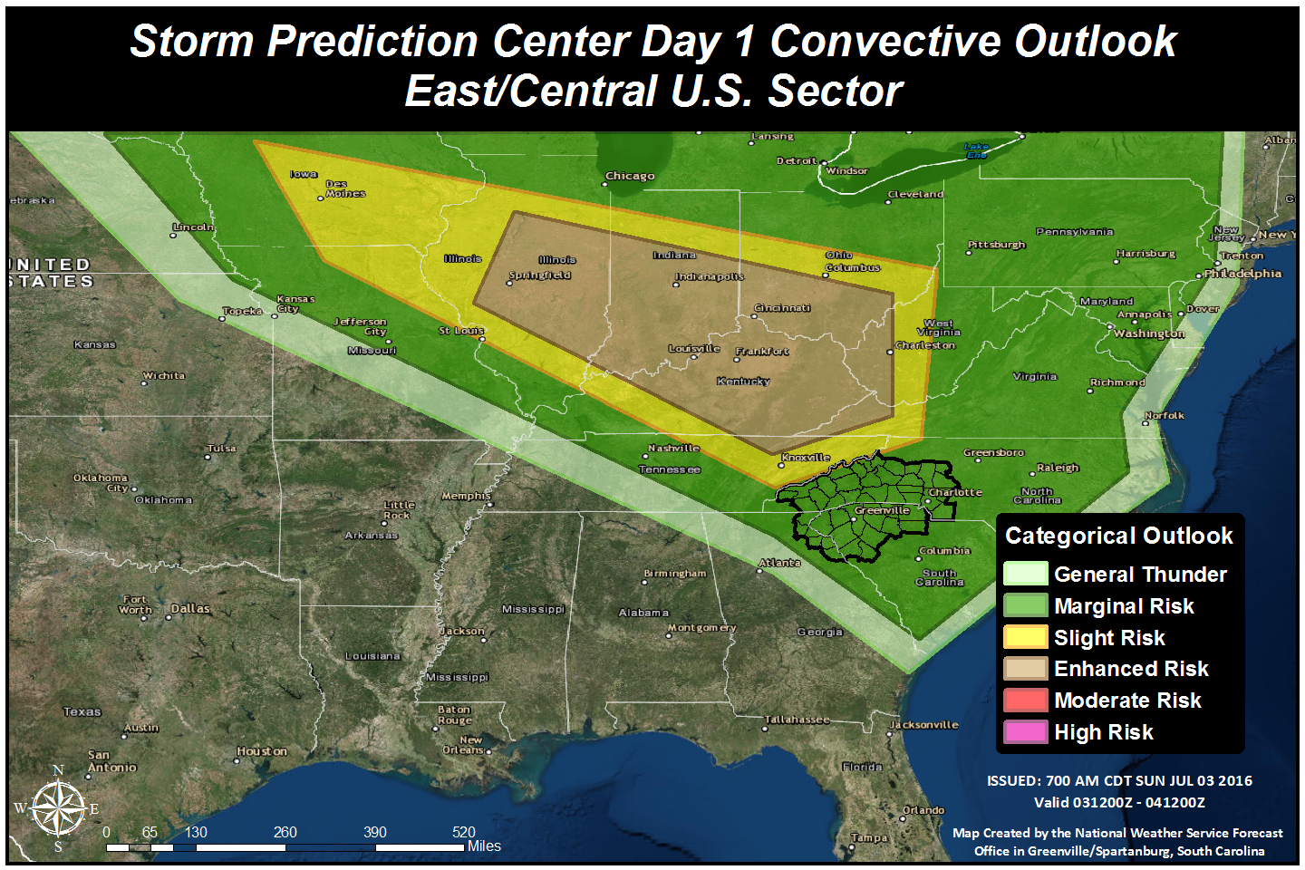
SPC Day 1 Categorical Outlook
Greenville/Spartanburg

Slide 10
The End
Greenville/Spartanburg
Please go to www.weather.gov/gsp for the latest forecasts.
These slides are also posted at: www.weather.gov/media/gsp/YouTube/brief.pdf

Slide 11
Discussion
Greenville/Spartanburg
What are your main concerns re: weather impacts at this point?
What special actions/messaging do you implement based upon the current forecast info?
How do you handle the uncertainty regarding the severe weather outlook?

Slide 12
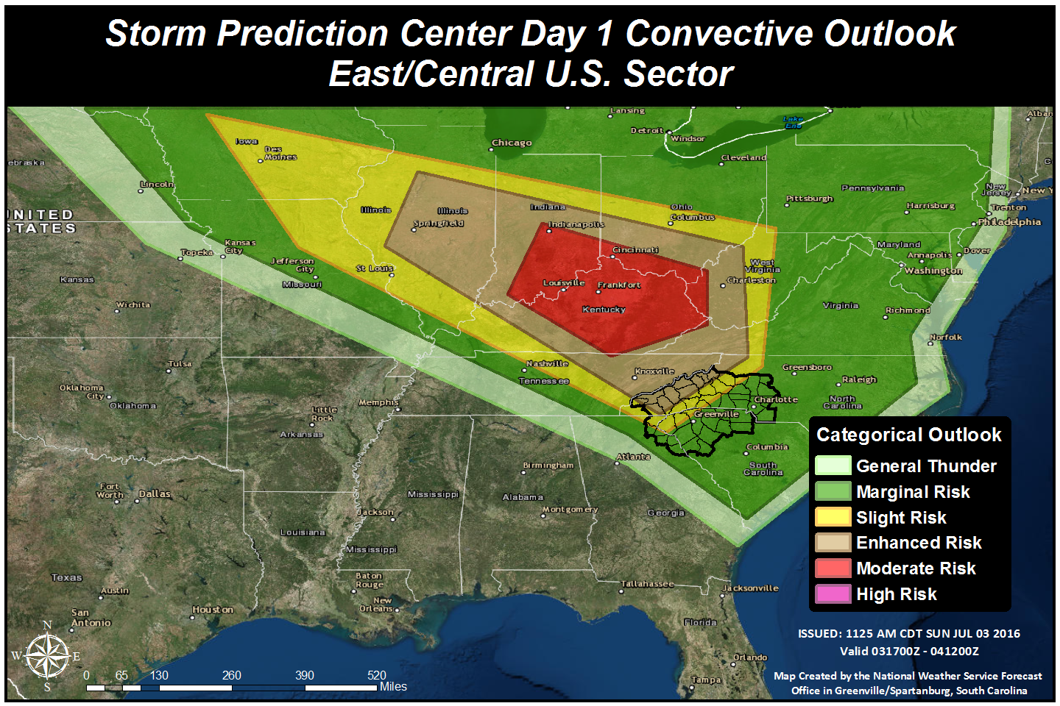
SPC Day 1 Categorical Outlook (Update at 1225 EDT)
Greenville/Spartanburg

Slide 13
Discussion
Greenville/Spartanburg
Does this information cause any changes to your plan of action/messaging?

Slide 15
Potential Severe Weather Outbreak and Extreme Heat
Greenville/Spartanburg
Sunday, July 3rd
4:30 PM EDT

Slide 16
Talking Points
Greenville/Spartanburg
A line of severe thunderstorms over northern Kentucky is expected to drop quickly southeast toward the southern Appalachians this afternoon, likely reaching far western North Carolina by mid-evening.
There will be an enhanced risk of widespread damaging winds across the mountains during this time, possibly resulting in numerous downed trees and at least scattered power outages
As usual, there is quite a bit of uncertainty as to the likelihood of the line of storms maintaining its intensity as it moves over the high terrain. Interests in the Piedmont and foothills should pay especially close attention to the latest forecast information this evening
Otherwise, a strong ridge of upper level high pressure centered over the Mississippi Valley will maintain very hot and humid conditions across our area.
Heat advisories/Excessive heat warnings remain in effect for much of the area through early evening
Although today is expected to be the hottest day, above normal levels of heat and humidity are expected to continue into the early part of the work week.

Slide 17
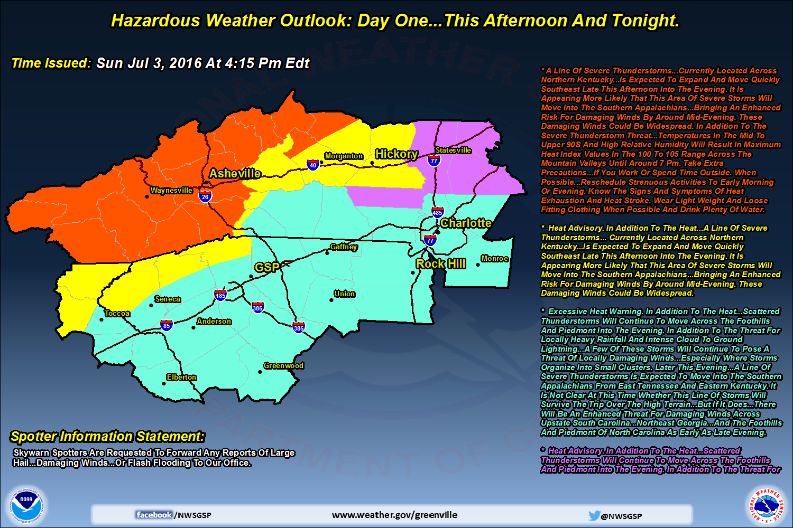
Hazardous Weather Outlook
Greenville/Spartanburg

Slide 18
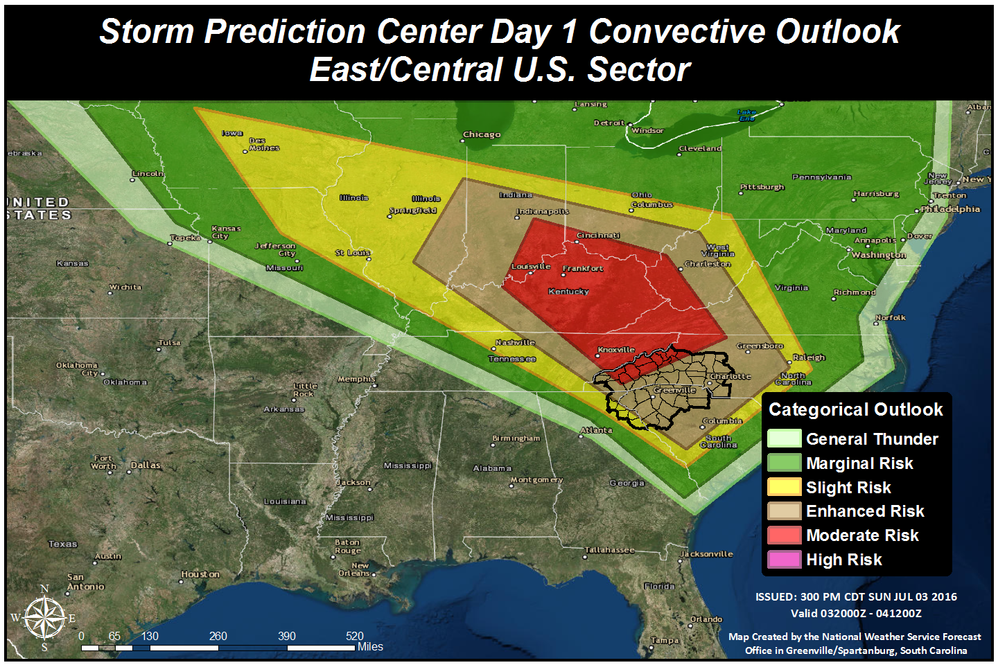
SPC Day 1 Categorical Outlook
Greenville/Spartanburg

Slide 19
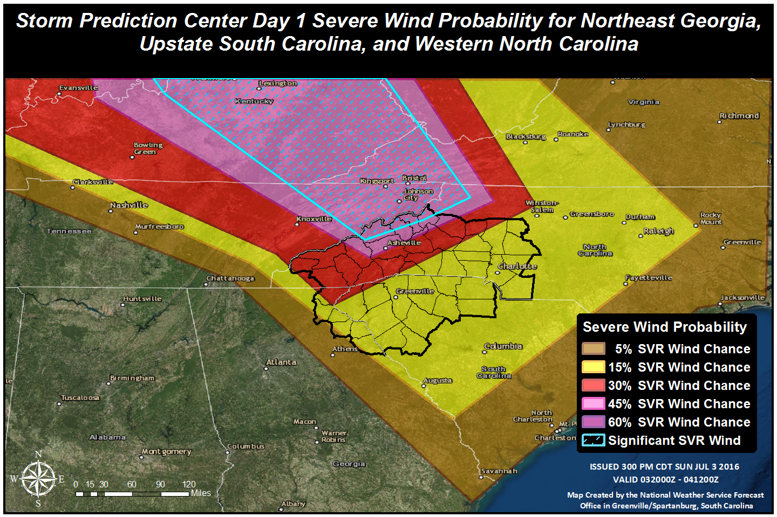
SPC Day 1 Probabilistic Outlook (Damaging winds)
Greenville/Spartanburg

Slide 20
Heat Index For Today
Greenville/Spartanburg

Slide 21
Active Warnings/Advisories
Greenville/Spartanburg

Slide 22
Extended Hazardous Wx Outlook
Greenville/Spartanburg

Slide 23
The End
Greenville/Spartanburg
Please go to www.weather.gov/gsp for the latest forecasts.
These slides are also posted at: www.weather.gov/media/gsp/YouTube/brief.pdf

Slide 24
Discussion
Greenville/Spartanburg
What are your main concerns re: weather impacts at this point?
What special actions/messaging do you implement based upon the current forecast info?

Slide 25
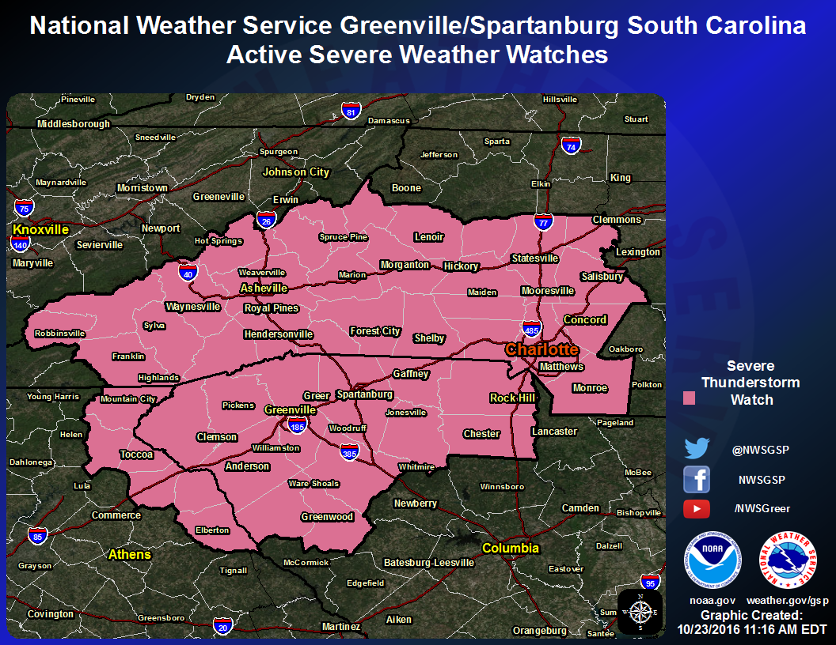
“PDS” Severe Tstorm Watch Issued at
5:30 PM
Greenville/Spartanburg

Slide 26
Discussion
Greenville/Spartanburg
What special actions/messaging do you implement based upon the current forecast info?

Slide 27
Special Weather Statement Issued 1-2 hours prior to expected arrival of storms
Greenville/Spartanburg
...A LINE OF SEVERE THUNDERSTORMS PRODUCING WIDESPREAD WIND DAMAGE WILL MOVE INTO THE NORTH CAROLINA MOUNTAINS BETWEEN 730 AND 830PM...
AT 630 PM...NATIONAL WEATHER SERVICE RADAR INDICATED A LINE OF INTENSE THUNDERSTORMS EXTENDING FROM THE VIRGINIA AND KENTUCKY BORDER INTO NORTHEAST TENNESSEE...MOVING SOUTHEAST AT 55 MPH. THESE STORMS HAVE A HISTORY OF PRODUCING WIDESPREAD WIND DAMAGE ACROSS KENTUCKY AND NORTHERN TENNESSEE. THIS LINE OF STORMS IS EXPECTED TO MOVE INTO THE COUNTIES OF WESTERN NORTH CAROLINA BORDERING TENNESSEE BY AROUND 730 PM...AND RACE QUICKLY ACROSS THE MOUNTAINS AND FOOTHILLS THROUGH 830 PM.
THIS IS A DANGEROUS SITUATION. WIDESPREAD DOWNED TREES AND POWER LINES...MINOR TO MODERATE STRUCTURAL DAMAGE TO FRAME STRUCTURES...AND MAJOR DAMAGE TO MOBILE HOMES WILL BE POSSIBLE AS THIS LINE OF STORMS MOVES ACROSS THE AREA THIS EVENING. STAY TUNED TO NOAA ALL HAZARDS WEATHER RADIO OR LOCAL NEWS OUTLETS FOR LATER STATEMENTS AND POSSIBLE WARNINGS.

Slide 28
Discussion
Greenville/Spartanburg
What special actions/messaging do you implement based upon the current forecast info?

Slide 29
Severe Thunderstorm Warning Issued at 7:00 PM
Greenville/Spartanburg
THE NATIONAL WEATHER SERVICE IN GREENVILLE-SPARTANBURG HAS ISSUED A
* SEVERE THUNDERSTORM WARNING FOR...
NORTHERN CALDWELL COUNTY IN WESTERN NORTH CAROLINA...
NORTHWESTERN BURKE COUNTY IN WESTERN NORTH CAROLINA...
MADISON COUNTY IN WESTERN NORTH CAROLINA...
JACKSON COUNTY IN WESTERN NORTH CAROLINA...
MITCHELL COUNTY IN WESTERN NORTH CAROLINA...
CENTRAL MCDOWELL COUNTY IN WESTERN NORTH CAROLINA...
SWAIN COUNTY IN WESTERN NORTH CAROLINA...
YANCEY COUNTY IN WESTERN NORTH CAROLINA...
NORTHEASTERN GRAHAM COUNTY IN WESTERN NORTH CAROLINA...
AVERY COUNTY IN WESTERN NORTH CAROLINA...
BUNCOMBE COUNTY IN WESTERN NORTH CAROLINA...
HAYWOOD COUNTY IN WESTERN NORTH CAROLINA...
NORTHEASTERN MACON COUNTY IN WESTERN NORTH CAROLINA...
* UNTIL 815 PM EDT
* AT 328 PM EDT...SEVERE THUNDERSTORMS WERE LOCATED ALONG A LINE
EXTENDING FROM 8 MILES EAST OF ABINGDON TO 4 MILES EAST OF
MARYVILLE...MOVING SOUTHEAST AT 50 MPH.
THESE ARE VERY DANGEROUS STORMS.
HAZARD...90 MPH WIND GUSTS.
SOURCE...RADAR INDICATED.
IMPACT...YOU ARE IN A LIFE-THREATENING SITUATION. FLYING DEBRIS
MAY BE DEADLY TO THOSE CAUGHT WITHOUT SHELTER. MOBILE
HOMES WILL BE HEAVILY DAMAGED OR DESTROYED. HOMES AND
BUSINESSES WILL HAVE SUBSTANTIAL ROOF AND WINDOW DAMAGE.
EXPECT EXTENSIVE TREE DAMAGE AND POWER OUTAGES.
* LOCATIONS IMPACTED INCLUDE...
ASHEVILLE...FRANKLIN...SYLVA...SPRUCE PINE... WAYNESVILLE...
BURNSVILLE...BRYSON CITY...MARSHALL...NEWLAND AND BEECH
MOUNTAIN.
PRECAUTIONARY/PREPAREDNESS ACTIONS...
THIS IS AN EXTREMELY DANGEROUS SITUATION. TAKE IMMEDIATE ACTION TO
PROTECT YOUR LIFE. TORNADO FORCE WINDS WILL DESTROY MOBILE HOMES.
MAJOR DAMAGE TO HOUSES IS POSSIBLE. SEEK SHELTER IN AN INTERIOR ROOM
ON THE LOWEST LEVEL OF A HOUSE OR OFFICE BUILDING.

Slide 30
Severe Thunderstorm Warning Issued for much of the Piedmont at 7:30 PM
Greenville/Spartanburg
THIS IS A DANGEROUS SITUATION. HURRICANE FORCE WINDS WILL BLOW DOWN NUMEROUS TREES AND POWER LINES. MOBILE HOMES COULD BE FLIPPED. FALLING TREES CAN CAUSE DEATH OR SERIOUS INJURY...AND SEVERELY DAMAGE HOUSES. SEEK SHELTER IN AN INTERIOR ROOM ON THE LOWEST FLOOR OF A HOUSE OR OFFICE BUILDING.

Slide 31
Discussion
Greenville/Spartanburg
What special actions/messaging do you implement based upon the current forecast info?
What are your main concerns re: recovery in the coming days?

Slide 32
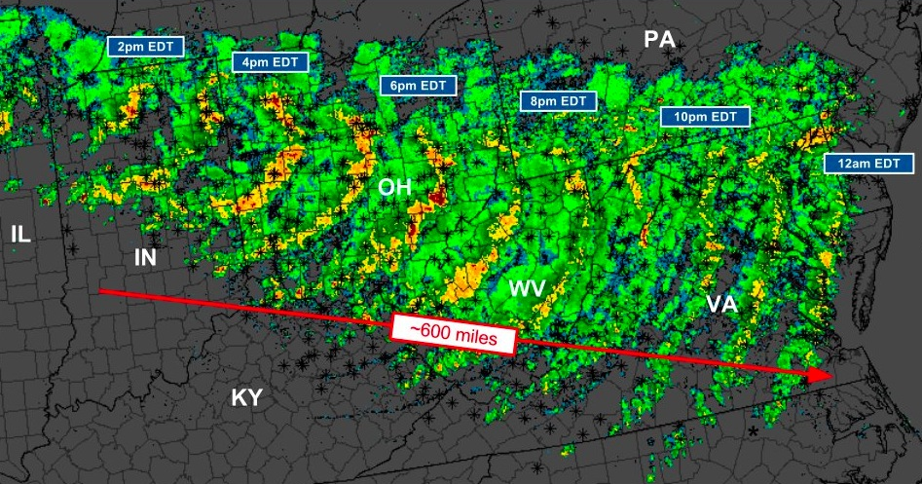
2012 Midwest/Mid-Atlantic Derecho
Greenville/Spartanburg
22 fatalities (mostly falling trees)
Millions w/o power, in some cases for weeks
Occurred during record-breaking heat wave
SoEs declared in OH, WV, VA, MD

