Slide 1
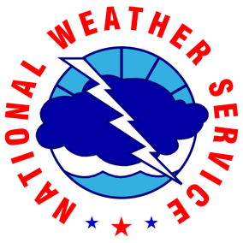
NWS GSP Hydrology Products
Review and Application
NWS GSP Integrated Warning Team Meeting
Charlotte, NC
October 25, 2016

Slide 2
Hydrology Products
WFO Greenville-Spartanburg
Outline
1
a
b
c
Preparation Products
Hydrologic Outlook
Flood
Watch
Flash Flood
Watch
2
Take-Action Products
a
b
c
d
Flood Advisory
Flood Warning
Flash Flood Warning
Flash Flood Emergency
3
Severity & Lead Time
Typical product severity & lead time
4
a
b
Products & Streamgauges
River Fcst
Gauges
Flash Flood
Gauges
2016 Integrated Warning Team Meeting – Charlotte

Slide 3
Hydrology Products
WFO Greenville-Spartanburg
Preparation Products: Summary
Hydrologic Outlook
Products
Hydrologic Outlook
Flood Watch
Flash Flood Watch
Flood Watch
Flash Flood Watch
Alert public/partners of increased likelihood of “slow” (>6 hrs) stream & overland flooding; flash flood threat lower, but not zero.
Alert public/partners of increased likelihood of rapid (<6 hrs) stream & overland flooding; mainstem flooding possible, but secondary.
Inform public/partners of significant heavy rain & flood potential 24-48 hours to 7 days in advance of event
Alert public/partners of increased likelihood of “slow” (>6 hrs) stream & overland flooding; flash flood threat lower, but not zero.
Alert public/partners of increased likelihood of rapid (<6 hrs) stream & overland flooding; mainstem flooding possible, but secondary.
Inform public/partners of significant heavy rain & flood potential 24-48 hours to 7 days in advance of event
Purpose
TAKEAWAY: Flash Flood Watches are more commonly issued for W NC, Upstate SC, and NE GA due to
topography and urban influences.
Headline; Synopsis; Affected Regions/Counties; Effective Time; Antecedent Conditions; Mainstem Flooding Details; Impact & Action Statements
Headline; Expected Rainfall & Timing; Weather Synopsis; Antecedent Conditions; Impacts & Severity
Headline; Synopsis; Affected Regions/Counties; Effective Time; Antecedent Conditions; Mainstem Flooding Details; Impact & Action Statements
Nearly identical to Flood Watch, but mainstem flooding may not be expected or prioritized due to more convective nature of event.
Headline; Expected Rainfall & Timing; Weather Synopsis; Antecedent Conditions; Impacts & Severity
Nearly identical to Flood Watch, but mainstem flooding may not be expected or prioritized due to more convective nature of event.
Contents
TAKEAWAY: Flood/Flash Flood Watches highlight the area forecasters think flooding is most likely. This does NOT mean areas outside of the watch will be flood-free, just that the predicted threat is lower.
Closely monitor weather & river forecasts; finalize prep & warning action plan for flood-/slide-prone areas; assess travel/event plans; enhance coordination
Closely monitor weather & river forecasts; finalize prep & warning action plan for flood-/slide-prone areas; assess travel/event plans; enhance coordination
Similar to Flood Watch, but be aware increased likelihood of rapid flooding may require an adjusted response plan.
Monitor latest forecasts; initial preparation for flood-prone areas; know warning response; begin coordination
Similar to Flood Watch, but be aware increased likelihood of rapid flooding may require an adjusted response plan.
Monitor latest forecasts; initial preparation for flood-prone areas; know warning response; begin coordination
Desired Response
TAKEAWAY: Flood and Flash Flood Watches differentiate between
response times, NOT the severity of flooding.
Prepare – Take Action – Severity & Lead Time – Products & Streamgauges
Notes:
The hydrologic outlook is a tool that, in the past, has been less frequently used by WFO GSP, but one that may see more usage in the future as we struggle with QPF amounts and the uncertainty of upcoming weather systems. For example, there may be confidence of a significant rainfall event for the Carolinas, but a lack of confidence in timing and exact location may prohibit a watch. However, a message of potential concern to give people a heads-up is still warranted.
FLOOD WATCH vs. FLASH FLOOD WATCH – A Flood Watch is more likely to be issued if flooding is already ongoing. This happened in December 2015 when mainstem rivers and some tributaries were already in flood from a previous event. Furthermore, if the perceived threat is convective, where the heaviest rainfall will fall over a period of only a few hours, then a Flash Flood Watch is more likely. Therefore, if the perceived threat is due to a prolonged period of light to moderate rainfall which will result in heavy accumulations over the course of 12-48 hours, then a Flood Watch is more likely.

Slide 4
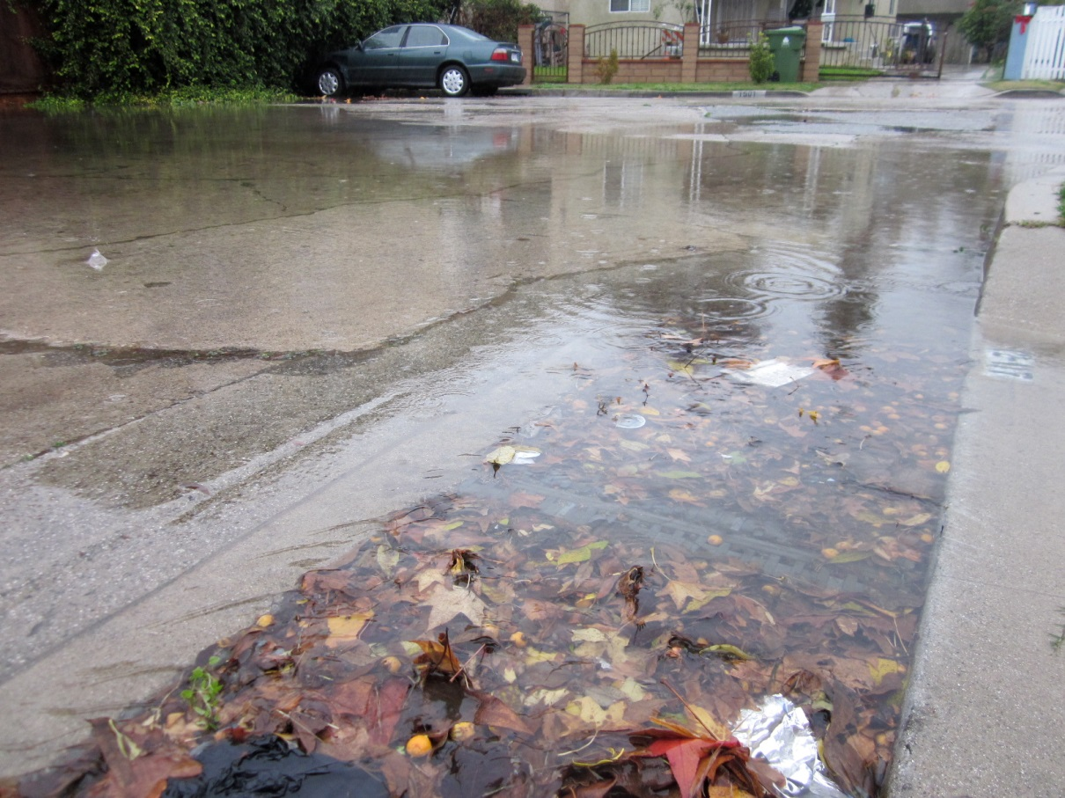
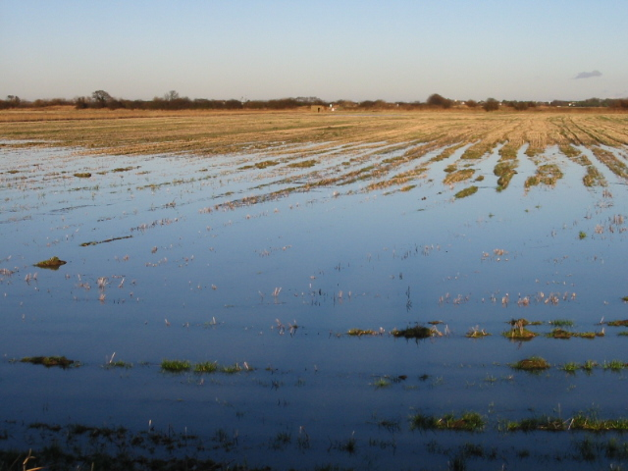
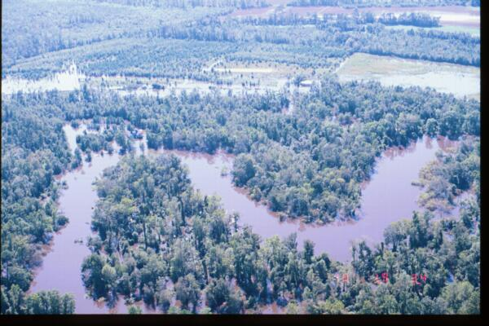
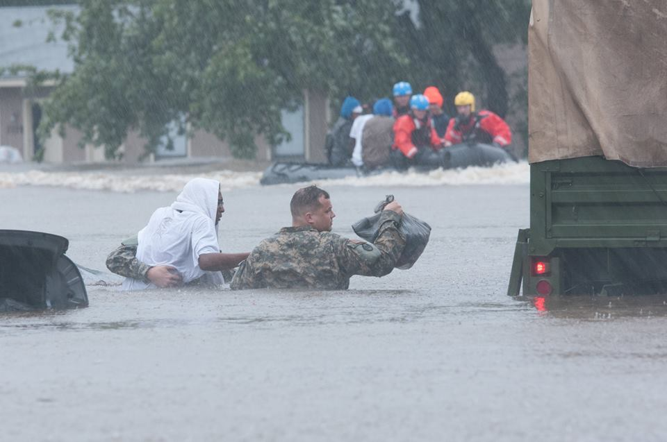
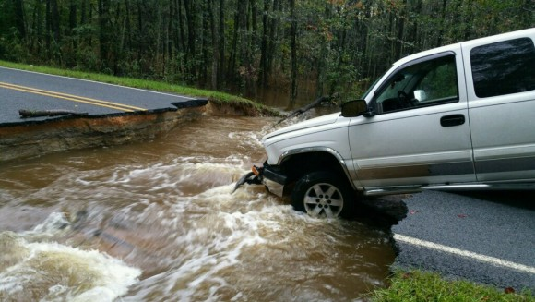
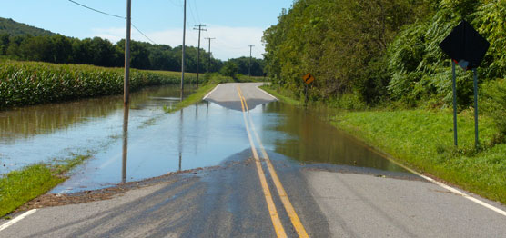
Hydrology Products
WFO Greenville-Spartanburg
Take-Action Products: Summary
Flash Flood Warning
Flash Flood Emergency
Products
Flood Advisory
Flash Flood Warning
Flash Flood Emergency
Flood Advisory
Flood Warning
Flood Warning
Warn public/partners of “slow” (>6 hrs) minor, mod, major, or record stream & overland flooding
Elevate ongoing event for catastrophic rapid flooding; urge immediate life-saving measures
Warn public/partners of “slow” (>6 hrs) minor, mod, major, or record stream & overland flooding
Warn public/partners of rapid (<6 hrs) minor to record flooding
Elevate ongoing event for catastrophic rapid flooding; urge immediate life-saving measures
Alert public/partners of nuisance flooding and/or streams just out of their banks
Warn public/partners of rapid (<6 hrs) minor to record flooding
Alert public/partners of nuisance flooding and/or streams just out of their banks
Purpose
Credit: NCDOT
Use caution when driving; take property precautions; be alert/ready/prepared for more serious flooding (warnings)
Use caution when driving; take property precautions; be alert/ready/prepared for more serious flooding (warnings)
Seek higher ground NOW; Turn Around, Don’t Drown; obey barricades; avoid flood-prone areas, crossings even if dry.
Assess risk; move property to higher ground; Turn Around, Don’t Drown; obey barricades & official evacuations
Seek higher ground NOW; Turn Around, Don’t Drown; obey barricades; avoid flood-prone areas, crossings even if dry.
Avoid warned area; strongly discourage travel within area; obey local official evacuations, orders (State of Emergency)
Assess risk; move property to higher ground; Turn Around, Don’t Drown; obey barricades & official evacuations
Avoid warned area; strongly discourage travel within area; obey local official evacuations, orders (State of Emergency)
Desired Response
Credit: US NPS
Wide-ranging based on severity of flood; can include widespread/deep overland, road, & structure flooding
Flooding from clogged or poor storm drainage; ponding within low-lying areas; minimal flooding of farmlands
Wide-ranging based on severity of flood; can include widespread/deep overland, road, & structure flooding
Rapid flooding of smaller streams; sig. overland flooding & road closures; iso/scat structure flooding & road washouts
Flooding from clogged or poor storm drainage; ponding within low-lying areas; minimal flooding of farmlands
Rapid flooding of smaller streams; sig. overland flooding & road closures; iso/scat structure flooding & road washouts
Numerous swift water rescues & road/bridge washouts; significant structure flooding; ongoing evacuations; sig. dam failures
Numerous swift water rescues & road/bridge washouts; significant structure flooding; ongoing evacuations; sig. dam failures
Impacts
Credit: NC National Guard
Credit: USGS
Prepare – Take Action – Severity & Lead Time – Products & Streamgauges
Notes:
These are the products available to us as mandated by NWS Directives. There are variations of these products, but it is our goal to focus on these primary products and why they exist.
FLOOD ADVISORY - Flood Advisories can be precursors to Flood Warning or Flash Flood Warnings and are intended to prepare the public for the potential for more serious flooding if rainfall does not abate. When we have a Flood Advisory out, we should be asking local officials whether or not flooding is due to streams or well-known poor-drainage areas. If stream flooding is causing road closures, a warning is necessary.
FLOOD WARNING – The flood warning can also be issued for gauged streams where forecasts are issued by the NWS River Forecast Centers. Flood Warnings can be JUST AS SEVERE/DEVASTATING as Flash Flood Warnings. Flood Warnings for gauged streams can often provide enough lead time for affected citizens to assess their level of risk and move property (e.g., livestock, farm equipment, vehicles) to higher ground. They should often be able to protect their structures or evacuate unprotected homes/offices that may be prone to flooding. This is a primary difference between Flood Warnings and Flash Flood Warnings as with Flash Floods, there is usually very little to no time to protect property and when a Flash Flood Warning is issued, the primary goal is protection of life. Unfortunately, however, there is no EAS alert on a Flood Warning and no official permission to issue a Flood Emergency. It is a major challenge to get public/partners? to take Flood Warnings seriously.
FLASH FLOOD EMERGENCY – We want to coordinate the issuance of a FFE with Emergency Management because of the significant increase in awareness it will generate.
FLASH FLOOD EMERGENCY – By the time the FFE is issued, higher ground should have already been reached. It is too late to protect property, the only objective should be to protect life.

Slide 5
Hydrology Products
WFO Greenville-Spartanburg
Take-Action Products: Summary
Products
Flood Advisory
Flood Warning
Flash Flood Warning
Flash Flood Emergency
Purpose
TAKEAWAY: Diversity of flood products exists to help provide an appropriate level of risk assessment and response to a
diverse range of flood types based on severity and response time.
Desired Response
Impacts
Prepare – Take Action – Severity & Lead Time – Products & Streamgauges
Notes:
These are the products available to us as mandated by NWS Directives. There are variations of these products, but it is our goal to focus on these primary products and why they exist.
FLOOD ADVISORY - Flood Advisories can be precursors to Flood Warning or Flash Flood Warnings and are intended to prepare the public for the potential for more serious flooding if rainfall does not abate. When we have a Flood Advisory out, we should be asking local officials whether or not flooding is due to streams or well-known poor-drainage areas. If stream flooding is causing road closures, a warning is necessary.
FLOOD WARNING – The flood warning can also be issued for gauged streams where forecasts are issued by the NWS River Forecast Centers. Flood Warnings can be JUST AS SEVERE/DEVASTATING as Flash Flood Warnings. Flood Warnings for gauged streams can often provide enough lead time for affected citizens to assess their level of risk and move property (e.g., livestock, farm equipment, vehicles) to higher ground. They should often be able to protect their structures or evacuate unprotected homes/offices that may be prone to flooding. This is a primary difference between Flood Warnings and Flash Flood Warnings as with Flash Floods, there is usually very little to no time to protect property and when a Flash Flood Warning is issued, the primary goal is protection of life. Unfortunately, however, there is no EAS alert on a Flood Warning and no official permission to issue a Flood Emergency. It is a major challenge to get public/partners? to take Flood Warnings seriously.
FLASH FLOOD EMERGENCY – We want to coordinate the issuance of a FFE with Emergency Management because of the significant increase in awareness it will generate.
FLASH FLOOD EMERGENCY – By the time the FFE is issued, higher ground should have already been reached. It is too late to protect property, the only objective should be to protect life.

Slide 6
Hydrology Products
WFO Greenville-Spartanburg
Severity and Lead Time
5-7 hours
30 min
2 hrs
24 hrs
48 hrs
Flood Warning
FFE
Flash Flood Emergency
FFW
Major
Flood
Warning
Flash Flood Warning
Product
Flood Advisory
Moderate
Flood Watch
Minor
Flash Flood Watch
Flood Advisory
Hydrologic Outlook
Severity
Time from Rainfall Onset
Lead Time
Prepare – Take Action – Severity & Lead Time – Products & Streamgauges

Slide 7
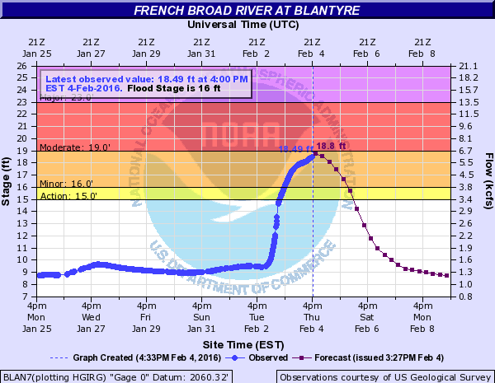
Hydrology Products
WFO Greenville-Spartanburg
Products and Streamgauges: River Forecast Gauges
Hydrographs, Impact Statements, Crest History, Photos: http://water.weather.gov/ahps2/index.php?wfo=gsp
For a given crest…
Flood Warning (FLW)
Flood Warning
Flood Advisory (FLS)
Hydrologic Outlook
Flood Watch
Impact Verification: 1) Call EMs, media, etc. and review social media; 2) perform site visit/flood survey; 3) adjust impacts and flood stages as needed
Hydrologic Outlook
Flood Watch
Impact Verification: 1) Call EMs, media, etc. and review social media; 2) perform site visit/flood survey; 3) adjust impacts and flood stages as needed
Prepare – Take Action – Severity & Lead Time – Products & Streamgauges
Notes:
This slide is meant to visualize how we use streamgauges to issue/verify hydrologic products. It’s a little tricky because there’s two things going on here: 1) What we would do for a generic river forecast OR slower-response gauge (i.e., imagine there is no hydrograph here); and 2) What we would do for this specific observed and forecast occurrence. So, the way this is animated is as 1), then 2).
Remember, this is just an idealized example and there is plenty of gray area on when products are issued. This example illustrates generally the maximum time a product would be active. For example, the Flood Watch was issued 48 hours before the occurrence of the flood. This is the maximum amount a time a Flood Watch would be active and not all Flood Watches would be valid for 48 hours. Also, if the Flood Watch is for a contiguous area and not for a single forecast point, the Flood Watch would remain in effect until the heavy rain/flood threat had ended or all flooding already had associated warnings.
A Flood Warning may be issued as much as 24-30 hours in advance of a Minor Flood Stage exceedance if confidence is high.
For a given crest means that if the crest occurs within Action Stage, then a Flood Advisory will be issued and if the crest occurs or is expected to occur within Minor, Moderate, Major, or Record Flood Stage, then a Flood Warning will be issued. If a flood crest is downgraded (e.g., from Minor to Moderate), then a new Flood Warning is issued.
The Flood Warning remains in effect until the river falls below Minor Flood Stage and it is clear the river’s stage will continue to fall below Action Stage. For this reason, Flood Warnings are NOT expired immediately after a fall below Minor Flood State and also because Flood-Advisory level impacts are still being felt. The only time a Flood Warning would be expired and replaced with a Flood Advisory is if the river is expected to remain above Action Stage but below Minor Flood Stage for a period of at least several hours. Again, forecasters are allowed to use their best judgment.
Impact Verification is done as much as time allows.

Slide 8
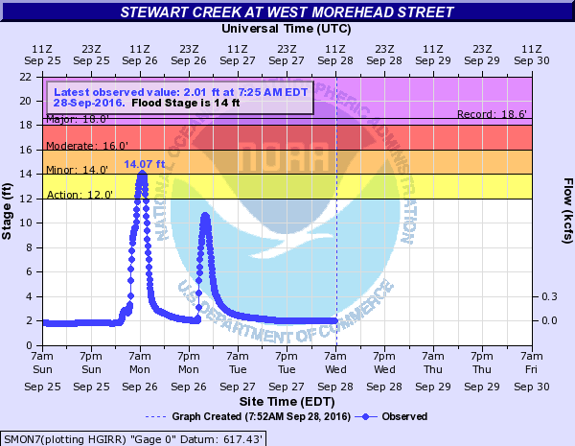
Hydrology Products
WFO Greenville-Spartanburg
Products and Streamgauges: Flash Flood Gauges
Hydrographs, Impact Statements, Crest History, Photos: http://water.weather.gov/ahps2/index.php?wfo=gsp
For a given crest…
Flash Flood Emergency
F
FW
Transition to Flood Warning or Advisory if other flooding remains in area
Flash Flood Warning (FFW)
Flood Advisory (FLS)
Flash Flood Watch
Impact Verification: 1) Call EMs, media, etc. and review social media;
2) adjust impacts and flood stages as needed
Prepare – Take Action – Severity & Lead Time – Products & Streamgauges

Slide 9
Hydrology Products
WFO Greenville-Spartanburg
Products and Streamgauges: Takaways
Hydrographs, Impact Statements, Crest History, Photos: http://water.weather.gov/ahps2/index.php?wfo=gsp
TAKEAWAY: Please share stream-based impacts with us to help us improve our impact statements and warnings!
TAKEAWAY: Nearest forecast points to Charlotte:
South Fork Catawba River at Lowell;
and Rocky River at Norwood
Forecasts provided by the Southeast River Forecast Center in Peachtree City, GA (www.weather.gov/serfc)
Prepare – Take Action – Severity & Lead Time – Products & Streamgauges
Notes:
We have 240 Streamgauges in our area. We do not have the staff to actively survey and keep up with every one, which is why we need your help.

Slide 10
Hydrology Products
WFO Greenville-Spartanburg
The End
Thank You!
We look forward to working with you!
Questions, Comments, Feedback?
Please contact Joshua Palmer, Service Hydrologist
joshua.palmer@noaa.gov
2016 Integrated Warning Team Meeting – Charlotte

