Slide 1

New Probabilistic Snow Products
Coming to NWS Websites
National Weather Service
Weather Forecast Office GSP

Slide 2
Generally speaking, precipitation forecasts are good to a factor of 2
If there is a lot of model agreement, the uncertainty is less,
and if there is a lot of model disagreement, the uncertainty is greater.
Probabilistic products are an attempt to communicate this.

Slide 3
Three Products - Winter 2016-2017
  1) Minimum / Most Likely / Maximum Snowfall
    “Goal Posts” of Possibilities
    NWS Forecast Is the Most Likely Forecast
  2) Chance that Snow Will Be Greater Than…
    0.1”, 1”, 2”, 4”, 8”, 12” and 18”
  3) Locality Tables
    Info for Several Locations in Each County
Will be available here: weather.gov/gsp/winter
(weather.gov/btv/winter currently works)
Expect at least this much
Potential for this much

Slide 4
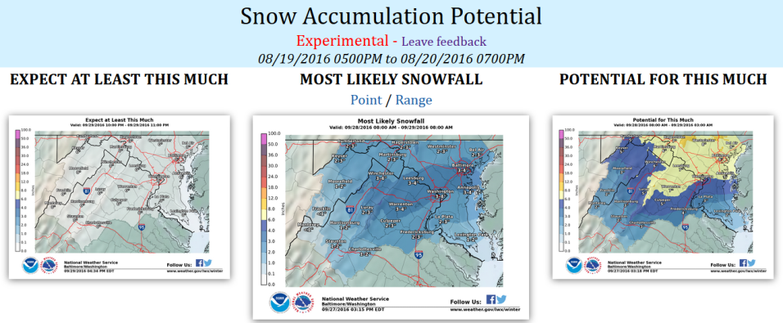
Range of Possibilities
{use local CWA example if available}

Slide 5
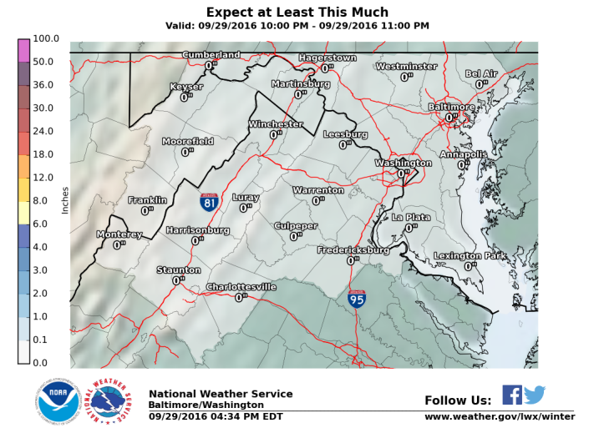
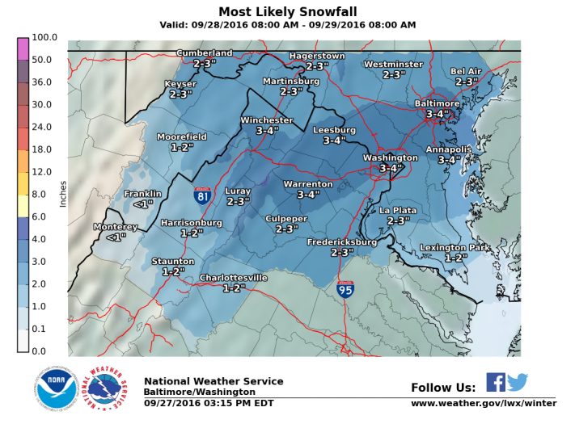
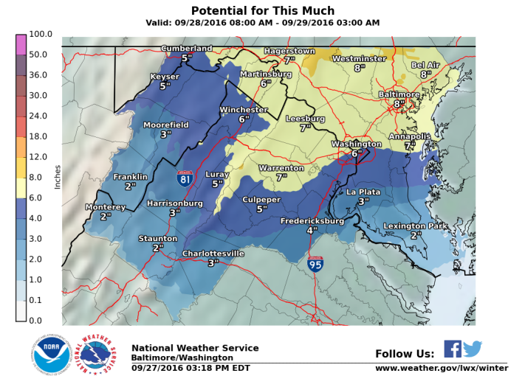

Slide 6
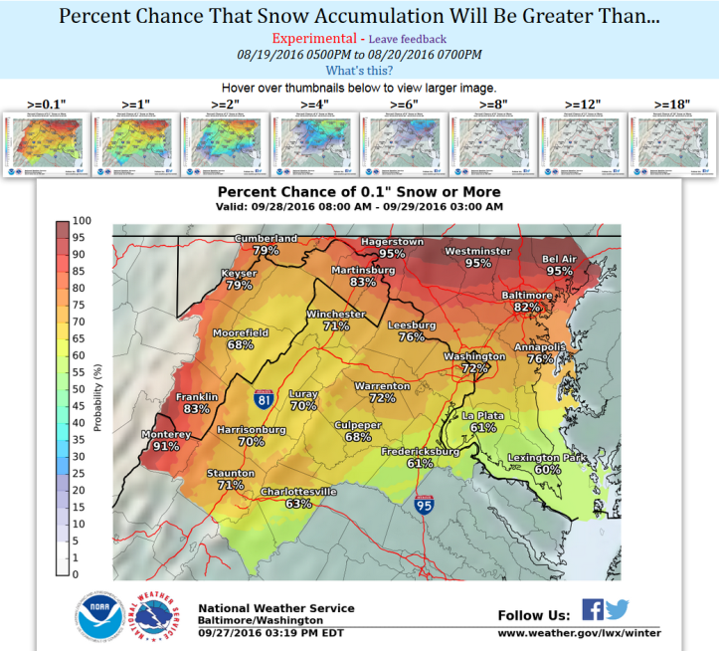

Mouse-over/Touch for large image

Slide 7
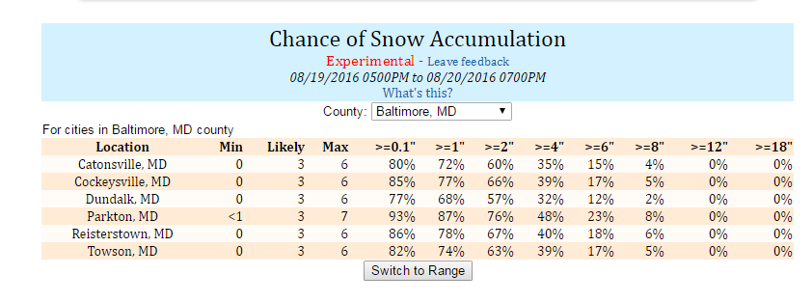
Locality Tables
What about MY town ?
Defaults to regional list
Can Select County/City
for Local Towns
Probability that snowfall will exceed an amount

Slide 8
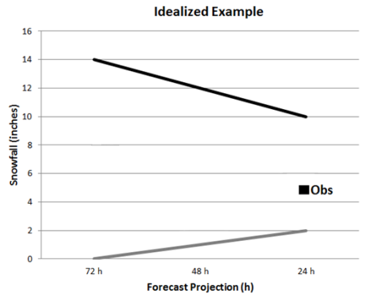
Idealized Situation
As Storm Nears…
  Range of Possibilities Shrinks
  Confidence Increases
NWS Forecast stays between Max/Min
Max
Max
Max
Snowfall (inches)
NWS Forecast; Most Likely
Actual
Snowfall
Min
Min
3 Days 2 Days 1.5 Days 24 Hrs 12 Hrs Snow +6 Hrs +9 Hrs Snow
Storm Timeline
Starts Ends

Slide 9
Example

Slide 10

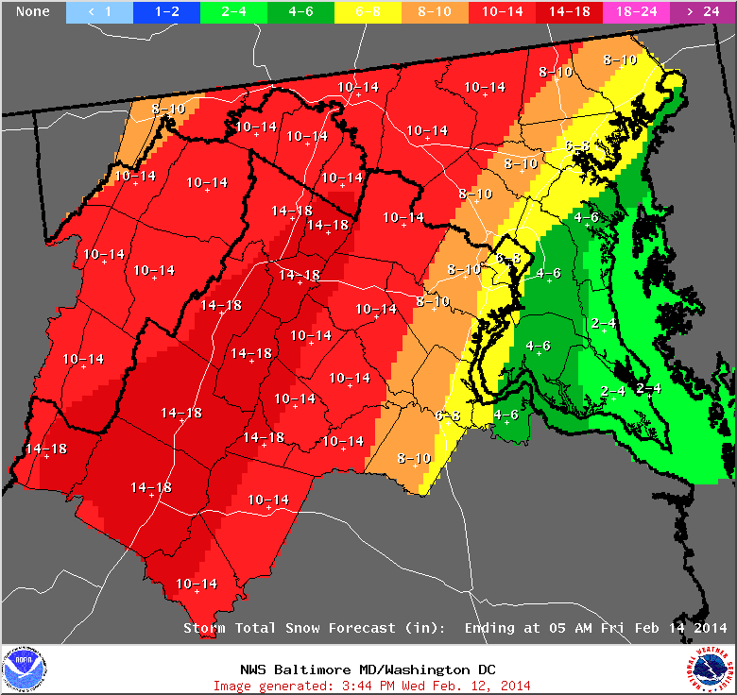
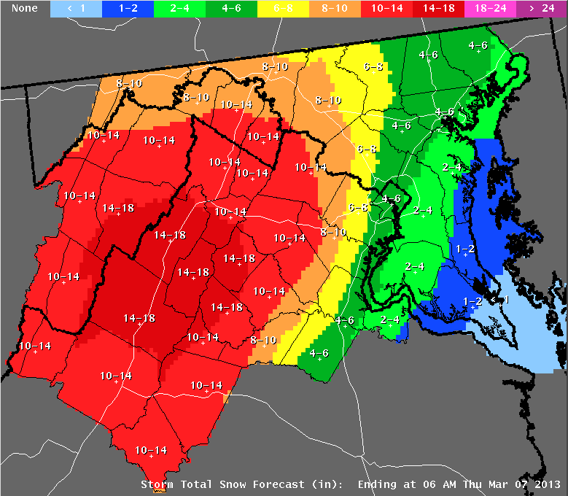
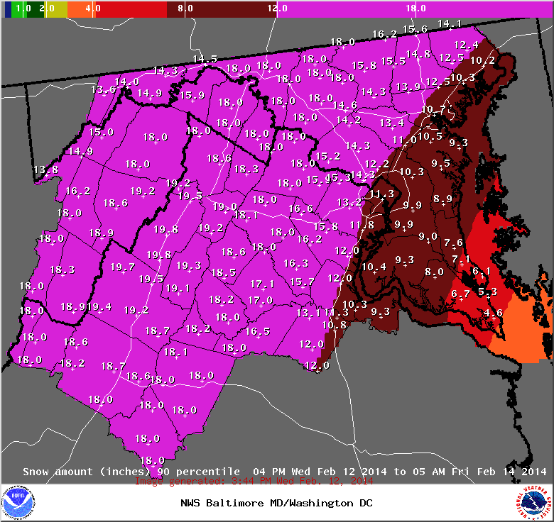
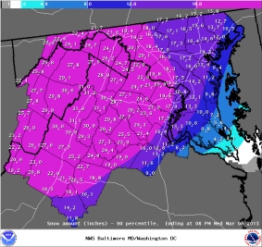
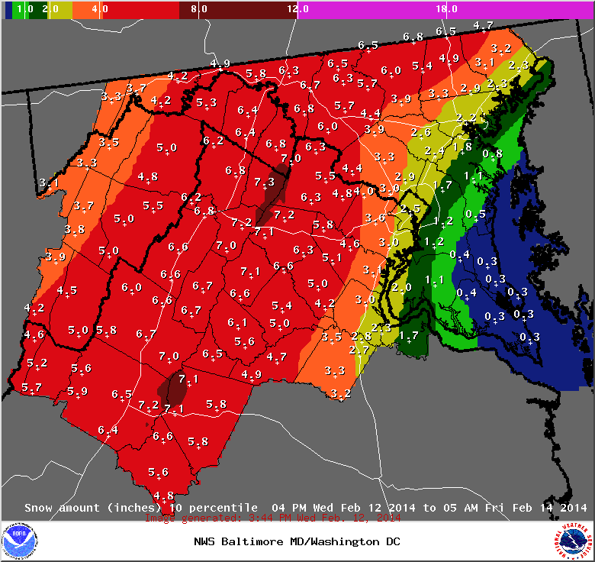
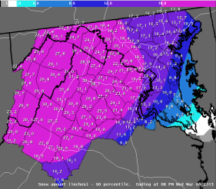
February 12-13, 2014
Minimum
Most Likely
Maximum
Expect at least this much
Official NWS Forecast
Potential for this much

Slide 11
February 12-13, 2014
Winchester, VA
Actual – 18”
Inches of
Snow
Time Before Storm

Slide 12
February 12-13, 2014
Charlottesville, VA
Actual – 15”
Inches of
Snow
Time Before Storm

Slide 13
February 12-13, 2014
Leonardtown, MD
Inches of
Snow
Actual – 5”
Time Before Storm

Slide 14
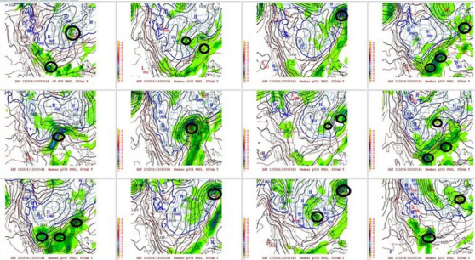
What Science is Behind This?
69 Members
Equally Weighted
25 Euro Members
1 Euro Op Run
1 Euro Ens Mean
26 SREF Members
10 GEFS Members
1 GEFS Ens Mean
1 GFS Op Run
1 NAM Op Run
1 Canadian Op Run
2 WRF Mesoscale
Provided From Ensemble*of Models
*Ensemble: Many different models of the atmosphere evaluated to show uncertainty/spread in forecast snow amounts

Slide 15
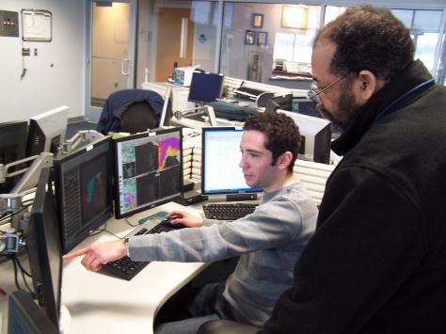
What Science is Behind This?
NWS Forecasters:
  Improve on Computer Guidance Before Releasing Forecast
Final product combines:
  Computer Model Ensembles
  NWS National Center Snow Forecast Guidance
  Local NWS Forecaster Knowledge/Experience!!!

Slide 16
Summary
Three New Products (In addition to what we routinely produce)
  Minimum - Most Likely - Maximum
  Chance of Exceeding X Inches
  Locality Table
New Winter Weather Webpage
  http://weather.gov/gsp/winter/
Communicating Uncertainty Enables Better Decisions
  Minimize Winter’s Impact on the Region
Expect at least this much
Potential for this much

