Slide 1

2016 GSP Integrated Warning Team Workshop
Winter Weather Breakout Session

Slide 2
Outline
Event minus 24 Hours
  NWS Fcst
  Discussion
    Action plan
    Preparations
Event minus 12 Hours
  NWS Fcst
  Discussion
    Reevaluate action plan
    Further preparations
Event minus 6 Hours
  NWS Observations/Fcst
Event minus 3 Hours
  NWS Observations/Fcst
Event Ongoing
  NWS Observations/Fcst
  Discussion
    Sit-Rep
    Recovery
    Further action plans

Slide 3
Event minus 24 Hours
4:00 PM Sunday January 29th
A dry surface cold front will pass through the region this evening, ushering in cooler air
Forecast guidance indicates the potential for banding precipitation on Monday January 30th
Some or all of these precipitation bands could yield accumulating snowfall along/south of the I85 corridor
Given the expected convective nature of the rain/snow showers, confidence in precipitation amounts, timing, as well as placement is low
Strong winds as well as light accumulating snowfall are possible across the North Carolina high terrain

Slide 4
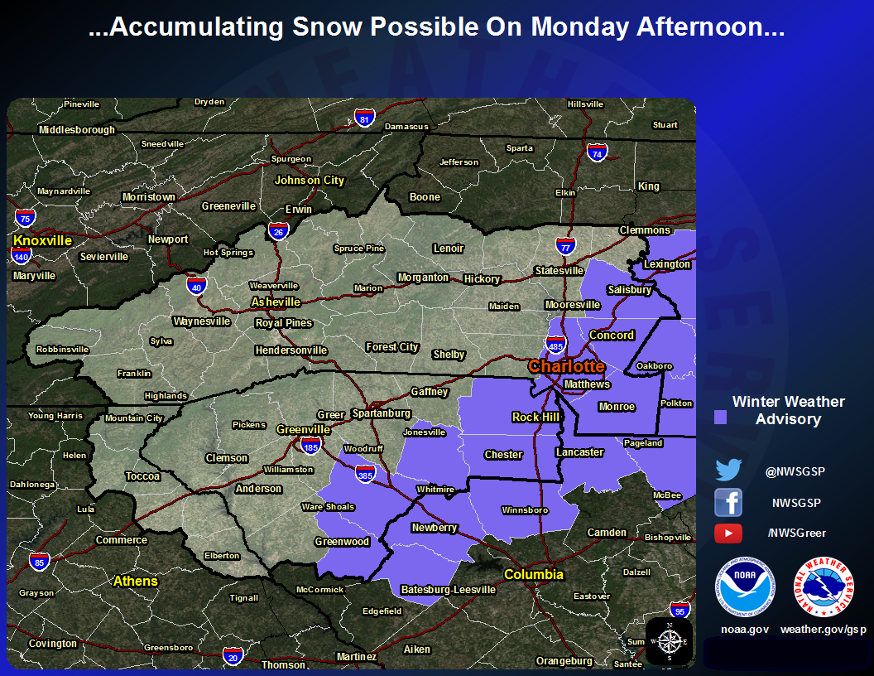
A Winter Weather Advisory has been issued
Valid: 12PM Monday January 30th – 8AM Tuesday January 31st

Slide 5
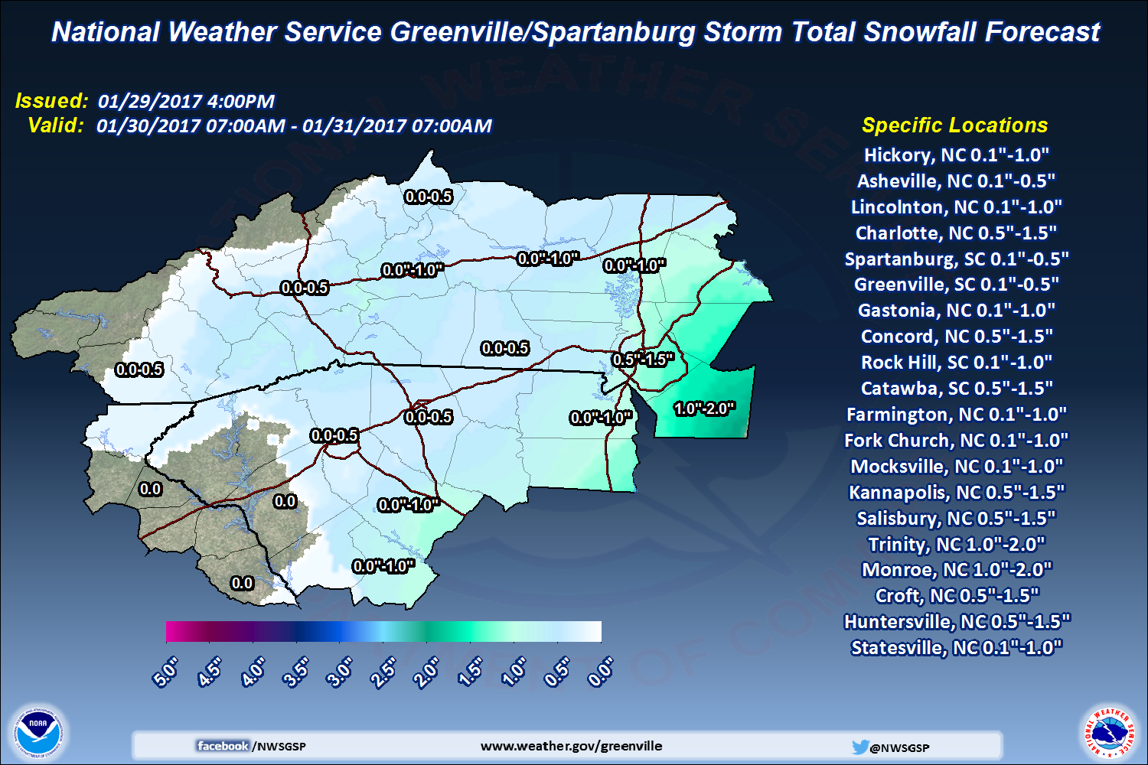
Storm Total Snowfall Forecast
Monday January 30th AM – Tuesday January 31st AM

Slide 6
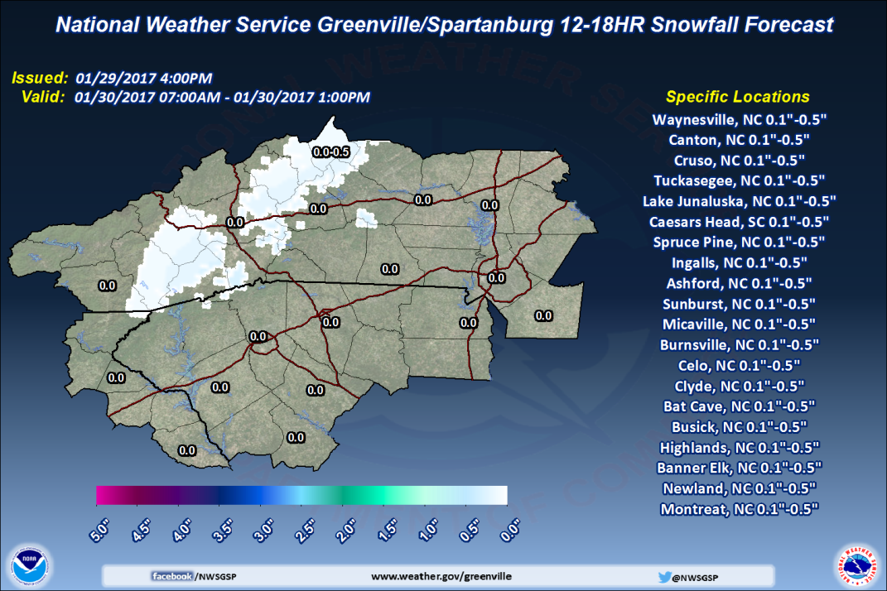
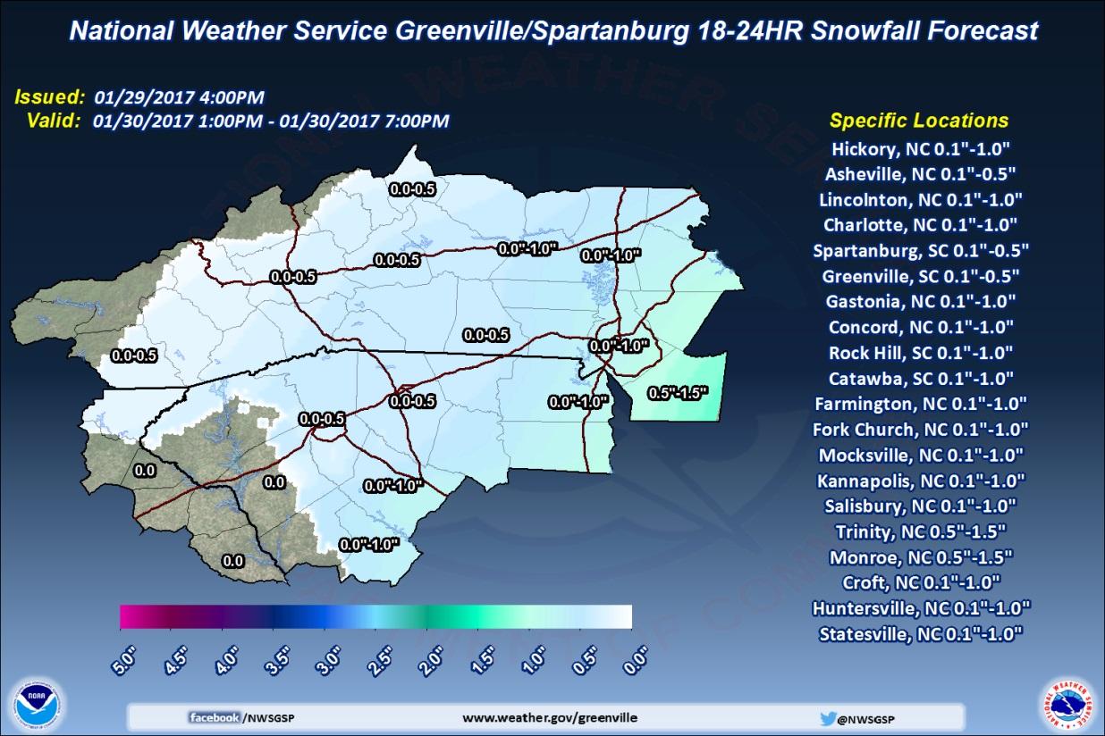
Timing
Monday January 30th 1PM-7PM
Monday January 30th 7AM-1PM

Slide 7
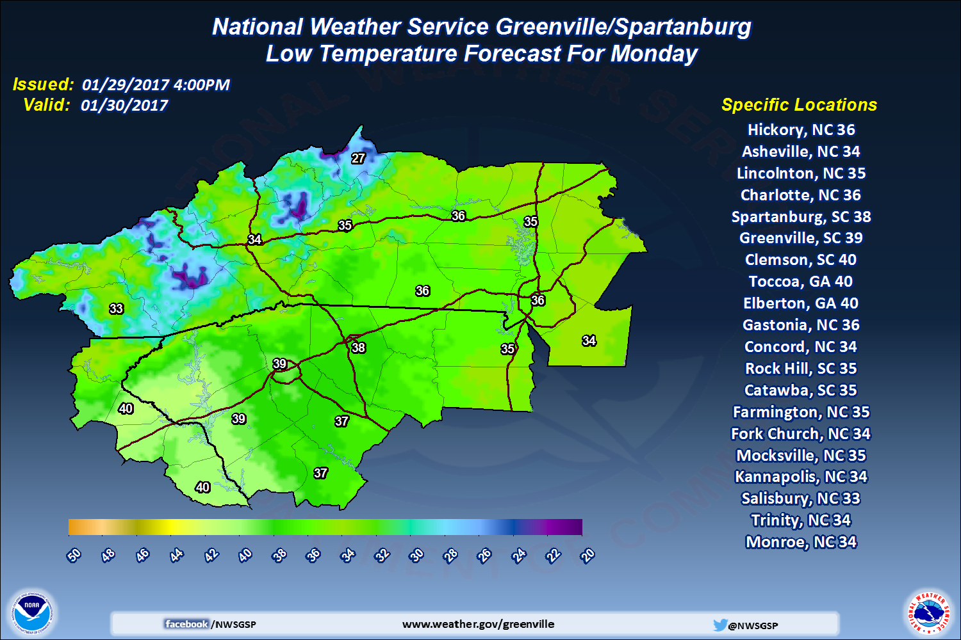
Low Temperature Forecast for
Monday AM January 30th

Slide 8
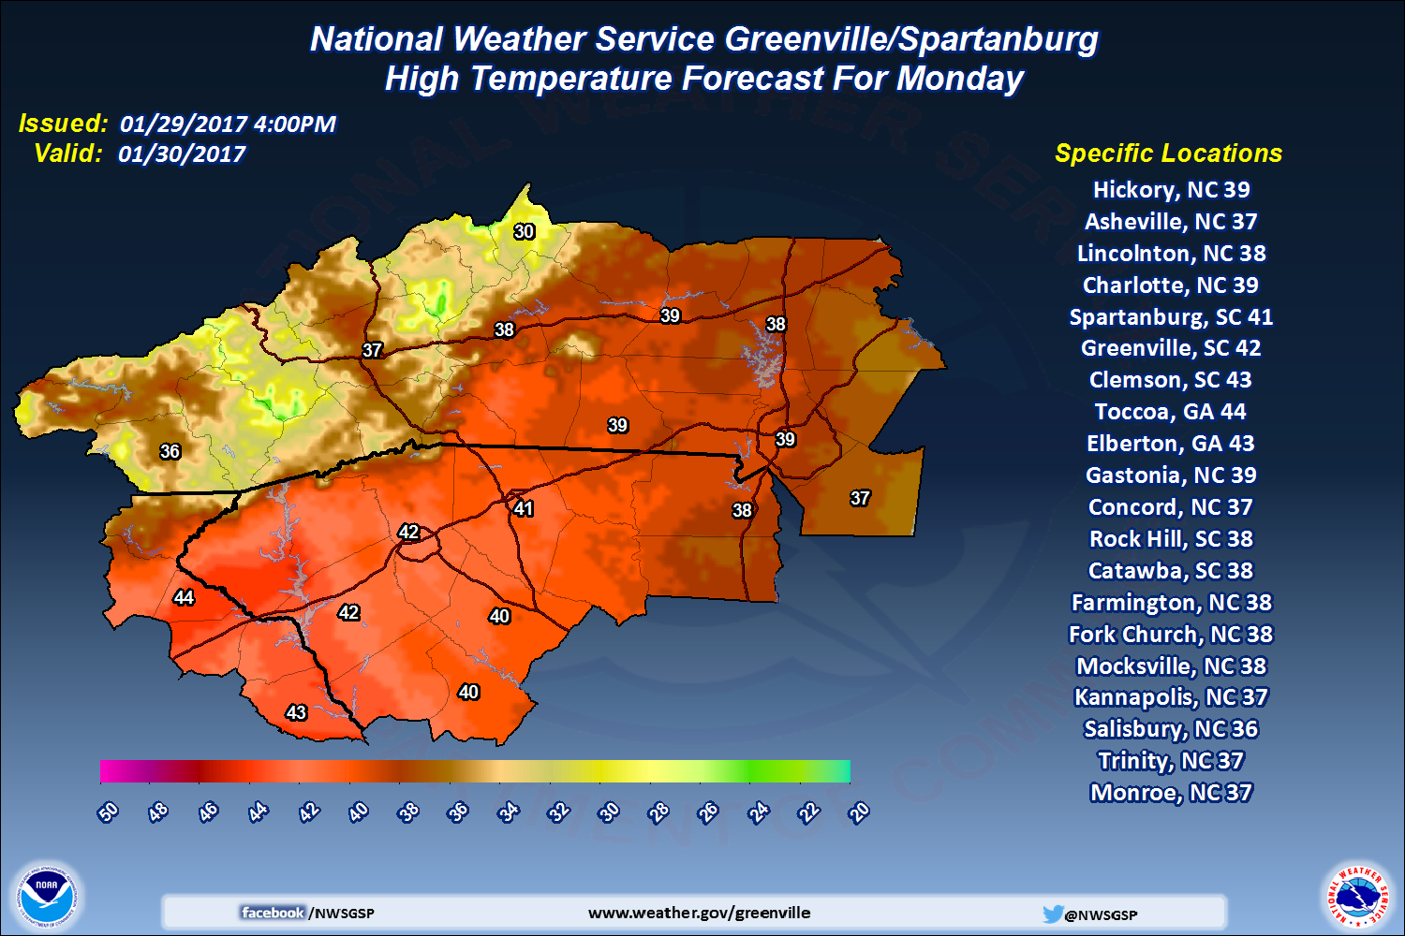
Maximum Temperature Forecast for Monday PM January 30th

Slide 9
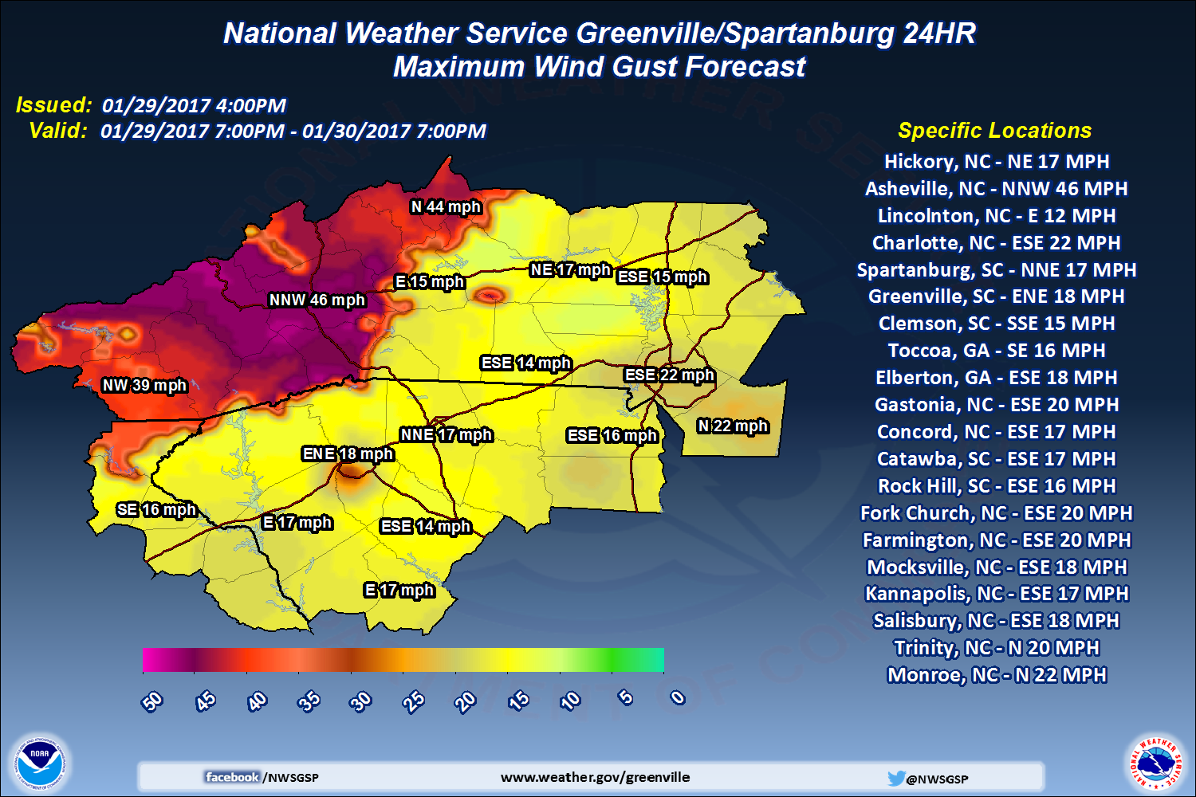
Maximum Wind Forecast
Sunday PM January 29th – Monday PM January 30th

Slide 10
Discussion
Questions about the forecast?
Action Plans
Preparations

Slide 11
Event minus 12 Hours
4:00 AM Monday January 30th
Near term guidance now has more consensus on “general” placement of any convective precipitation bands
  Along and south of the I85 corridor
  Mid to late afternoon
  Precipitation amount forecasts have increased, but will be highly variable
  Starting as rain, quickly changing to snow as temperatures fall
North Carolina high terrain winds look even stronger, and slightly delayed

Slide 12
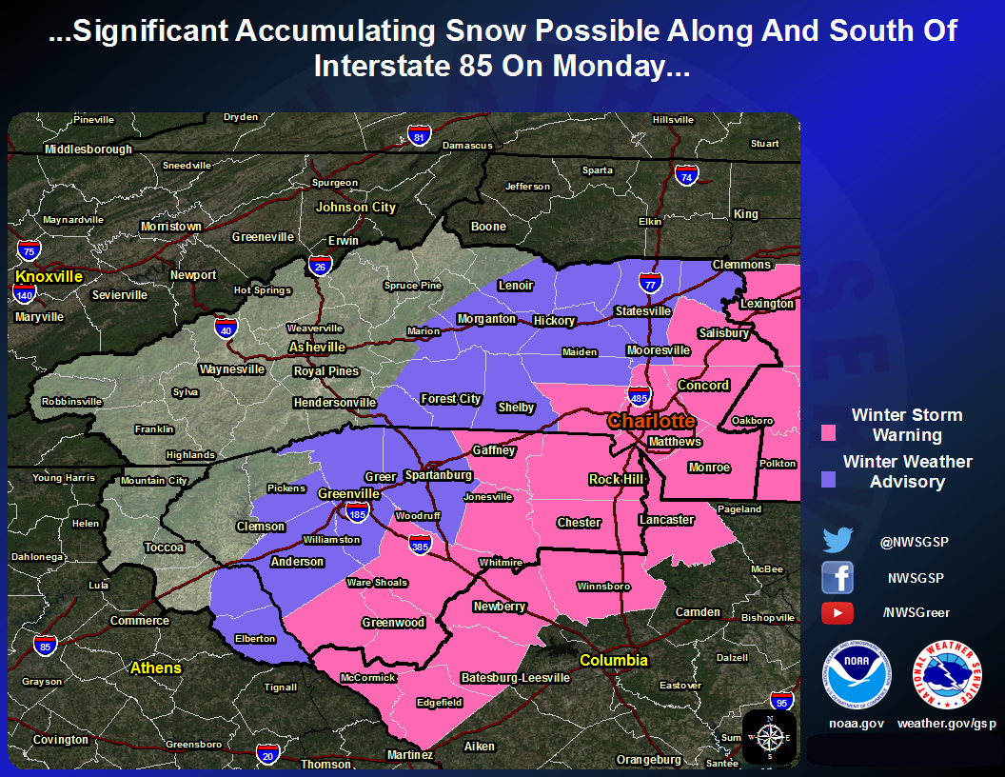
Winter Weather Advisory expanded north, upgraded to a Warning south
Valid: 12PM Monday January 30th – 8AM Tuesday January 31st

Slide 13
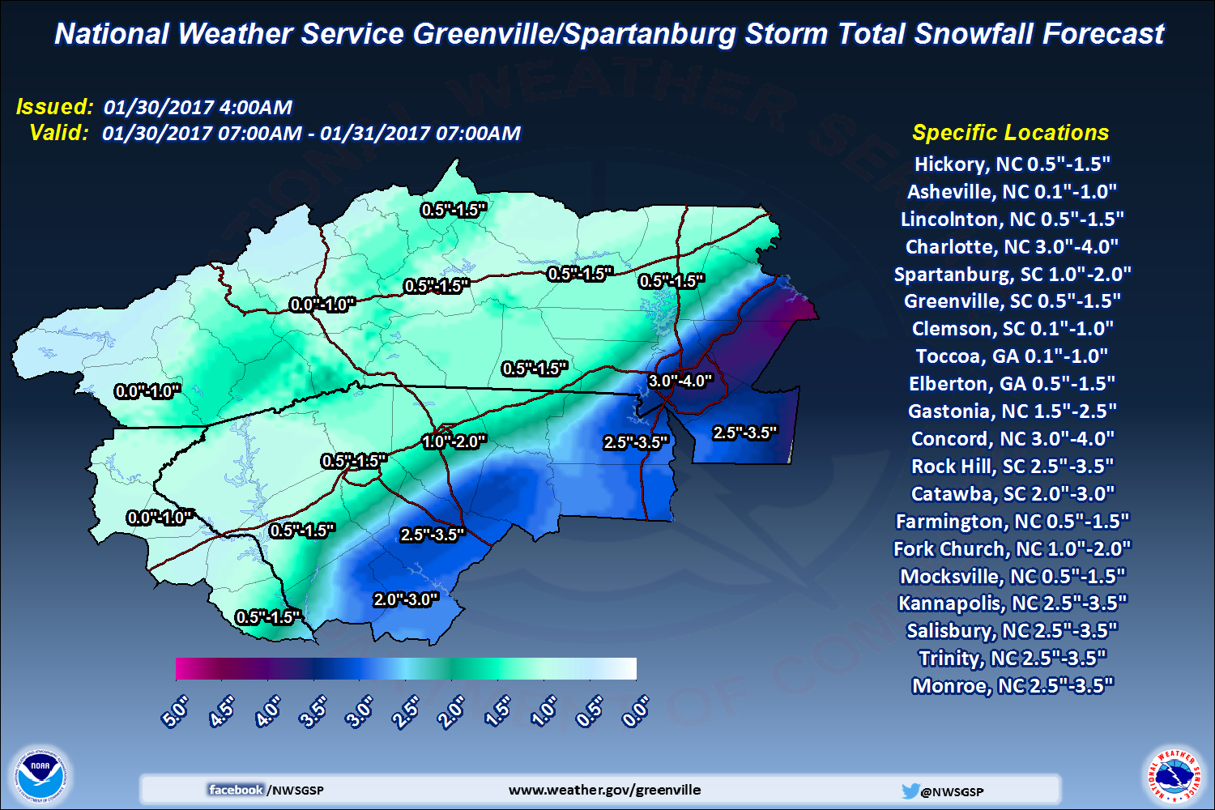
Storm Total Snowfall Forecast
Monday January 30th AM – Tuesday January 31st AM

Slide 14
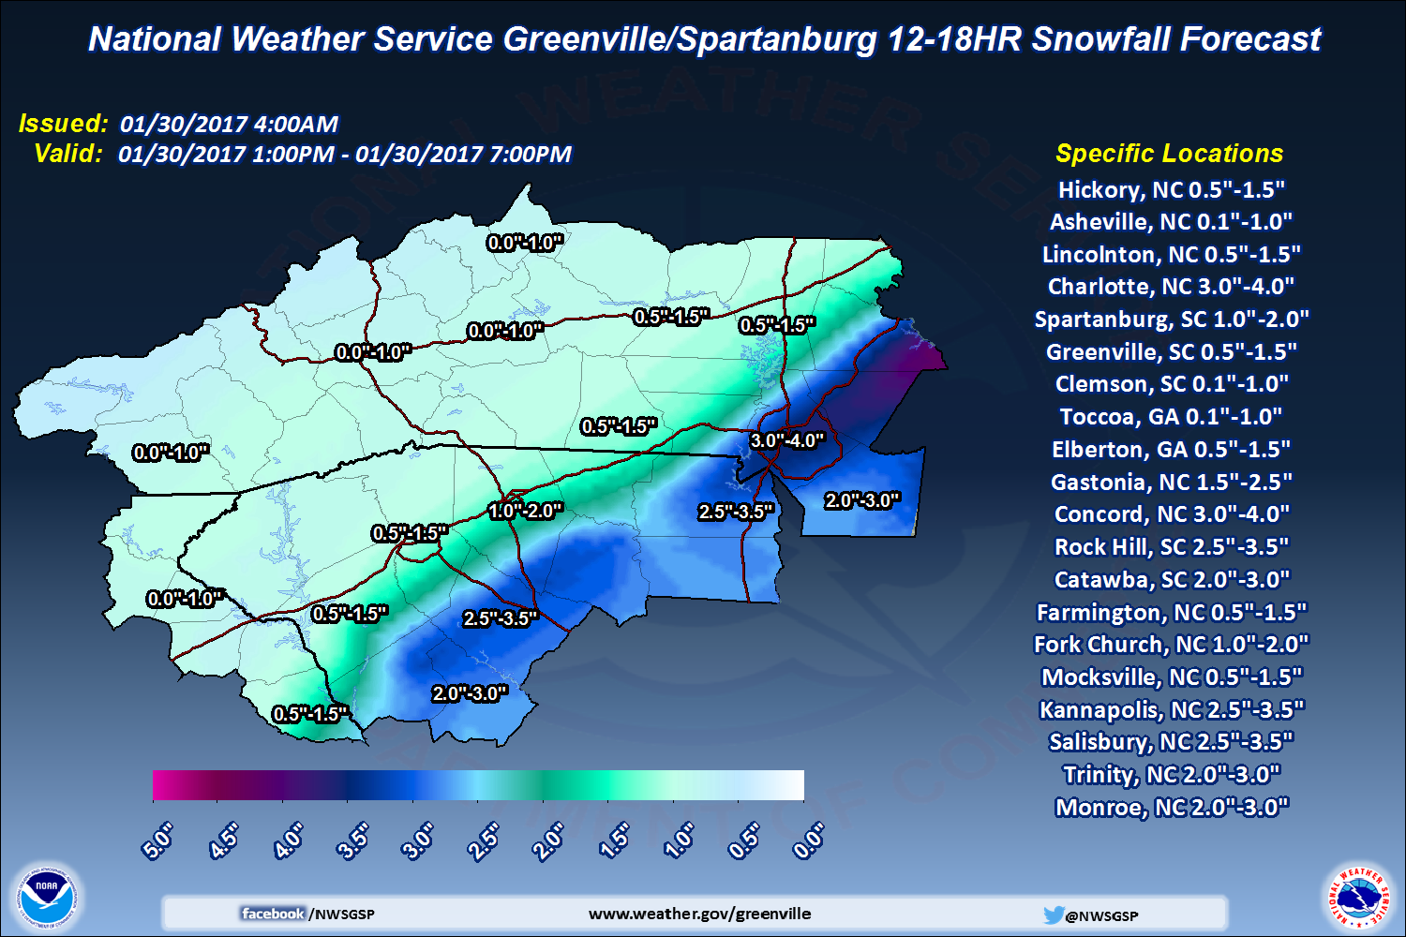
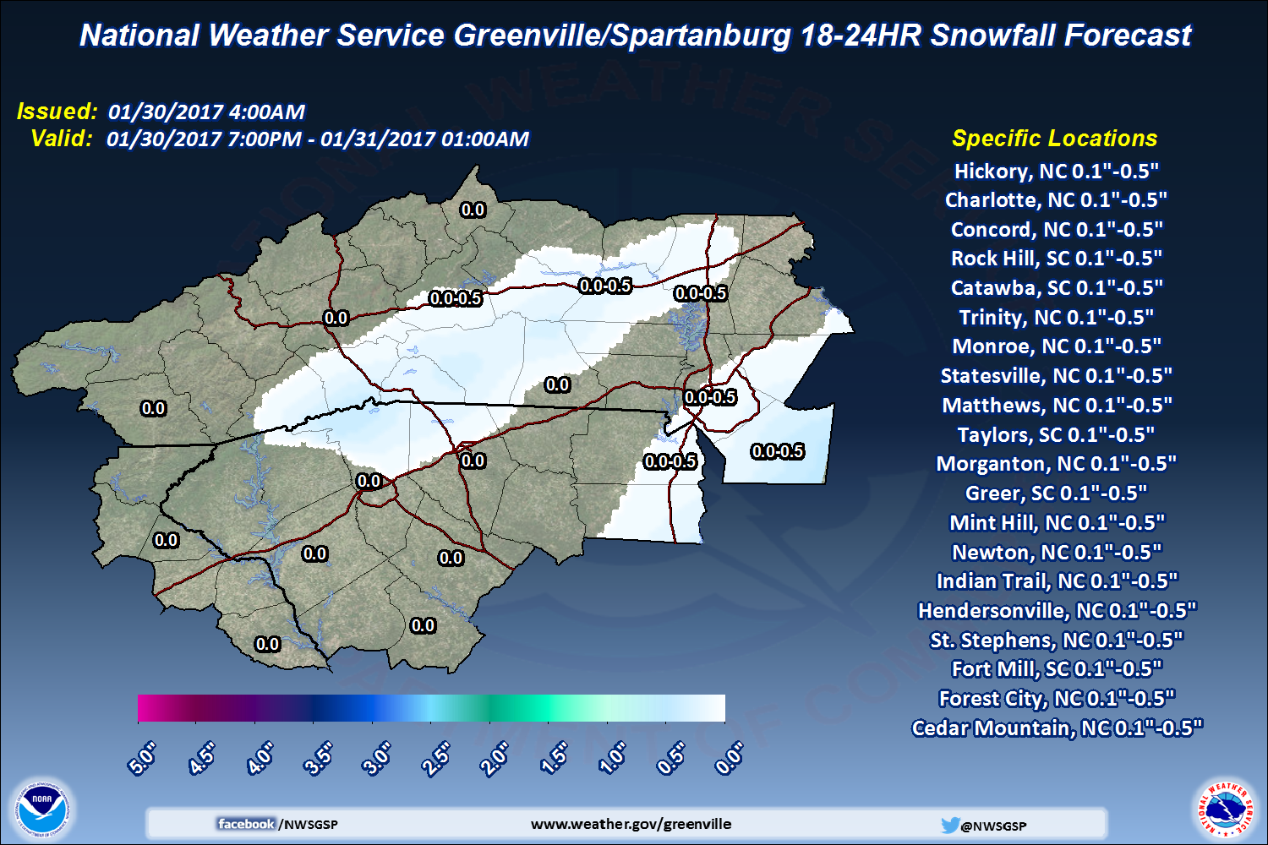
Latest Timing
Monday January 30th 7PM – Tuesday January 31st 1AM
Monday January 30th 1PM-7PM

Slide 15
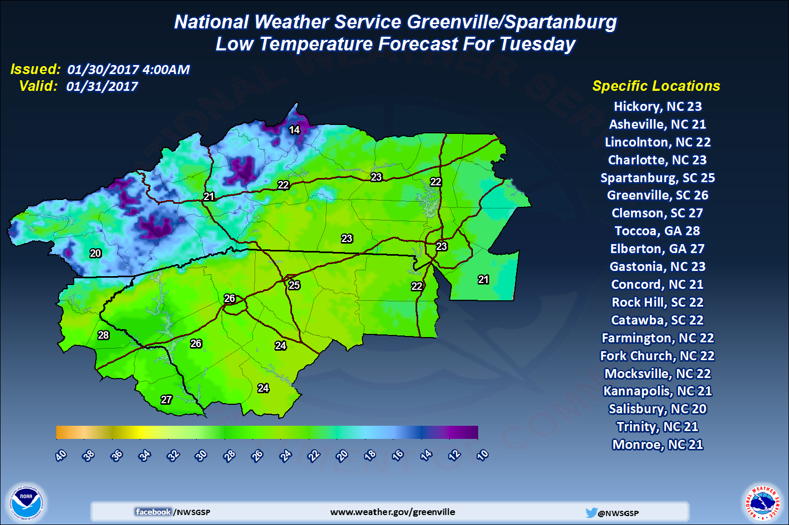
Minimum Temperature Forecast for Tuesday AM January 31st

Slide 16
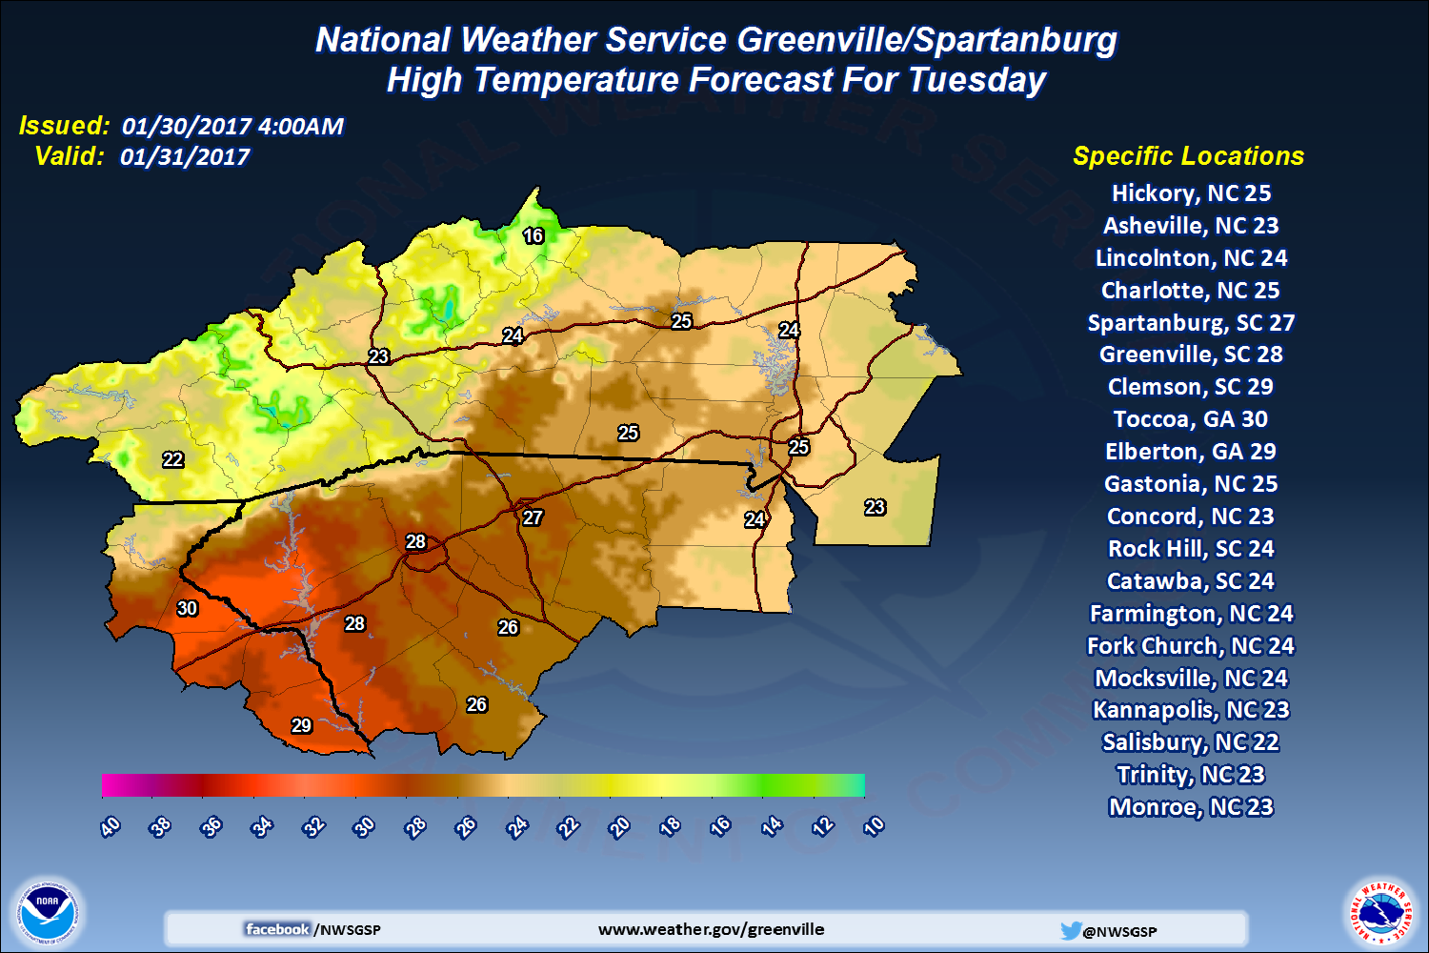
Maximum Temperature Forecast for Tuesday PM January 31st

Slide 17
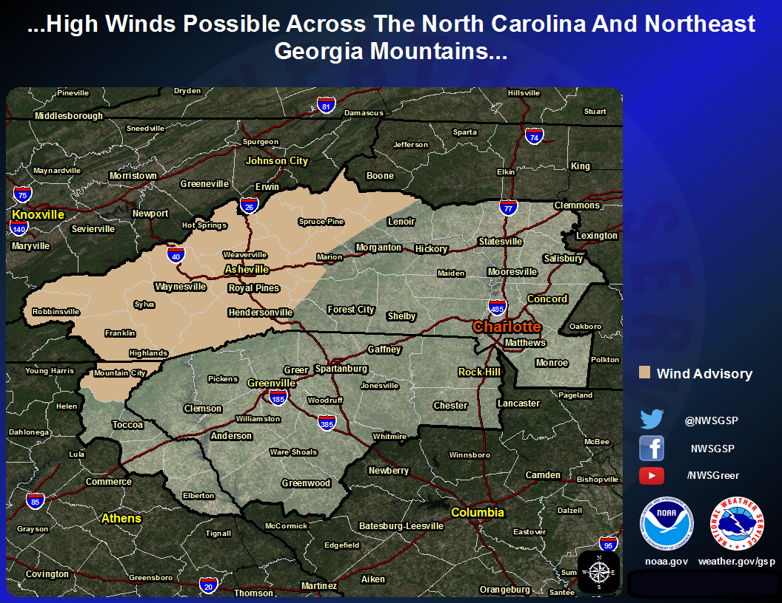
A Wind Advisory has been issued
Valid: 8AM Monday January 30th – 12AM Tuesday January 31st

Slide 18
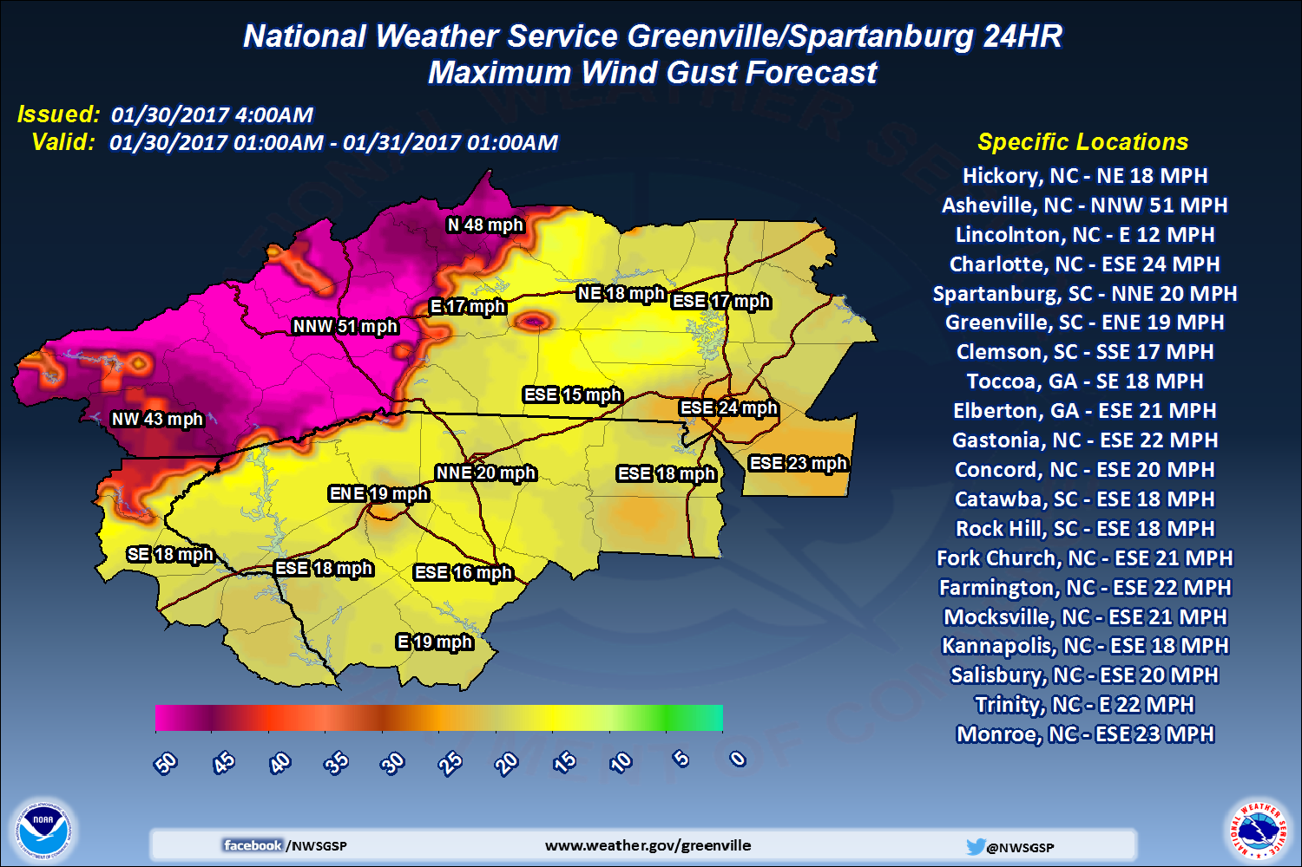
Maximum Wind Forecast
Monday AM/PM January 30th

Slide 19
Discussion
Questions about the forecast?
Action Plans
Preparations

Slide 20
Event minus 6 Hours
10:06 AM Monday January 30th
Light rain showers continue to move across the NC/SC Piedmont
Light snow showers starting to initiate across the central foothills and southern NC mountains
Temperatures hold steady in the upper 30s to lower 40s along the I85 corridor
Further convective precipitation expected into the afternoon/evening hours
Near term guidance continues to favor heavy precipitation along the I85 corridor

Slide 21
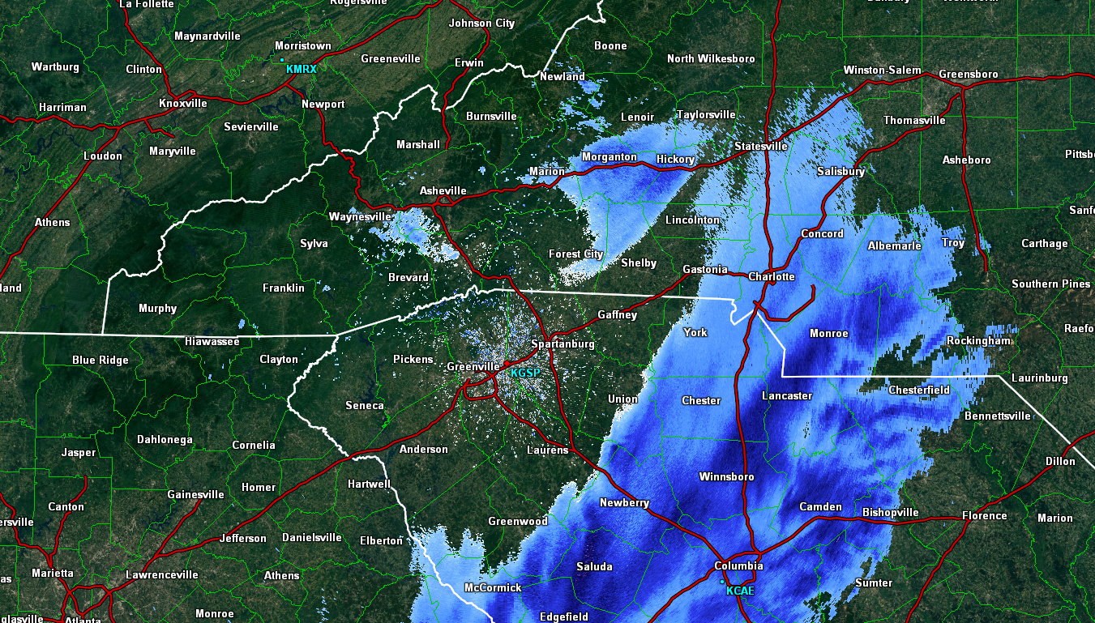
Event minus 6 Hours
10:06 AM Monday January 30th
Snow
Rain

Slide 22
Event minus 3 Hours
1:00 PM Monday January 30th
Coverage of light rain showers has subsided somewhat and moved east
Convective snow banding has now expanded along the Blue Ridge escarpment, southward into the SC Upstate
Snow rates of 1-2” per hour are possible
High winds amidst the falling snow are creating white out conditions along I40
Heavy wet snow starting to accumulate across the Blue Ridge causing falling trees and power outages amidst high winds

Slide 23
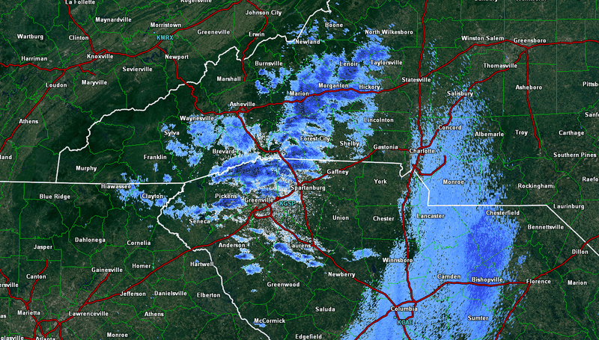
Event minus 3 Hours
1:00 PM Monday January 30th

Slide 24
Event ongoing
4:20 PM Monday January 30th
It’s rush hour during the week of Super Bowl 51 and many Panthers fans are trying to get to Houston
Temperatures have fallen to near freezing along the I85 corridor
A line of moderate to heavy snow showers has developed
Now moving further southeast into Charlotte Metro
Expecting snowfall rates of up to 2” per hour
Major airport AND traffic delays

Slide 25
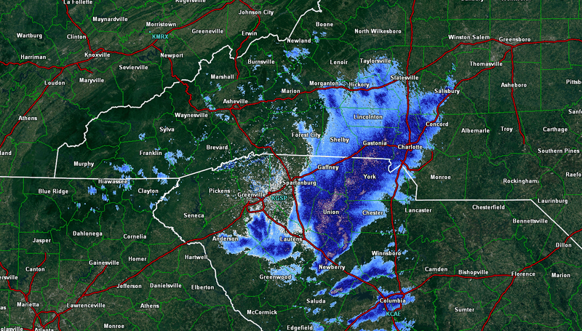
Event ongoing
4:20 PM Monday January 30th

Slide 26
Discussion
Sit-Rep
Recovery
  Temperatures are not expected to exceed freezing on Tuesday
  Scattered to widespread power outages across the NC/SC Piedmont region as well as across the Blue Ridge
  Some roadways still impassable, major interstates clear
Further action plans

Slide 27
The End

