Slide 1
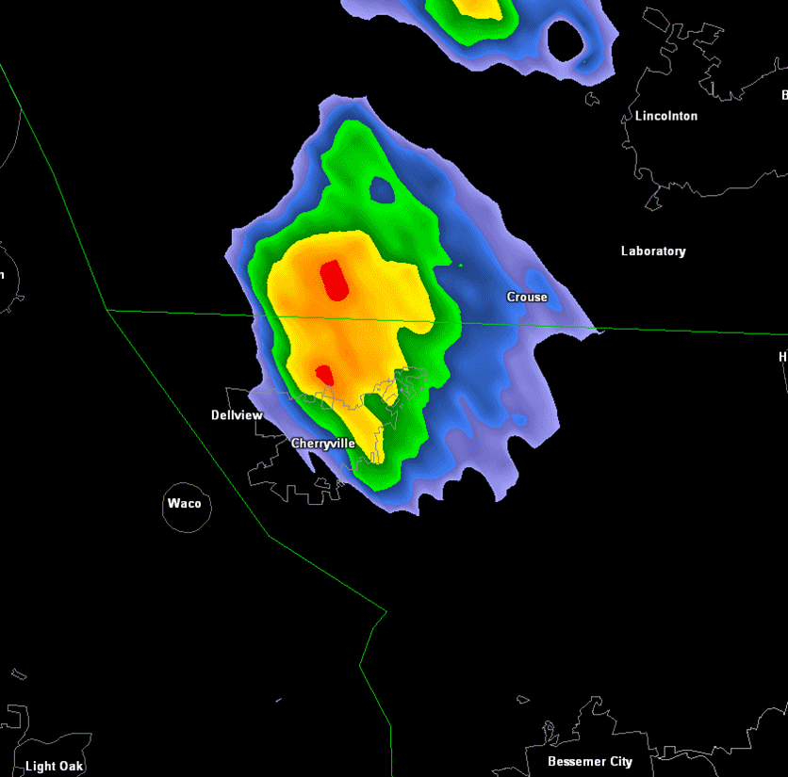
NWS Warnings for Very Localized/Low Impact Severe Weather: Is There a Better Way?
Greenville/Spartanburg
Justin Lane- NOAA/NWS Greer, SC
2016 IWT Meeting

Slide 2
Severe Tstorm Definition
Greenville/Spartanburg
Any storm producing:
- 1” Diameter Hail or Larger
- 58+ mph wind gusts
- A tornado

Slide 3
NWS’ Mandate
Greenville/Spartanburg
To satisfy NWS mission of “protecting lives and property”:
Severe Thunderstorm Warnings issued for all storms expected to meet criteria
Tornado Warnings issued for all storms expected to produce a tornado
But not all storms meeting these criteria are equal...

Slide 4
Greenville/Spartanburg
Classic “Supercell” Thunderstorm (most organized Tstorm type and very rare in our area)...

Slide 5
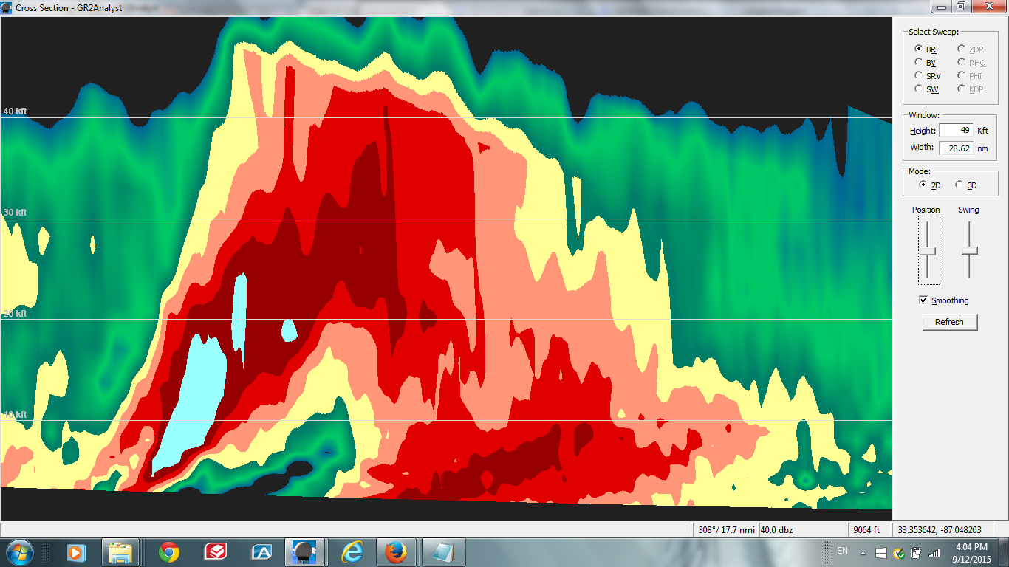
40,000 FT
POWERFUL, TILTED UPDRAFT
PRECIP (DOWNDRAFT) CASCADES AHEAD OF UPDRAFT, AWAY FROM INFLOW
UP
DIRECTION OF MOVEMENT

Slide 6
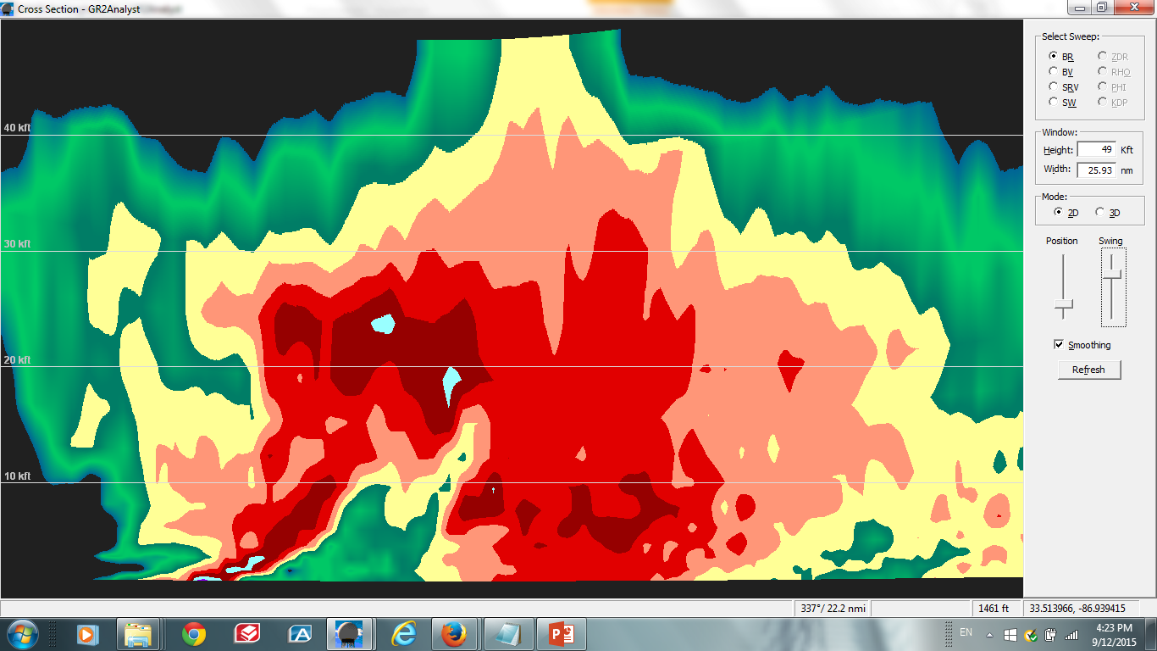
SAME STORM, 30 MINUTES LATER

Slide 7
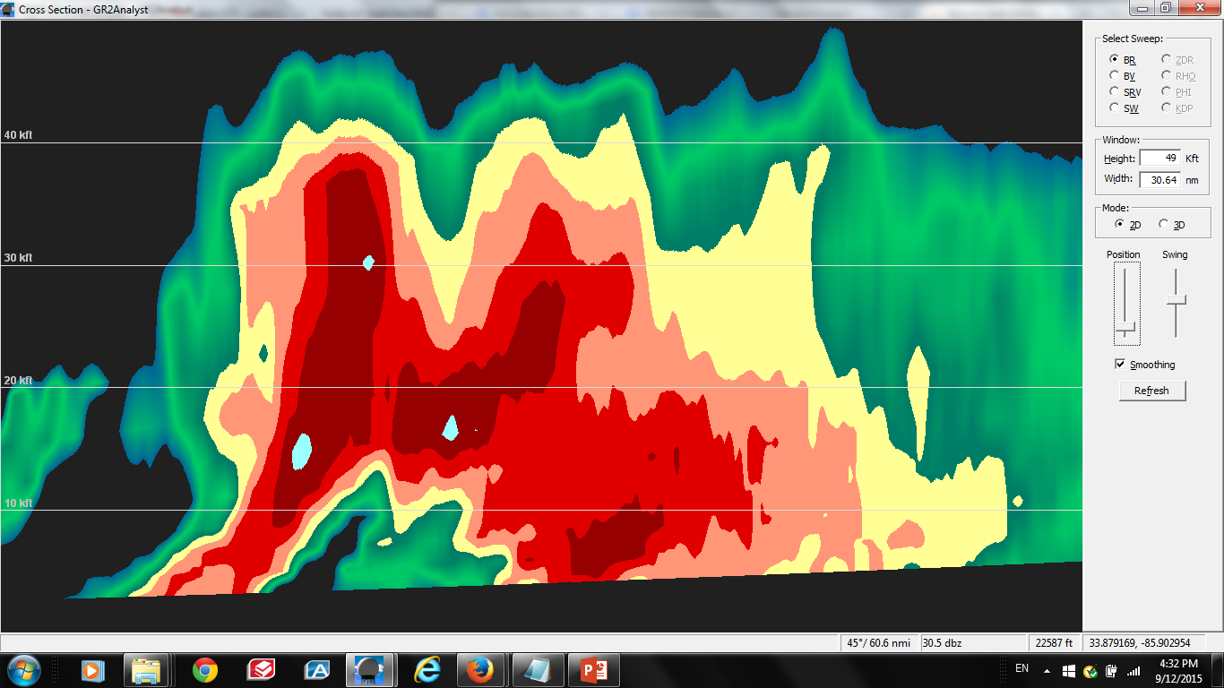
SAME STORM, 90 MINUTES LATER

Slide 8
Warnings for Organized Storms
Greenville/Spartanburg
‘Actionable’ Information (Long Lead Time)
Small False Alarm Area
Protect Lives and Property

Slide 9
Greenville/Spartanburg
“Pulse” thunderstorms (least organized Tstorm type and very common in our area)...

Slide 10
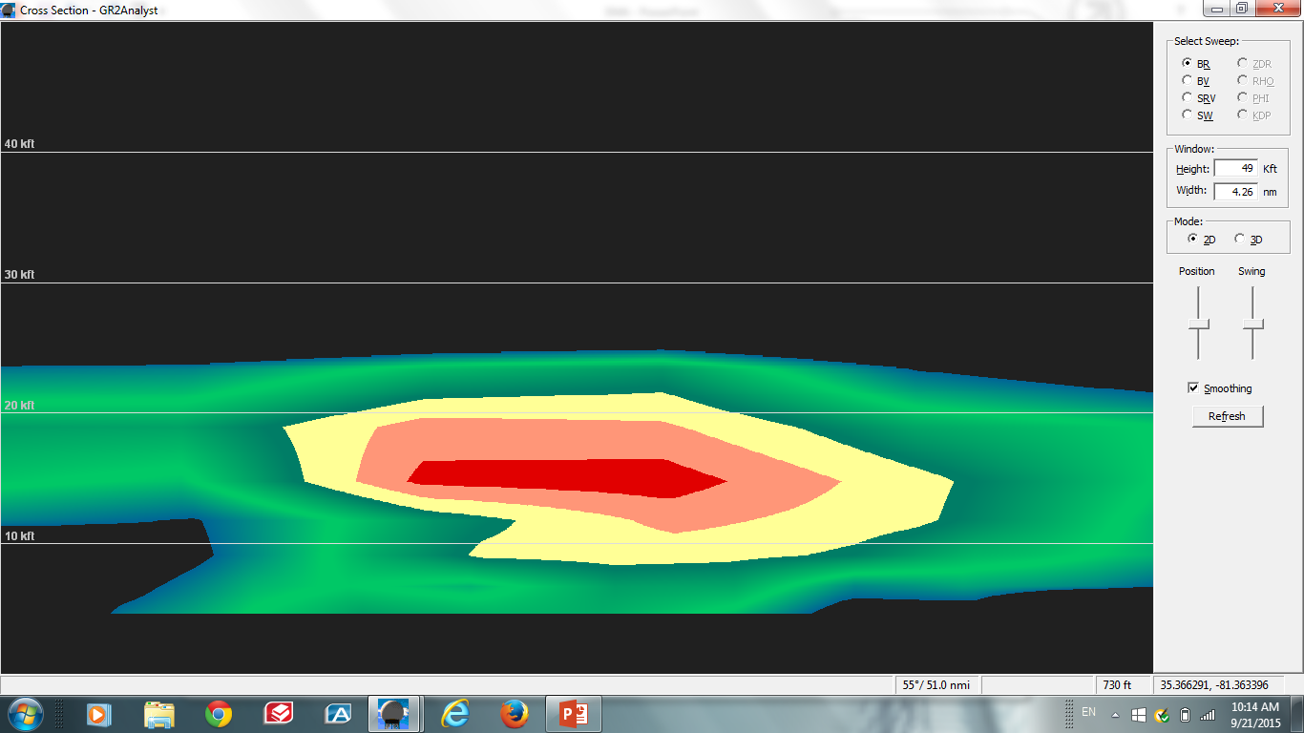
NEW CELL
20,000 FT
STRONG, VERTICAL UPDRAFT

Slide 11
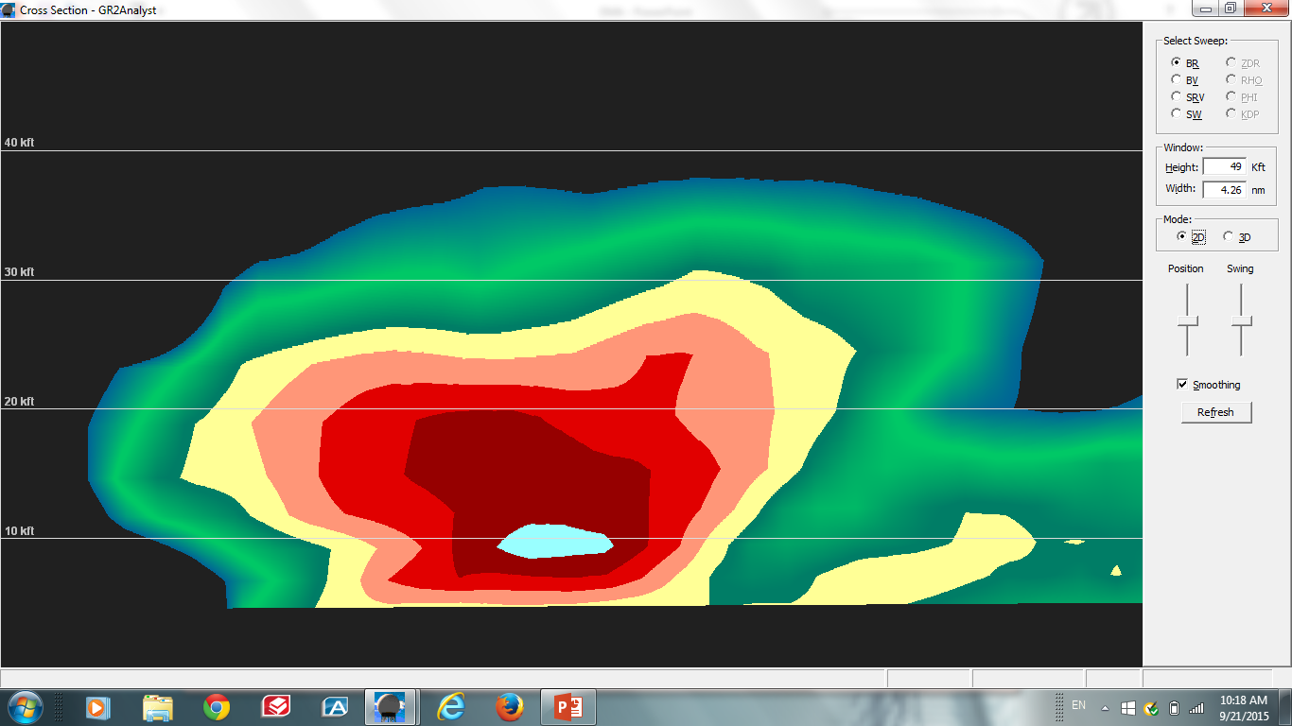
SAME STORM, 9 MINUTES LATER
20,000 FT
DOWNDRAFT (MICROBURST) WILL REACH THE GROUND IN THE MATTER OF A COUPLE OF MINUTES
PRECIP CASCADES INTO UPDRAFT, “CHOKING OFF” INFLOW

Slide 12
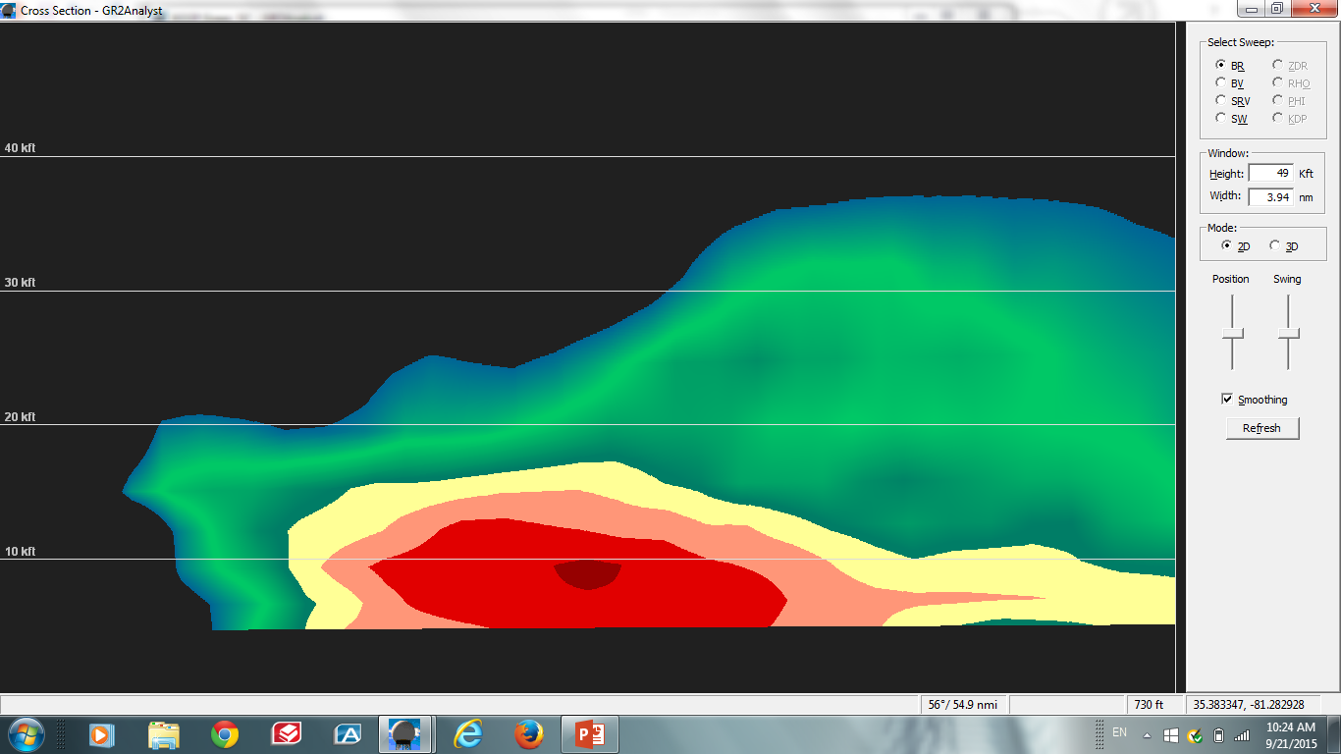
SAME STORM, 20 MINUTES LATER
20,000 FT

Slide 13
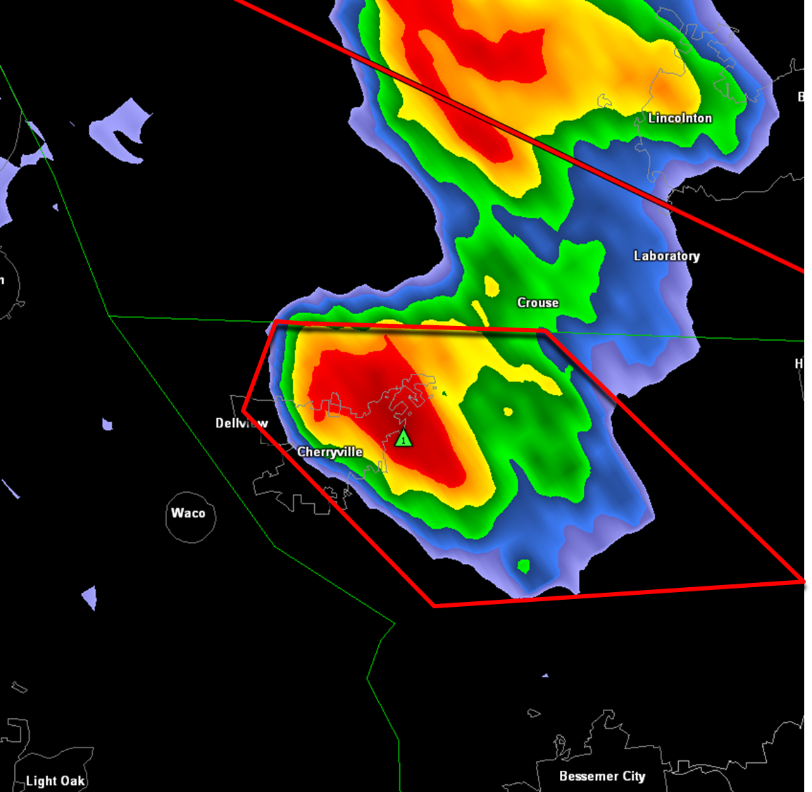
FALSE ALARM AREA

Slide 14
Warnings for “Pulse” Storms
Greenville/Spartanburg
Very small/0 lead time
‘Actionable’ info unlikely for those beneath the storm
Large False Alarm Area
Protection of lives and property?
Allows meteorologist to say “We got a warning out?”

Slide 15
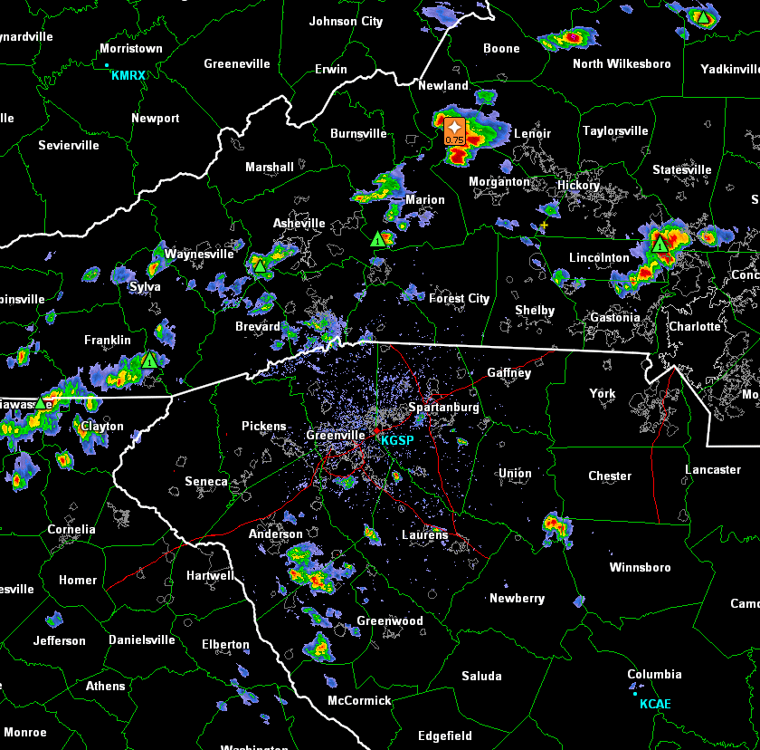
What are the ramifications when this happens multiple days over multiple years?

Slide 16
The Other Issue (Verification!)
Greenville/Spartanburg
Statistics must be maintained for performance metrics
- % of successful warnings
- % of severe wx events occuring in a warning
- Average lead time
Scientific curiosity/self evaluation
Congress, NOAA/NWS Management, etc. use these metrics to evaluate office performance

Slide 17
The Other Issue (Verification!)
Greenville/Spartanburg
“Objective” verification of 58+ mph winds extremely rare (sparse data network)
Verification of severe wind gusts is therefore impact-based
- Tree damage
- Structural damage
“Two trees” blown down in the same general area is the standard NWS definition of minimal severe tstorm wind gusts

Slide 18
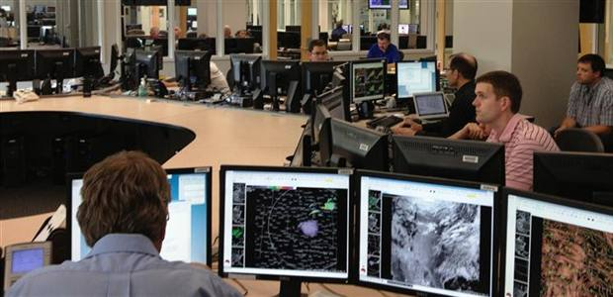
What’s Goes Through an NWS Warning Forecaster’s Head?
Greenville/Spartanburg
If it’s a supercell or other “organized” event...
If it’s a disorganized, “pulse” event...
“I’m protecting life and property”
“This storm is probably only going to produce 50 mph wind gusts, but that will probably be good enough to knock down a couple of trees. Better issue a warning to make the stats look decent (i.e., make the bosses happy), even though it won’t go out in time to do anyone any good, and the vast majority of folks under the warning will consider it a “false alarm.”

Slide 19
Questions for Consideration
Greenville/Spartanburg
Are we “training” the public to ignore Severe Thunderstorm Warnings?
What are the ramifications when we REALLY need the public to take heed?
The same can also be said of tornadoes/ Tornado Warnings

Slide 20
Questions for Consideration
Greenville/Spartanburg
If the intent of the NWS warning system is to protect lives and property, are we wasting “credibility capital” by trying to issue warnings for rapidly developing, highly localized, “low impact” events in which the probability of providing “actionable” lead time is virtually 0?

Slide 21
Potential “Solutions”
Greenville/Spartanburg
Keep doing what we’re doing
Change verification definitions
Issue Special Wx Statements/Sig. Wx Advisories with statements like “brief large hail and damaging winds possible...” (or Severe Tstorm Warnings with statements such as “a brief, weak tornado may develop...”)
Add another EAS tier for Severe Thunderstorm Warnings (e.g., “NO EAS ACTIVATION”)

