Slide 1
Finding Lift: Forecasting for Unpowered Flight
Tony Condon
Kansas Soaring Association
US Soaring Team

Slide 3
Types of lift
Thermals
Ridge
Wave
Other interesting phenomenon
Obstruction Wave
Frontal Boundaries
Outflow Boundaries
Undular Bore

Slide 4
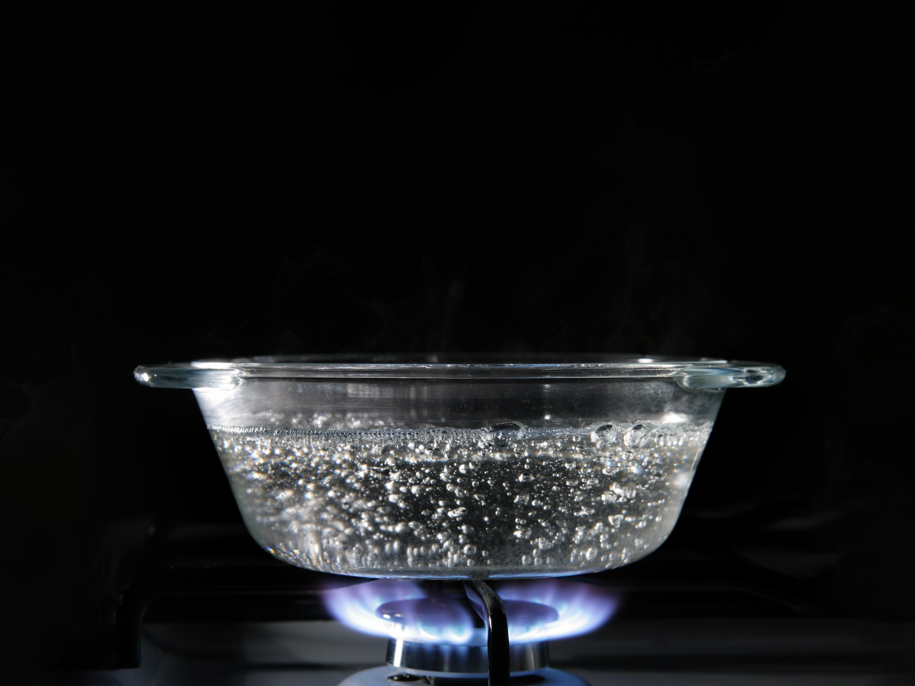

Slide 5
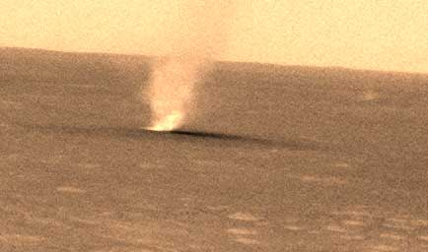
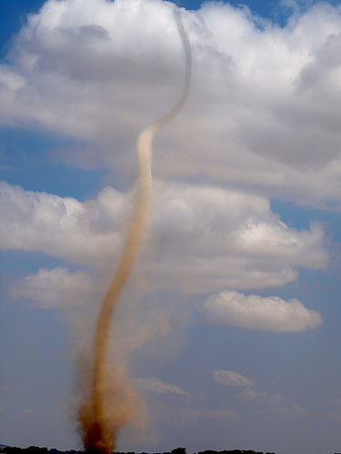
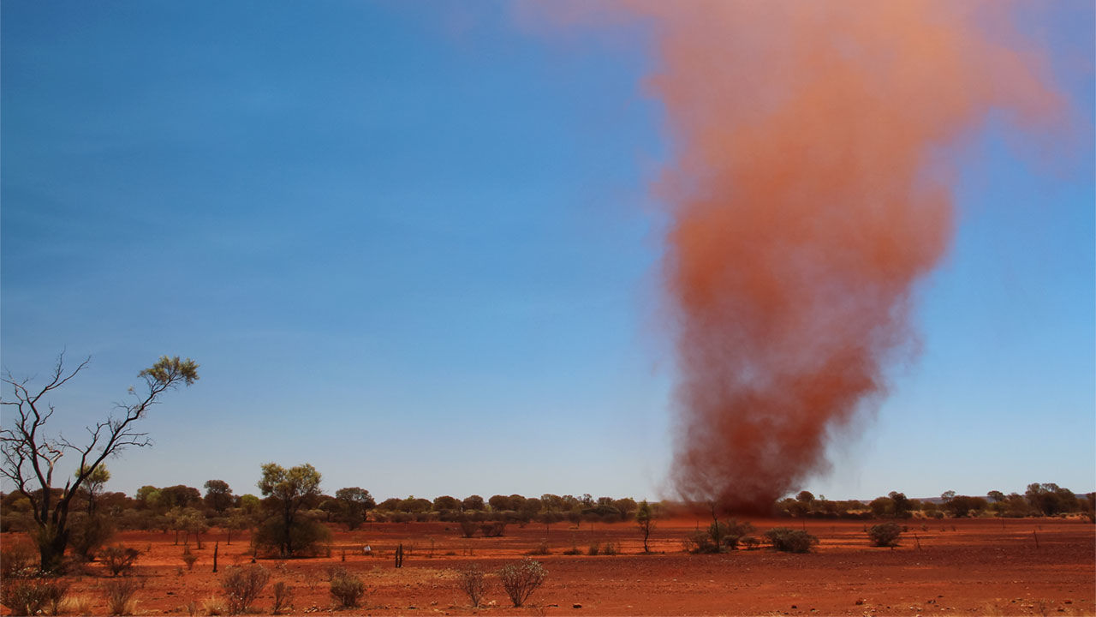

Slide 6
Thermal Process
Sun Heats Ground
Ground Heats Air
“Trigger” and the bubble is released and rises
PV=nRT
Bubble cools at 3C (5.4F) / 1000 ft (Dry Adiabatic Lapse Rate)
Bubble continues to rise until it has cooled to equal the temperature of the surrounding air.

Slide 7
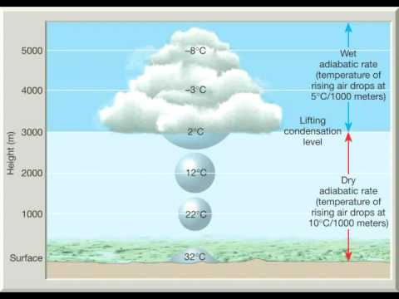

Slide 8
Must have information:
Surface Temperature
Forecasts generally pretty good
Easy to take measurements
Temperature Aloft
Direct measurement difficult
Radiosondes in DDC & TOP not too helpful
Computer models often miss forecast low inversions

Slide 9
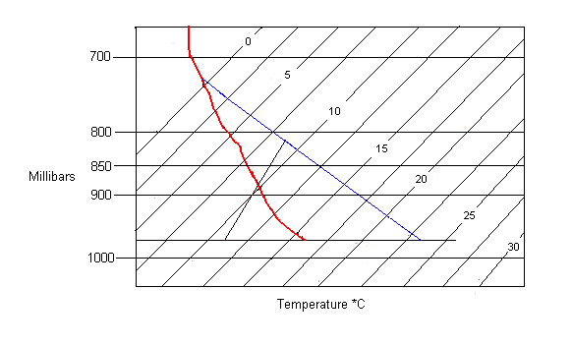
Cloudbase
T.I.

Slide 10
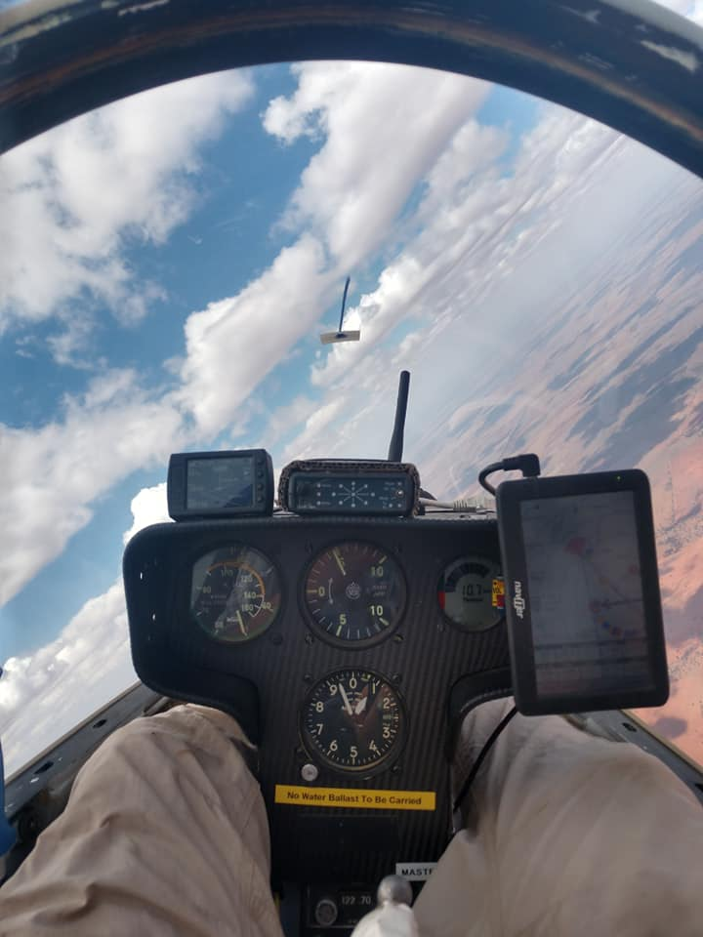
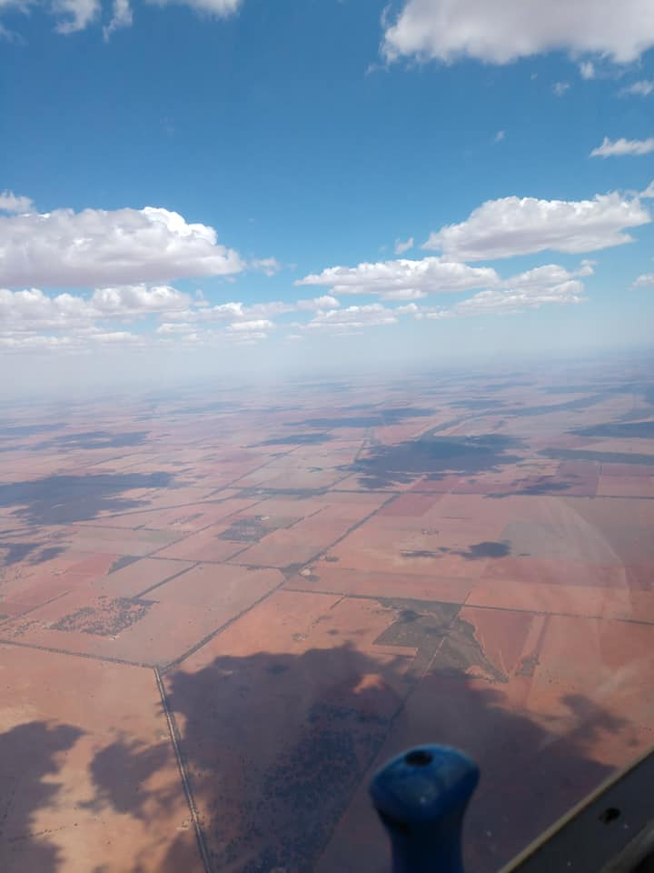

Slide 11
Something Useful!
(Surface Temp – Dew Point)/2.2 = Cloudbase in 1000’s of ft

Slide 12
What makes a good thermal soaring day
Relatively warm surface
Relatively cool air aloft
Cumulus Clouds
Light winds (Generally)

Slide 13
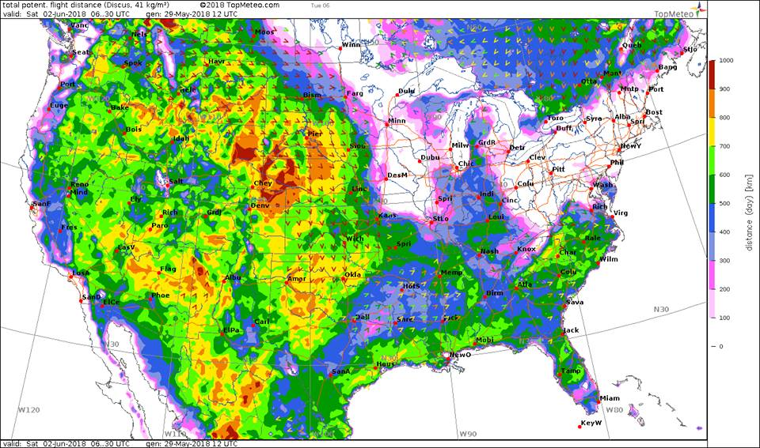

Slide 14
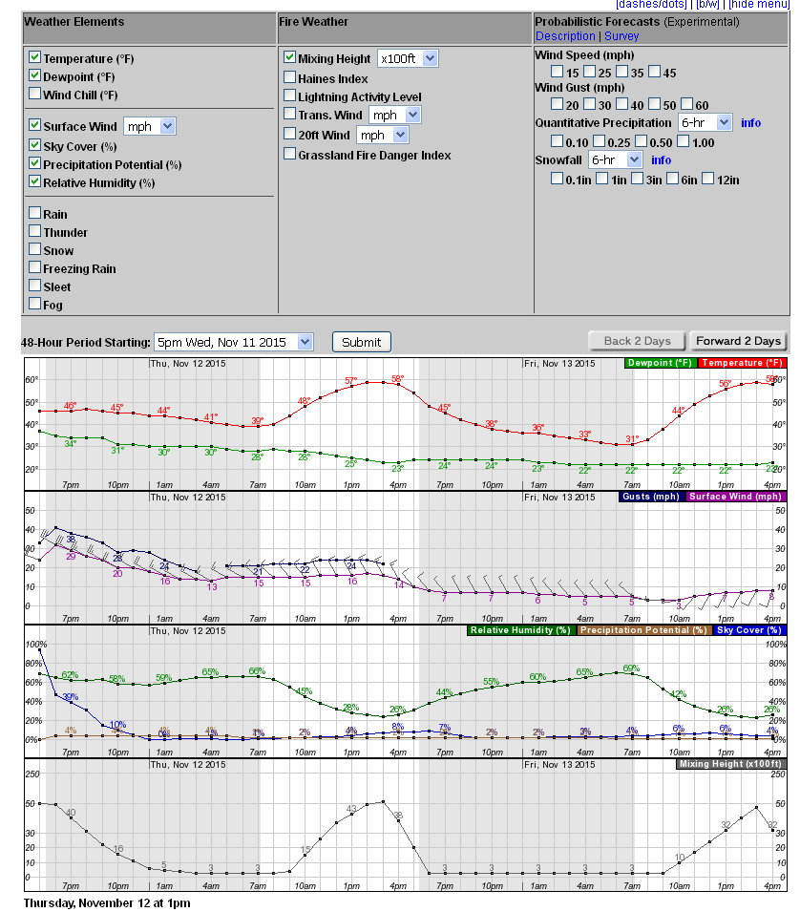
NWS Hourly Forecast
Select “Mixing Height” under Fire Weather – AGL height of Thermals
Hourly Temp/Dew Point
Wind
Sky Cover

Slide 15
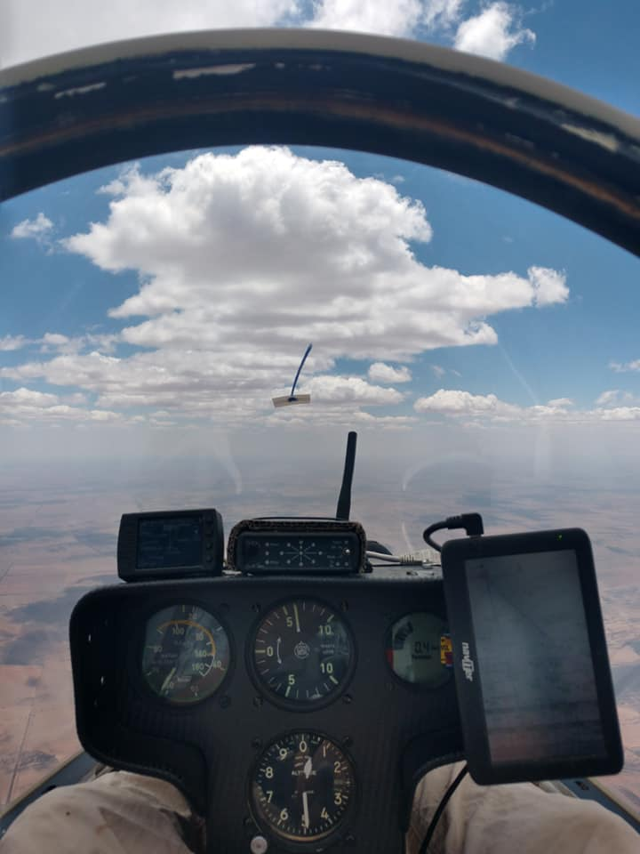

Slide 16
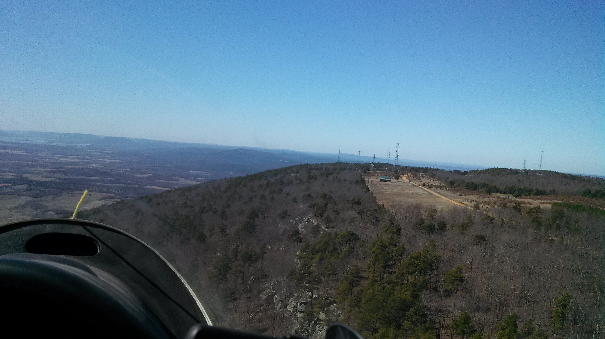
Ridge Lift
Wind blowing up the side of a hill.
Minimum Wind Speed depends on shape of hill

Slide 17
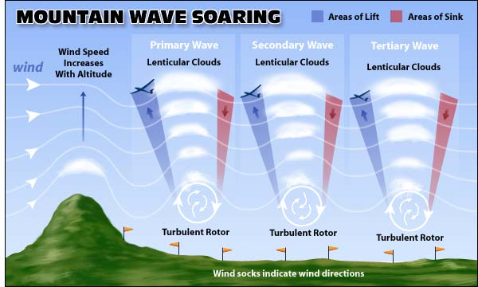
Mountain Wave
20 kts of Wind across the ridge line
Stable air at ridge top height
Increasing wind speed with altitude

Slide 18
20,000 ft over Oklahoma in Wave

Slide 19
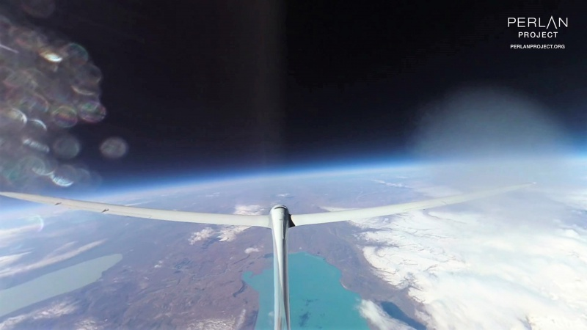

Slide 20
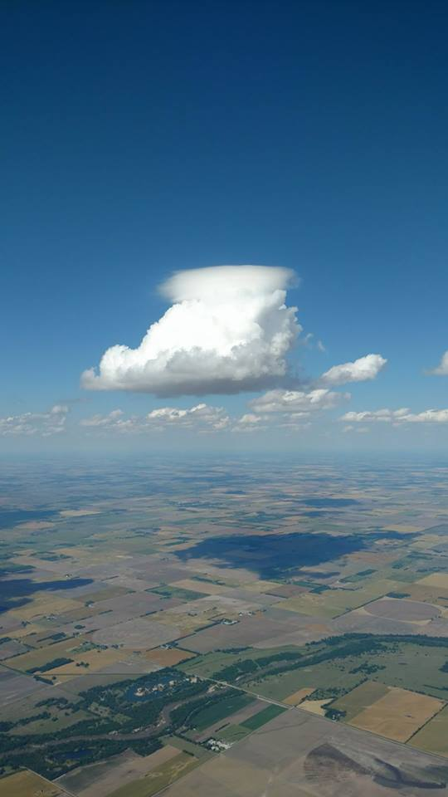
Obstruction Wave
Increasing Wind Speed with altitude
Wind blows up and over Cumulus

Slide 21
Frontal Zone

Slide 22
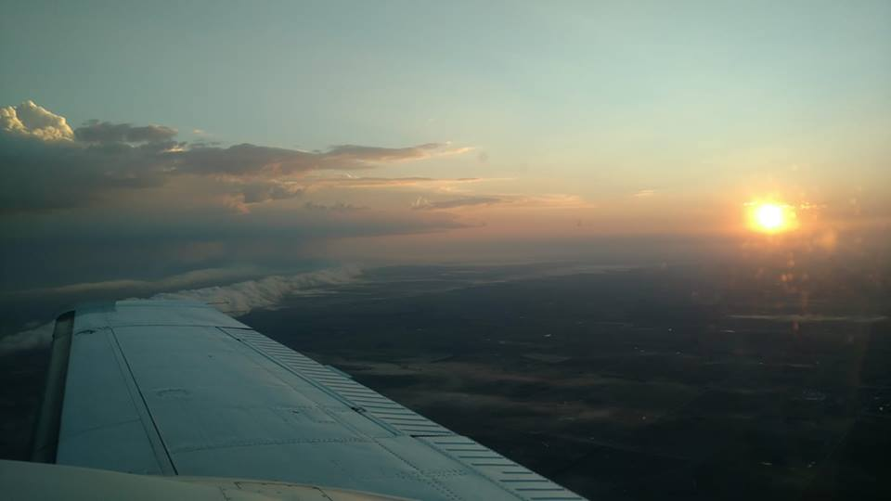
Outflow Boundary

Slide 23
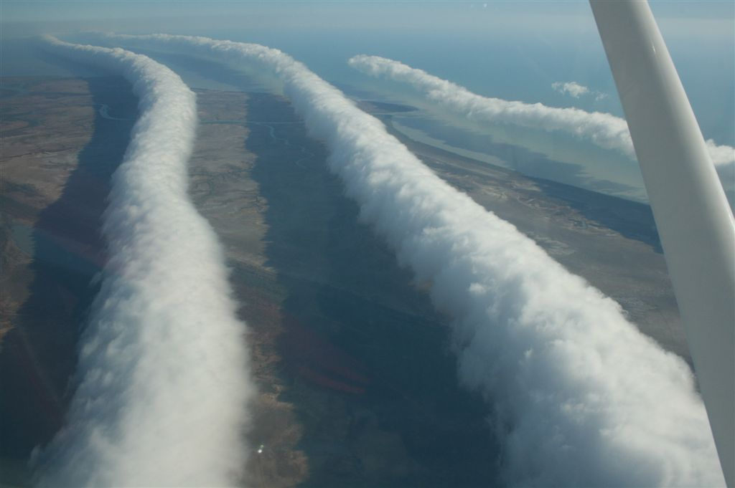
Undular Bore
“Compression Wave” upstream of a collapsing storm system
Morning Glory cloud
Well known in Australia
Observed but not explored in Kansas

Slide 24
Questions??

