Slide 1
Kansas City District Air Traffic Control
Safety, Service, and Efficiency
Annual NWS Wichita Aviation Symposium
Eric S Jennings
Traffic Management Officer
Kansas City District

Slide 2
Kansas City District

Slide 3
Kansas City District
14 Federal ATC facilities
  ARTCC, 1 TRACON, 7 TRACABs, 7 ATCTs)
5 Senior Managers, 6 Support Managers plus staff
  Training, Airspace, Quality Control, Programs
22 Federal Contract Towers
3 Military ATC facilities
  Vance AFB, Whiteman AFB, Fort Riley

Slide 4
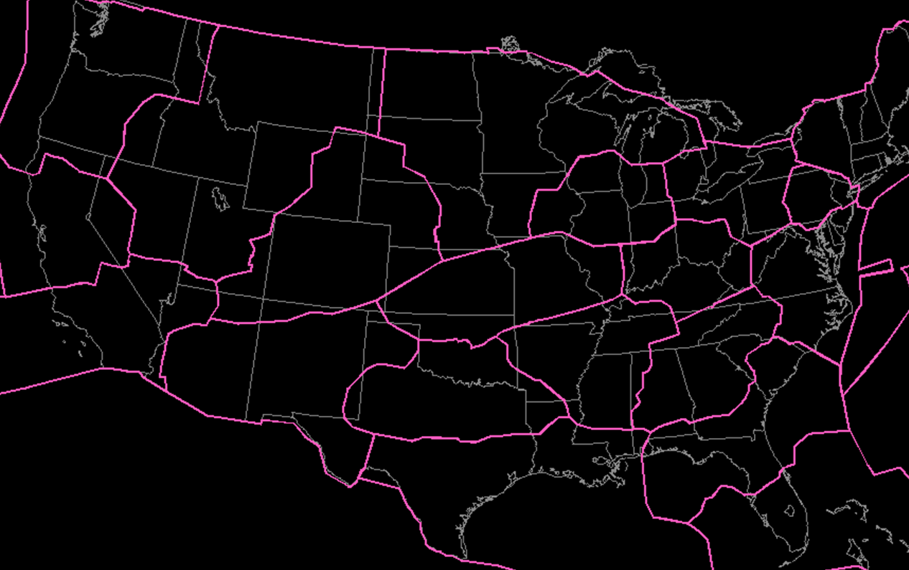
ARTCCs
ZKC

Slide 5
Kansas City ARTCC
200,000 square miles of airspace
55 Managers/Supervisors/Staff
175 Controllers (80 trainees)
7 Traffic Management Coordinators (TMU)
4 National Weather Service Meteorologists (CWSU)
60 Technicians/Automation support/contractors
1,824,270 aircraft operations FY18
  (12% increase since FY13)

Slide 6
Purpose and duty
Safety
  Primary purpose is to prevent a collision involving aircraft operating in the system.
Service and efficiency
  Provide a safe, orderly, and expeditious flow of air traffic, and Support National Security and Homeland Defense missions.

Slide 7
Safety
Separating aircraft and issuing safety alerts
Dissemination of weather information
Emergency Assistance
  Squawk 7700, loss of RADAR/Radio contact, ELT
Aircraft orientation
  location/altitude/heading/speed assistance

Slide 8
Safety
VFR aircraft in weather difficulty
  RADAR ID and vectors, MSAW alert
  Emergency airport recommendations
    Based on fuel and weather – consult with CWSU
    Guidance to emergency airport (RADAR, pilotage, etc)
Search and Rescue
  ALNOTs, RCC, and local law enforcement

Slide 9
Service
VFR Flight following
  Safety Alerts (traffic and terrain) and Traffic Advisories, Search and Rescue
Advise of depicted precipitation
PIREP dissemination
  Icing, turbulence, thunderstorms, wind shear, etc.
Suggested routes, alternate airports
  CWSU consultation

Slide 10
Traffic Management
Efficiency
  Balance air traffic demand with system capacity to ensure the maximum efficient utilization of the NAS.
Systemic analysis and improvement (daily)
  Delays, holding, arrival rates, route structure
Special Events
  Superbowls, eclipse, NASCAR, PGA Championship, Airshows, shareholder meetings, AOPA fly-ins

Slide 11
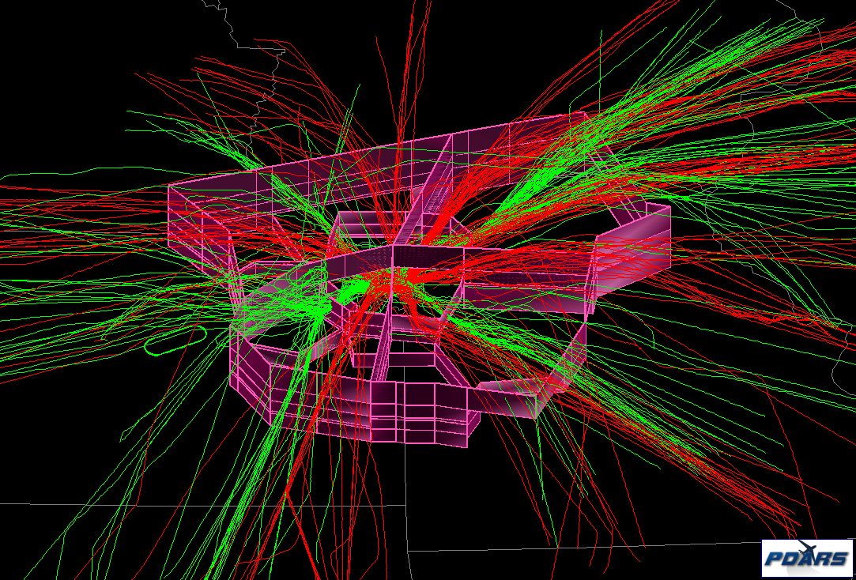
MCI
Arrivals
Departures

Slide 12
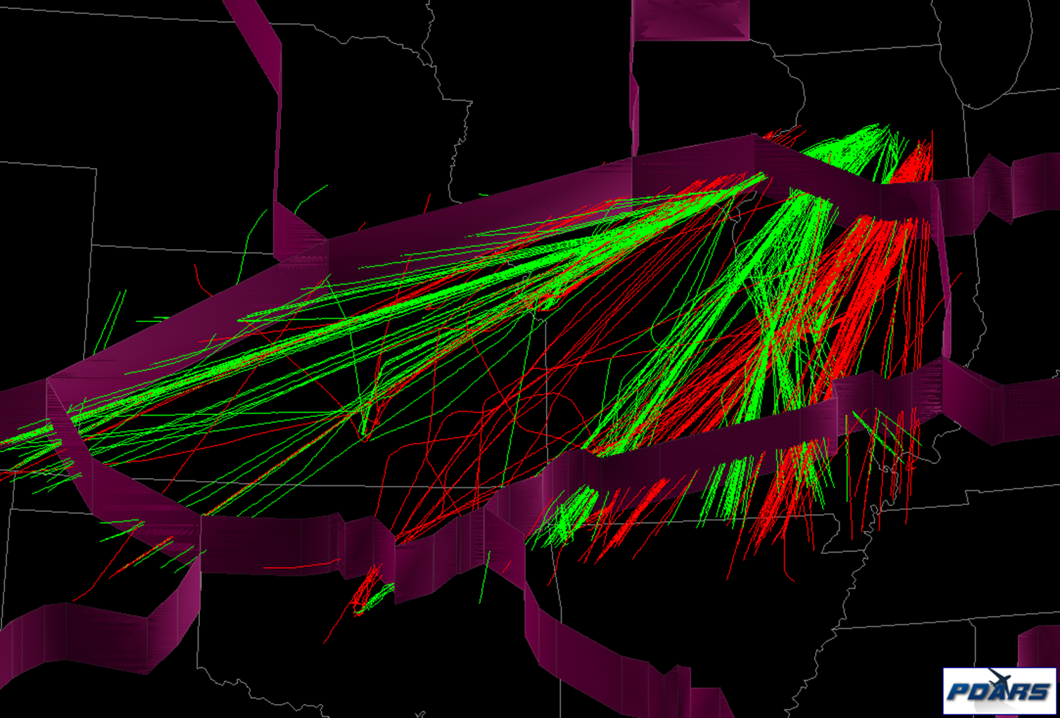
ORD
Arrivals
Departures

Slide 13
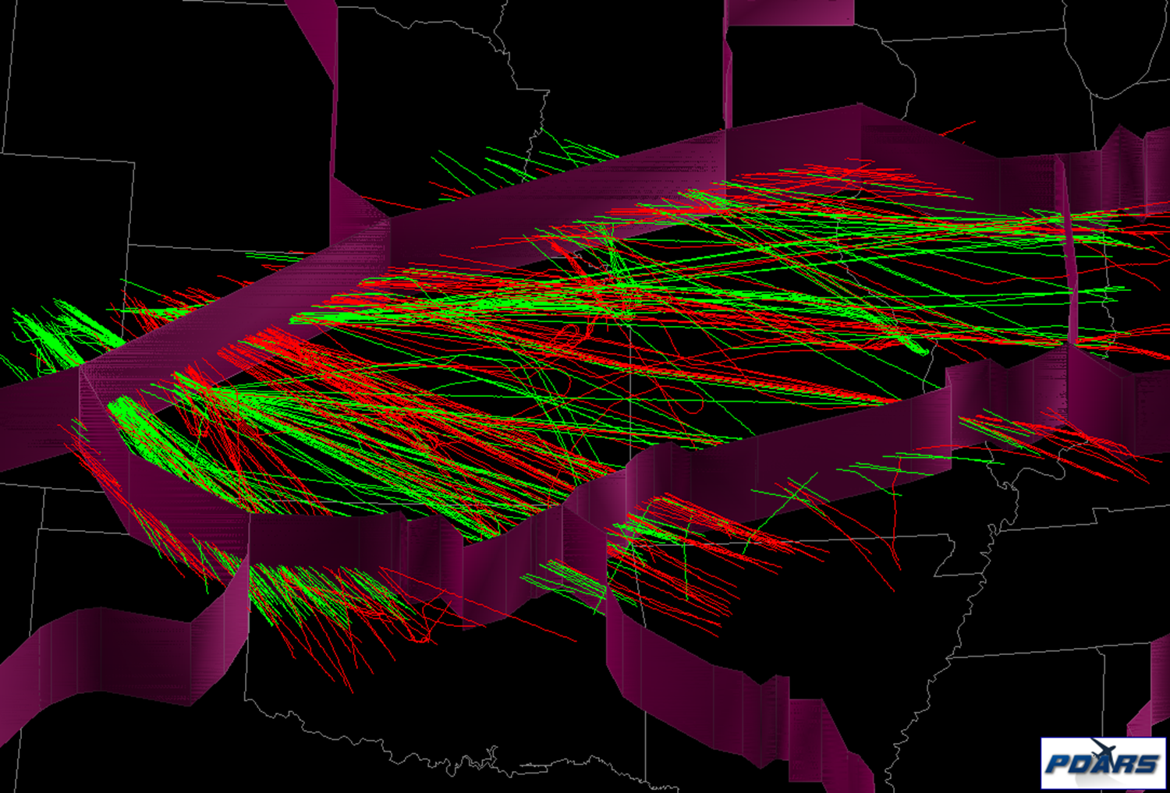
DEN
Arrivals
Departures

Slide 14
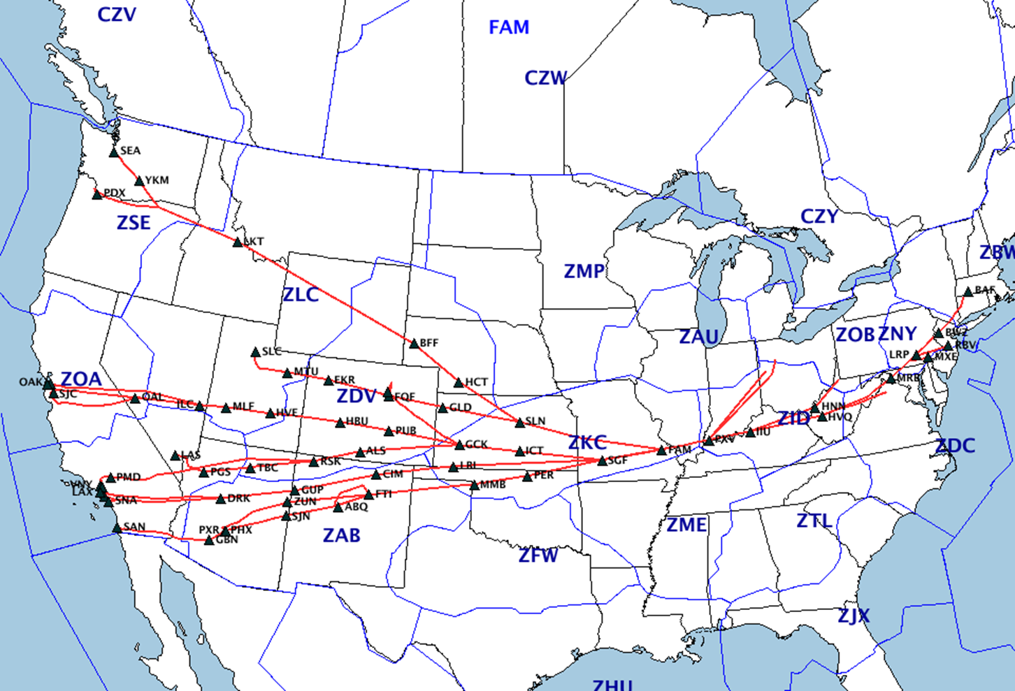

Slide 15
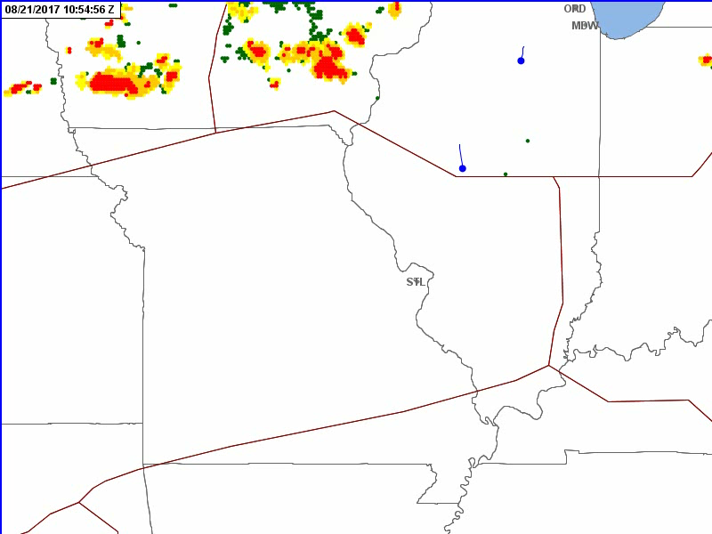
Eclipse
8/21/2017

Slide 16
Unmanned Aircraft Systems (UAS)
www.faa.gov/uas/programs_partnerships/data_exchange
LAANC - Low Altitude Authorization and Notification Capability
www.faa.gov/uas/
Rules and regulations
https://faadronezone.faa.gov/#/
Drone registration

Slide 17
Questions?

