Slide 1
WEATHER QUESTIONS For Your Next FAA FAR 61.56 and 61.57 Flight Checks
Kirby Ortega
FAA Designated Pilot Examiner
2001 FAA National Flight Instructor of the Year
Kortega56@msn.com

Slide 2
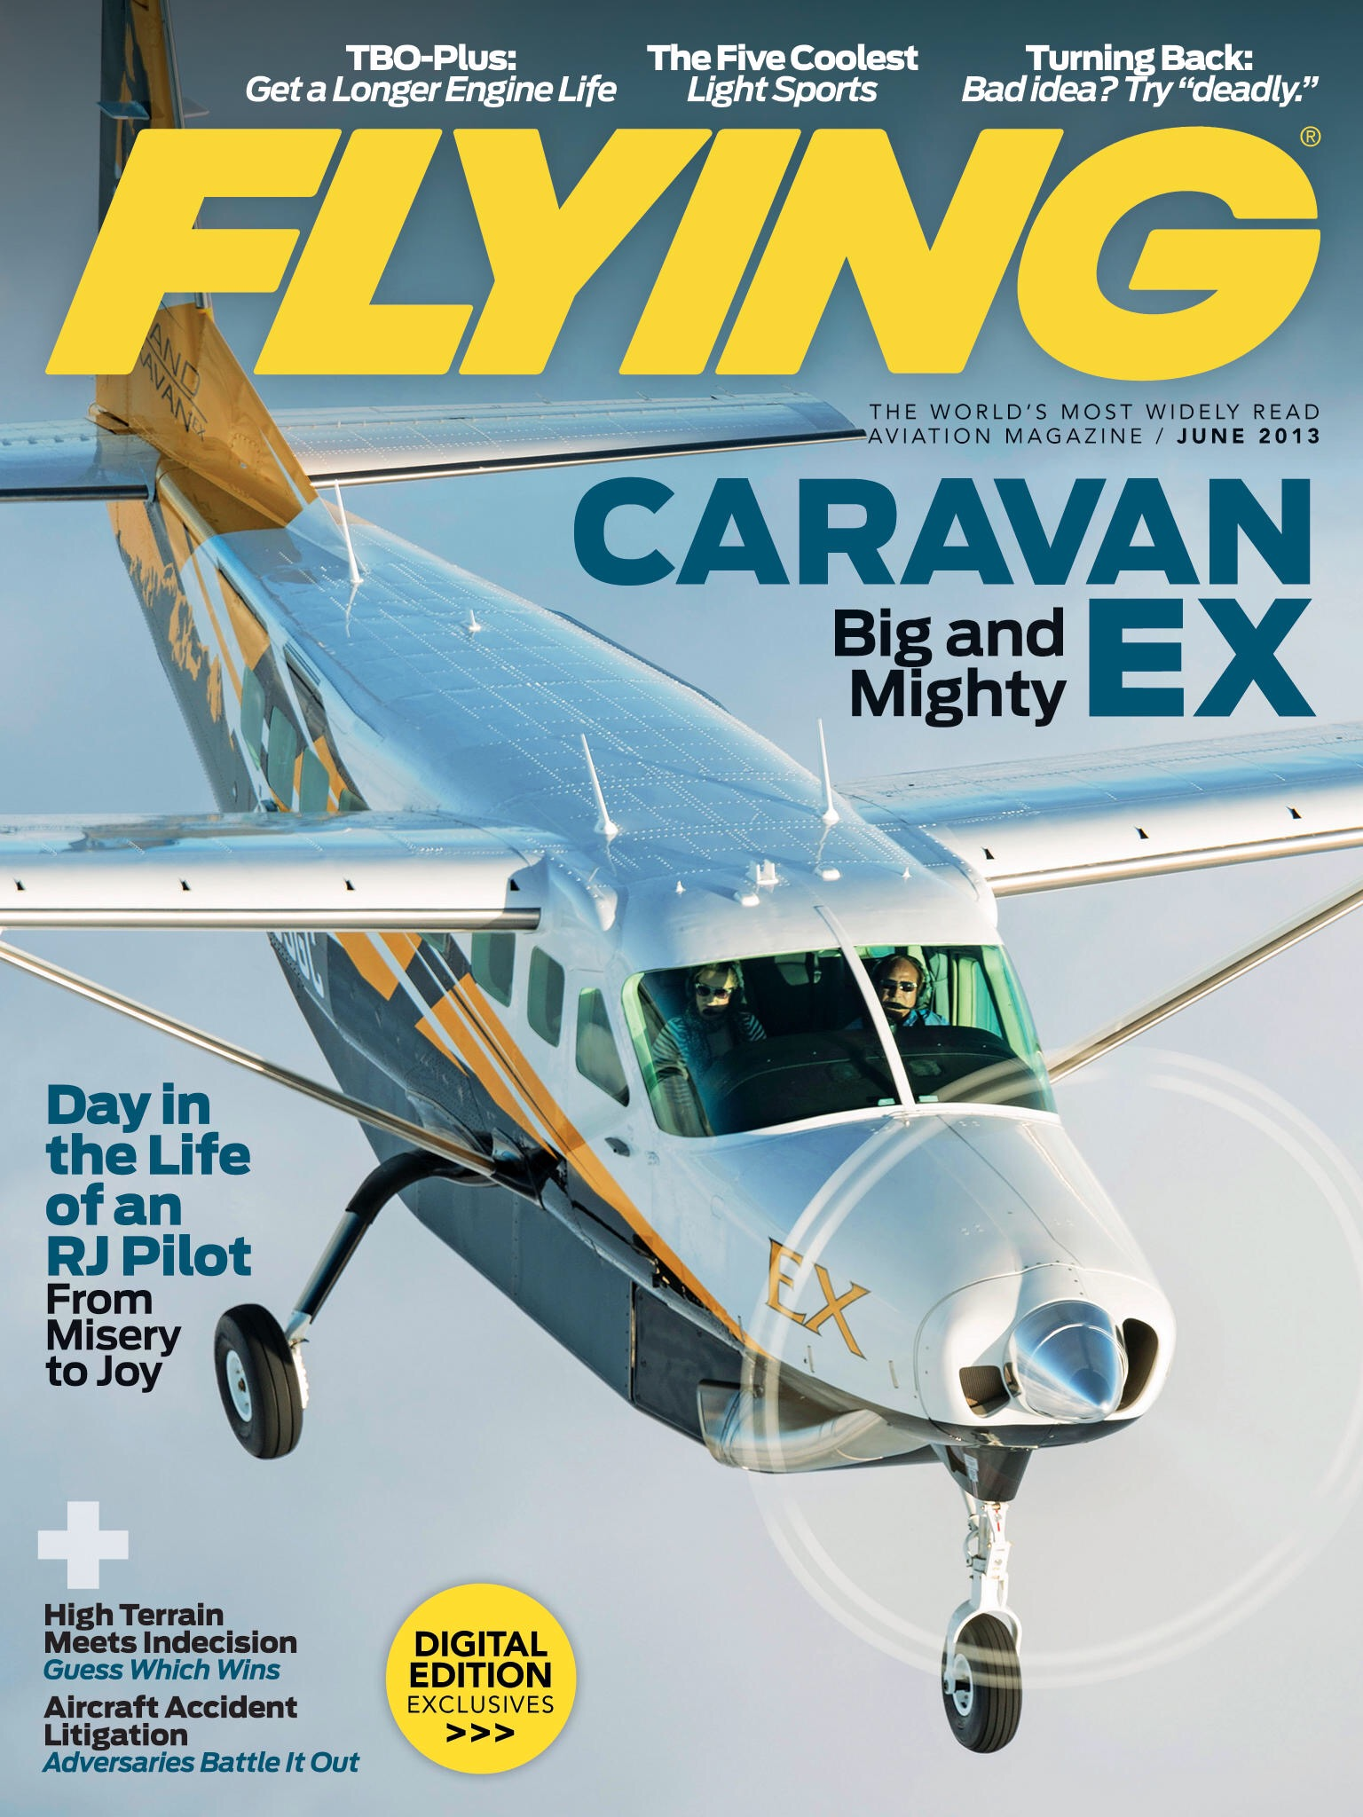
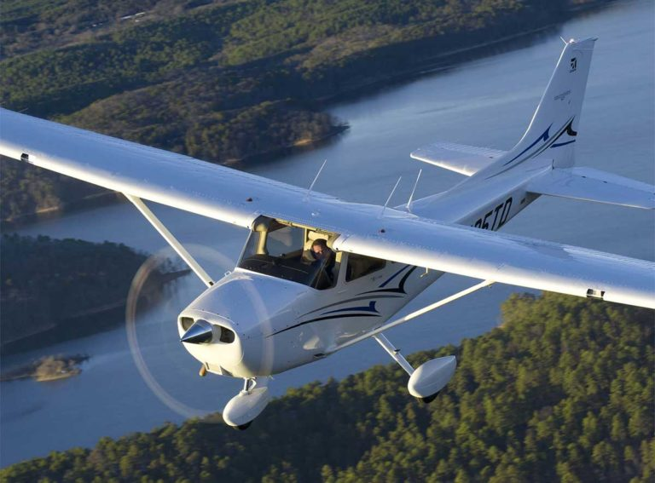
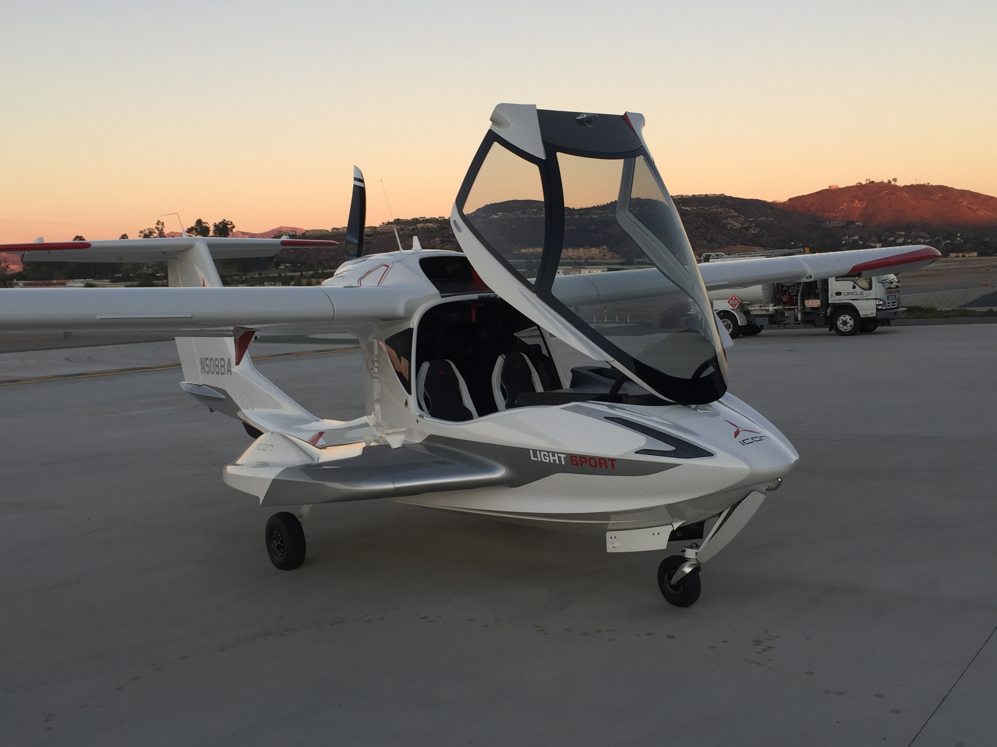
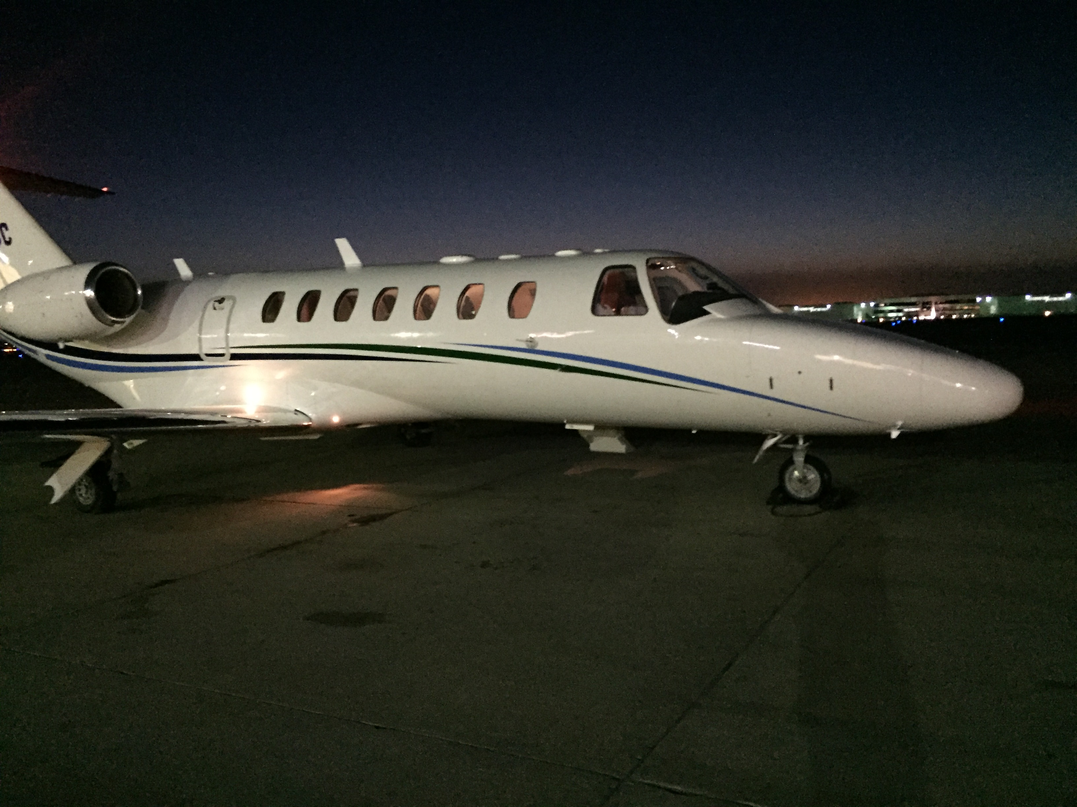

Slide 3
FAR 61.56 Flight Review
Flight review. (a) Except as provided in paragraphs (b) and (f) of this section, a flight review consists of a minimum of 1 hour of flight training and 1 hour of ground training. The review must include:
(1) A review of the current general operating and flight rules of part 91 of this chapter; and
(2) A review of those maneuvers and procedures that, at the discretion of the person giving the review, are necessary for the pilot to demonstrate the safe exercise of the privileges of the pilot certificate.

Slide 4
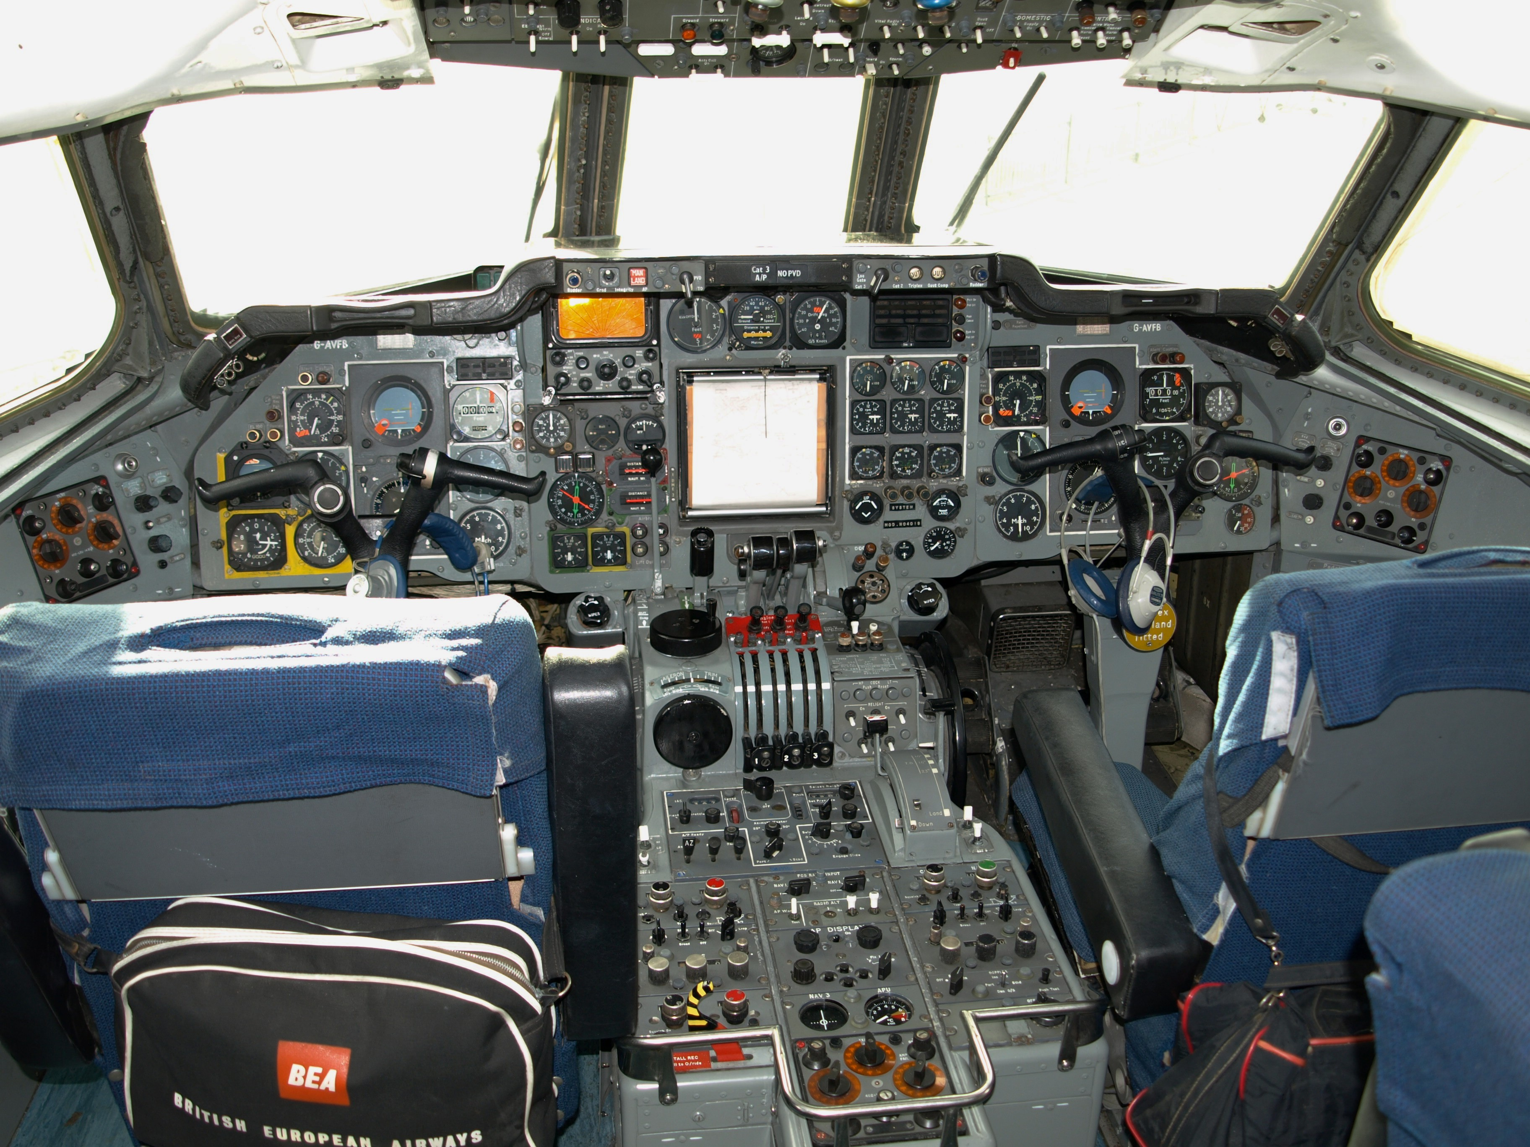
FAR 61.57 Recent flight experience: Pilot in command.
(d) Instrument proficiency check. (1) Except as provided in paragraph (e) of this section, a person who has failed to meet the instrument experience requirements of paragraph (c) of this section for more than six calendar months may reestablish instrument currency only by completing an instrument proficiency check. The instrument proficiency check must consist of at least the following areas of operation:
(i) Air traffic control clearances and procedures;
(ii) Flight by reference to instruments;
(iii) Navigation systems;
(iv) Instrument approach procedures;
(v) Emergency operations; and
(vi) Postflight procedures.
(2) The instrument proficiency check must be—
(i) In an aircraft that is appropriate to the aircraft category;

Slide 5
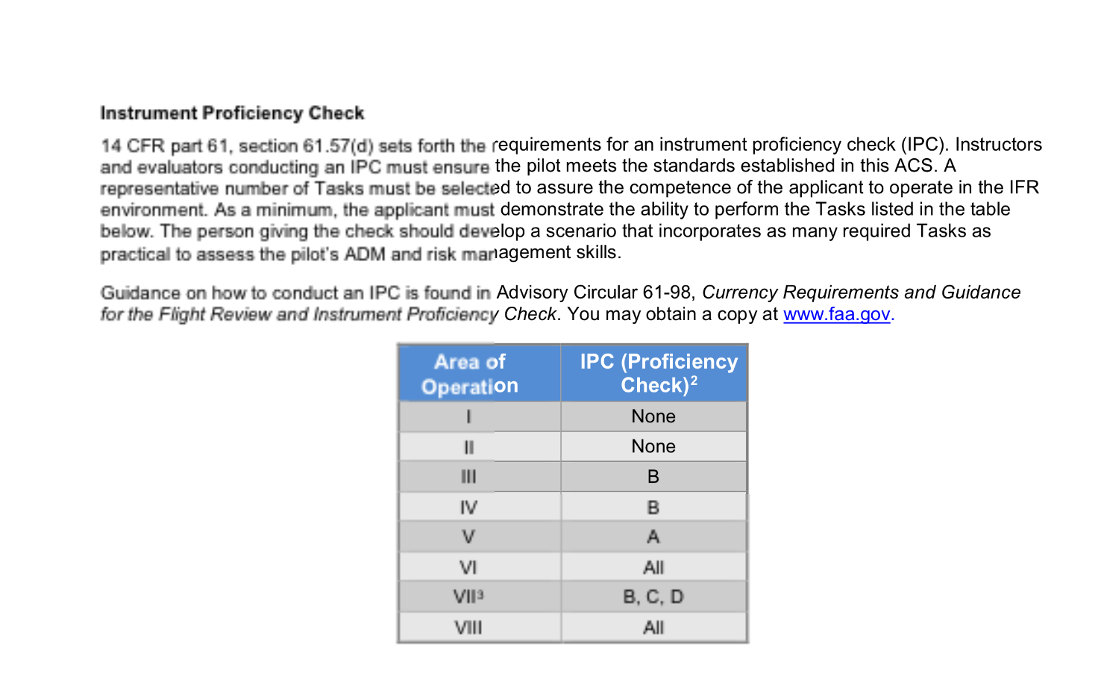

Slide 6
FAR 91. Preflight Action
§91.103 Preflight action.
Each pilot in command shall, before beginning a flight, become familiar with all available information concerning that flight. This information must include—
(a) For a flight under IFR or a flight not in the vicinity of an airport, weather reports and forecasts, fuel requirements, alternatives available if the planned flight cannot be completed, and any known traffic delays of which the pilot in command has been advised by ATC;

Slide 7
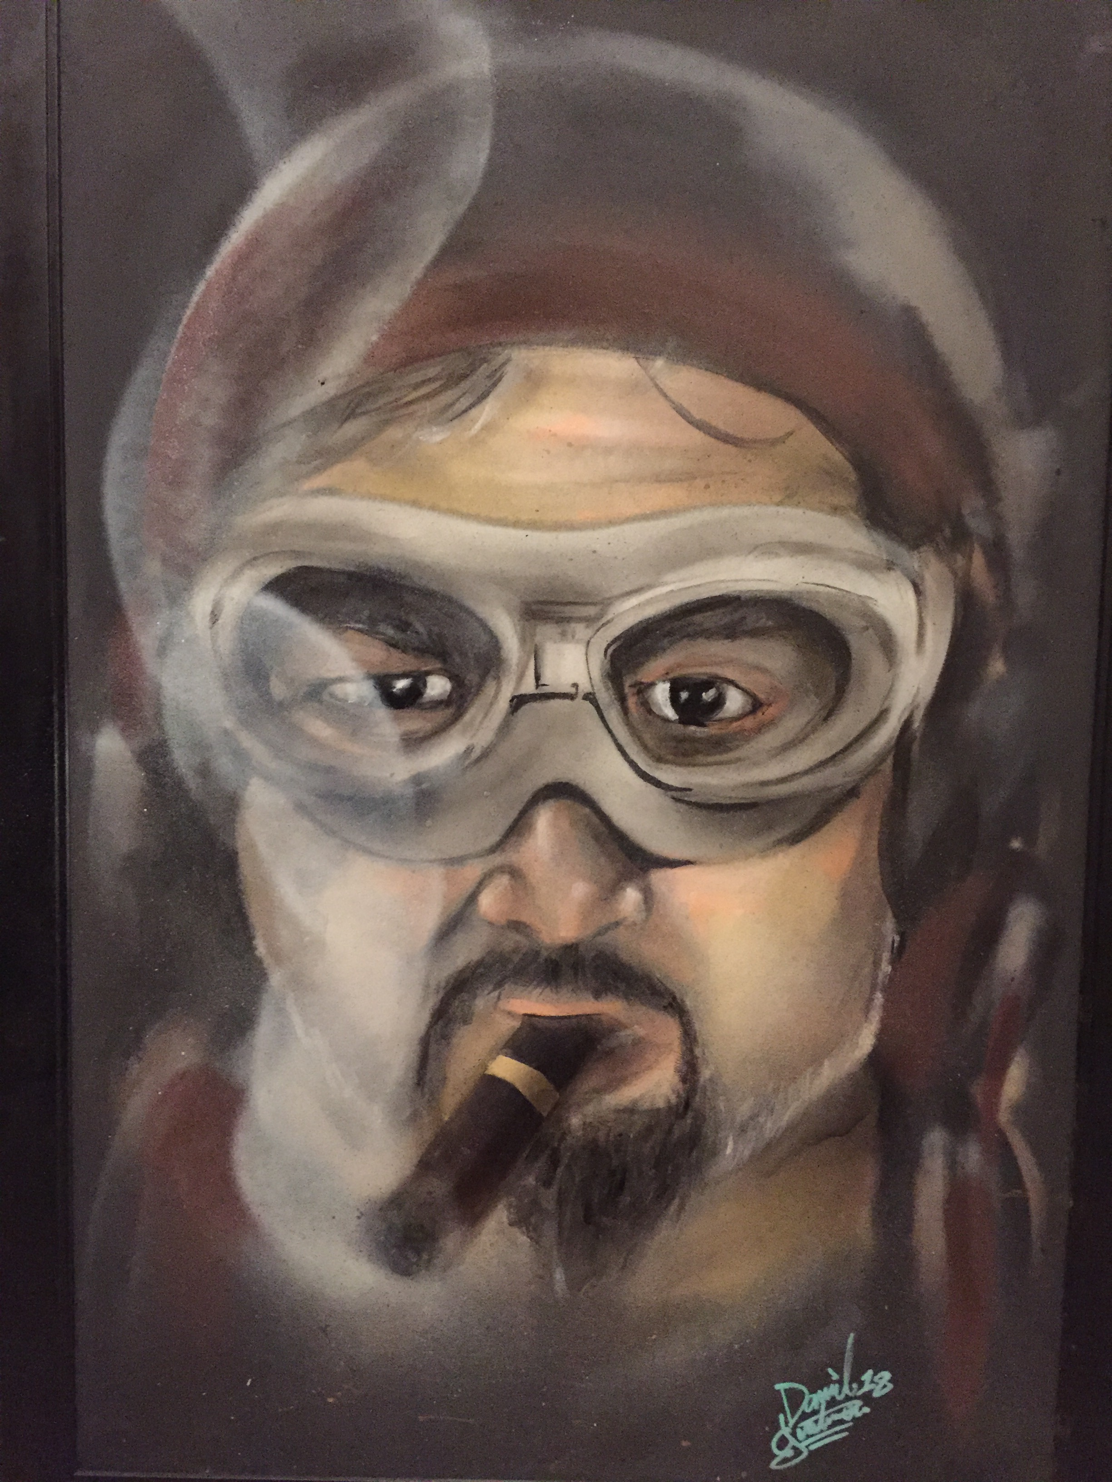
Your CFI

Slide 8
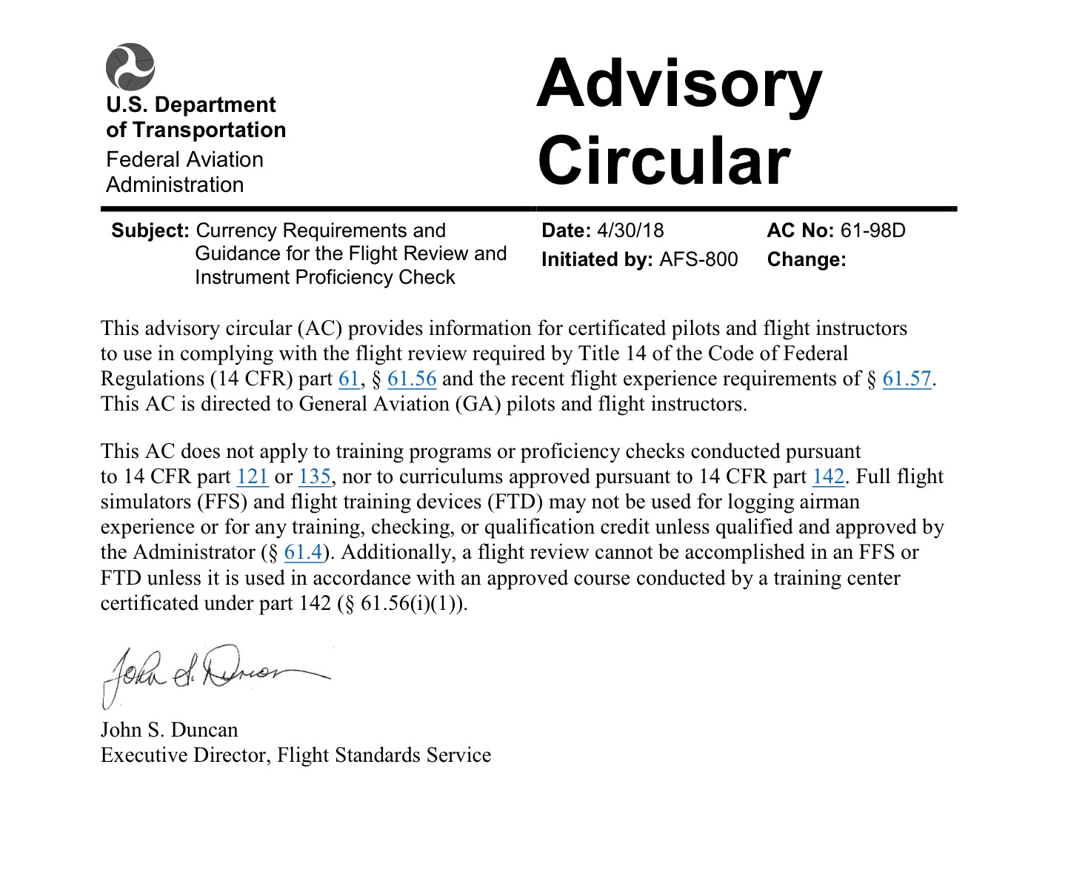

Slide 9
“What type of cloud is that, Junior?”

Slide 10
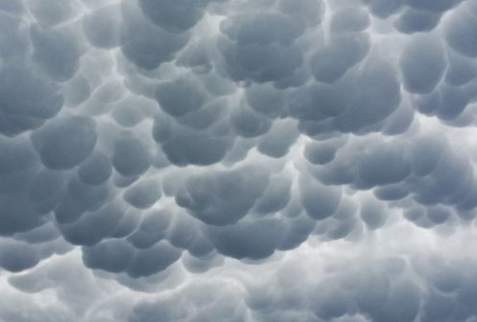
OK, Test Time!
“Wet your finger and tell me the wind direction, velocity, altimeter setting, temperature, dew point and how high we should build The Wall!”

Slide 11
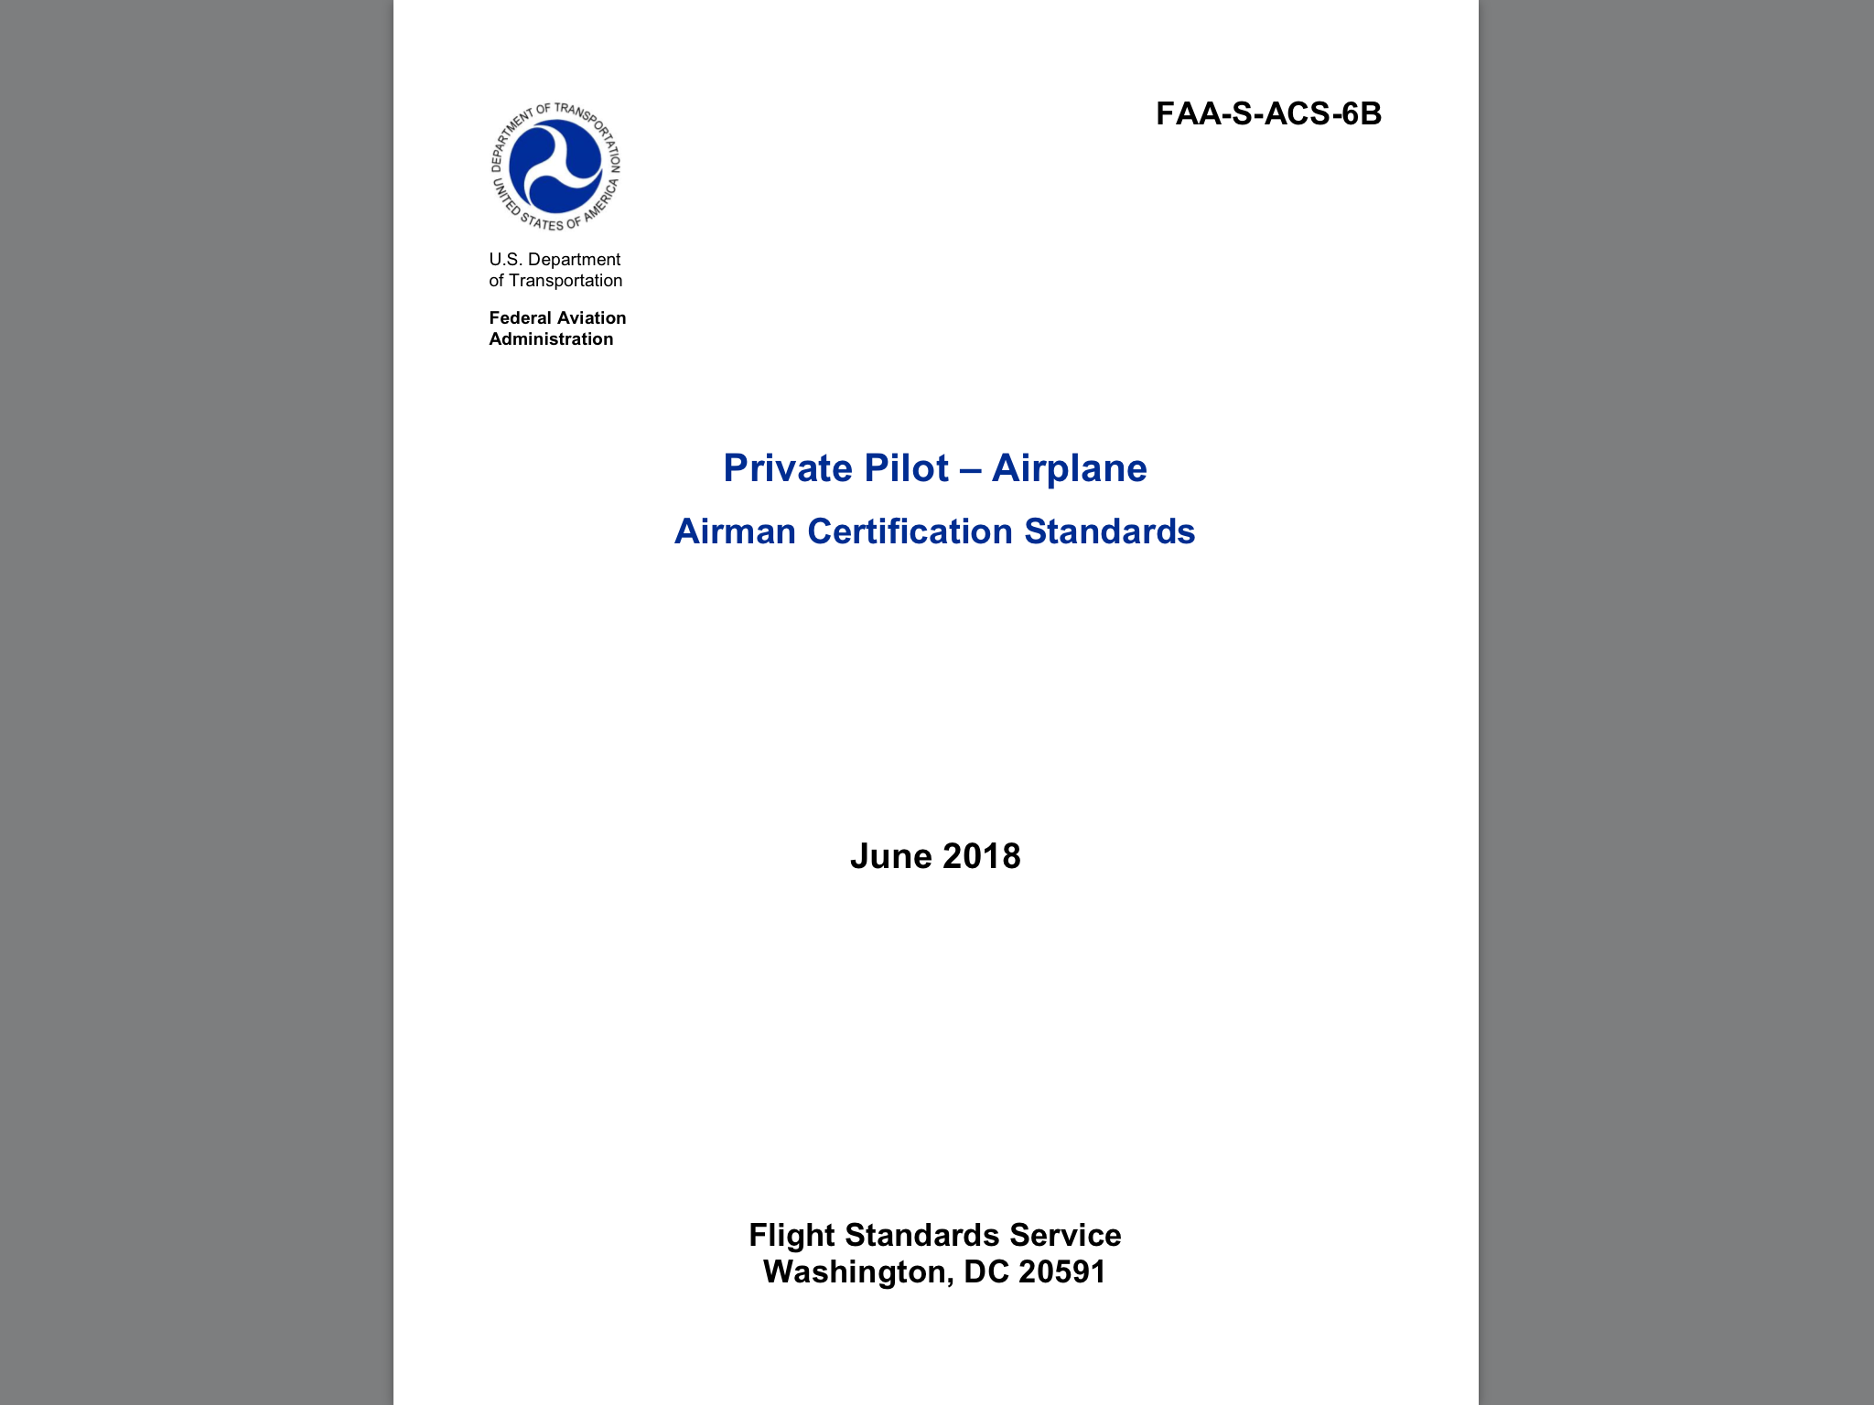
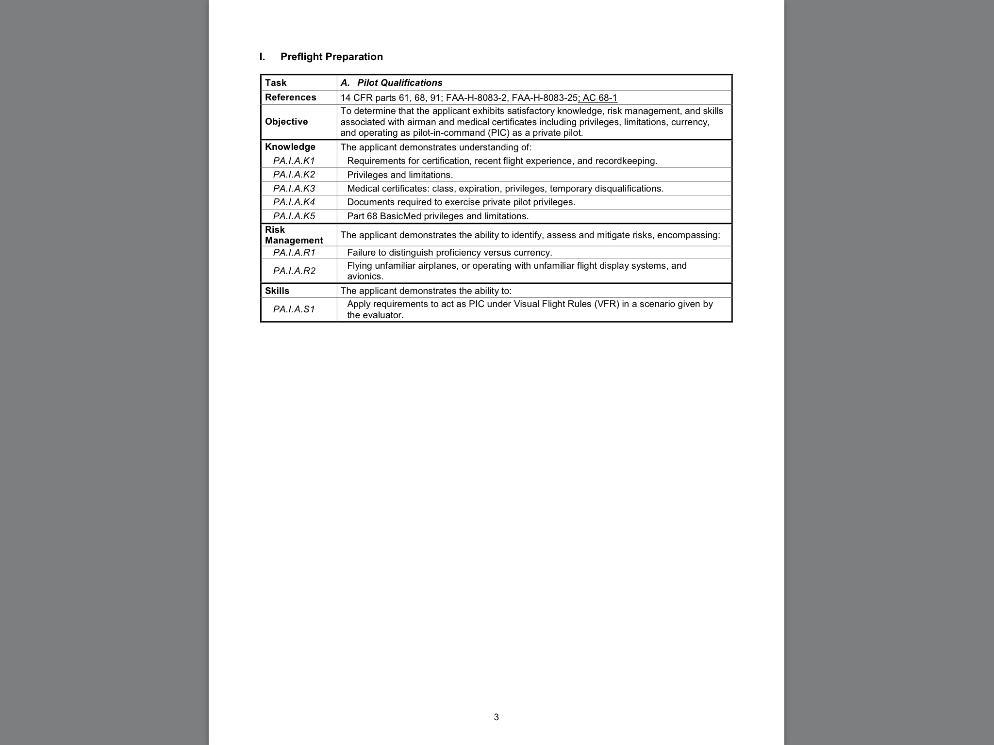

Slide 12
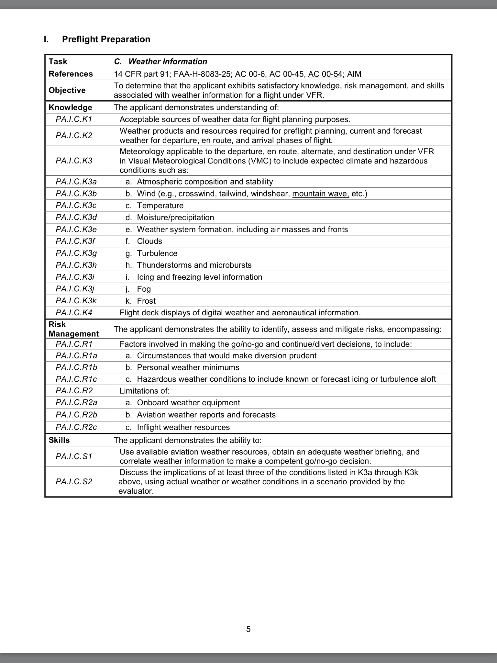

Slide 13
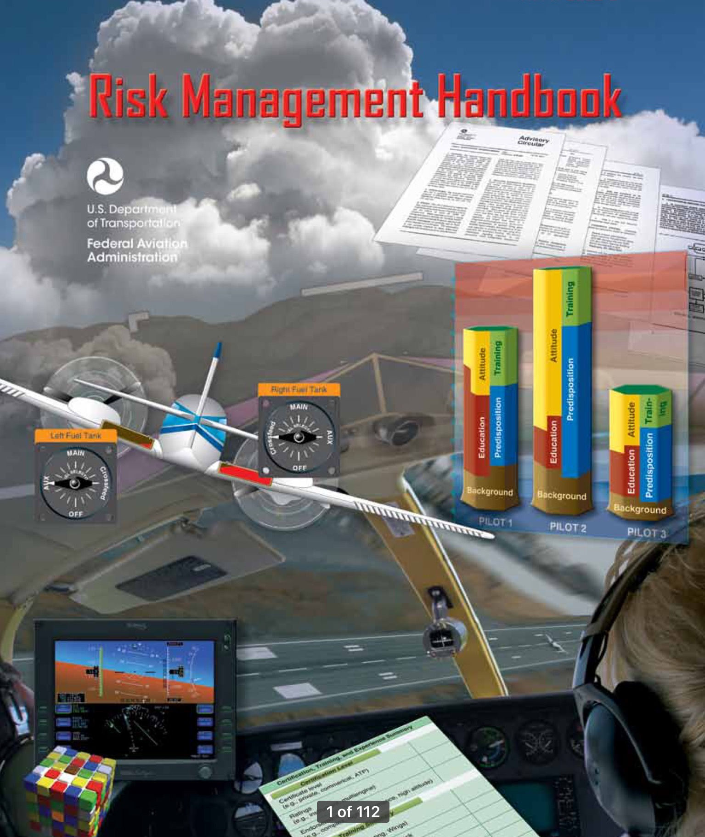
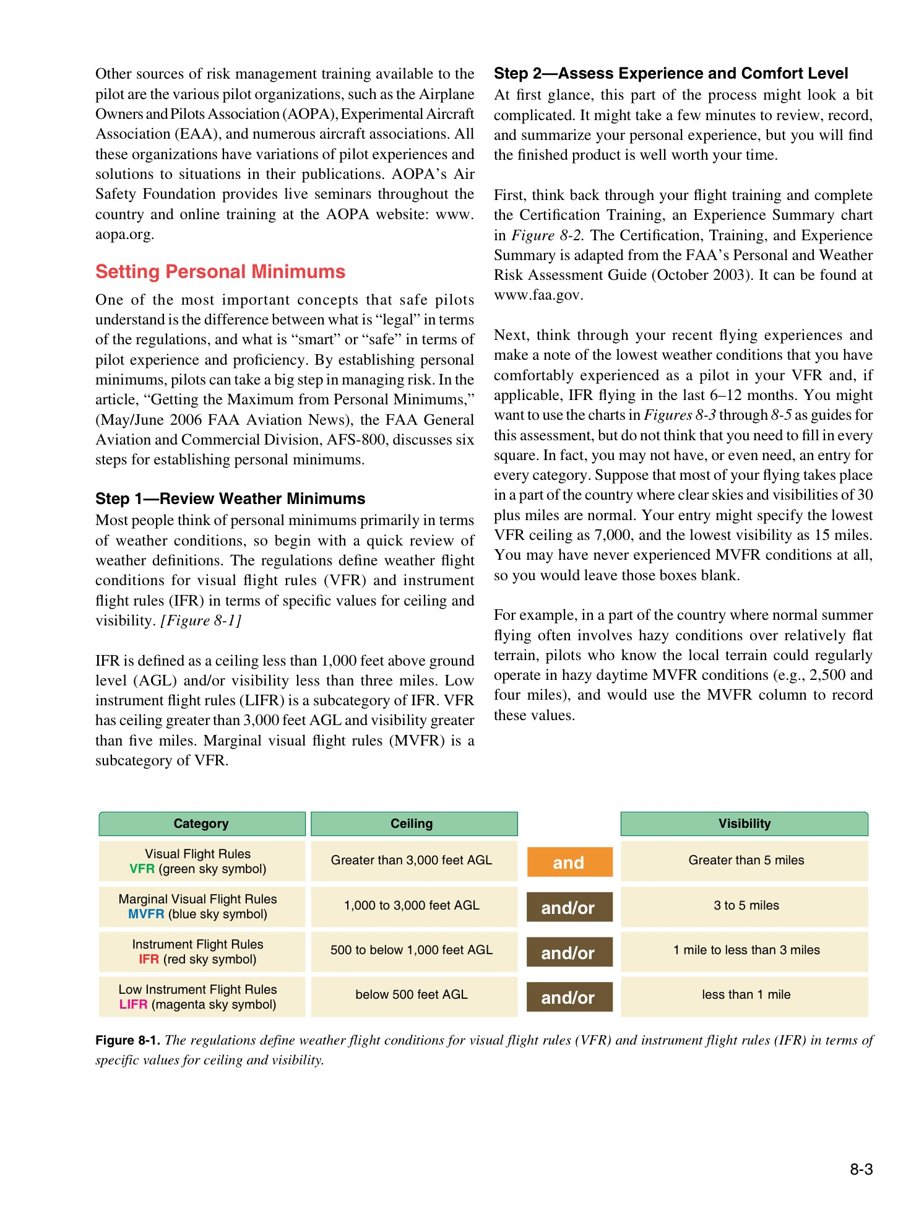

Slide 14
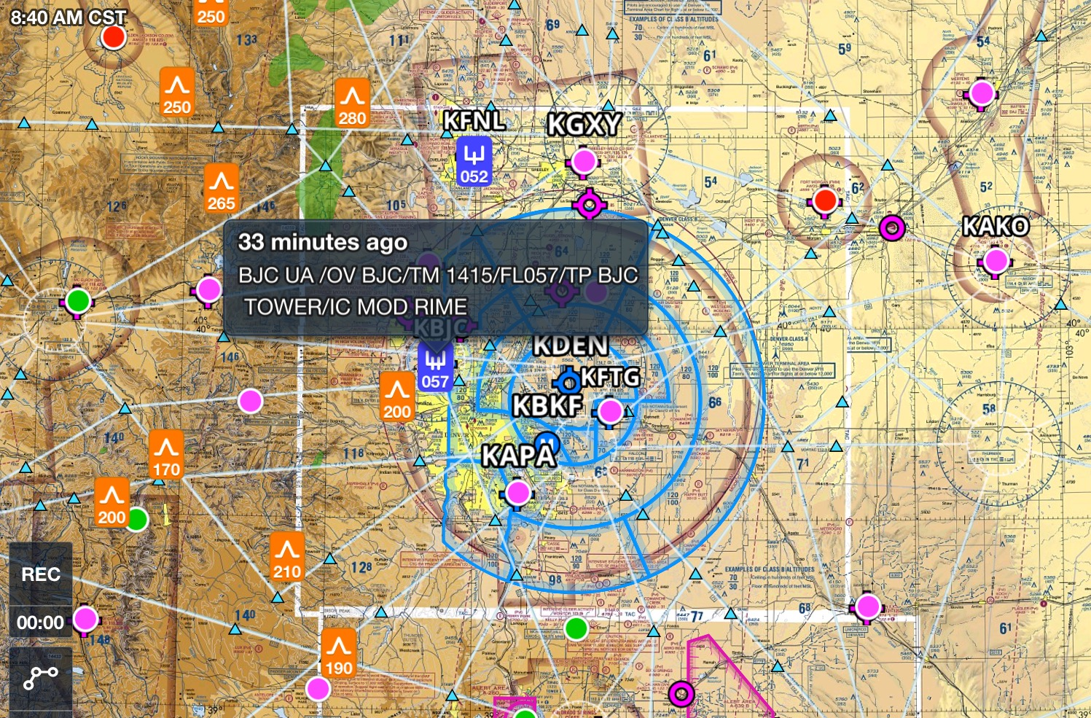
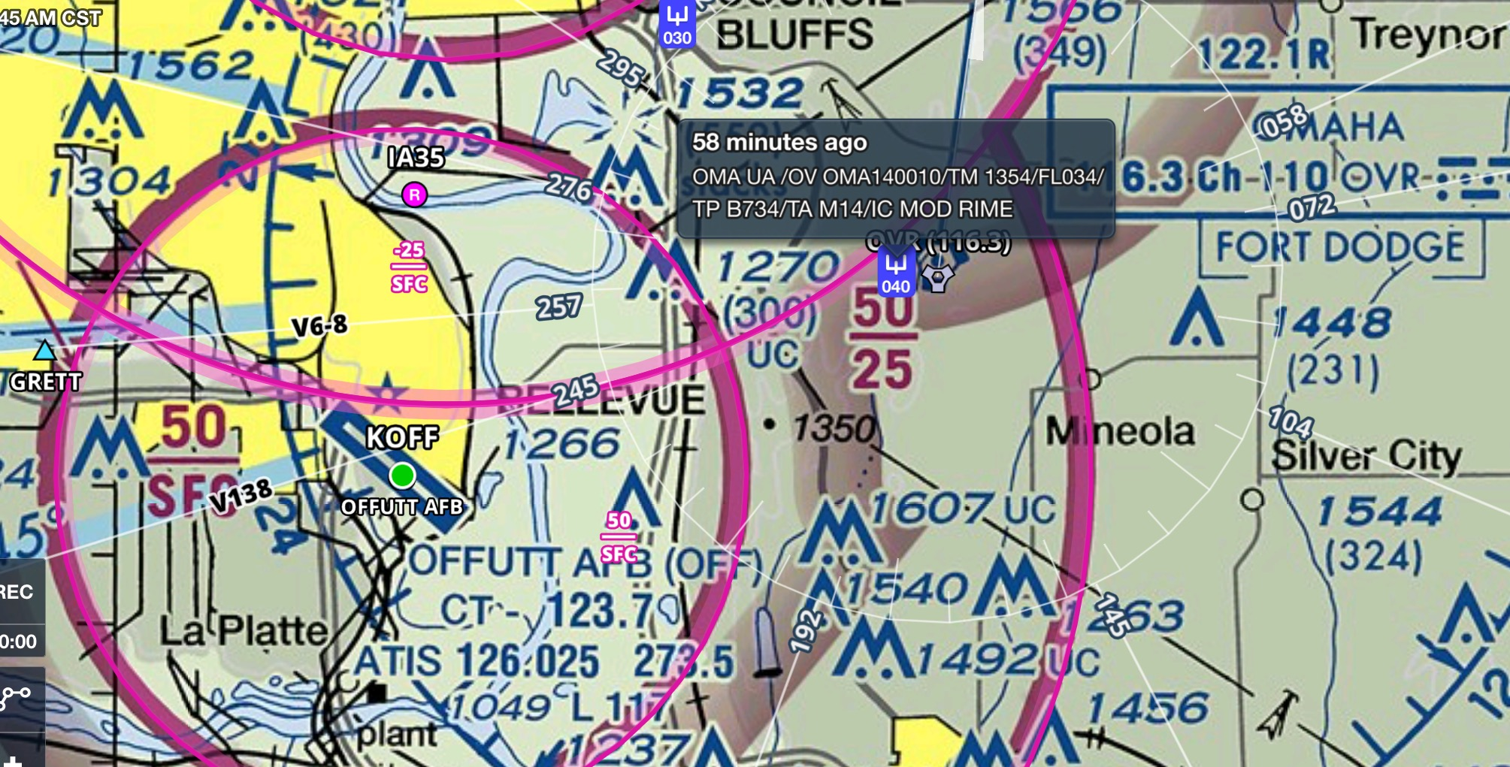
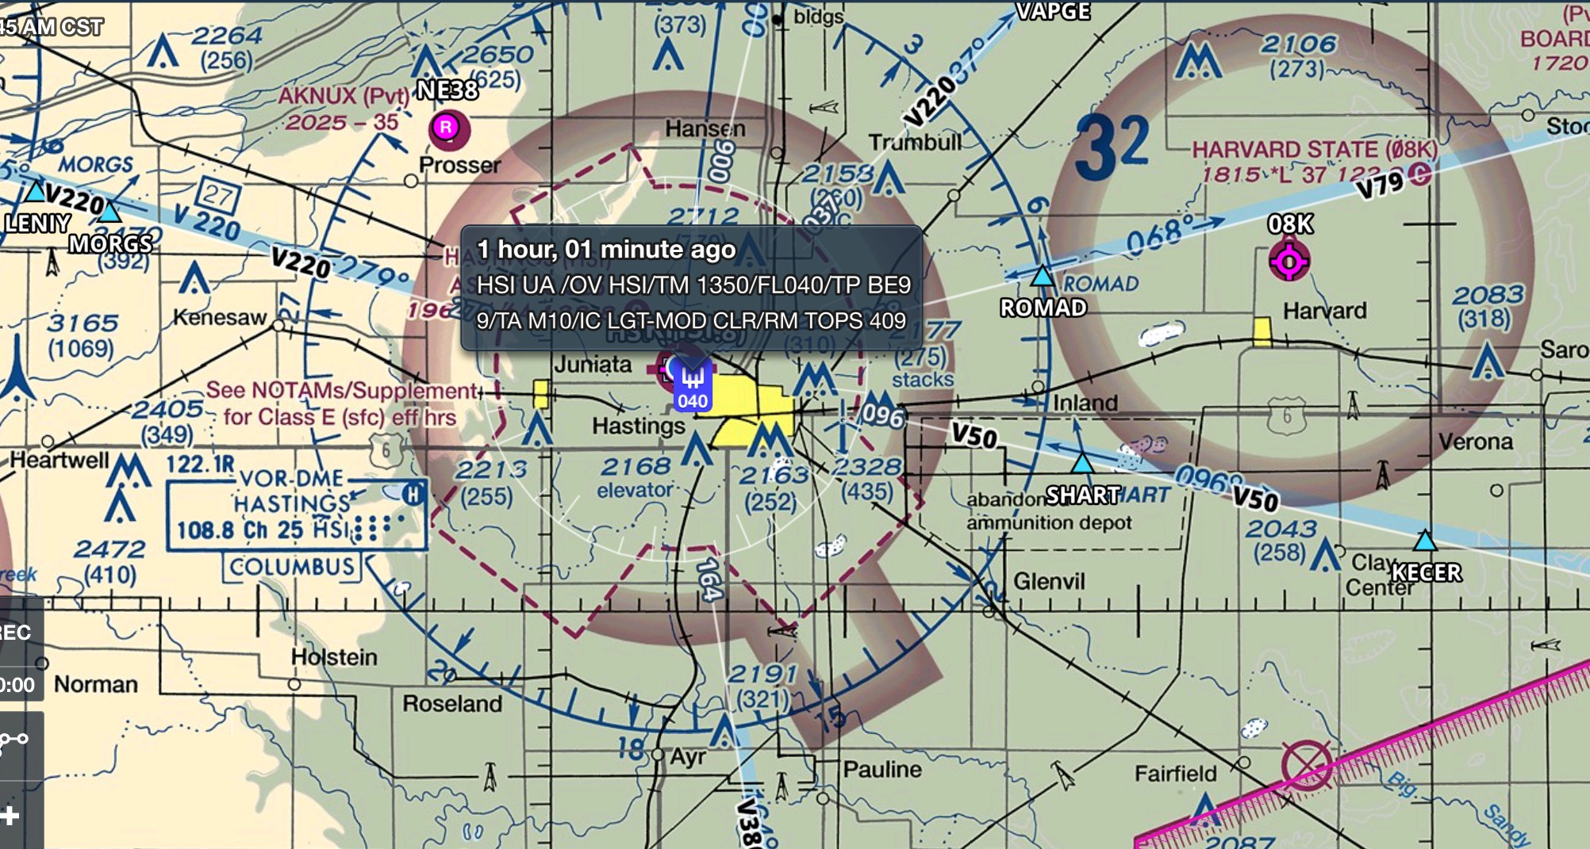
........a word about ICE!

Slide 15
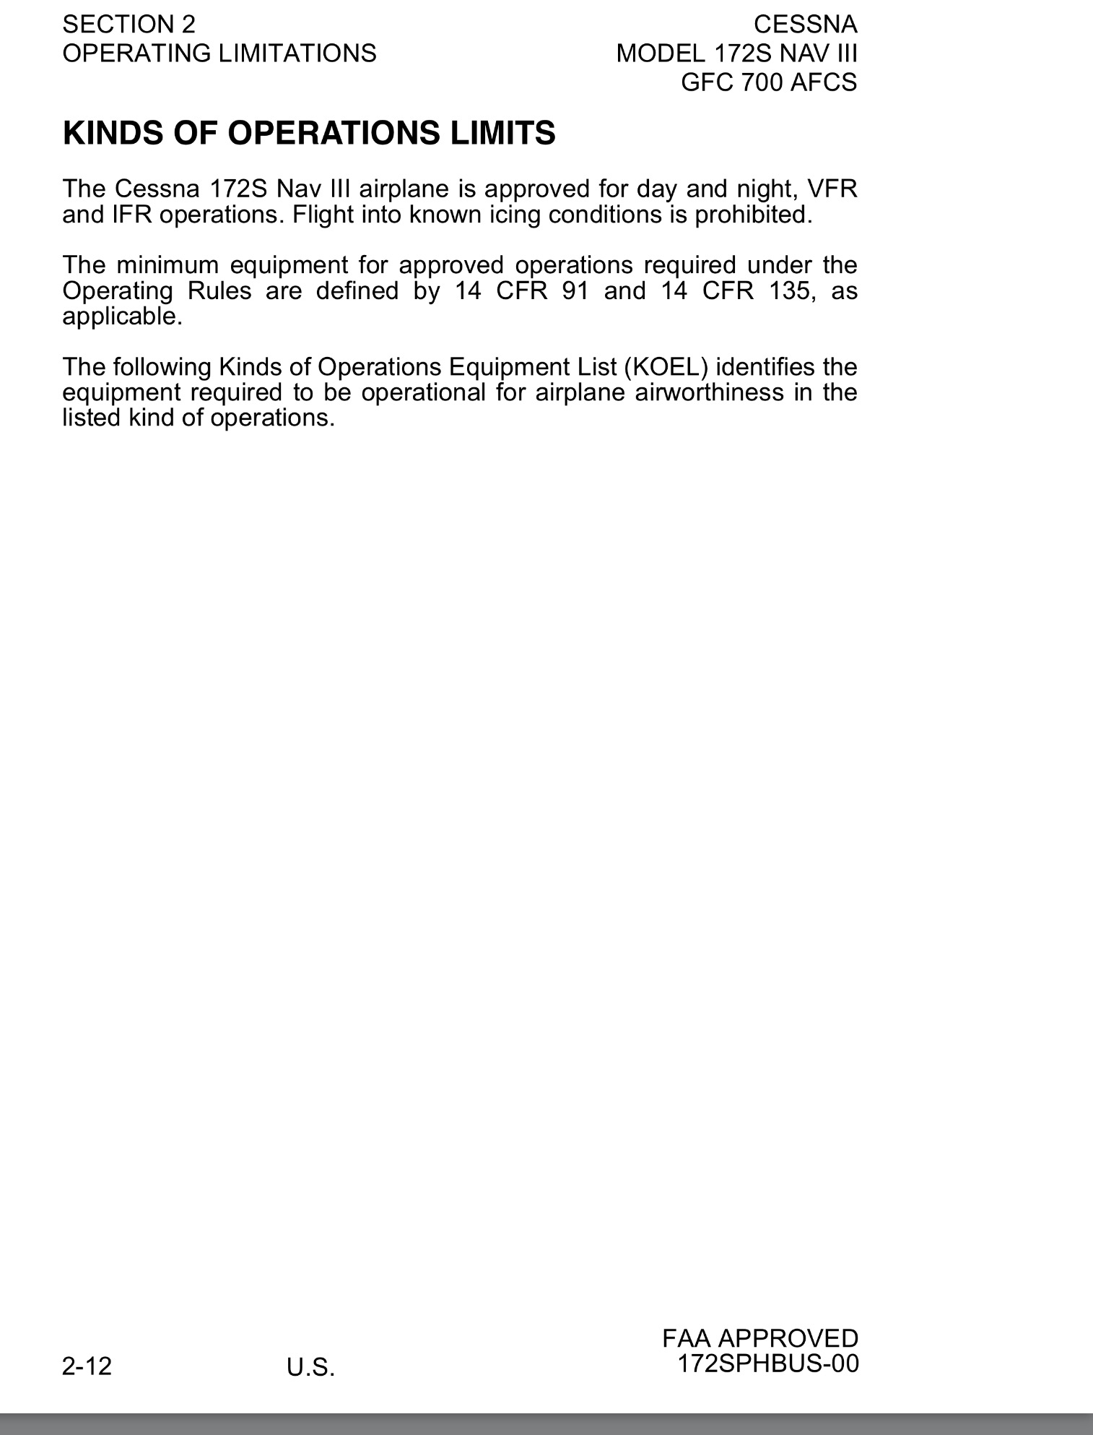
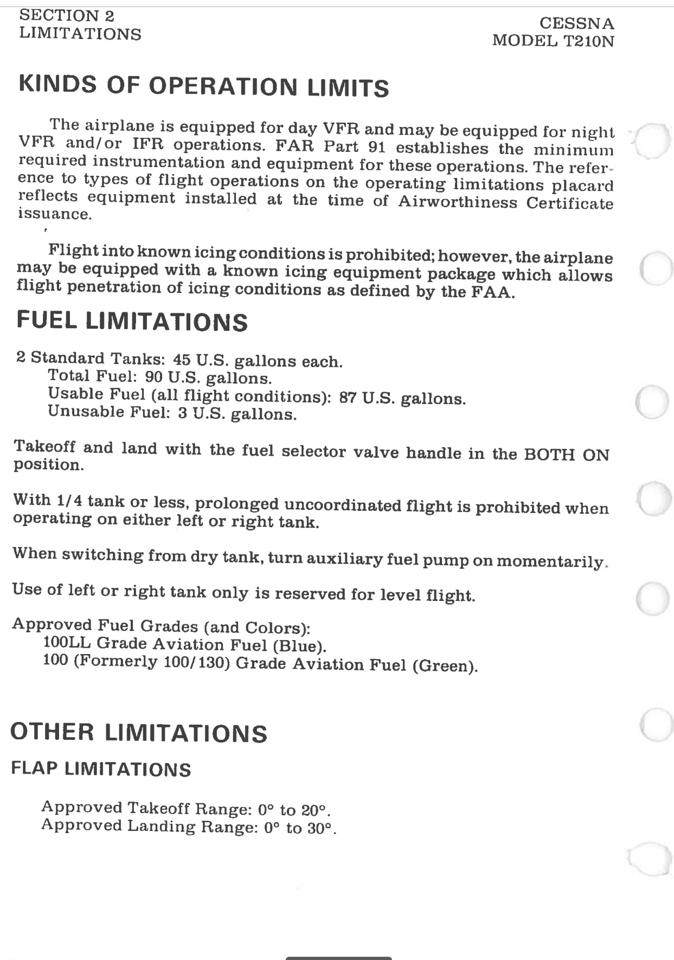
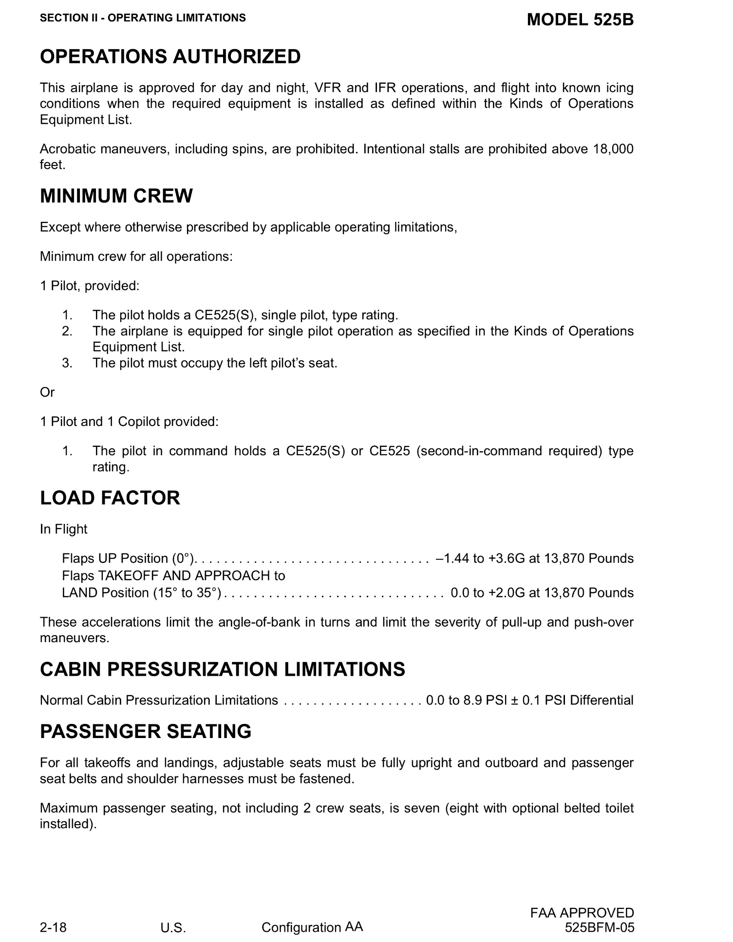

Slide 16
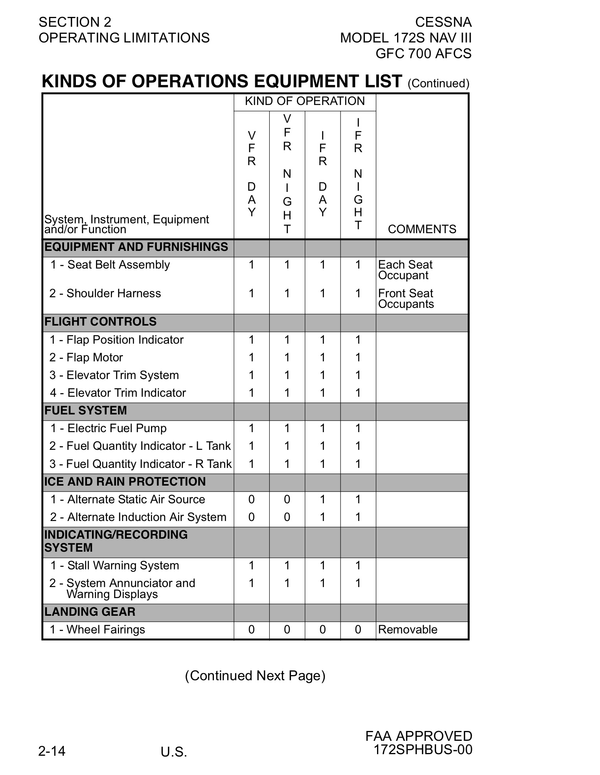
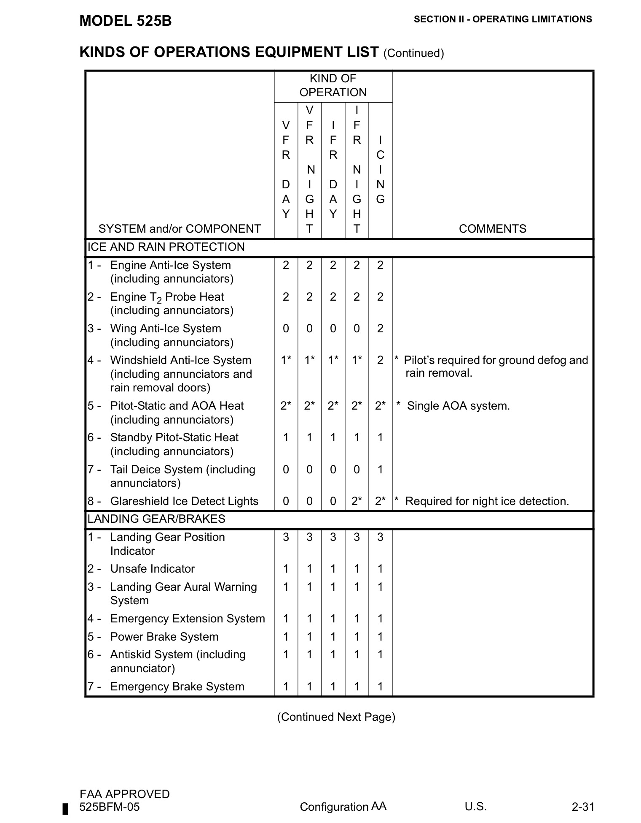

Slide 17
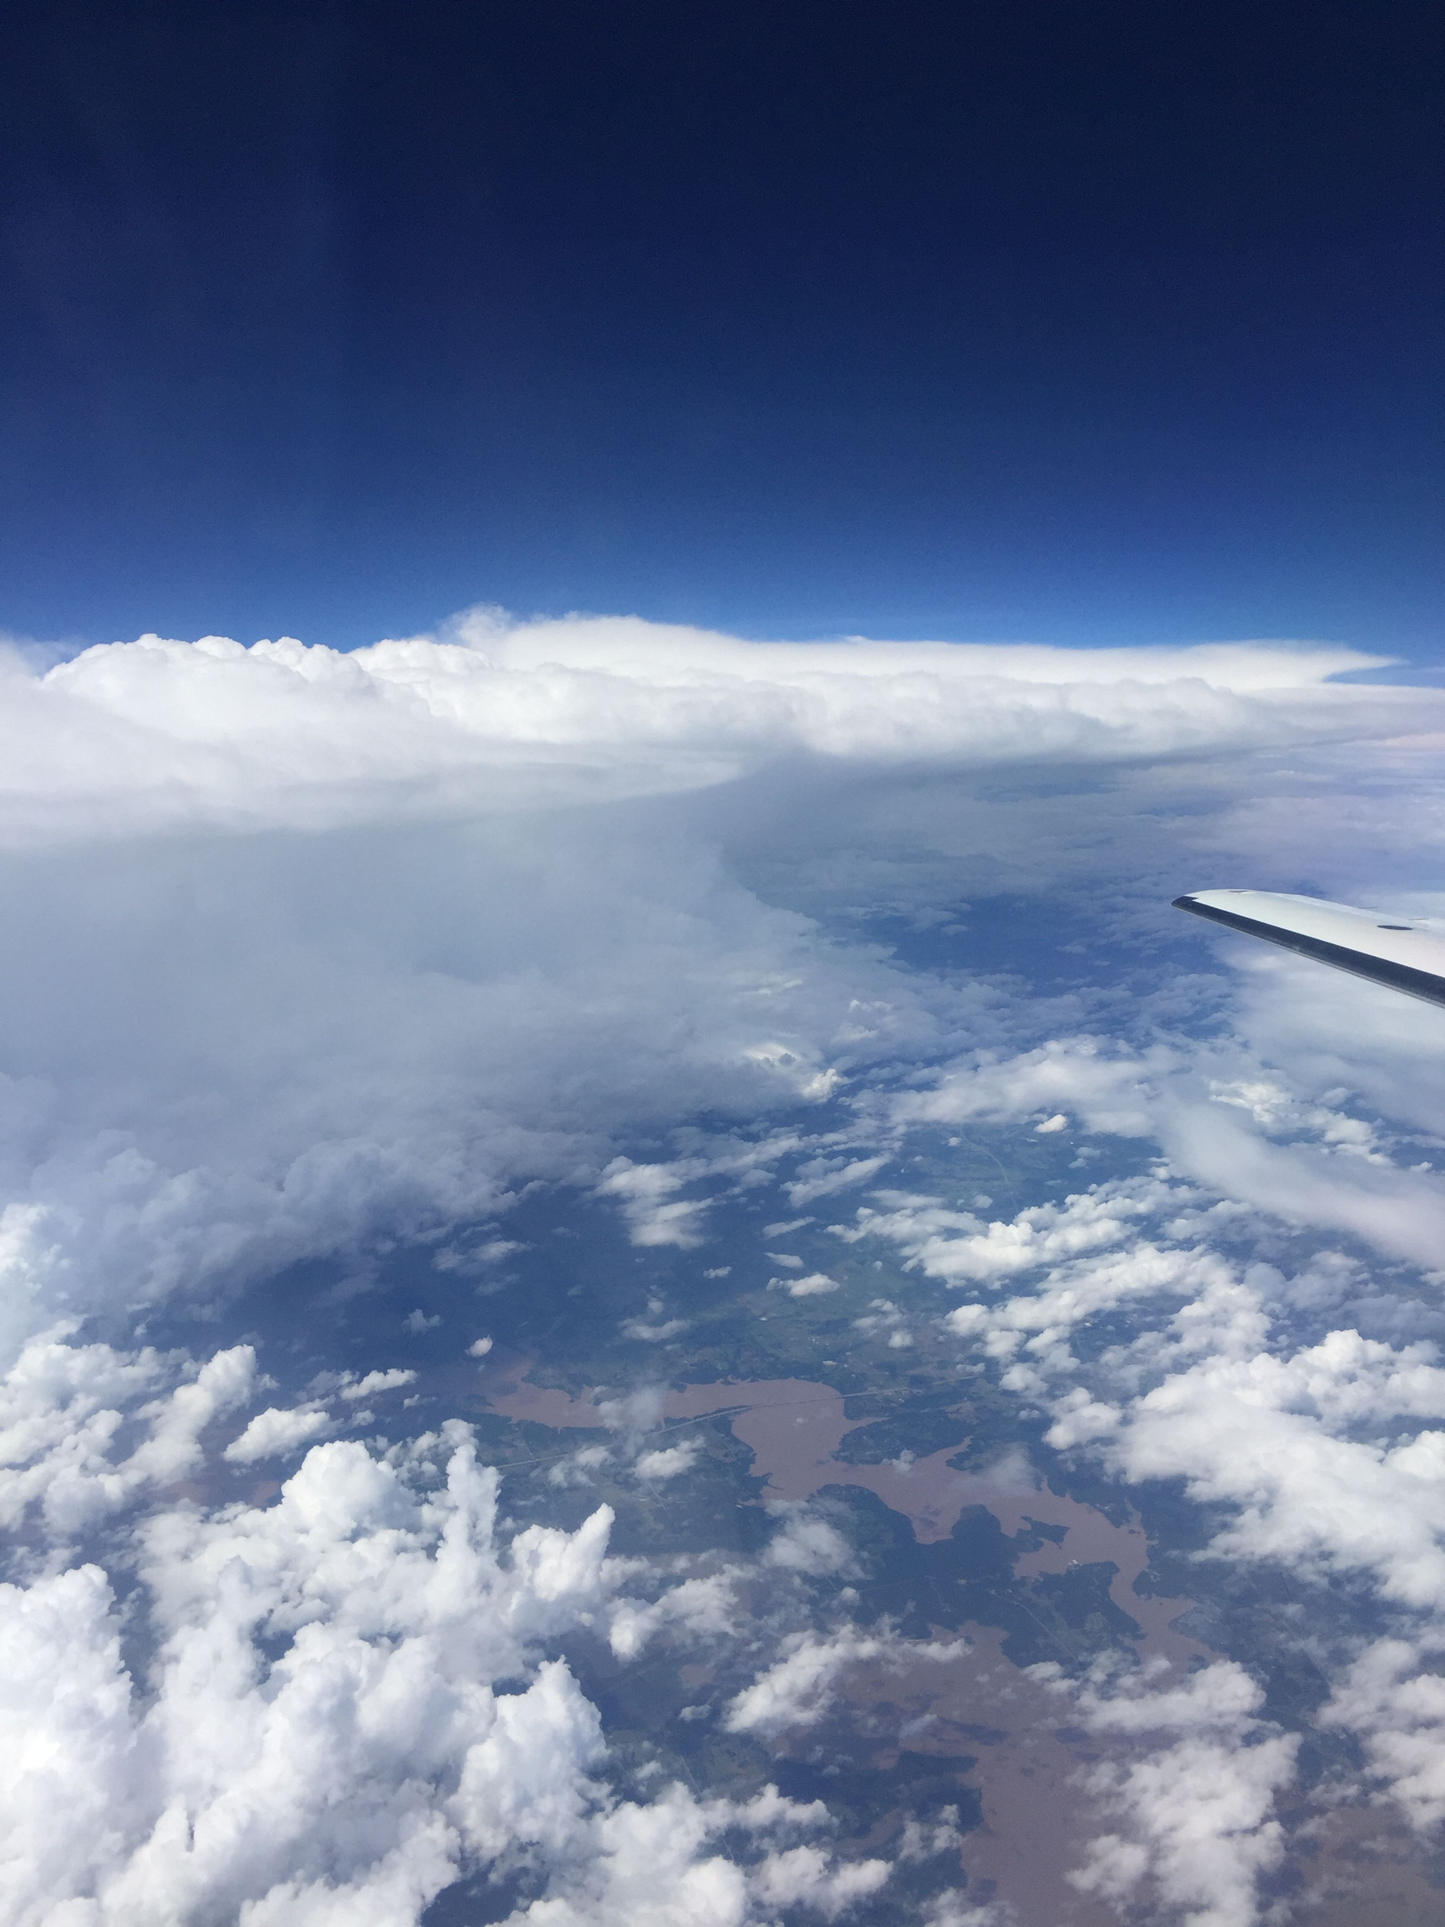
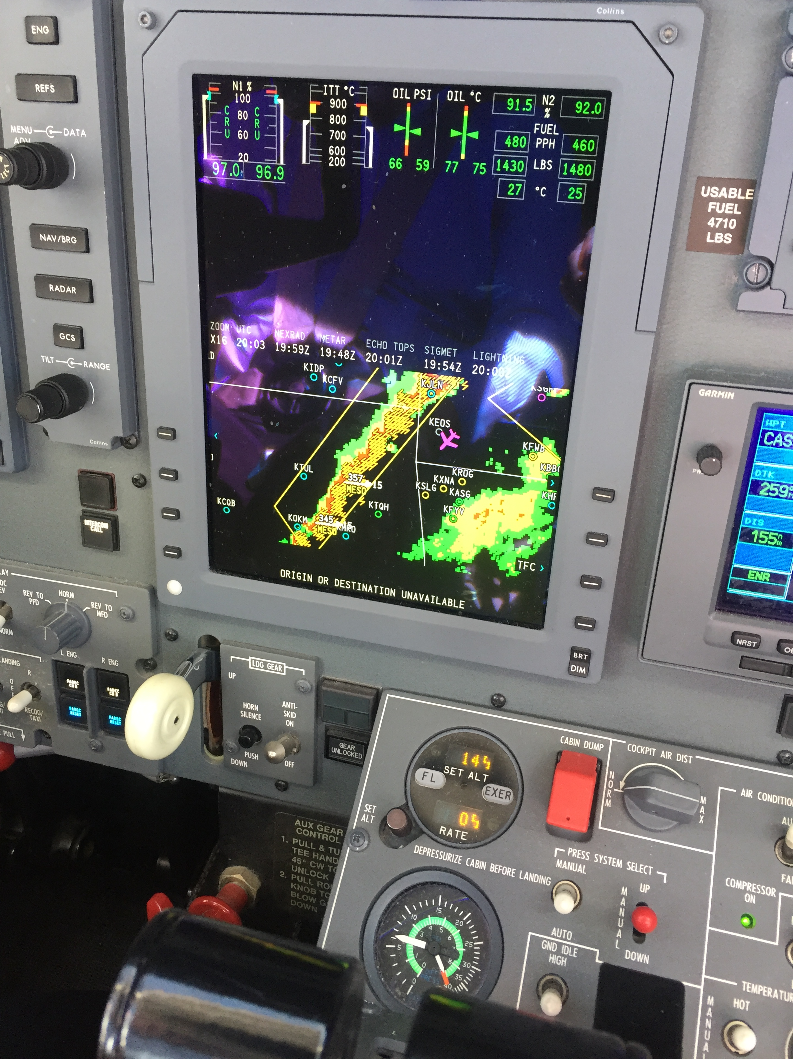
………a word about THUNDERSTORMS!

Slide 18
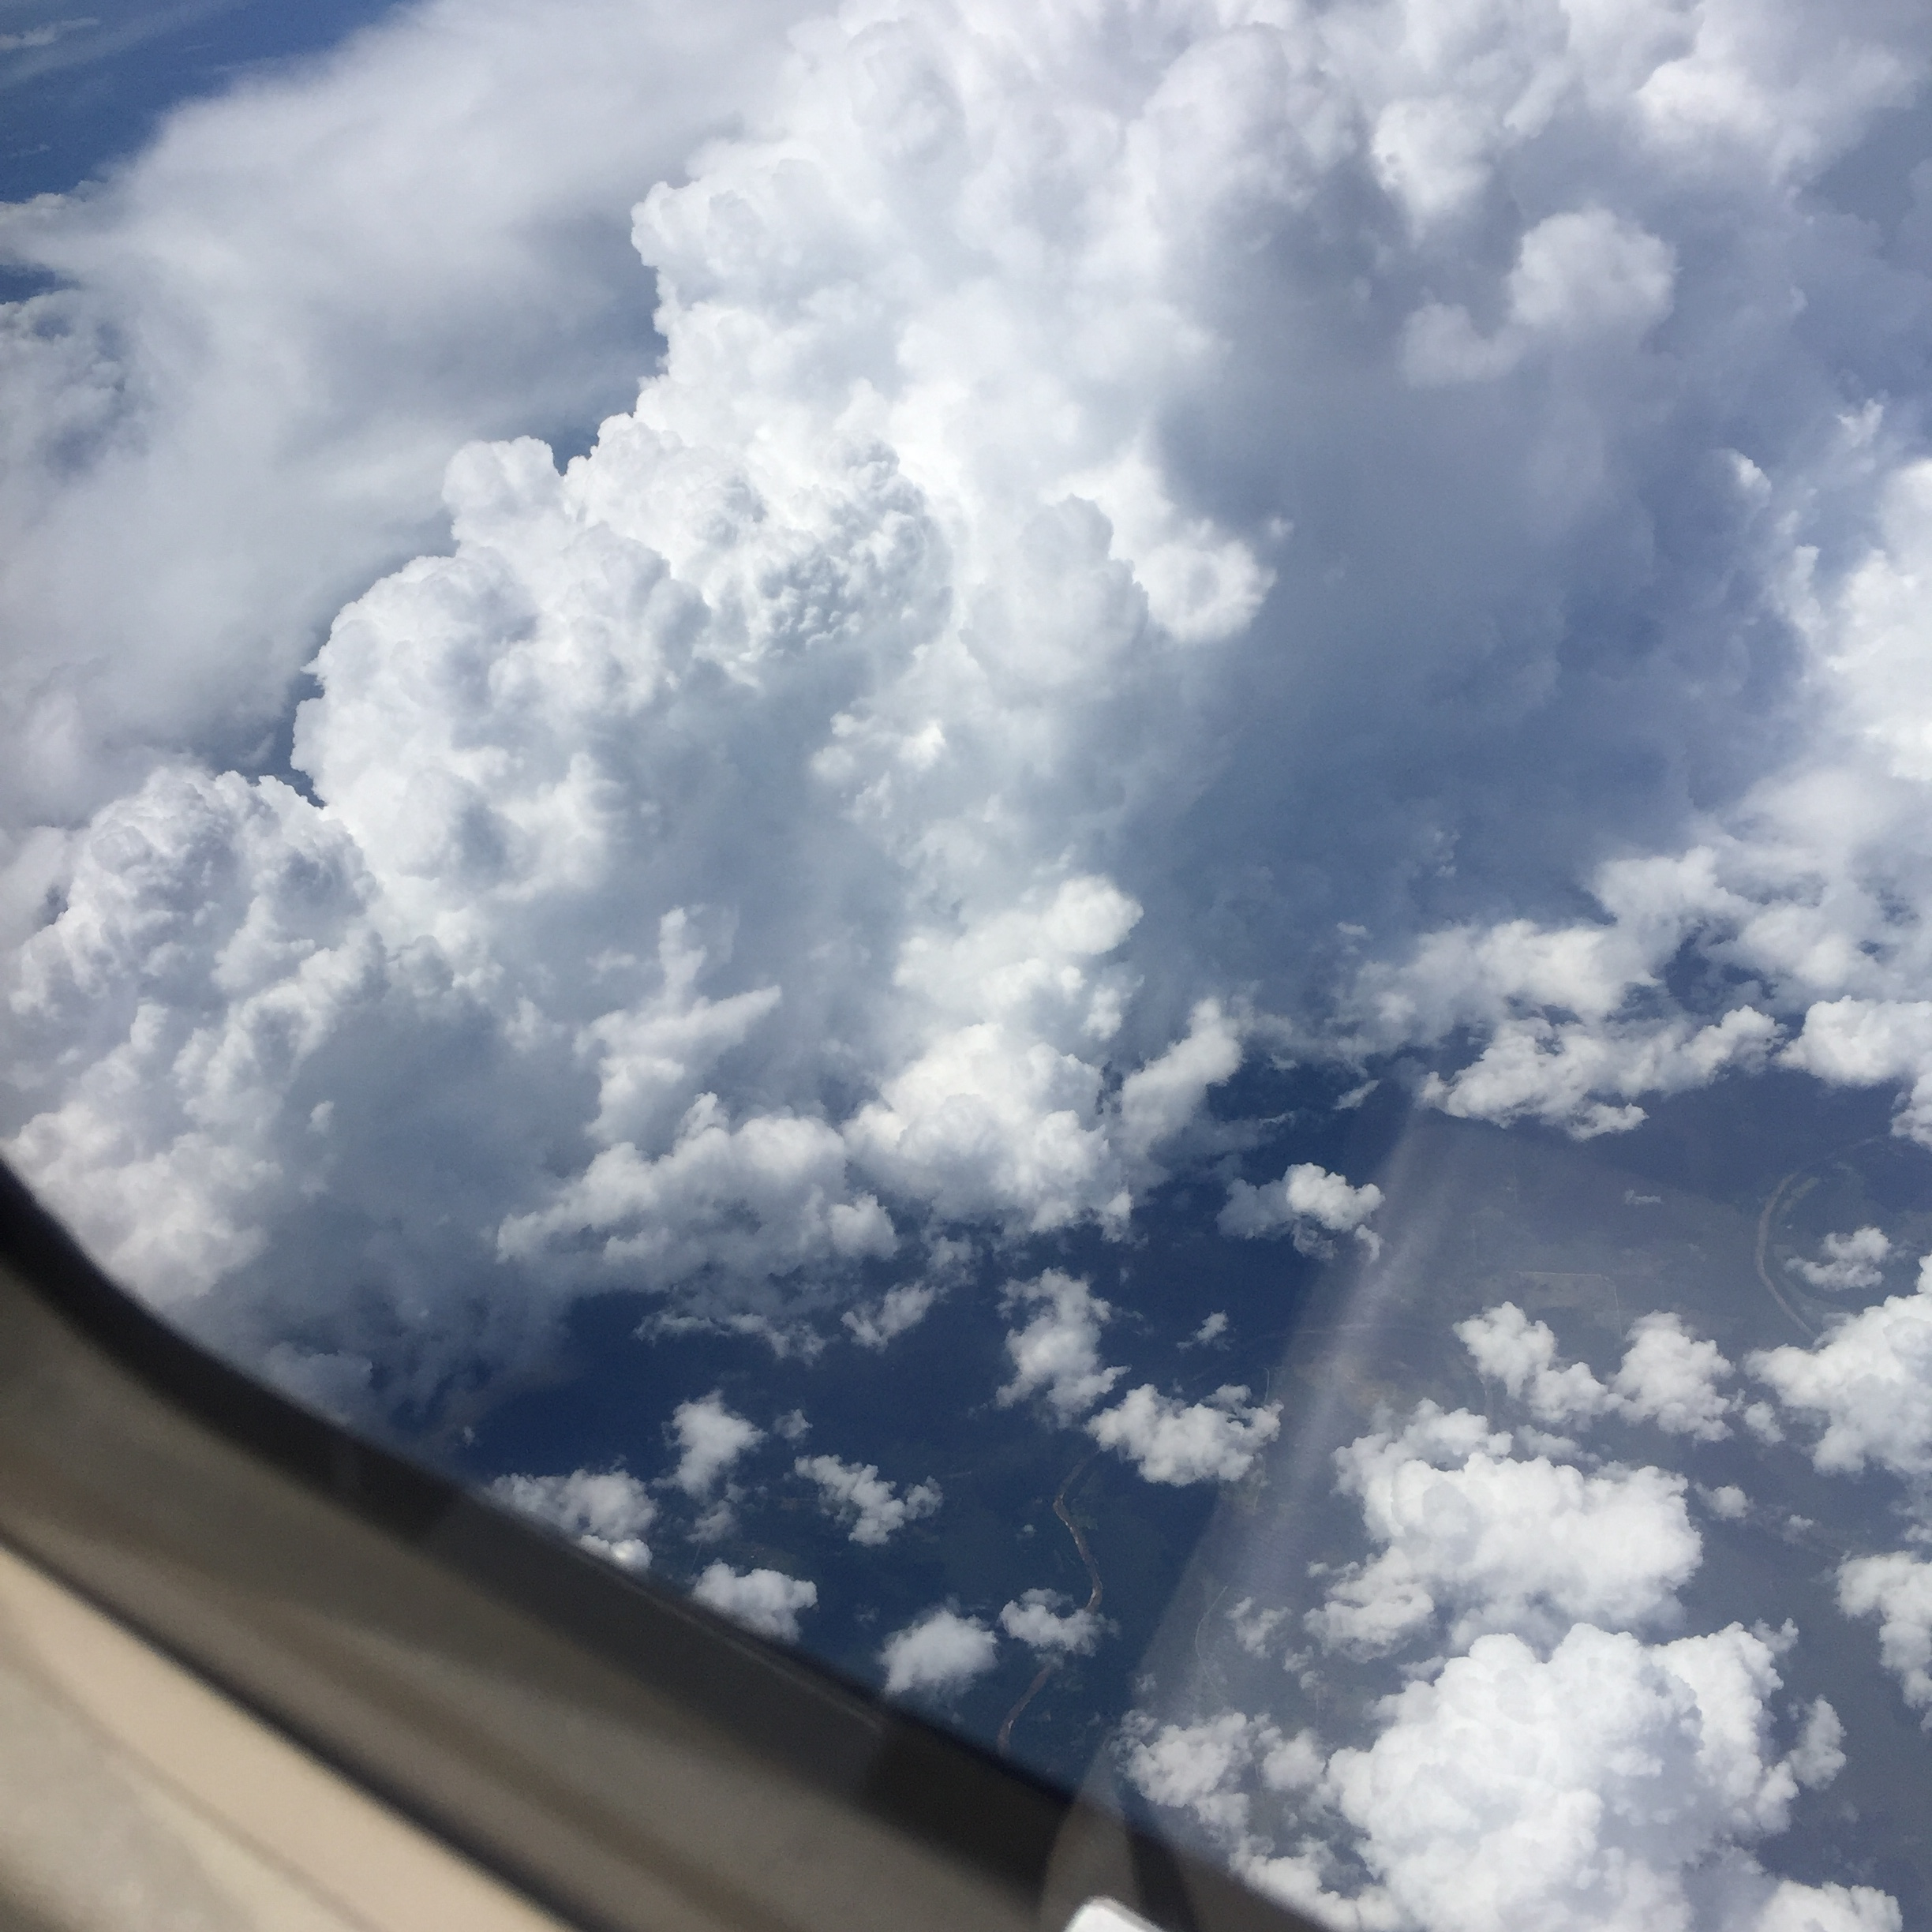
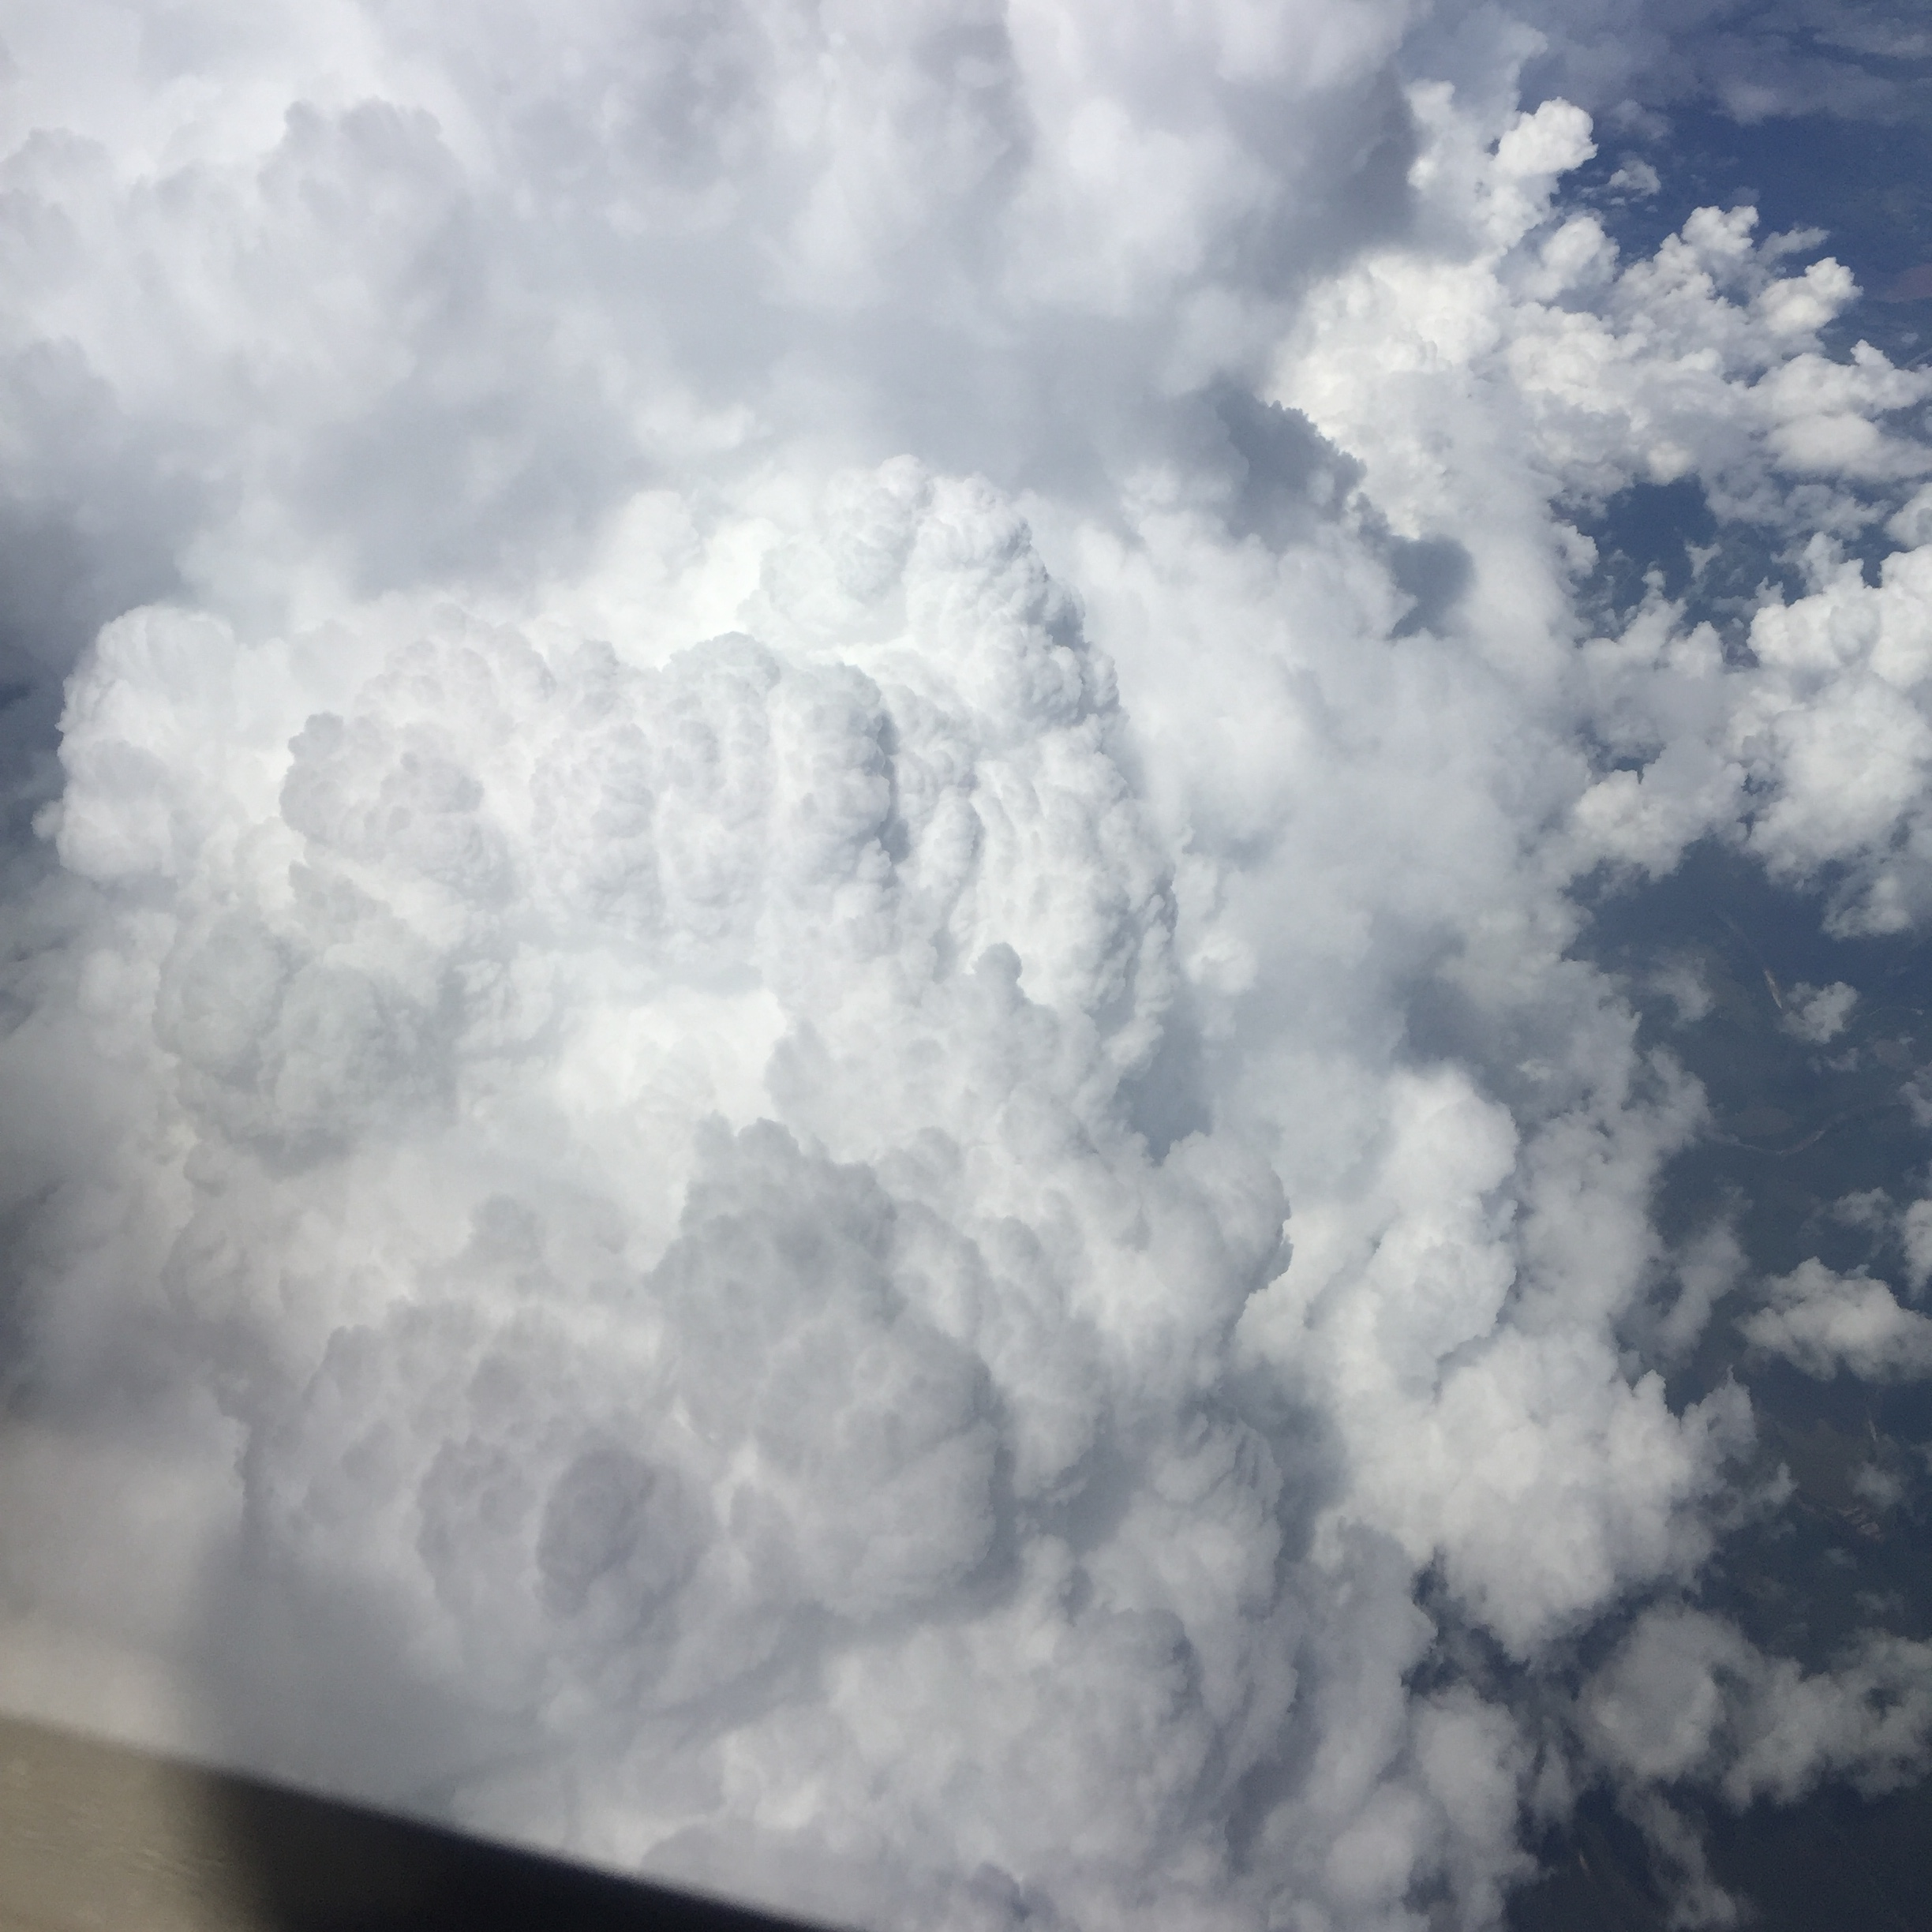

Slide 19
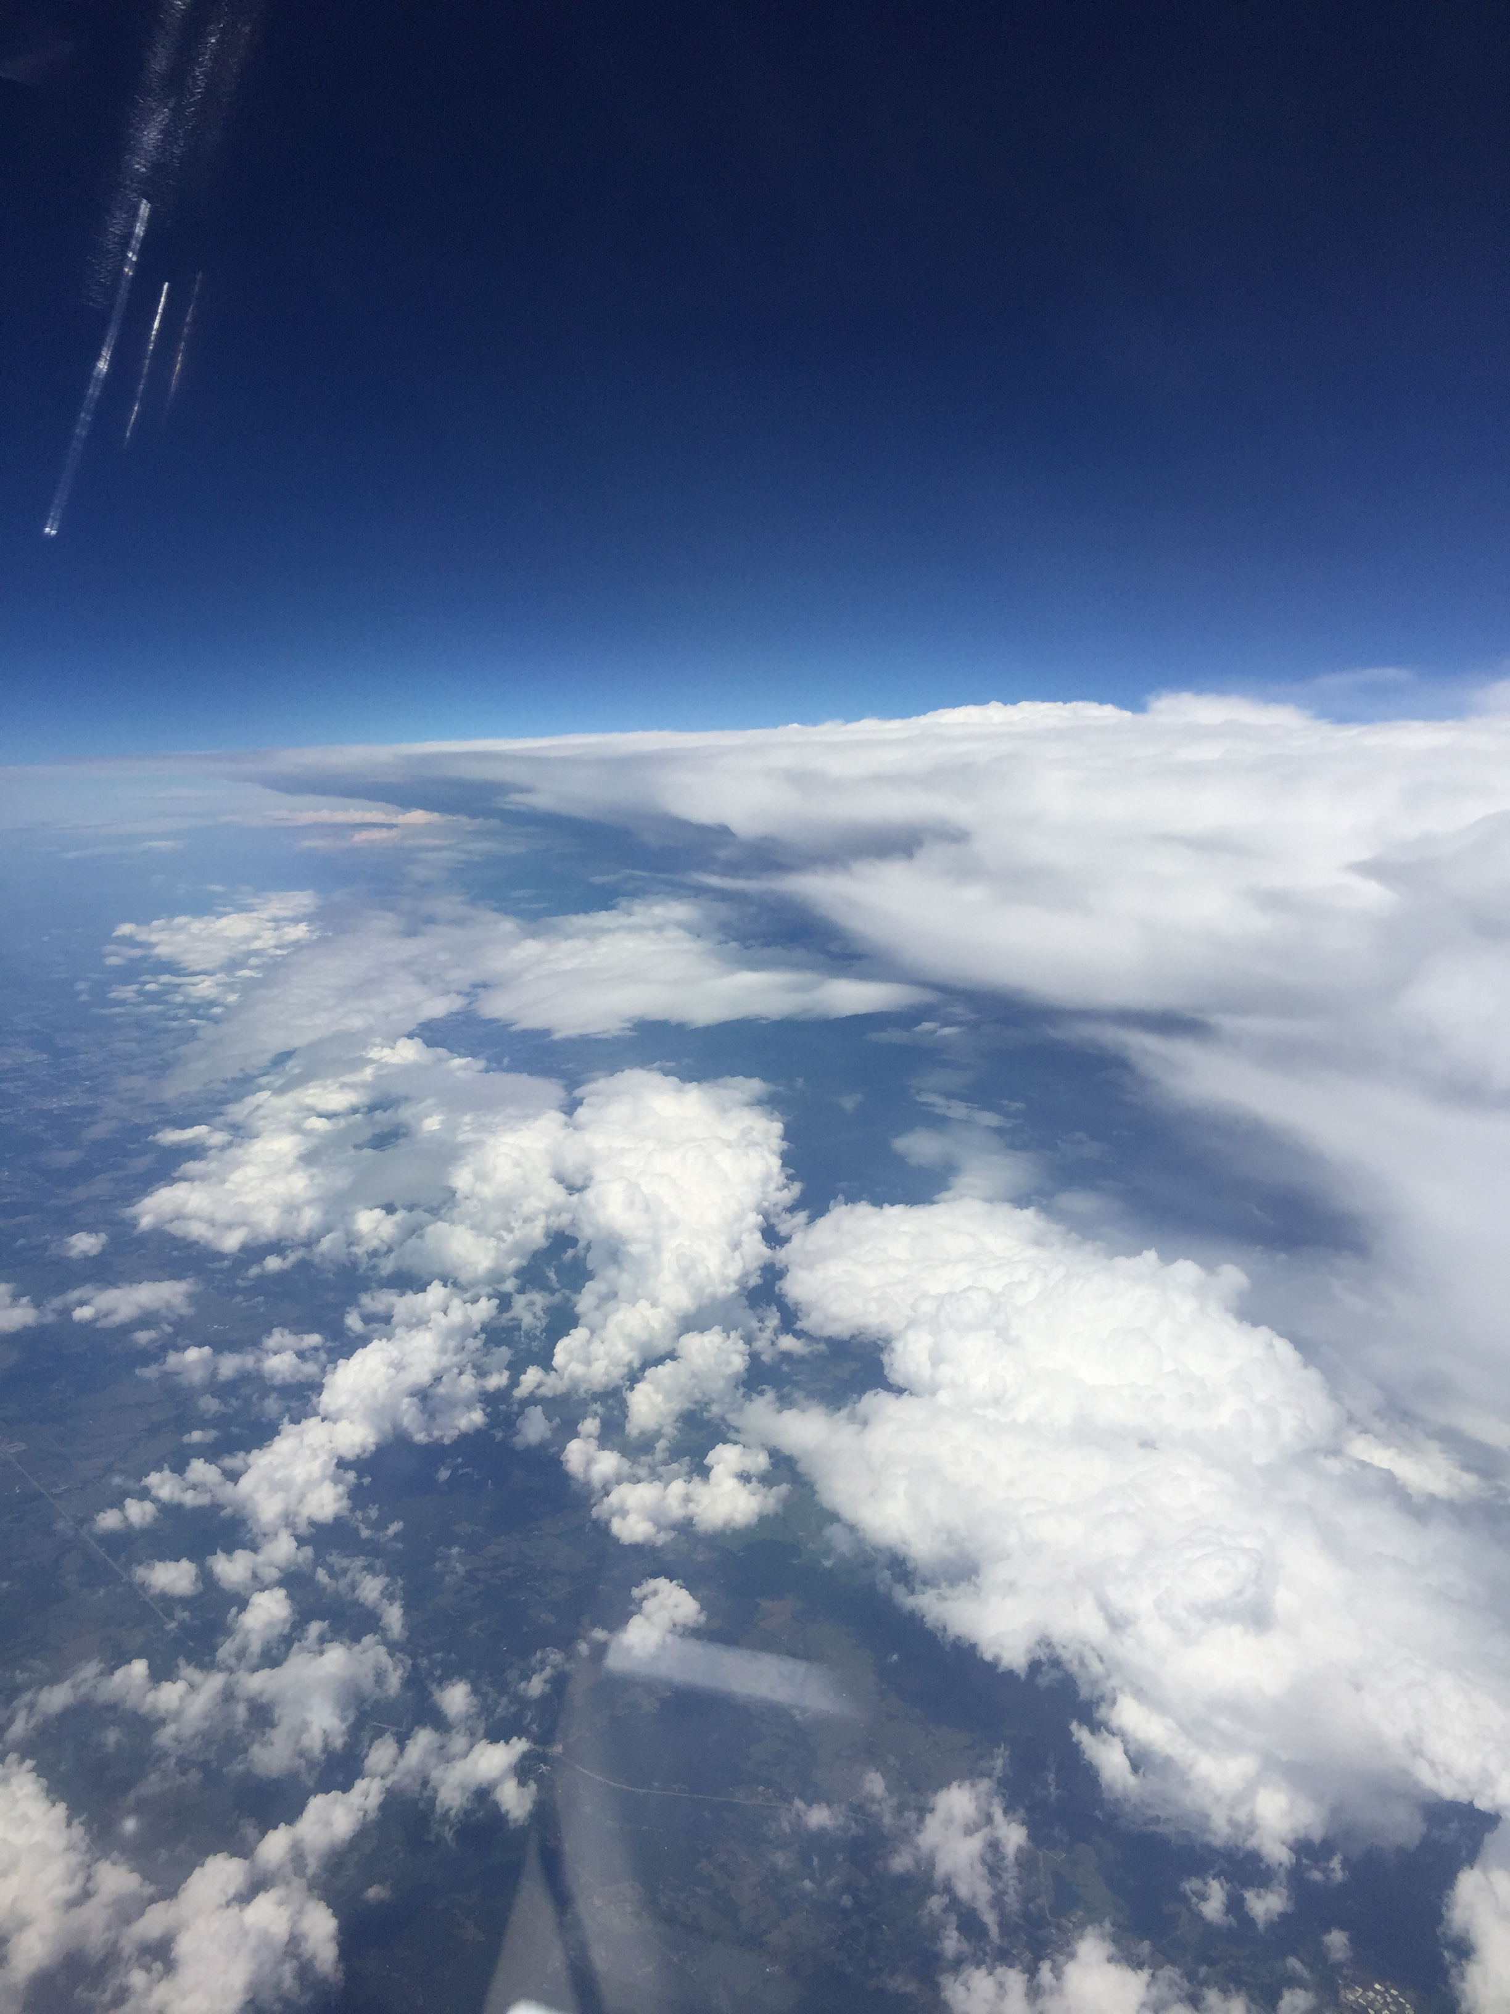

Slide 20
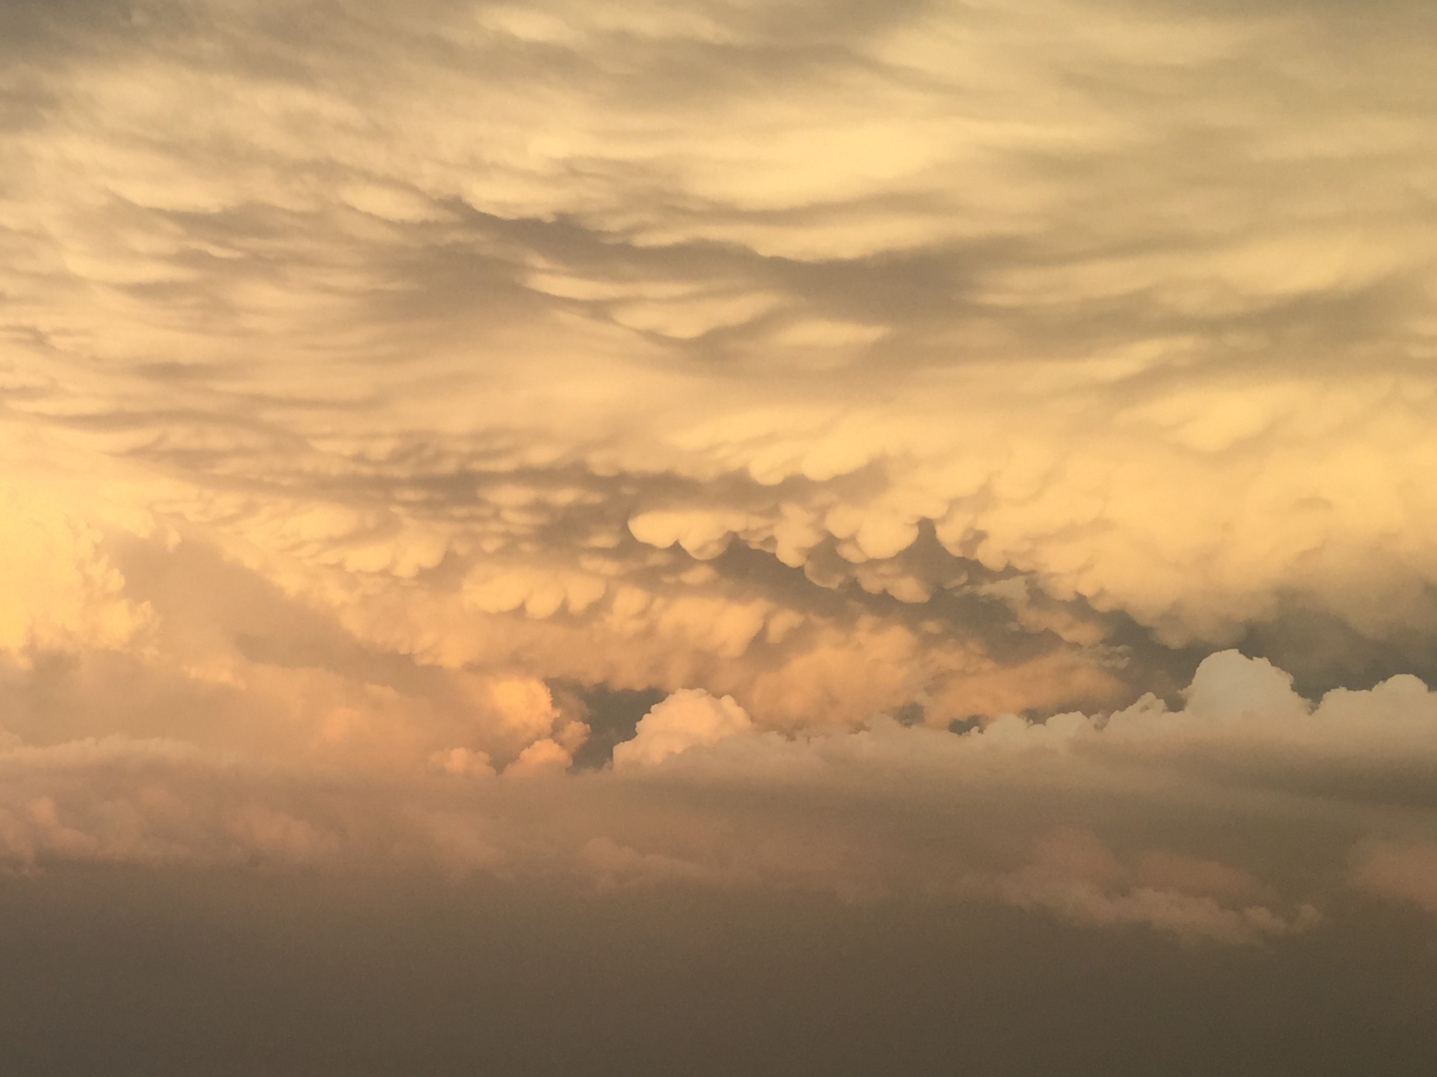
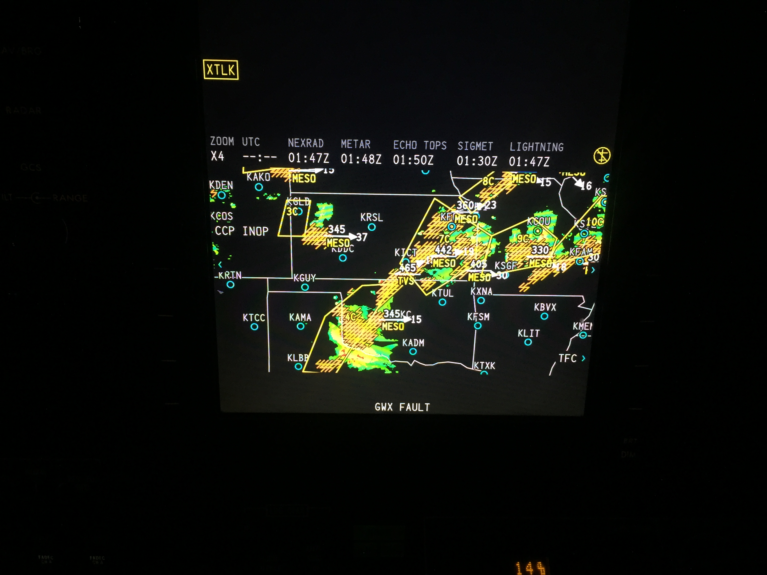

Slide 21
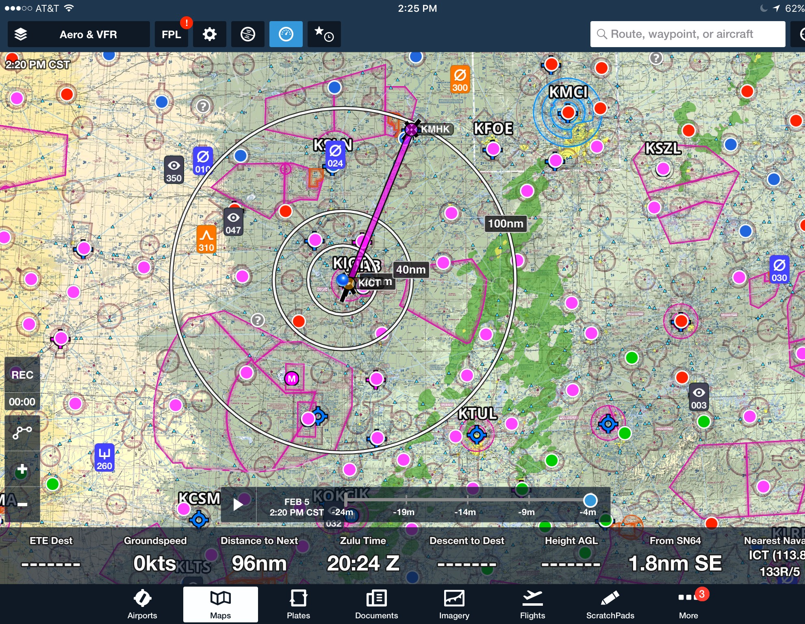
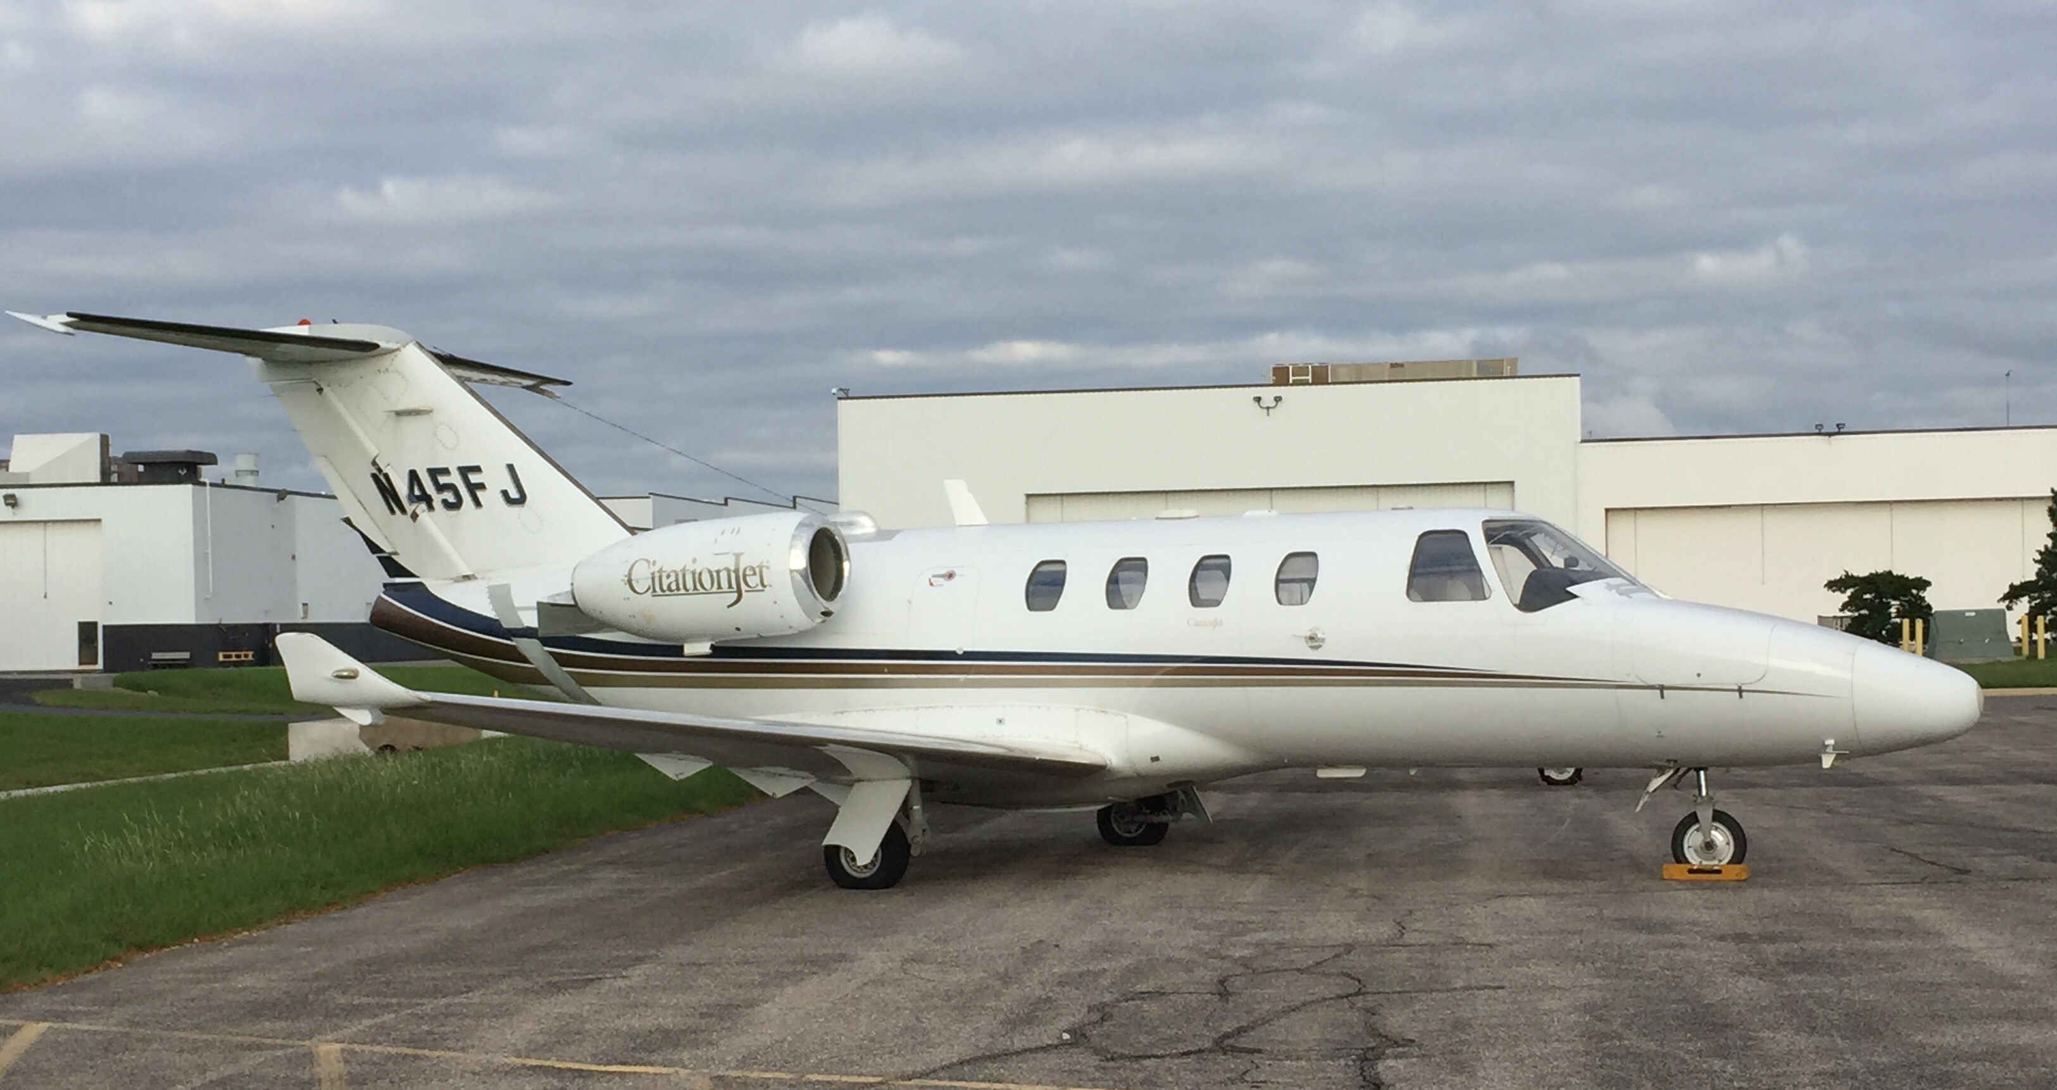
What would Jay do?

Slide 22
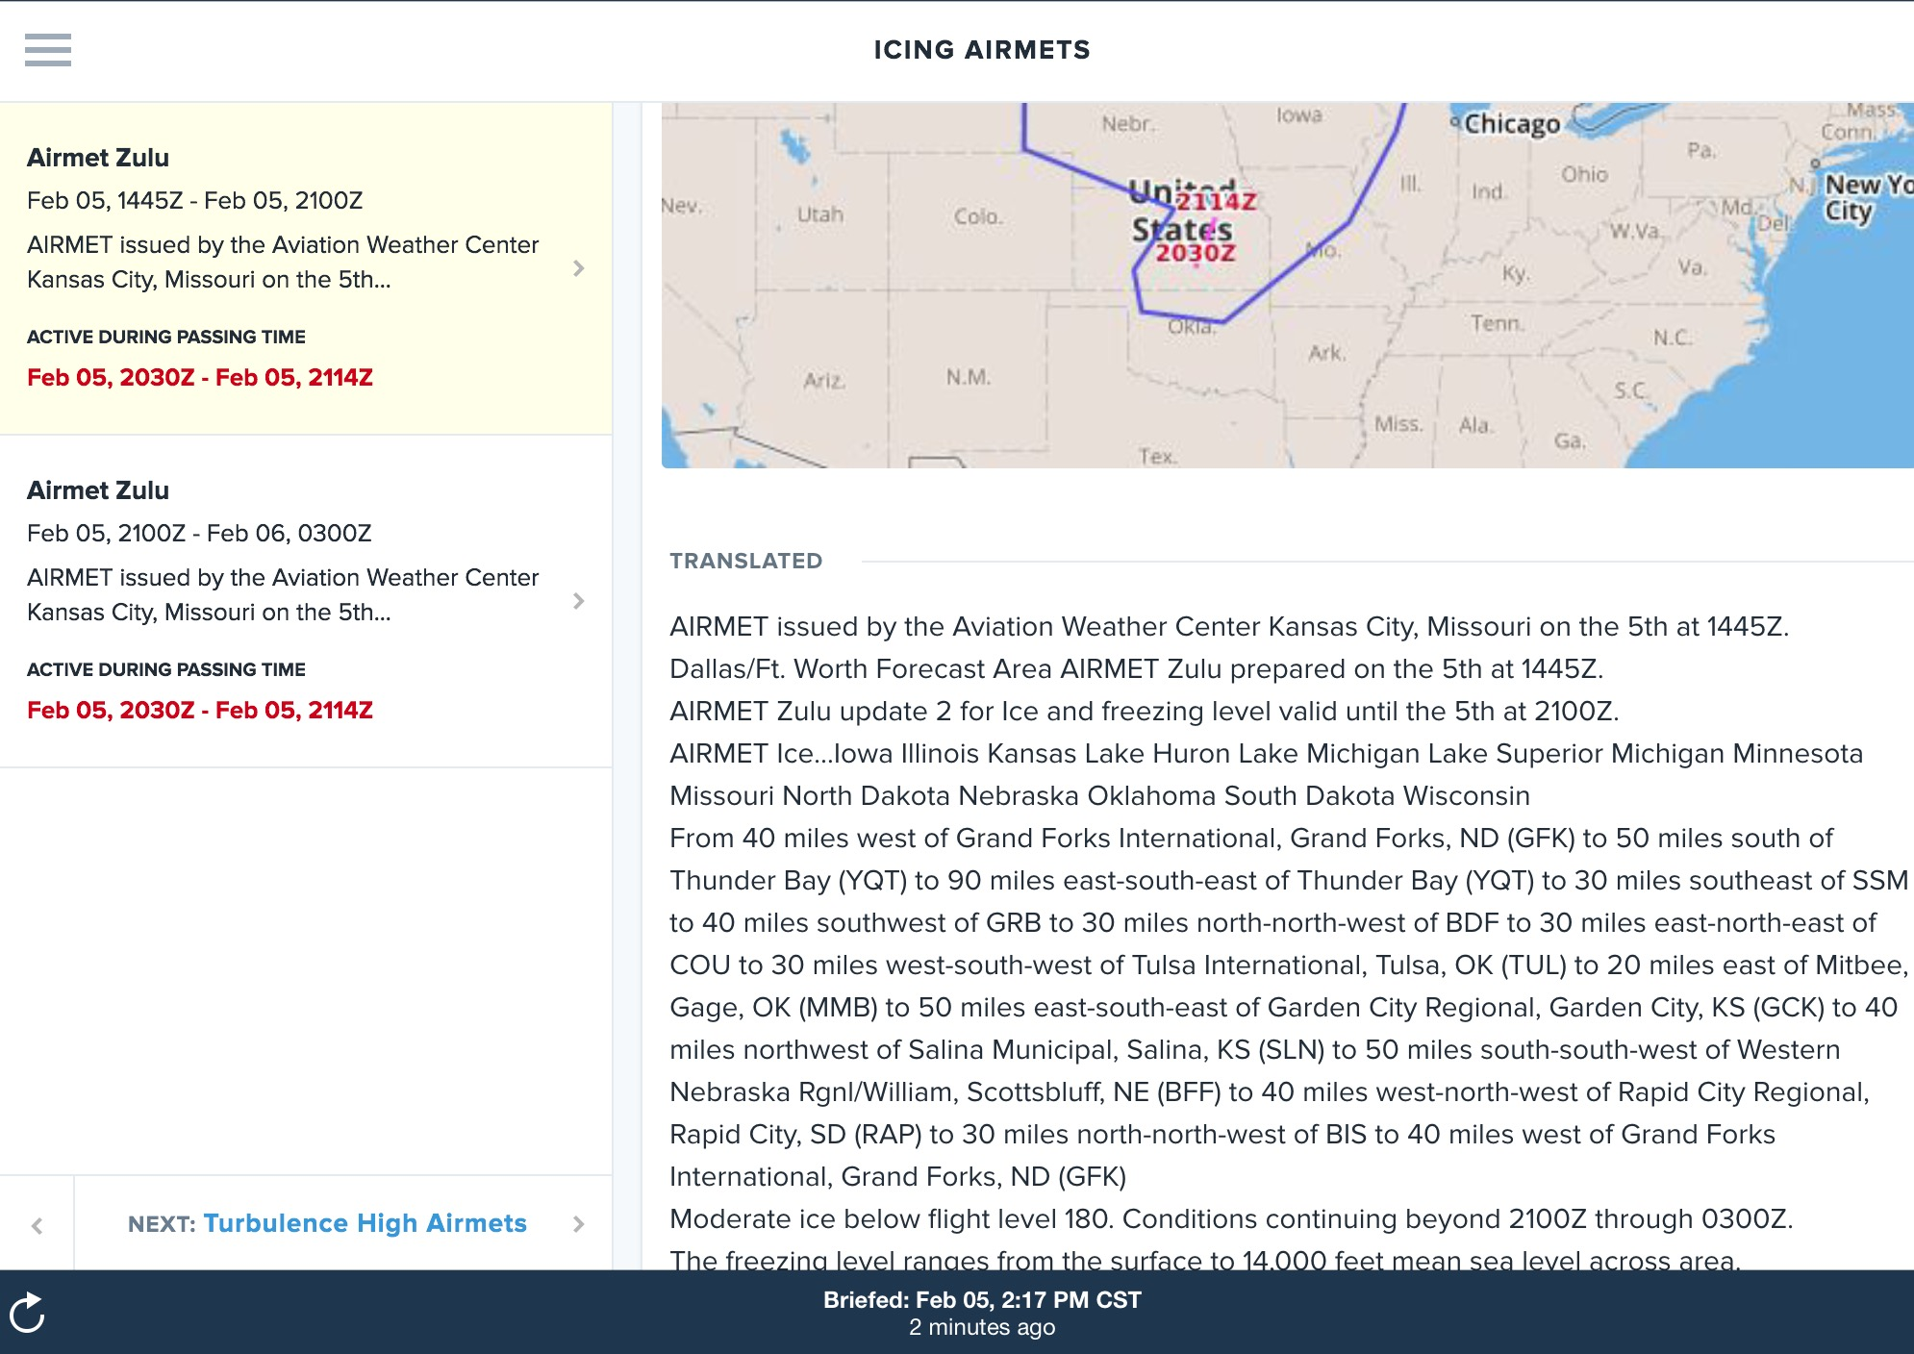
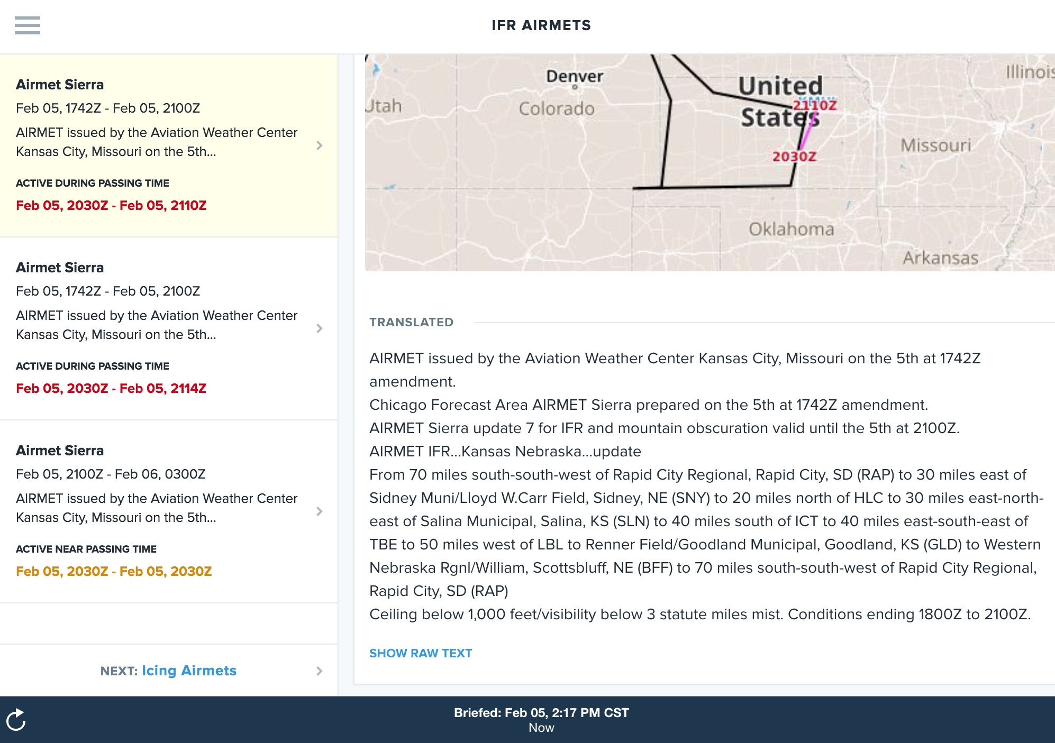

Slide 23
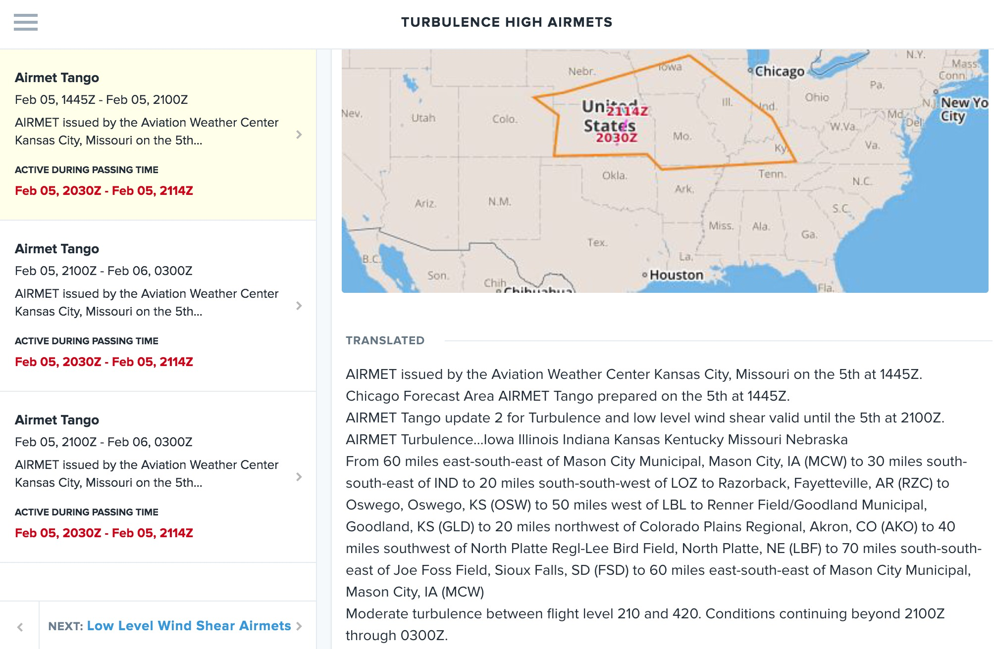
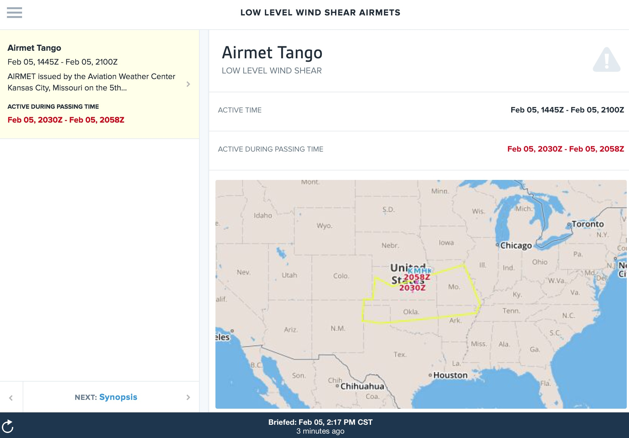

Slide 24
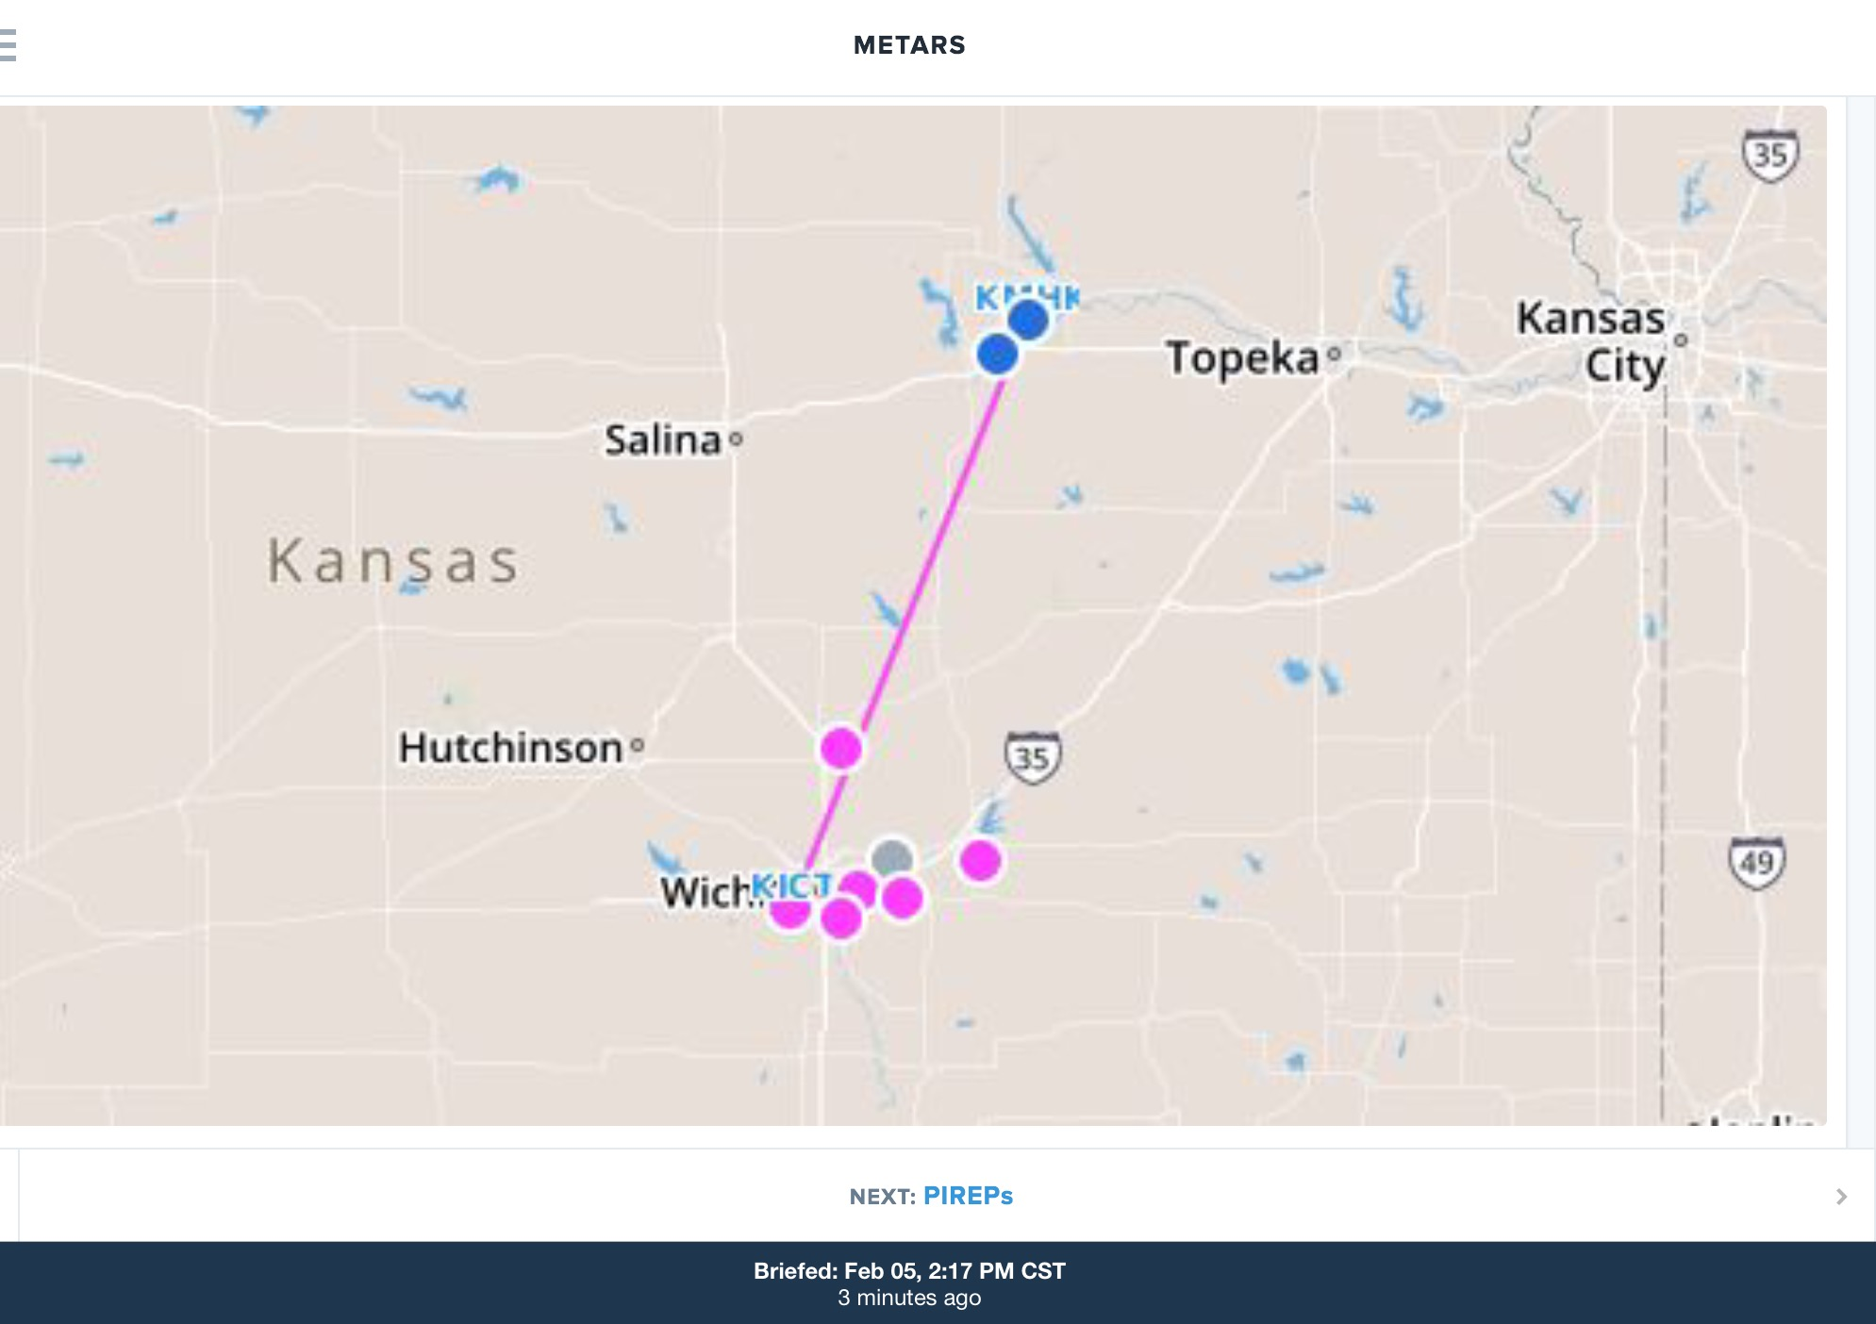
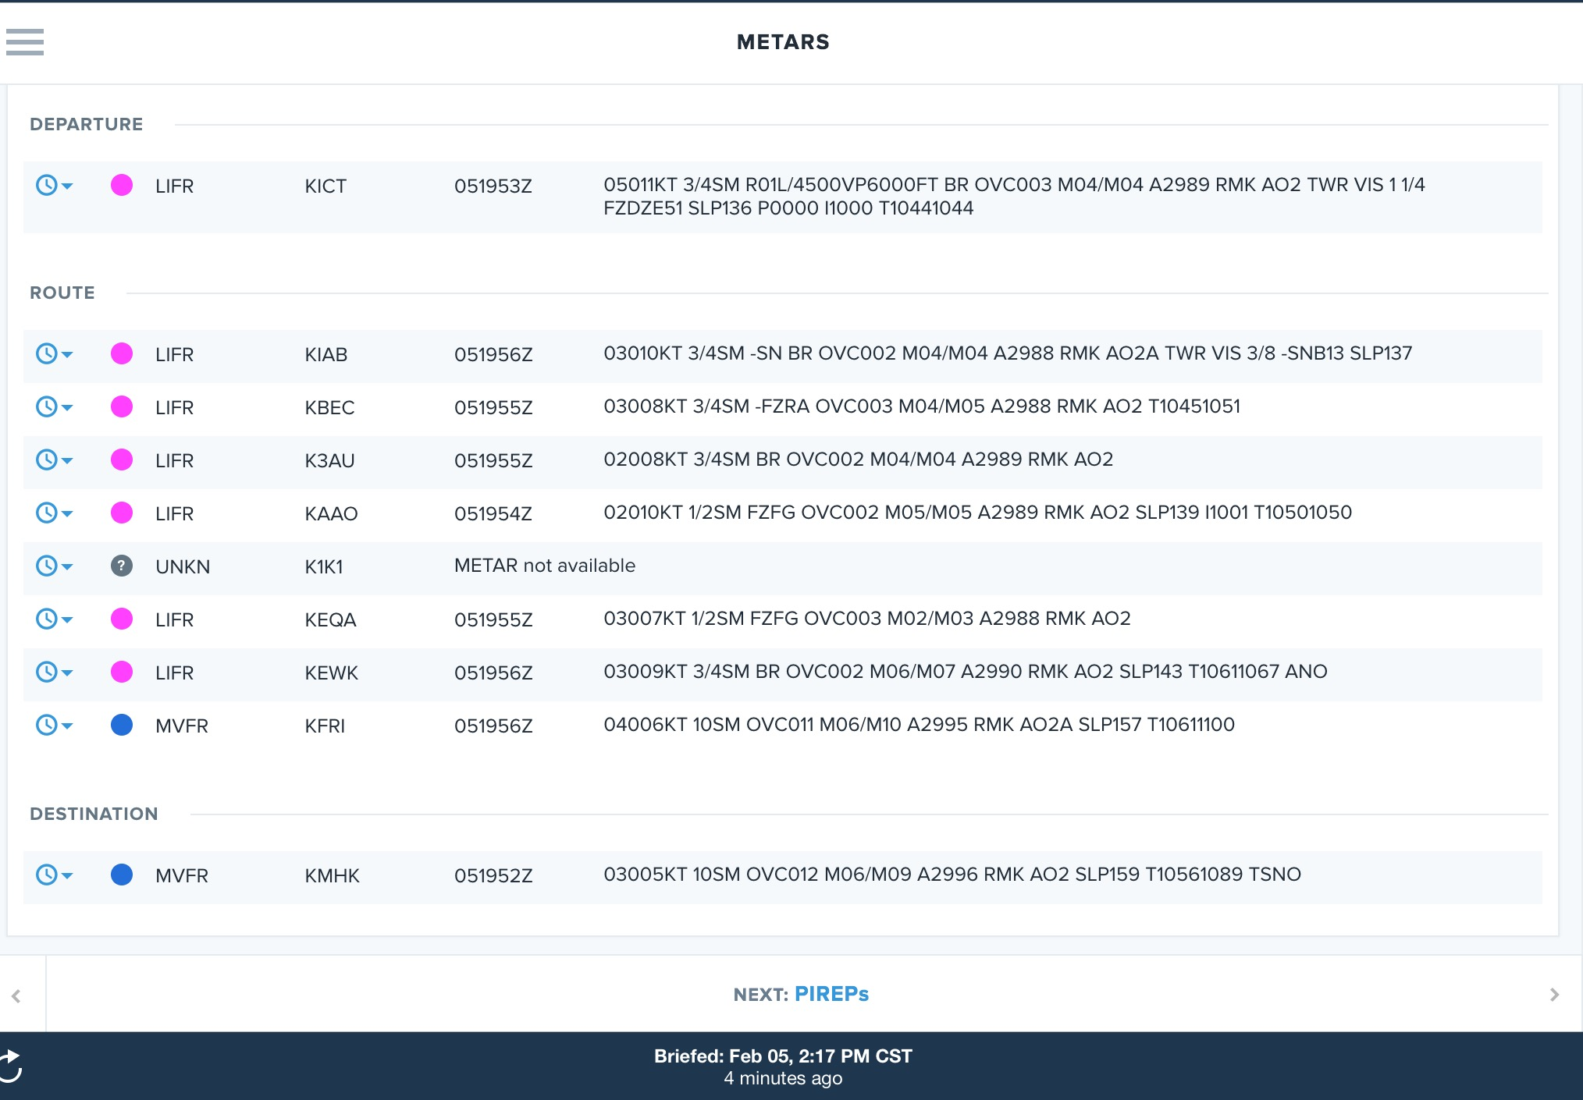

Slide 25
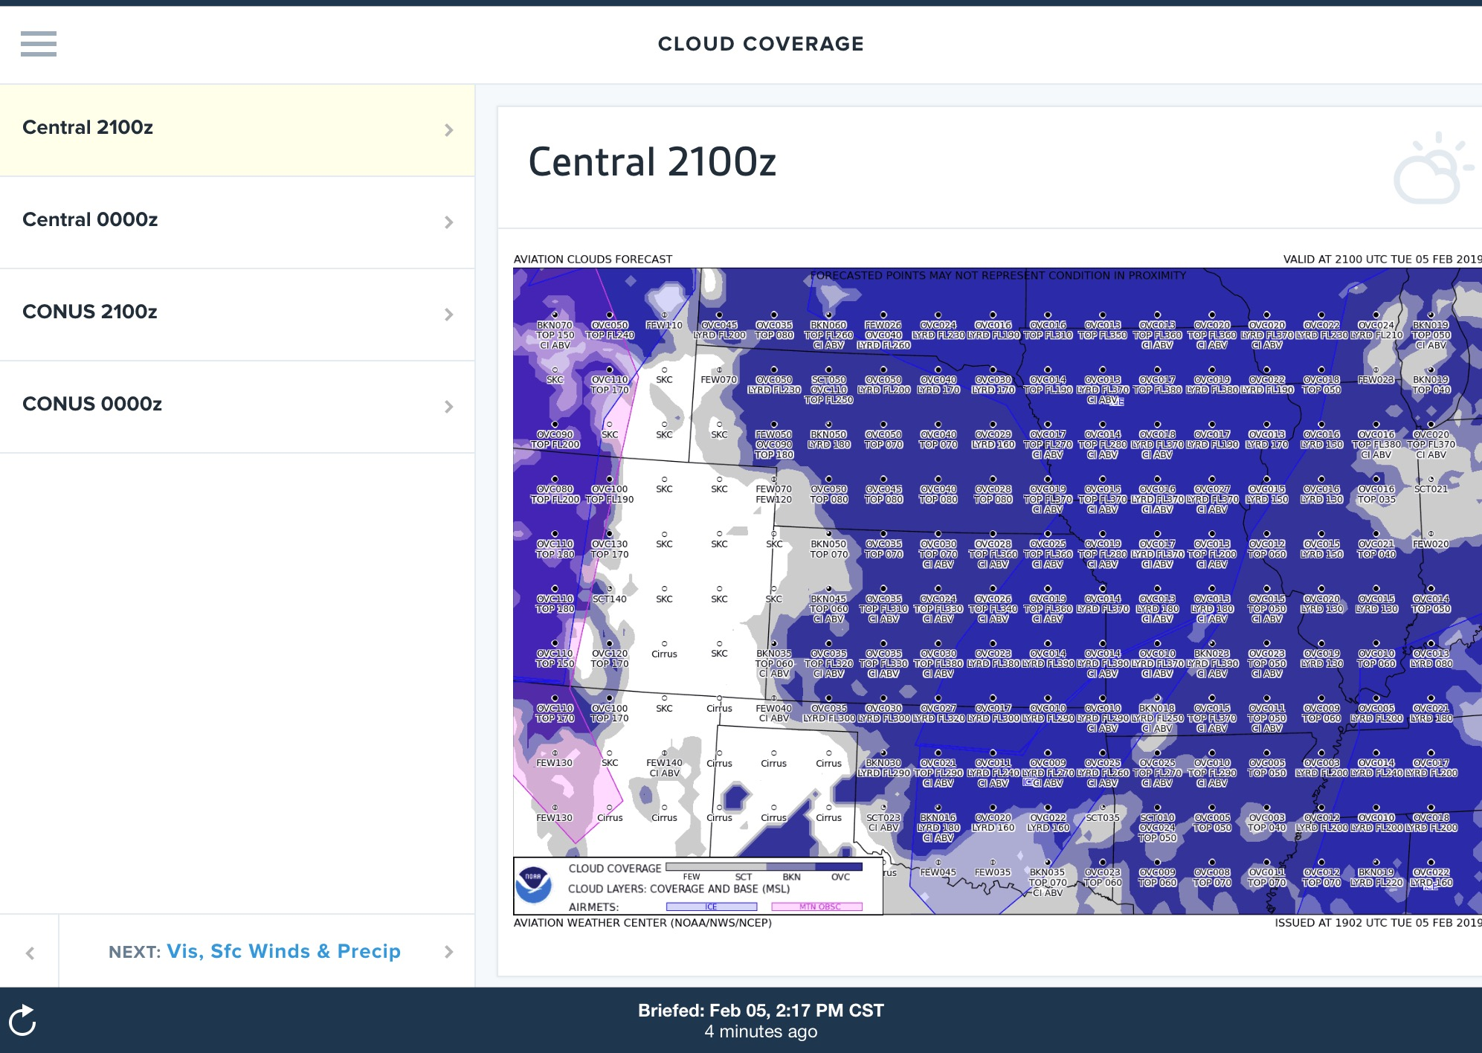
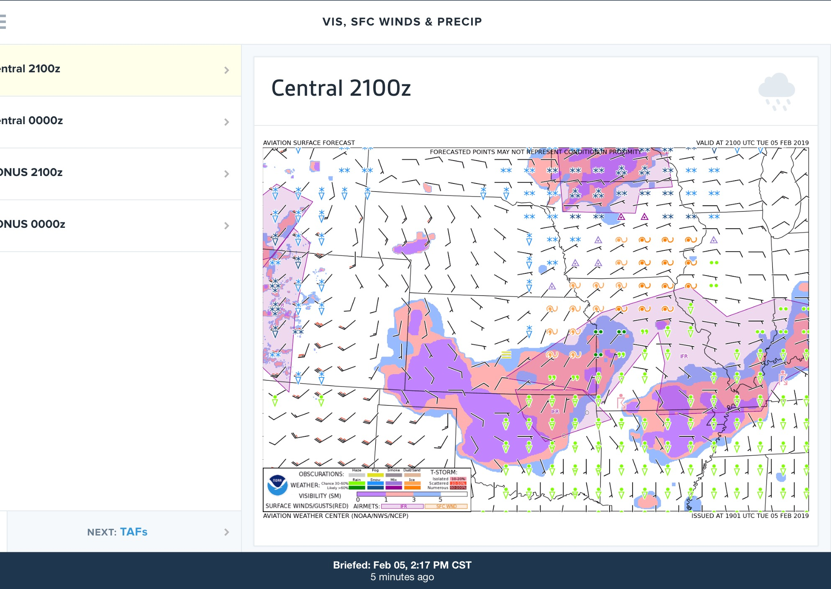

Slide 26
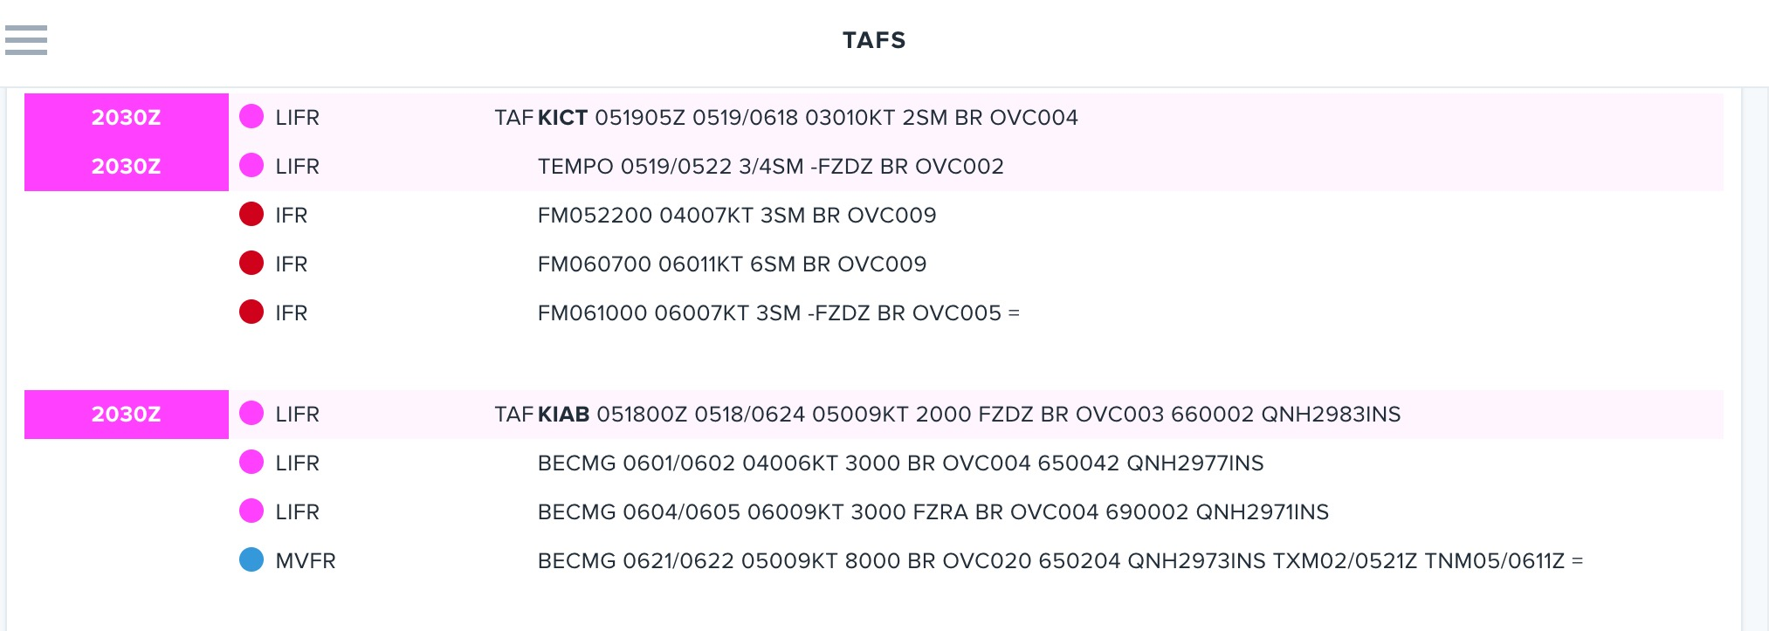
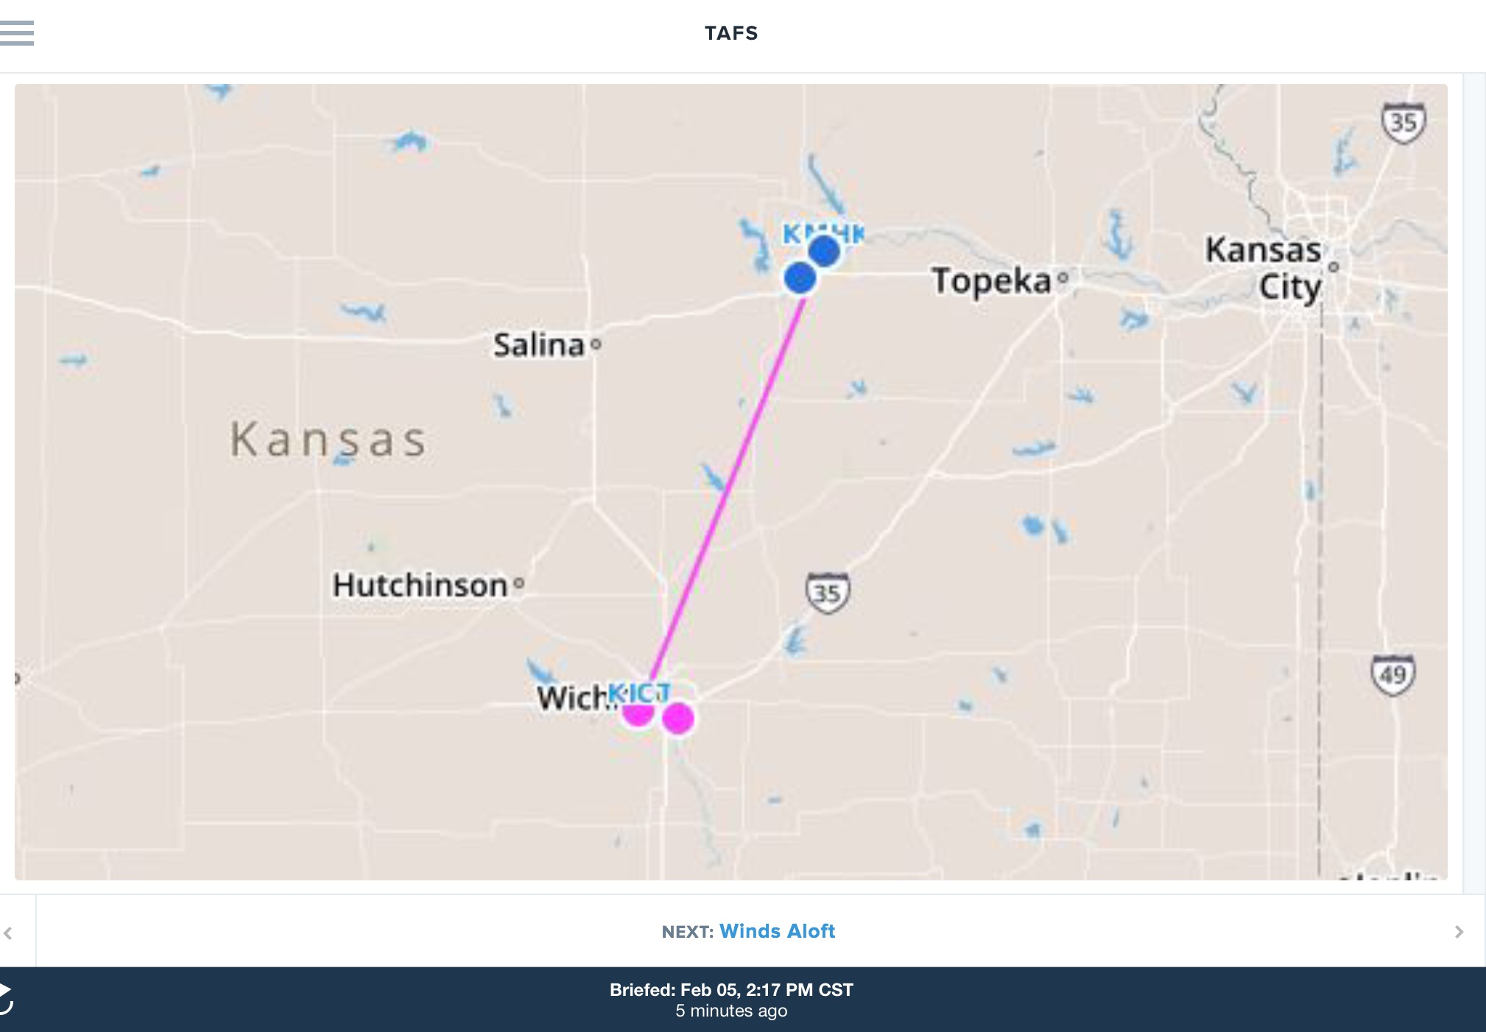
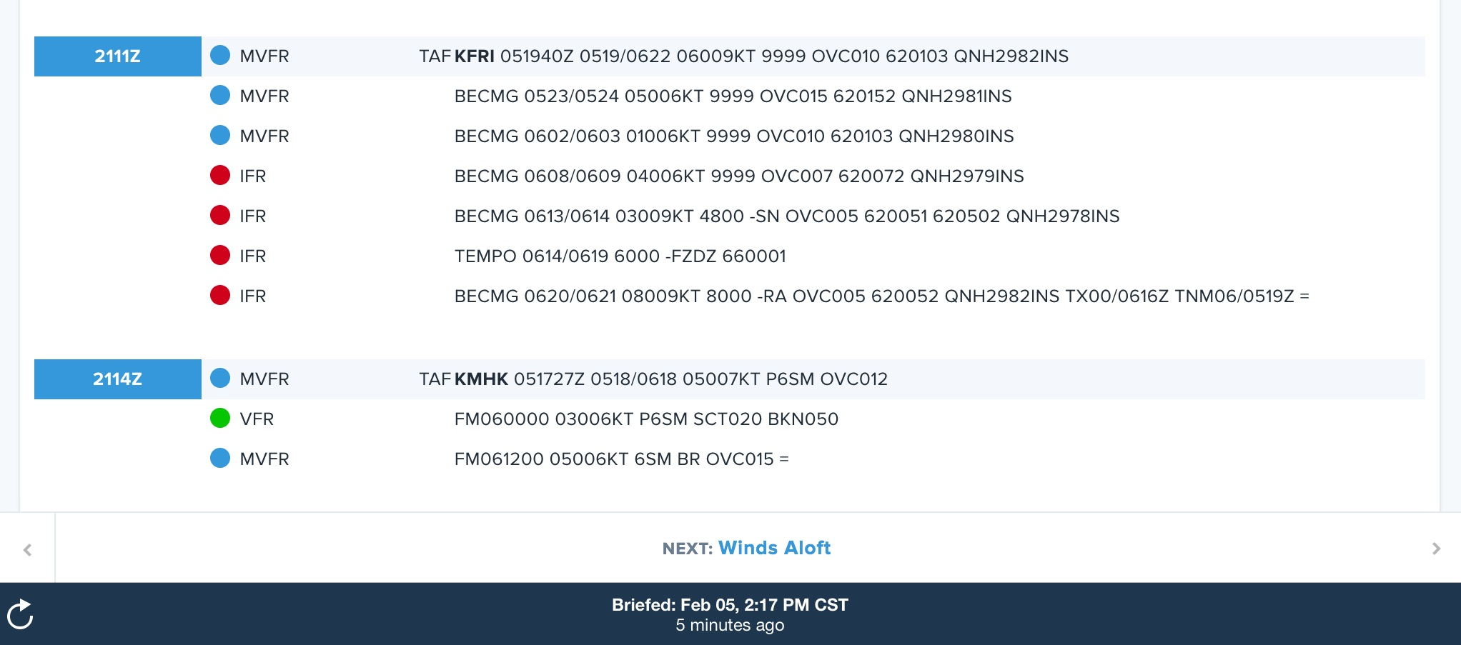

Slide 27
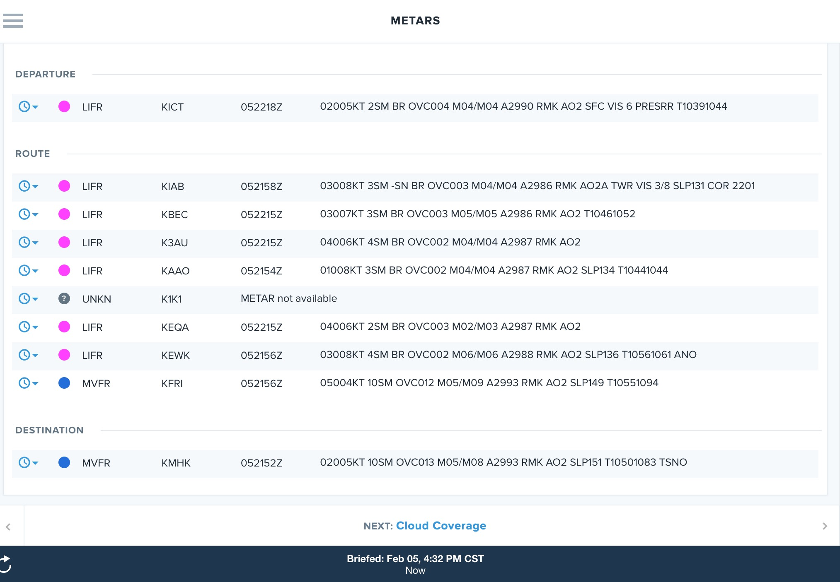
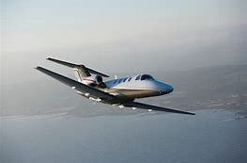
GO or NO GO?

Slide 28
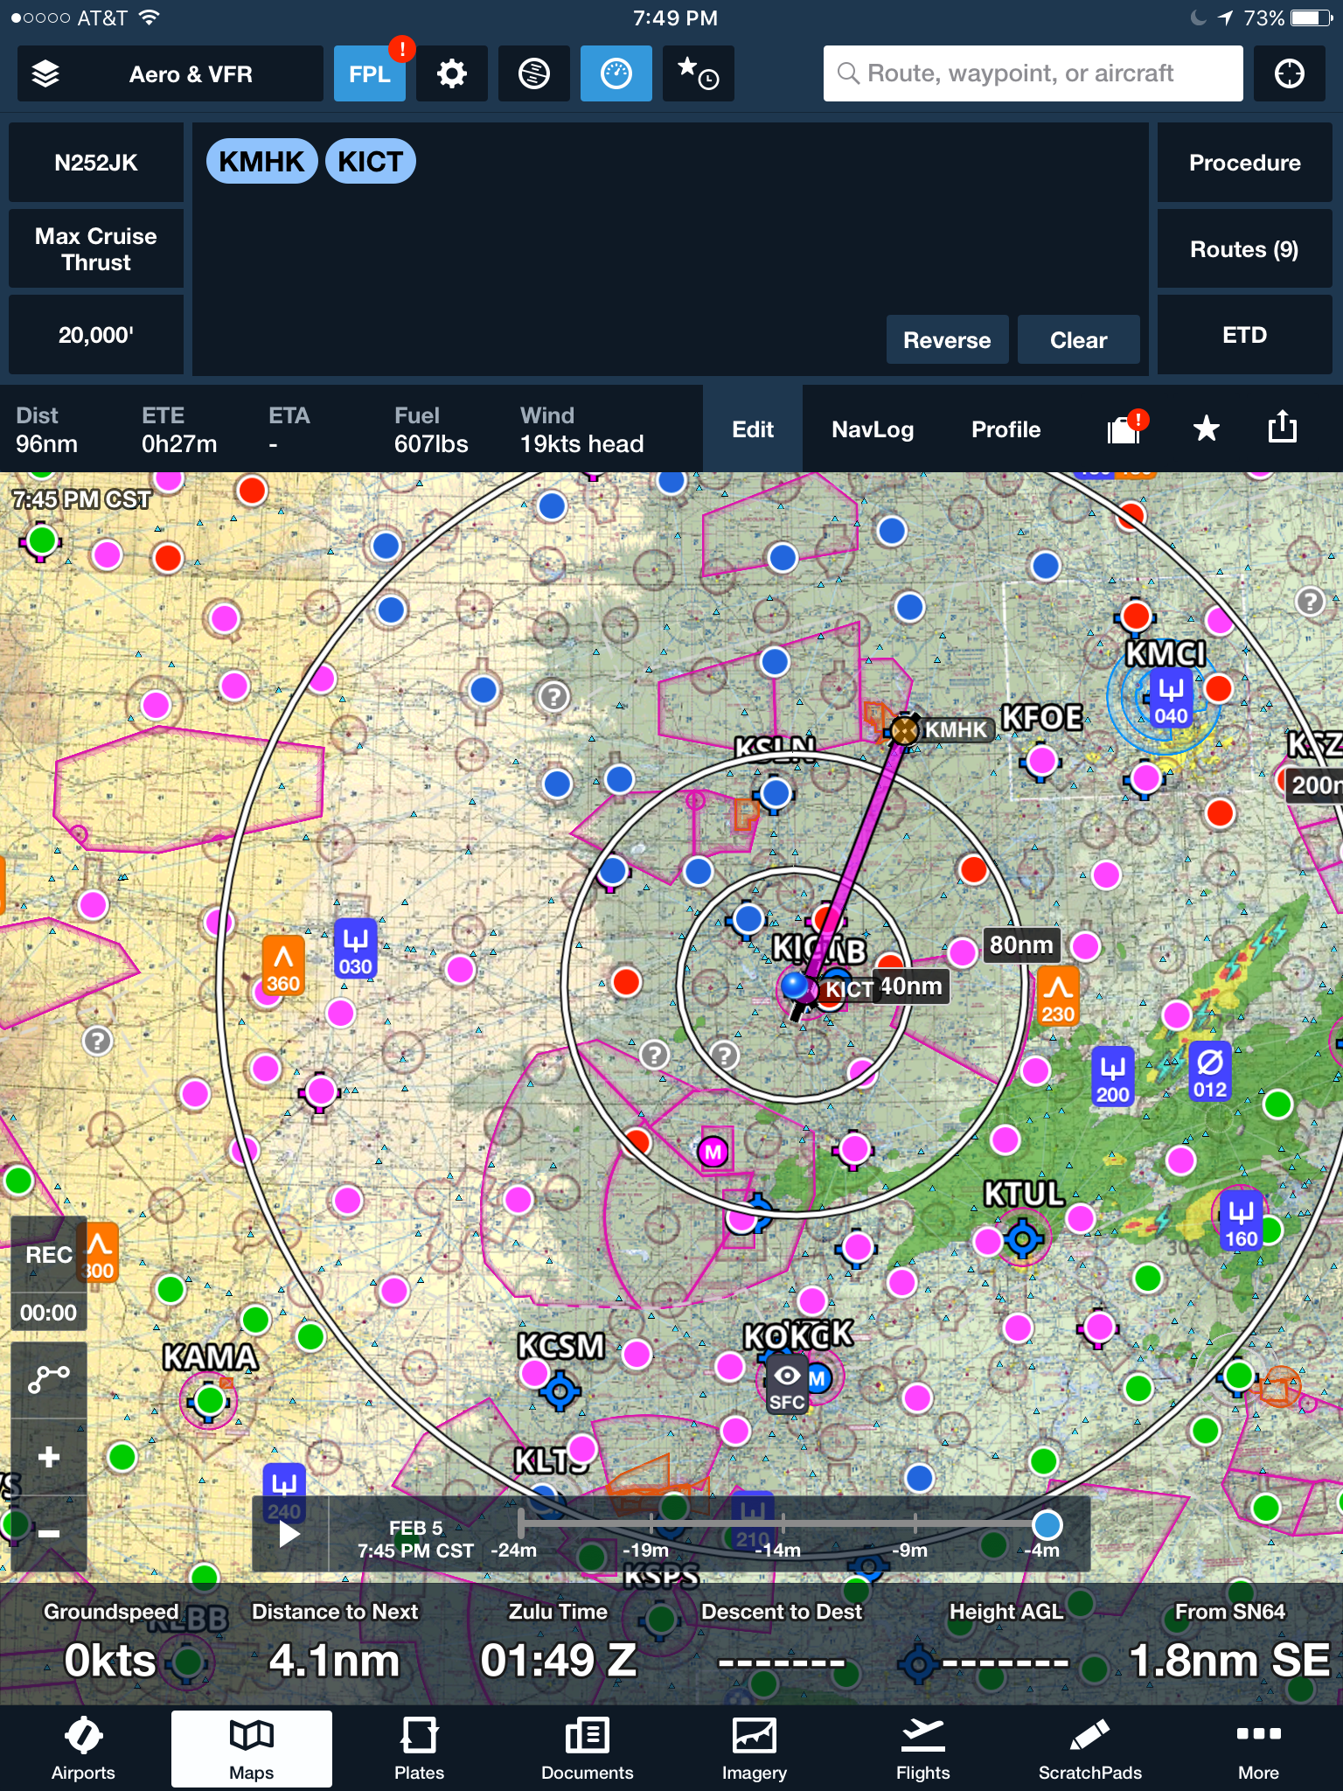
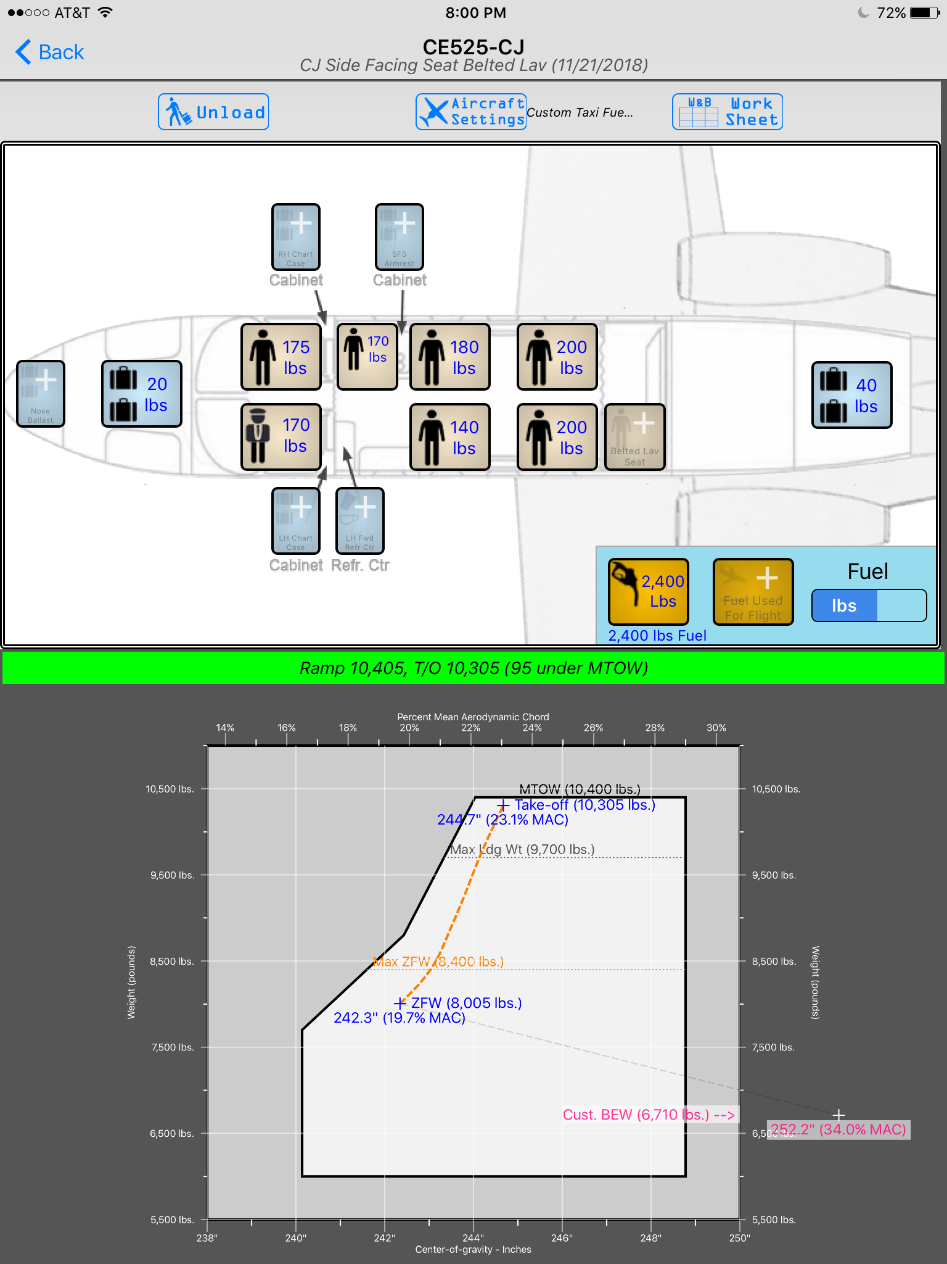

Slide 29
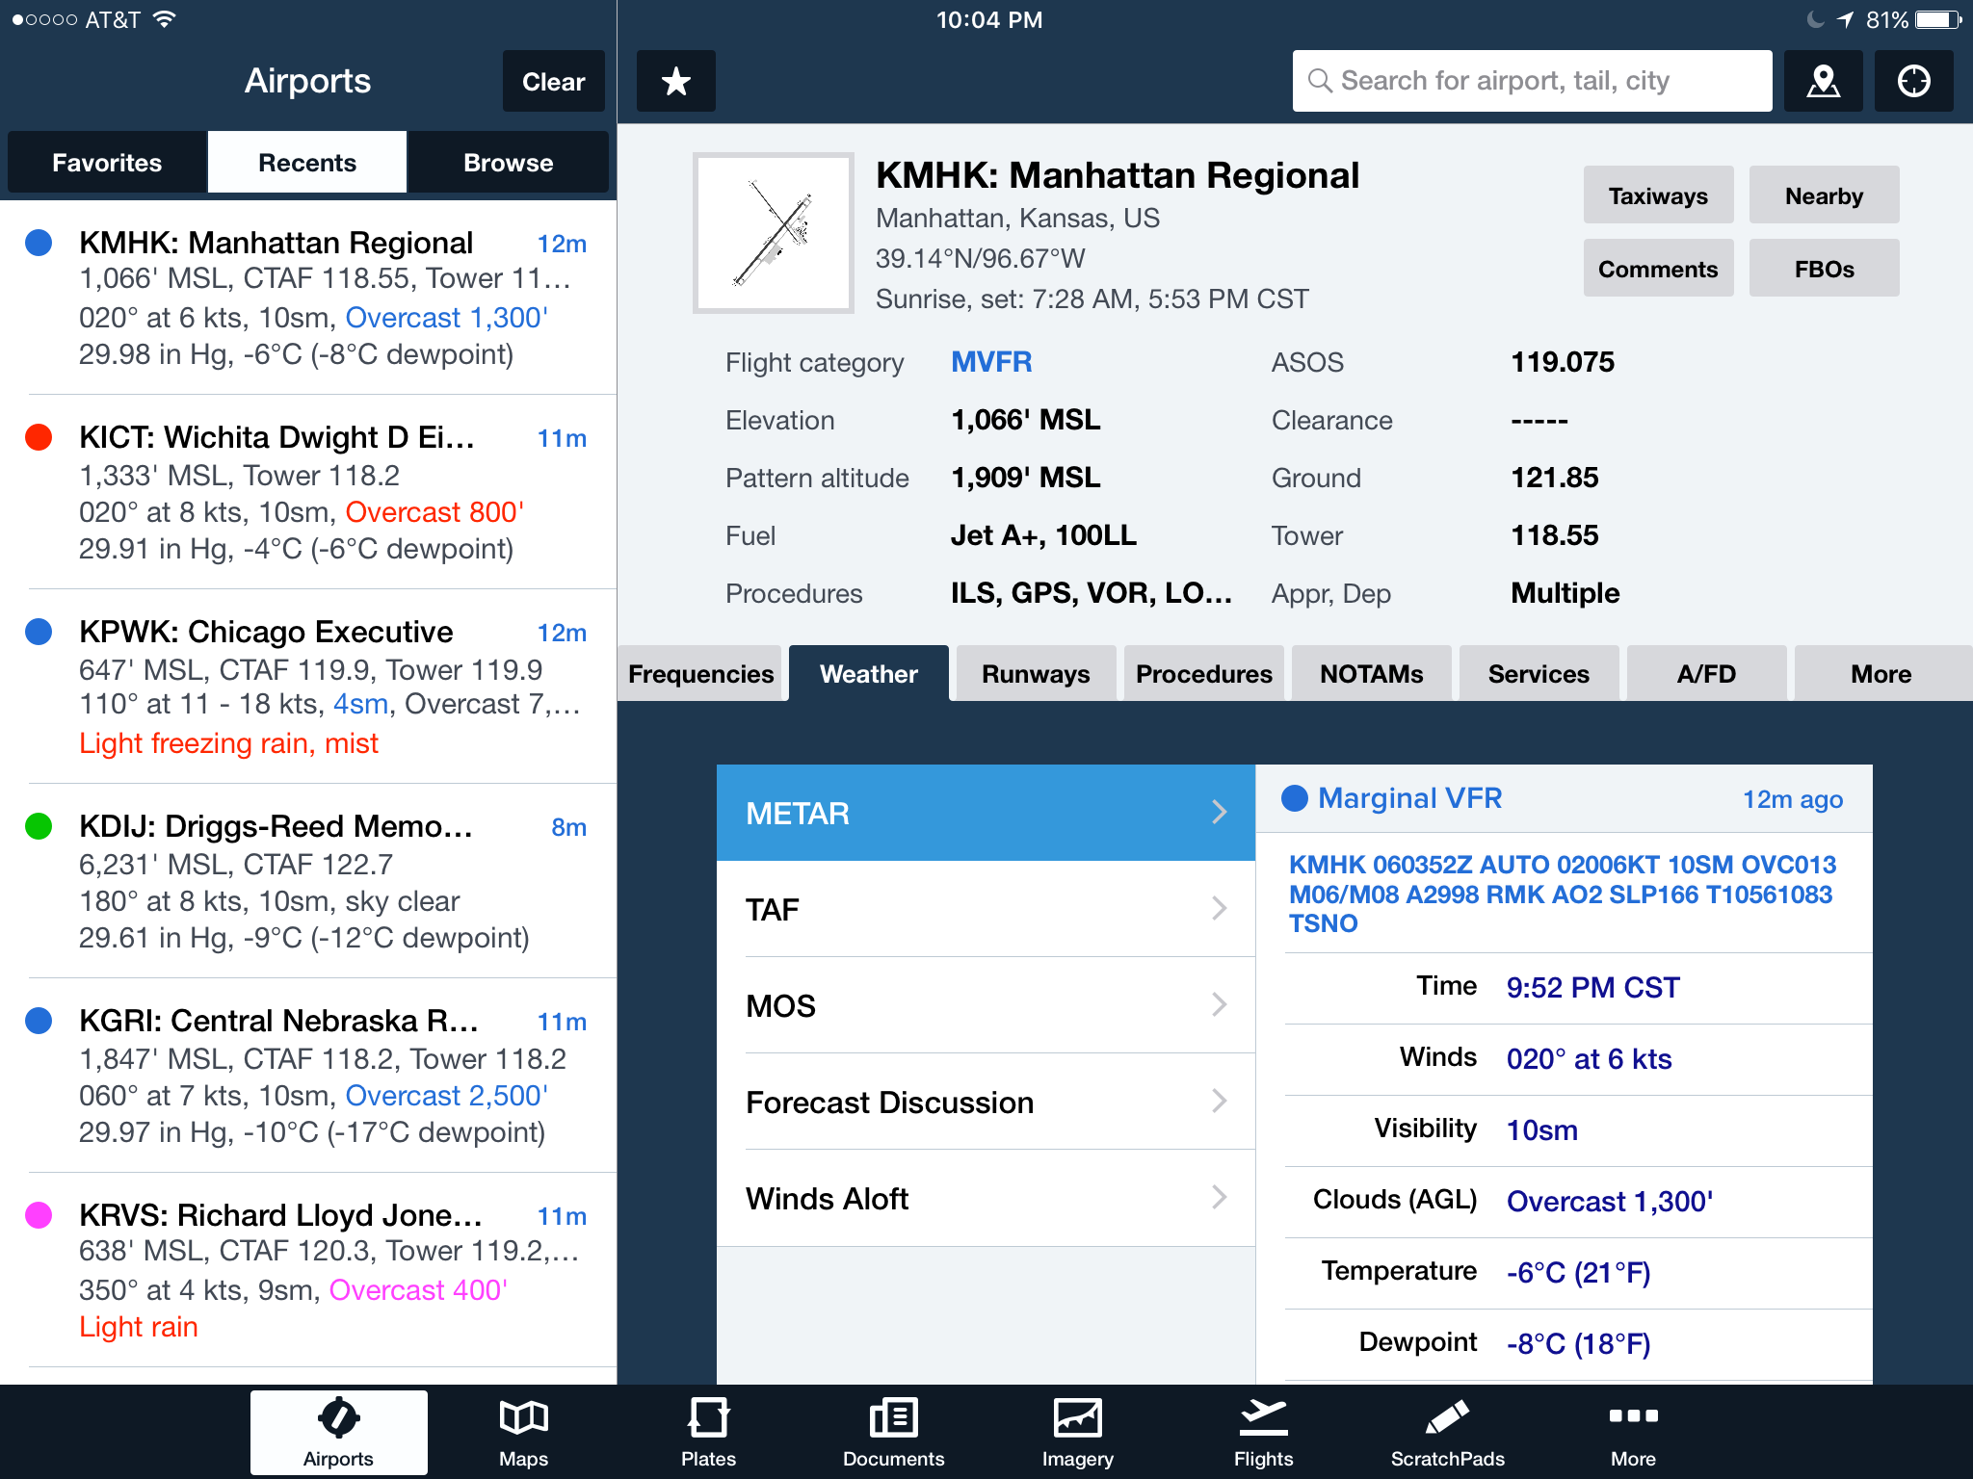
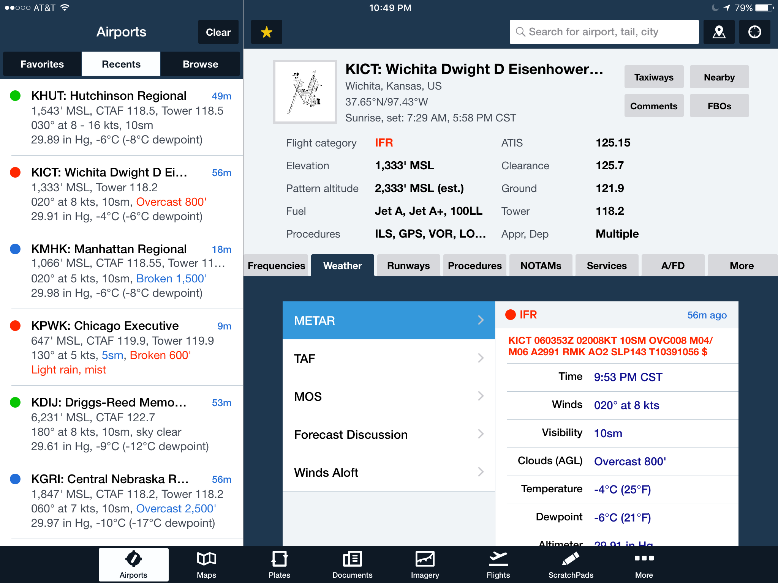

Slide 30
NO GO!
Although I’m current in the C525, I’m not proficient in the new avionics package recently installed and weather did not permit a familiarization flight.
At the time of dispatch freezing rain was still in the forecast, the forecast throughout the day never trended to what was to be.
Passenger load did not allow for a pilot to go familiar with the avionics and he was unavailable anyway.
Most of the available alternates were more than 200 NM away from Wichita.

Slide 31
MAMMATUS CLOUD, Junior!

