Slide 1
Decision Points: Lessons from Local Weather Accidents
Thomas P. Turner
Executive Director, ABS Air Safety Foundation

Slide 2
Aviation Weather Hazards
Thunderstorms
Turbulence
Reduced Visibility
Airframe Ice

Slide 3
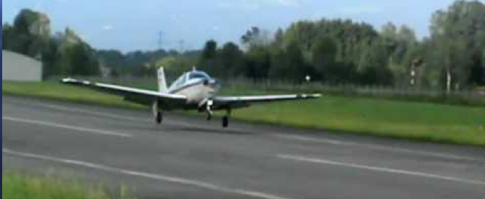
Thunderstorms
July 7, 1994
Beech A36 Bonanza
Wichita Jabara Airport
Four fatalities, one
“serious” injury
Aircraft destroyed
NTSB CHI94FA222

Slide 4
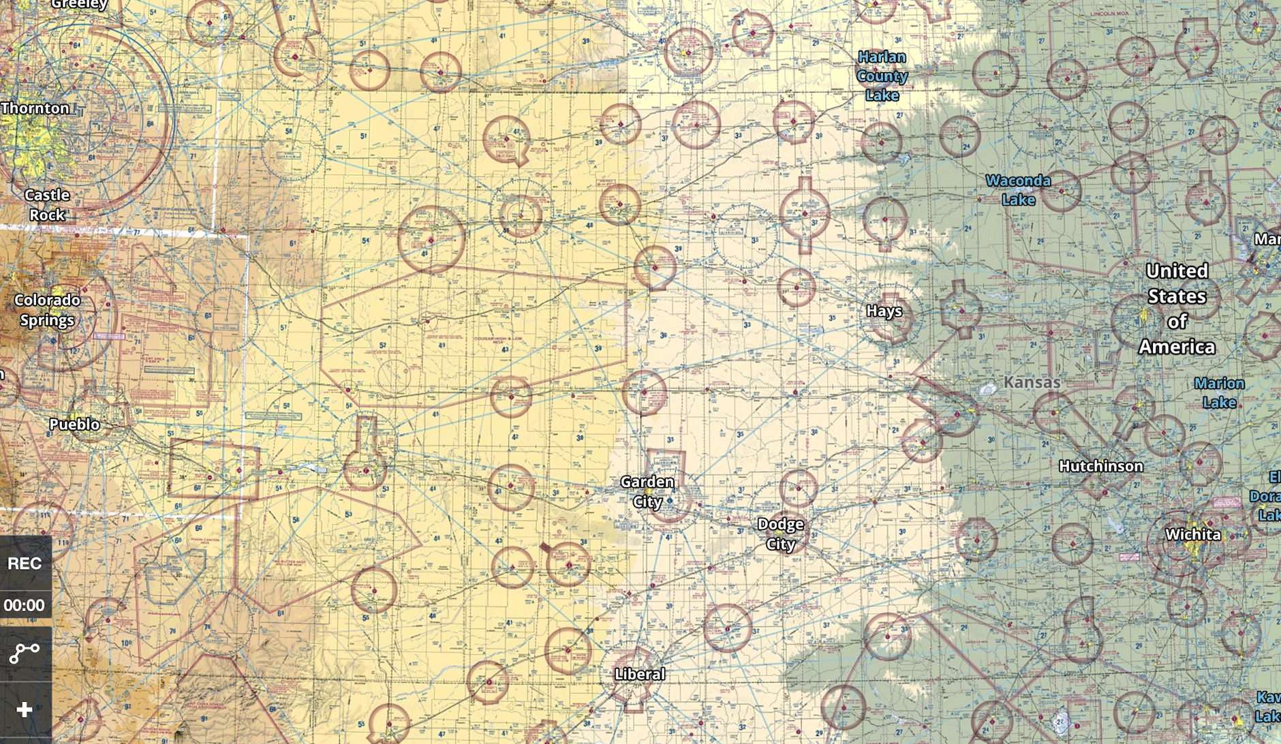

Slide 5
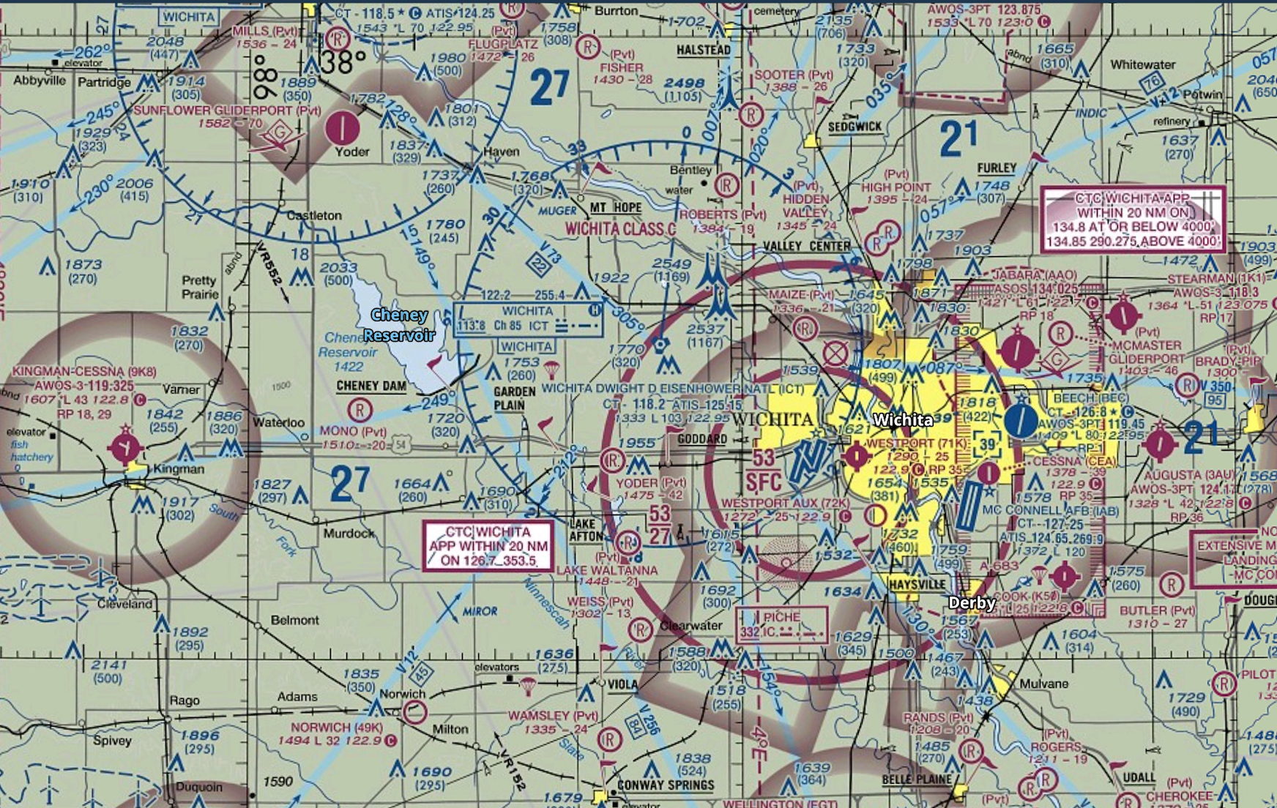

Slide 6
CHI94FA222
Departed Runway 18
At the same time a strong, northerly gust front arrived at the airport
Level 6 thunderstorm adjacent to airport
Abrupt wind shift with gusts to 58 knots

Slide 7
CHI94FA222
Witness reports:
Airplane pitched up and left wing dropped “as if the airplane was going to enter a spin”
“Engine sounded like it was producing full power”
Investigation
No evidence of preimpact failure
183 pounds over maximum weight and aft of CG limits

Slide 8
CHI94FA222
NTSB Probable Cause:
The pilot’s attempt to take off into known adverse weather and the subsequent stall.
Factors were the thunderstorm, the tailwind, and the excessive airplane gross weight and aft center of gravity

Slide 9
Thunderstorms
“Getting out ahead” of the weather
Outflow and gust fronts
Wind shear indications, recovery
Effects of weight and CG location on stability, performance and control

Slide 10
Mitigations
20-mile thunderstorm separation
Technology makes this easier
Compute aircraft weight and balance
Technology makes this easier now, too
Passenger expectations

Slide 11
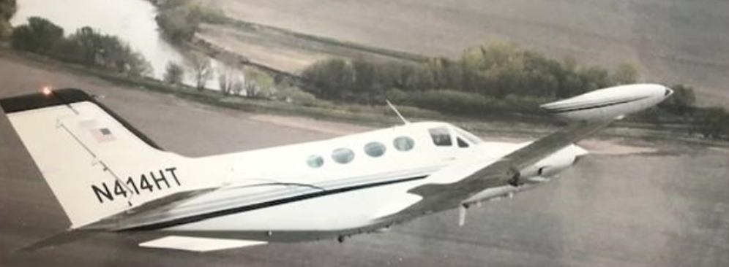
Reduced Visibility
February 16, 2008
Cessna 414A
Benton Air Park (Stearman Field)
Two fatalities
Aircraft destroyed
NTSB DEN08FA059

Slide 12
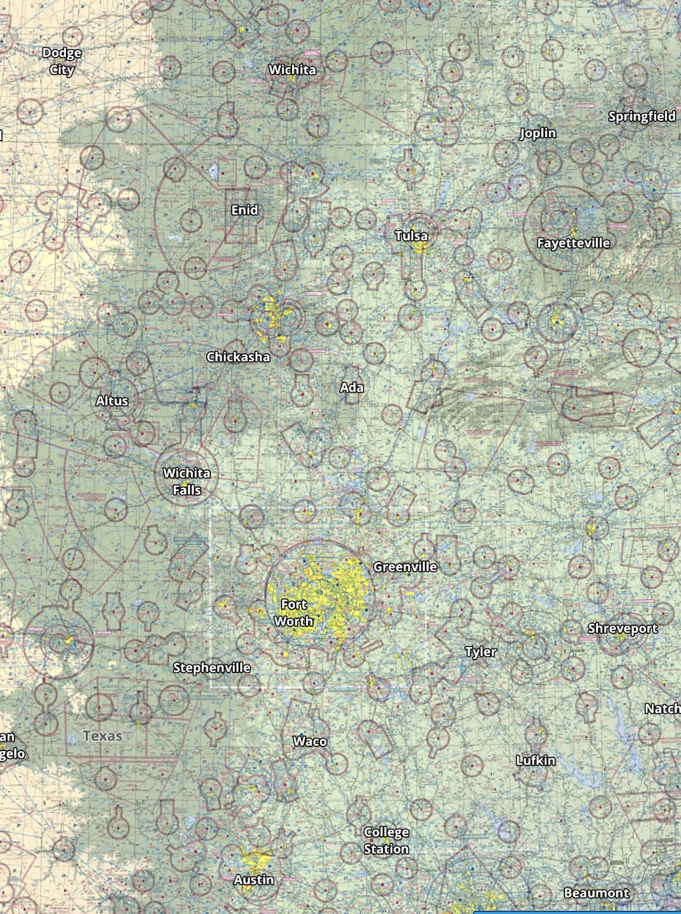
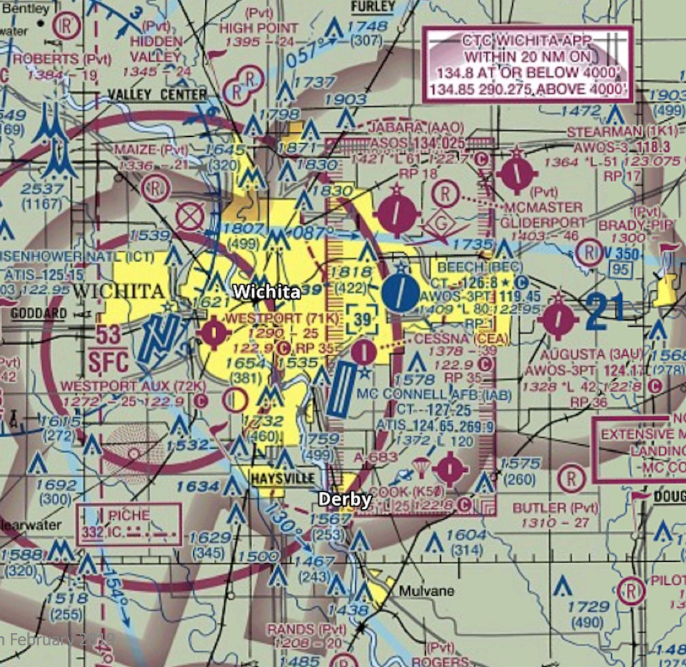

Slide 13
DEN08FA059
Witness reports:
Airplane departed Rwy 35 and “flying in and out of clouds”
Dark night “but could see silhouette of an airplane”
No evidence of preimpact failure
KAAO: 300 OVC, 6 in rain and mist, +1°C/0°C

Slide 14
Airspace
VFR Minimums

Slide 15
DEN08FA059
NTSB Probable Cause:
The pilot’s failure to maintain clearance from the trees.
Contributing: the pilot’s flight into known adverse weather conditions and the low clouds and visibility

Slide 16
Reduced Visibility
Short “positioning flight”
Behind schedule
Pressure to arrive
Night IMC
Ice avoidance?
Somatogravic “false climb” illusion

Slide 17
Mitigations
VFR minimums and IFR requirements
Treat a positioning flight the same as the trip itself
Personal and external pressure, and flight delays
Give yourself more than one day to get to an important event
Passenger expectations

Slide 18
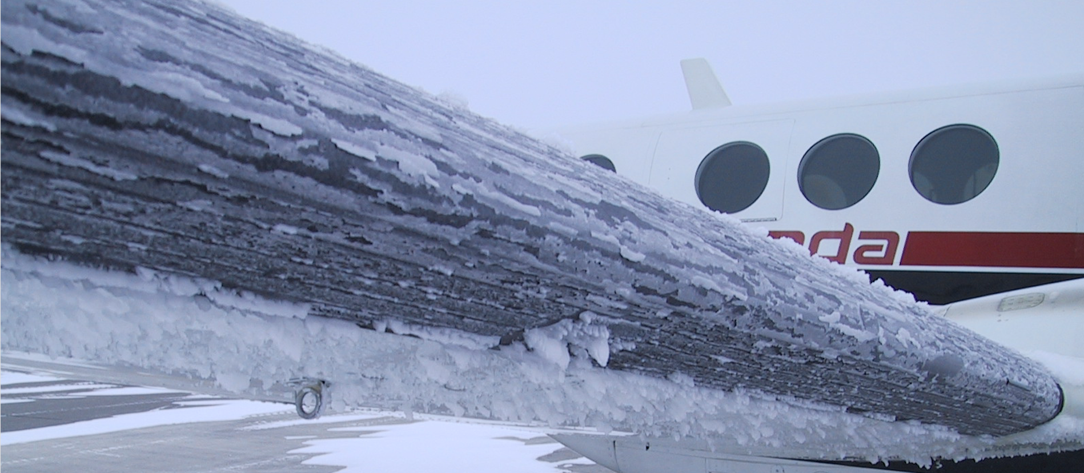
Airframe Ice
March 1, 2014
Beech B60 Duke
Wichita Mid-Continent (Eisenhower
National)
No injuries
Aircraft “written off”
ASN Occurrence # 164438

Slide 19
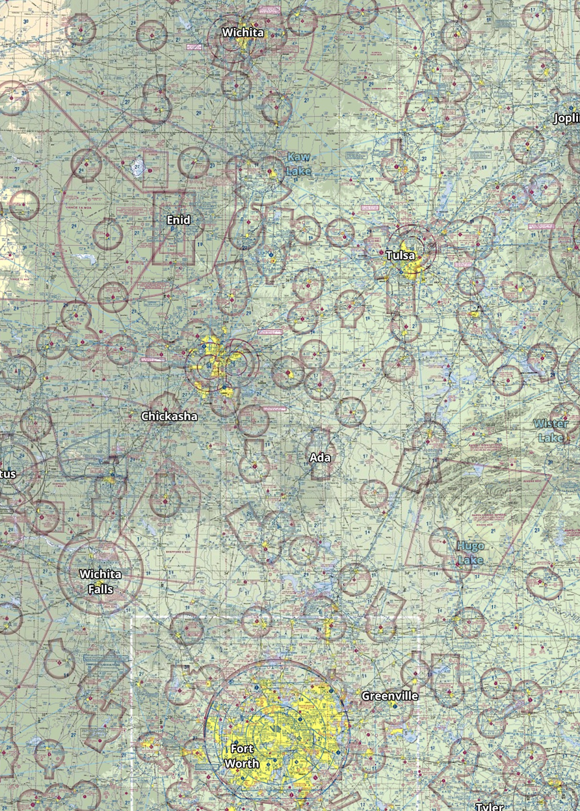
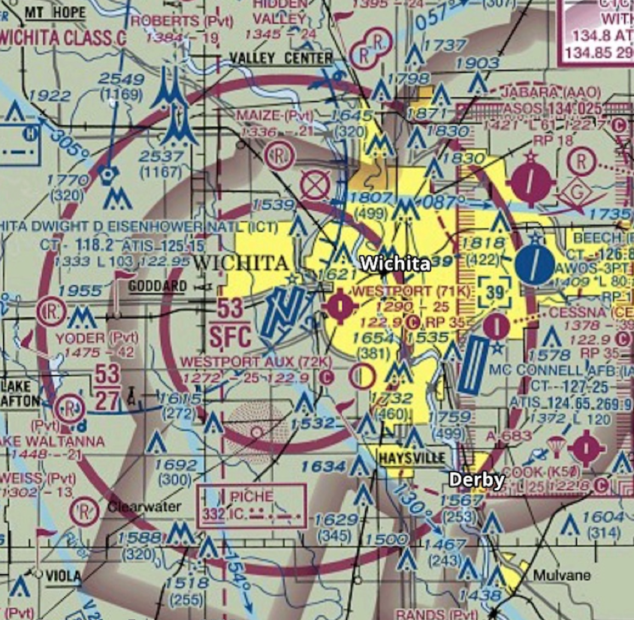

Slide 20
ASN Occurrence #164438
Instrument approach into KICT
Loss of airspeed, landed short of the runway
Aircraft damage “unknown”, but totaled

Slide 21
Airframe Ice
Limitations on Certification for Flight in Icing Conditions
Don’t approach into ice, or if unable to remove ice
Practice use of hot plate windshield for landing
Go around/balked landing

Slide 22
Aviation Weather Hazards
Thunderstorms
Turbulence
Reduced Visibility
Airframe Ice

Slide 23
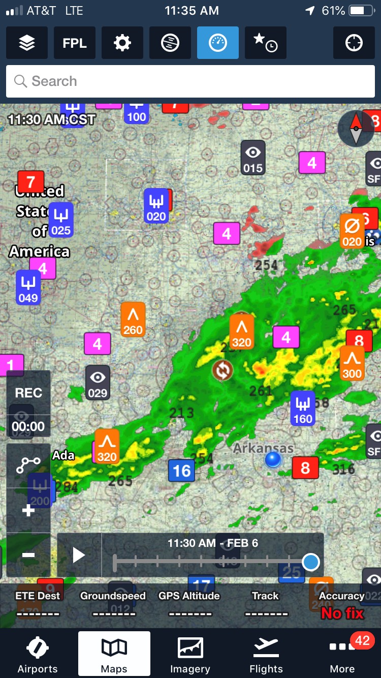
Making the Weather Decision
Expectations
Self-imposed time pressures
Aircraft limitations

Slide 24
www.mastery.flight.training.com

Slide 25
Decision Points: Lessons from Local Weather Accidents
Thomas P. Turner
Executive Director, ABS Air Safety Foundation

