Slide 1
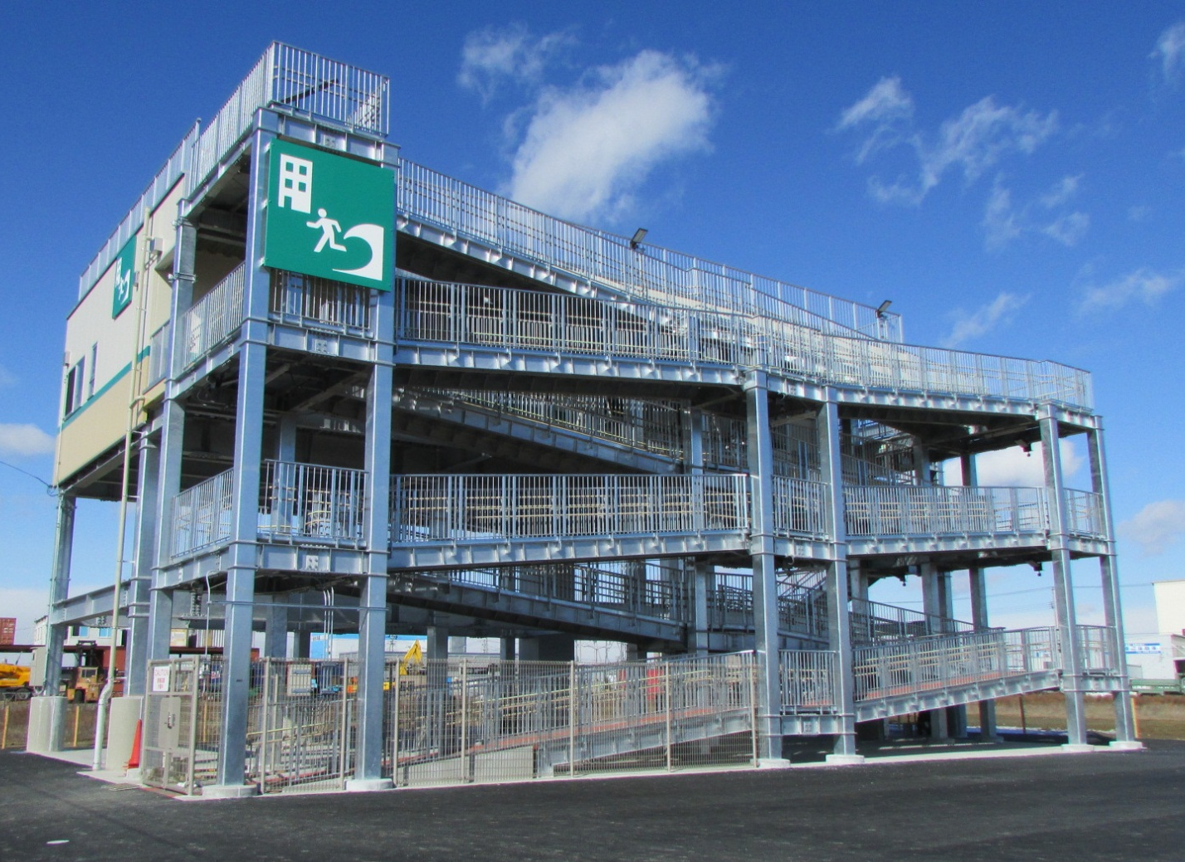
Development of
tsunami evacuation facilities
in Sendai city
Nakano 5-chome Tsunami evacuation tower
March 2015 Sendai City

Slide 2
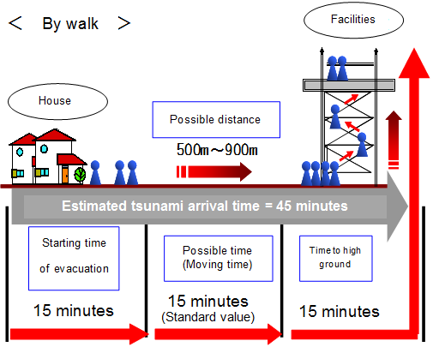
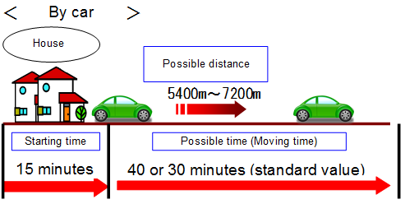

Orientations related to the development of tsunami evacuation facilities
「Sendai city earthquake disaster reconstruction plan」,「Execution plan of Sendai city」 etc.
To be reviewed by the research committee
Basic concepts related to the development of tsunami evacuation facilities（March 2013）
○Concept of the target area
Target area：Eastern part of the Sendai Tobu expressway ※Areas outside the target area will also be considered if necessary.
Estimated tsunami arrival time：Set to 45 minutes
○Concept of evacuation by walk and car
・Assumes the evacuation follows pedestrian general rules
(Including bicycles)
・Assumes car evacuation considering evacuees on it
○Concept of population estimation
Population is assumed referring to occupation at major properties before the disaster(villages※, parks, etc.) and considering ongoing reconstruction and relocation projects.
※Except for disaster hazard zones
○Concept of evacuation behavior
①Estimated
evacuation
by walk
Possible to walk to nearby evacuation facilities or high ground
People who are living in villages
People who are in recreation facilities, etc.
Evacuees inside the target area
People who need evacuation with attention
People who need support during disaster
Elderly, disabled person, etc.
Pregnant women, newborn baby, etc.
②Estimated
evacuation
by car
People who need evacuation for long distance
Farmers inside agriculture areas, etc.
People who are on cars at the moment of the disaster
Evacuees who are on the road, etc.
（Arrow is a moving of human or car）
※Confirmed that all the evacuees completed their evacuation by evacuation behavior simulation
(Evacuation method of villages is set as 80% by walk and 20% by car)
○Facility requirements
Concept for size and capacity：
・To be set based on evacuation distance and method, and the assumed population evacuation behavior
・To ensure about 1㎡ area per evacuee
Concept for facility：
・Moving to high place ex)Lighting, Outside stairs, etc.
・Emergency case ex)Water, Provisions, Medical supplies, Blanket, Partition, etc.
・Others ex)Toilet, Emergency power source, Information equipment, etc.

Slide 3
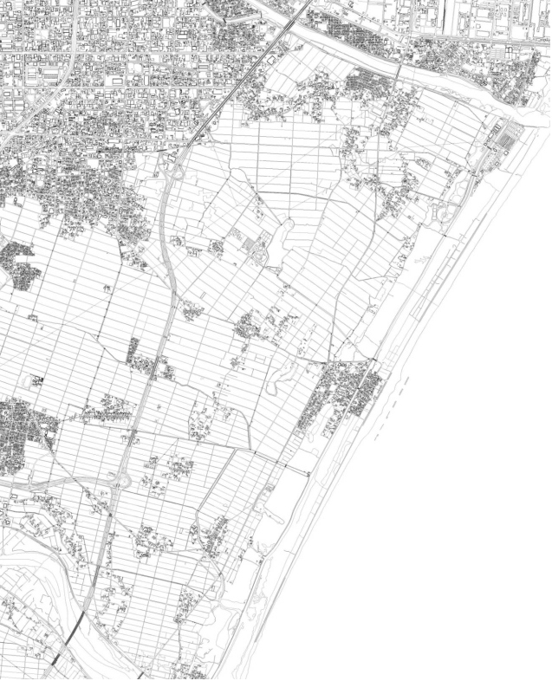

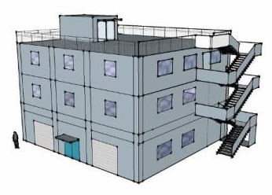
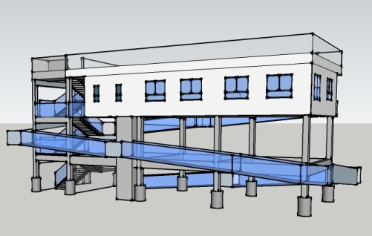

Placement of tsunami evacuation
【Legend】
Takasago Junior high school
（Evacuation stairs）
Nakano 5-chome Tsunami evacuation tower
(Tower type・300people)
Existing evacuation facility belonged to the city
City’s land that is considered for the placement of evacuation facilities (Capacity)
Konan Tsunami evacuation tower
(Tower type・250people)
Okada Elementary school
（Evacuation stairs）
Evacuation stairs at the slope of the Tobu road
Minamigamo Tsunami evacuation tower
(Tower type・250people)
Main evacuation route
Gamo-maedori Tsunami evacuation building
(Building type・400people)
Elevated road
Inundation areas other than the target areas for moving
Shinhama Tsunami evacuation tower
(Tower type・250people)
Sasayashiki Tsunami evacuation building
(Building type・300people)
Sanbontsuka-nakayachi Tsunami evacuation tower
(Tower type・150people)
Sanbontsuka-gonta Tsunami evacuation building
(Building type・250people)
Ido Tsunami evacuation tower
(Tower type・125people)
Futaki Tsunami evacuation building
(Building type・400people)
Tanatsugi Tsunami evacuation building
(Building type・100people)
Figure of image
Building Type
（Establish together with fire station）
Tower Type

Slide 4
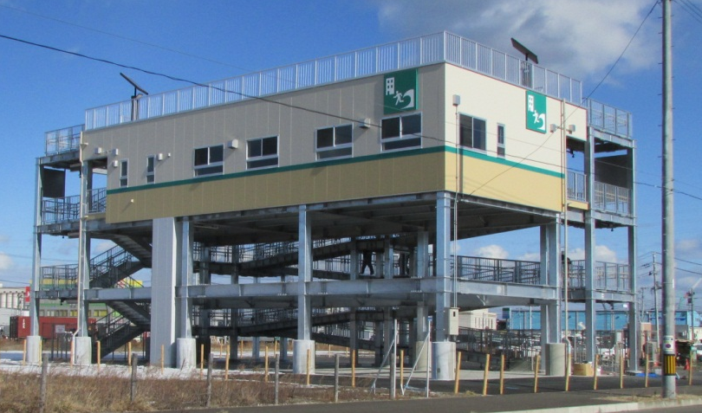
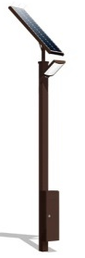
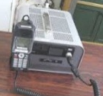
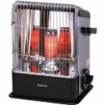


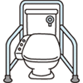


Outline of the Nakano 5-chome Tsunami evacuation tower
○Facility overview
・Location：5-chome Nakano, Miyagino Ward, Sendai (Sendai Port Hinterland Park No.3)
・Construction cost：Approx. 230 million yen ・Construction：Steel-frame (double layer)
・Floor area：400㎡ ・Maximum occupancy：Approx. 300 people
・Height above ground level：Enclosed evacuation space 6.6m; rooftop evacuation space 9.9m
・Tsunami countermeasures：Taking into consideration liquefaction and tsunami wave power, 26.4m foundation
pillars were used. The tower is also sturdily built to withstand collisions with flotsam
○Features of the Tsunami Evacuation Tower
Provisions for a nighttime loss of power
In order to facilitate a nighttime evacuation even when power has been lost, solar power generating pillars are installed on the roof to light the stairs, ramp, and rooftop.
In addition, a gas-powered generator and an LED floodlight are stockpiled.
Accommodation for evacuees in wheelchairs
A ramp is included to accommodate evacuees in wheelchairs.
A means of communication with the outside
Measures against cold weather and wind
An emergency wireless set is stocked to allow communication with Sendai’s Disaster Response Headquarters during evacuation.
An enclosed space is provided as a measure against cold weather and wind. Blankets and gas stoves are also stockpiled.
○Features of the Enclosed Evacuation Space (height equivalent to third story of a building)
Consideration of emotional stress during evacuation
Consideration of the needs of the elderly
Out of consideration for emotional stress during an evacuation, the interior space can be partitioned with accordion curtains.
Benches and a spacious bathroom take into consideration the needs of the elderly during evacuation.
Stockpiled supplies
Bench
Outside stair
・Food, water, blankets
・First aid kit,
emergency radio
・Generator, floodlight
・Gas stoves
・Simple toilet set
・Emergency wireless set
・Rope
・Lifejacket, inner tube
Accordion curtain
Toilet
Stockpiled space
アコーディオンカーテン
Evacuation space
Lavatory
Stockpiled space
Entrance
Outside corridor
Entrance
Ramp
【Contact】 City of Sendai Crisis Management Department Disaster-resilient City Promotion Section
〒980-8671 7-1, Kokubuncho 3-chome, Aoba-ku, Sendai
Tel:022-214-3047/Fax:022-214-8096 Mail:kks000120@city.sendai.jp

