Slide 1
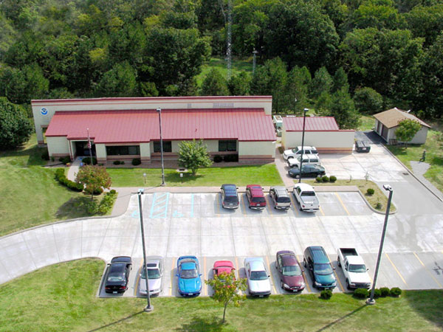
Welcome to the National Weather Service Decision Support Workshop

Slide 2
National Weather Service Decision Support Workshop
AGENDA:
8:00 am…Welcome and Introductions (Wes Browning, Meteorologist in Charge)
8:15-9:30…Review of National Weather Service Emergency Management Products
(Jim Kramper, Warning Coordination Meteorologist and Mark Fuchs, Hydrologist)
9:30-9:45…Break
9:45-10:15…Dissemination Methods for National Weather Service Products (Jim Kramper)
10:15-10:45…Decision Support Services (Wes Browning)
10:45-11:30…Overview of Damage Surveys (Ron Przybylinski, Science and Operations Officer)
11:30-12:30…Lunch
12:30-1:30…Interpretation of WSR 88D Imagery (Fred Glass and Mark Britt, Senior Forecasters)
1:30-1:45…Break
1:45-2:30…Emergency Simulations…Interpretation of NWS Products and EM Responses (Wes Browning)
2:30-3:00…Open Discussion Centered on EM Requirements (Group)

