Slide 1
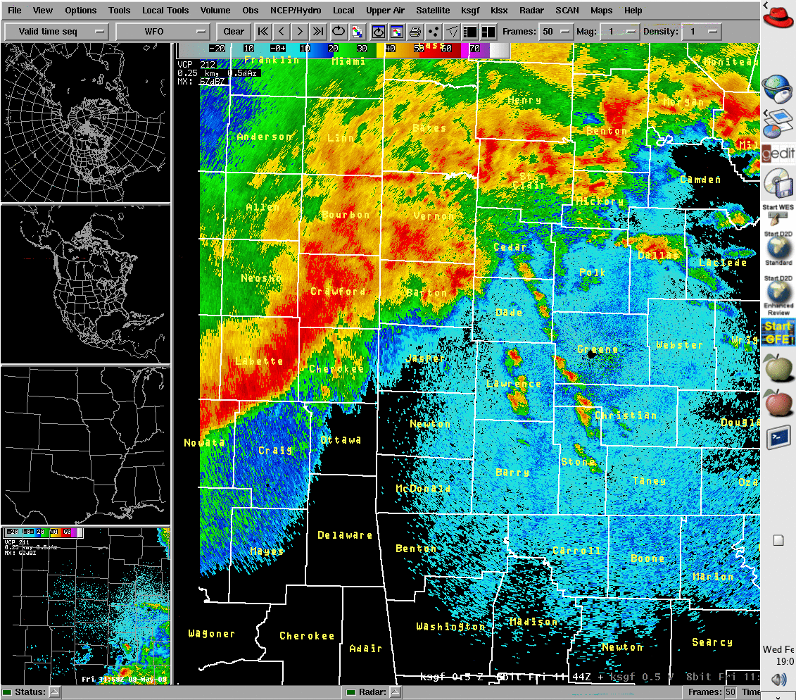
Case 1…You are the Emergency Manager for Jasper County Using this reflectivity image and the following 2 velocity and storm-relative velocity images, what type of severe weather (if any) would you expect?

Slide 2
Velocity

Slide 3
Storm-Relative Velocity

Slide 4
STOP!
DO NOT TURN PAGE

Slide 5
Case 2 (Part 1)…30 minutes later… You are the Emergency Manager for Dade County. Using reflectivity, velocity, and storm-relative velocity images, what kind of severe weather do you expect?

Slide 6
Velocity

Slide 7
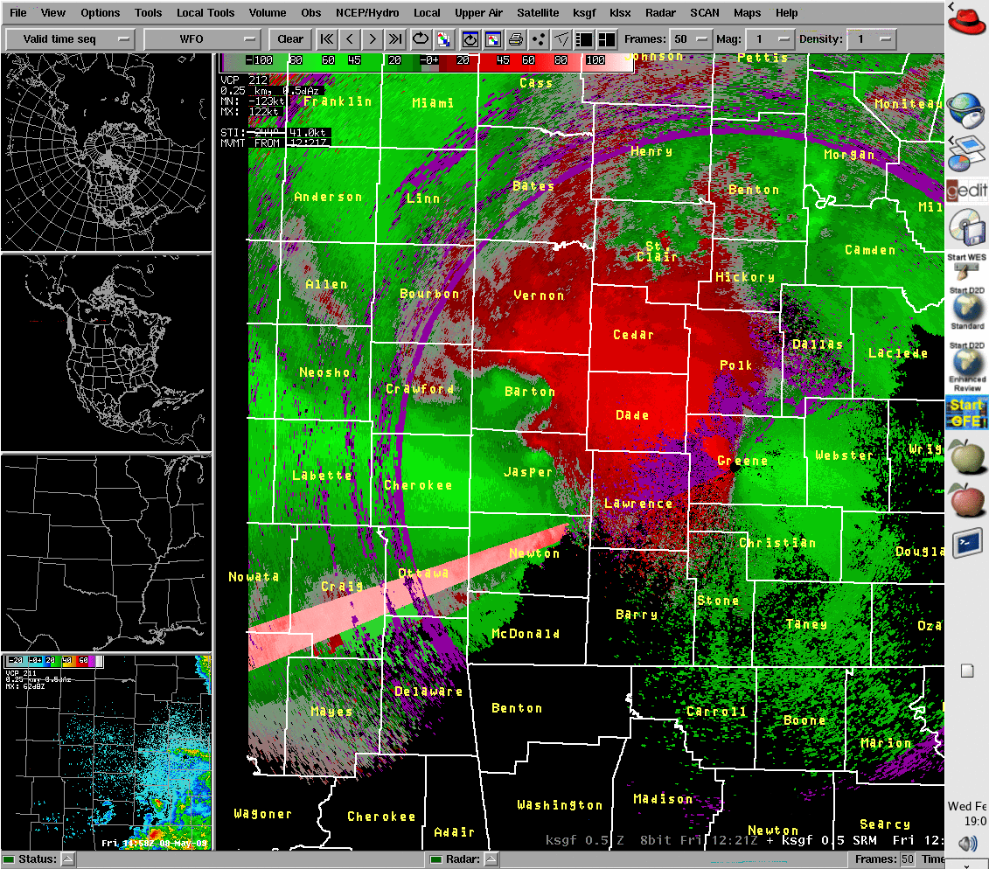
Storm-Relative Velocity

Slide 8
STOP!
DO NOT TURN PAGE

Slide 9
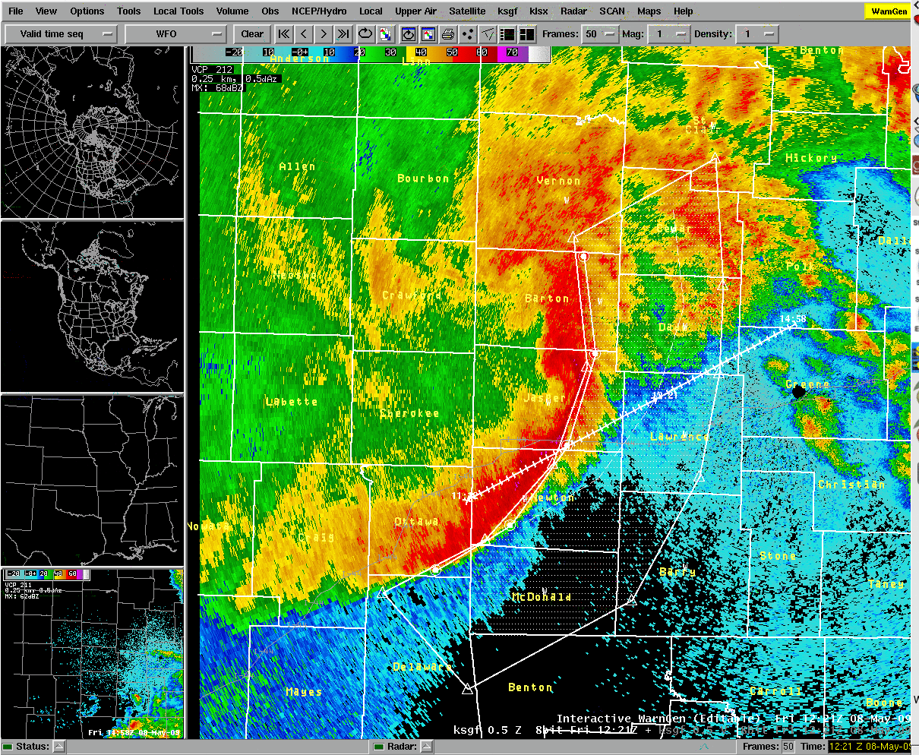
Case 2 (Part 2)…A Severe Thunderstorm Warning has been issued for winds up to 100 mph for the boxed area, including your county…Dade (see next slide). What additional information do you need?

Slide 10
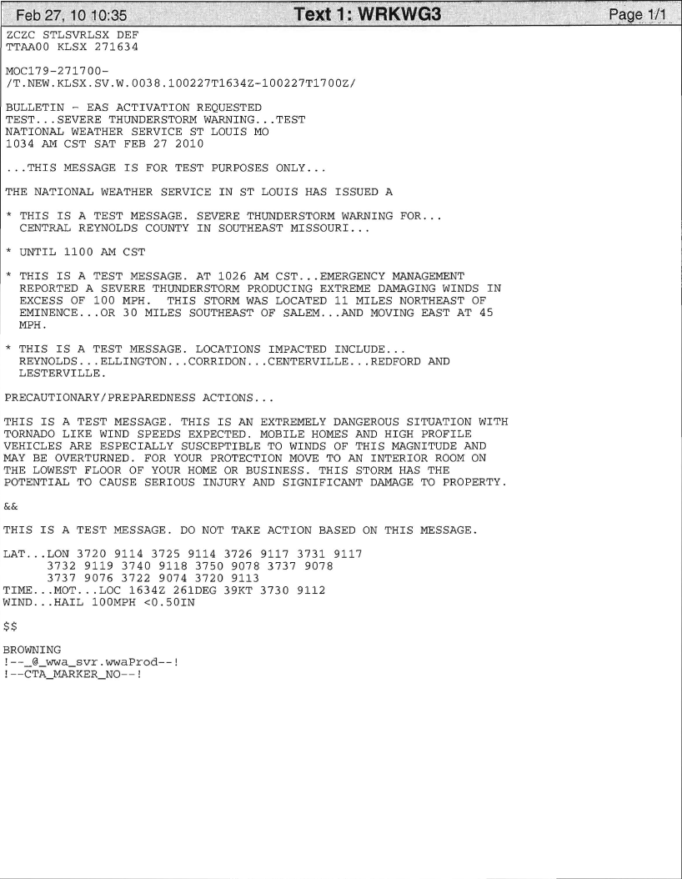
Example of new severe with wind/hail tag line

Slide 11
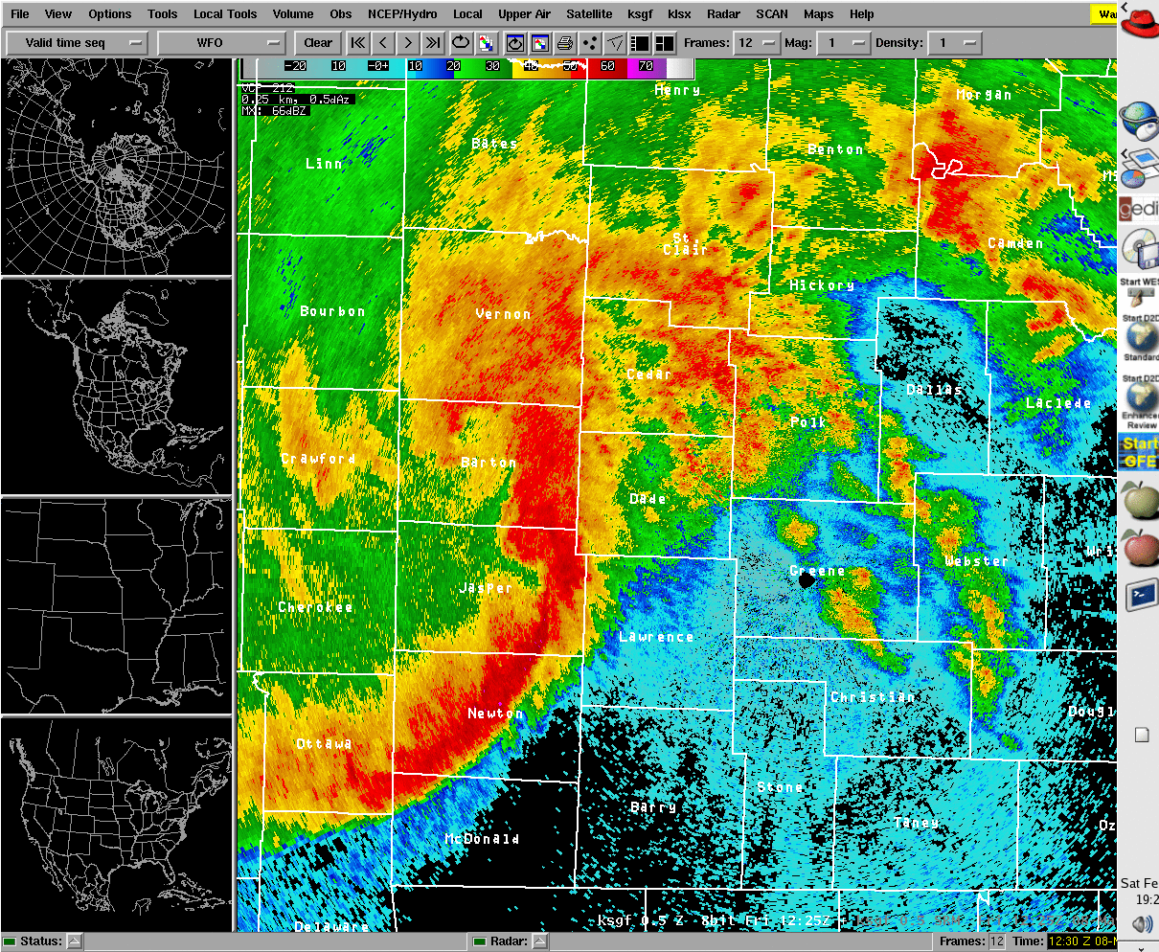
5 minutes later, the reflectivity looks like this…

Slide 12
Velocity

Slide 13
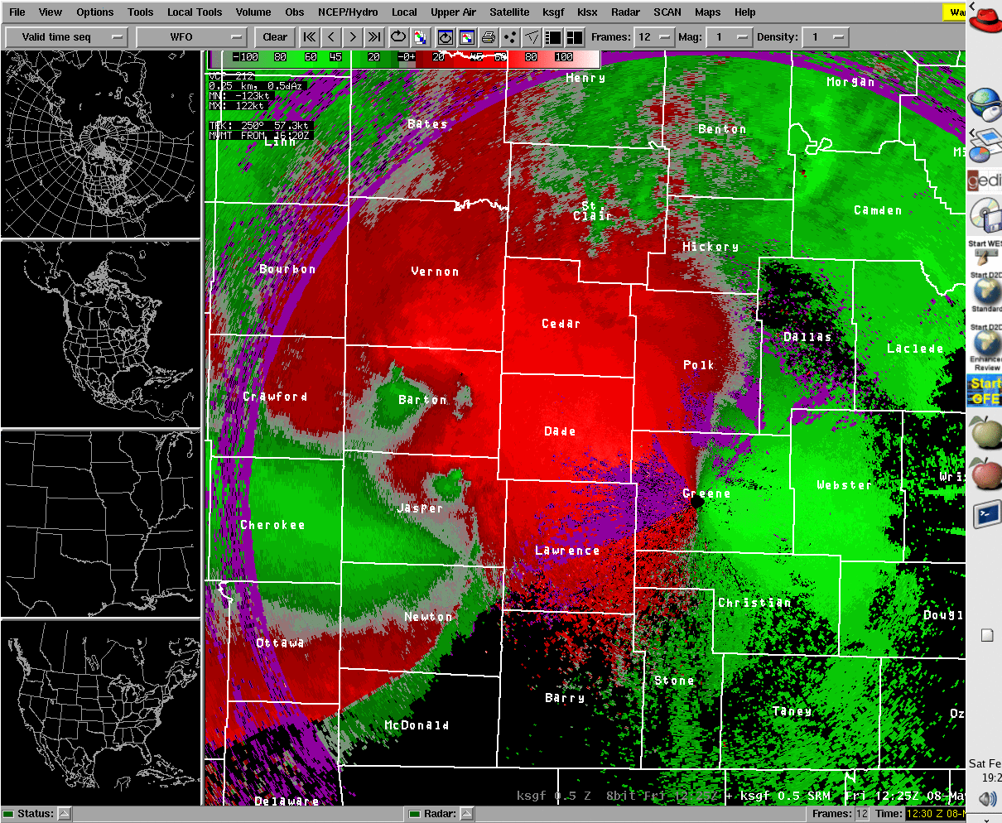
And the Storm-Relative Velocity looks like this…

Slide 14
What type of severe weather would you expect in Dade County?
What actions would you take as EM?

Slide 15
STOP!
DO NOT TURN PAGE

Slide 16
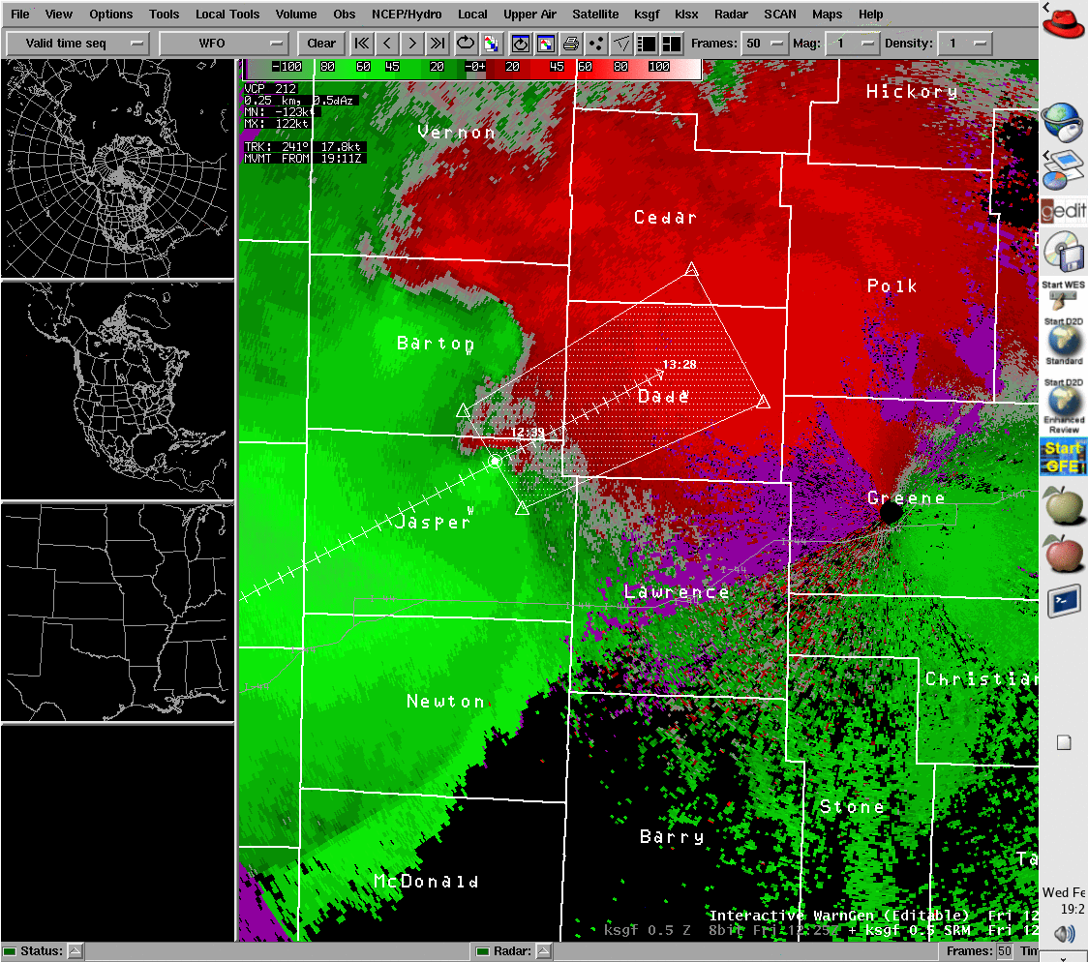
Case 2 (Part 3)…A Tornado Warning (see next slide) has been issued for the boxed area . What actions would you now take as EM, and what additional information would you like to have?

Slide 17
Example Tornado Warning

Slide 18
STOP!
DO NOT TURN PAGE

Slide 19
Case 3…You are the EM for St. Louis County. It’s February, and you see the following radar images from the NWS St. Louis EM webpage. What type of severe weather (if any) would you expect? Reflectivity

Slide 20
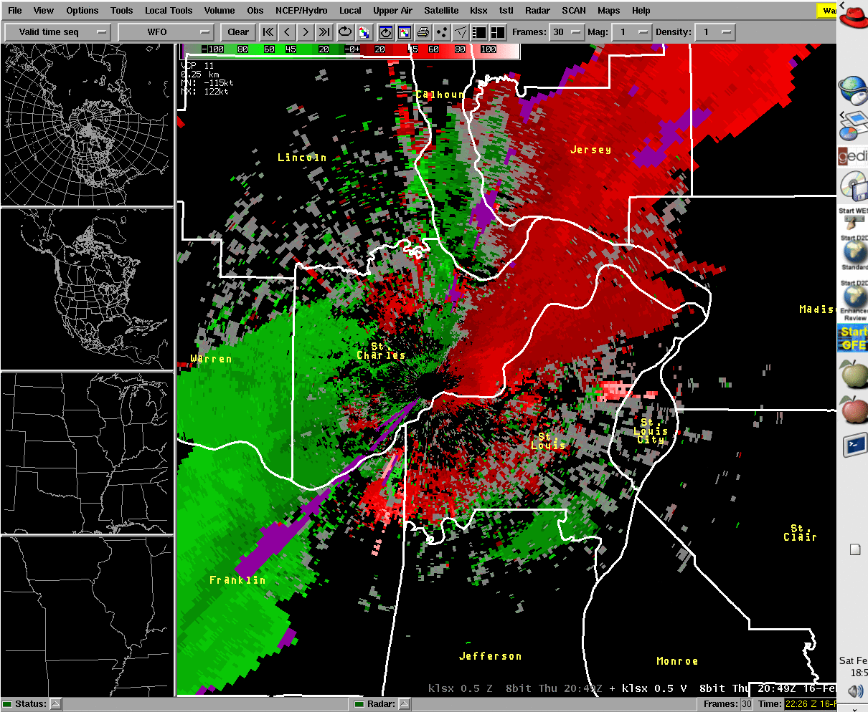
Velocity

Slide 21
Storm-relative Velocity

Slide 22
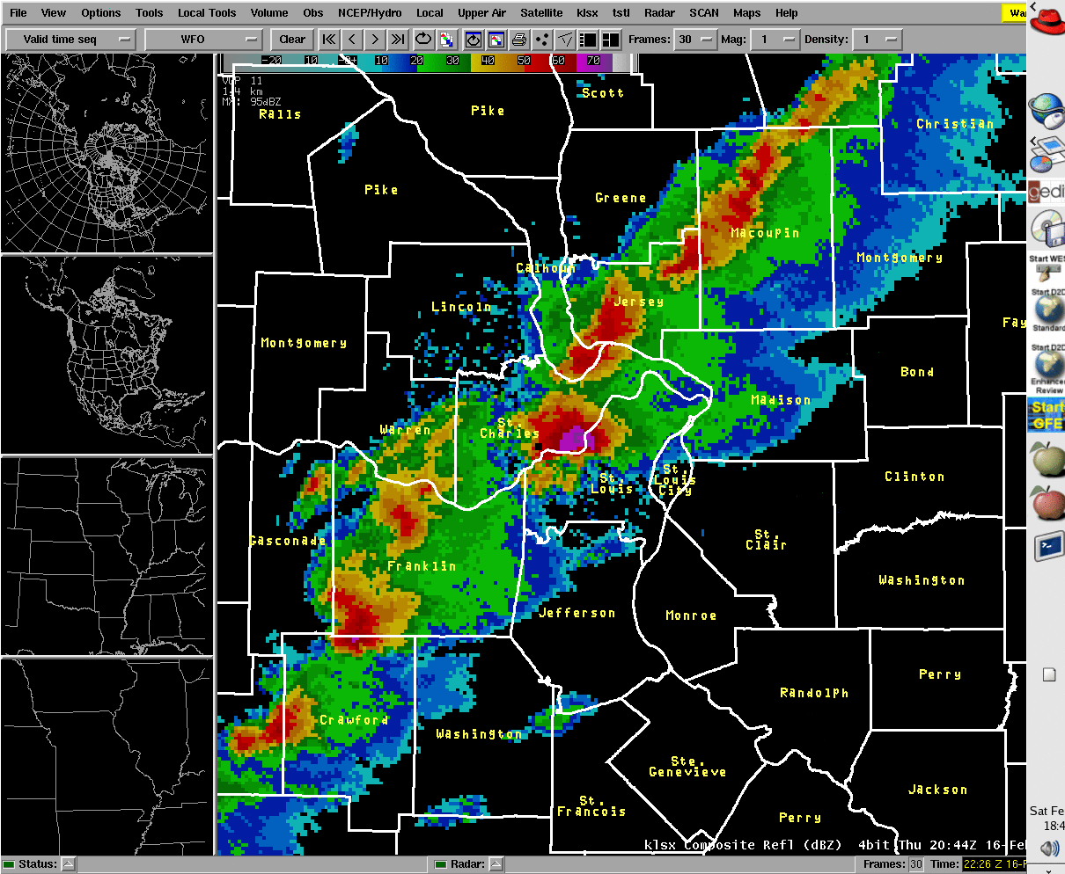
Composite Reflectivity

Slide 23
STOP!
DO NOT TURN PAGE

Slide 24
Composite Reflectivity
Hail up to baseball size pounded the northwest part of St. Louis County. Several automobile dealerships suffered major damage to
their vehicle inventory. Many homes from Maryland Heights, to Hazelwood, to Florissant, to Spanish Lake were going to need new
roofs due to the hail damage. Many private vehicles were also damaged by the hail.

Slide 25
STOP!
DO NOT TURN PAGE

Slide 26
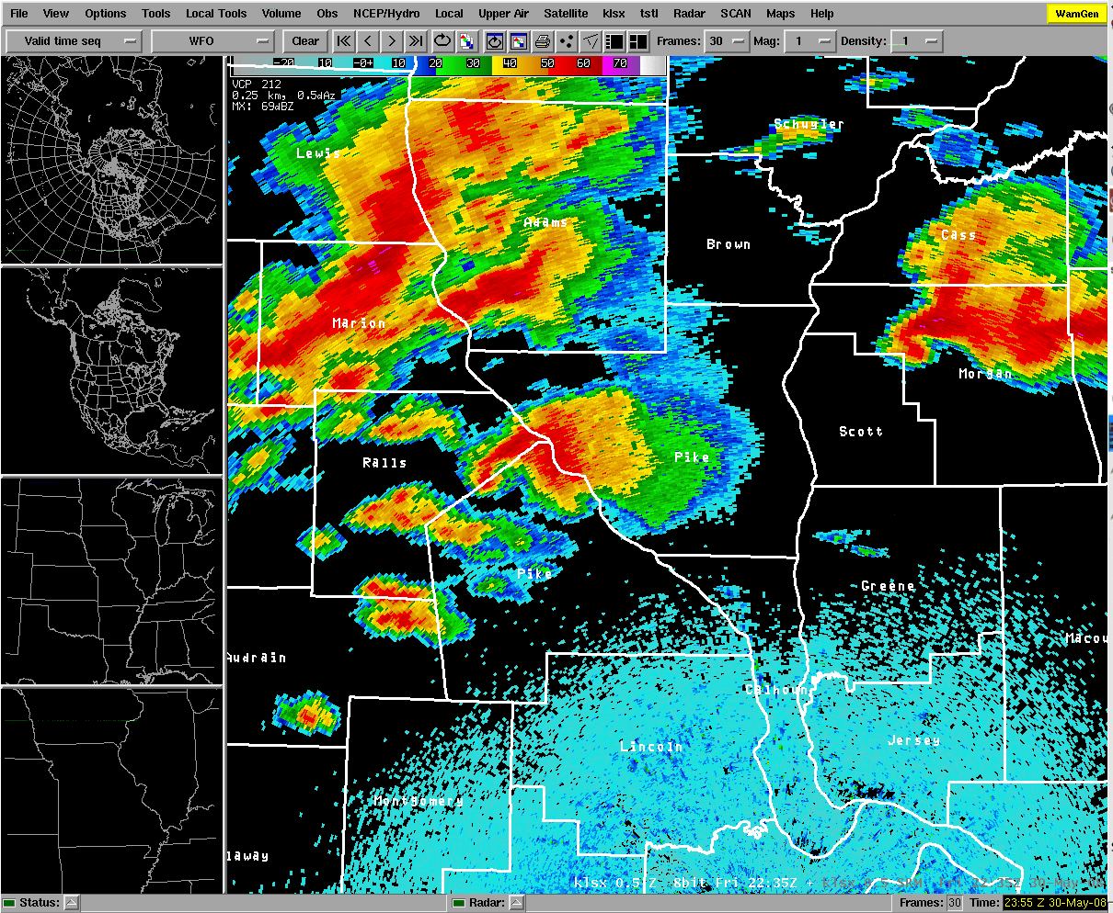
Case 4…You are the EM for Pike County, Illinois. What type of severe weather (if any) would you expect? Reflectivity

Slide 27
Velocity

Slide 28
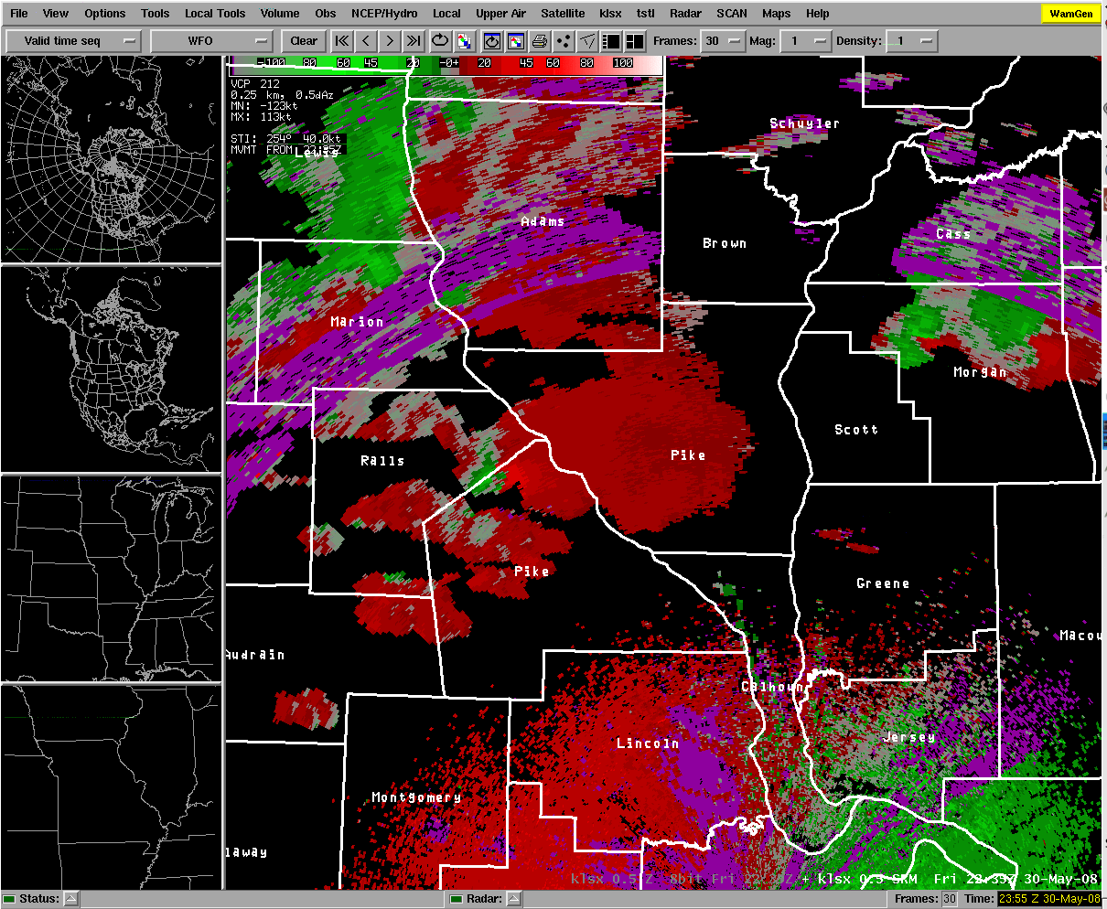
Storm-relative Velocity

