Slide 1
Changes to the St. Louis
Hydrologic Service Area
Mark Fuchs
Service Hydrologist

Slide 2
Four new forecast points
Two RFC-supported forecast gages
  PMZM7: Middle Fork Salt River near Holliday, MO
  DRCM7: Dardenne Creek at St. Peters, MO
Two Locally-supported forecast gages
  LSLM7: Peruque Creek above Lake St. Louis, MO
  TGRM7: Hinkson Creek at Columbia, MO

Slide 3
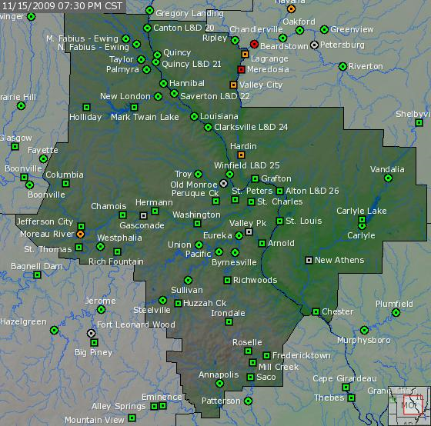
New NCRFC River Forecast locations

Slide 4
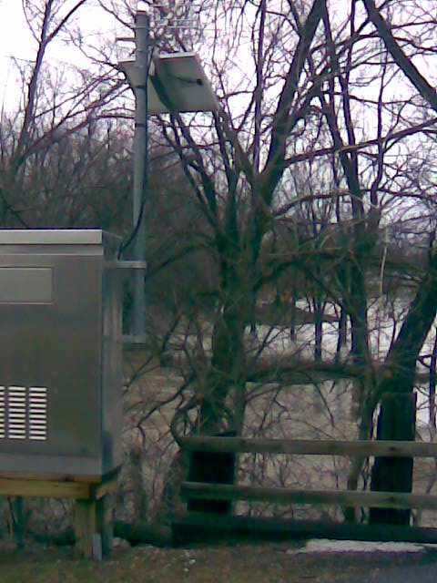
DRCM7 - Dardenne Creek at St. Peters, MO

Slide 5
DRCM7 – Dardenne Creek at St. Peters, MO
Basis: Widespread flood impacts both up and downstream of the gage. Parks, athletic fields, roads, and agricultural concerns. Local officials for the city of St. Peters show considerable interest.
Status: Currently being calibrated by NCRFC.

Slide 6
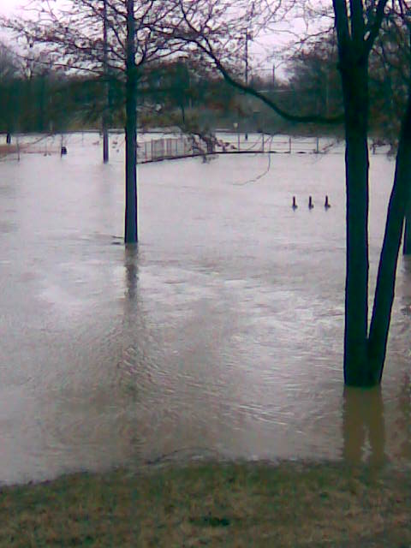
DRCM7 - February 6, 2008

Slide 7
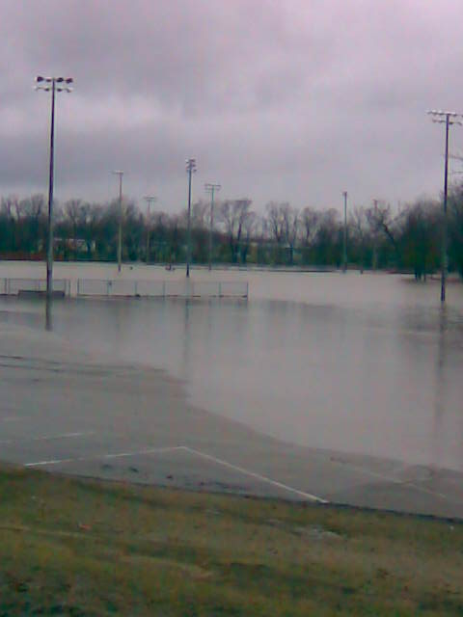
Ball field flooding – February 6, 2008

Slide 8
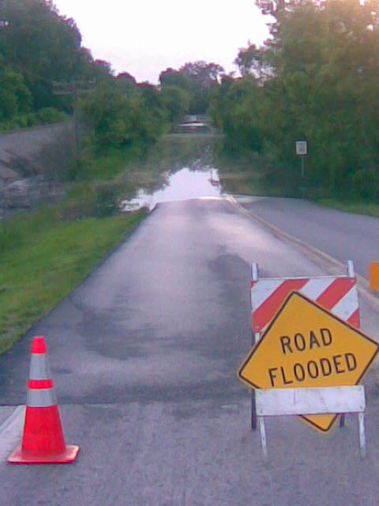
Salt River Road flooding – May 26, 2008

Slide 9
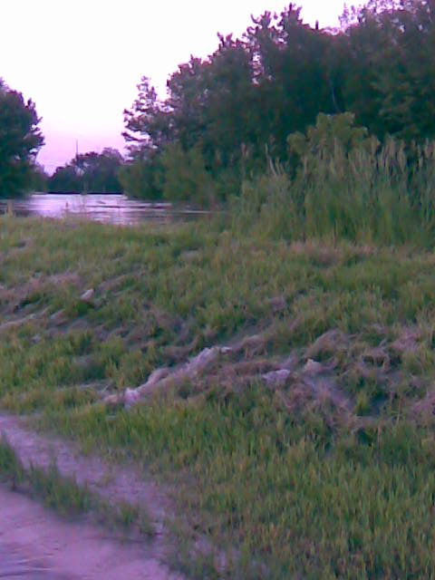
Highway C levee in bad shape

Slide 10
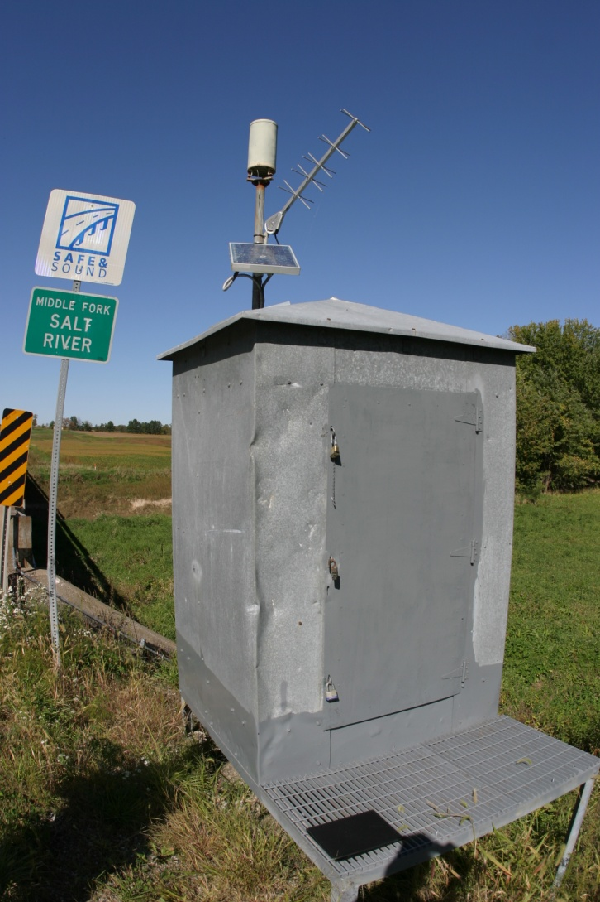
PMZM7 – Middle Fork Salt River near Holliday, MO

Slide 11
PMZM7 – Middle Fork Salt River near Holliday, MO
Basis: City of Paris City Superintendent is showing considerable interest. Major flooding generates widespread road closures and threatens residential structures and businesses in Paris.
Status: Calibration completed by NCRFC. Flood-only forecasts are now available via the MSPRVFTMO products.

Slide 12
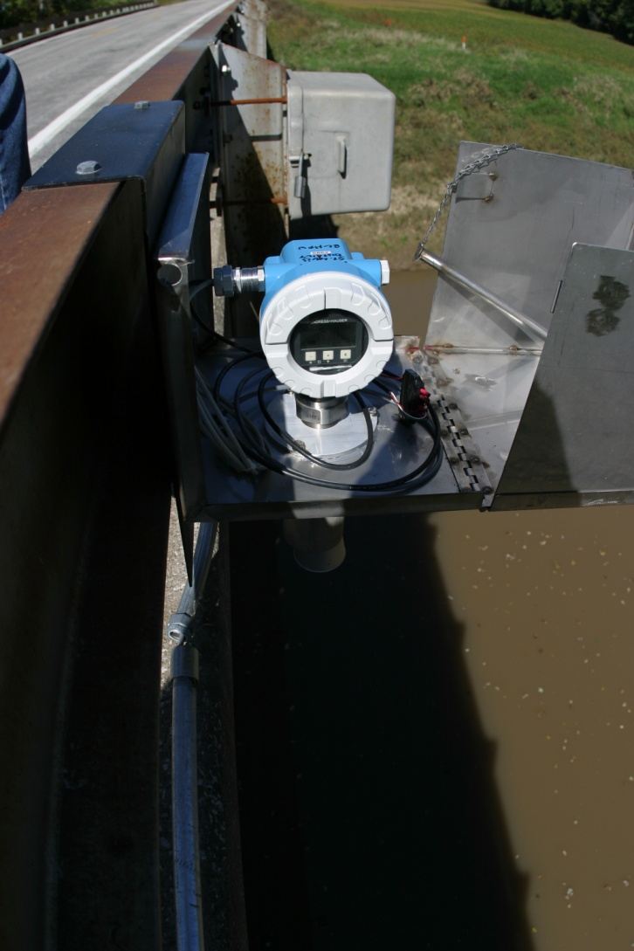
Optical Doppler river gage

Slide 13
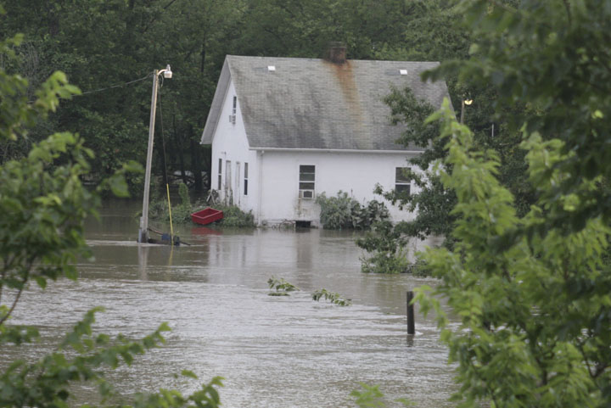
Paris impacts: Flood of July, 2008

Slide 14
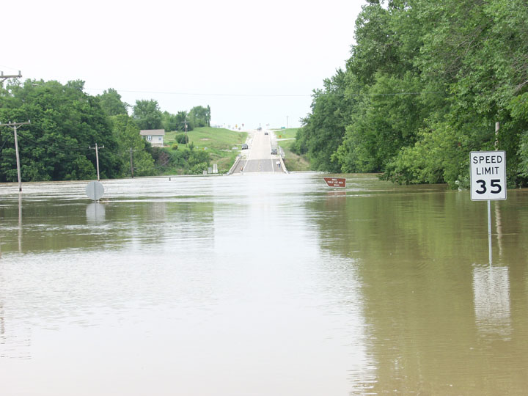
Highway 24 (Main Street) looking north

Slide 15
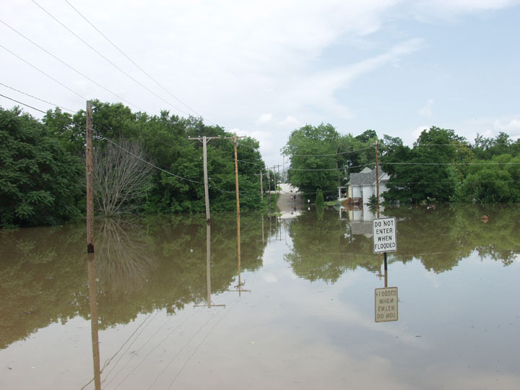
Paris: East Locust Street

Slide 16
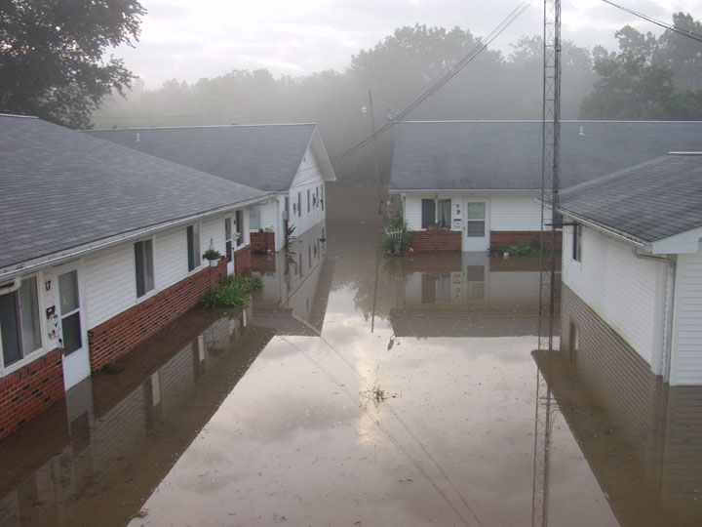
Paris Senior Center

Slide 17
Meramec River at Fenton, MO
Basis: Significant flood impacts in downtown area and in downstream residential areas. City officials would like a gage on the new Gravois Road bridge (old Gravois Road, new bridge) ONLY if we provide forecast services.
Status: NCRFC has agreed to develop and USGS has agreed to install if city can provide adequate funding.

Slide 18
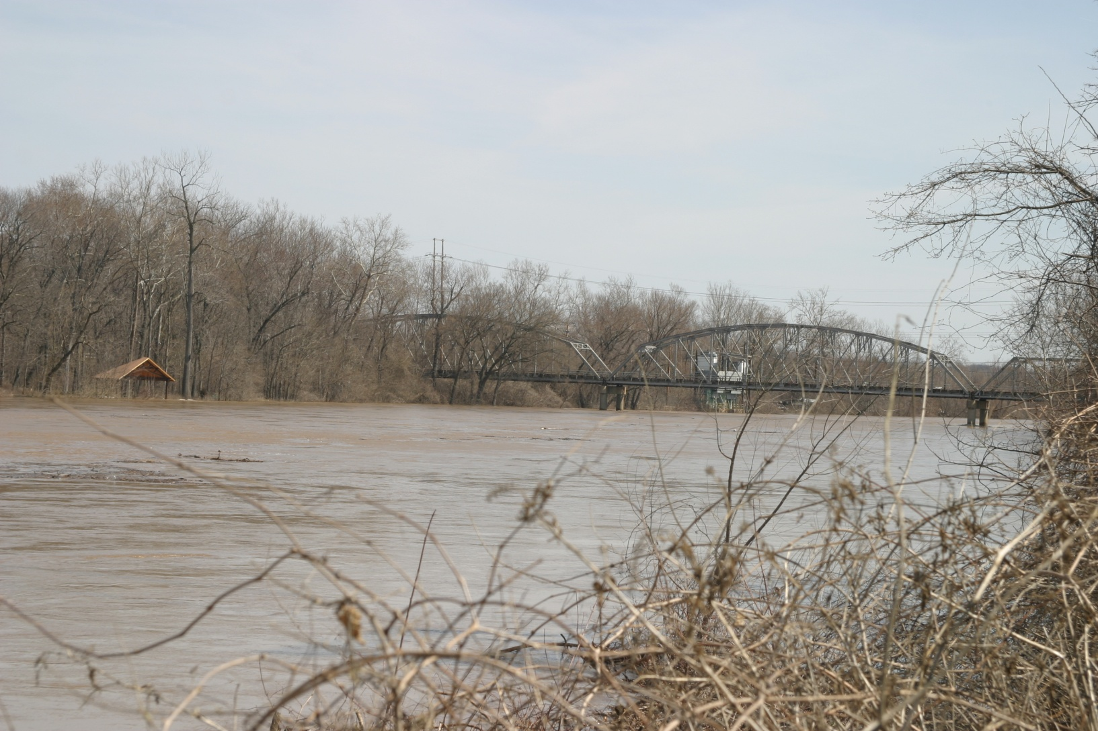
Meramec River at Fenton, MO

Slide 19
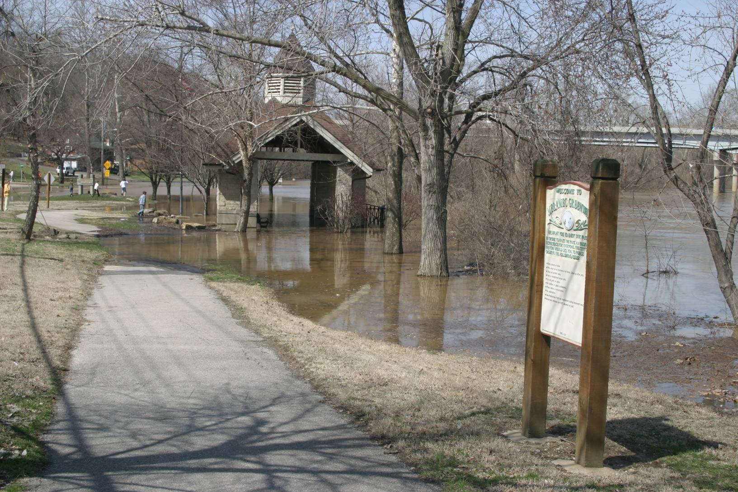
Fenton flooding: March 2008

Slide 20
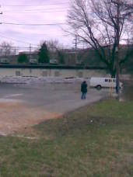
Fenton flooding: March, 2008

Slide 21
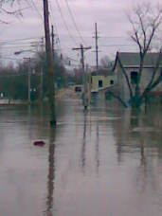
Downtown Fenton: March, 2008

Slide 22
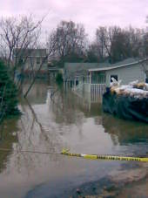
Downtown Fenton: March, 2008

Slide 23
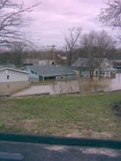
Downtown Fenton: March, 2008

Slide 25
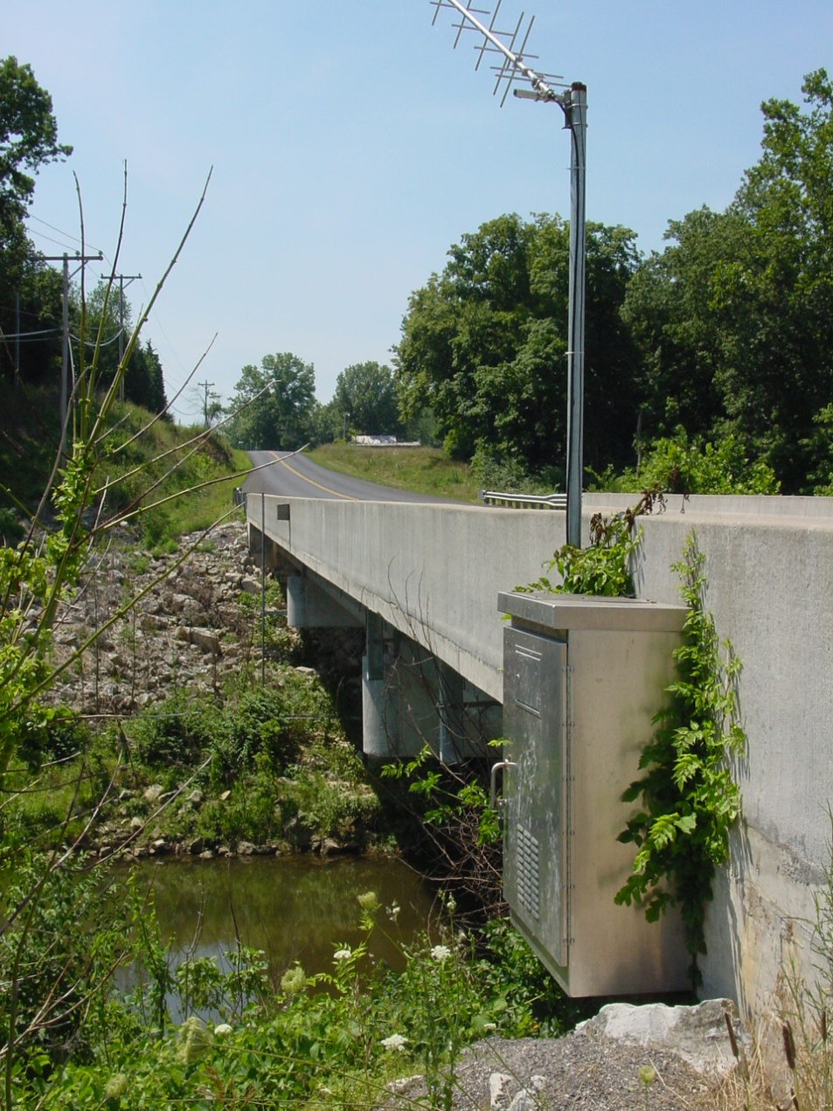
LSLM7 – Peruque Creek above
Lake St. Louis, MO

Slide 26
LSLM7 – Peruque Creek above
Lake St. Louis, MO
Basis: Considerable flooding of significant roadways (Hoff Road, Koch Road, Summit Estates Drive, and Highway P), along with some businesses. Mayor of St. Paul, MO is very supportive.
Status: Site Specific parameters and NWSRFS calibration are nearing completion.

Slide 27
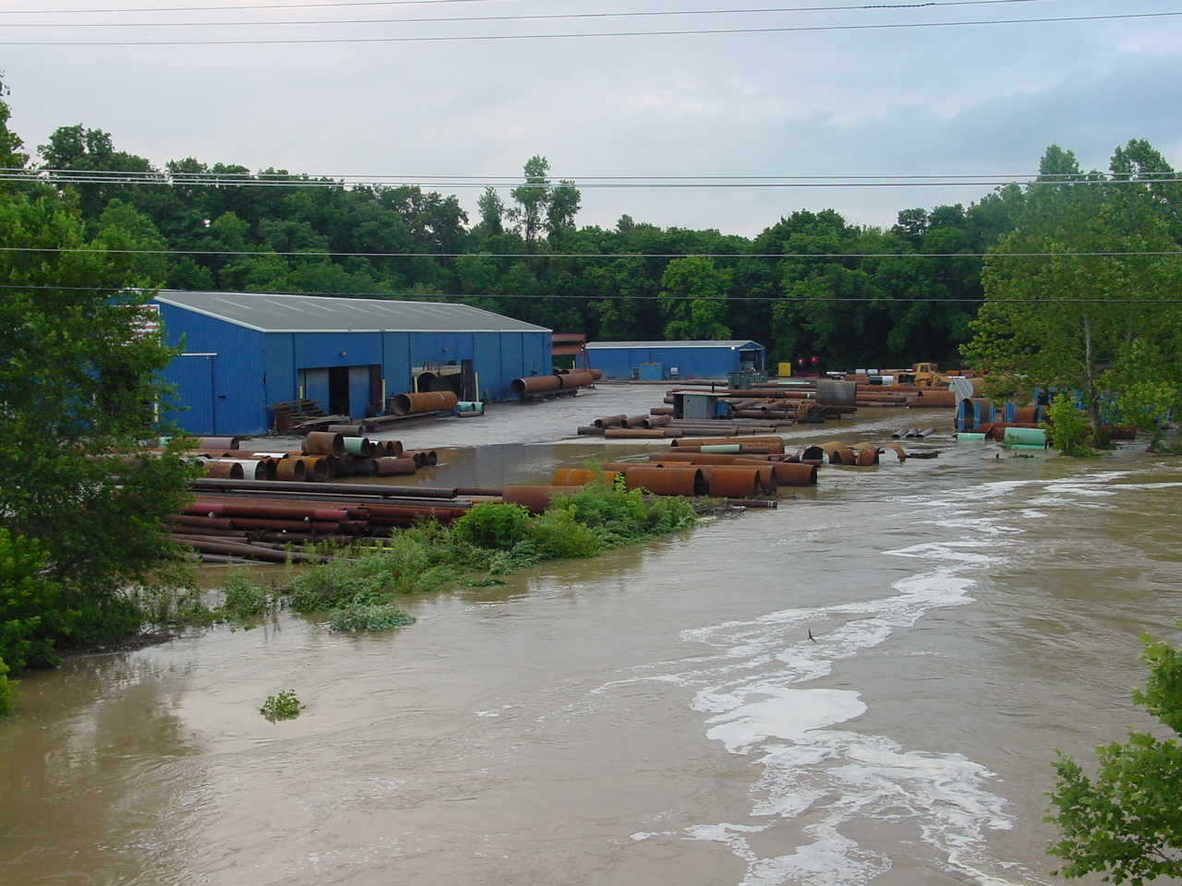
Just below the Lake St. Louis Dam
June 15, 2009

Slide 28
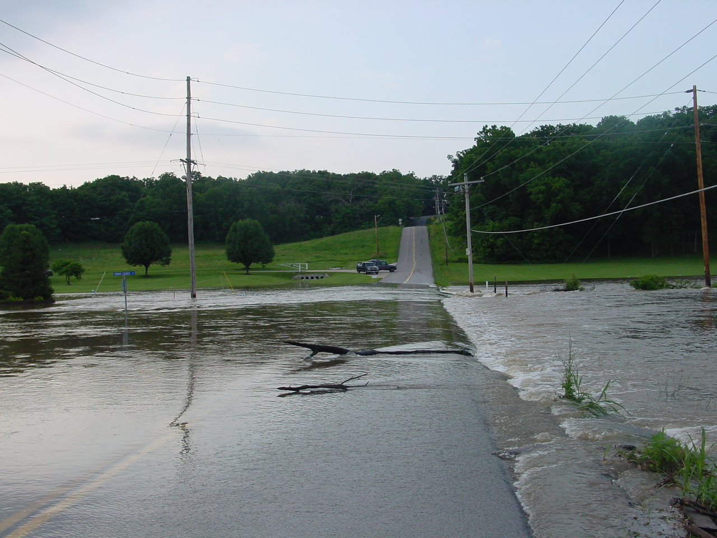
Summit Estates Drive & Hoff Road

Slide 29
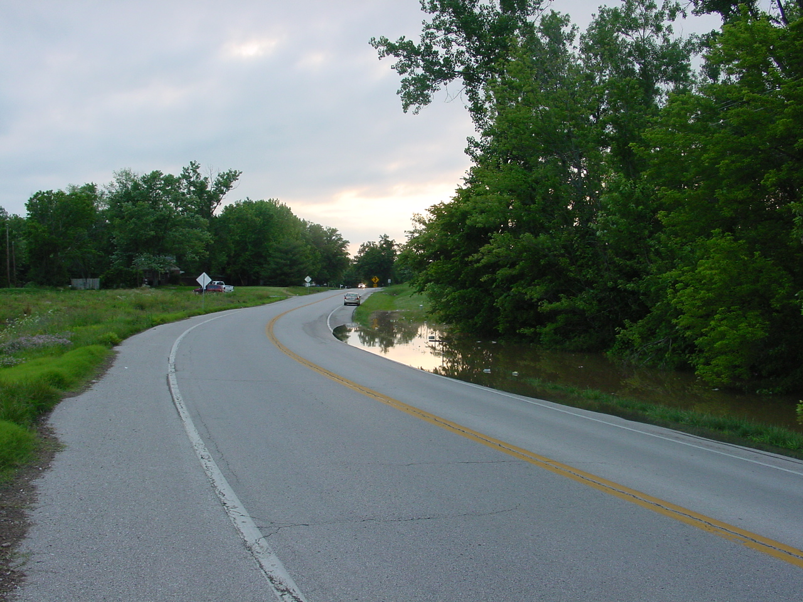
Highway P west of Peruque Creek
June 15, 2009

Slide 30
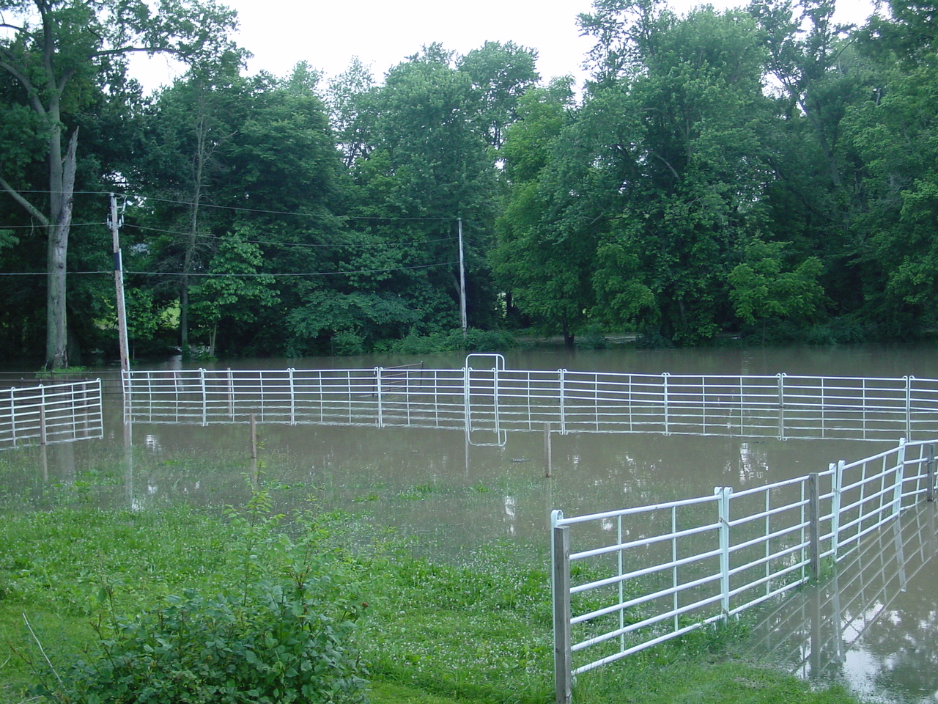
Bunker Drive off Koch Road
June 15, 2009

Slide 31
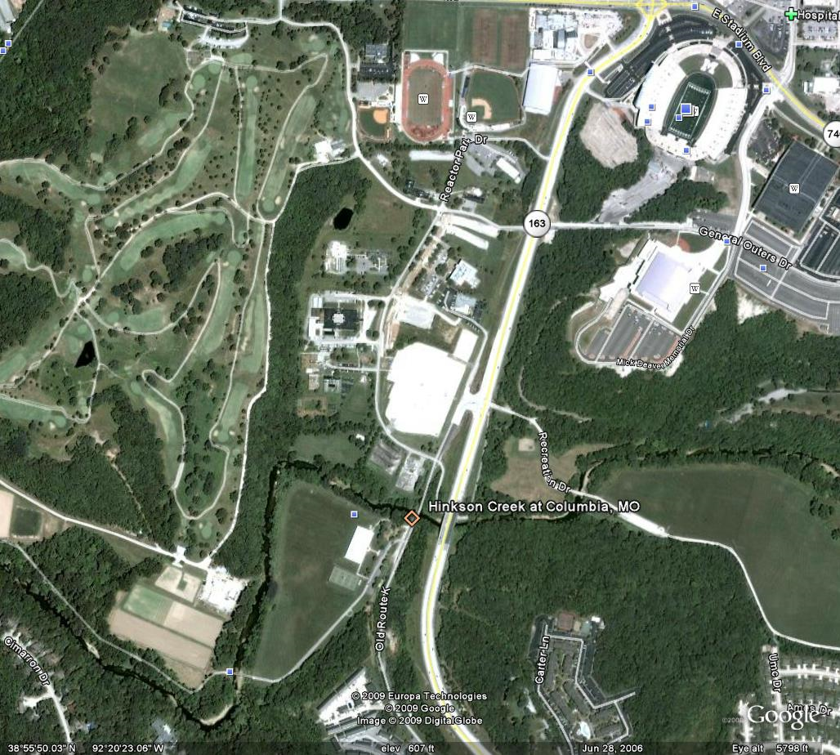
TGRM7 – Hinkson Creek at Columbia, MO

Slide 32
TGRM7 – Hinkson Creek at Columbia, MO
Basis: Boone County EM has shown considerable interest with impacts to numerous athletic fields near the gage and a power substation at the gage. Level of impact to upstream apartments and two golf courses currently unknown.
Status: MBRFC just beginning calibration and SSHP parameter development. Target date is 31 January 2010. Will pursue as a full RFC-supported forecast point, but may defer to Site Specific if events dictate better model performance.

Slide 33
Local Forecast Points
Multisensor Precipiation Estimator (MPE)
Site Specific Hydrologic Predictor (SSHP)

