Slide 1
Decision Support Services for Hydrology, a.k.a. Advanced Hydrologic Prediction Services (AHPS)
Mark Fuchs
Service Hydrologist
WFO St. Louis, MO

Slide 2
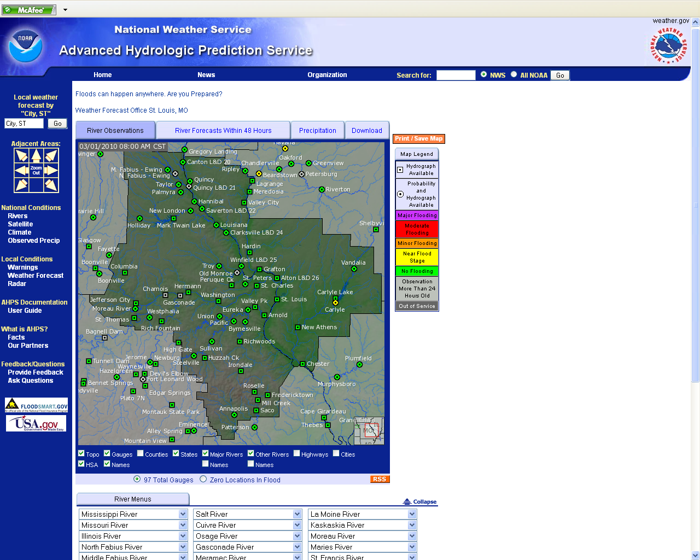

Slide 3
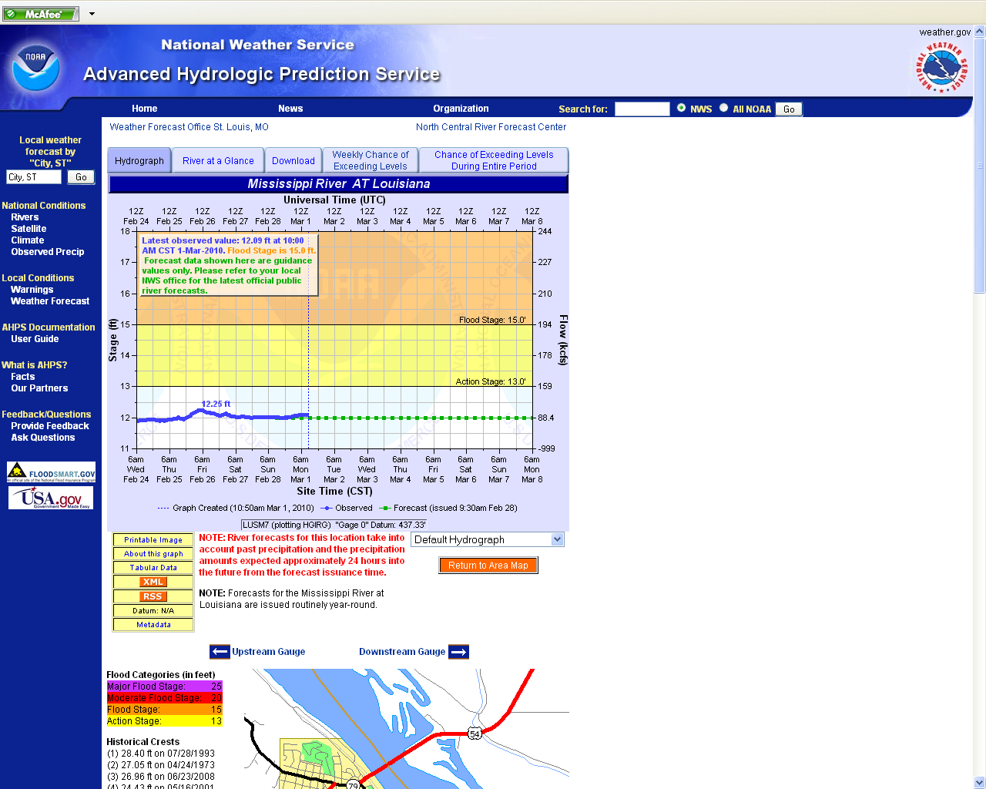

Slide 4
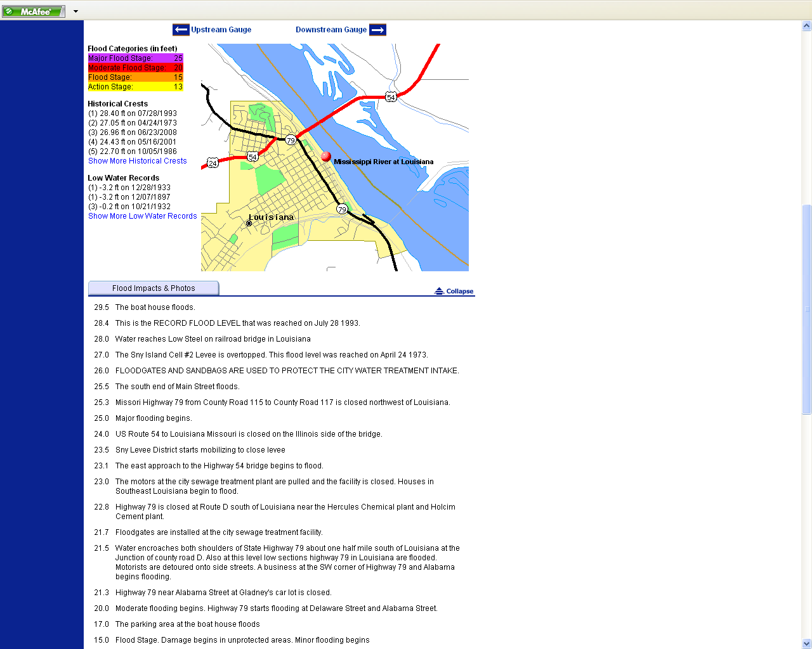

Slide 5
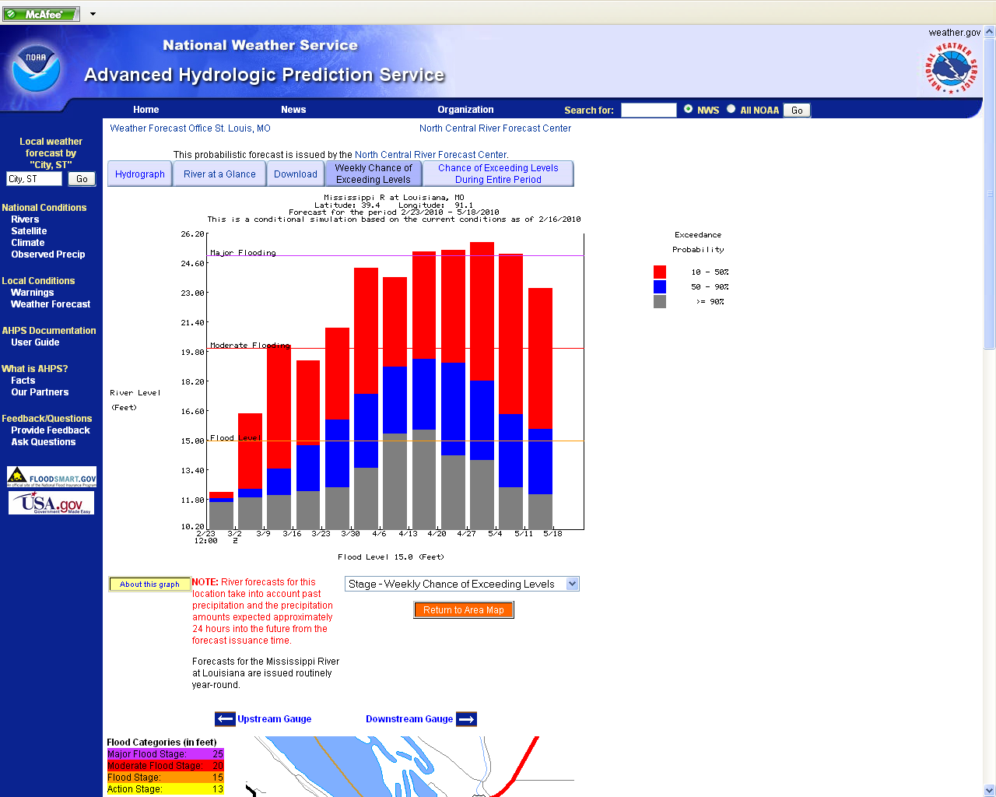

Slide 6
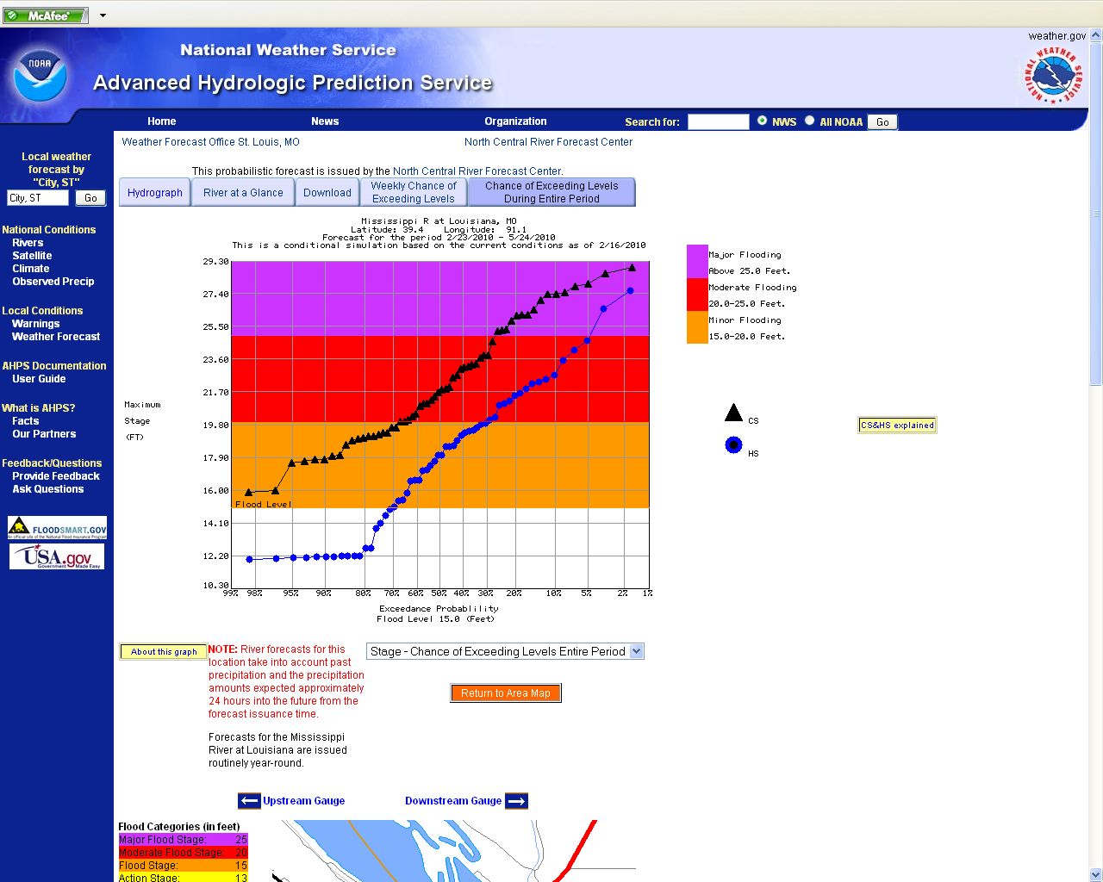

Slide 10
New Addresses (maybe) on March 16
National River Forecast Point Map:
Old: www.weather.gov/ahps
New: water.weather.gov
National Precipitation Accumulation Map:
Old: www.water.weather.gov
New: water.weather.gov/precip
National River Condition RSS feeds:
Old: www.weather.gov/ahps/rss
New: water.weather.gov/ahps/rss

Slide 11
New Addresses (maybe) on March 16
Hydrographs
Old: www.crh.noaa.gov/ahps2/hydrograph.php? wfo= lsx&gage=lusm7
New: water.weather.gov/ahps2/hydrograph.php? wfo=lsx&gage=lusm7
St. Louis HSA gage map:
Old: www.crh.noaa.gov/ahps2/index.php?wfo=lsx
New: water.weather.gov/ahps2/index.php?wfo=lsx

Slide 12
Summary: Coming Soon…
90-day probability graphics every month
24, 48, 60, and 72 hour QPF forecasts including max/min QPF scenarios – April 1.
New addresses for national river products.
Questions???? mark.fuchs@noaa.gov

