Slide 1
NWS St. Louis Decision Support Workshop Dissemination of NWS Information

Slide 2
NWS St. Louis Webpage
weather.gov/stlouis

Slide 3
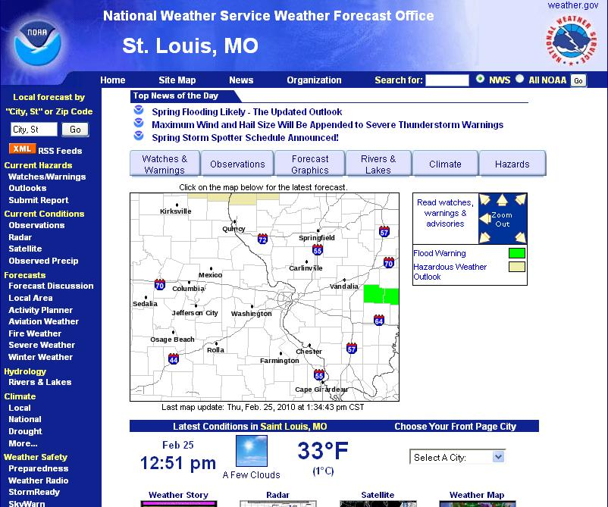

Slide 4
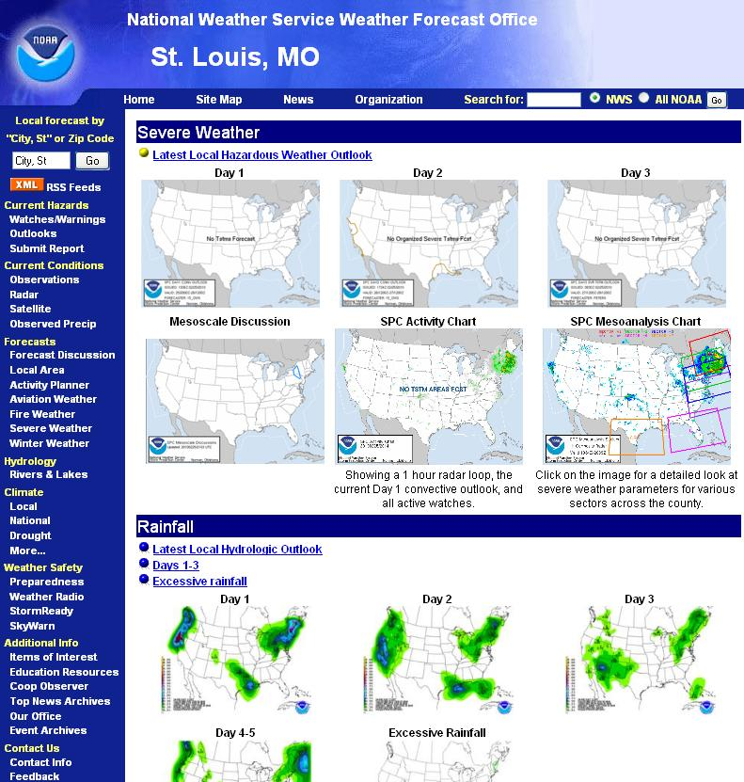

Slide 7
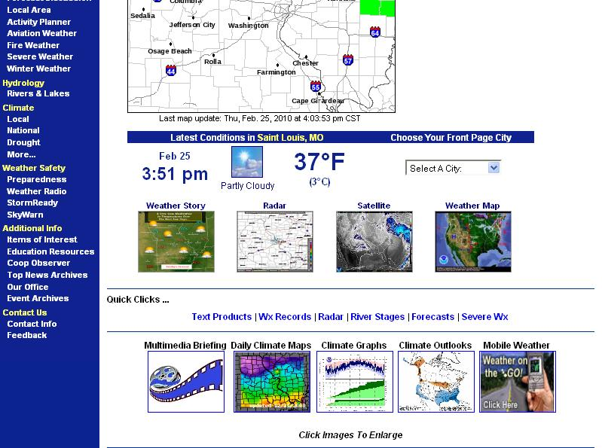

Slide 8
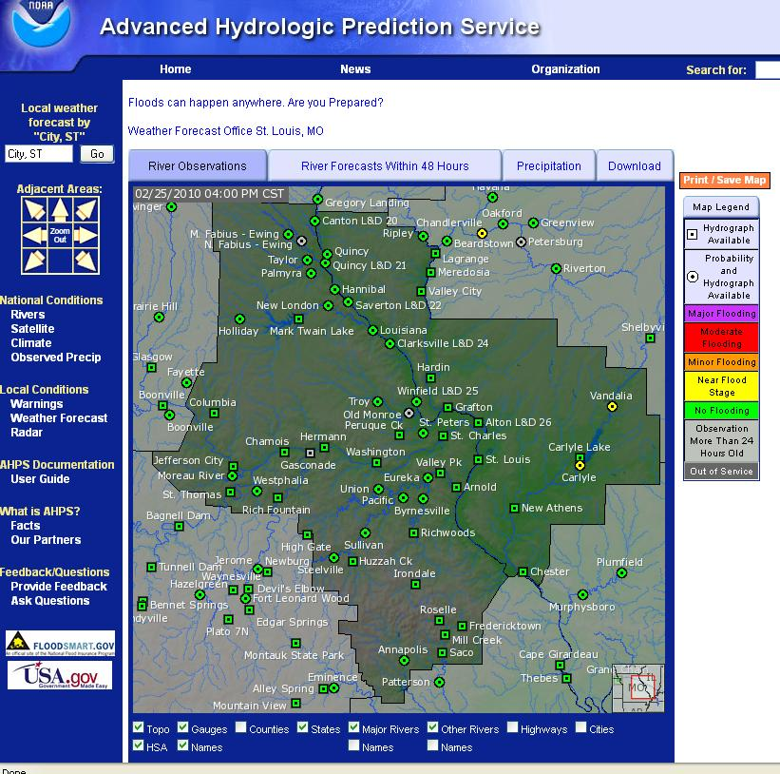

Slide 11
iNWS

Slide 12
iNWS
Community emergency planning and response management (i.e. emergency managers, law enforcement managers, fire and emergency response managers, public officials)
Skywarn Net Control operators, government partners of NWS offices, and the electronic media. Do not register if you do not fit this description. Your registration request will be reviewed before it is approved or denied.

Slide 13
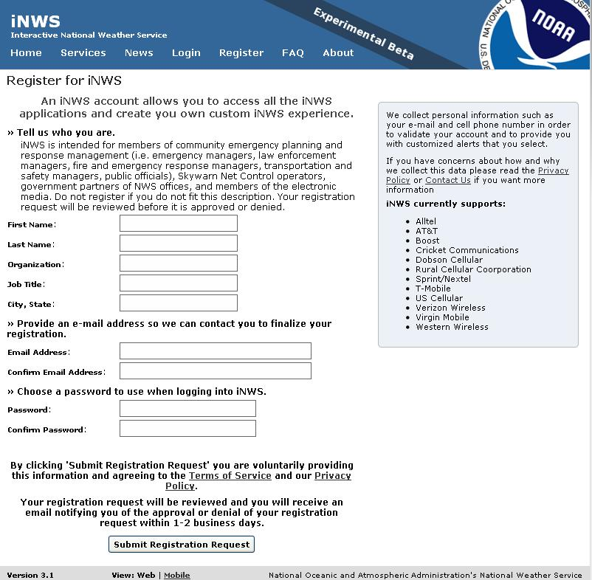
iNWS

Slide 14
NWS Mobile
HTTP enabled wireless devices: mobile.weather.gov
WAP enabled wireless devices: cell.weather.gov

Slide 15
Commercial Mobile Alert Service
CMAS: Extension of Emergency Alert System (EAS) to mobile cellular devices
Warning, Alert, and Response Network Act of 2006
Text
Later: voice, video, other data

Slide 16
Commercial Mobile Alert Service
Not based on Short Message Service (SMS)
Cellular broadcasting technology
Common Alert Protocol (CAP)
Geographically targeted: GPS

Slide 17
Commercial Mobile Alert Service
Specs October 2009
Carriers and Service Providers: Optional
MUST let users know that they are not participating in CMAS
Users: CMAS is Opt out!

