Slide 1




Measuring CO₂ in the atmosphere
Andrew Woodcock
Lead Forecaster
National Weather Service
Baltimore/Washington DC
Forecast Office

Slide 2
This lesson has three main objectives
We’ll discuss where these observations are taken, why, and how
We’ll learn how to access the CO2 measurement data
We’ll input that data into an Excel spreadsheet and create graphs

Slide 3
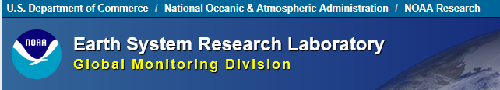

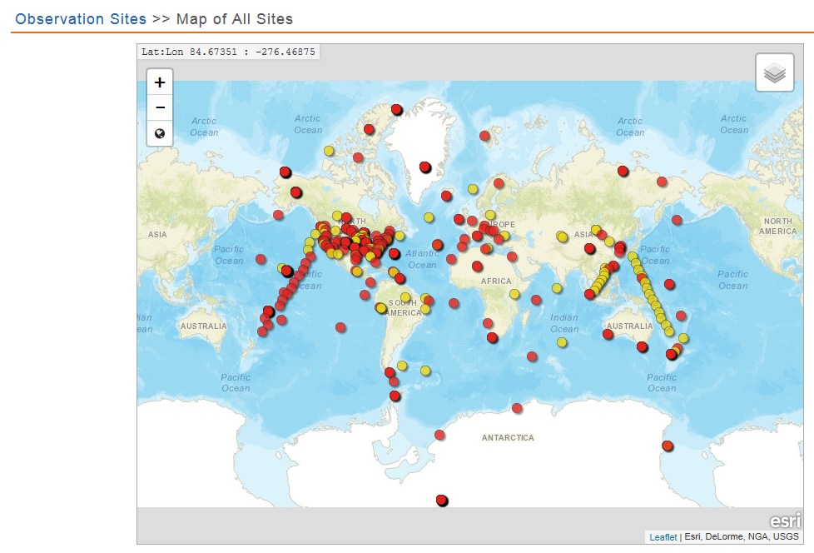
http://www.esrl.noaa.gov/gmd/dv/site/map.html

Slide 4
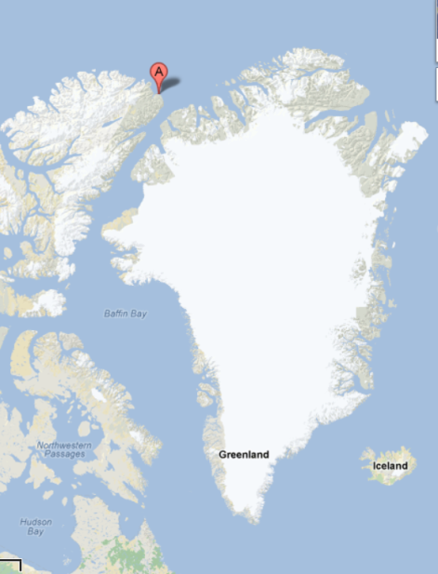
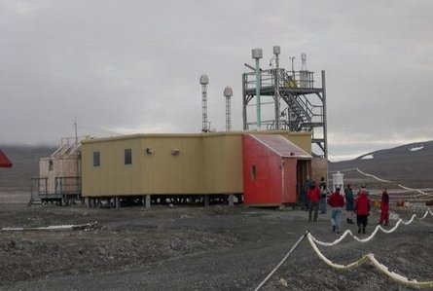
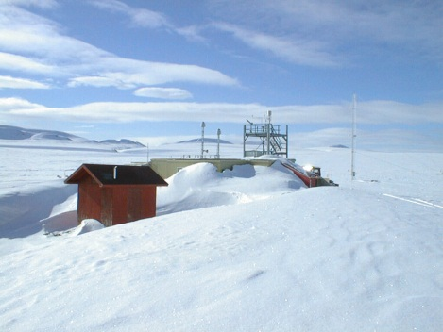
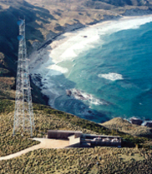
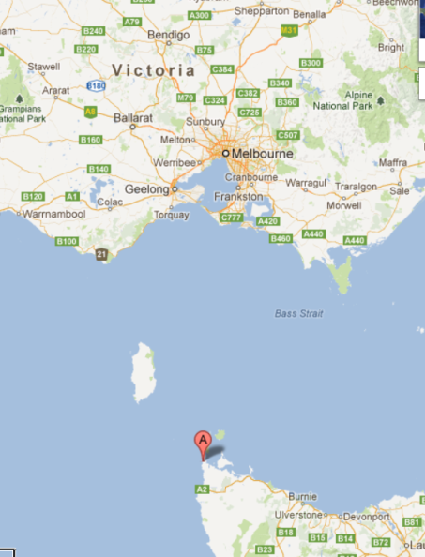
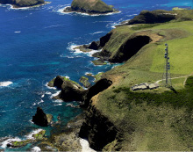
These observing sites are in remote locations so the air sample will as pristine as possible
Alert, Nunavut
Cape Grim, Tasmania

Slide 5
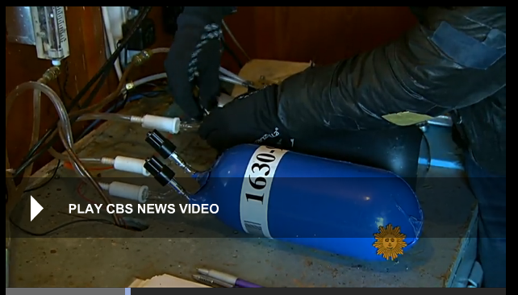
http://www.cbsnews.com/news/the-scientific-truth-about-climate-change/
1:30-3:30 minutes

Slide 6
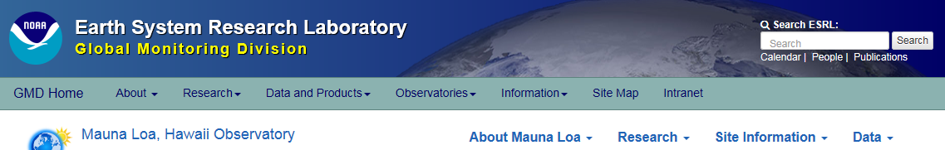
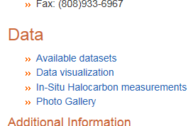
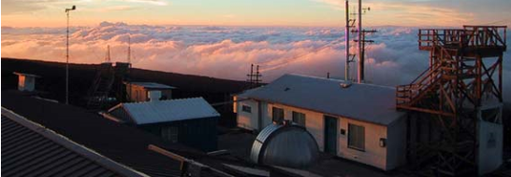
http://www.esrl.noaa.gov/gmd/obop/mlo/

Slide 7
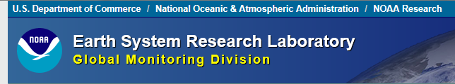
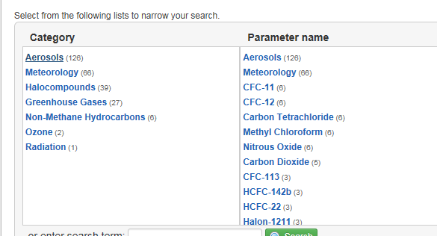
http://www.esrl.noaa.gov/gmd/dv/data/index.php?site=mlo

Slide 8
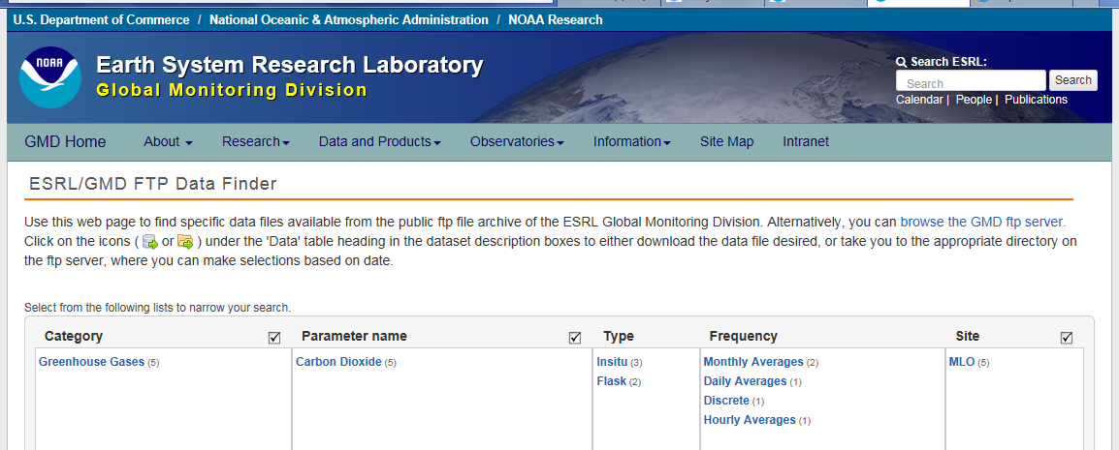
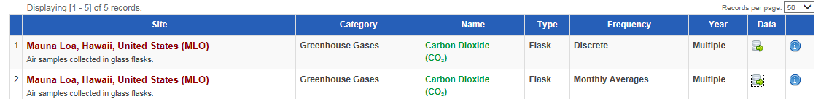

Slide 9
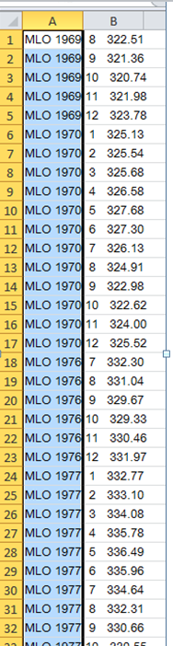
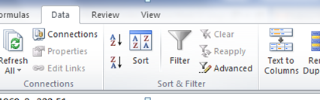
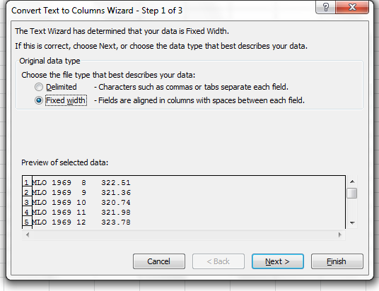
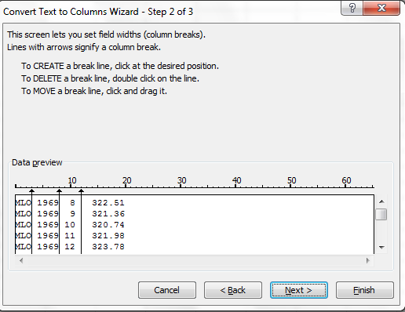
After you block and
copy the data and paste
it into Excel it will
not be in individual
columns.
In Excel, use the mouse
to block the data you want
to look at.
Go to the “data” tab, then
“text to columns”
There’s a three step
process which will
convert the data
to individual columns.
Click “next” after each
step

Slide 10
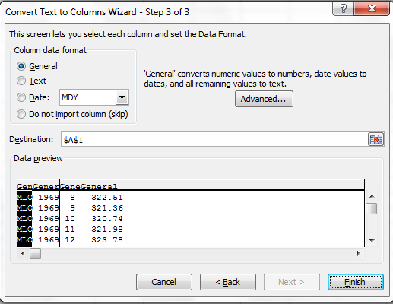
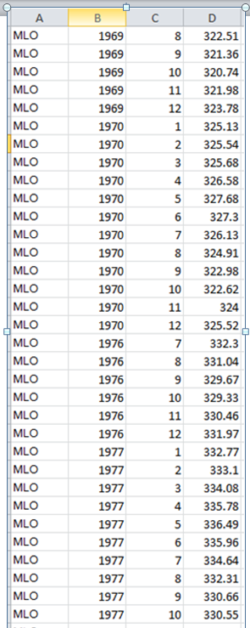
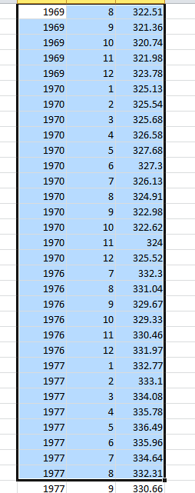
Upon completion, the data will
now appear in separate columns
To begin making a graph
use the mouse to block
the data and input it into
the Excel spreadsheet

Slide 11
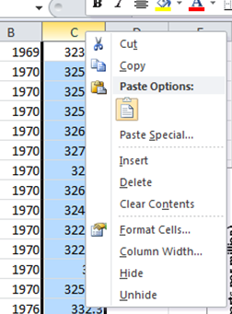
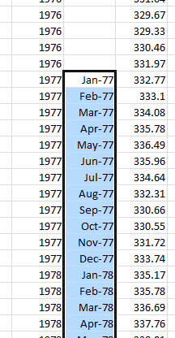
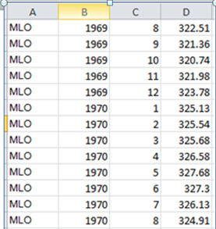
Find the spot where the data becomes continuous month after month. Type in
the abbreviated name of the month and year (Jan 1977). Under “format cells” choose custom and “mmm-yy”
You’ll want to get rid of “C”
the column with the month
number. Over “C” right click
and choose “delete”
Then insert a blank column.
Right click on “C” and choose
“insert”
Then click on that box so it’s outlined in
black. Then in the lower corner double
left click on the box. All following months
will appear.
Finally, block the data you’ll want to put
in your graph

Slide 12
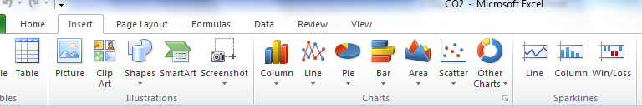
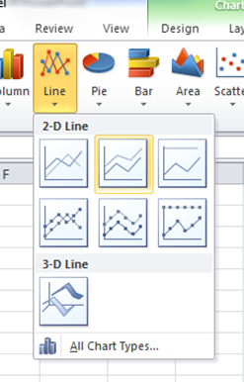
After blocking the data you want to use go up to “insert”
on the tool bar. In this example we’ll be using the line plot.
A drop down menu will appear. I chose “stacked line.”

Slide 13
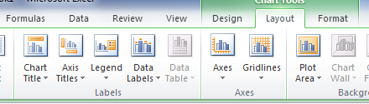
The initial graph will need fine tuning,
use the features under the “layout” tab
Select “chart title.” After writing it hit enter, then go to the “home” tab and choose the best size/font so the title fits
Use “axis titles” to label the x and y axis. I choose “rotated title” for the vertical (y) axis
Choose “gridlines.” Under “primary vertical” choose “major” to have lines
To allow for a larger horizontal graph under “legend” choose “show legend at bottom”
To turn the years on their side right click on the axis, choose “format axis,” select “alignment,” then “custom angle”

Slide 14
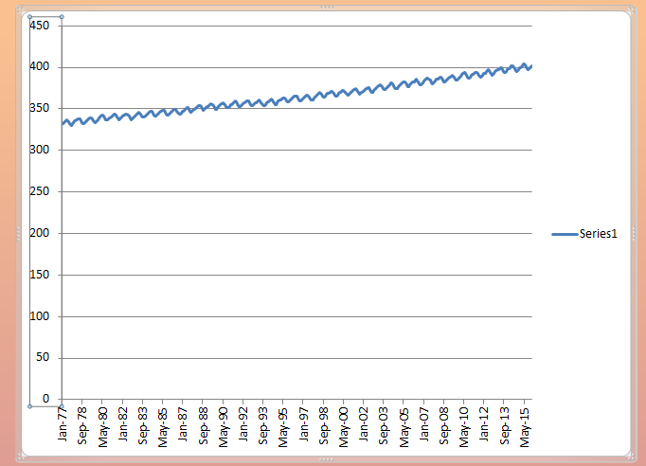
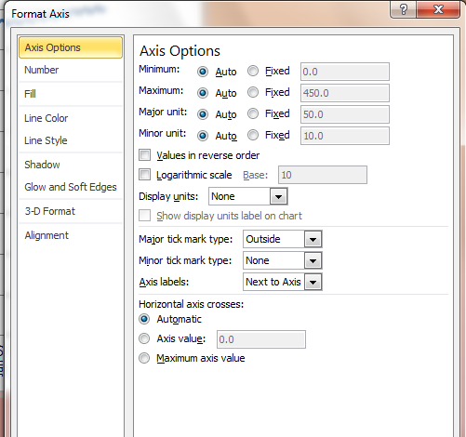
To “tighten up” the value on the y axis click on the number. This will bring up a menu. Choose “format axis.”
Adjust the minimum and maximum values to what you think are appropriate values, as well as the major unit. To start this click “fixed.” In this case we’ll set the lower limit at 320, the maximum to 420, and the major interim unit to 20

Slide 15
To change the dates on the x-axis click on the x-axis, select “format axis.”
Under “major unit” hit the fixed button, choose “1” and “year”

Slide 16
Why does the amount of CO2 go up and down during the year?
Vegetation. Plants take in CO2 during the growing season. This causes CO2 levels
to diminish. During winter CO2 levels in the atmosphere rise.

Slide 17
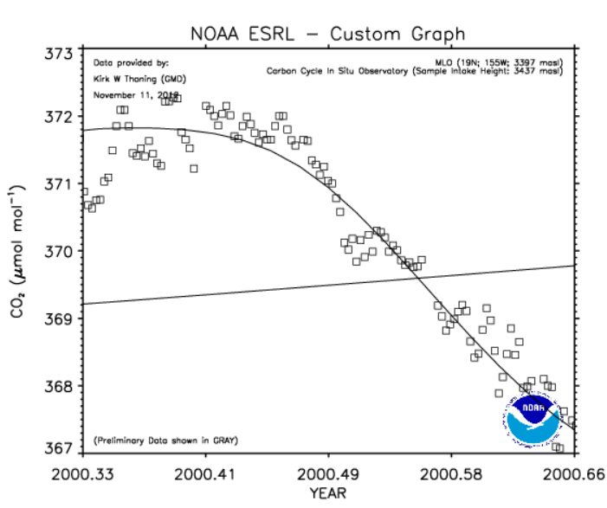
Carbon Dioxide
Look at the April to August plot. If you had
never seen the full range of data spanning
multiple decades, what might you conclude
from this plot?
You would have to conclude that the amount
of CO₂ in the atmosphere at Mauna Loa is
diminishing.
Carbon dioxide measurements at Mauna Loa – April 2000-Oct 2000

Slide 18
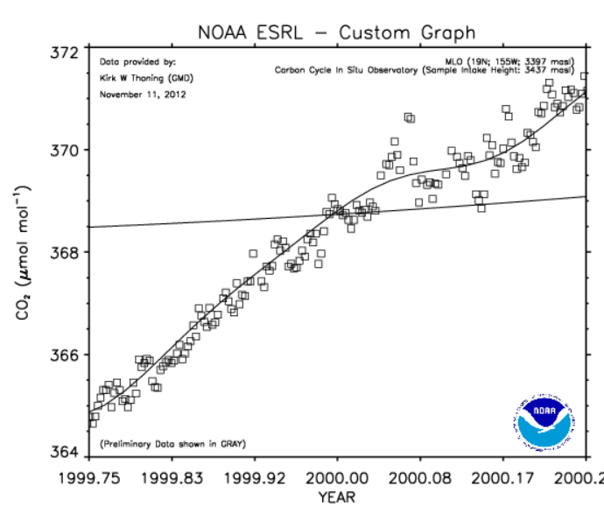
Carbon Dioxide
Look at the September to March plot. If you had never seen the full range of data spanning multiple decades, what might you conclude from this plot?
If we were only to use this graph to
determine what the future of CO₂ at
Mauna Loa was, you would have to
conclude that CO₂ would rise
continually in the atmosphere.
Carbon dioxide measurements at Mauna Loa – Sept 1999-Mar 2000

Slide 19
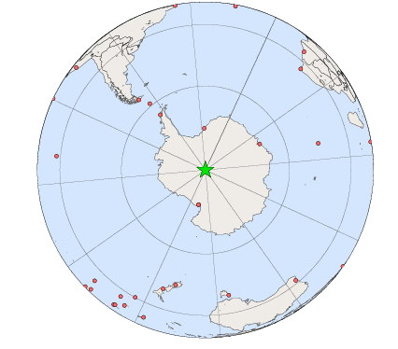
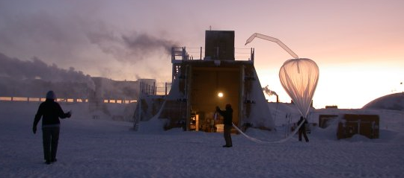

Slide 20
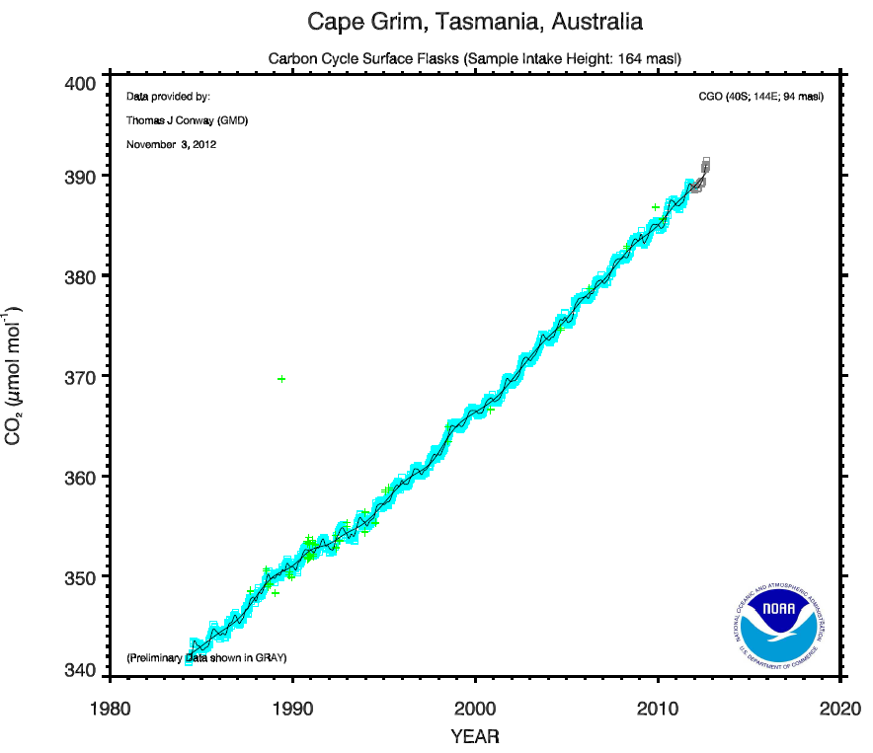
Carbon Dioxide

Slide 21
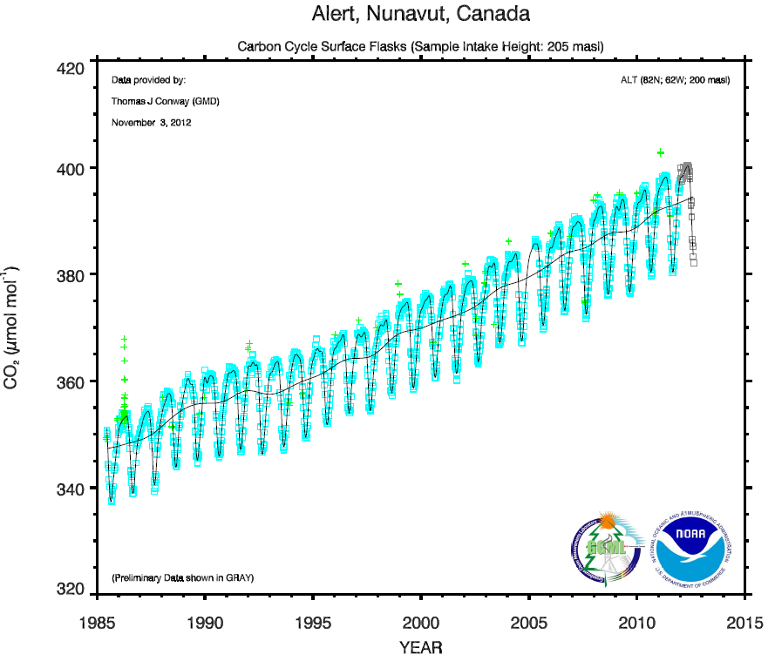
Carbon Dioxide

Slide 22
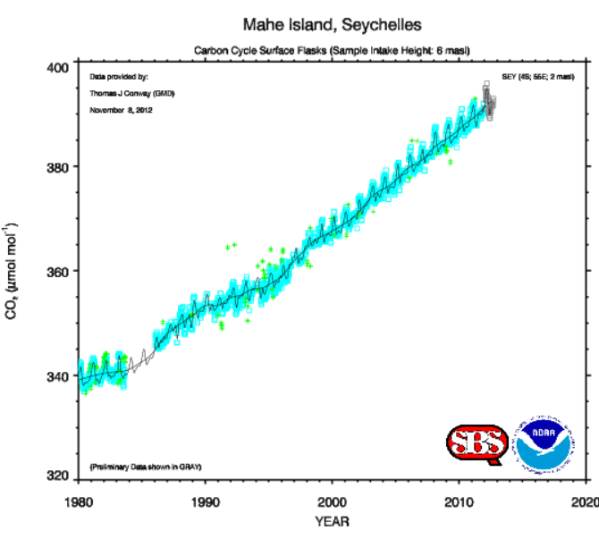
Carbon Dioxide
Seychelles (Indian Ocean)

Slide 23
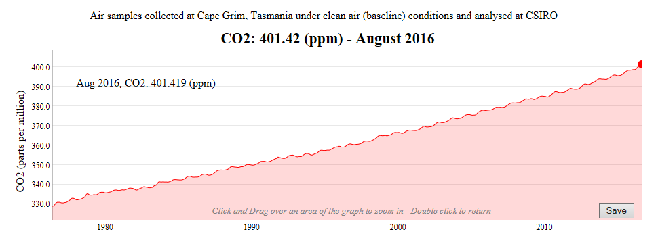
http://www.csiro.au/greenhouse-gases/

Slide 24
NOAA and NASA both offer more information on greenhouse gases
https://www.ncdc.noaa.gov/monitoring-references/faq/greenhouse-gases.php
http://climate.nasa.gov/causes/

Slide 25

Photo taken by Apollo 12, November 1969 showing earth’s atmosphere
https://www.youtube.com/watch?v=TRz56VbQRjM

Slide 26
If you have questions, would like a copy of this narration, or have ideas for other weather topics you’d like us to explain…
Please send an email from your educator email account to
andrew.woodcock@noaa.gov

