Slide 1
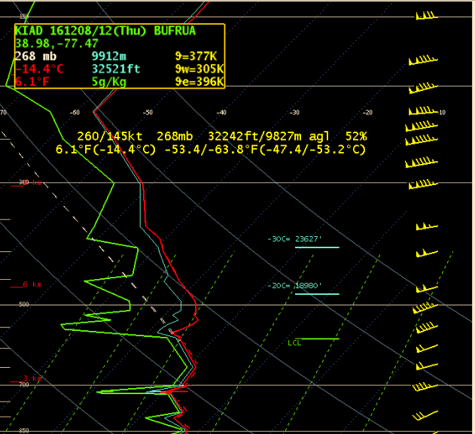
Very
strong
winds
aloft

Slide 2
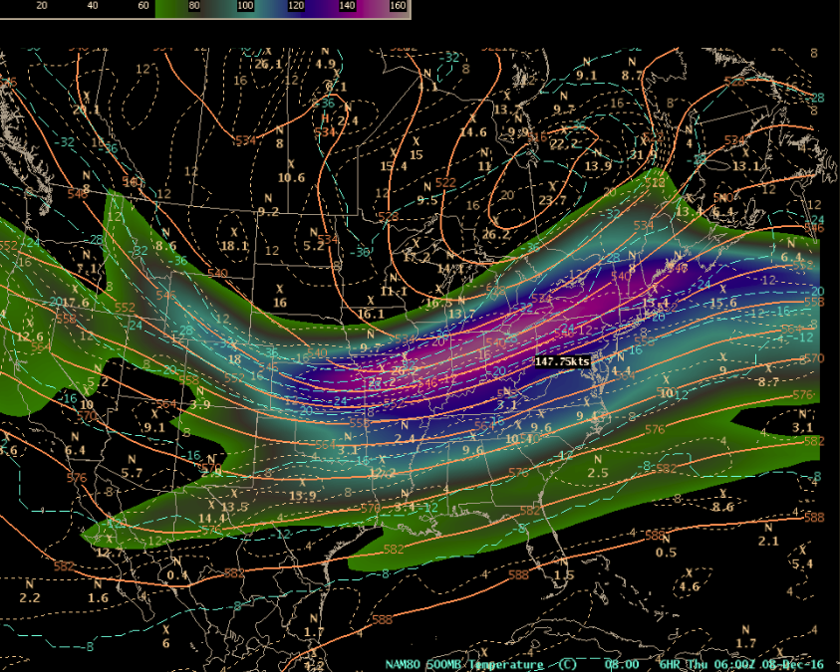
Strong jet stream at 30,000 feet running from eastern Nebraska to Maine

