Slide 1
Jan 10, 2017, Andrew Woodcock, NWS Sterling
I've created a short power point on the extreme precipitation that is
occurring in the west at the moment. I focus on Yosemite National Park, which
is one of the most amazing places I've ever been. You may know California has
been in a multi-year drought, and Yosemite has experienced large widespread
fires in recent years. This ongoing flow of moisture into the region is helping to
replenish the watershed, although so much rain is also causing mudslides.
I've included web links that you could share with your students.

Slide 2
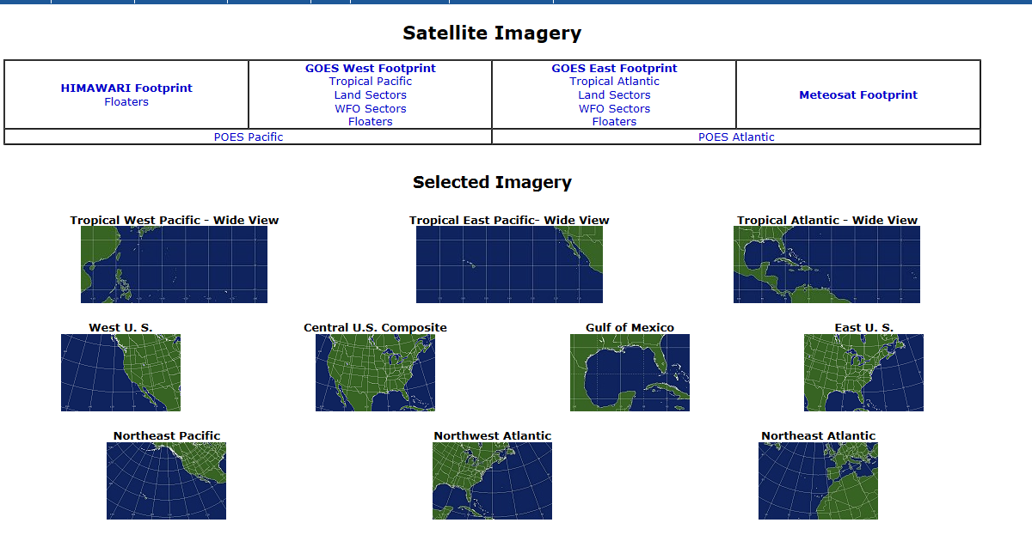
You can look at satellite images from the “satellite” link on our web page
http://www.weather.gov/lwx/
Or from this link:
http://www.ssd.noaa.gov/imagery/index.html
I chose the “West US” sector. From the menu on the next page I selected “water vapor.”

Slide 3
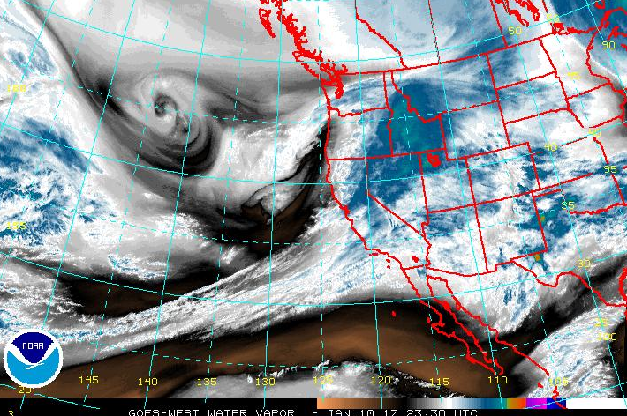
Which led me to this image:
Satellite water vapor image
Low
Pressure
Center
L
“Pineapple Express” a strong fetch of moisture extending the tropical Pacific (25ºN) into central California

Slide 4
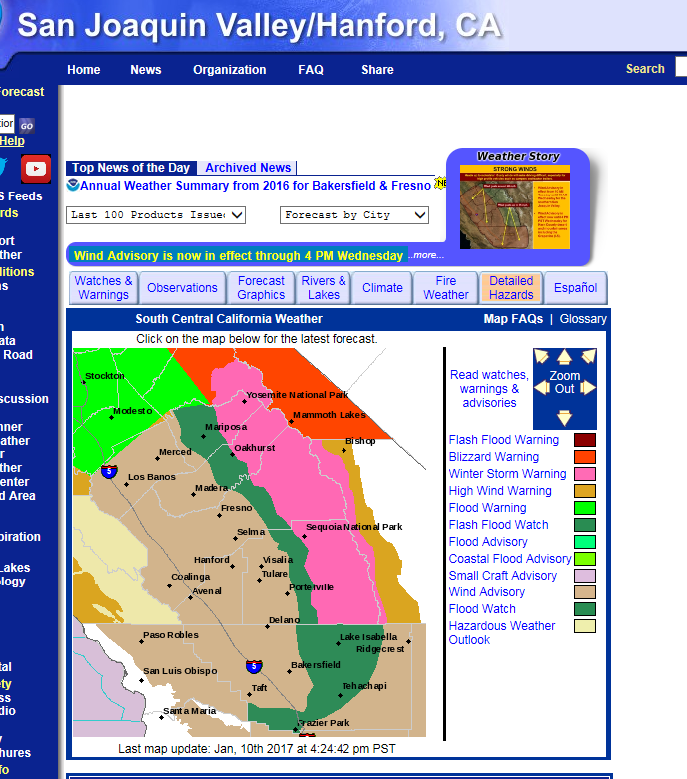
I used the NWS national web site: http://www.weather.gov/, and then clicked on
Central California. Our offices in Sacramento and Hanford, CA serve the Sierra
Nevada mountains.
To see how all of this rainfall has affected
the rivers I chose the “rivers and lakes” tab.

Slide 5
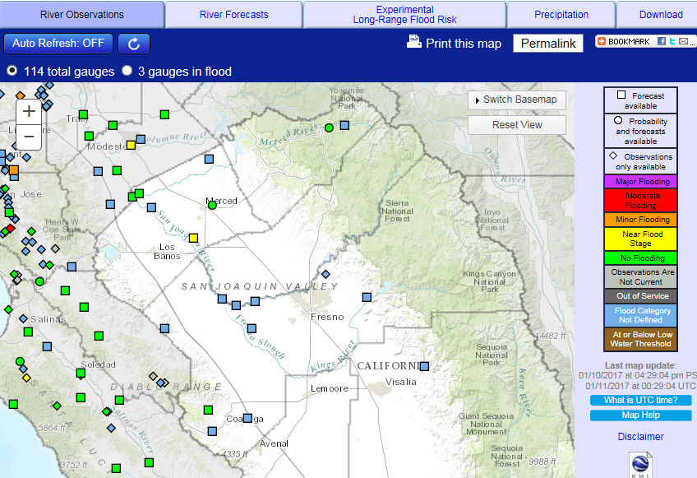
Although the river observing
sites in Yosemite are not currently
in flood I clicked on the green
icon on the Merced River. You can
see there are a few sites (yellow)
near flood stage as well as a few
(orange and red) in flood.

Slide 6
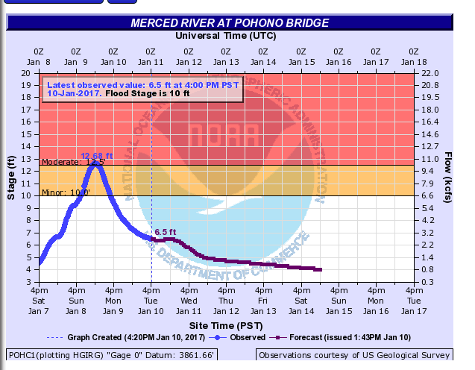
When I clicked on the green
dot a hydrograph came up.
You can see that the river was
in flood Sunday and Monday.
With that large moisture
fetch on satellite it is certainly
possible this could occur
again in the near future,
as the ground is saturated.
Aside from using this program in our area during flood situations, I also like to look at it when other areas of the country are in flood. There was a really bad flood near Boulder, CO a few years where this was very insightful. Also a few of the large floods on the Mississippi River. The threat levels minor/moderate/major” are coordinated with local emergency Managers, so it is known what will occur (“Main Street is flooded”) as each level is reached.

Slide 7
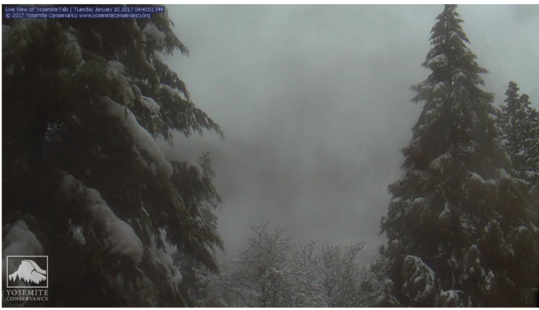
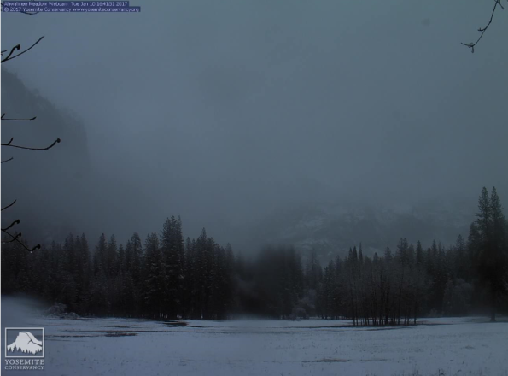
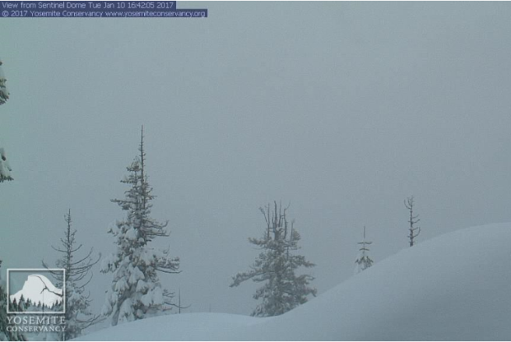
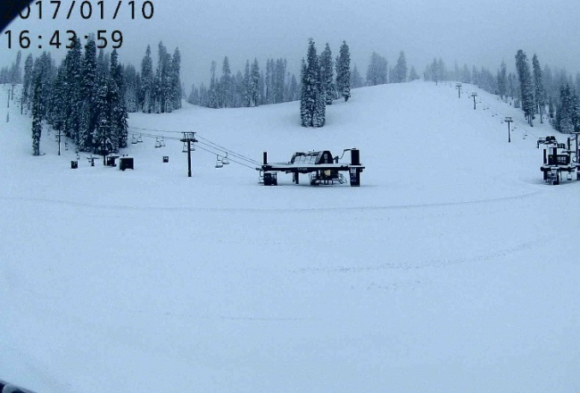
To put “the rubber to the road” I like to look at these cameras in Yosemite:
https://www.nps.gov/yose/learn/photosmultimedia/webcams.htm
Yosemite Falls
Half Dome from Yosemite Valley
Above 8,000 feet
Yosemite Ski Area
Given the multiyear drought California has experienced, the goal would be for the Sierras to receive a deep snowpack,
and then have a slow melt in the Spring to help to recharge aquifers

Slide 8
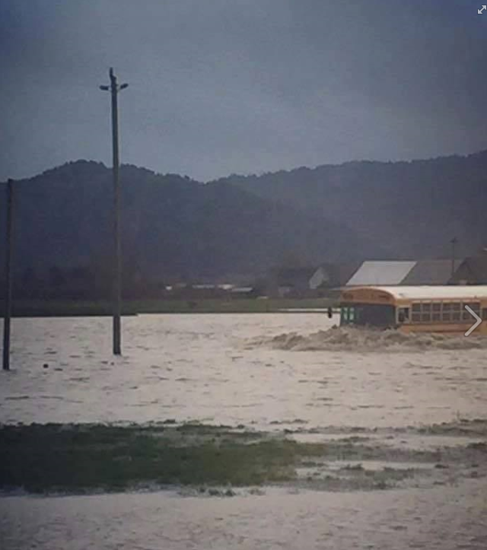
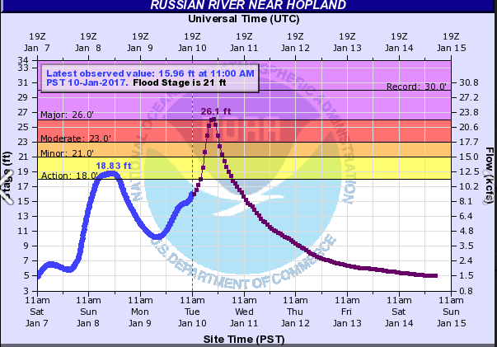
Right after I emailed the tutorial to teachers I saw this photo taken of a school bus in Ferndale, CA "plowing" through the water from all of this recent rain.
I am also attaching another hydrograph from that area showing the Russian River (100 miles north of San Francisco) at major flood stage.

