Slide 1
Teaching Weather to Schoolteachers
Andrew Woodcock
Lead Forecaster
National Weather Service
Baltimore/Washington DC
Forecast Office

Slide 2
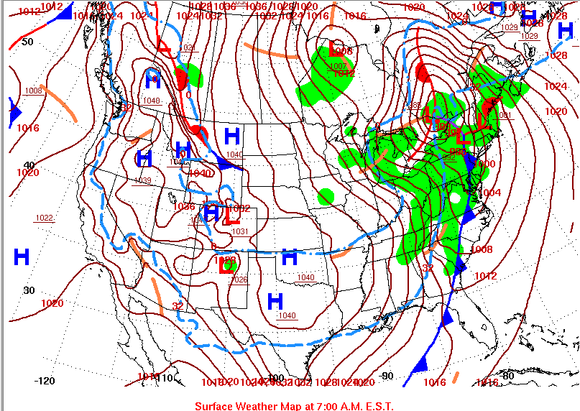
How to read a weather map. What’s on it?

Slide 3
Terms we’ll be discussing…
Iso – “equal”
Isobar – “lines of equal pressure”
Isotherm – “lines of equal temperature”
Air Pressure – “the weight of the column of air on a surface”
Pressure Gradient – “the difference in pressure between points”
Temperature – “the measure of the speed of movement of air molecules”
Dewpoint – “a measure of the amount of moisture in the air”
Relative Humidity – “the amount of moisture in the air with respect to temperature”
Station Plot/Surface Observation – “a plot showing multiple weather variables at a
specific location, including sky condition, temperature, and winds”
Air mass – “a portion of the atmosphere with similar moisture and temperature
characteristics”
Cold front/warm front – “boundaries between air masses”
We put all of this together to create a surface map analysis

Slide 4
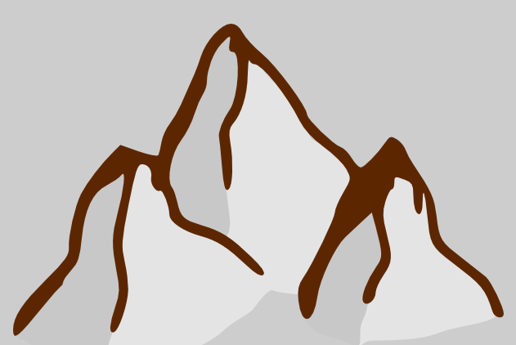
Air Pressure
What is air pressure?
People on the ground can’t tell, but air has weight to it. Air is a fluid. The weight is from all of the gases in the atmosphere (oxygen and nitrogen are two of the main gases).
The top of the atmosphere that has these gases is roughly around 40,000 feet – the height large airplanes fly at.
If you’re at the surface, the weight of that column of air up to 40,000 feet is pushing down on you (think about diving in a swimming pool, the deeper you dive the more pressure is on your ears). Likewise, if you climb to 5,000
feet you’ll have less air pressure on you.
So air pressure is a measure of the weight
of a column of air pressing down on any
spot on earth.
40,000 feet
20,000 feet
Weight of air pressing down on surface is air pressure
5000 feet

Slide 5
Air Pressure
What is air pressure?
People on the ground can’t tell, but air has weight to it. Air is a fluid. The weight is from all of the gases in the atmosphere (oxygen and nitrogen are two of the main gases).
The top of the atmosphere that has these gases is roughly around 40,000 feet – the height large airplanes fly at.
If you’re at the surface, the weight of that column of air up to 40,000 feet is pushing down on you (think about diving in a swimming pool, the deeper you dive the more pressure is on your ears). Likewise, if you climb to 5,000
feet you’ll have less air pressure on you.
So air pressure is a measure of the weight
of a column of air pressing down on any
spot on earth.
40,000 feet
20,000 feet
Weight of air pressing down on surface is air pressure
5000 feet
What are the units of measurement?
It depends where you live. In the U.S. it is
usually measured in terms of inches of
mercury. 29.92 inches is considered
“standard.” Much of the rest of the world
uses the metric system, and measures
pressure in millibars. 1013 millibars is
considered the pressure of a standard
atmosphere.

Slide 6
High pressure – how does it form? what does it do?
Colder air is dense, and has more weight, than
warmer air. A direct function of how warm or cold
an air mass (an area of air with uniform
temperature and moisture qualities) gets is from
the amount of incoming solar radiation the earth
below it receives. Because of the angle of the
Earth (23.5 degrees) in winter portions of
the northern hemisphere receive no sunlight,
hence it becomes very cold. This allows the air mass
to become heavy, and the pressure is high.
Being heavier, air associated with
high pressure sinks. When it hits
the ground it spreads out. In addition,
sinking air also causes the atmosphere
to dry, hence skies are generally
clearer, visibility better, with little
chance of precipitation when high
pressure moves into your area.
Think of standing on a can of soda –
which way will be the soda go?
Sinking air spreads out as it
reaches the surface
H

Slide 7
High pressure – how does it form? what does it do?
Colder air is dense, and has more weight, than
warmer air. A direct function of how warm or cold
an air mass (an area of air with uniform
temperature and moisture qualities) gets is from
the amount of incoming solar radiation the earth
below it receives. Because of the angle of the
Earth (23.5 degrees) in winter portions of
the northern hemisphere receive no sunlight,
hence it becomes very cold. This allows the air mass
to become heavy, and the pressure is high.
Being heavier, air associated with
high pressure sinks. When it hits
the ground it spreads out. In addition,
sinking air also causes the atmosphere
to dry, hence skies are generally
clearer, visibility better, with little
chance of precipitation when high
pressure moves into your area.
Think of standing on a can of soda –
which way will be the soda go?
The leading edge of the high pressure
area is the cold front.
Sinking air spreads out as it
reaches the surface
H

Slide 8
Low pressure – how does it form? what does it do?
Warmer air is lighter. Just like a hot air balloon
lighter air want to rise. Thus at the surface if
the air is lighter then the pressure is lower.
Rising air generally cools with height. As it rises
and cools any moisture will condense; microscopic
water droplets will condense to form cloud
droplets. If condensation continues those will
continue to coalesce to form raindrops.
There are several ways that the
atmosphere can provide lift: one of
the most common during the summer
months is surface heating. On a sunny
day by mid morning air will be rushing
upward, creating low pressure at the
surface.
H
L
Air flows out from high pressure and into
low pressure. That air flowing is the wind.
The greater the difference in pressure
between the two, the stronger the wind.
L

Slide 9
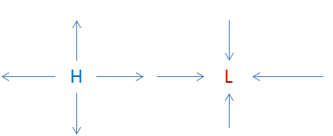
Pressure gradient causes the wind
Air flowing from high pressure to low pressure Is what causes the wind. The difference in strength between the two is called the pressure gradient. The greater the difference in pressure, the stronger the wind will be. A good way to think of it is to think of a roller coaster – the greater the height difference between the top (high pressure) and the bottom (low pressure) the greater the speed that the car will go on the coaster.

Slide 10
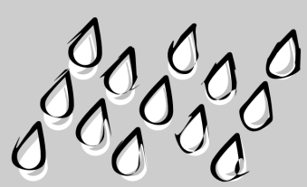
Dew point. What is it?
The dew point value is a measure of the amount of moisture in the air at a particular site. If the temperature and dew point are the same this means the air is 100% saturated. When this happens it is probably foggy, precipitating, or both. The bigger the difference between the two numbers, the drier the air is.
In this example, the boxes represent the air temperature, the drops
are the amount of moisture in the atmosphere – the dew point. In
both examples the dew point is the same. But the left box is larger,
implying the air temperature is higher. The air is closer to saturation,
and the temperature closer to the dew point, in the right box.

Slide 11
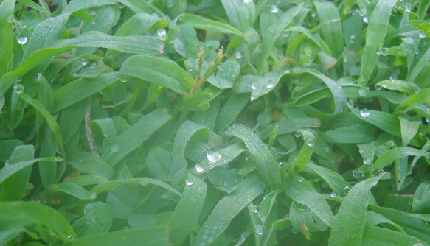
Dew point. What is it?
The dew point value is a measure of the amount of moisture in the air at a particular site. If the temperature and dew point are the same this means the air is 100% saturated. When this happens it is probably foggy, precipitating, or both. The bigger the difference between the two numbers, the drier the air is.
A good way to demonstrate dew point, and the moisture in the air, is to think of a glass of ice water on a summer day.
What is happening? – the ice water is
cooling the air on the outside of the
glass to the dew point, which in turn
is causing the moisture to condense
into droplets.
Would this be as likely to occur in the
winter?
In this example, the boxes represent the air temperature, the drops
are the amount of moisture in the atmosphere – the dew point. In
both examples the dew point is the same. But the left box is larger,
implying the air temperature is higher. The air is closer to saturation,
and the temperature closer to the dew point, in the right box.
When the air
temperature
approaches the dew
point, dew forms on
grass. When it’s cold,
frost forms.

Slide 12
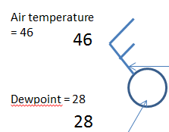
How does dew point differ from relative humidity?
Relative humidity is also a measure of the moisture in the air, but it is
dependent on temperature, as warmer air can hold more moisture. So in
the above case even though both have the same amount of moisture, in
the example on the left the relative humidity would be lower. The only
way to raise it would be to add more moisture.
Below temperature on the station plot Is the dewpoint.
In the summer, because warmer air can hold
more moisture, the dewpoints are typically higher.
When the dewpoints reach the 60s it begins to
feels sticky from the humidity. When these reach
the 70s it feels oppressive.
If the amount of moisture in the air stayed the same during
the day, as the temperature goes up the relative humidity
will drop. This is why dewpoint is a better measure of the
amount of moisture in the air.

Slide 13
What can be told from a Weather Station plot?
Air temperature
= 46
46
Air pressure = 1025.1 millibars (mb)
251
28
Winds – the flag points to
the direction the wind
is coming from. A long
stick coming from the top is
equal to 10 knots (12 mph). A
short one is worth 5 knots. Add
them to get the speed. In this case
the winds are coming from the
northwest at 15 knots (18 mph)
Dewpoint = 28
If the circle is hollow
that means the sky is clear.
If it is filled in the sky is cloudy.

Slide 14
How do we use station plots to analyze a weather map?
33
073
1008 millibar isobar line
.
.
025
31
41
40
983
1004 millibar isobar line
41
40
65
982
45
017
1000 millibar isobar line
58
42
69
012
75
026
61
Actual weather observations
Dec 22, 2013 11 PM EST
63
The black penciled lines are isobars.
Isobars = “lines of equal pressure.” This is like playing connect the dots. Start from a pre-determined value in the upper right , usually in increments of 2 or 4 mb. For example, to draw the 1004 mb line look for all places on the map where the station air pressure is greater than 1001 mb but less than 1007 mb. Once you complete one line the others often are shaped the same way.

Slide 15
How do we use station plots to analyze a weather map?
40 degree isotherm
33
073
1008 millibar isobar line
.
.
025
31
41
40
983
1004 millibar isobar line
41
40
65
982
50 degree isotherm
45
017
1000 millibar isobar line
60 degree isotherm
58
42
69
012
70 degree isotherm
75
026
61
Precipitation
If there is weather occurring at the station it will appear on the left under the temperature. Dots mean rain, * means snow, two or three horizontal lines would be fog. The more dots/snow symbols the heavier the precipitation.
Actual weather observations
Dec 22, 2013 11 PM EST
63
The black penciled lines are isobars.
Isobars = “lines of equal pressure.” This is like playing connect the dots. Start from a pre-determined value in the upper right , usually in increments of 2 or 4 mb. For example, to draw the 1004 mb line look for all places on the map where the station air pressure is greater than 1001 mb but less than 1007 mb. Once you complete one line the others often are shaped the same way.
The orange lines are isotherms
Isotherm = “line of equal temperature.” Look at the numbers in the upper left corner. Again play connect the dots, drawing a line where the temperature is the same. Use increments of ten degrees. Sometimes the lines will be very close together, other times the temperature will be nearly the same over large areas so there won’t be many lines.

Slide 16
Now – let’s put pressure centers and fronts on the map
40 degree isotherm
H
33
073
1008 millibar isobar line
Light
rain
.
.
025
31
41
Northwesterly
winds
behind
the cold
front
1004 millibar isobar line
40
983
41
40
65
982
50 degree isotherm
45
017
L
60 degree isotherm
1000 millibar isobar line
58
42
Warm front
Cold front
69
012
70 degree isotherm
75
026
61
Warm air, southerly winds south of the warm front
Dec 22, 2013 11 PM EST
63
What’s on the weather map?
After you have drawn the highest value isobar, place a blue “H” inside to signify high pressure. Likewise place a red “L” inside the lowest value isobar to signify low pressure. On the east side the winds will be from the southwest, on the west side the winds will be from the northwest. You may see the isotherms are close together along with the northwest winds. The transition zone would be a cold front – to the west of this is where colder air and higher pressure are. Eventually cooler temperatures and clearing skies would likely arrive behind the cold front. The warm front is the dividing line between a warmer and colder air
mass as well.

Slide 17
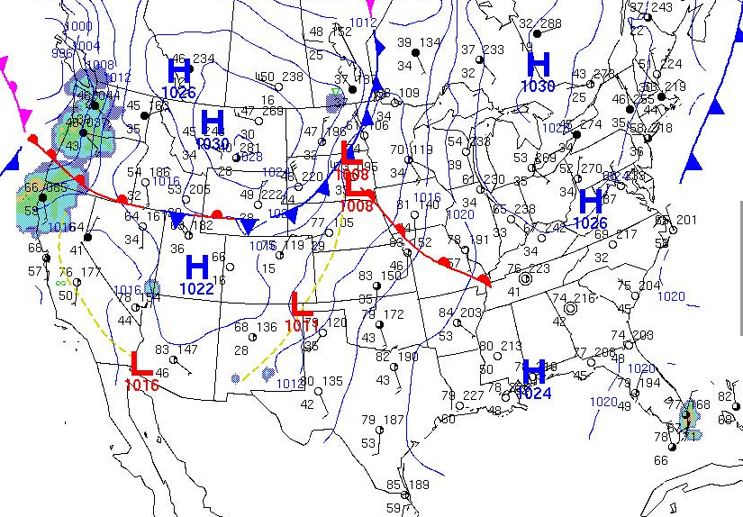
Putting it all together on a weather map
A United States
weather map.
A cold front extends
from Minnesota to
Wyoming. High pressure
Is centered over Montana.
Notice that in Minneapolis
the temperature is 70 with
winds from the south at
20 knots (24 mph). On the
north side of the cold front
in North Dakota the
temperatures is 47 with north
winds of 15 knots.
A warm front extends across
Missouri. On the south side
of the front the temperature
is in the 80s. North of the
front it drops into the low 60s
in Chicago and the 50s in
Wisconsin.
Over the southeast the circles for
the station plots are hollow. This means skies are clear.
In the northeast the closed circle station plots indicate it is cloudy.
To see today’s weather map go to: http://www.wpc.ncep.noaa.gov/dailywxmap/

Slide 18
If you have questions, would like a copy of this narration, or have ideas for other weather topics you’d like us to explain…
Please send an email from your educator email account to
andrew.woodcock@noaa.gov

