Slide 1
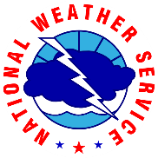
CWSU…Who? A look inside the National Weather Service “Center Weather Service Units”
Rick Winther
National Weather Service CWSU ZDC

Slide 2
nws history highlights
1849 - Smithsonian Institution supplies weather instruments to telegraph companies and establishes extensive observation network.
1870 - President Ulysses S. Grant signed into law a new weather “Signal Service” within the U.S. Army Signal Service’s Division of Telegrams and Reports.
1890 - The Signal Service was transferred to the Agriculture Department as the National Weather Bureau.
1904 - The government begins using airplanes to conduct upper air atmospheric research.
1909 - The Weather Bureau begins its program of free-rising balloon observations.
1918 - The Weather Bureau begins issuing bulletins and forecasts for domestic military flights and for new air mail routes.

Slide 3
A few nws history highlights
1940 – National Weather Bureau transferred to the Department of Commerce.
1948 - USAF Air Weather Service meteorologists issue first tornado warnings from Tinker Air Force Base.
1960 - The world's first weather satellite, the polar-orbiting TIROS I, successfully launches.
1970 – National Weather Bureau renamed the National Weather Service.
1978 - FAA contracted NWS to set up 3 person weather units in 13 Air Route Traffic Control Centers.
1982 - MIC (4 person unit) position created for 20 ARTCC.
1980s through the 1990s - Modernization and associated restructuring (MAR). The MAR fundamentally changed the NWS field office structure to ensure that rapid detection and timely forecasts and warnings are delivered to the public.
1997 - Nationwide WSR-88D radar network is fully deployed.

Slide 4
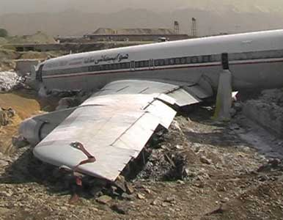
WHY WAS THE CWSU FORMED?
Southern Flight 242 (DC-9)
From Huntsville, AL to Atlanta, GA
Flew into intense part of thunderstorm due to attenuation of 3 cm onboard weather radar during the summer of 1977
Both engines flamed out due to hail
62 of the 85 on board and 8 on the ground died near New Hope, GA

Slide 5
NTSB Recommendation A-77-68
Formulate rules and procedures for timely dissemination by AT controllers of all available severe weather information to INBOUND and OUTBOUND flight crews
in the TERMINAL AREA

Slide 6
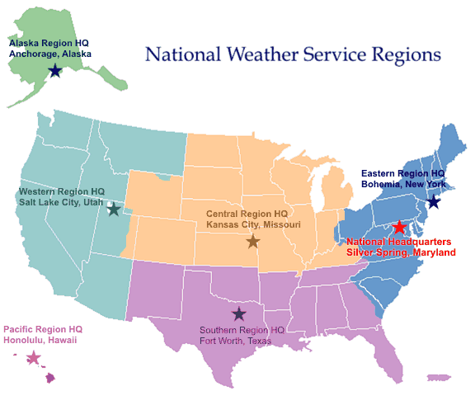
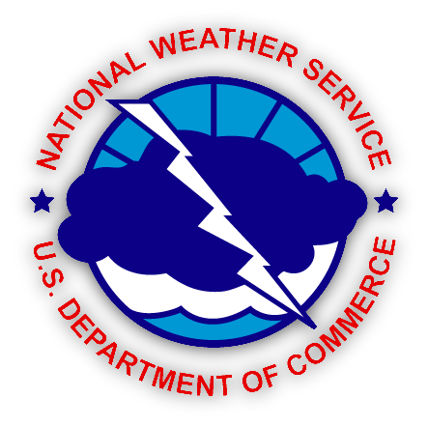
Organization

Slide 7
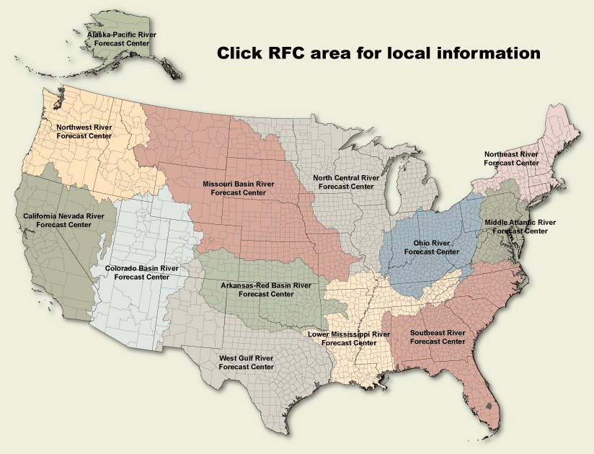
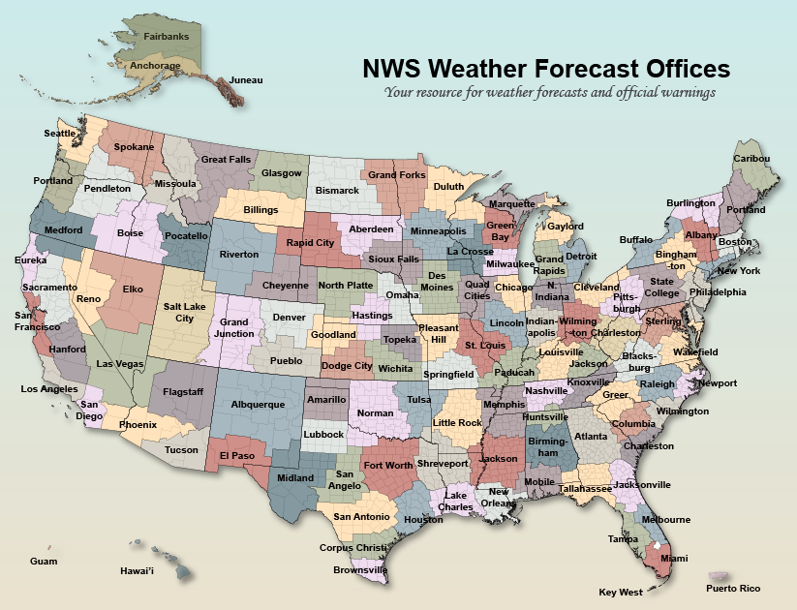
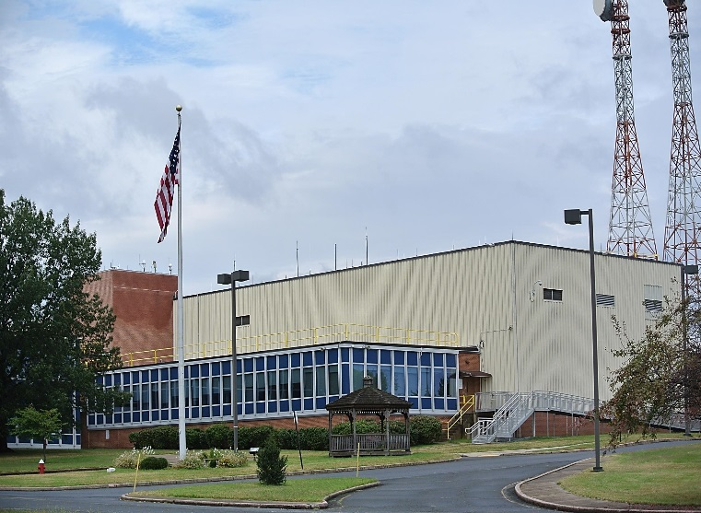
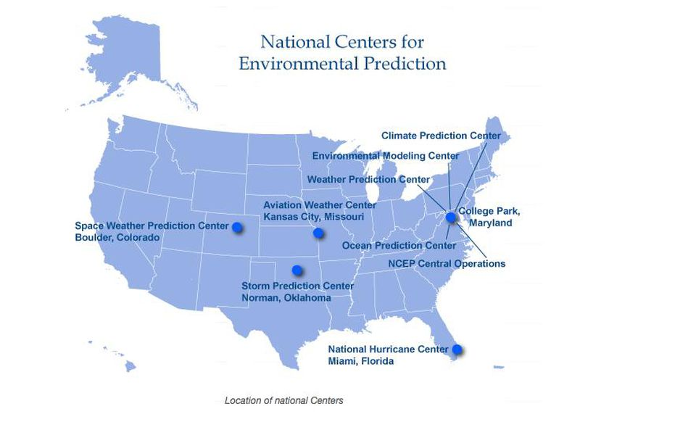
National weather service OFFICES
River Forecast Centers (RFCs) 13 offices
Weather Forecast Office (WFOs) 122 offices
National Centers (SPC, AWC, Space WX, WPC, Tsunami,etc)
Center Weather Service Units (CWSU) 84 meteorologist

Slide 8
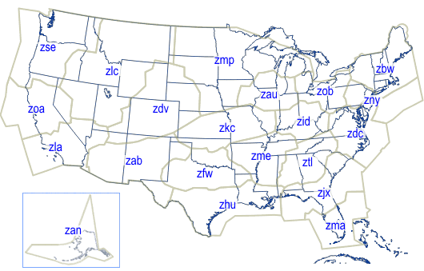
Center Weather Service Units
Northeast CWSU Locations
New York Center (ZNY)
Boston Center (ZBW)
Washington Center (ZDC)
Cleveland Center (ZOB)
Mission:
Center Weather Service meteorologists provide weather support and consultation to FAA air traffic managers and controllers. Rerouting of aircraft around hazardous weather is based largely on forecasts provided by CWSU meteorologists.
Map of FAA Air Route Traffic Control Centers
Notes:
Center Weather Service Units are specifically designed to support the FAA. There are 21 CWSUs nationwide, and all are located at FAA Air Route Traffic Control Centers. Four of the CWSUs are located in the northeastern U.S.
CWSU web site links:
New York: http://www.erh.noaa.gov/zny
Boston: http://www.erh.noaa.gov/zbw
Washington: http://www.erh.noaa.gov/zdc
Cleveland: http://www.erh.noaa.gov/zob

Slide 9
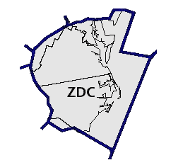
CWSU Support
Hours of Operation – 5 AM to 9 PM.
4 Meteorologist.
2 standup Briefings daily - 7:00am & 3:30pm
3 Pre-Duty Weather Briefings daily (Towers, Tracons, Center) 5:45 AM, 12:30 PM and 8:30 PM.
3 Conference calls daily - 8:15 AM with DC Towers/PCT, 10 AM call with PHL Tower / Tracon/PHL WFO / American Airlines.
Collaboration every two hours – TCF collaboration during the summer on the 4,6 and 8 hour Thunderstorm forecast.
Notes:
Graphics produced by CWSU only available to ARTCC personnel.

Slide 10
CWSU Support
On-Demand Briefings as needed for controllers.
Graphical Forecasts of convection, icing, compression, turbulence outlooks for airports and TRACON Gates. Available on web pages.
SWAP Statement – Issued at ZDC around 10:30 am in the summer.
TAF Collaboration – DC/PHL for OEP airports.
Written short-term forecast statements and advisories (Meteorological Impact Statements and Center Weather Advisories).
Briefing sheet – Issued at the start of each shift.
Notes:
Graphics produced by CWSU only available to ARTCC personnel.

Slide 11
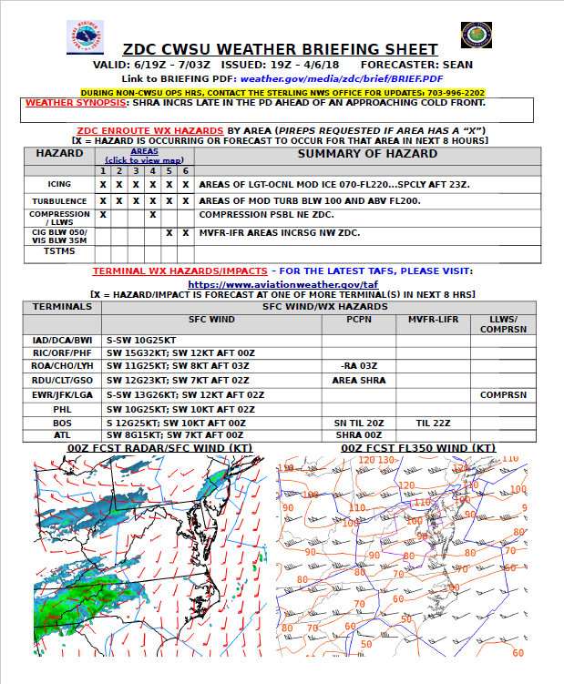
Local Products
Briefing sheet
Severe Weather Avoidance Plan(s) (SWAP) Statement

Slide 12
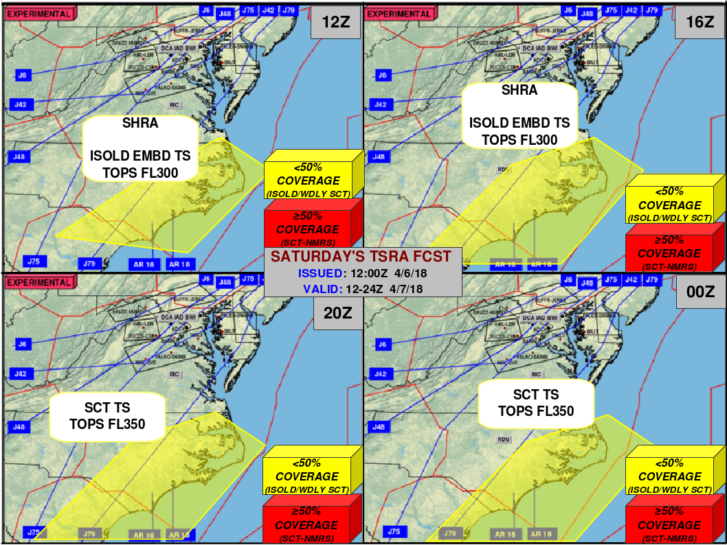
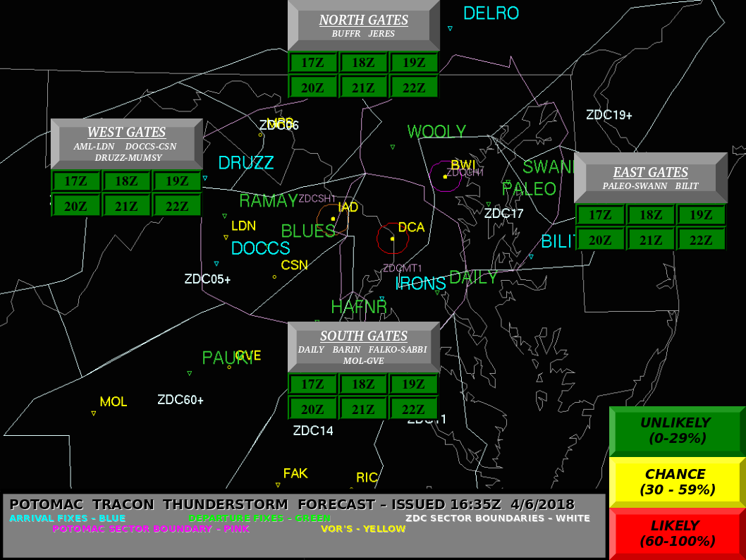
Web Products
Potomac TRACON (PCT)
TSTM Gate Forecast
Day 2 TSTM Forecast

Slide 13
it is all about Collaboration & COMMUNICATION
We no longer live in a world where products exist and are developed in isolation.
13
Notes:
13

Slide 14
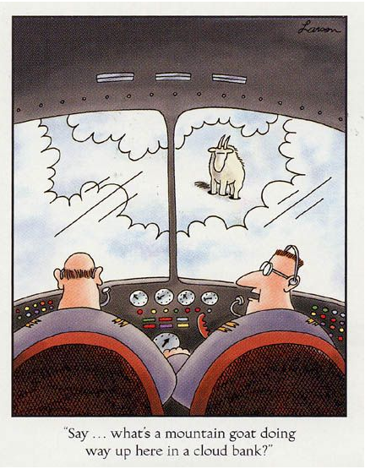
questions

