Slide 1
13 August 2018 T-storm Event:
Severe Weather Avoidance Plans (SWAP) enacted for Washington Air Route Traffic Control Center (ARTCC) airspace (ZDC)
Presented by:
Sean Campbell
ZDC Center Weather Service Unit Meteorologist

Slide 2
Pre-Event Highlights
0900Z: Arrive at work, assess thunderstorm (TS) potential, create Pre-Duty Weather Briefing (PDWB) with TS slides
NLT 0945Z: Post PDWB
Every 2 hrs (0945Z…), Mar – Oct: Collaborate 4-8 hr Traffic Flow Management Convective Forecast (TCF) for National Airspace System (NAS) with Aviation Weather Center (AWC)
1100Z: Brief TS potential to ZDC ops leaders at Stand-Ups
NLT 1230Z: Coordinate International Arrival/Departure Gate
TS Forecast with Boston ARTCC CWSU
NLT 1430Z: Send ZDC SWAP statement to ZDC Traffic Mgmt Unit (TMU) and Supervisory Traffic Management Coordinator (STMC)
Update STMC, TMU, ops leaders as necessary

Slide 3
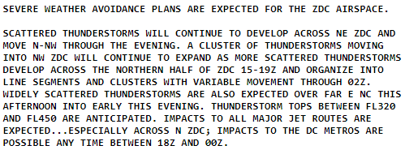
SWAP Statement Example (13 August 2018)

Slide 4
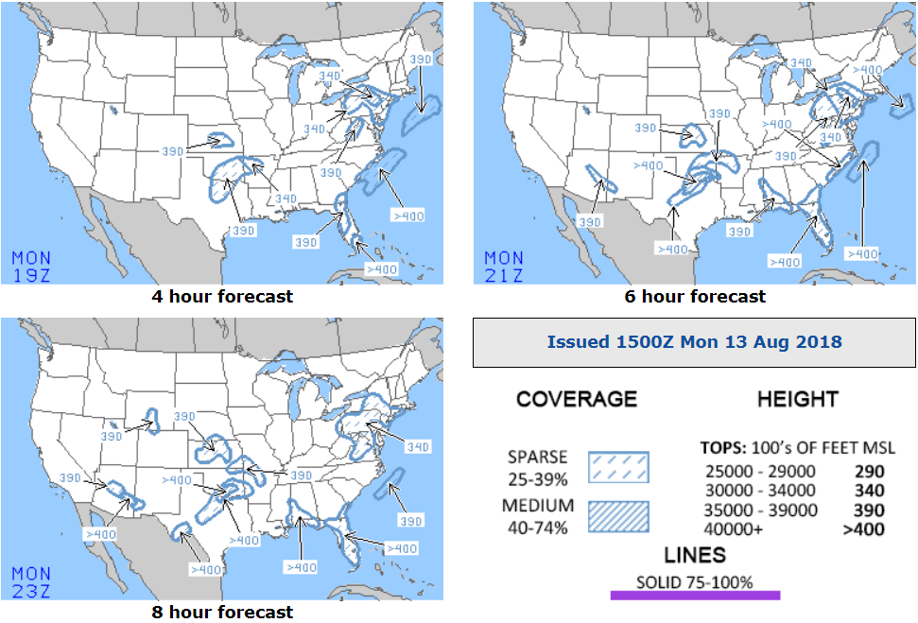
TCF Graphic Example: 1500Z 13 August 2018

Slide 5
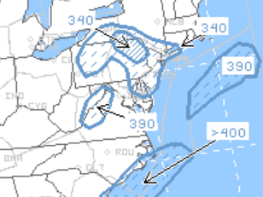
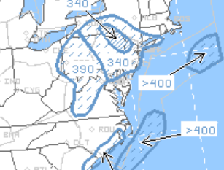
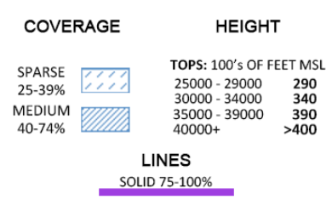
1500Z 13 August 2018 TCF Graphics (zoomed in)
4 hr forecast (1900Z)
6 hr forecast (2100Z)

Slide 6
Consolidated Storm Prediction for Aviation (CoSPA) images
(courtesy of MIT Lincoln Labs)
1900Z 13 Aug 18
2000Z 13 Aug 18
2100Z 13 Aug 18

Slide 7
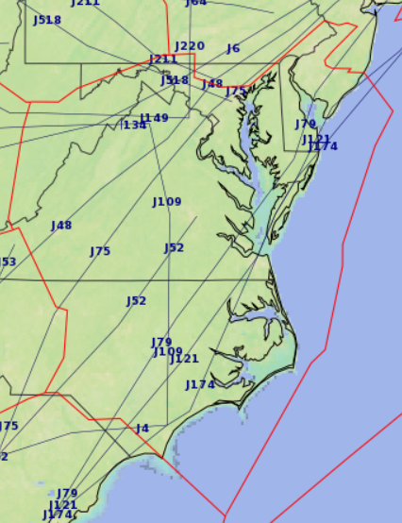
Select Impacts
1702Z: ZNY stopped J220 until 14/0000Z
1725Z: J518 stopped until 1900Z
1841Z: J6 stopped until 2100Z
1900Z: J48 stopped until 2100Z
1918Z: J75 stopped until 2100Z
1940Z – 2038Z & 2144Z – 2240Z: IAD Ground Stops
1942Z – 2044Z: DCA Ground Stop
1946Z – 2047Z: BWI Ground Stop
J518
J220
J48
J6
J75

Slide 8
Thanks!
Questions?
References:
FAA Northeast Recap Logs (available upon request)
AWC TCF website: https://www.aviationweather.gov/tcf
AWC website: https://www.aviationweather.gov/
Massachusetts Institute of Technology Lincoln Labs CoSPA: https://cospa.wx.ll.mit.edu/

