Slide 1
NOAA/National Weather Service Digital Aviation Services
Andrew Snyder
Aviation Program Leader
Senior Forecaster
NWS Baltimore/Washington
Aviation Customers Forum
November 13, 2019

Slide 2
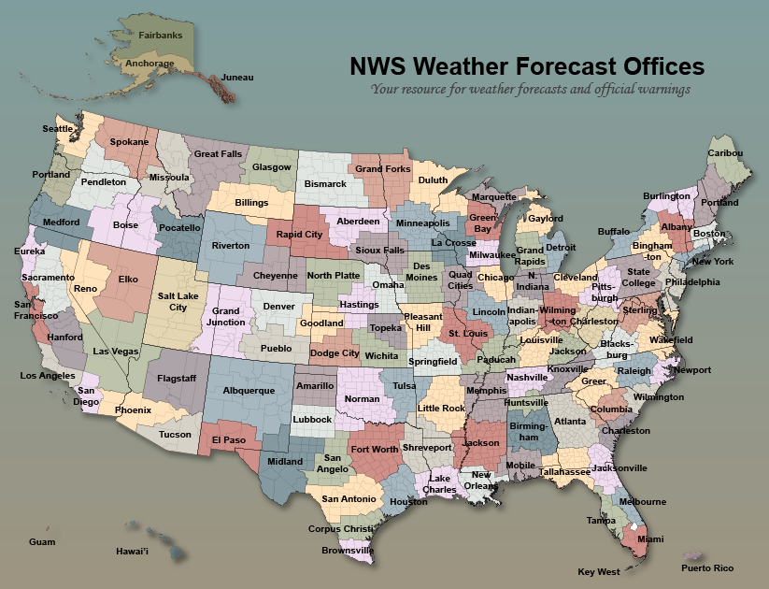
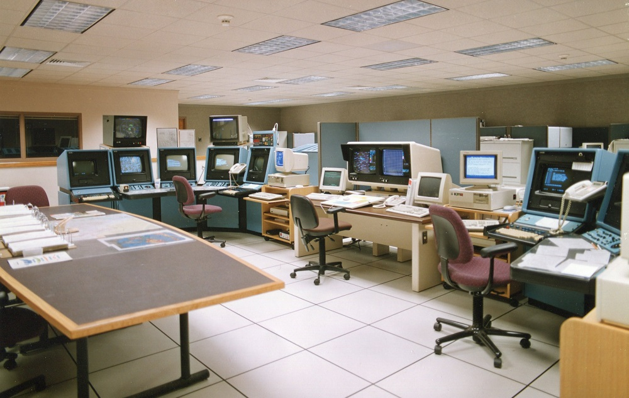
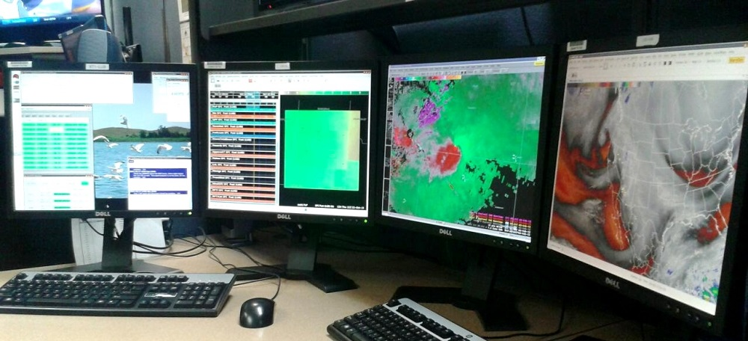
Background
“Modernization” effort created local forecast office and Doppler radar structure in the mid 1990s
Move to consolidate systems to single, redundant computer workstations in late 1990s (AWIPS)
Graphical Forecast Editor (GFE) rolled out in early 2000s to create digitized forecast database
Eliminated or reduced manual composition of text products

Slide 3
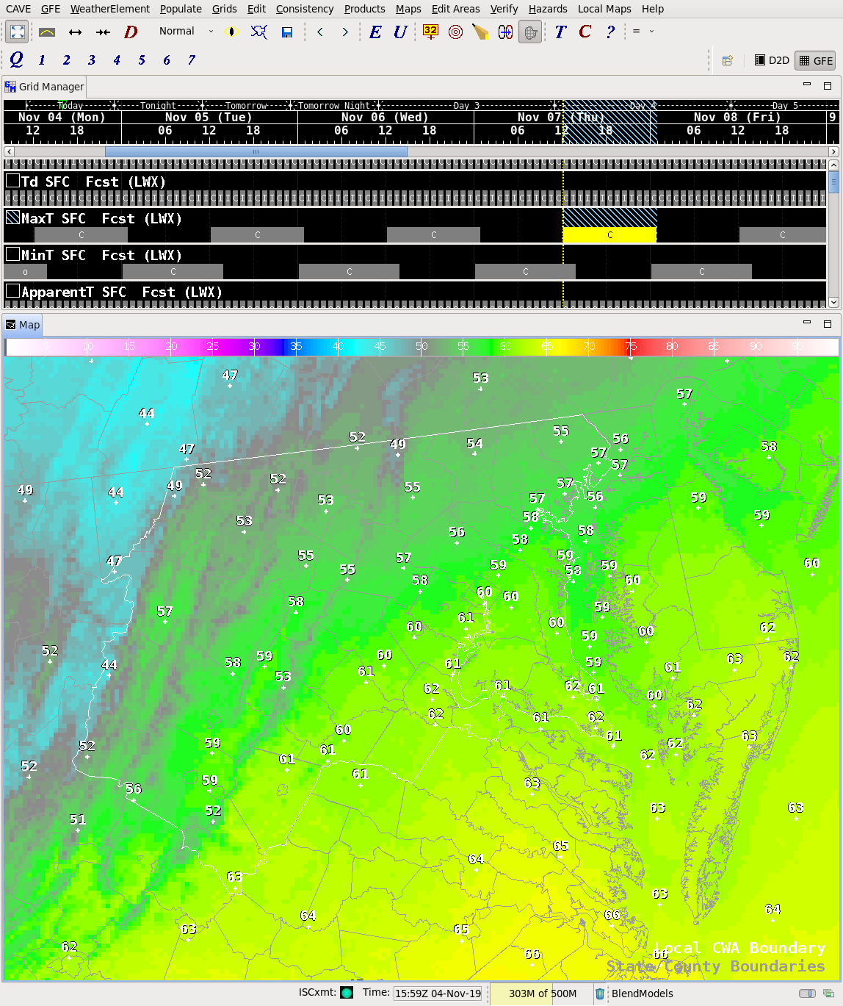
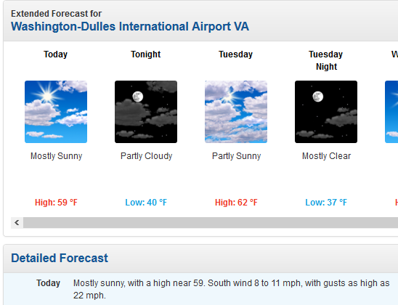
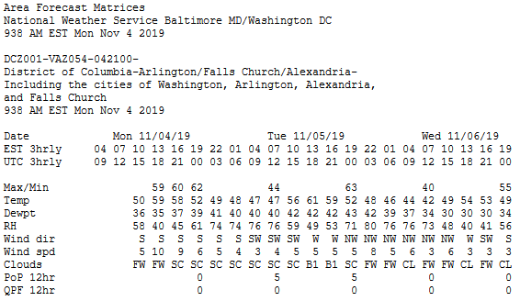
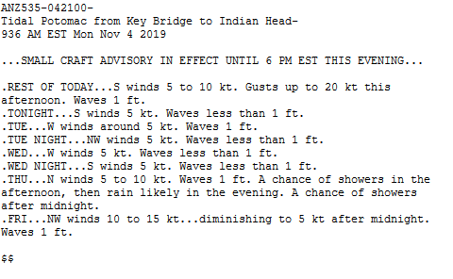
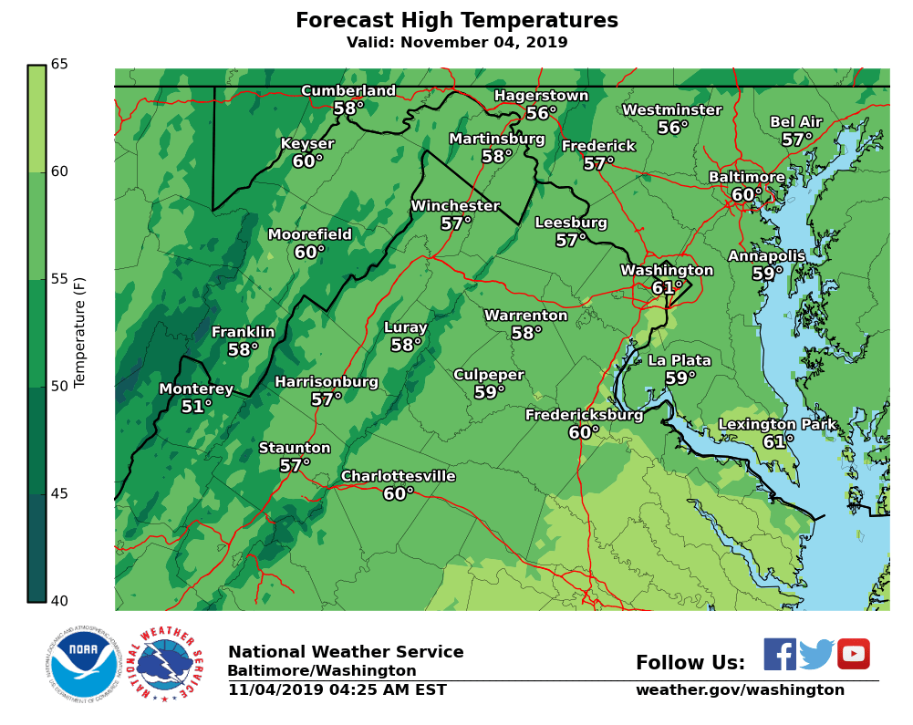
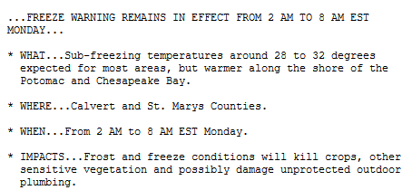
GFE
Manipulate database by using model data, “Smart Tools,” and hand-editing techniques
2.5 x 2.5 km grid boxes sampled by programs to create products

Slide 4
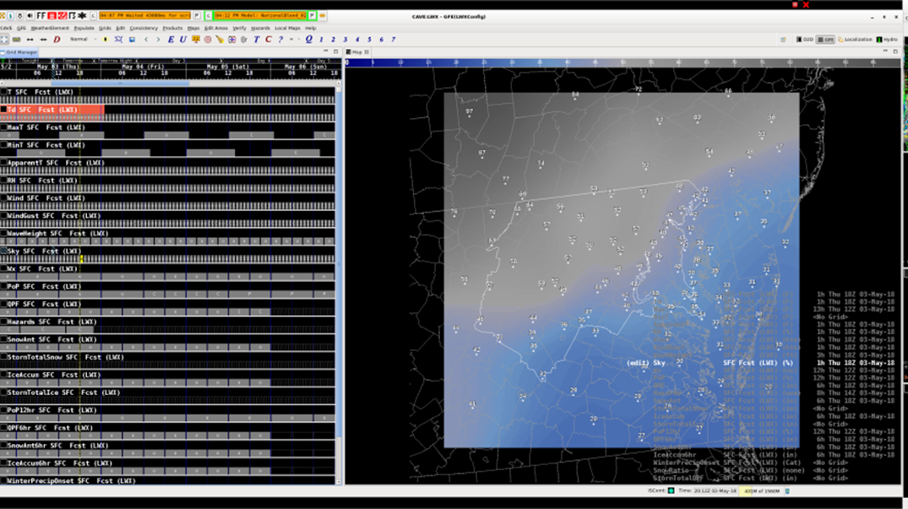
Background
Services produced from GFE continue to expand
Tidal forecasts, probabilistic snow/ice
NWS Boston led charge to a digital aviation database early this decade
For the Baltimore-Washington WFO service area, process migrated from a hand-typed forecast to a product derived from GFE in August 2012.
Continues to expand across country

Slide 5
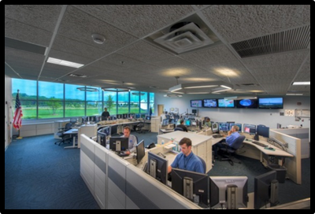
Forecast responsibility
One person is usually responsible for forecast elements from 0-72 hours
Includes all routine and amended TAFs
Staffed 24/7/365
“Long term” forecaster usually writes outlook portion of aviation forecast discussion

Slide 6
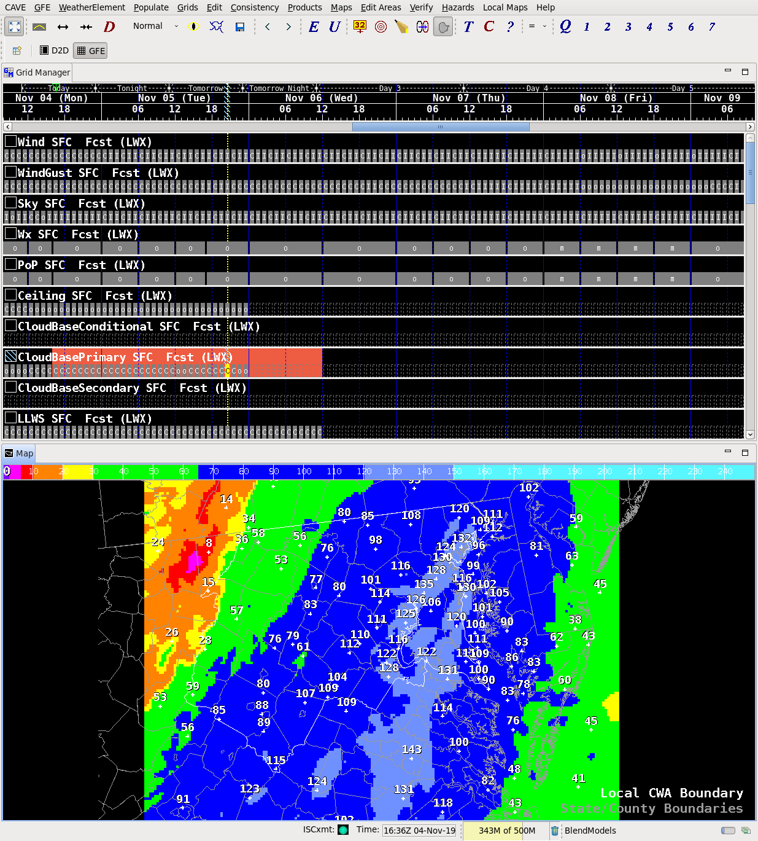
How tafs are produced
One common database serves the needs of General Public, Aviation, Marine, Fire Weather, and Tidal Users
Different users have different thresholds, resolutions, considerations
Ensures consistency among all NWS forecast products
Can increase efficiency in producing forecast for diverse needs
Hourly resolution possible
TAF grid points are sampled and text “drops out” of database

Slide 7
Aviation forecast elements

Slide 8
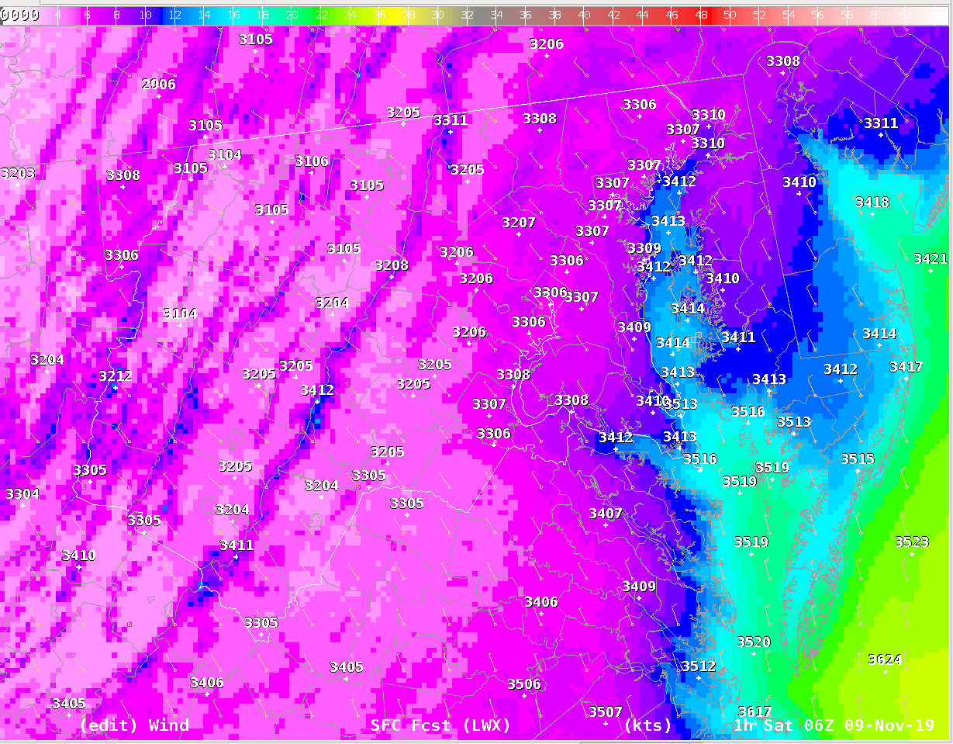
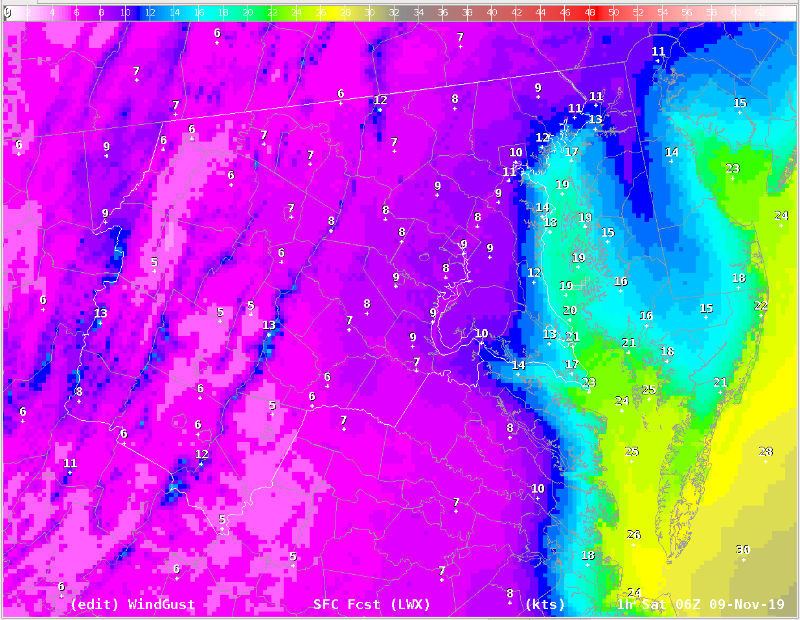
Aviation forecast elements
Wind (direction/speed) – shared with other element groups. Hourly. Populated from model guidance.
WindGust – shared with other element groups. Hourly. Populated from model or derived from winds.

Slide 9
Aviation forecast elements
Sky -- shared with other element groups.
Hourly.
Populated from model guidance.

Slide 10
Aviation forecast elements
Wx – shared with other element groups. Time step varies.
Forecaster-created grid, utilizing a variety of tools.
Tied to a Probability of Precipitation (PoP) grid in the ‘Public’ forecast.
Slight Chance/Isolated = 15-24%
Chance/Scattered = 25-54%
Likely/Numerous = 55-74%
Definite = 75-100%
Includes visibility obstructions (fog)
Thunder – can match category of PoP or be “lower order”

Slide 11
Aviation forecast elements
No consideration made to coverage, just the heights where clouds can be found.
Forecaster created grids, utilizing model guidance and tools whenever possible.
CloudBasePrimary
Always included.
CloudBaseSecondary
Optional (“second layer”). Occasionally included.
CloudBaseConditional
Optional (“temporary conditions”). Rarely Included.

Slide 12
CloudBase Elements
Statistical guidance
Some only in 3-hour time steps
Often misses alto and diurnal convective/cumulus clouds
Raw computer models
Pixelated/splotchy – sometimes “blends” work
Derive from vertical relative humidity profiles
Tools are “black box”
Model saturation/dry bias can have effect

Slide 13
Aviation forecast elements
Ceiling – Calculated grid
Code looks at CloudBase and Sky grids, and returns a Ceiling wherever coverage is greater than 57% (“BKN”).
If using multiple CloudBase grids, can choose which height is the ceiling. So, if the Sky grid reads 62%...
SCT050 BKN150
BKN050 BKN150

Slide 14
Aviation forecast elements
LLWS – Auto-populated from Model/algorithm. Hourly. In tandem with LLWSHgt grid.
LLWSHgt – Auto-populated from Model/algorithm (usually 2000 ft). Hourly. In tandem with LLWS grid.
Visibility – Forecaster populated. Usually from Model, but with post-processing. Need to ensure consistency with Wx (if there is a restriction, make sure there is a weather element causing it).

Slide 15
taf creation/dissemination
Formatter code reads the hourly grids and creates an hourly forecast.
Code then compares the forecast line-by-line and contracts/deletes lines through a “ranking system”
Adheres to NWS TAF Directive

Slide 16
taf creation/dissemination
Formatter ranks Categorical Amendment Criteria highly
Some level of airport impact included
Limits too much “bouncing around” in FM groups
Other airport impact thresholds may not be “triggers”
Wind speeds forcing runway configuration
Ceilings reducing arrival rates (can add an additional ceiling threshold)

Slide 17
Weather rules
Time | Probability of Thunderstorms
Hour | 25-54% | 55% +
0-11 | VCTS | -TSRA
12-30 | None | VCTS
Time | Probability of Precipitation
Hour | 0-54% | 55% +
All | None | -SHRA, -RA, -SN, etc.
Example: 60% showers, chance (30%) thunderstorms @ T+6 = -SHRA VCTS
This is configurable!
Rules can also be customized per airport
Additional options possible (e.g., amount of wind gust above wind to mention; peak VRB speed)

Slide 18
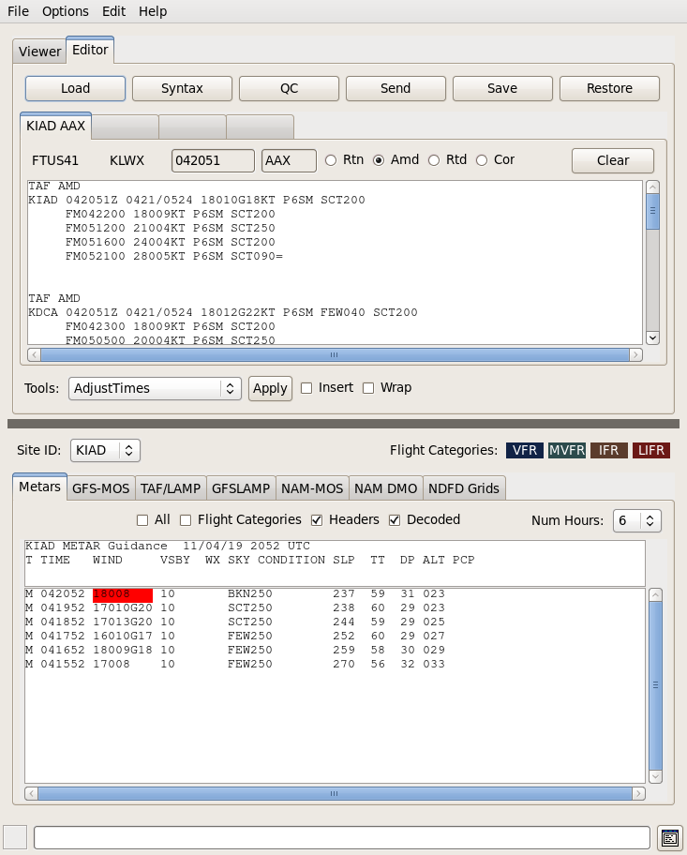
taf creation/dissemination
Output ingested into separate software for quality control before dissemination
Delete unnecessary lines
Add resolution that can’t come from grids
Software alerts when TAFs are out of tolerance to observed flight categories

Slide 19
Local practices
To limit over-use for “chance of rain,” VCSH is not automatically inserted but can be added at forecaster discretion
Limit prevailing TSRA to time period when thunderstorms are most likely
PROB30 is not used (overwarning of high impact, low probability events)
IFR conditions are discouraged for thunderstorms until a direct-hit is expected, with the time frame as limited as possible
Start with MVFR if thunderstorms are likely
TEMPO groups should only be used for short (1-2hr) time frames when conditions are expected to be temporary
Not to express a “chance” of something happening

Slide 20
Philosophical Adjustments
Models often under-estimate sky cover compared to METARs
Less impact to mostly/partly sunny public forecast vs. SCT/BKN ceilings
Models often under-estimate winds during stronger events
Less important in public forecast unless high wind advisories were needed
Patchy fog required to be inserted in forecast to get BR into TAF
Does the public consider MVFR visibility as “fog”?
Consistency must be ensured between visibility and fog/precipitation grids
Previously vsby only used for marine forecasts and dense fog
Tool can help

Slide 21
Limits of formatter
Still “Experimental”: Evolution of the formatter/code ongoing
Doesn’t always return what you expect
Ranking system can’t cover all situations (usual results: too many lines, conditions lasting longer than needed)
Increasing suggestions/demands from around country make code complex
Differing grid practices means what works in one place may cause issues elsewhere
Need to know meteorology and programming to expertly configure
Can’t handle TEMPO winds or weather types
Can’t handle sub-hourly resolution

Slide 22
Status of aviation grids
Not publicly available (yet)
Good regional awareness of aviation hazards…
…But some question of regional reliability
Poor model guidance in areas of terrain (e.g., low ceilings, valley fog)
Grid editing techniques tend to focus on TAF locations
Still have a ways to go to create seamless national database
Different offices have taken different approaches in this experimental stage
Can’t do grid verification (no observation/analysis grid to compare -- yet)
Some offices create “shadow TAFs” for other airports in the background as a way to provide wider verification (not touched by humans nor publicly transmitted)

Slide 23
Thank you for your time

