Slide 1
NOAA/National Weather Service
Aviation Services
Andrew Snyder
Aviation Program Leader
Senior Forecaster
NWS Baltimore/Washington
Aviation Customers Forum
November 13, 2019

Slide 2
outline
NWS Overview
Aviation Resources
External Activities

Slide 3
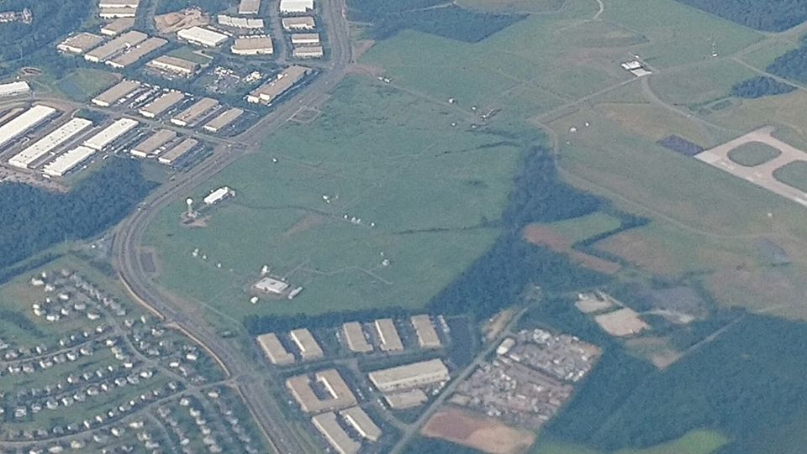
Overview

Slide 4




Administrative Structure
Department of Commerce
National Oceanic & Atmospheric Administration
National Weather Service (NWS)
Notes:
4

Slide 5
NWS Mission
Provide climate, water, weather forecasts and warnings to protect life and property and the enhancement of the national economy
Vision: A Weather-Ready Nation. Society is prepared for and responds to weather, water, and climate-dependent events.
Maintain the national climate database
Data and products are used by other government agencies, the private sector, the public and the global community

Slide 6
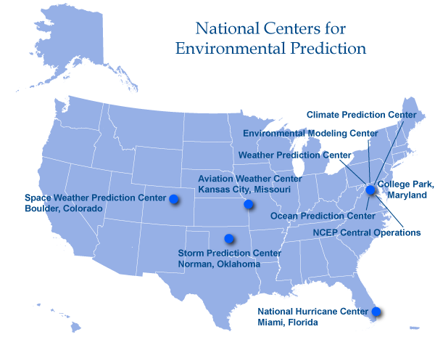
OVERVIEW OF THE NWS
National Centers for Environmental Prediction
Notes:
NCEP

Slide 7
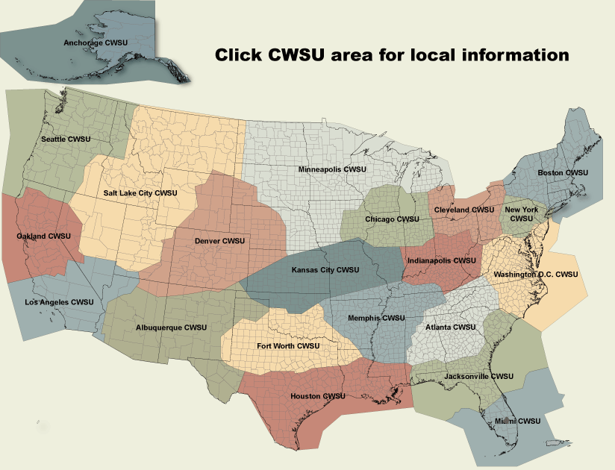
OVERVIEW OF THE NWS
Center Weather Service Units
More on this shortly!

Slide 8
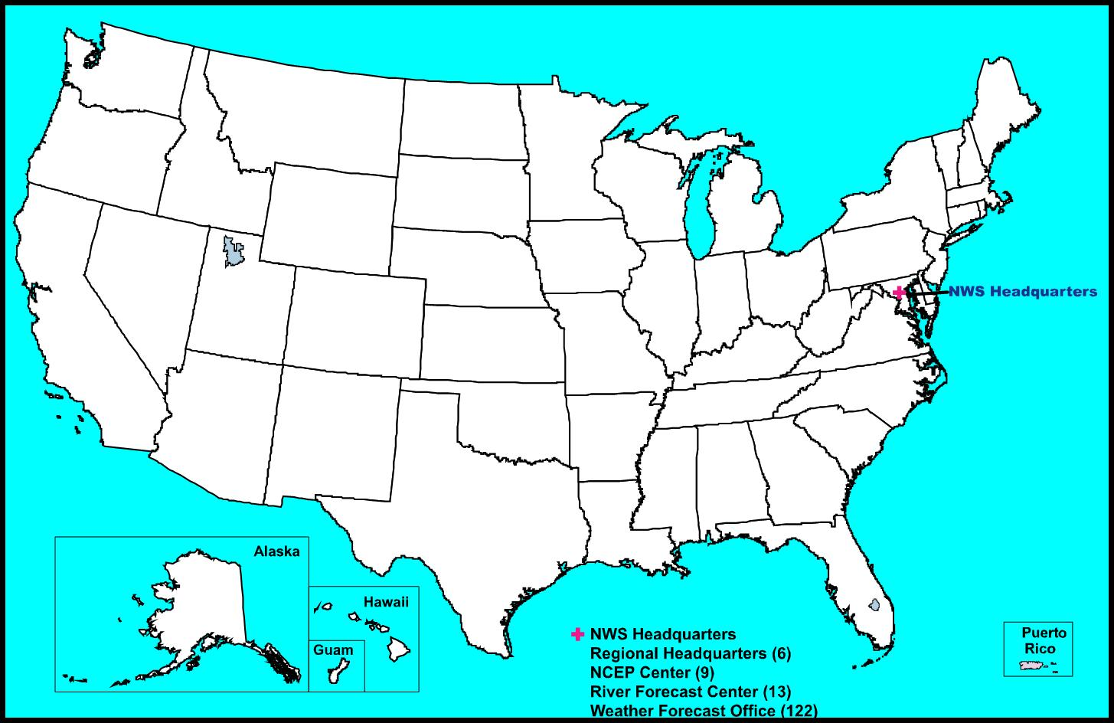

OVERVIEW OF THE NWS
Weather Forecast Offices
Notes:
There are 122 offices across the country called Weather Forecast Offices (WFO). Every state except RI, CT and DE has at least one office, including PR, Guam and American Samoa.

Slide 9
Staffing
24x7, 3 shifts/day, minimum of 2/shift
Meteorologist-in-Charge Jim Lee
Science and Operations Officer Steve Zubrick | Warning Coordination Meteorologist Chris Strong | Electronic Systems Analyst Art Patrick
[5] Lead Meteorologists (Shift supervisors) [8] Meteorologists |  | [3] Electronic Technicians
Observing Program Leader – {vacant} Senior Service Hydrologist – Jason Elliott Information Technology Officer – Ivan Altamirano Administrative Support Assistant – {vacant}

Slide 10
Operations & Services
Forecasts
Public
Marine
Aviation
Fire Weather
River
Coastal
Data Collection
Climate
Cooperative Observers
Upper air soundings
Watch/Warnings/Advisories
Convective
  Tornado
  Severe Thunderstorm
Tropical Systems
  Hurricanes
  Tropical Storms
Non-Precipitable
  Heat
  High Wind
  Dense Fog
  Wind Chill/Excessive Cold
Hydrological
  Flash Floods
  River Floods
  Small Stream & Tributaries
Winter Storms
Coastal (Tidal) Flooding
Wildfire (Red Flag)

Slide 11
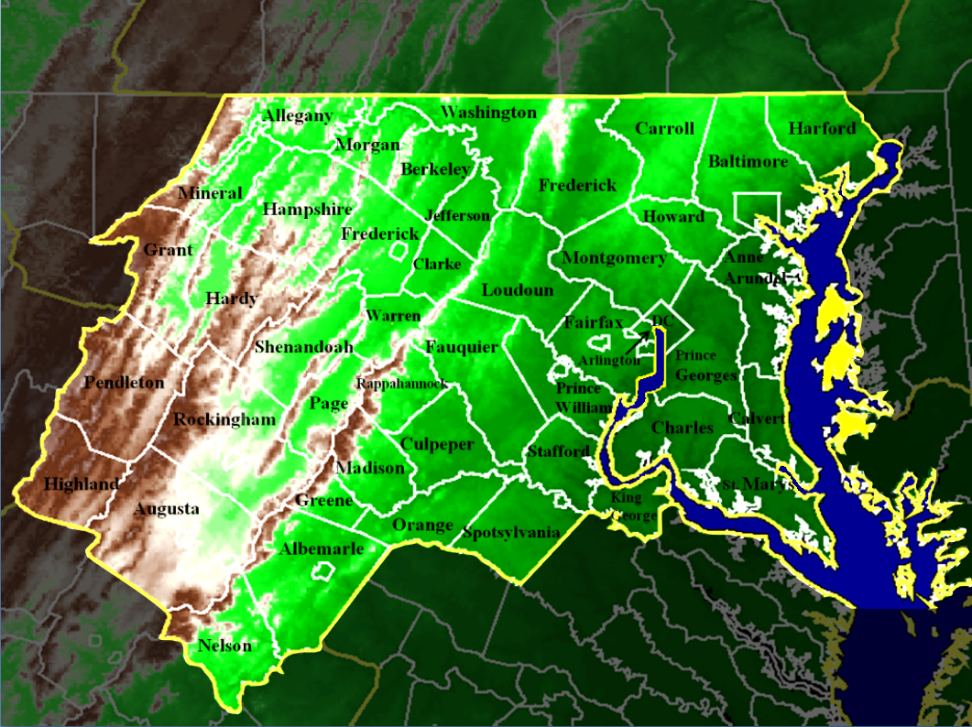
The area we serve
Counties
…nearly 10 million people to look out for!
Notes:
The National Weather Service Blatimore/Washington Forecast Office is located in Sterling, Virginia…in eastern Loudoun county on the north end of Dulles International Airport.

Slide 12
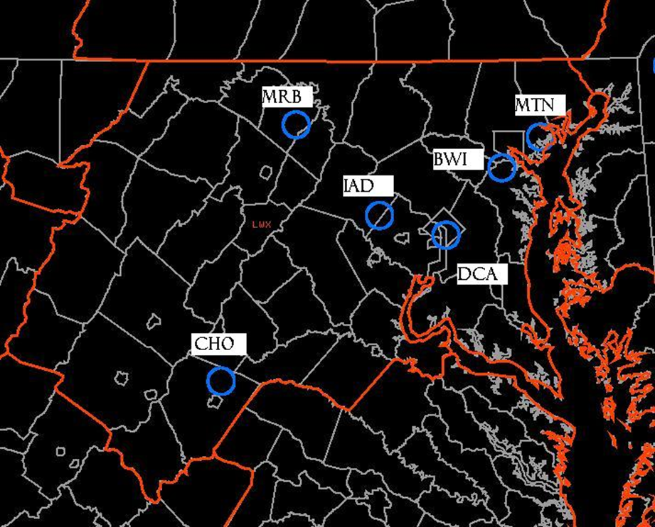
The area we serve
Terminals
Includes 3 “Core 30” Airports

Slide 13
Airport Operations
Airport | Total Ops | Air Carrier | Air Taxi | Gen Aviation | Military | Local
IAD | 305543 | 60 | 28 | 12 | <1 | -
DCA | 297048 | 79 | 19 | 1 | 1 | -
BWI | 266569 | 83 | 12 | 5 | <1 | -
JYO | 106679 | 0 | 2 | 11 | 1 | 85
CHO | 94848 | 9 | 24 | 35 | 2 | 30
HEF | 86730 | 0 | 1 | 68 | 1 | 30
FDK | 83648 | 0 | 3 | 43 | 2 | 52
MTN | 83069 | 0 | 3 | 47 | 2 | 48
CJR | 76755 | 0 | 1 | 38 | 5 | 55
DMW | 56224 | 0 | <1 | 33 | <1 | 67
HWY | 49877 | 0 | 1 | 35 | 1 | 63
GAI | 48000 | 0 | 2 | 3 | <1 | 95
HGR | 46083 | 1 | 10 | 33 | 13 | 43
OKV | 43100 | 0 | 4 | 52 | 0 | 43
2W6 | 33588 | 0 | 3 | 39 | <1 | 58
RMN | 30141 | 0 | 0 | 67 | 7 | 26
EZF | 29707 | 0 | 0 | 14 | 1 | 85
MRB | 29303 | 0 | <1 | 48 | 14 | 38

Slide 14
Airport Operations
Airport | Total Ops | Air Carrier | Air Taxi | Gen Aviation | Military | Local
VBW | 16621 | 0 | 4 | 35 | 2 | 59
8W2 | 16168 | 0 | 0 | 25 | 1 | 74
FRR | 16025 | 0 | 3 | 47 | 3 | 47
SHD | 14966 | <1 | 10 | 1 | 40 | 49
W99 | 14600 | 0 | 0 | 49 | 1 | 49
CBE | 14300 | 0 | 0 | 17 | 2 | 81
W13 | 13877 | 0 | 7 | 23 | 0 | 70
VKX | 12024 | 0 | <1 | 17 | 0 | 83
GVE | 11527 | 0 | <1 | 22 | 3 | 74
OMH | 8947 | 0 | 1 | 60 | 1 | 38
LUA | 3661 | 0 | 5 | 56 | 1 | 38
CGS | 3232 | 0 | 1 | 29 | 4 | 66
W35 | 750 | 0 | 0 | 33 | 0 | 67
*Operations are for the most recent 12 month period available. Time periods differ for each airport.

Slide 15
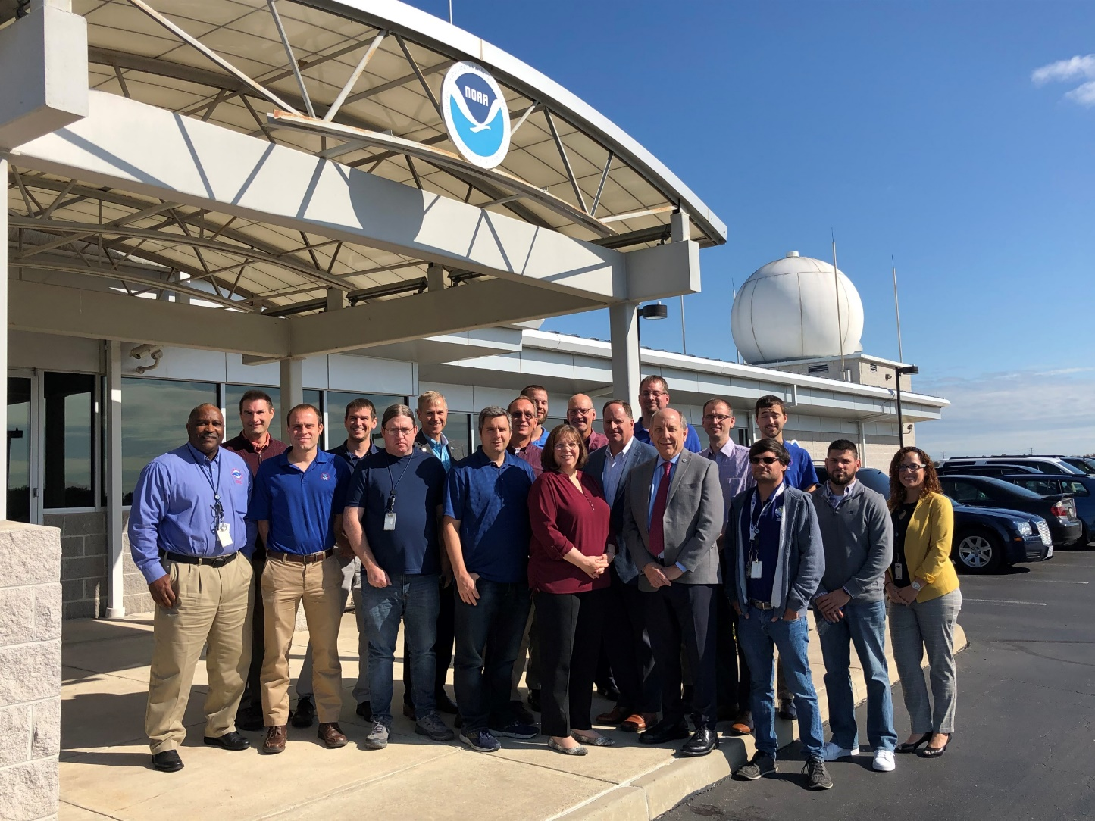
Weather Forecast Office
Aviation Resources

Slide 16
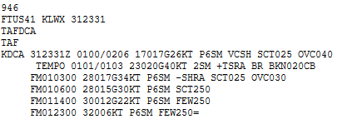
Terminal AerodRome Forecast (TAF)
Routinely issued every 6 hours (by 0540, 1140, 1740, 2340 UTC)
Forecast next 24 hours
  As part of “Core 30” airports, BWI, DCA, IAD receive 30-hour TAFs
Each FM group should represent a “significant change” in prevailing conditions
Forecast Elements
  Wind direction, speed, gust
  Surface visibility
  Weather / obstructions to vision
  Clouds or vertical visibility
  Low level wind shear of at least 30 kt in lowest 2000 ft

Slide 17
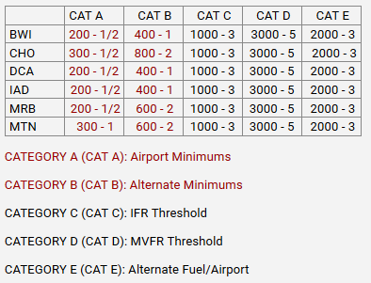
TAF Amendments
When conditions/categories have changed and are expected to persist
New guidance indicates TAF isn’t representative of the first 12 hours
Use “Categorical Amendment Criteria”
Core 30 Airports receive scheduled
amendments at 09, 15, 21 UTC
No amendments at MTN 02-12 UTC
  AWOS not augmented / tower closed

Slide 18
From our Directive (10-802)
TAF represents conditions within 5SM of the center of the runway complex
  Vicinity weather (e.g. VCTS) represents 5-10SM
Try to limit to 6 lines unless more needed for significant weather
Include the most detail in the first 12 hours
TEMPO: 50% chance of condition lasting less than one hour within the first 9 hours of TAF (group cannot exceed 4 hours)
PROB30: 30% chance of thunderstorms/precipitation and their obstructions after 9 hours; only “30” allowed
  Not used at our office
NIL TAFs should only be issued in rare circumstances
  06Z MTN TAF now issued with “AMD NOT SKED”

Slide 19
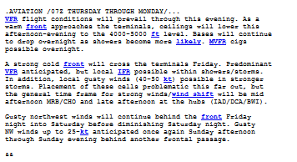
NWS Baltimore-Washington Weather Forecast Office
Area Forecast Discussion
Discussion of conditions within the valid TAF period
  Basic description of what is driving weather
  Range of possible timing for changes in conditions
  Confidence level / where the TAF might go wrong
  Model guidance sources
  Why TAF was written a certain way
“Sound bites” of important weather through Day 5
Updated around 4:00 AM, 10:30 AM, 3:00 PM, 9:30 PM
https://www.weather.gov/lwx/ Scroll to bottom

Slide 20
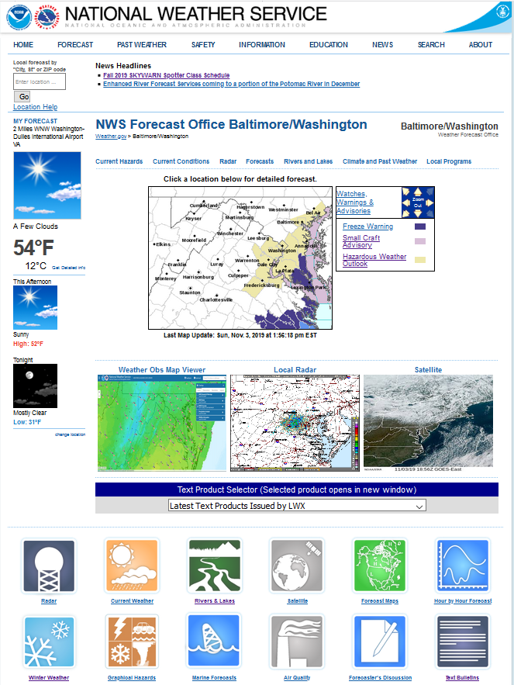
NWS Baltimore-Washington Weather Forecast Office
Website Sources
https://www.weather.gov/lwx/
Traditional forecasts
Satellite/radar
Snowfall/ice forecasts (in season)
Area Forecast Discussion: scroll toward bottom for aviation section

Slide 21
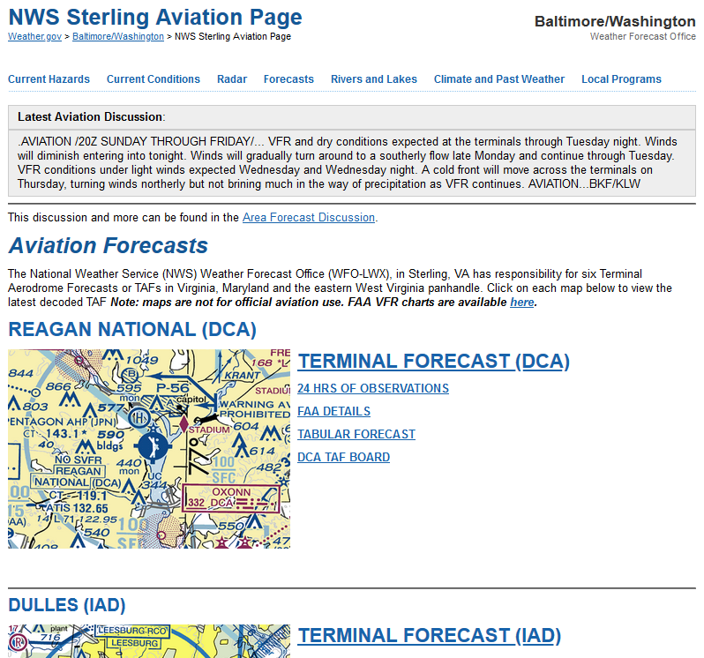
NWS Baltimore-Washington Weather Forecast Office
Website Sources
https://www.weather.gov/lwx/aviation
or Forecasts drop down → Aviation
Aviation Forecast Discussion
Hourly weather details
Hourly TAF details/impacts
At the bottom:
CWSU links
Weather maps
Wind rose data
Other links

Slide 22
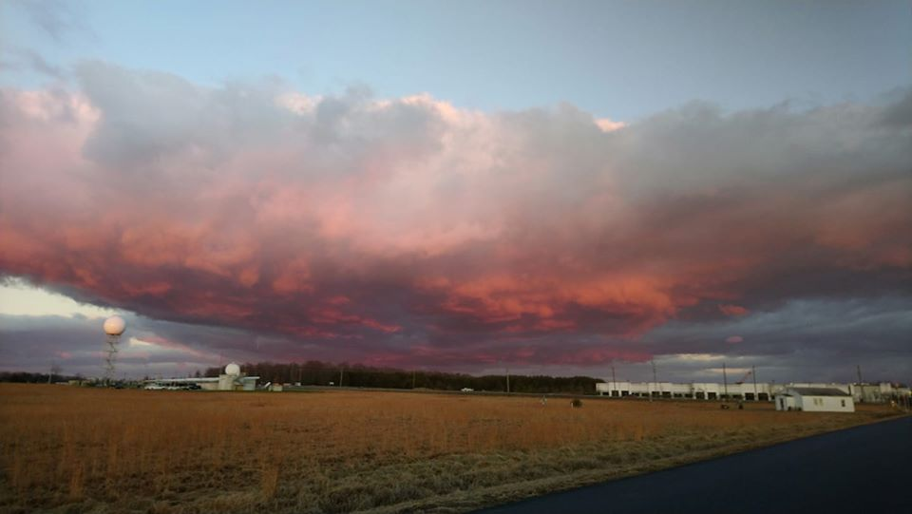
external Activities

Slide 23

Outreach
Visits to Potomac TRACON and FAA Command Center
Annual tower visits to IAD, DCA, and BWI
  Visits to MTN, MRB, and CHO resource dependent
Dulles Customers Forum monthly meeting
Spin-up Aviation Users Group from this meeting!

Slide 24
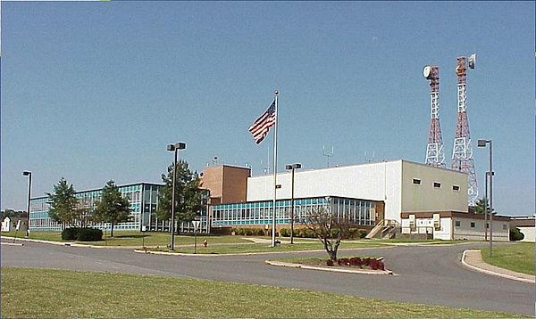
CWSU interaction
Familiarization / collaboration visits by program leader
  Regular visits by WFO MIC
  “Open door” for other staff to visit
ZDC staff attends WFO seasonal preparedness workshops if available
Can use internal chat room (or phone call!) to discuss questions or insights into TAFs

Slide 25
Thank you for your time

