Slide 1
LAMP/GLMP v2.1.0
Science Briefing
Judy Ghirardelli
NWS/OSTI/MDL/LAMP
Jerome Charba, Fred Samplatsky, Bob Glahn, Adam Schnapp, Chenjie Huang, Phil Shafer, Andrew Kochenash, Felicia Guarriello, Mike Allard, Gordana Rancic, Joe Nettesheim, and Aimee Gibbons
June 23, 2017

Slide 2
Outline
Outline
MDL Science Summary
AWC Feedback (Steve Lack)
All Other Evaluation Feedback

Slide 3
Summary of Changes
Summary of Changes
Convection and Lightning Upgrade
Adding stations to LAMP guidance to match MOS stations (per WFO requests)
Using the most recent METAR observation and SPECI observations as input into LAMP (FAA AWRP funding)
Running LAMP/GLMP every 15 minutes (FAA AWRP funding)
All of the above running on WCOSS in the Production Whitespace (Phase 1) for better availability for evaluation prior to handoff and implementation

Slide 4
1. Convection and Lightning Changes
1. Convection and Lightning Changes

Slide 5
Convection and Lightning Upgrade
Convection and Lightning Upgrade
Convection and Lightning Summary
Adding 1-hr guidance to eventually replacing 2-hr guidance once AWIPS transitions to use the 1-hr guidance
Proposing changing the color scheme for “potential”
Uses new inputs of:
HRRR Model Output, MRMS, and Total Lightning (TL) data
Improvements:
At stations and on grid
To deterministic and probabilistic guidance
Dissemination of 2-hr GRIB2 guidance will continue until 1-hr guidance is available in AWIPS
REMOVAL of 5-km GRIB2 guidance because it is no longer used in AWIPS. Remaining guidance is valid on a 2.5-km grid.
ADDITION of GRIB2 guidance valid over 1-hr periods
CHANGE to text bulletins to replace 2-hr with 1-hr guidance
NO CHANGE to bufr messages until AWIPS/AvnFPS can be modified for 1-hr guidance (→ inconsistency in AWIPS between 2-hr gridded/bufr guidance and 1-hr text bulletin guidance: unavoidable due to AWIPS limitations on changes)

Slide 6
Convection and Lightning Upgrade
Convection and Lightning Upgrade
KBWI GFS LAMP GUIDANCE 6/06/2017 1200 UTC UTC 13 14 15 16 17 18 19 20 21 22 23 00 01 02 03 04 05 06 07 08 09 10 11 12 13 TMP 70 70 70 70 71 72 73 73 73 74 73 72 68 66 64 62 61 60 59 59 58 57 57 60 61 DPT 61 59 57 56 55 55 54 54 53 53 52 53 53 53 54 54 54 53 53 54 54 53 53 54 53 WDR 32 32 32 32 31 31 31 31 32 32 32 35 04 05 06 06 06 06 06 05 05 05 06 06 06 WSP 10 10 10 11 09 10 09 10 09 08 07 05 04 04 04 05 05 05 05 05 06 06 06 07 08 WGS NG NG NG NG NG NG 16 NG NG NG NG NG NG NG NG NG NG NG NG NG NG NG NG NG NG PPO 1 0 0 0 0 0 0 0 1 1 1 2 1 1 1 0 0 0 1 3 5 7 8 10 8 PCO N N N N N N N N N N N N N N N N N N N N N N N N N P06 5 13 9 25 LP2 0 0 0 0 0 1 1 2 0 1 0 0 0 0 LC2 N N N N N N N N N N N N N N CP2 0 0 1 1 1 2 3 5 5 4 1 2 1 1 CC2 N N N N N N N N N N N N N N CLD BK BK BK BK BK BK BK BK BK BK BK BK BK BK BK OV OV OV OV OV OV OV OV OV OV CIG 8 8 8 7 7 7 7 7 8 8 8 8 8 7 7 7 6 6 4 4 4 4 4 3 3 CCG 7 7 6 6 6 6 6 6 6 6 6 6 6 6 6 6 5 5 4 4 3 3 3 3 3 VIS 7 7 7 7 7 7 7 7 7 7 7 7 7 7 7 7 7 7 7 7 7 7 7 7 7 CVS 7 7 7 7 7 7 7 7 7 7 7 7 7 7 7 7 7 7 7 6 5 5 5 6 6 OBV N N N N N N N N N N N N N N N N N N N N N N N N N
2-hr convection and lightning guidance
Current LAMP Bulletin Format
KBWI GFS LAMP GUIDANCE 6/06/2017 1200 UTC UTC 13 14 15 16 17 18 19 20 21 22 23 00 01 02 03 04 05 06 07 08 09 10 11 12 13 TMP 70 70 70 70 71 72 73 73 74 74 74 72 69 66 64 62 61 60 59 59 58 57 57 60 61 DPT 61 59 57 56 56 55 54 54 53 53 52 53 53 53 54 54 54 53 53 54 54 53 53 54 53 WDR 32 32 32 32 31 31 31 31 32 32 33 35 04 05 06 06 06 06 06 05 05 05 06 06 06 WSP 09 10 10 11 09 10 09 09 09 08 07 05 04 04 05 05 05 05 05 05 06 06 06 07 08 WGS NG NG NG NG NG NG NG NG NG NG NG NG NG NG NG NG NG NG NG NG NG NG NG NG NG PPO 1 0 0 0 0 0 0 0 1 1 1 2 1 1 1 0 0 0 1 3 5 7 8 10 8 PCO N N N N N N N N N N N N N N N N N N N N N N N N N P06 5 13 9 25 LP1 0 0 0 0 0 0 0 1 1 1 2 2 3 2 1 1 1 1 0 0 0 0 0 0 0 LC1 N N N N N N N N N N N N N N N N N N N N N N N N N CP1 1 0 0 0 0 0 0 0 0 0 1 1 2 3 4 2 3 2 1 1 2 2 1 0 0 CC1 N N N N N N N N N N N N N N N N N N N N N N N N N CLD BK BK BK BK BK BK BK BK BK BK BK BK BK BK BK OV OV OV OV OV OV OV OV OV OV CIG 8 8 8 7 7 7 7 7 8 8 8 8 8 7 7 7 6 6 4 4 4 4 4 3 3 CCG 7 7 6 6 6 6 6 6 6 6 6 6 6 6 6 6 5 5 4 4 3 3 3 3 3 VIS 7 7 7 7 7 7 7 7 7 7 7 7 7 7 7 7 7 7 7 7 7 7 7 7 7 CVS 7 7 7 7 7 7 7 7 7 7 7 7 7 7 7 7 7 7 7 6 5 5 5 6 6 OBV N N N N N N N N N N N N N N N N N N N N N N N N N
1-hr convection and lightning guidance
New LAMP Bulletin Format

Slide 7
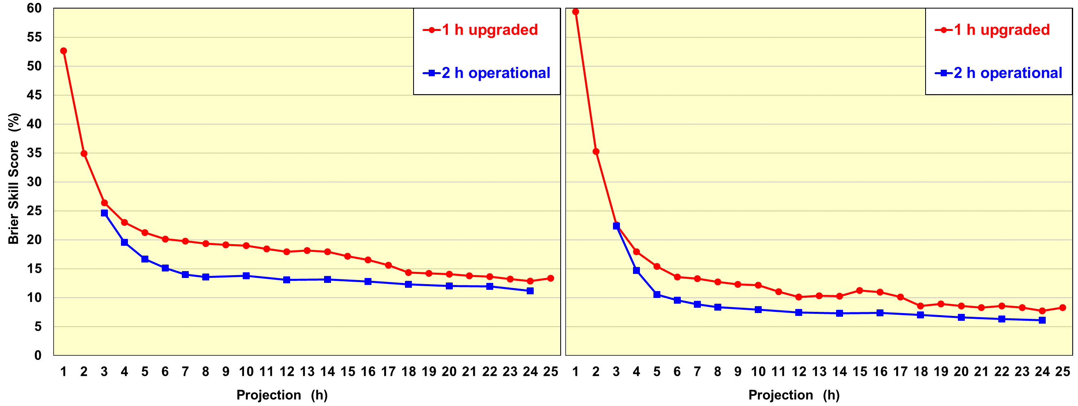
Probability Skill: Convection and Lightning 1-h upgraded versus 2-h operational
Probability Skill: Convection and Lightning
1-h upgraded versus 2-h operational
Independent sample: 246 random days from 05/06/2014 – 05/31/2016
LAMP cycles: 18 and 06 UTC (combined)
Convection
Lightning
Upgraded better than operational
Convection better than lightning beyond 2 hours

Slide 8
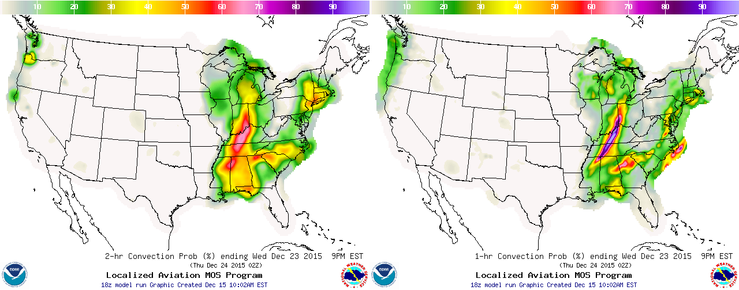
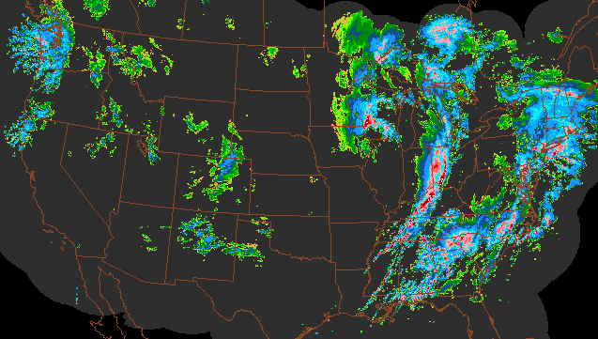
Ex. Convection Probability: Operational versus Upgraded
Ex. Convection Probability: Operational versus Upgraded
8-h forecast from 18 UTC 12/23/2015
Operational valid 00-02 UTC
Upgraded valid 01-02 UTC
Upgraded has better focus in east and better pattern in west
MRMS composite reflectivity at
0130 UTC

Slide 9
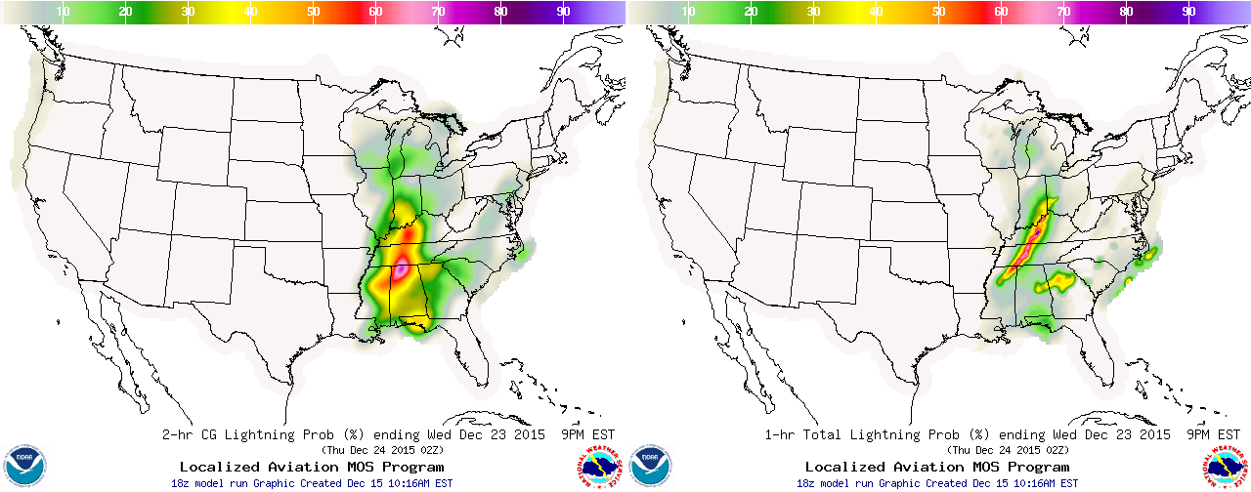
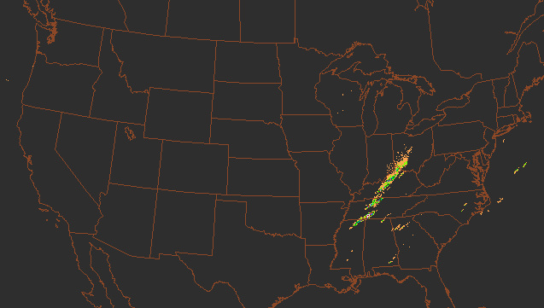
Ex. Lightning Probability: Operational versus Upgraded
Ex. Lightning Probability: Operational versus Upgraded
8-h forecast from 18 UTC 12/23/2015
Operational valid 00-02 UTC
Upgraded valid 01-02 UTC
Upgraded has much better focus
Lightning complements convection
Lightning flash count during
0100-0200 UTC

Slide 10
Non-Science Change: “Potential” color scheme
LAMP/HRRR v2.1.0 Implementation
MDL has received comments that the current LAMP Convection and Lightning Potential color scheme makes it difficult to distinguish between the different “potential” categories, especially on some monitors.
A new color scheme is being proposed with this implementation to replace the current color scheme.

Slide 11
Non-Science Change: “Potential” color scheme
Medium and High are sometimes difficult to distinguish, especially on some monitors
New proposed color scheme easier to distinguish the three categories
Current color scheme
Proposed color scheme

Slide 12
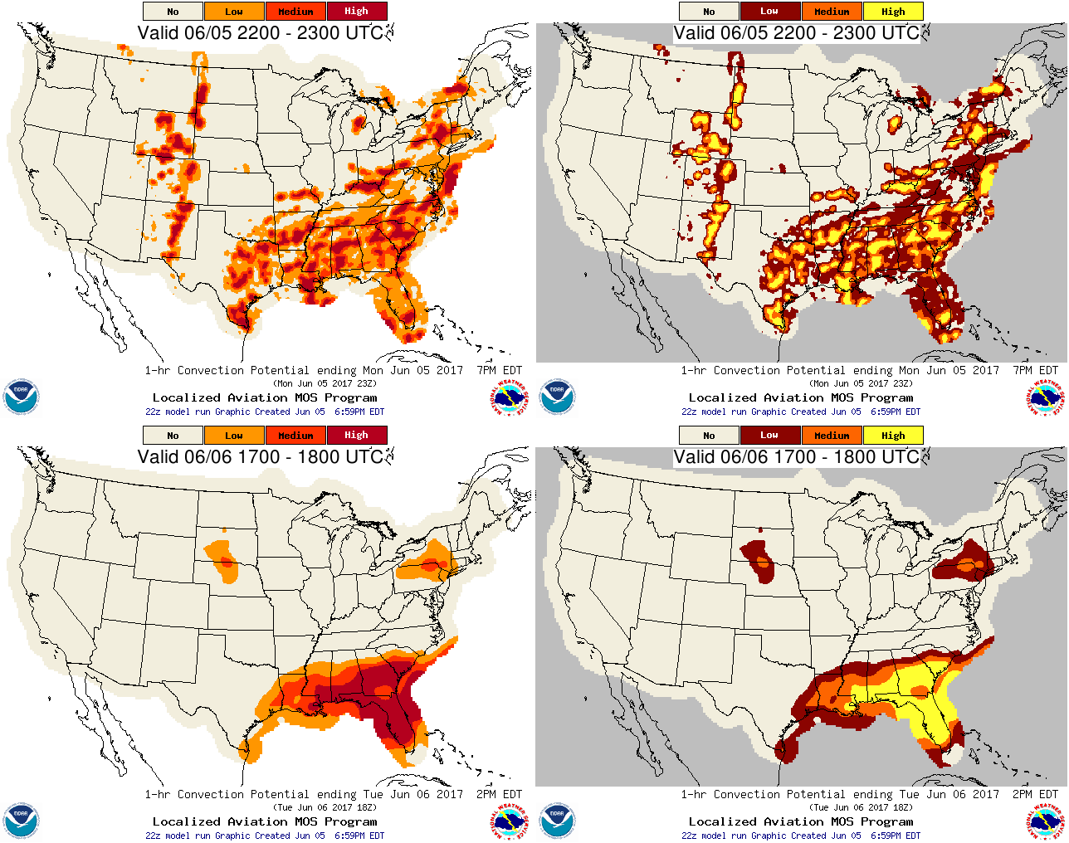
Non-Science Change: “Potential” color scheme
Current color scheme
Proposed color scheme

Slide 13
2. Adding stations to LAMP guidance to match MOS stations (per WFO requests)
2. Adding stations to LAMP guidance
to match MOS stations (per WFO requests)

Slide 14
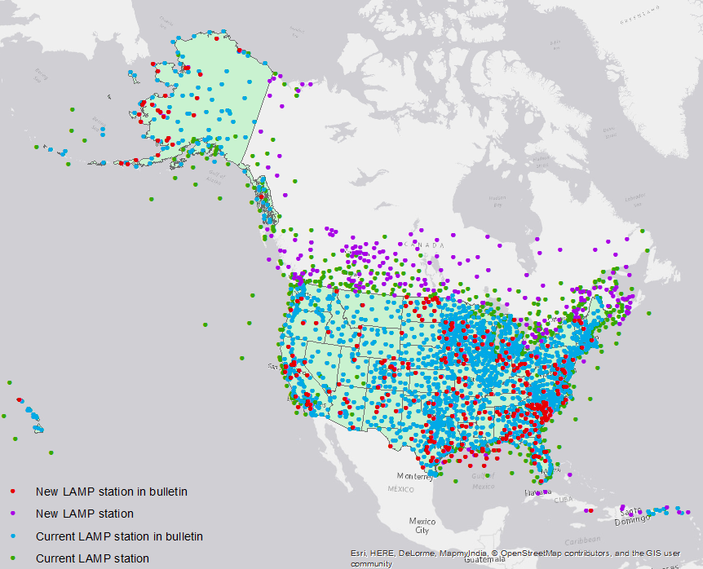
New Stations
New Stations
Adding stations to LAMP guidance
Adding 555 new stations for use in LAMP to already existing equations and thresholds
332 of those new stations will be added to the LAMP text Bulletins and BUFR
Adding these stations for ceiling, visibility, obstruction to vision, convection, and lightning guidance
Other elements will follow in time
New stations will be added to GLMP as inputs in the next implementation (FY18)

Slide 15
3. Using the most recent METAR observation and SPECI observations as input into LAMP (FAA AWRP funding)
3. Using the most recent
METAR observation and SPECI observations
as input into LAMP (FAA AWRP funding)

Slide 16
Most Recent Observations
Most Recent Observations
Using the most recent METAR and SPECI observations as input (FAA AWRP Ceiling & Visibility funding)
MDL is working together with NWS AWC and NCEP/EMC
Specific LAMP focus: improve the 0-3 hour Ceiling Height and Visibility forecast guidance by utilizing all available observations
Historically, LAMP products have only used the “hourly” METAR observations taken at the “top of the hour”
The METAR report taken closest to the “top of the hour” were used, even if a more recent METAR observation was available
SPECI observations were not considered
Upgrade:
Use most recent METAR or SPECI observation for all elements
Benefits LAMP at stations and on the grid
Preliminary results indicate there is a small improvement in the first few hours of the period for ceiling and visibility

Slide 17
4. Running LAMP/GLMP every 15 minutes (FAA AWRP funding)
4. Running LAMP/GLMP
every 15 minutes (FAA AWRP funding)

Slide 18
15-minute updates
15-minute updates
Running LAMP/GLMP every 15 minutes (FAA AWRP funding):
Updated LAMP guidance will be available for the NWS AWC’s Helicopter Emergency Medical Services (HEMS) Tool
Base Run ~HH:30 same as present (forecasts out to 25 hours) except using most recent observations (METAR and SPECIs)
Additional Runs ~HH:00, ~HH:15, and ~HH:45 for:
Ceiling and visibility only; LAMP and GLMP
00-hr gridded analysis
Forecasts only out 3 hours (01, 02, and 03-hr forecasts) with updated forecasts still valid at top of the hour
Dissemination:
Available operationally to AWC for HEMS tool
Available experimentally on website for WFO evaluation to determine if it should be added to SBN (coordinated in April 2017 with NWS RAMs)

Slide 19
15-minute updates
15-minute updates
Nominal Run Time | Most recent obs in period | Forecast Elements | Projections
00 (Early Early) | (HH-1):00 – (HH-1):59 | Ceiling & Visibility | 3 hrs
15 (Early) | (HH-1):15 – (HH):14 | Ceiling & Visibility | 3 hrs
30 (Base) | (HH-1):30 – (HH):29 | All Elements | 1-25 hrs
45 (Late) | (HH-1):45 – (HH):44 | Ceiling & Visibility | 3 hrs

Slide 20
Regular LAMP Bulletin
Regular LAMP Bulletin
KLAX GFS LAMP GUIDANCE 6/14/2017 2200 UTC
UTC 23 00 01 02 03 04 05 06 07 08 09 10 11 12 13 14 15 16 17 18 19 20 21 22 23
TMP 72 71 70 68 67 66 66 65 65 65 64 64 64 64 64 65 67 70 72 73 74 74 73 73 72
DPT 58 58 59 59 59 59 59 59 59 59 59 59 59 59 59 59 59 59 59 59 60 59 59 60 60
WDR 26 26 26 26 25 25 24 23 21 21 20 16 17 14 13 13 14 20 24 25 26 26 26 26 26
WSP 12 12 11 10 08 06 05 04 03 03 03 03 03 02 02 03 03 03 05 07 08 10 11 12 12
WGS NG NG NG NG NG NG NG NG NG NG NG NG NG NG NG NG NG NG NG NG NG NG NG NG NG
PPO 0 0 0 0 0 0 0 0 0 0 0 0 0 0 0 0 0 0 0 0 0 0 0 0 0
PCO N N N N N N N N N N N N N N N N N N N N N N N N N
P06 0 0 1
LP1 0 0 0 0 0 0 0 0 0 0 0 0 0 0 0 0 0 0 0 0 0 0 0 0 0
LC1 N N N N N N N N N N N N N N N N N N N N N N N N N
CP1 0 0 0 0 0 0 0 0 0 0 0 0 0 0 0 0 0 0 0 0 0 0 0 0 0
CC1 N N N N N N N N N N N N N N N N N N N N N N N N N
CLD CL CL FW FW SC SC SC BK BK OV OV OV OV OV OV OV OV BK SC FW FW FW FW FW FW
CIG 8 8 8 8 8 8 8 8 8 6 4 4 4 4 4 4 4 4 8 8 8 8 8 8 8
CCG 8 7 6 3 7 6 4 4 4 4 4 3 4 3 3 3 3 3 6 7 6 7 6 7 6
VIS 7 7 7 7 7 7 7 7 7 7 7 7 7 7 6 5 5 5 5 6 7 7 7 7 7
CVS 7 7 7 6 6 5 6 5 5 5 5 5 5 5 4 4 4 3 3 5 5 5 5 6 5
OBV N N N N N N N N N HZ BR BR BR BR BR BR BR HZ HZ HZ HZ HZ N N N
KLAX GFS LAMP GUIDANCE 6/14/2017 2200 UTC
UTC 23 00 01
CIG 8 8 8
VIS 7 7 7
OBV N N N
Updated LAMP Bulletin 2245 UTC

Slide 21
Most Recent Observations
Most Recent Observations
Using the most recent observation is not a science change, but more of technical change. Therefore we didn’t feel a full verification was needed. However, we did a limited to verification to confirm there were no problems and to see if there might be any measurable impact.
Verification:
Very limited sample of data (19, 30, and 8 days) (May - June)
Only Ceiling and Visibility were verified
Preliminary results indicate:
there is a small improvement in the first few hours of the period for ceiling and visibility
Skill improves slightly with each 15 minute update run

Slide 22
Most Recent Observations Verification: CIG 0000 UTC
19 days: 5/13/17 – 5/31/17

Slide 23
Most Recent Observations Verification: CIG 1200 UTC
19 days: 5/13/17 – 5/31/17

Slide 24
Most Recent Observations Verification: VIS 0000 UTC
19 days: 5/13/17 – 5/31/17

Slide 25
Most Recent Observations Verification: VIS 1200 UTC
19 days: 5/13/17 – 5/31/17

Slide 26
Multiple Runs Verification: CIG 1200 UTC 30 days of Data
30 days: 5/13/17-6/4/17 (:00 window too small) with 6/13/17-6/20/17 (:00 window fixed)
Obs collection window at :00 too restrictive (fixed 6/12/2017) resulting in lower skill for :00 run

Slide 27
Multiple Runs Verification: CIG 1200 UTC 8 days of Data (:00 window fixed)
8 days: 6/13/17 – 6/20/17 (:00 window fixed)
Fix to the :00 run’s window for accepting obs greatly improves the :00 skill, as expected

Slide 28
Importance of recent inter-hourly observation
Importance of recent inter-hourly observation
0600:SPECI KPYM 010528Z AUTO 22004KT 1/2SM FG VV002 14/14 A2992 RMK AO2 T01440139 TSNO
0615: KPYM 010552Z AUTO 24005KT 1 3/4SM BR OVC002 14/14 A2993 RMK AO2 SLP134 60001 T01440139 10167 20133 55000 TSNO
0615:SPECI KPYM 010559Z AUTO 23005KT 2 1/2SM BR OVC002 14/14 A2994 RMK AO2 T01440139 TSNO
0630:SPECI KPYM 010606Z AUTO 22005KT 6SM BR BKN002 14/14 A2994 RMK AO2 T01440139 TSNO
0630:SPECI KPYM 010617Z AUTO 22006KT 10SM SCT002 14/13 A2995 RMK AO2 T01390133 TSNO
0645:SPECI KPYM 010617Z AUTO 22006KT 10SM SCT002 14/13 A2995 RMK AO2 T01390133 TSNO
KPYM: Plymouth MA June 01, 2017 06 UTC Runs
Green = oper 0630 run
Orange = prototpye 0600 run
Black = prototpye 0600 run
Pink = prototpye 0600 run
Cyan = prototpye 0600 run
Red ▲= Top of the Hour obs
Red ★= SPECI obs
Result: Updated and
improved forecasts with the new 0630 Base run. Captures
improved conditions
1 hour earlier than with current operational system.

Slide 29
Importance of recent inter-hourly observation
Importance of recent inter-hourly observation
1400: KMRY 141254Z AUTO 25005KT 8SM OVC005 12/11 A3001 RMK AO2 SLP174 T01170106
1415: KMRY 141354Z VRB03KT 7SM OVC006 12/10 A3001 RMK AO2 SLP173 T01170100
1430:SPECI KMRY 141420Z 00000KT 8SM BKN006 12/10 A3000 RMK AO2 T01170100
1445:SPECI KMRY 141429Z 00000KT 9SM SCT006 12/11 A3000 RMK AO2 T01220106
KMRY: Monterey CA June 14, 2017 14 UTC Runs
Green = oper 0630 run
Orange = prototpye 0600 run
Black = prototpye 0600 run
Pink = prototpye 0600 run
Cyan = prototpye 0600 run
Red ▲= Top of the Hour obs
Red ★= SPECI obs
Result: Updated and improved forecasts with the new 1445 Mini run. Captures improved conditions
45 minutes earlier than with current operational system.

Slide 30
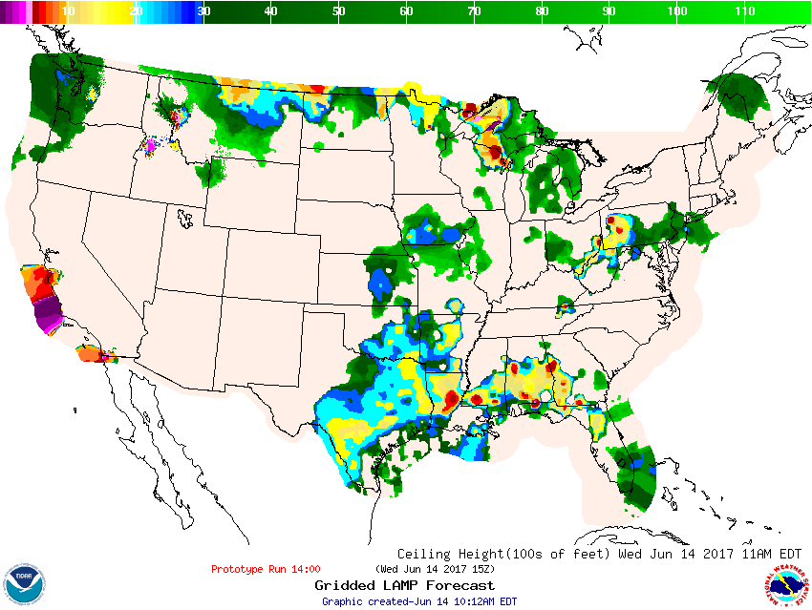
15-minute updates
15-minute updates
15-Min GLMP Prototype 6/14/2017
1400z run valid at 15:00z

Slide 31
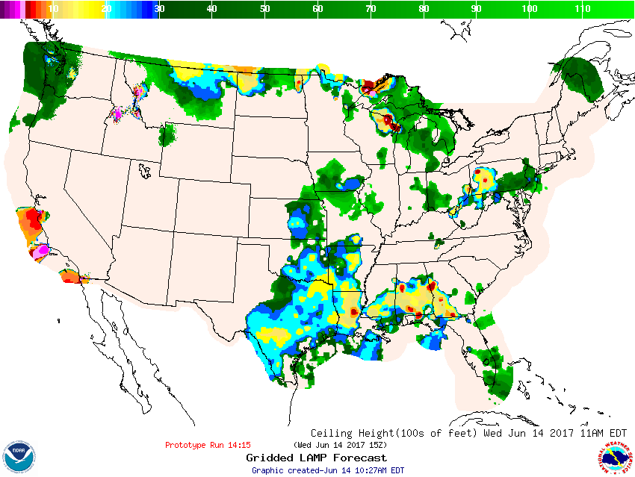
15-minute updates
15-minute updates
15-Min GLMP Prototype 6/14/2017
1415z run valid at 15:00z

Slide 32
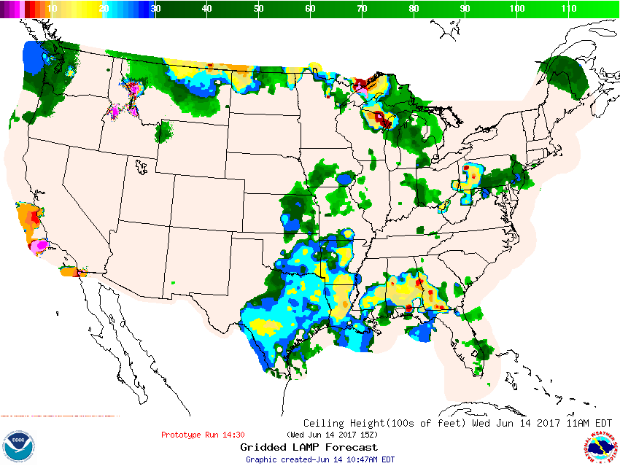
15-minute updates
15-minute updates
15-Min GLMP Prototype 6/14/2017
1430z run valid at 15:00z

Slide 33
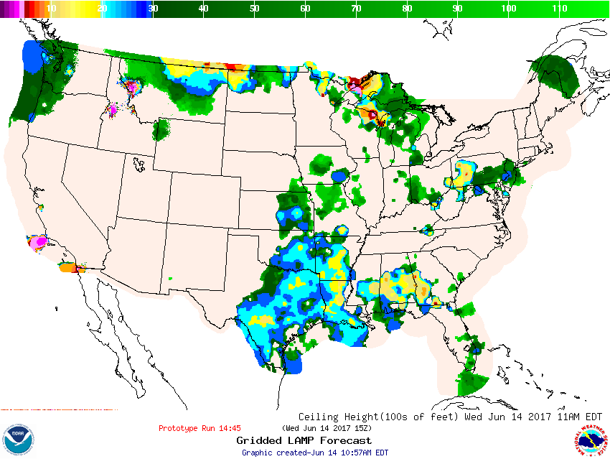
15-minute updates
15-minute updates
15-Min GLMP Prototype 6/14/2017
1445z run valid at 15:00z

Slide 34
Summary
LAMP/HRRR v2.1.0 Implementation
Changes:
1. Adding 1-hr Convection and Lightning
2. Adding New Stations to LAMP Ceiling and Visibility
3. Using most recent METAR and SPECI observations
4. Producing 15-min runs of ceiling and visibility guidance out to 3 hours (experimentally available)
Running in the WCOSS Production machine White Space for better availability during evaluation period and prior to implementation
User feedback period 6/7/17 – 6/21/17. Two presentations provided and live experimental data avail. Google form for feedback.
Some changes made during evaluation, one more change for GLMP to be made

Slide 35
Changes made during Evaluation
MAJOR: Due to timing of the :00 run, we were missing a large number of important METAR observations in the HH:00 runs (fixed 6/9/17). The result was that MORE METAR obs were allowed into the system, which was the original intent.
Minor: This however necessitated increase in array which “broke” :30 GLMP runs (fixed 6/12/17).
Minor: Due to location checking, we were being overly restrictive with a small number (< 50 CONUS stations) of METAR stations and not allowing them into the LAMP system at all hours (fixed 6/14/17 for the LAMP system).
Future change: The same fix should be done for GLMP
We believe that all of the above changes are minor and if any impact is noted, it would only be to improve the results of LAMP/GLMP.
We believe that this doesn't invalidate any evaluation that has already been done.
The 1-hour convection and lightning guidance was totally unaffected by the above since those elements do not use METAR observations as input.

Slide 36
Summary
LAMP/HRRR v2.1.0 Implementation
13 evaluation responses received; all recommend implementation
Code handoff NLT 6/30/2017
Implementation October 2017

Slide 37
Outline
Outline
MDL Science Summary
AWC Feedback (Steve Lack) https://docs.google.com/presentation/d/1OLtaGULQM72cU6p0daB9WPALy_G2cKwFC9jMbFQ3Dg8/edit#slide=id.g2288f029b4_0_40
All Other Evaluation Feedback

Slide 38
Outline
Outline
MDL Science Summary
AWC Feedback (Steve Lack)
All Other Evaluation Feedback

Slide 39
Summary
LAMP/HRRR v2.1.0 Implementation
Data for evaluation – links for all experimental/prototype images and data can be found at the LAMP Experimental website: http://www.weather.gov/mdl/lamp_experimental
Questions/comments? Email to: Judy.Ghirardelli@noaa.gov
Thank You!

