Slide 1
LAMP Convection Probability and “Potential” Guidance: An Experimental Hi-Res Upgrade 01/11/2015 Jess Charba MDL LAMP* convection/lightning leader Judy Ghirardelli MDL LAMP manager/leader Phil Shafer MDL Fred Samplatsky MDL Andy Kochenash MDL
AMS 23rd Conf. on Probability and Statistics in the Atmospheric Sciences
* LAMP = Localized Aviation MOS Program developed by MDL
Notes:
1

Slide 2
Introduction
LAMP (Localized Aviation MOS Program) convection probability and “potential” guidance operational in NWS since April 2014 (http://www.nws.noaa.gov/mdl/gfslamp/convection.php)
Two-hour convection probability and potential out to 25 hours produced every hour on 20-km grid over the CONUS
Primary users are aviation operations interests
Some users indicated need for increased spatial-temporal resolution
MDL is developing increased resolution (“hi-res”) upgraded convection prototype product
Real time production of initial hi-res upgraded prototype began October 2015
Focus: What are the upgrades? Were upgrade objectives achieved?

Slide 3
Upgraded Convection Predictand
Yes/no occurrence of radar reflectivity ≥ 40 dBZ or ≥ 1 total lightning flashes in 1-h period for 20 km grid boxes spaced 10 km apart
MRMS fine-scale composite reflectivity (replaces coarse-resolution legacy RCM reflectivity) with MDL supplemental QC improves convection specification (QC discussed in Extended Abstract)
Total lightning (includes cloud flashes) data (replaces cloud-to-ground flashes) further improves convection specification
1-h (replaces 2-h) valid period provides increased temporal resolution
10 km (replaces 20 km) forecast grid enables increased spatial resolution
Upgrades highlighted with blue text

Slide 4
New Predictor Databases
Hourly fine scale observational data
10 km grids of most recent MRMS reflectivity parameters *
10 km grids of most recent total lightning (TL) flash count parameters **
“Strategic rendering” of MRMS (1 km res.) and TL parameters applied for 10 km observational grids
Observational grids advected to time-match LAMP forecast projections
Hourly fine scale NWP (numerical weather prediction) model output from HRRR (High Resolution Rapid Refresh) ***
“Strategic rendering” of native HRRR (3 km res.) grids applied for 10 km grids (as for MRMS and TL grids)
Note: HRRR forecasts not available for 15 - 25h LAMP projections
Six-hourly large scale NWP-based predictors
GFS-based MOS convection probability on 10 km grid
As above except NAM based
MOS probabilities (rather than direct model predictors) shrinks number of candidate LAMP predictors to tractable level
* MRMS archive provided by OAR/NSSL
** TL archive provided by ENI
*** HRRR archive provided by OAR/ESRL/GSD

Slide 5
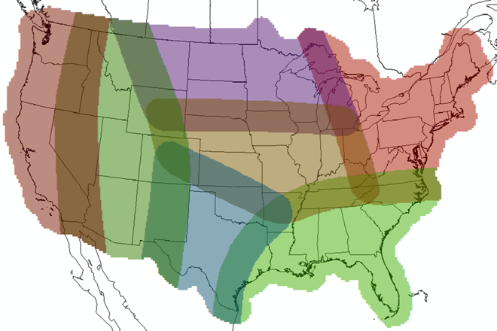
Highlights of Convection Probability Development
Convection probability (for 1-h periods and 20-km gridboxes) produced by predictors in regression equations applied on 10 km grid
Regression equations developed with historical predictor-predictand “training” sample (Jan 2012 – present)
Unique equations/predictors apply to –
Each hourly LAMP cycle
Each of three “seasons” (spring = 03/16 – 06/30; summer = 07/01 – 10/15; cool = 10/16 – 03/15)
Each of 7 overlapping geographical regions
Region overlap avoids inter-region discontinuities in probability grid
PC = Pacific Coast
RM = Rocky Mountains
SP = Southern Plains
CP = Central Plains
NP = Northern Plains
SE = Southeast
NE = Northeast
Large PC and RM regions provide adequate samples there
NP
PC
NE
RM
CP
SP
SE

Slide 6
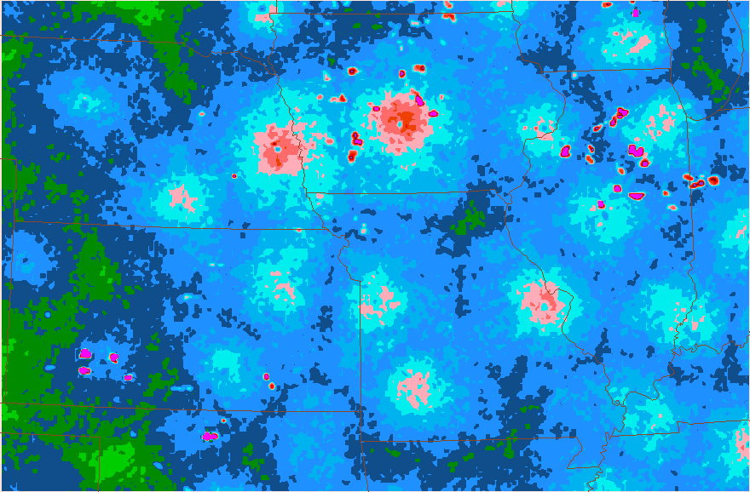
Top 7 Predictors in 18z Regression Equations*
Ranking Spring Summmer Cool_
1 MRMS vil (init) HRRR cref MRMS cref (init)
2 HRRR cref GFS MOS prob MRMS cref (adv)
3 GFS MOS prob MRMS vil (init) GFS MOS prob
4 MRMS cref time chg (adv) NAM MOS prob (GFS X NAM ) MOS prob
5 MRMS cref (adv) MRMS cref time chg (adv) MRMS vil (adv)
6 MRMS cref (init) (GFS X NAM ) MOS prob HRRR cref
7 NAM MOS prob MRMS vil (adv) HRRR 1h precip amt
Abreviations: vil = vertically integrated liquid; init = initial time; prob = convection probability; cref = composite reflectivity
chg = change; adv = advected; precip amt = total precipitation amount
Colors: fine scale observation; fine scale model; large scale model
* Each equation contains 20 predictors
* Substantial variation in predictors between regions

Slide 7
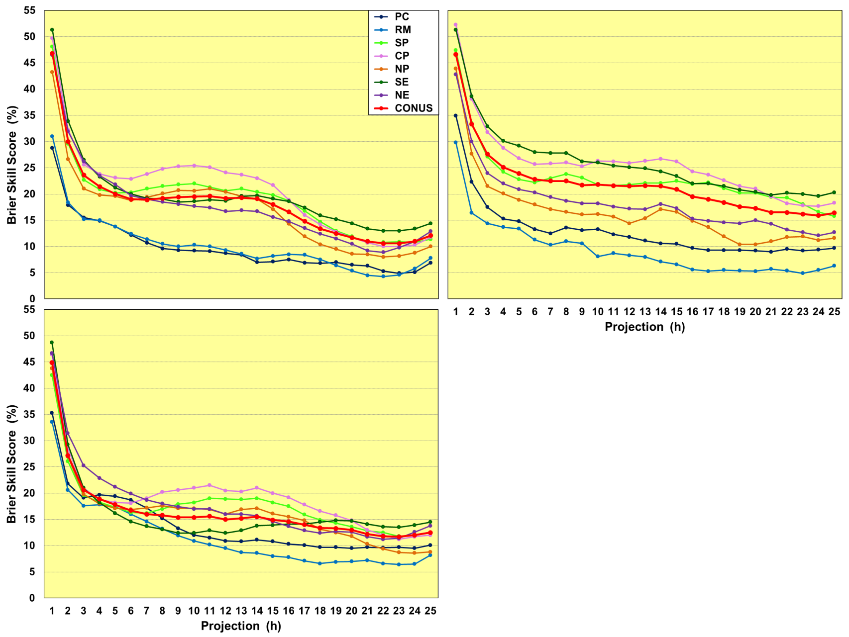
Geographical Variation of Convection Probability Skill
18z LAMP cycle
Spring
Dependent sample
Cool
Dependent sample
Summer
Dependent sample
Legend description:
Scores for each region (listed)
CONUS = all-region average score

Slide 8
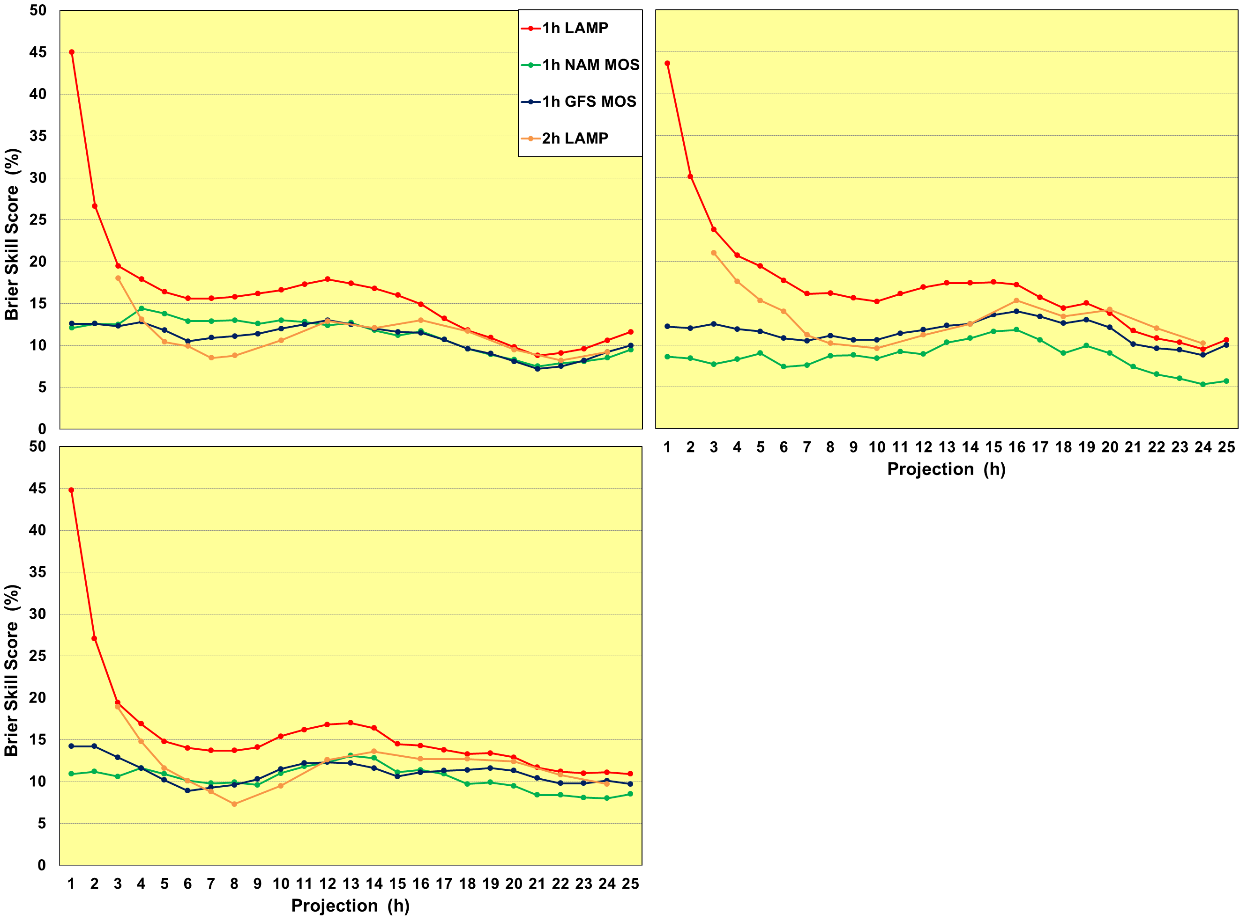
Skill of LAMP Versus other Convection Probabilities 18z LAMP cycle
Spring indep. sample
2015: 06/01 – 06/30
Cool indep. sample
2015: 02/15 – 03/15
Summer indep. sample
2015: 09/01 – 09/30
Legend description:
1h or 2h = 1-h or 2-h predictand valid period
LAMP = 18z LAMP
NAM MOS = 12z NAM-based MOS
GFS MOS = 12z GFS-based MOS

Slide 9
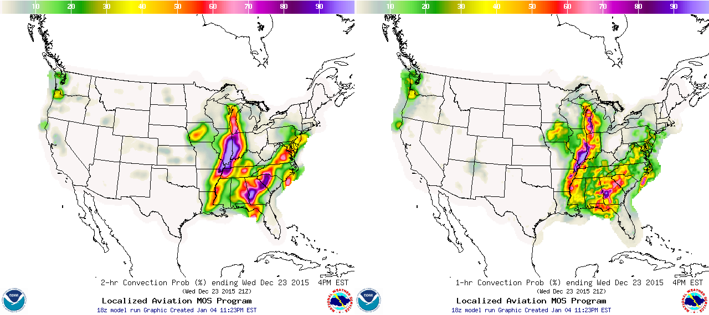
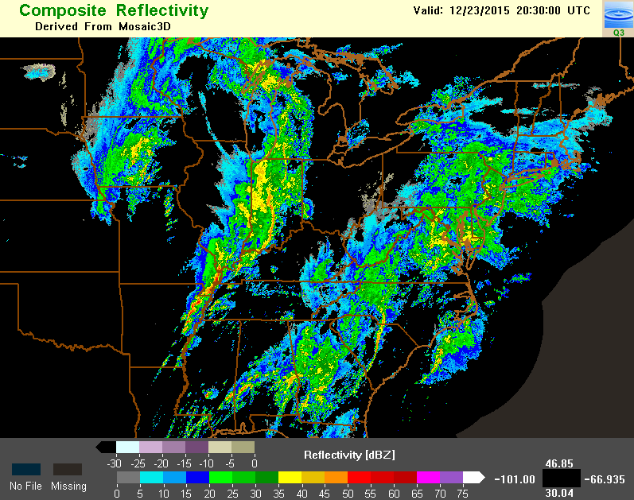
18z LAMP Convection Probability
23 Dec 2015
2-h Operational
3-h Forecast
1-h Upgraded
1-h has better spatial focus and positioning of intense echo line

Slide 10
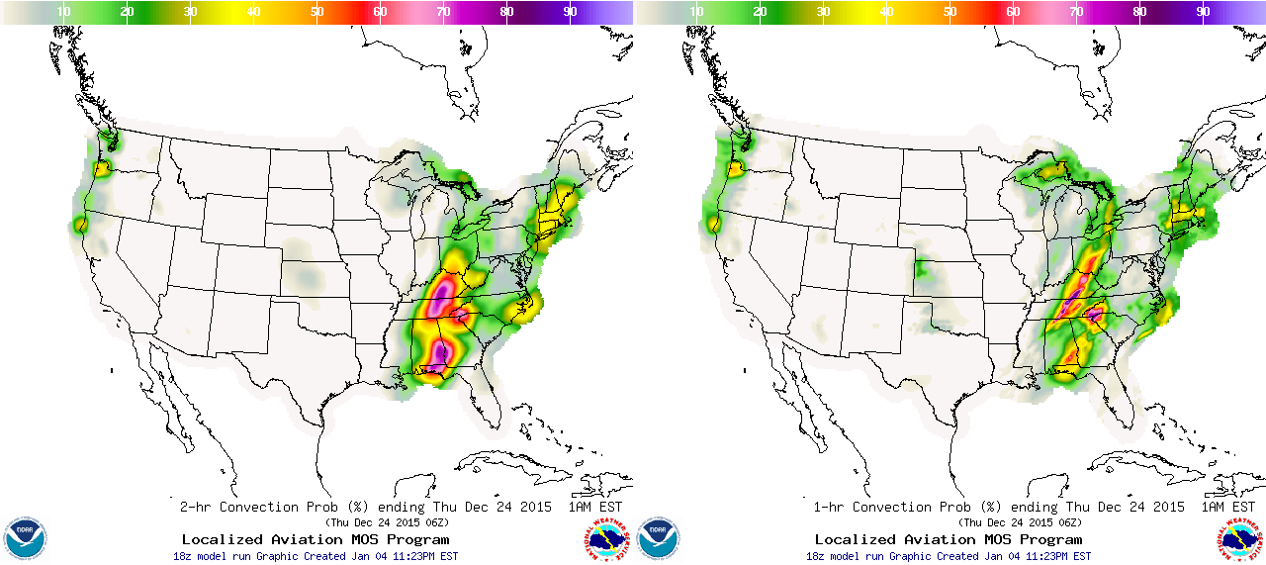
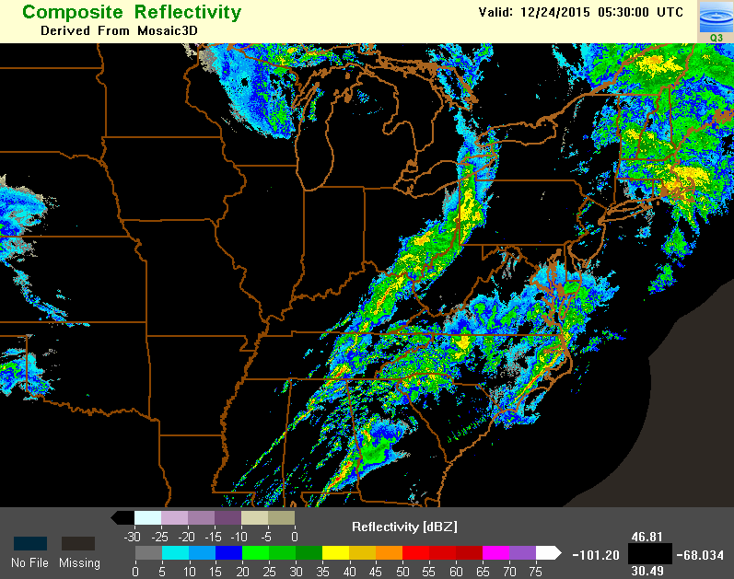
18z LAMP Convection Probability
23 Dec 2015
2-h Operational
12-h Forecast
1-h Upgraded
1-h: (A) has better spatial focus for convection line from northwest AL to western PA, (B) as for (A) in southeast AL; (C) forecasts convection observed over Lake Superior while 2-h does not
C
C
A
A
B
B
C
A
B

Slide 11
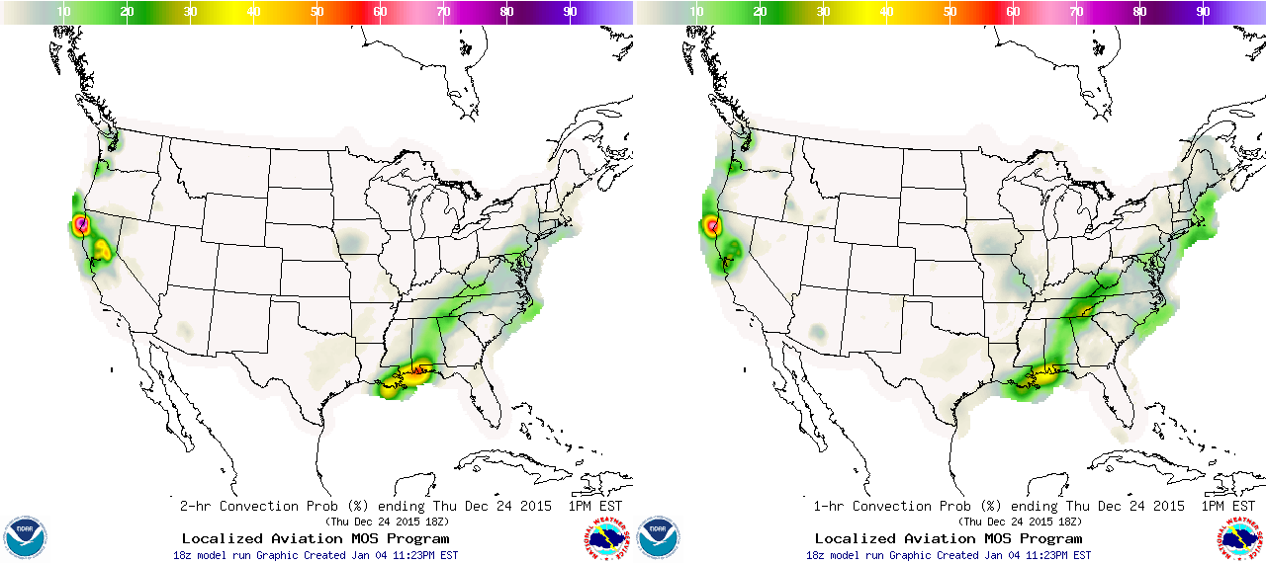
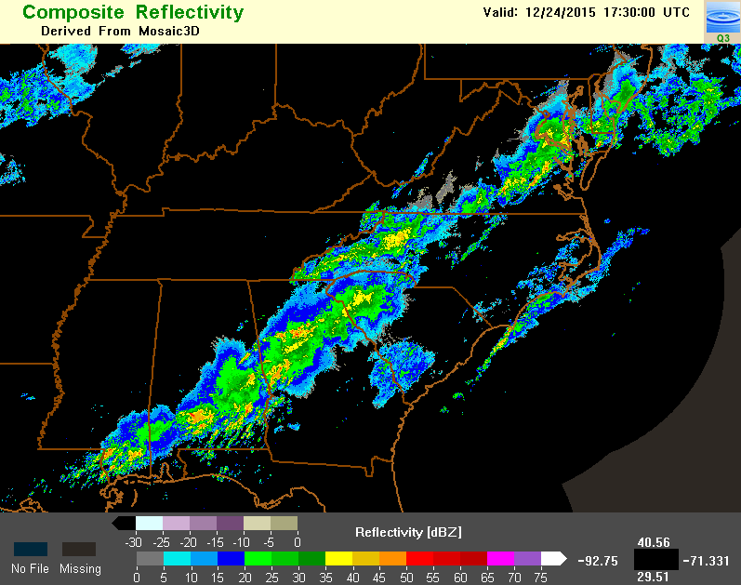
18z LAMP Convection Probability
23 Dec 2015
2-h Operational
24-h Forecast
1-h Upgraded

Slide 12
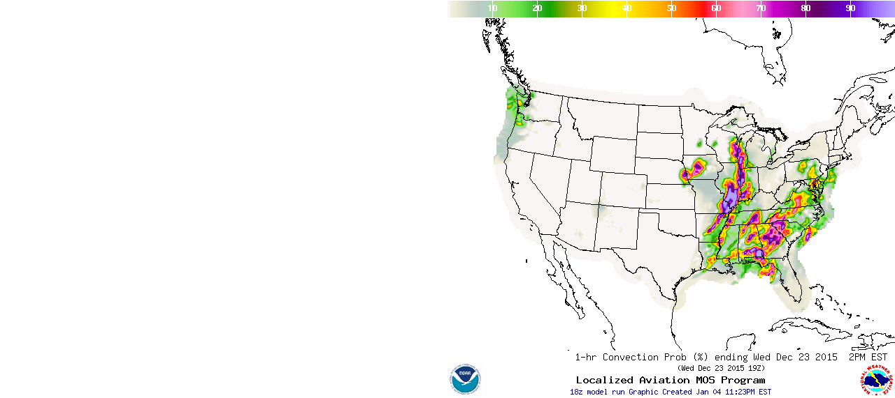
18z LAMP Convection Probability
23 Dec 2015
2-h Operational
Animated
1-h Upgraded

Slide 13
How is Convection Potential Derived from Probability?
Four convection potential “risk” levels specified from three pre-derived probability thresholds
A convection potential occurrence level is forecast when probability ≥ corresponding threshold (non-occurrence otherwise)
Thresholds derived by maximizing threat score with bias in narrow range
use development sample
Threshold Probability Convection Potential Bias Range
low low 2.70 – 2.83 (high bias)
moderate moderate 1.03 – 1.13 (~unbiased)
high high 0.38 – 0.43 (low bias)
Unique thresholds across seasons, hourly cycles, and regions ensures consistency in convection potential specification over full LAMP domain
“Yes/no” convection forecasts obtained by applying “potential-level” thresholds
Enables threat and bias score computation for ≥ low, ≥ moderate, and high potential

Slide 14
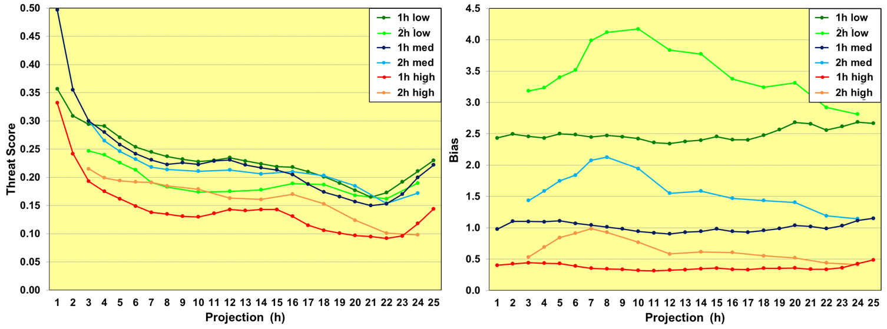
1h LAMP Convection Forecasts Have Generally Better Threat and Bias Scores than for 2h LAMP
18z LAMP cycle
Spring indep. sample
2015: 06/01 – 06/30
Legend description:
1h or 2h = predictand valid period
low - low and above potential = convection forecast; else non-occurrence
med - medium and above potential = convection forecast; else non-occurrence
high - high potential = convection forecast; else non-occurrence

Slide 15
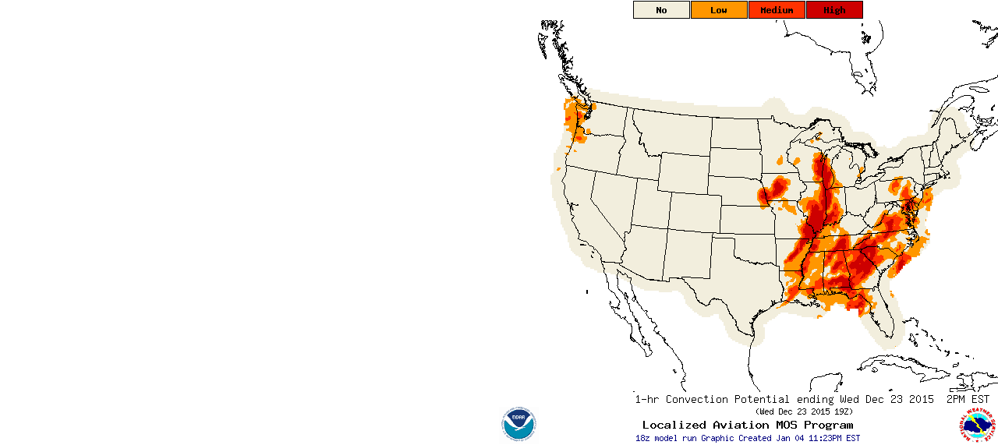
18z LAMP Convection Potential
23 Dec 2015
2-h Operational
Animated
1-h Upgraded

Slide 16
18z LAMP Convection Probability
23 Dec 2015
2-h Operational
Animated
1-h Upgraded

Slide 17
Principal Findings
New LAMP 1-h versus 2-h operational convection probability and potential has improved -
temporal and spatial resolution
skill
accuracy and bias
New LAMP 1-h convection probability shows consistent skill improvement on corresponding MOS probability
Improvement strong for short projections, moderate in mid-range, and small beyond 18 hours
Fine scale detail: for very short projections due to MRMS predictors …HRRR predictors for subsequent projections
MDL supplemental QC of MRMS data likely improves convection predictors and predictand specification (MRMS QC documentation pending)

Slide 18
Conclusions and Plans
Upgrade goals (improved resolution and forecast skill) for operational LAMP 2h convection probability and potential achieved with new 1h product
New 1h product now being expanded to all 24 hourly cycles
New 1h convection probability and potential available in real time for user evaluation at http://w2.weather.gov/mdl/lamp_experimental

Slide 19
Questions ?
Questions ?
http://www.nws.noaa.gov/mdl/lamp/cnv1h.php
http://nmq.ou.edu/

Slide 20
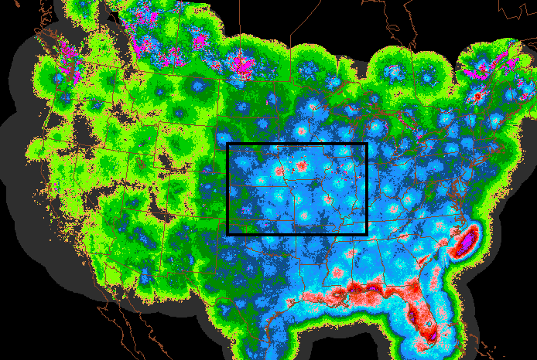
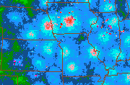
Echo Climatology Shows Systematic Error in Composite Reflectivity
Relative frequency (RF) of ≥ 40 dBZ
April - September
2012 – 2014
Extensive areas of unrealistically high (magenta) and low (gray) RF due to AP and poor radar coverage, respectively
Rectangle magnified below
Small spots of spurious high RF (magenta) due to wind farm AP

Slide 21
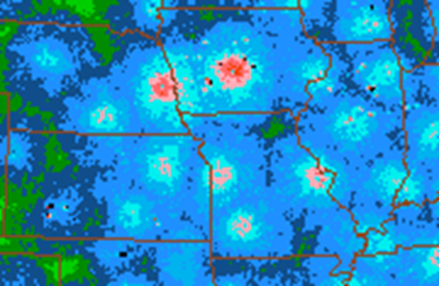
Echo Climatology after MDL Supplemental QC
Relative frequency (RF) of ≥ 40 dBZ
Removal of large spurious RF peaks due to dynamic echo screening
Static mask applied (black areas) where RF was unrealistically low
Otherwise as before
Mitigation of small spurious RF peaks due to dynamic echo screening
Static mask applied (small black spots) where mitigation of wind farm AP not sufficient

