Slide 1
Further Improvements to Localized Aviation MOS Program (LAMP) and Gridded LAMP Guidance for Aviation*
Judy Ghirardelli Presenting
Judy Ghirardelli, Bob Glahn, Adam Schnapp**,
Phil Shafer, Felicia Guarriello**
National Weather Service
OSTI/MDL/LAMP
** Affiliation: KBRwyle Science, Technology & Engineering Group
September 20, 2017
NWA 2017 Annual Meeting
Garden Grove, CA
* This research is in response to requirements and funding by the Federal Aviation Administration (FAA). The views expressed are those of the authors and do not necessarily represent the official policy or position of the FAA.

Slide 2
Outline
Outline
Summary: April 2017 Implementation
Status: Fall 2017 Implementation
Future plans

Slide 3
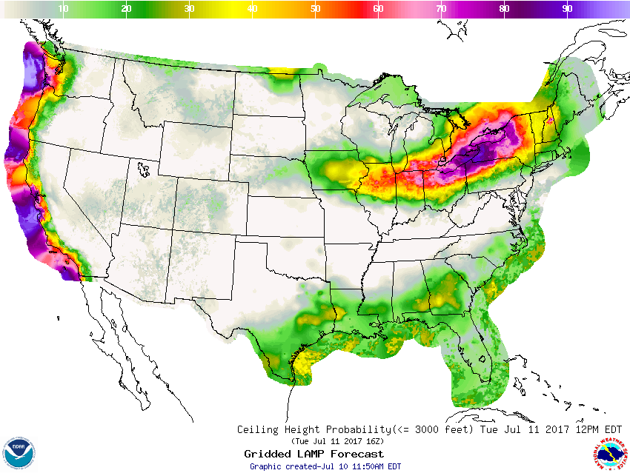
April 2017 Implementation
LAMP and GLMP Upgrade to Ceiling and Visibility (aka LAMP/HRRR Meld) guidance over the CONUS:
Improvements due to utilizing High Resolution Rapid Refresh (HRRR) model output
Implemented April 2017
Resulted in improvements to:
Station-based ceiling and visibility guidance in the CONUS
Gridded ceiling heights and visibility analyses and forecasts
SBN Dissemination of Gridded LAMP probability forecasts:
Probability of ceiling < 500 ft.
Probability of ceiling < 1000 ft.
Probability of ceiling ≤ 3000 ft.
Probability of visibility < 1 mile
Probability of visibility < 3 miles
Probability of visibility ≤ 5 miles

Slide 4
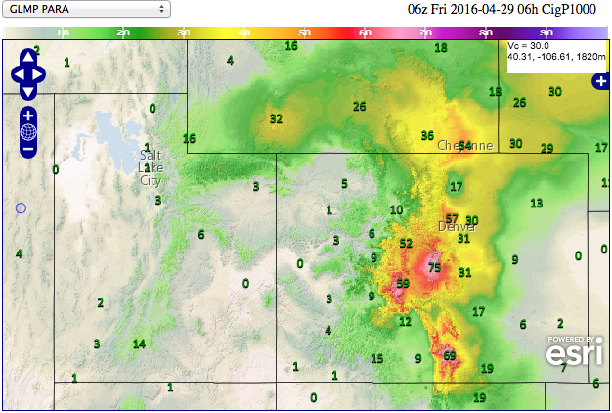
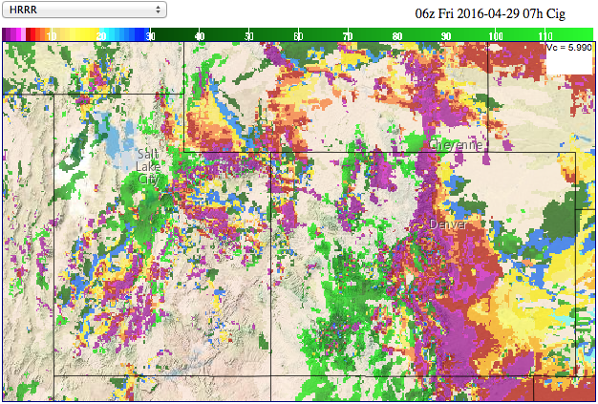
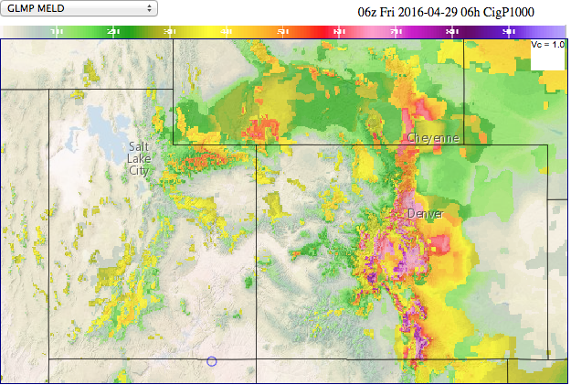
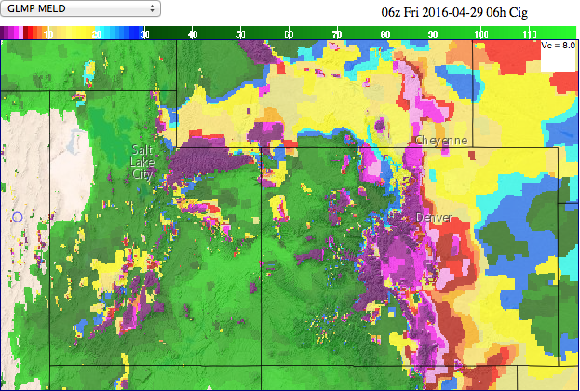
LAMP Probability Meld Example: Ceiling < 1000 feet
GLMP Prob CIG < 1000 ft
3 runs of HRRR Ceiling Height
GLMP Meld Prob CIG < 1000 ft
GLMP Meld Ceiling Height

Slide 5
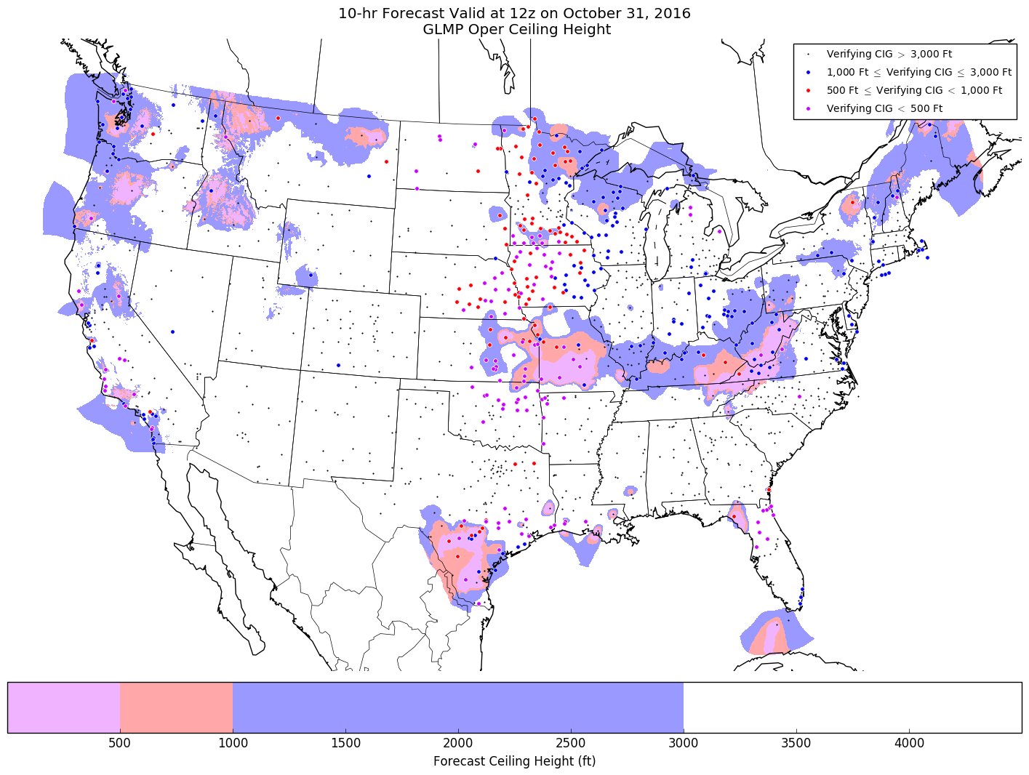
Example Ceiling (Verified)
Operational GLMP missed many areas of low ceilings
GLMP Oper

Slide 6
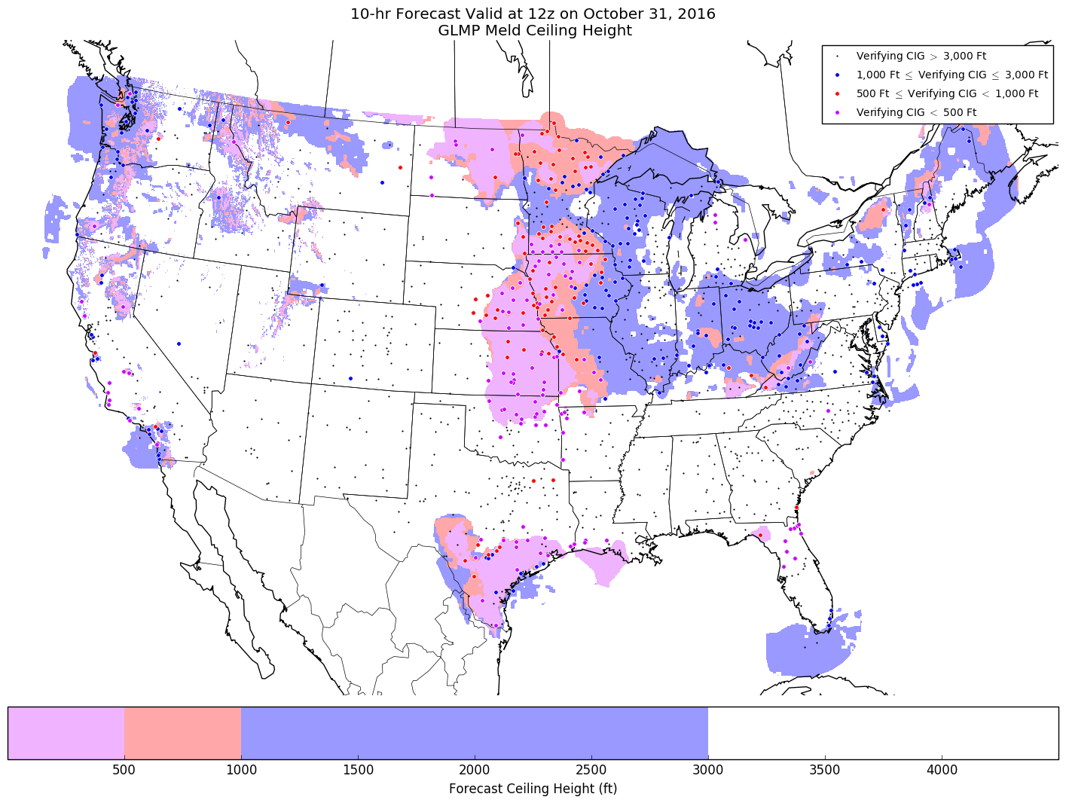
Example Ceiling (Verified)
Meld provided much better guidance for the event
GLMP Meld

Slide 7
Ceiling & Visibility: Threat Scores

Slide 8
Ceiling & Visibility: Threat Scores

Slide 9
Fall 2017 Implementation
Fall 2017 Implementation
Fall 2017 Implementation
Adding 1-hr Convection and Lightning Guidance
Adding stations to LAMP guidance to match MOS stations (per WFO requests)
Using the most recent METAR observation and SPECI observations as input into LAMP (FAA AWRP funding)
Running LAMP/GLMP every 15 minutes (FAA AWRP funding)

Slide 10
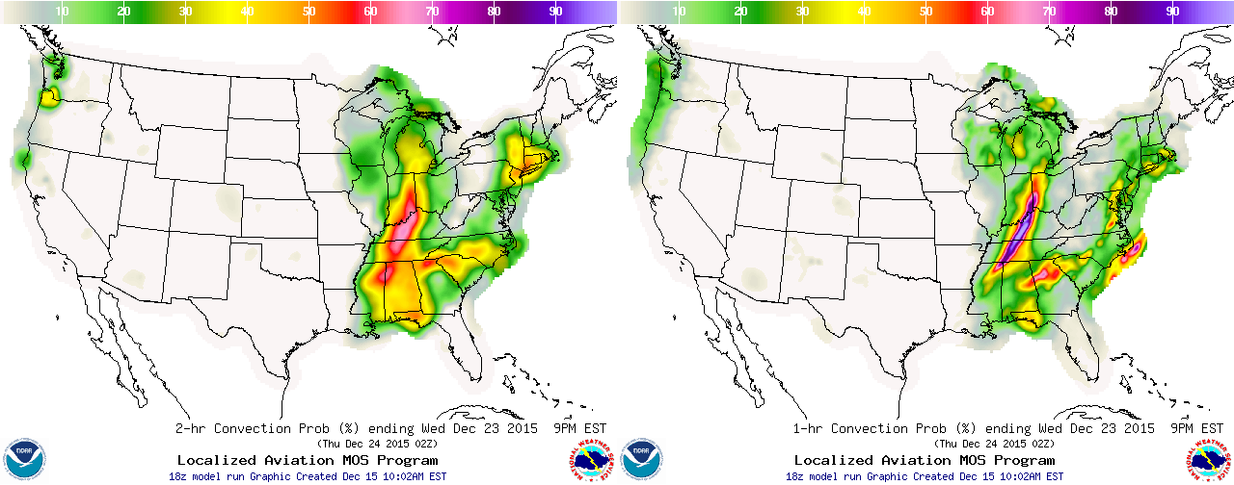
Fall 2017 Implementation
Fall 2017 Implementation
A. Adding 1-hr Convection and Lightning Guidance
8-h forecast from 18 UTC 12/23/2015
Operational 2-hr product
Valid 00-02 UTC
Upgraded 1-hr product
Valid 01-02 UTC
By incorporating HRRR data, MRMS data, and Total Lightning data, this upgrade results in better temporal (1-hr projections) and spatial resolution of convection and lightning guidance

Slide 11
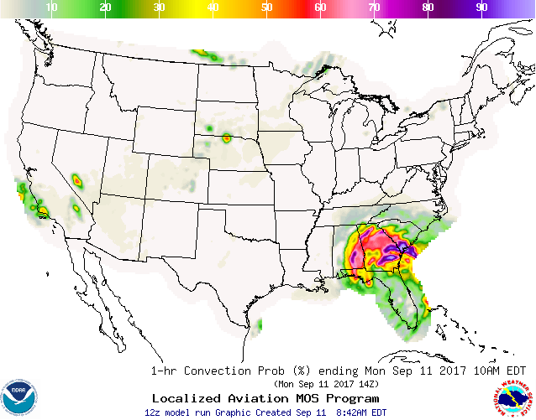
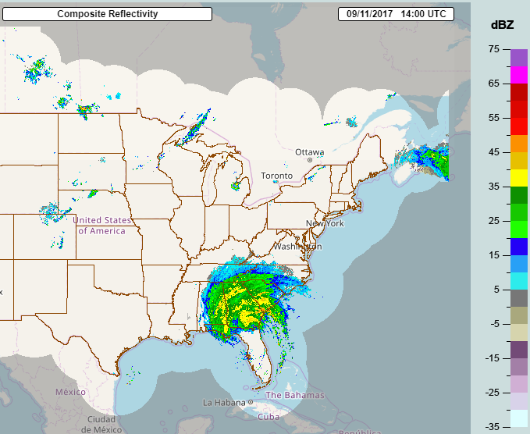
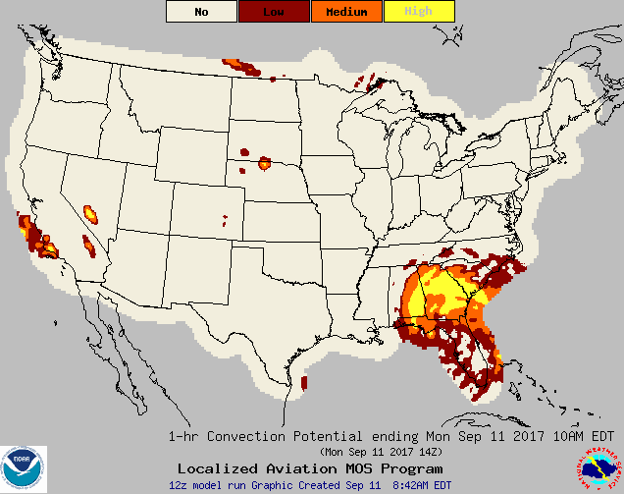
1-hr Convection Example: Hurricane Irma
1-hr Convection Example: Hurricane Irma
09/11/2017 1200 UTC 1-2-h forecast
LAMP 1-hr Convection Probability (top) and Potential (bottom)
Verifying MRMS Composite Reflectivity valid at 1400 UTC

Slide 12
Convection and Lightning Upgrade
Convection and Lightning Upgrade
KBWI GFS LAMP GUIDANCE 6/06/2017 1200 UTC UTC 13 14 15 16 17 18 19 20 21 22 23 00 01 02 03 04 05 06 07 08 09 10 11 12 13 TMP 70 70 70 70 71 72 73 73 73 74 73 72 68 66 64 62 61 60 59 59 58 57 57 60 61 DPT 61 59 57 56 55 55 54 54 53 53 52 53 53 53 54 54 54 53 53 54 54 53 53 54 53 WDR 32 32 32 32 31 31 31 31 32 32 32 35 04 05 06 06 06 06 06 05 05 05 06 06 06 WSP 10 10 10 11 09 10 09 10 09 08 07 05 04 04 04 05 05 05 05 05 06 06 06 07 08 WGS NG NG NG NG NG NG 16 NG NG NG NG NG NG NG NG NG NG NG NG NG NG NG NG NG NG PPO 1 0 0 0 0 0 0 0 1 1 1 2 1 1 1 0 0 0 1 3 5 7 8 10 8 PCO N N N N N N N N N N N N N N N N N N N N N N N N N P06 5 13 9 25 LP2 0 0 0 0 0 1 1 2 0 1 0 0 0 0 LC2 N N N N N N N N N N N N N N CP2 0 0 1 1 1 2 3 5 5 4 1 2 1 1 CC2 N N N N N N N N N N N N N N CLD BK BK BK BK BK BK BK BK BK BK BK BK BK BK BK OV OV OV OV OV OV OV OV OV OV CIG 8 8 8 7 7 7 7 7 8 8 8 8 8 7 7 7 6 6 4 4 4 4 4 3 3 CCG 7 7 6 6 6 6 6 6 6 6 6 6 6 6 6 6 5 5 4 4 3 3 3 3 3 VIS 7 7 7 7 7 7 7 7 7 7 7 7 7 7 7 7 7 7 7 7 7 7 7 7 7 CVS 7 7 7 7 7 7 7 7 7 7 7 7 7 7 7 7 7 7 7 6 5 5 5 6 6 OBV N N N N N N N N N N N N N N N N N N N N N N N N N
2-hr convection and lightning guidance
Current LAMP Bulletin Format
KBWI GFS LAMP GUIDANCE 6/06/2017 1200 UTC UTC 13 14 15 16 17 18 19 20 21 22 23 00 01 02 03 04 05 06 07 08 09 10 11 12 13 TMP 70 70 70 70 71 72 73 73 74 74 74 72 69 66 64 62 61 60 59 59 58 57 57 60 61 DPT 61 59 57 56 56 55 54 54 53 53 52 53 53 53 54 54 54 53 53 54 54 53 53 54 53 WDR 32 32 32 32 31 31 31 31 32 32 33 35 04 05 06 06 06 06 06 05 05 05 06 06 06 WSP 09 10 10 11 09 10 09 09 09 08 07 05 04 04 05 05 05 05 05 05 06 06 06 07 08 WGS NG NG NG NG NG NG NG NG NG NG NG NG NG NG NG NG NG NG NG NG NG NG NG NG NG PPO 1 0 0 0 0 0 0 0 1 1 1 2 1 1 1 0 0 0 1 3 5 7 8 10 8 PCO N N N N N N N N N N N N N N N N N N N N N N N N N P06 5 13 9 25 LP1 0 0 0 0 0 0 0 1 1 1 2 2 3 2 1 1 1 1 0 0 0 0 0 0 0 LC1 N N N N N N N N N N N N N N N N N N N N N N N N N CP1 1 0 0 0 0 0 0 0 0 0 1 1 2 3 4 2 3 2 1 1 2 2 1 0 0 CC1 N N N N N N N N N N N N N N N N N N N N N N N N N CLD BK BK BK BK BK BK BK BK BK BK BK BK BK BK BK OV OV OV OV OV OV OV OV OV OV CIG 8 8 8 7 7 7 7 7 8 8 8 8 8 7 7 7 6 6 4 4 4 4 4 3 3 CCG 7 7 6 6 6 6 6 6 6 6 6 6 6 6 6 6 5 5 4 4 3 3 3 3 3 VIS 7 7 7 7 7 7 7 7 7 7 7 7 7 7 7 7 7 7 7 7 7 7 7 7 7 CVS 7 7 7 7 7 7 7 7 7 7 7 7 7 7 7 7 7 7 7 6 5 5 5 6 6 OBV N N N N N N N N N N N N N N N N N N N N N N N N N
1-hr convection and lightning guidance
New LAMP Bulletin Format

Slide 13
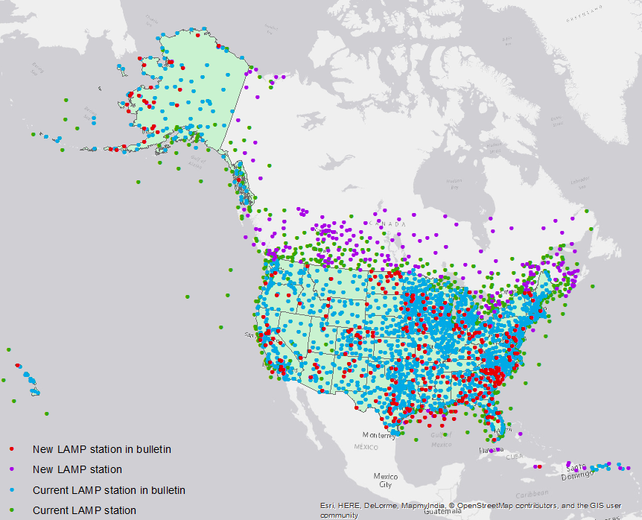
Fall 2017 Implementation
Fall 2017 Implementation
Adding stations to LAMP guidance
Adding 555 new stations for use in LAMP to already existing equations and thresholds
332 of those new stations will be added to the LAMP text Bulletins and BUFR
Adding these stations for ceiling, visibility, obstruction to vision, convection, and lightning guidance
Other elements will follow in time
New stations will be added to GLMP as inputs in the next implementation (FY18)

Slide 14
Fall 2017 Implementation
Fall 2017 Implementation
C. Using the most recent METAR observation and SPECI
observations as input into LAMP
Specific LAMP focus: improve the 0-3 hour Ceiling Height and Visibility forecast guidance by utilizing all available observations
Historically, LAMP products have only used the “hourly” METAR observations taken at the “top of the hour,” even if a more recent METAR observation was available, and SPECI observations were not considered
Upgrade: use most recent METAR or SPECI observation for all elements
Benefits LAMP at stations and on the grid
SPECI (“Aviation Selected Special Weather Report”) as defined by the FMH-1: “SPECI is an unscheduled report that is taken when any of a set of significant criteria have been observed”

Slide 15
Benefit of using the most recent observations including Specials
Benefit of using the most recent observations including Specials

Slide 16
Benefit of using the most recent observations including Specials
Base Run of LAMP using the most recent observations (pink line) improves over operational LAMP (green line) in early projections.

Slide 17
Fall 2017 Implementation
Fall 2017 Implementation
D. Running LAMP/GLMP every 15 minutes (FAA AWRP funding):
Continue to run hourly 1-25 hours for all elements (Base run)
In addition, run 3 extra times per hour for ceiling and visibility only, going out 3 hours
Dissemination:
Available operationally to AWC for use in Helicopter Emergency Medical Services (HEMS) Tool
Available experimentally on website for evaluation to determine if it should be added to SBN
KLAX GFS LAMP GUIDANCE 6/14/2017 2200 UTC
UTC 23 00 01
CIG 8 8 8
VIS 7 7 7
OBV N N N
Example: Updated LAMP Bulletin 2245 UTC

Slide 18
Ceiling Threat Score < 1000 ft 1200 UTC, Summer 2017

Slide 19
Ceiling Threat Score < 1000 ft 1200 UTC, Summer 2017

Slide 20
Ceiling Threat Score < 1000 ft 1200 UTC, Summer 2017

Slide 21
Ceiling Threat Score < 1000 ft 1200 UTC, Summer 2017
Each 15-minute run of LAMP improves on the previous run due to updated observations and reduced lead time

Slide 22
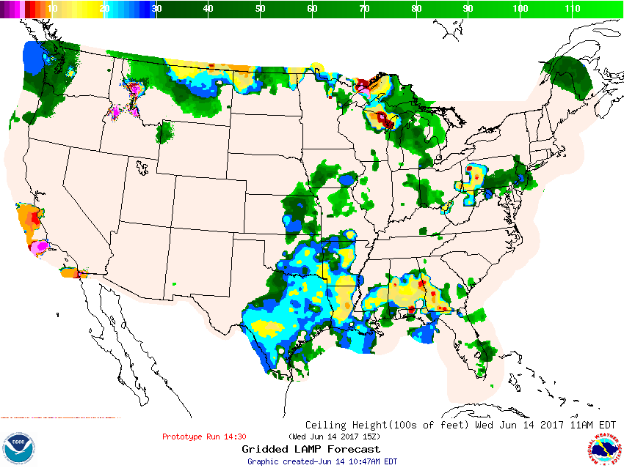
15-minute updates
15-minute updates
15-Min GLMP Prototype 6/14/2017
1430z run valid at 15:00z

Slide 23
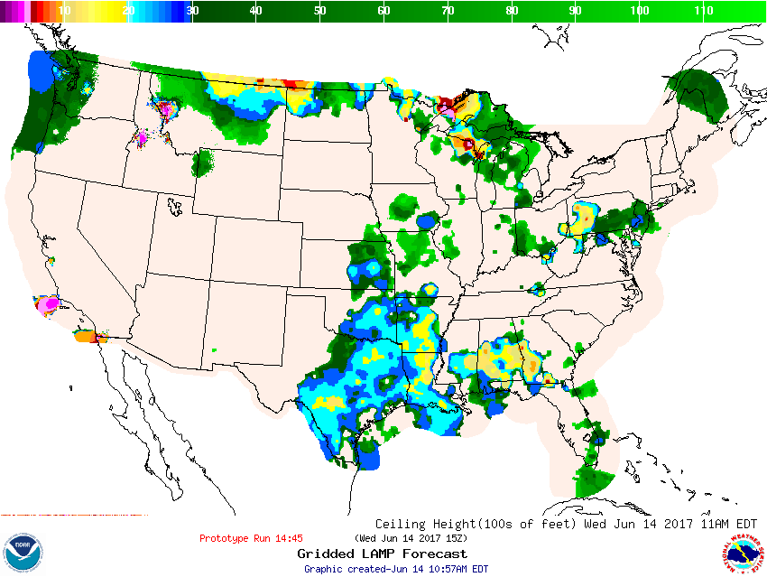
15-minute updates
15-minute updates
15-Min GLMP Prototype 6/14/2017
1445z run valid at 15:00z
As the observations change, the updated station forecasts change, and the updated gridded forecasts change

Slide 24
Future work beyond 2017* to support National Blend of Models
Future work beyond 2017* to support
National Blend of Models
Redeveloping:
Ceiling and Visibility Guidance using:
Additional Stations
Updated GFS MOS input
Updated HRRR input
Temperature, Dewpoint, and Wind guidance at stations to include additional stations
Extending LAMP/GLMP to cover the 36-hour forecast period at least 4 times a day
Extending GLMP grids to support National Blend of Models
POP01, QPF01
GLMP for Additional elements & areas (Alaska)
* All future work contingent on prioritization and available funding

Slide 25
Additional Resources
Additional Resources
LAMP website: http://weather.gov/mdl/lamp_home
LAMP Experimental website: http://www.weather.gov/mdl/lamp_experimental
Contact: Judy.Ghirardelli@noaa.gov
Thank You!

