Slide 1
Holistic approach to dust mitigation: vegetating fallow lands in arid regions without irrigation
Nate Allen
Tucson, AZ
“Everybody talks about the weather,
but nobody does anything about it.”
-Mark Twain

Slide 2
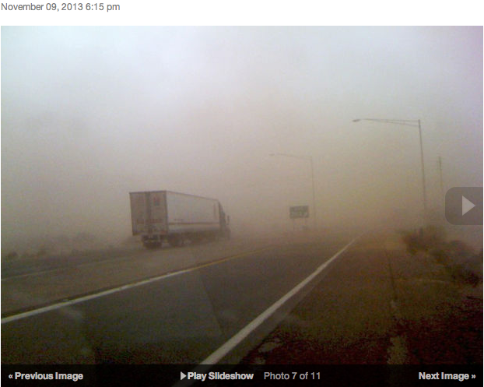
Notes:
All that is well and good… I first got interested in this issue from a seeing images like these.

Slide 3
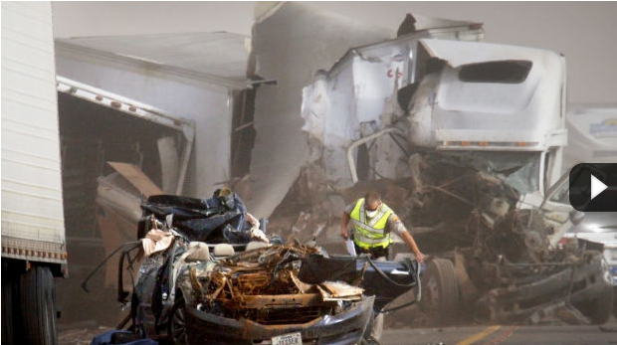
Notes:
ADOT estimates nearly 3B$ in economic losses from auto accidents in AZ in 2012. Again, in 2012, 98 auto accidents associated with dust storms.
The dust has larger economic implications that just transportation. Public perceptions about health and quality of life in AZ.
No just an issue in Arizona but throughout the SW and W.

Slide 4
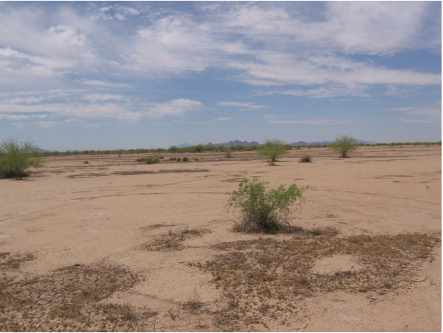
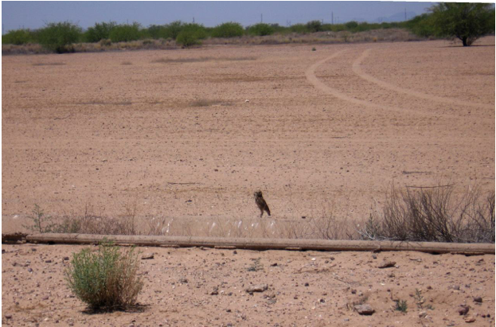
Land Use Change

Slide 5
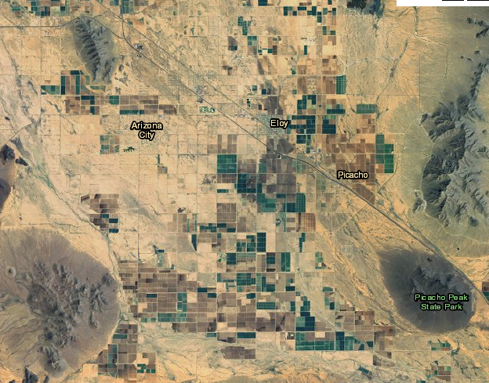
Most Dangerous Dust Storms
Notes:
So why is the dust soo bad in this particular 2 mile stretch of I-10? Many of you in this room will certainly have a better understanding of how this works than I do.. Here’s how I’ve come to think about it after visiting with folks like JJ Brost.
Due to localized geography, non threatening winds get channeled between mountain outcroppings and pick up speed very quickly. Dust storms associated with accidents on I-10 are small, localized, fast moving storms. Wind from the West pick up dust quickly without warning.

Slide 6
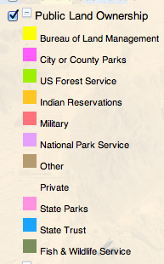
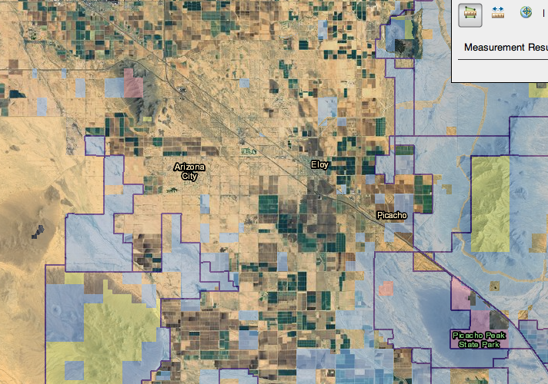
Variety of Land Governance
Notes:
But the reality is that it’s more than just an issue of weather…. This is an issue of land management
State Park Lands, BLM, State Trust Land, Tribal Lands
Lands highlighted in light blue are State Trust Land. Areas bordered in purple indicate existing lease contracts.
Yellow is BLM.
Lands on the West Boarder of the image are mostly Tribal.

Slide 7
Sources of Dust
Notes:
Areas with the least amount of ground cover and activity are most apt to be dust sources…

Slide 8
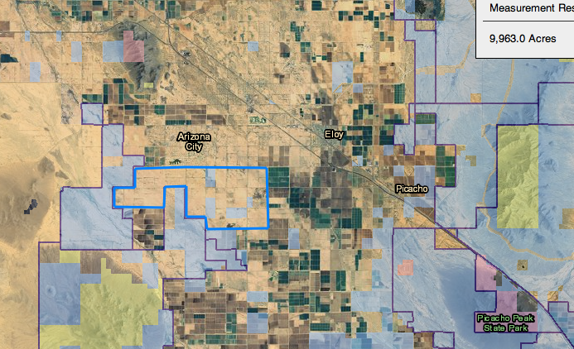
Where to Start?
Notes:
Acknowledge pros and cons to working with private and state lands.

Slide 9
Terraforming
Animal Impact is a Natural Catalyst
  Hoof Action
    Pushes organic matter into soil
    Opens crusted soil cap to rainfall
    Establishes a stable soil “horizon”
  Manure/Urine
    Organically support microflora populations
    Introduces amino acids/complex carbon chains
Concentrated Impact Literally “Builds” Soil

Slide 10
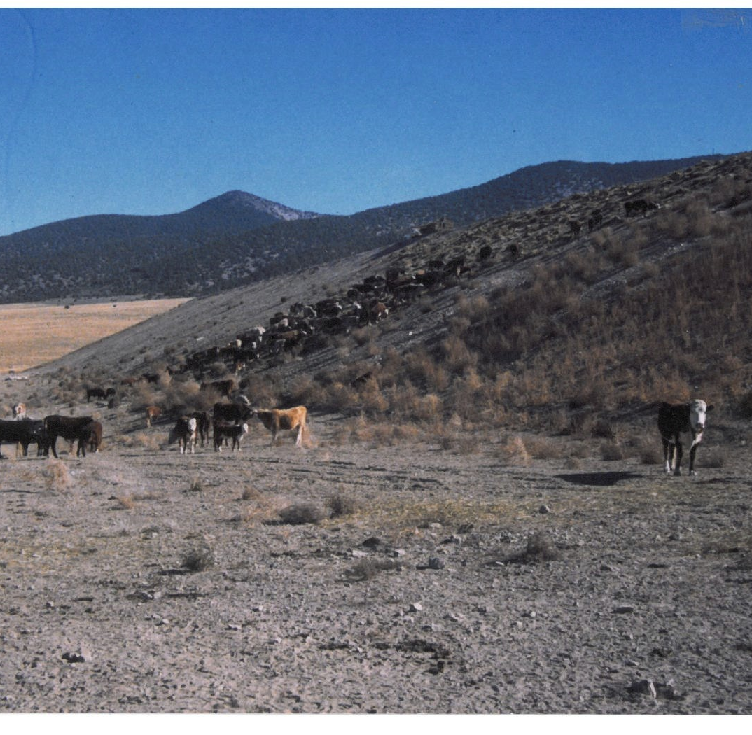
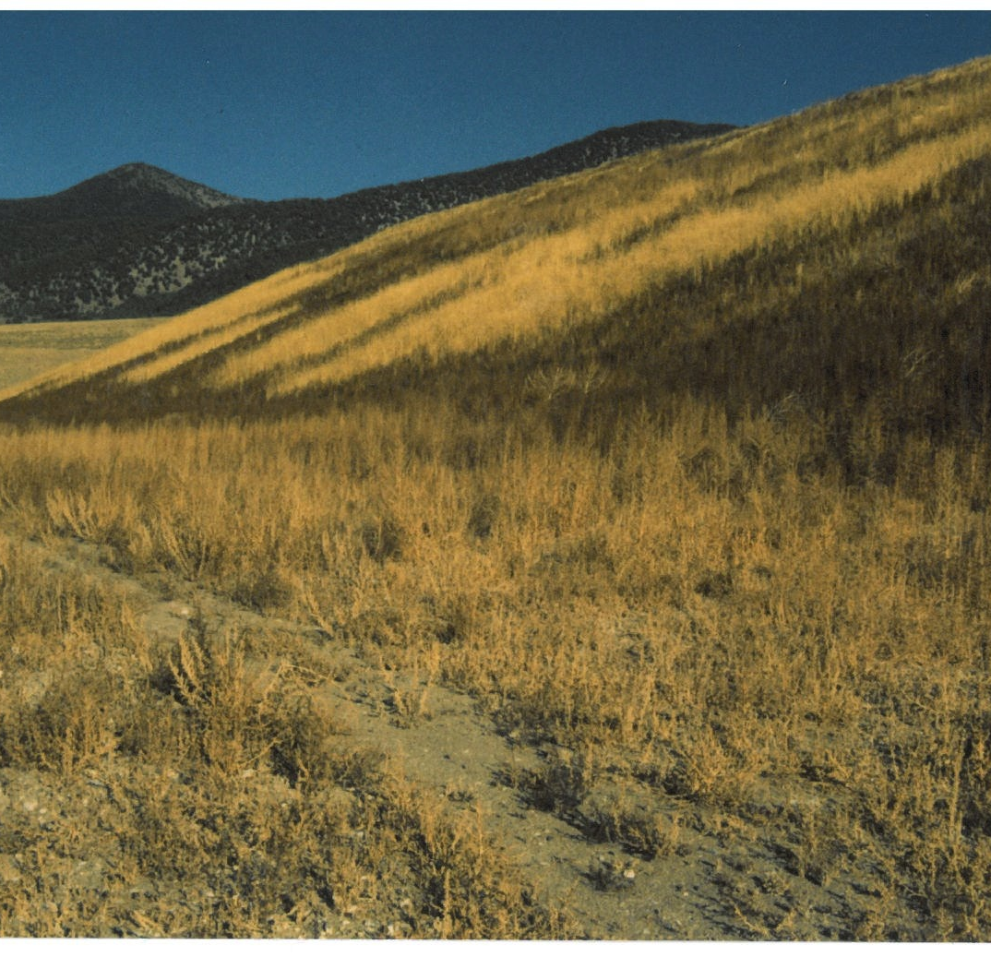
Mine Tailings
Before
After
Austin, NV, 1989-1990
Notes:
Tommie Martin took these pics in Austin ,Nv (#1 Oct 1989, #@ May 1990, #3 & #4 Nov 1990) on the cyanide leach pit of the Austin Gold Venture Mine (Inspiration Copper and FMC) – pre-dates Globe mine tailings by 1-2 years and was first intentional use of livestock (cattle) to reclaim sterilized soil that I know of. Four of us – my sister Jerrie Tipton, her husband Tony Tipton, a man we hired for the duration and I fed 32 ton of hay to 600+ cows/calves over a 6 day period on the 15 acre face of the cyanide pond. 1 year and 6” of rainfall/snowfall later, we clipped and weighed 3+ton to the acre of dry meadow grass/forbs off this site
Pic #1 – Oct 89 beginning the feeding
Pic #2– Nov 90 1 year later distance

Slide 11
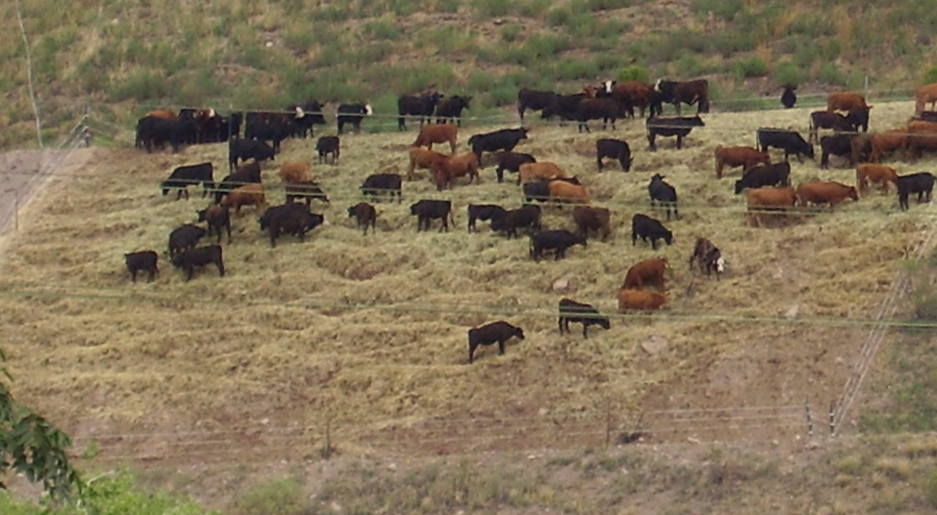
Cattle At Work…

Slide 12
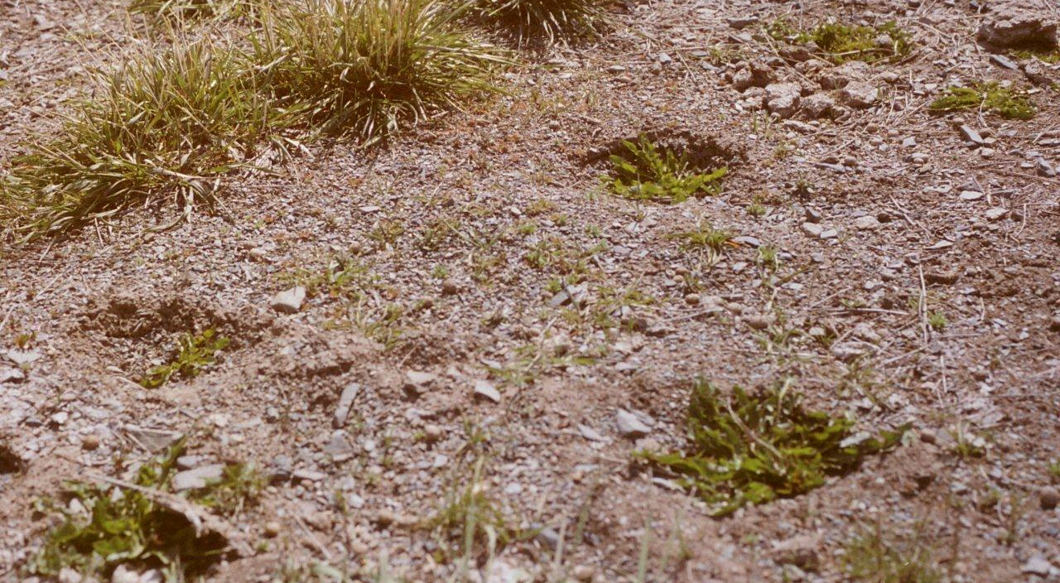
Grass Grows where Hooves Go

Slide 13
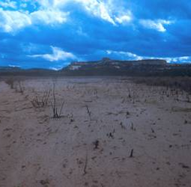
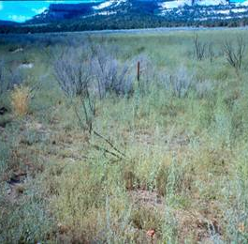
Burned Area Recovery
Before
After
BLM Prescribed Burn, 1989-1990, Mountain Island Ranch, Glade Park Colorado T. Wheeler
Notes:
Denuded area had been burned (prescribed) in 1984 and the before picture was taken in 1989. Four years of animal exclusion had led to zero growth. After one season of applied animal impact (2200 head of sheep), establishment of grasses began and continued for 3 years in which succession led to greater species variety and perennial grass establishment.

Slide 14
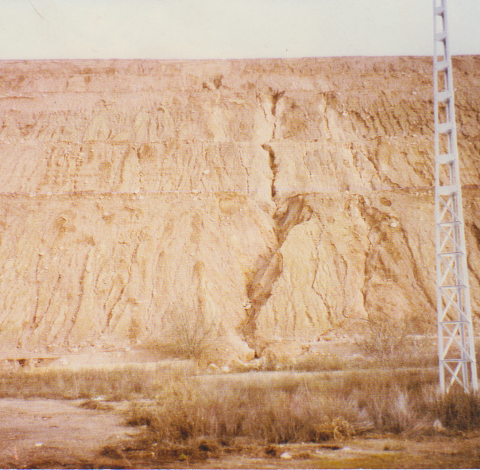
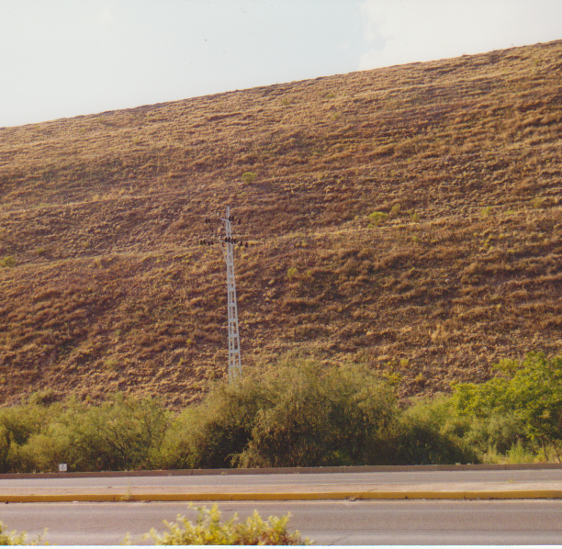
Mine Tailings
Before
After
Globe/Miamii mine tailings, 1994 (?), T. Wheeler
Notes:
Radio station joking about bbq grills

Slide 15
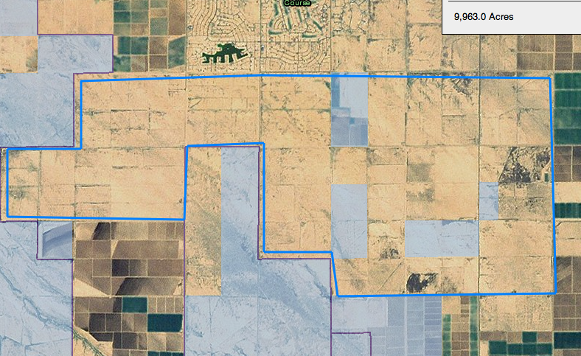
Holistic Solution
Notes:
Zooming in you can see some of the most bare land is fallowed agriculture land. No remnants of the original desert biology. In many areas you can recognize patterns of housing development….. Oops, development still seems to be far off for this area. What happens to the land now?
Dust is symptom of a larger economically driven ecological condition. To resolve the dust problem, the solution must address the root cause, the fallowed land. How can we make this land usable again and contribute once more to the local economy?
Introduce the road blocks to management….

Slide 16
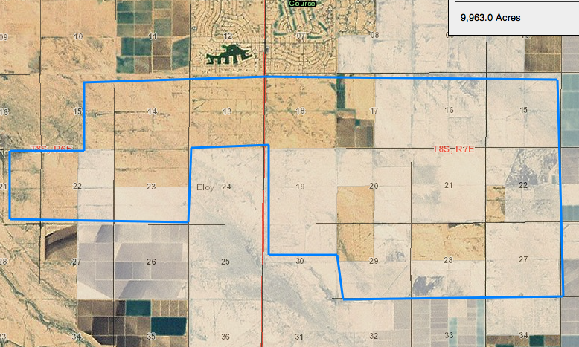
Notes:
Much of this land has been incorporated into nearby municipalities i.e. Eloy…
The water rights have gone to the city as well… making irrigation for dust mitigation not an option

Slide 19
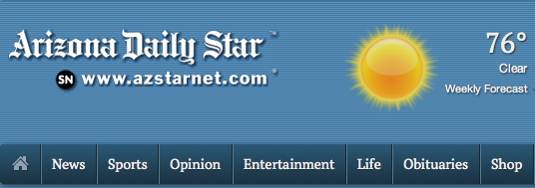
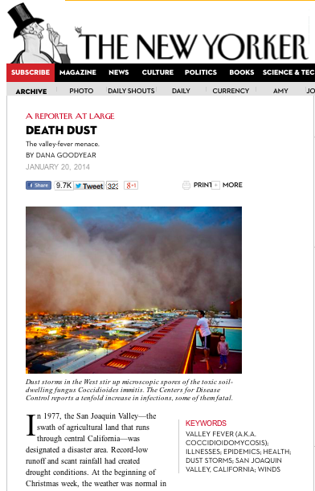
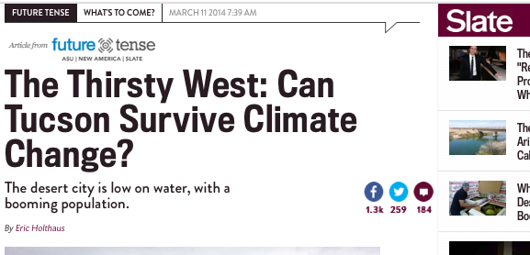
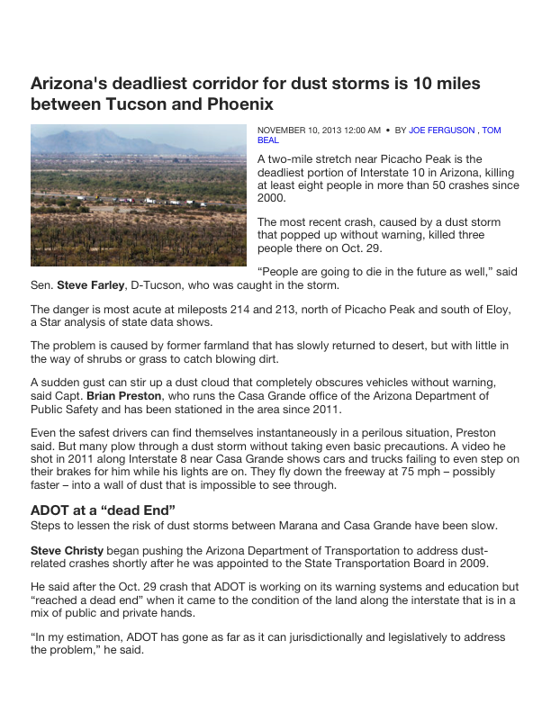
Notes:
Dust has been in the headlines a lot lately.

Slide 20
Dustiest place in the U.S. – EPA
Deadliest Stretch of Roadway in Arizona
Notes:
AZ has the opportunity to turn this into an opportunity for national leadership. First step is to understand the problem. Lot’s of great presentation and discussion earlier today that address this.
As we go through the rest of these slides I think you’ll recognize that the circumstances that have lead to the dust problems in this area are ones that can be found throughout the West.

