Slide 1
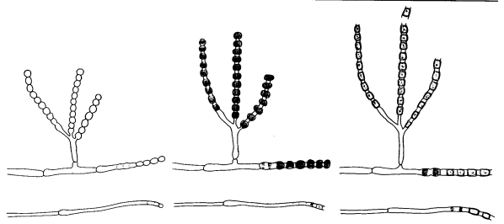
Valley Fever and the Weather
2014 Arizona Dust Storm Workshop
19 March 2014
Heidi E. Brown, Ph.D., M.P.H.
University of Arizona
College of Public Health
Notes:
20 MIN TALK – 10 MIN Questions
(a, b, c.) Sketch of the saprophytic form of Coccidioides immitis as it appeared in its natural state on a substrate of decaying vegetation in desert soil. From left to right the sketches "a" thru "c" represent a change in appearance due to growth as well as dehydration. The sketches are of coverslip preparations stained with methylene blue to show the internal structure. The form at the left which was moist and glistening in appearance absorbed very little stain. This immature form looks deceptively like a Penicillium sp. because of the conidiophore. Dehydration of the spores in the conidiophore as well as in the mycelium results in a shrinking inside a more stable outside wall. The characteristic barrel-shaped arthrospore with the empty spaces between are the result.

Slide 2
Valley fever and the weather
Where??
  Lower Sonoran Life Zone
When??
  Weather (Grow & Blow)
  Susceptible individuals
(So) What??
  Strengthening the association

Slide 3
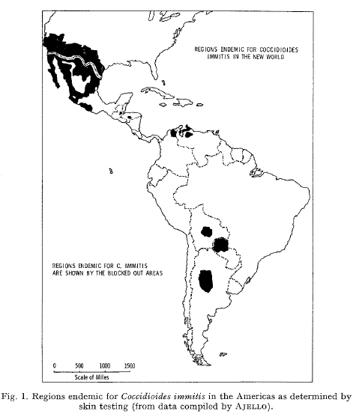
Where?
Western Hemisphere
  North, South & Central
Namesake: San Joaquin Valley, CA
Usually rural
  Like Maricopa Co & Tucson…
Swatek, 1970
Notes:
Image Swatek, 1970

Slide 4
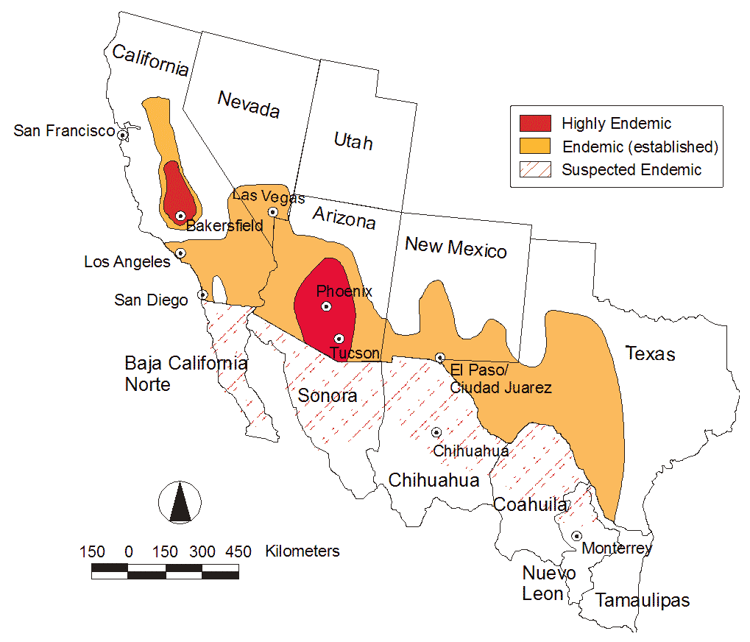
Where?
US – AZ = 66% of cases
  (CDC reports 1998-2011)
Lower Sonoran Life Zone
  Association with soil type
  Narrow definition of area
    Semi-arid areas
Notes:
Lower Sonoran Life Zone as defined by Merriam contains the largest number of sites of C. immitis known at this time; however, soil isolations and medical reports of cases outside this area are also known.
LSLZ put forth by Maddy in 1958

Slide 5
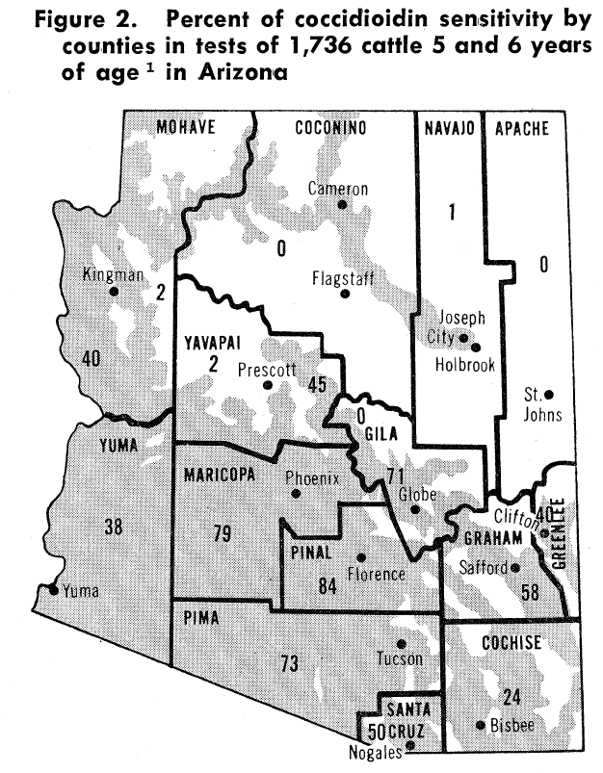
Where?
Areas with:
‘Sterilizing heat’
  Hot & Dry
  Reduces competing fungi
Then rain
  Promoting fungal growth
Then wind
  Aerosolizes spores
Maddy, 1958
Notes:
Image Maddy, 1958
“The prevalence of coccidioidin sensitivity in persons who do not move about a great deal is comparable to the prevalence of coccidioldin sensitivity in cattle in the same area. Persons who have lived in an area for 12 years or more have about the same rates as 5- and 6-year-old cattle.
Maddy 1958:
It appears that C immitis can grow only where there is a definite period of very hot weather during which there is little or no rainfall. During this period of time the surface soil becomes somewhat sterilized. C immitis likely remains viable just below the sterile layer of soil, as well as in the moister and more nitrogen rich environment of desert rodent holes. When a rain does eventually fall, the humidity in the surface soil probably approaches the optimum for the growth of the fungus. 185
C immitis grows well until other soil micro-organisms interfere with its growth or until the soil dries. The fungus probably still grows for a while down in the earth cracks and holes until the humidity in these sites drops and/or other soil micro-organisms interfere with its growth. At this time the environment is most infective with winds picking up dust and arthrospores and carrying them about. A study of prevailing winds over the entire endemic area does not give any overall clue to spread of this fungus, as was suggested for histoplasmsoci by Furncolow and Horr (Proc Histo Conference, 1956). Possible the fungus cannot remain viable for long periods of time when airborne. A majority of human and animal infections seem to occur during the windy, dusty weather following the wet season. 185

Slide 6
Valley fever and the weather
Where??
  Lower Sonoran Life Zone
When??
  Weather (Grow & Blow)
  Susceptible individuals
(So) What??
  Strengthening the association

Slide 7
Hugenholtz P. 1957. Climate and coccidioidomycosis. In: Symposium on Coccidioidomycosis
Notes:
Hugenholtz P. 1957. Climate and coccidioidomycosis. In: Symposium on Coccidioidomycosis, Phoenix, Arizona:Washington, DC: U.S. Public Health Services, 136-143

Slide 8
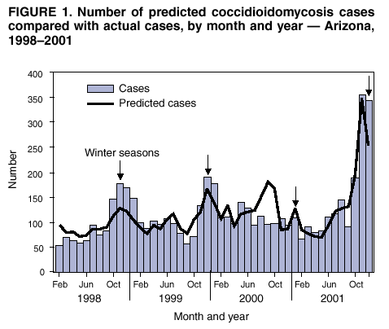
Seasonality
http://www.cdc.gov/mmwr/preview/mmwrhtml/mm5206a4.htm#fig1
Notes:
Analysis by season demonstrated peak periods of disease incidence during the winter months (November--February) (Figure 1). The baseline rate between peak periods was stable, indicating that the seasonal periods were responsible for the overall annual increase in reported cases.

Slide 9
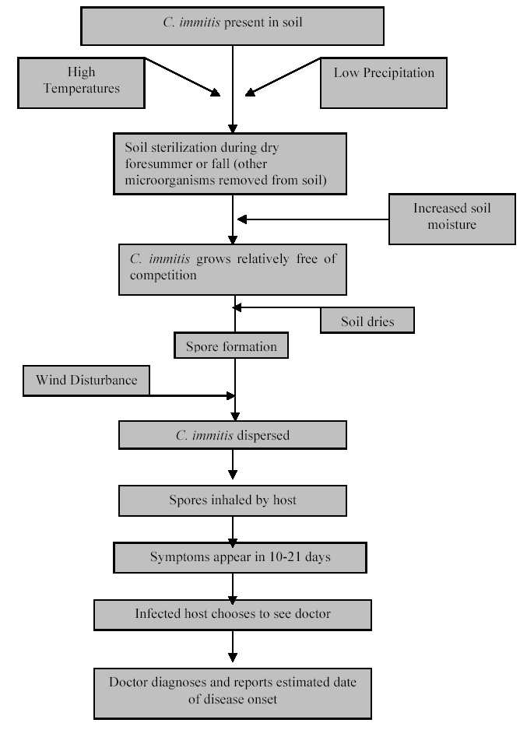

GROW in the Soil:
grow the fungus and subsequently form spores
MOIST → DRY
BLOW in the Air:
disperse spores by disturbance and/or wind
DRY & WINDY/DUSTY
Slide courtesy of A. Comrie

Slide 10
Grow: hi/lo OND precip → hi/lo cocci later
/
Oct Nov Dec Jan Feb Mar Apr May Jun Jul Aug Sep Oct Nov Dec Jan Feb Mar Apr May
Blow: moist/dry month → lo/hi cocci same month/season
/
Oct Nov Dec Jan Feb Mar Apr May Jun Jul Aug Sep Oct Nov Dec Jan Feb Mar Apr May
Slide courtesy of A. Comrie

Slide 11
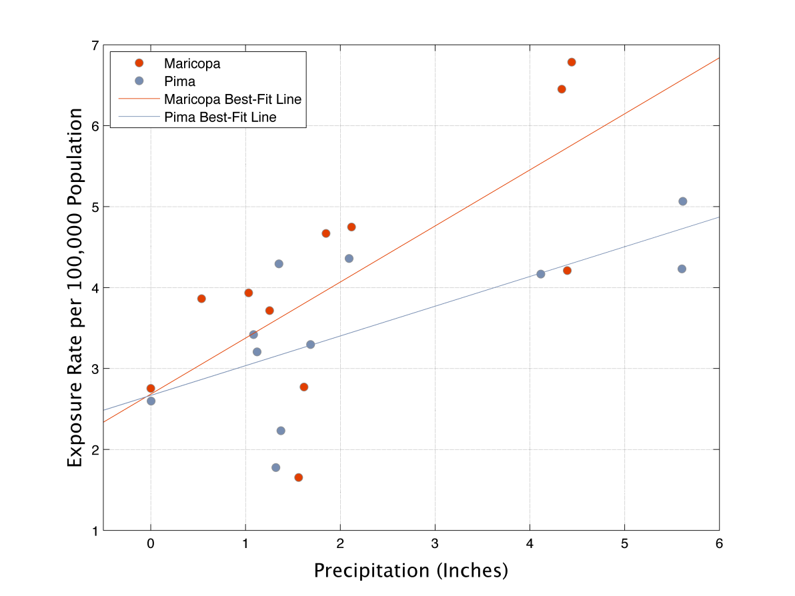
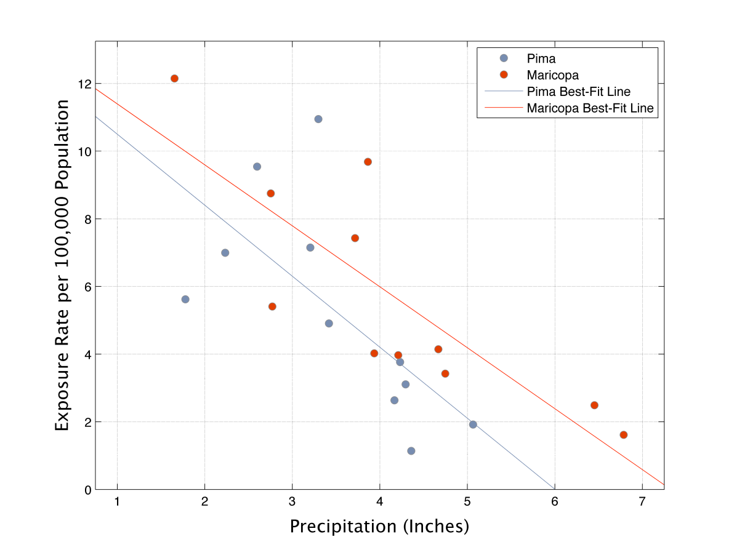
Precipitation and Cocci
Maricopa: R² = 0.52, p = 0.013
Pima: R² = 0.48, p = 0.019
Sep-May
precip vs. cocci
Maricopa: R² = 0.69, p = 0.002
Pima: R² = 0.46, p = 0.02
Oct-Dec precip vs. later Sep-Mar cocci
Grow
Blow
Slide courtesy of A. Comrie
Data: Tamerius & Comrie, 2011

Slide 12
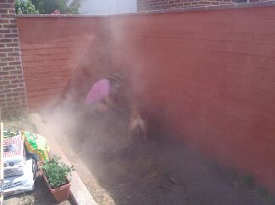
Susceptible Individuals & Activities
Dogs digging rodent holes while hunting
Digging
  Students excavating a building (1956)
  Airmen digging ditches (1956)
  Archeologists, Dinosaur Natl Mnmnt, Utah (2001)

Slide 13
Valley fever and the weather
Where??
  Lower Sonoran Life Zone
When??
  Weather (Grow & Blow)
  Susceptible individuals
(So) What??
  Strengthening the association

Slide 14
More is known about the disease coccidioidomycosis than about the organism that causes it.
The irregular and scattered resident growth of C immitis in the soil along with unpredictable sites of occurrence have made the search for this organism tedious and time consuming.
  Frank Swatek, Ecology of Coccidioides immitis, Mycopathologia et Mycologia applicata, 1970
Notes:
The irregular and scattered resident growth of C immitis in the soil along with unpredictable sites of occurrence have made the search for this organism tedious and time consuming. (33).

Slide 15
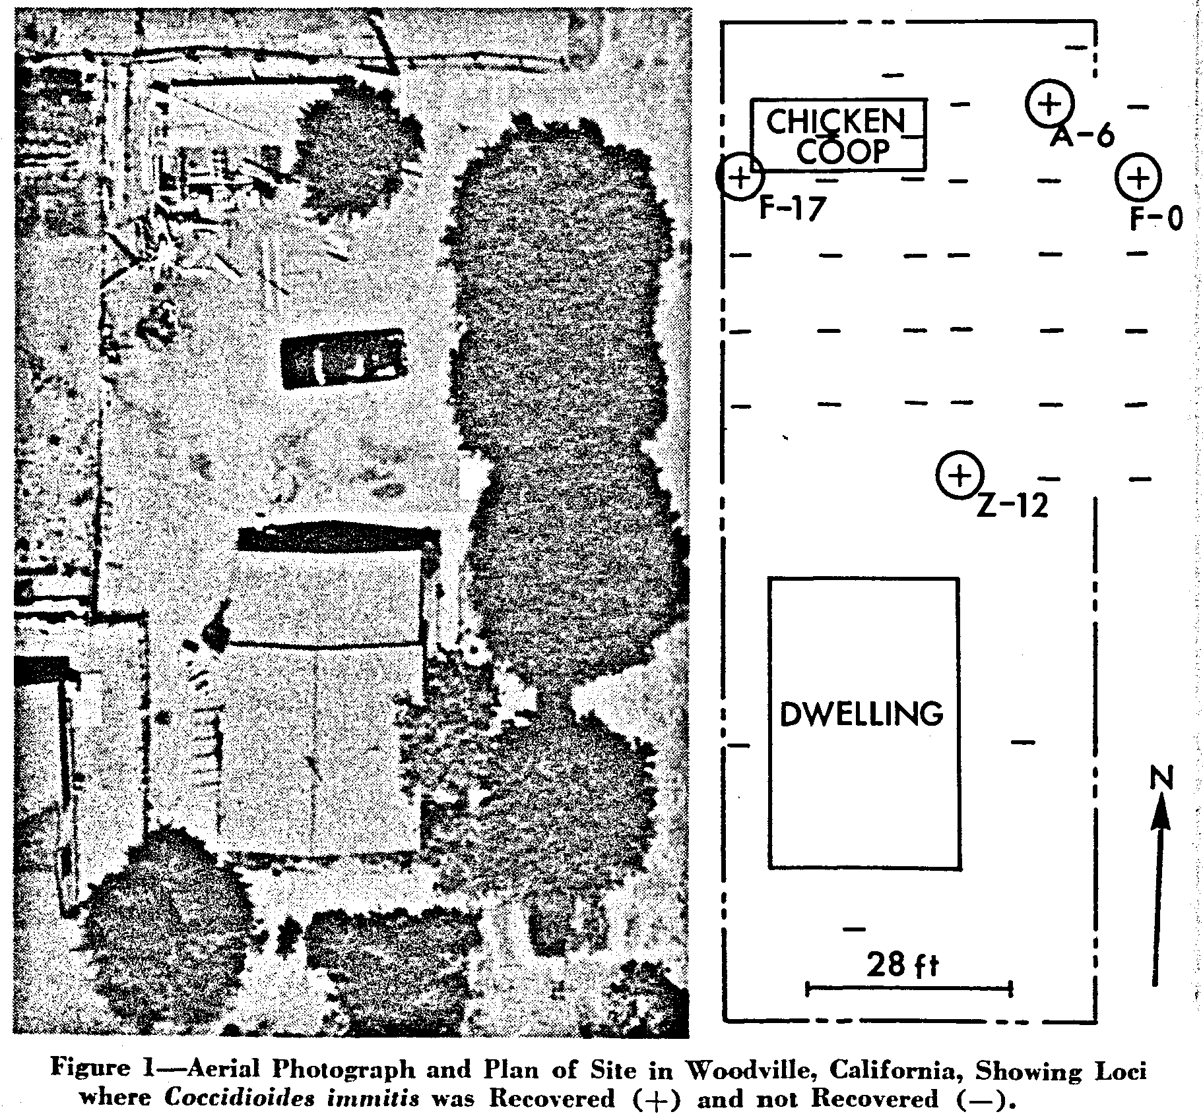
Levine & Winn, 1964
Notes:
Image: Levine & Winn: “In 1961 ten cases of human pulmonary coccidioidomycosis occurred in related children age 2 to 15 residing in Woodville, CA. … samples of soil from the suspected are were examined. The present report shows that Coccidioides immitis was present in approximately 11% of the samples. 29”
The ease with which it can be grown is paradoxical to its naturally restricted distribution to soils in endemic areas. Microbial inhibition has been reported for a limited number of microorganisms from endemic soil, however, no general antagonism in all soils has been seen. Abstract (Swatek, 1970)

Slide 16
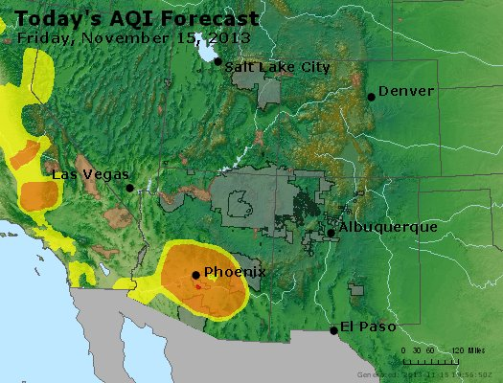
(So) What?
Better understanding of the fungus hopefully lead to better identification of
  When the exposure is greatest
  Where (at a finer resolution)
Inform public health
  “Cocci Air Quality Index”
  Treat specific areas
  Early warning of “bad cocci season”

Slide 17
Thank you
Heidi E. Brown
University of Arizona
College of Public Health
HeidiBrown@email.arizona.edu
http://brownlab.arizona.edu/
Notes:
20 MIN TALK – 10 MIN Questions

