Slide 1
Communication Plan for Windblown Dust
Arizona Department of Transportation
Research Center
Arizona Dust Storm Workshop
March 19, 2014
Casa Grande, Arizona

Slide 2
Communication Plan for Windblown Dust
Managed by the ADOT Research Center
Sponsored by ADOT Communications
Commenced January 2014
Expected completion December 2014
Consultant team
  Sonoma Technology, Inc.
  Western Transportation Institute
  Partners in Brainstorms

Slide 3
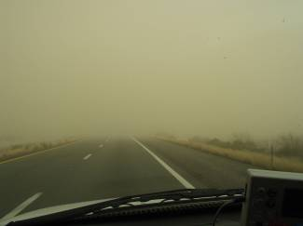
Windblown Dust
Background
Windblown dust events occur across Arizona, especially along I-10 between Phoenix and Tucson
Blowing dust has been considered a contributing factor in serious crashes on I-10
Visibility reduction is often localized and sudden

Slide 4
Windblown Dust
Background
ADOT Dust Task Force found that 302 dust-related accidents occurred in 2001-2010
37 accidents occurred between mile markers 211 and 220 (near Pacheco)
Dust-related accidents on I-10, 2001-2010
Phoenix
Tucson
Mile Markers

Slide 5
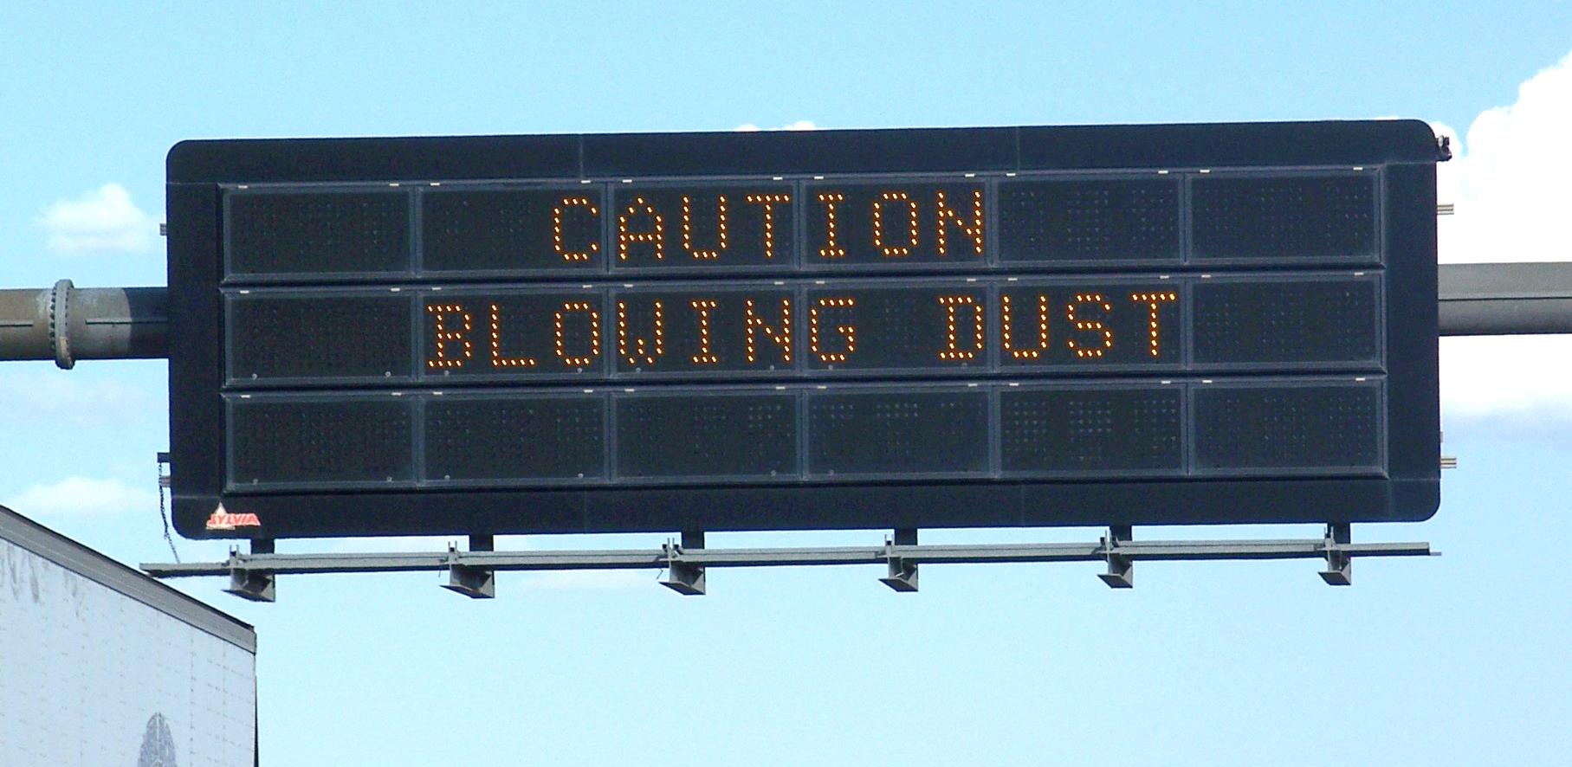
Project Objectives
Identify actionable recommendations for
The most effective means for acquiring data about approaching or in-progress dust storms; and
The best available methods for communicating information about these storms to the public
  Intelligent Transportation System assets
  Traditional media
  Social media

Slide 6
Project Overview
Scope of Work
Review of current practices
Needs assessment
Recommendations and final report

Slide 7
Review of Current Practices
Scope of Work
Identify and document ADOT practices for dust detection and warning through staff interviews and review of available documentation
Conduct phone interviews with industry experts across the country to identify
  Best practices for visibility detection and warning systems
  Effective intra-agency communication strategies

Slide 8
Review of Current Practices
Scope of Work
Need to understand past/current efforts:
Dust Task Force
I-10 Pilot Study in Safford District
University of Arizona Forecasting
Dust Storm Incident Response Committee
Dust Storm Workshops
Other

Slide 9
Needs Assessment
Scope of Work
Evaluate available systems for wind and visibility monitoring and forecasting
Assess communication needs from a traveler’s view
  Online survey of at least 300 individuals
  Two in-person focus groups (10-12 people per group)
Assess ADOT’s current practices and resources

Slide 10
Recommendations and Final Report
Scope of Work
Synthesize findings
Identify dust monitoring and communication methods that address ADOT’s needs
Develop actionable recommendations in the form of a communication implementation plan
Publish a final report
Project send-off (final event to present results)

Slide 11
Contacts
Stephen Reid Dianne Kresich
sreid@sonomatech.com dkresich@azdot.gov
707.665.9900 602.712.3134
Clinton MacDonald Tim Tait
clint@sonomatech.com ttait@azdot.gov
707.665.9900 602.712.7070

Slide 12
Consultant information

Slide 13
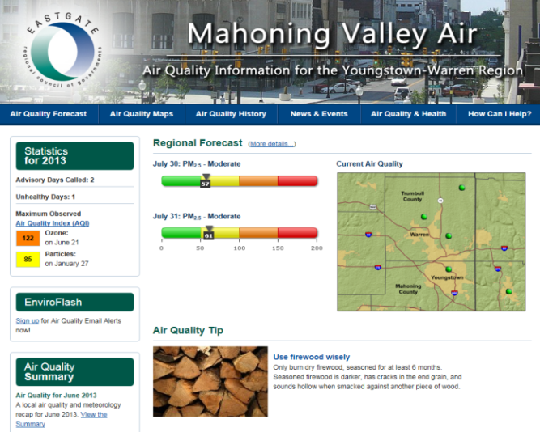

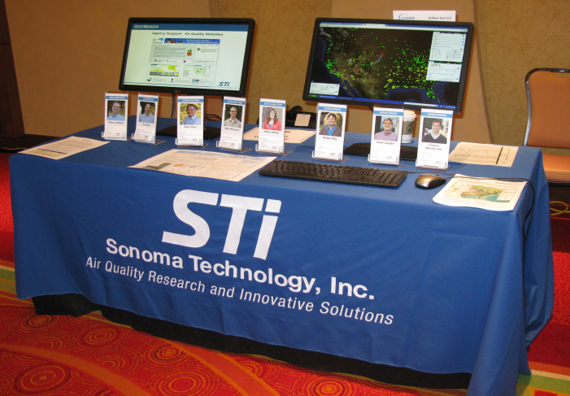
Sonoma Technology, Inc.
Introductions
We perform air quality, meteorological, and transportation-related research for clients around the world.
Founded in 1982
Headquarters in Petaluma, CA
Satellite offices in Fresno, CA; Laramie, WY; and Seattle, WA
60 employees
Employee-owned and directed

Slide 14
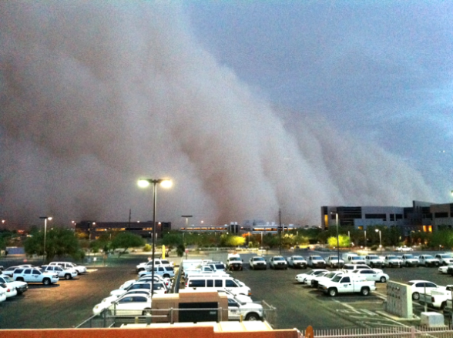
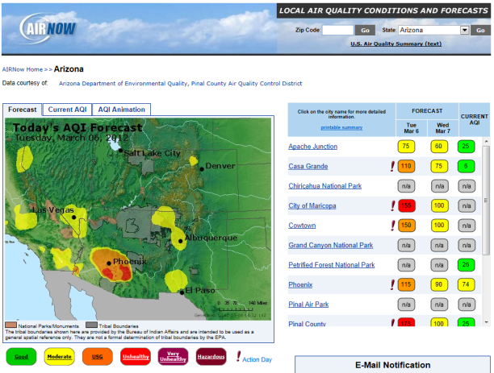
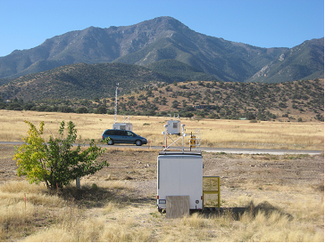
Sonoma Technology, Inc.
Introductions
Sample projects:
Caltrans RWIS Calibration and Maintenance
ADEQ Dust Event Analysis
ADOT Construction Emissions Study
Sacramento Air Quality Forecasting and Public Outreach
EPA AirNow System

Slide 15
Western Transportation Institute (WTI)
Introductions
One of the largest transportation institutes focusing on rural transportation issues ($10 M annual budget)
Department in the College of Engineering, Montana State University
  Supported by the College and by the umbrella of MSU administrative, academic, and research resources
Established in 1994 by the State Departments of Transportation of Montana and California
85-person multidisciplinary staff of professionals, students, and associated faculty

Slide 16
Western Transportation Institute (WTI)
Introductions
Eight integrated research areas create solutions to rural transportation issues, including
  Safety and operations
  Road ecology
  Infrastructure maintenance and materials
  Systems engineering and integration
  Transportation planning and economics
Conducted research in more than 30 states, at local, state, and federal levels

Slide 17


Partners In Brainstorms (PIB)
Introductions
Founded in 1991 and headquartered in Phoenix, Arizona.
Provided research and consulting services to ADOT for over a decade.
Current ADOT research projects include Implementation of Research at ADOT across all topic areas, Assessing Public Attitudes on Managed Lanes and Toll Roads Study, and the Arizona Highways Magazine Facebook Study.
Recently awarded Master Research and Survey Services Contract with the State of Arizona. In all research categories, PIB was the highest rated of all the final selected research and consulting vendors.

Slide 18











Partners In Brainstorms (PIB)
Introductions
History of innovation in data collection and research technologies, including a patent for online surveys.
Proprietary research panel – over 1.5 million adults, with Arizona residents comprising the majority.
Conducted over 1,000 online surveys and focus groups on behalf of executive, federal, and state government entities and agencies, and numerous Fortune 500 companies.

