Slide 1

Arizona’s Rural Safety Innovation Program
A Dust Monitoring System for
10
Presentation To:
2014 Dust Workshop
Monitor – Communicate - Educate
March 19, 2014
Notes:
FY

Slide 2
Project History
Dust Storms along I-10 along disturbed areas between San Simon and Bowie Arizona and New Mexico through recorded history.
RWIS on I-10 near San Simon and Bowie; late 1990’s weather + pavement condition sensors.
RSIP Grant Funding 2008; Bill Harmon, Safford DE and Reza Karimvand envisioned the project.
ITS Engineers integrated the system through an on-call contract completed in 2011.
Notes:
FY
Major Fatal Crash in 1995

Slide 3
Project Objectives
Reduce the number of dust and weather related crashes, injuries, and fatalities.
Monitor and detect wind and visibility parameters above agreed-to set points thus signaling potential for wind effects or dust related visibility reduction.
Communicate to drivers both conditions and response actions thru static signs with solar powered flashing beacons, DMS and HAR.
Immediately alert ADOT personnel to adverse conditions in the area.

Slide 4
Project Timeline
Grant Application: April 2008
RSIP Grant Awarded: August 27,2008
Design Initiated: February 2009
90% Design Completed: December 2009
System Development: December 2010
Field Deployment: May 2011
Evaluation Began: August 2011
Two Complete Seasons 2012 & 2013
Evaluations Continue 2014 - 2016

Slide 5
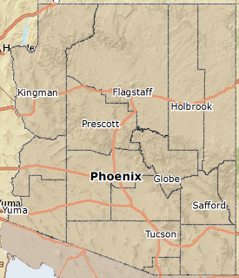
Location Map
East I-10 in Arizona
Northern Cochise County
San Simon Watershed
Three Dust Detection and Warning Zones
Bowie, Olga and San Simon Areas
Texas Canyon snow, wind & traffic monitor

Slide 6
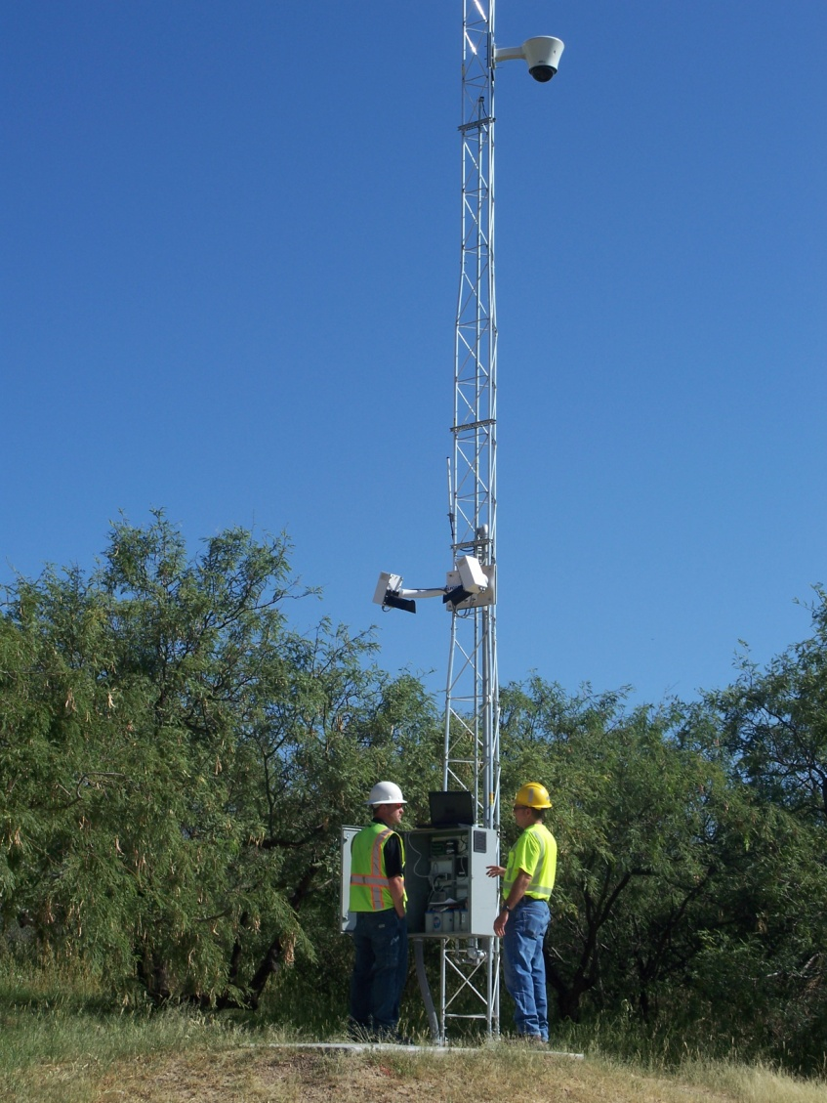
Sensors
Bowie to San Simon
Wind Speed
Visibility
CCTV
Texas Canyon RA
Barometer, Temp, Relative Humidity, Dew Point, Precip, Wind and CCTV

Slide 7
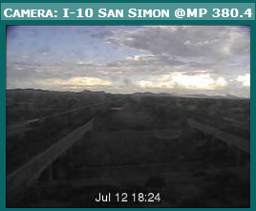
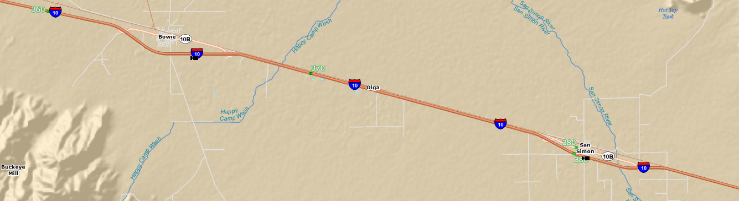
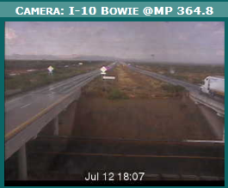
Project Features and Zones
Bowie (DMS on EB)
MP 362 to MP 368.5
Olga Road Site
MP 371 to MP 375
San Simon (DMS on WB)
MP 379.2 to MP 385.8

Slide 8
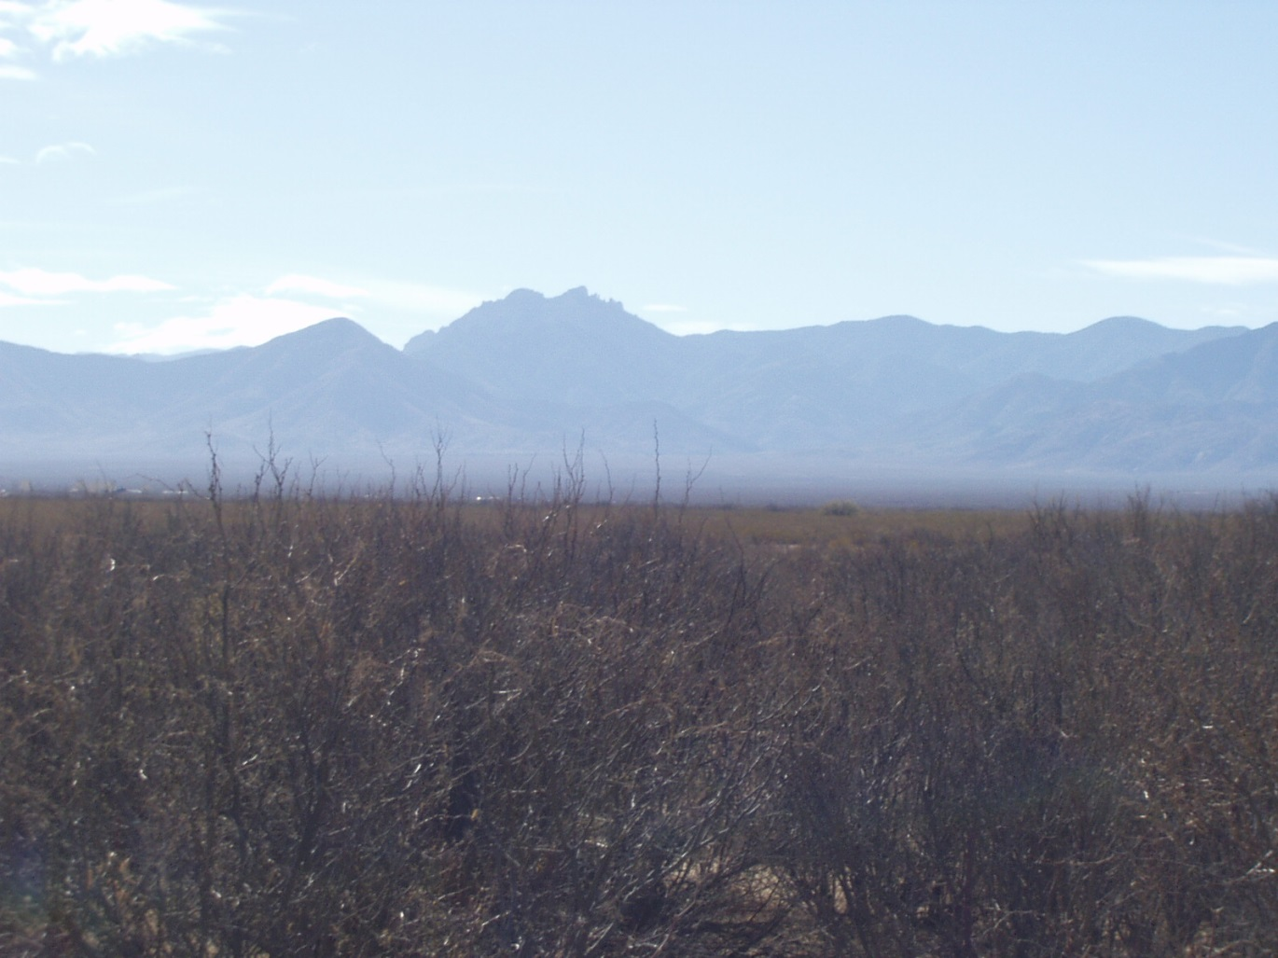
Weather Expectations
Notes:
Drivers Expect Good Weather on the Nation’s Southernmost Interstate

Slide 9
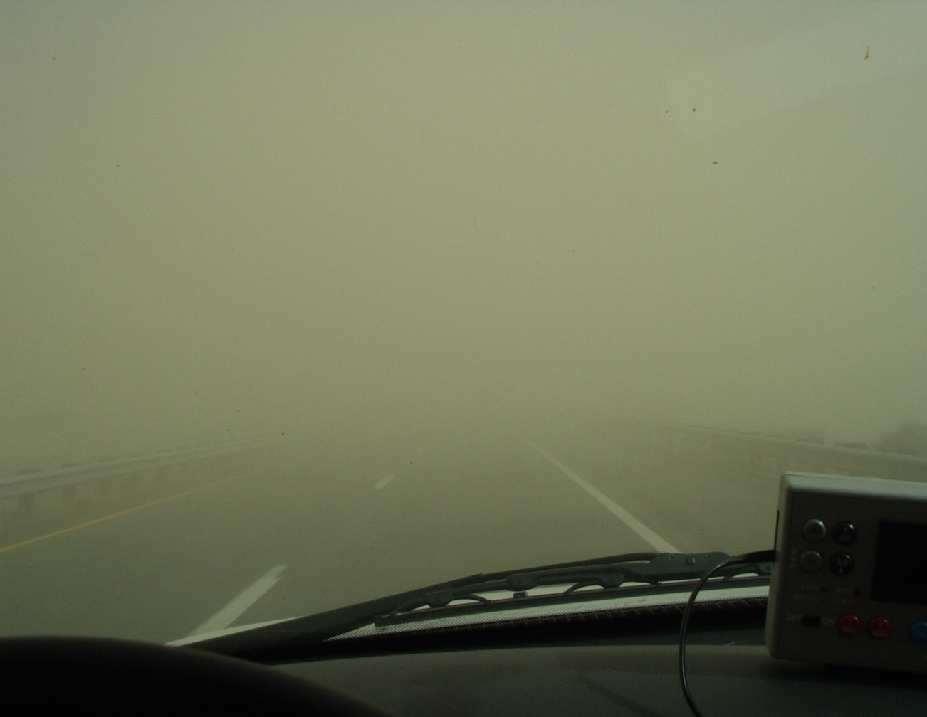
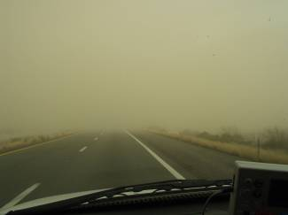
Severely Limited Visibility
Notes:
Visibility during this storm dropped to 80’ substantially less than stopping sight distance at 75 mph.
JL

Slide 10
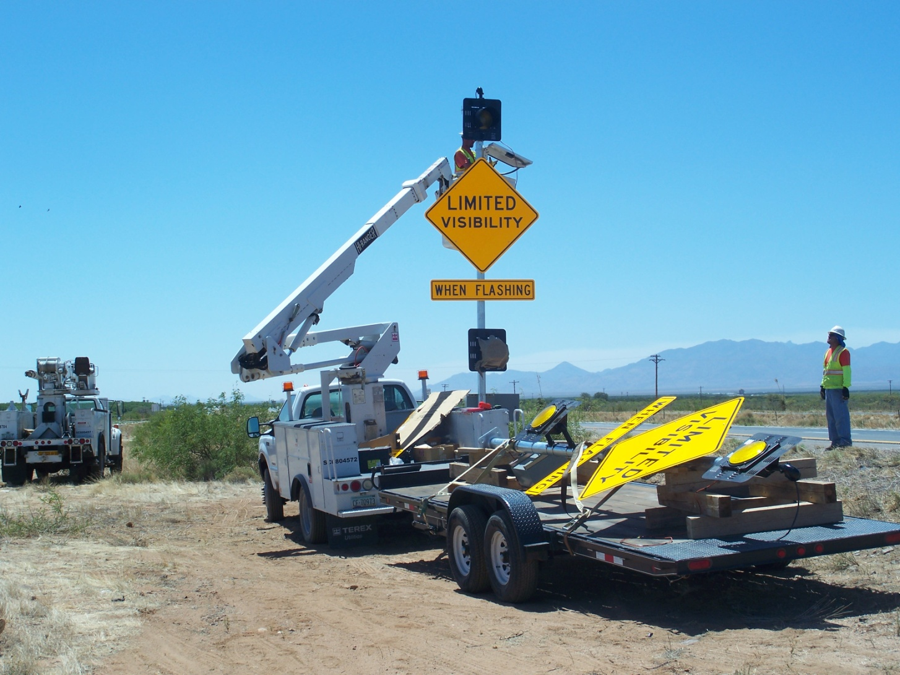
Static Signs and Beacons
Six Locations
Notes:
Conceptual Drawing and Design for 12 Beacon Locations

Slide 11
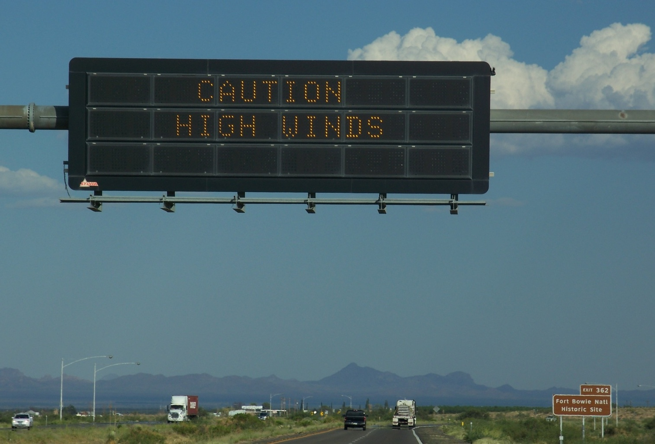
DMS Wind Warning
Notes:
The DUST monitoring has an XML interface with the two existing DMS at MP 362 and 385

Slide 12
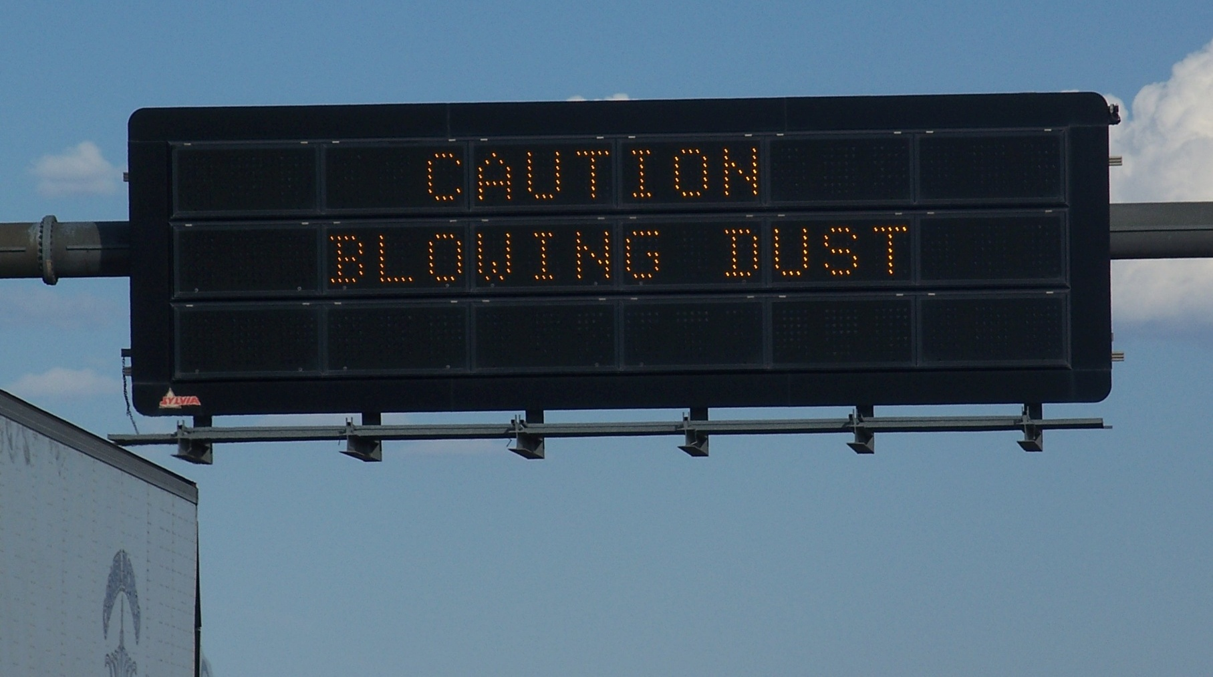
DMS DUST Warning
Notes:
The DUST monitoring has an XML interface with the two existing DMS at MP 362 and 385

Slide 13
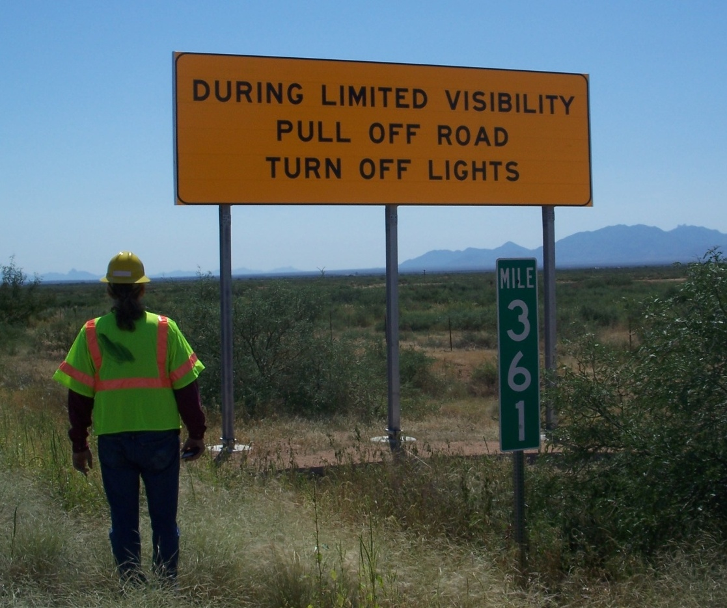
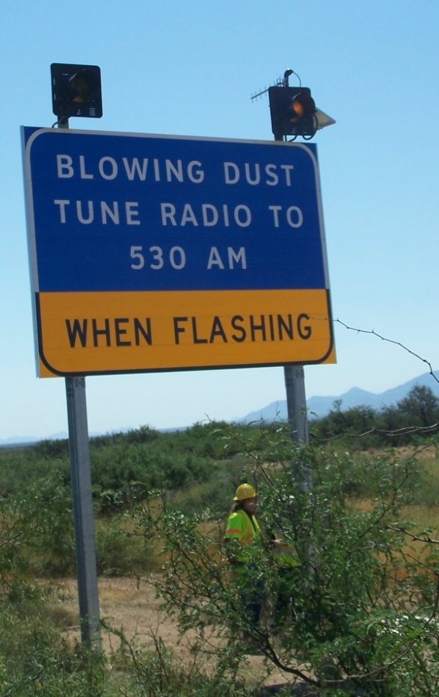
Education Elements
Notes:
Conceptual Drawing and Design for 12 Beacon Locations

Slide 14
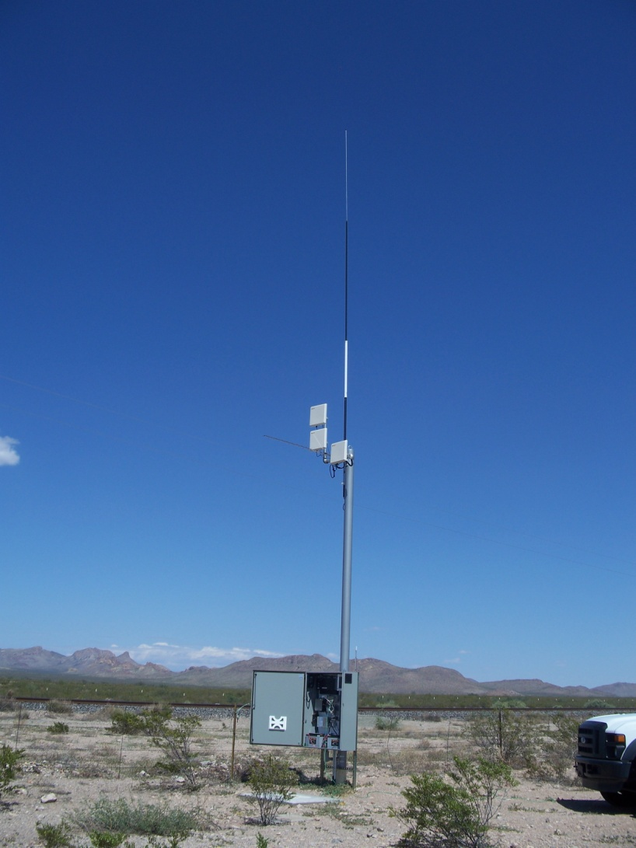
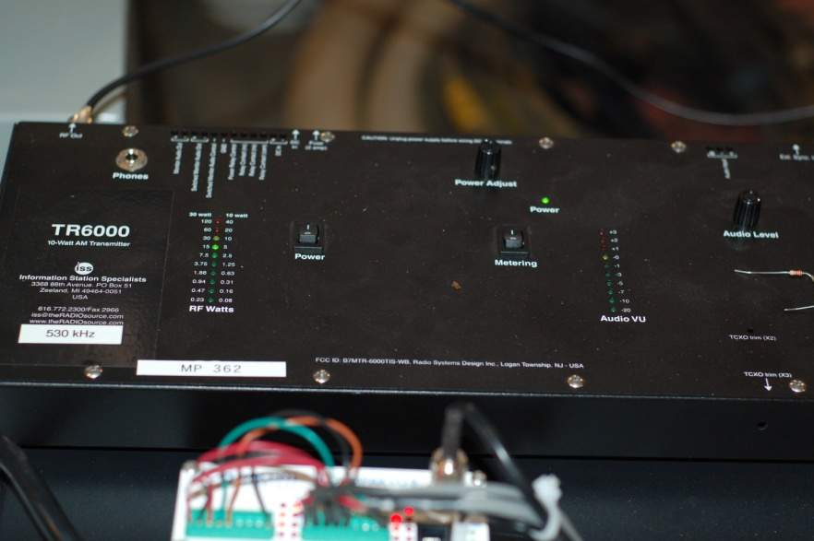
Highway Advisory Radio
Two Locations
Three Recorded Messages
Standard ADOT Information
Wind (proceed with) Caution
Low Visibility (pull aside stay alive) driver response

Slide 15
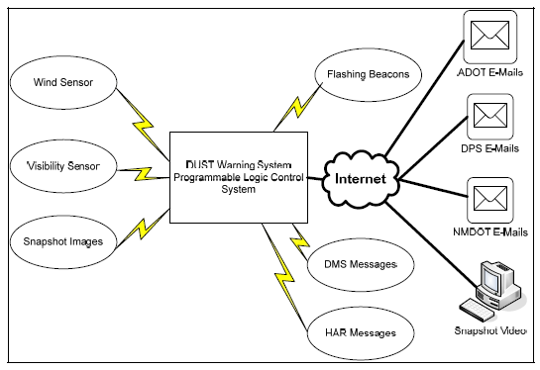
System Diagram
Notes:
JL

Slide 16
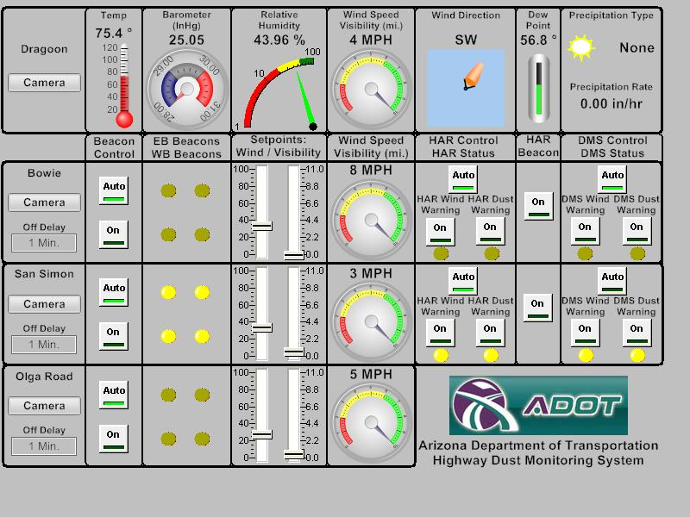
Sensors

Slide 17
System Values Added
Wind Data with operations notification
Visibility data with a notification
PTZ Camera with user controls
Data interconnection with the DMS message
Static Sign with safe operation statement
HAR presents a concise safety message
Early mobilization of responders if required
Information is communicated through signs/radio.

Slide 18
System Study Status
Data to date does not indicate the occurrence of a dust-related visibility event during evaluation period.
The effect of the system on driver behavior is not existent or anecdotal at best.
Visibility sensors are not robust - tendency to fail; replacement cost is high.
Visibility Sensors detection space limited.
Zone coverage additional sensors.

Slide 19
Comparison Caltrans and ADOT
Feature ADOT Caltrans
Location San Simon area Central Valley
DMS Message yes yes
Visibility yes yes
Spacing single unit/zone 0.5 mile
Speed sensing no yes
Spacing N/A 0.25 mile
Cameras yes yes
HAR yes yes

