Slide 1
Dust Detection Project
Ken Waters
National Weather Service, Phoenix
Dust Storm Workshop, Casa Grande
March 19, 2014

Slide 2
Concept
PROBLEM: Blowing dust can quickly reduce visibility to zero, creating dangerous driving conditions in Arizona
Many incidents are difficult to predict (e.g., small-scale dust “channel” events)
Few sources of observations (expensive to install and maintain, typically not situated near dust storm source regions)
SOLUTION: Design a very inexpensive network of dust particulate sensors.
Report in near-real-time to the “cloud”.
Potentially use as an alerting device for responders and the National Weather Service.
Cost is about $100 each installation.
Point is to not focus on the precise measurement values but rather simply on the detection of the onset of the event.
Low cost makes it more practical to populate a large network with much higher spatial resolution than could be achieved with much more expensive hardware.

Slide 3
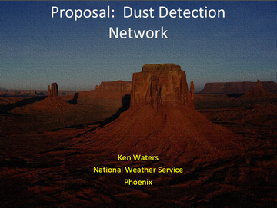
History
2013 Dust Storm Workshop
Project idea was floated to combine low-cost development platforms with low-cost environmental sensors which can send indications of dust conditions in real-time up to the “cloud”
2013 Initial Results
Only two dust events (both during the monsoon season) caught while sensor was activated
Both times the sensor showed immediate spike with a graduated fall back to normal levels after 20-30 minutes
Unfortunately a hard disk failure in September 2013 led to loss of the captured raw data sets
Second installation set up in January 2014 but was stopped with the failure of an SD card in the Raspberry Pi platform.
LESSONS LEARNED: back up all software and scripts on a recurring basis and on a different platform; document the process carefully; save off data sets on a regular basis;

Slide 4
2014 Update
After two hardware failures (Sept 2013 and Mar 2013) another real-time sensor was set up in mid-March 2014.
Now have added two additional sensors to detect Temperature, Relative Humidity, and optical levels
A Davis Instruments Vantage Pro 2 home weather station has logged numerous dust wall events and has been most responsive with immediate drops in temperature and increase in RH

Slide 5
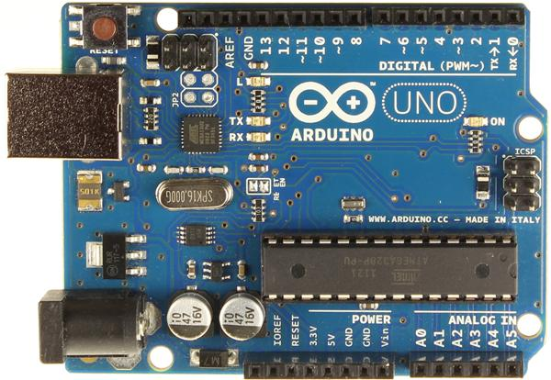
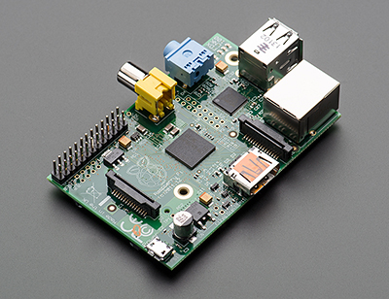
The “Maker Movement”
Low-cost platforms that easily interface with the environment
Arduino
Single board microcontroller providing analog and digital inputs and outputs
Raspberry Pi
Single board Linux-based computer
Both devices have gained tremendous interest from experimenters and developers

Slide 6
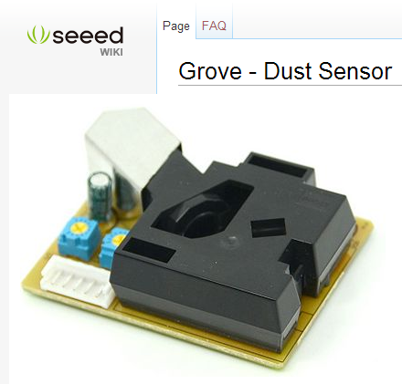
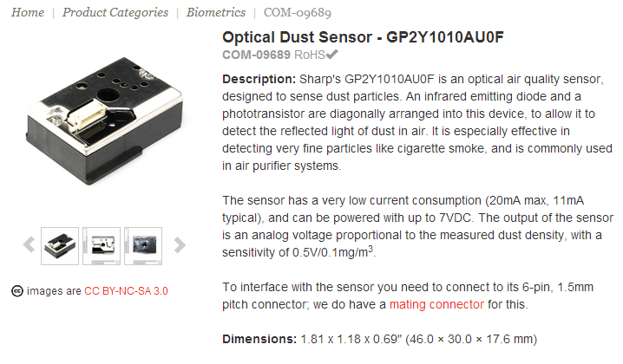
Dust Sensors Two low-cost options
Shinyei PPD42NS
Sharp GP2Y1010AU0F
Source: https://www.sparkfun.com/products/9689
Source: http://www.seeedstudio.com/wiki/Grove_-_Dust_Sensor

Slide 7
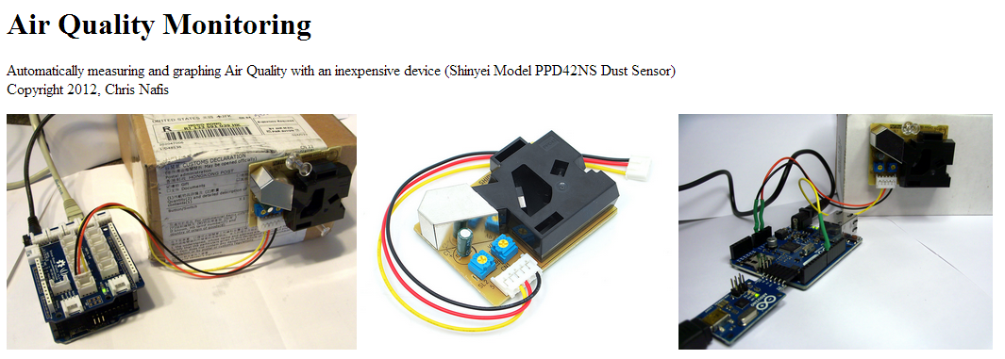
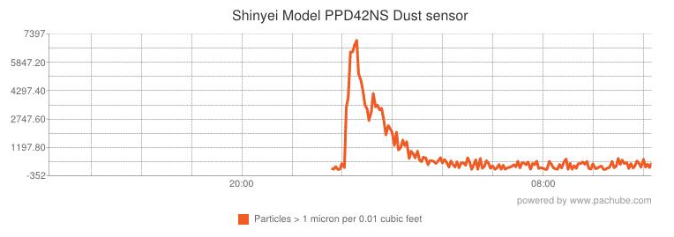
Sensor #1:Shinyei PPD42NS
Produces digital output of both PM2.5 and PM10 particulate (microg/m3)
Source: http://www.howmuchsnow.com/arduino/airquality/grovedust/

Slide 8
Shinyei PPD (aka Grove)
Source: Shinyei: https://mega.co.nz/#!FdRlBDrI!FL6eGF5GsjK5So81OI_DXvv0G3LxJfZyFmmjTn8LFGc

Slide 9
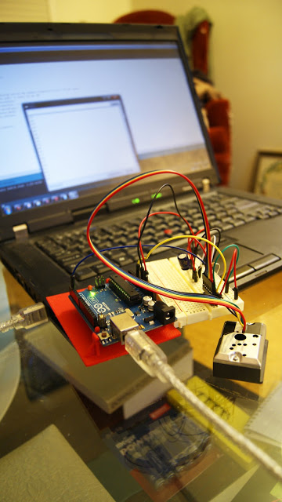
Sensor #2: Sharp GP2Y1010AU0F
Produces analogl output of both PM2.5 and PM10 particulate (microg/m3)
Source: http://www.mentalmunition.com/2013/05/dustduino-plan-to-crowdsource.html

Slide 10
Block Diagram
Communications to the server from the Raspberry Pi are done through a WiFi adapter so can be moved easily (up to ~100 feet).

Slide 11
Block Diagram – Field Version
Only connection needed will be 12V power which can be supplied with an inexpensive microUSB connector plugged into a car or laptop USB connection.

Slide 12
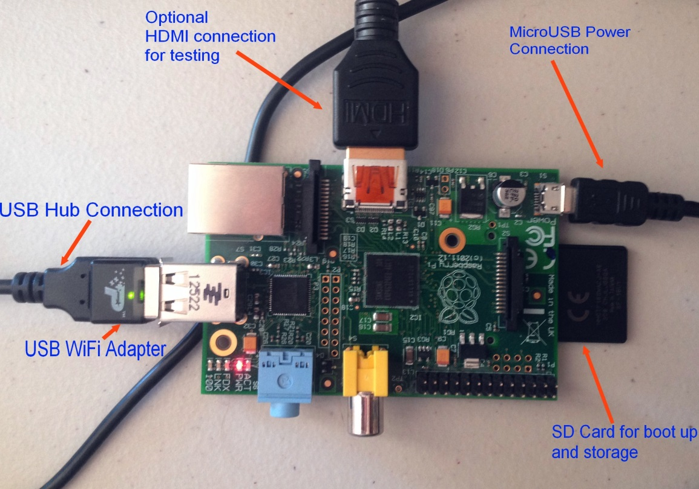
Dust Project Hardware
Raspberry Pi
Arduino and Sensors

Slide 13
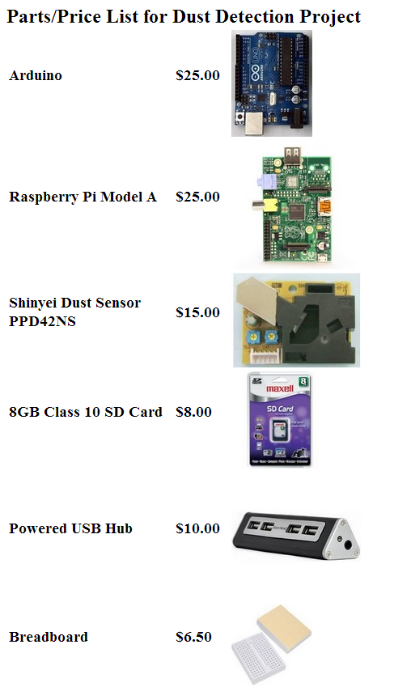
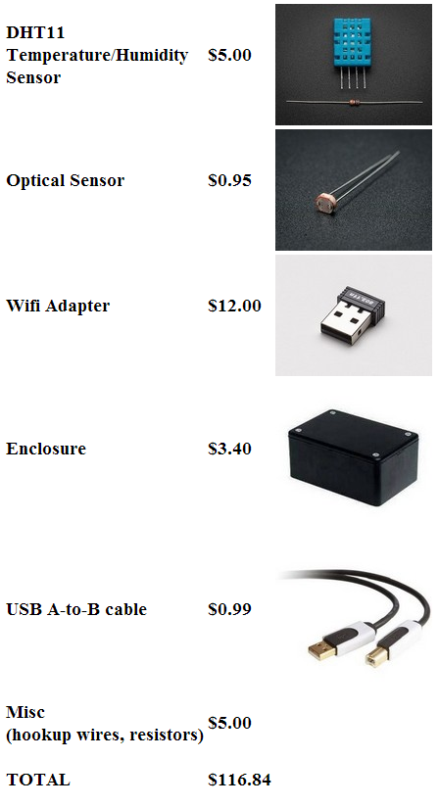
Components Cost: ~ $115.00
Full detail at: http://satwatcher.dyndns.tv/Dust/dustparts.html

Slide 14
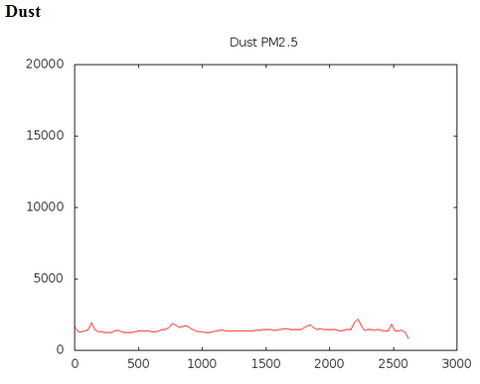
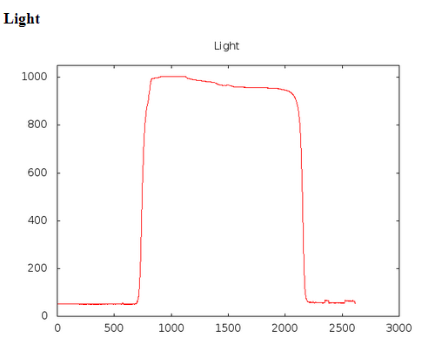
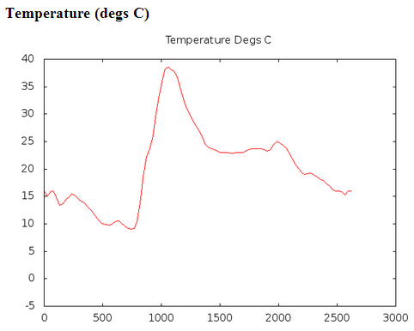
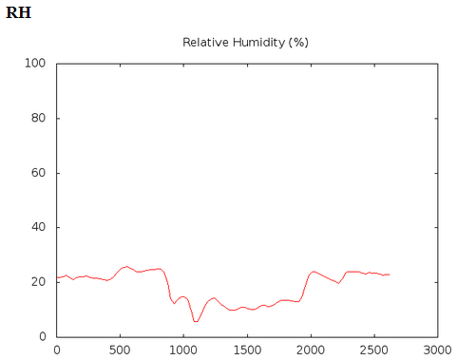
Current Setup
Raw data uploaded to the Internet:
http://satwatcher.dyndns.tv/html/live/oneline
Example: 2014/03/18,12:49,12:49:39,955.951,10.00,23.00,966
(Date,Time [MST],Time including seconds, dust value, RH, T, light)
Graphics produced every 15 minutes
Using GNUPlot on Linux servers
http://satwatcher.dyndns.tv/html/live/sensor_graphs.html

Slide 15
Near-Term Future Plans
Capture a live event (none since August 2013 in my location)
Construct more systems (money and time permitting) and ensure full backups of software in order to be able to quickly set up a new system in the event of another hardware failure
Deploy a field version (full system minus the live connection to server and Internet) in a test during a dust storm day, likely in Pinal County vicinity
Construct more systems and set up with voluntary spotters

Slide 16
Questions?
Ken Waters
Warning Coordination Meteorologist
National Weather Service, Phoenix
E-Mail: ken.waters@noaa.gov
Phone: 602-275-7002 x 223
Twitter: @wxphx and @PHX_innovations

