Slide 1
Meteorological Model Ensemble Forecast System (MMEFS)
“Ensemble River Forecast (Outlook)”
Ryan Fliehman
NWS Ohio River Forecast Center
Wilmington, Ohio

Slide 2
Where to Find the Outlooks
The location of the website for points from the Ohio River Forecast Center
  This includes everyone at the IWT in Ashland, KY
  https://www.weather.gov/erh/mmefs?Lat=39&Lon=-84&Zoom=6
From this link you will find a map similar to what you normally see for the river
forecasts.
Colors of the circles or squares on the map follow the same colors as the Action,
Minor, Moderate and Major flooding category colors.
Circles: = 30-69% chance of reaching the specified stage given the ensemble runs
Squares: = 70%+ chance of reaching the specified stage given the ensemble runs
Lets take a look at an Example on the next slide.

Slide 3
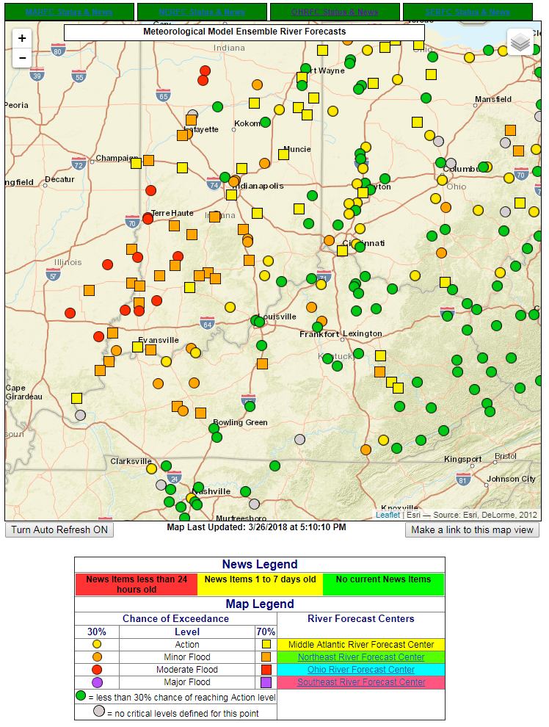
In the image to the left, we see green, yellow, orange and red circles and/or squares.
The legend at the bottom helps to break down the meaning of each.
For example, the 2 red circles within the large black circle labeled “1” in the image to the left would indicate that the ensembles think there is between a 30 to 69% chance of reaching moderate flood stage.
In the black circle labeled “2”, we see an orange square which means that there is a 70%+ chance of reaching flood stage given the ensemble outputs.
1.
2.

Slide 4
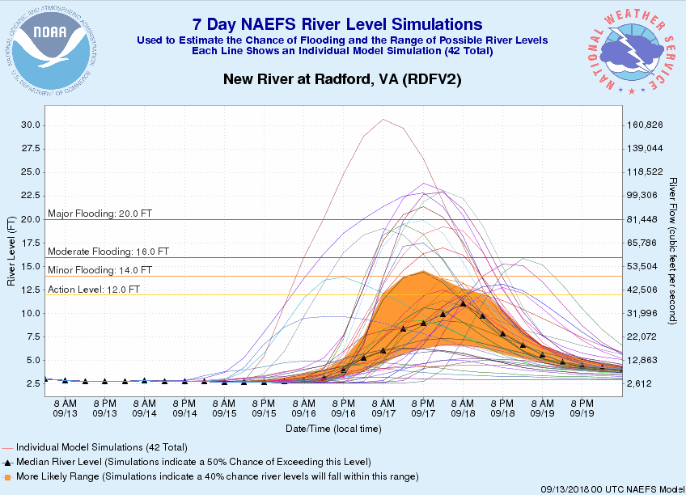
You can then click on any of the circles or squares in the previous map to see the charts.
These charts should look familiar from the IWT.
For example, in the image to the left, it shows the orange range which highlights the 30-70% likelihood of what the stage will reach given the ensembles. It also shows all of the ensemble outputs (all of the thin lines).
High River at Loweville

Slide 5
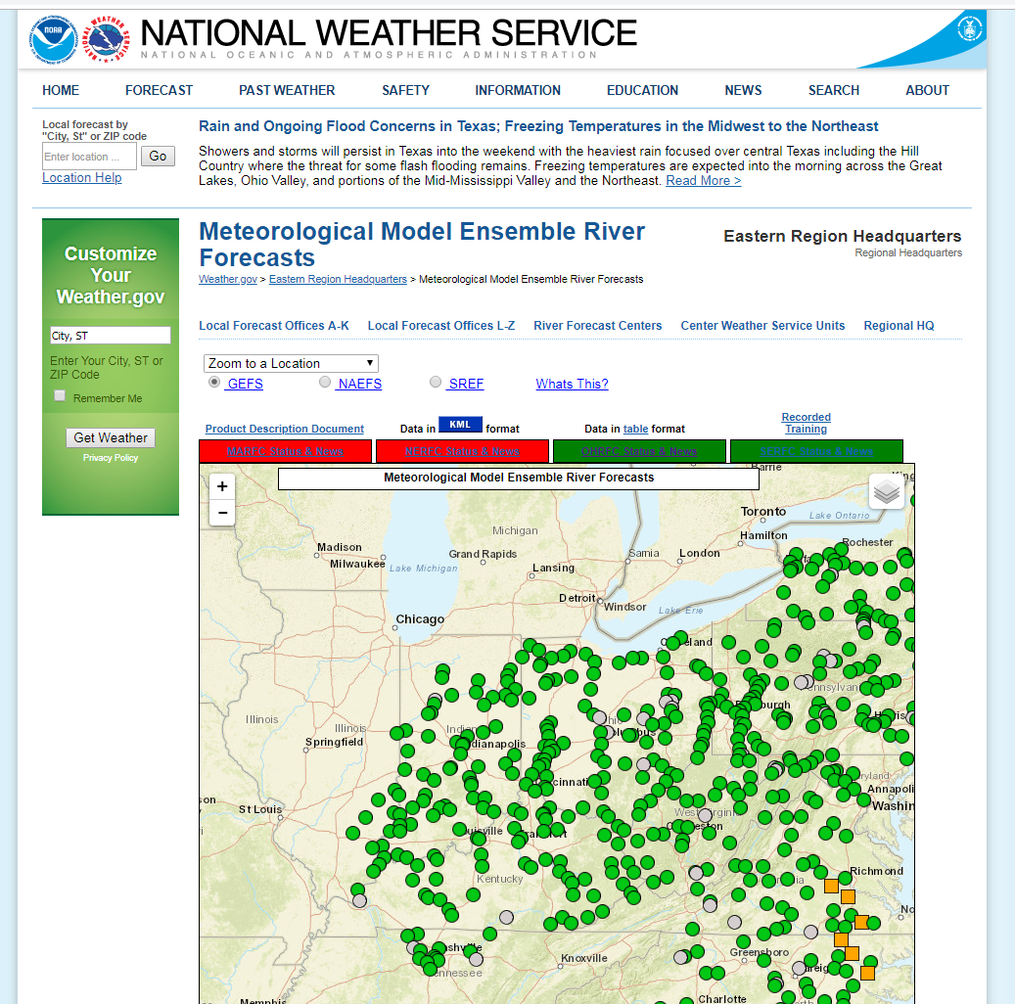
If you want to receive more training on the Ensemble Outlooks, feel free to click on the circled link in the image to the left.
If this does not answer your question(s), feel free to send me an email or talk to your local NWS Weather Forecast Office.
Ryan Fliehman
Ryan.Fliehman@noaa.gov

