Slide 1
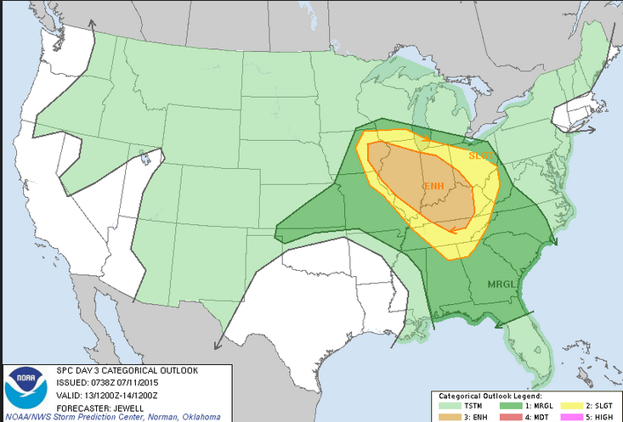
Severe Weather/Flood Potential Increasing for Saturday
Decision Support Briefing
As of: 1400 hrs Thursday October 18, 2018
Severe Weather Outlook - Saturday
Widespread severe thunderstorm outbreak becoming increasingly likely Saturday afternoon and evening
Damaging winds, large hail and flash flooding will be the primary threats. An isolated tornado will be possible.
A derecho with widespread damaging winds is possible.
Forecaster confidence is high that a severe weather event will occur; however, the greatest uncertainty is how far north and east the severe weather threat will reach.
Day 3 Severe Weather Outlook
Valid: 20/1200Z-21/1200Z

Slide 2
Main Points
Hazard | Impacts | Location | Timing
Severe Thunderstorms | Primary: Damaging Winds greater than 60 mph Secondary: Large hail larger than quarters / Isolated Tornado | Greatest Risk: S’rn Ohio/NE’rn Kentucky Greatest Uncertainty: W’rn West Virginia | Late Saturday afternoon into Saturday evening
Flash Flooding | Flooding of small creeks and streams and poor draining urban areas | Region-wide | Late Saturday afternoon through Saturday night

Slide 3
Summary of Greatest Impacts
Damaging Winds
None | Limited | Elevated | Significant | Extreme
Large Hail
None | Limited | Elevated | Significant | Extreme
Tornado
None | Limited | Elevated | Significant | Extreme
Flash Flooding
None | Limited | Elevated | Significant | Extreme

Slide 4
Saturday’s Severe Weather Outlook:
Sub-severe thunderstorms are likely in the morning followed by a break in the storms
Stronger complex of storms is expected to move across the region late Saturday afternoon and evening
A derecho is possible
Damaging winds greater than 60 mph are possible, along with large hail and an isolated tornado
Day 3 Severe Weather Outlook
Valid: 20/1200Z-21/1200Z
Notes:
Graphic is the WPC Rainfall Forecast for the next 7 Days.

Slide 5
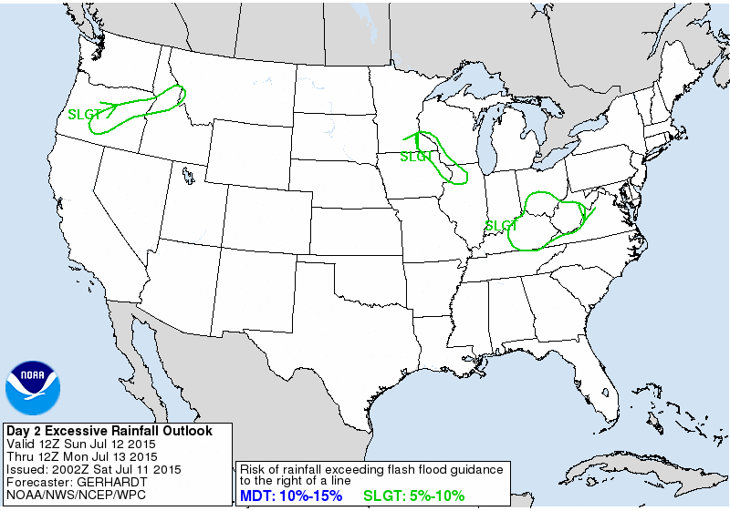
Saturday’s Flash Flood Potential:
Saturated ground from morning storms will increase potential for flash flooding Saturday afternoon through Saturday night
Training of storms is possible
Flash flooding is possible on small creeks and streams and poor draining urban areas
Day 3 Excessive Rainfall Outlook
Valid: 20/1200Z-21/1200Z
Notes:
Graphic is the WPC Rainfall Forecast for the next 7 Days.

Slide 6
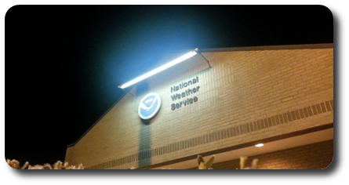
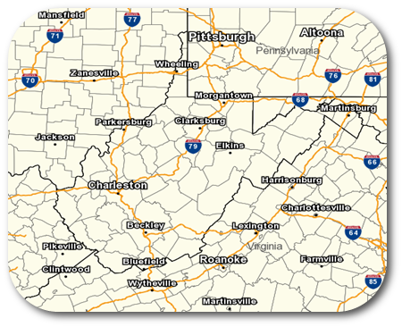
Contact and Next Briefing Information
Next Briefing
When: By time on date
Method: Insert next briefing method
Briefing Webpage:
http://www.weather.gov/rlx/briefwv
Web:
www.weather.gov/rlx
E-mail:
rlx.ops@noaa.gov
Phone (public):
(304) 746-0180
Facebook:
NWSCharlestonWV
Twitter:
NWSCharlestonWV
YouTube:
NWSCharlestonWV
Disclaimer: The information contained within this briefing
is time-sensitive, do not use after time month, date

