Slide 1
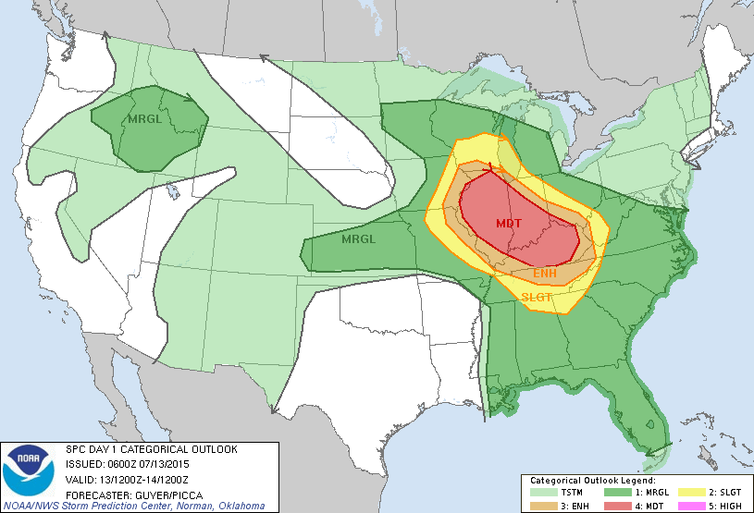
Severe Weather/Flood Potential Increasing for Saturday
Decision Support Briefing
As of: 1100 hrs Friday October 19, 2018
Severe Weather Outlook - Saturday
Widespread severe thunderstorm outbreak becoming increasingly likely Saturday afternoon and evening
A derecho will likely bring widespread damaging winds to the region late Saturday afternoon and evening.
Flash flooding will be a threat Saturday afternoon into Saturday night.
Forecaster confidence is high that a severe weather event will occur; however, the greatest uncertainty continues to be exactly how far north and east the severe weather threat will reach.
Day 2 Severe Weather Outlook
Valid: 20/1200Z-21/1200Z
National Weather Service
Local Office
Created:
10/19/18 10:30 AM

Slide 2
Main Points
Hazard | Impacts | Location | Timing
Severe Thunderstorms | Primary: Widespread damaging winds greater than 60 mph Secondary: Large hail larger than quarters / Isolated Tornado | Greatest Risk: S’rn Ohio/NE’rn Kentucky Greatest Uncertainty: W’rn West Virginia | Late Saturday afternoon into Saturday evening
Flash Flooding | Flooding of small creeks and streams and poor draining urban areas | Region-wide | Late Saturday afternoon through Saturday night
National Weather Service
Local Office
Created:
10/19/18 10:30 AM

Slide 3





Summary of Greatest Impacts
Damaging Winds
None | Limited | Elevated | Significant | Extreme
Large Hail
None | Limited | Elevated | Significant | Extreme
Tornado
None | Limited | Elevated | Significant | Extreme
Flash Flooding
None | Limited | Elevated | Significant | Extreme
National Weather Service
Local Office
Created:
10/19/18 10:30 AM

Slide 4
Saturday’s Severe Weather Outlook:
Morning thunderstorms should remain sub-severe but gusty winds up to 40 mph are possible with small hail
Stronger complex of storms, likely a derecho, is expected to move across the region late Saturday afternoon and evening
Widespread damaging winds greater than 60 mph are possible, along with large hail and an isolated tornado
Day 2 Severe Weather Outlook
Valid: 20/1200Z-21/1200Z
National Weather Service
Local Office
Created:
10/19/18 10:30 AM

Slide 5
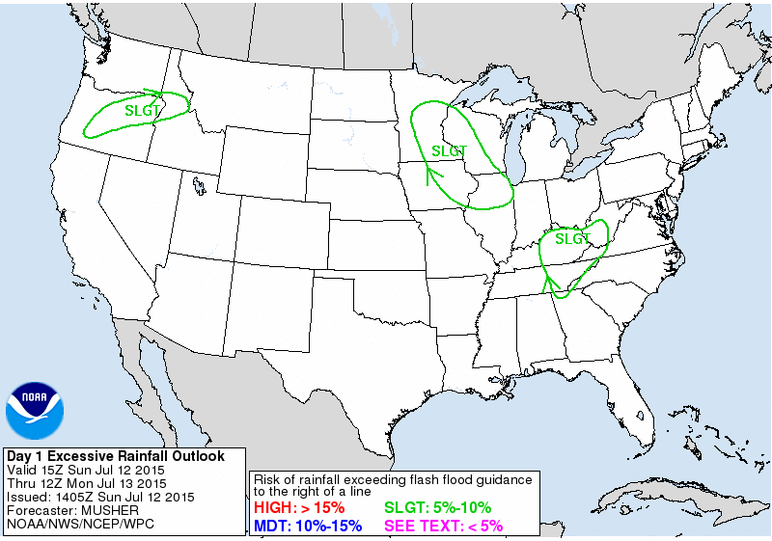
Saturday’s Flash Flood Potential:
Saturated ground from morning storms will increase potential for flash flooding Saturday afternoon through Saturday night
Training of storms is likely
Flash flooding is likely on small creeks and streams and poor draining urban areas
Day 2 Excessive Rainfall Outlook
Valid: 20/1200Z-21/1200Z
National Weather Service
Local Office
Created:
10/19/18 10:30 AM

Slide 6
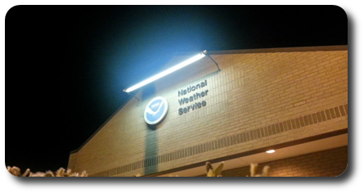
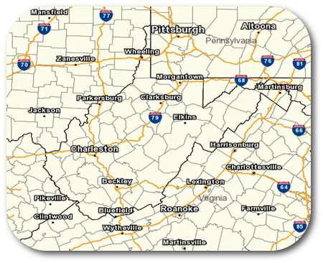
Contact and Next Briefing Information
Web:
www.weather.gov/
E-mail:
nws@noaa.gov
Phone (public):
(555) 555-5555
Facebook:
NWSLocalOffice
Twitter:
NWSLocalOffice
YouTube:
NWSLocalOffice
Disclaimer: The information contained within this briefing
is time-sensitive, do not use after time month, date
National Weather Service
Local Office
Created:
10/19/18 10:30 AM

