Slide 1
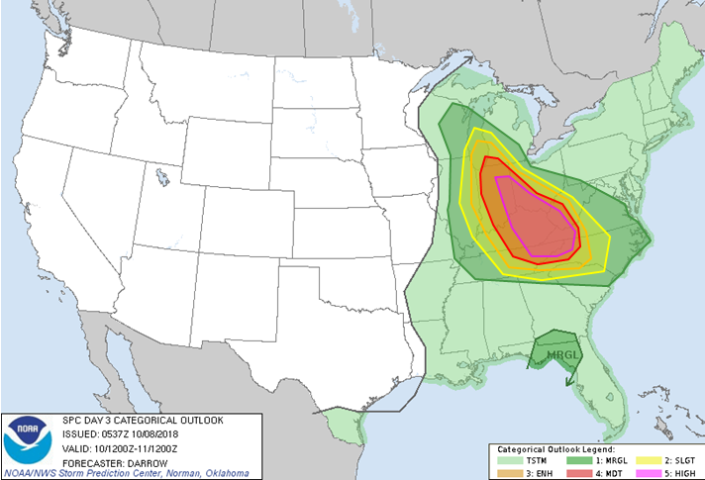
Severe Weather/Flood Potential Increasing for Saturday
Decision Support Briefing
As of: 1400 hrs Saturday October 20, 2018
Severe Weather Outlook - Today
Widespread damaging wind event likely as severe thunderstorm complex races across the area after 1800 today. This will down trees and cause numerous to widespread power outages across the region
Flash flooding will be a secondary concern as additional storms move over the area through tonight.
Large hail and an isolated tornado cannot be ruled out.
Day 1 Severe Weather Outlook
Valid: 20/1200Z-21/1200Z
National Weather Service
Local Office
Created:
10/20/18 1:30 PM

Slide 2
Main Points
Hazard | Impacts | Location | Timing
Severe Thunderstorms | Primary: Widespread damaging winds greater than 60 mph -Downed trees will cause widespread power outages Secondary: Large hail larger than quarters / Isolated Tornado | Region-wide | This evening
Flash Flooding | Flooding of small creeks and streams and poor draining urban areas | Region-wide | This evening through the night
National Weather Service
Local Office
Created:
10/19/18 10:30 AM
Created:
10/20/18 1:30 PM

Slide 3





Summary of Greatest Impacts
Damaging Winds
None | Limited | Elevated | Significant | Extreme
Large Hail
None | Limited | Elevated | Significant | Extreme
Tornado
None | Limited | Elevated | Significant | Extreme
Flash Flooding
None | Limited | Elevated | Significant | Extreme
National Weather Service
Local Office
Created:
10/20/18 1:30 PM

Slide 4
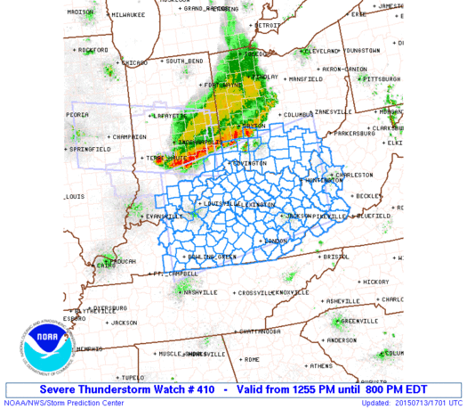
Severe Thunderstorm Watch until 10 PM
Storms moving south over Ohio and Indiana will increase in intensity as they move across the Tri-State later this evening.
Widespread damaging winds greater than 60 mph are possible, along with large hail and an isolated tornado
Day 1 Severe Weather Outlook
Valid: 20/1200Z-21/1200Z
Severe Thunderstorm Watch #410
Valid from 100 PM until 10 PM EDT
National Weather Service
Local Office
Created:
10/20/18 1:30 PM

Slide 5
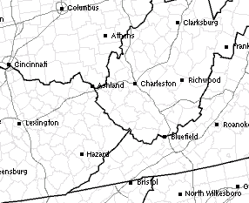
2 PM
4 PM
Damaging Wind Threat Timing
Timing indicated is earliest threat for damaging thunderstorm winds as the line of storms moves across the region.
6 PM
8 PM
10 PM
Day 1 Severe Weather Outlook
Valid: 20/1200Z-21/1200Z
National Weather Service
Local Office
Created:
10/20/18 1:30 PM

Slide 6
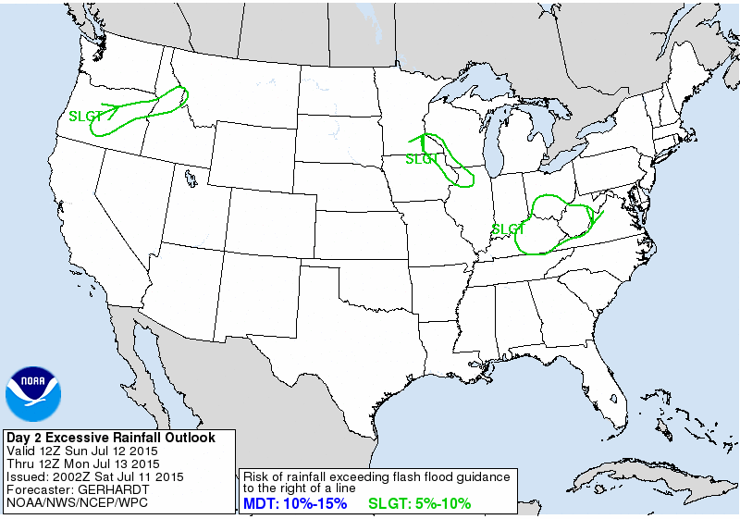
Flash Flood Potential through tonight:
Saturated ground will increase potential for flash flooding through tonight
Training of storms is likely
Flash flooding is likely on small creeks and streams and poor draining urban areas
MDT
Day 1 Excessive Rainfall Outlook
Valid: 20/1200Z-21/1200Z
National Weather Service
Local Office
Created:
10/20/18 1:30 PM

Slide 7
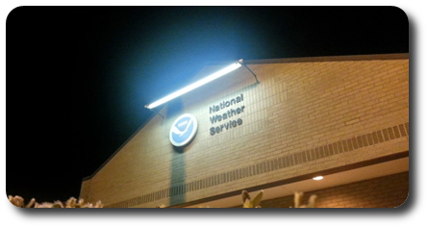
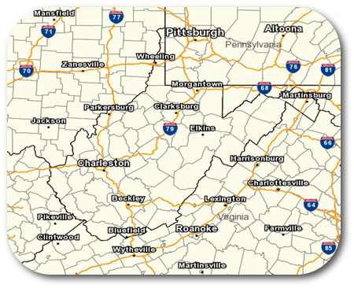
Contact and Next Briefing Information
Web:
www.weather.gov/
E-mail:
nws@noaa.gov
Phone (public):
(555) 555-5555
Facebook:
NWSLocalOffice
Twitter:
NWSLocalOffice
YouTube:
NWSLocalOffice
Disclaimer: The information contained within this briefing
is time-sensitive, do not use after time month, date
National Weather Service
Local Office
Created:
10/20/18 1:30 PM

