Slide 1
Evaluating Hydrologic Forecasting
“Exploring Outlooks vs. Forecasts”
Ryan Fliehman
NWS Ohio River Forecast Center
Wilmington, Ohio

Slide 2
Outline
Introduction
OHRFC Official Forecast Process
Outlook Forecast Process
Outlook vs Official Forecast Comparison
Outlook vs Official Forecast Exercise

Slide 3
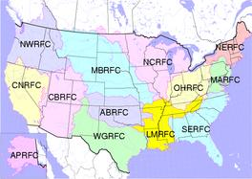
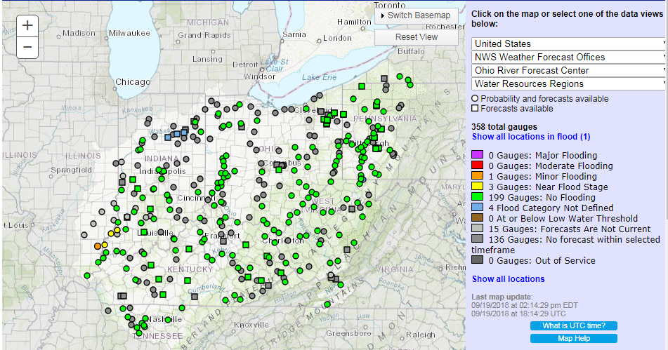
NWS Ohio River Forecast Center
Located in Wilmington, Ohio (SW Ohio)
Staffed 6am-10pm (24hrs as needed) / 365 days
Comprised of 16 meteorologists / hydrologists
Responsible for forecasting all water that flows through the Ohio River drainage.
Main task is daily hydrologic model run to complete river forecasts (shown right).
Many other research & development projects also take place to support a wide variety of local, state, and federal partners.

Slide 4
Quantifying Water
How do we quantify water in a stream / river ?
To end users, all they want to know is feet, but what does this number mean ?
At the RFC we need a volume (CFS) to be able to route water through the system.
- 29 feet at Marietta, OH is meaningless at Huntington, WV.
- 150,000cfs at Marietta, OH puts a values on flow and can be routed down.
This is where a USGS rating curve becomes extremely important.
Without a valid and up to date rating, this volume to height relationship becomes unreliable and any confidence in forecasting river stages is quickly lost.
Please support USGS gages!!!

Slide 5
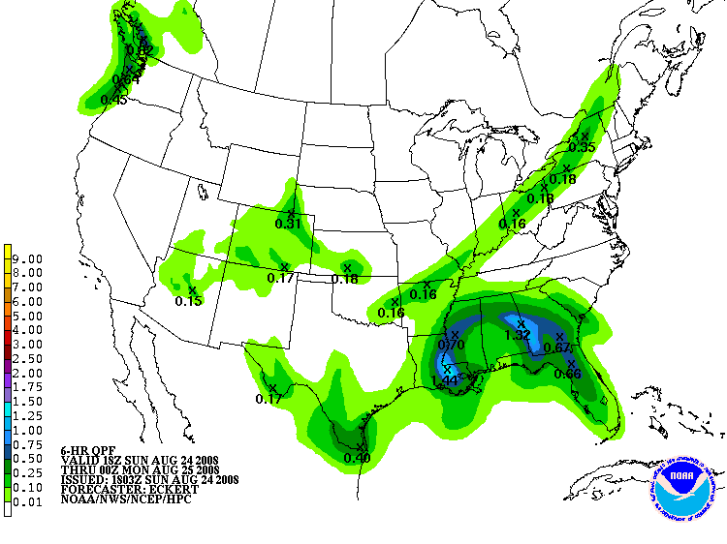
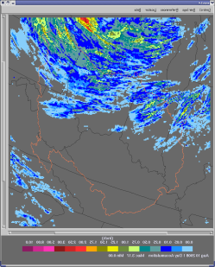
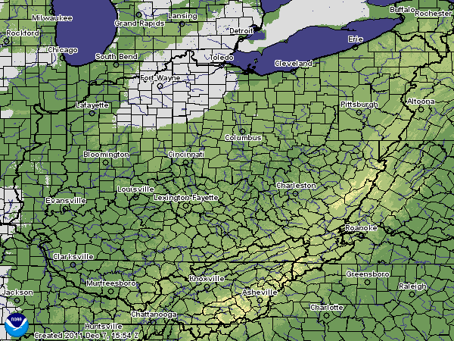
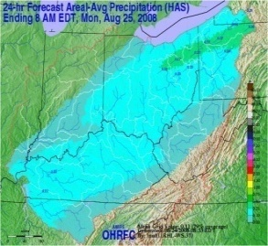
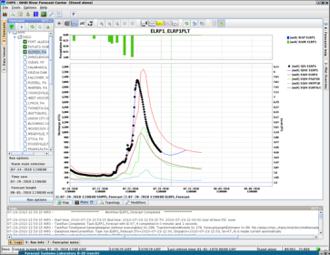
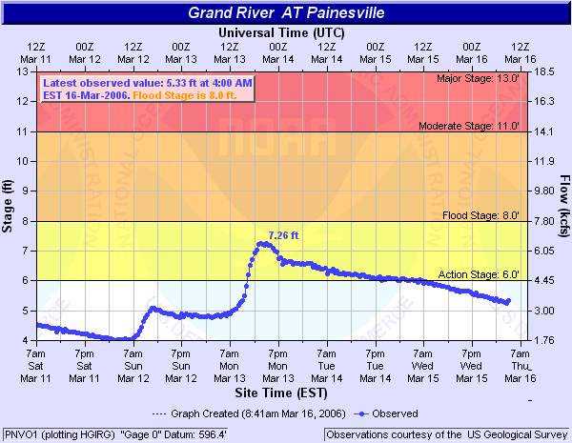
OHRFC River Forecast Process
Observed and radar rainfall estimates are quality controlled.
Snow water equivalent estimates are incorporated when needed.
Rainfall forecasts are generated by the Weather Prediction Center (WPC).
These rainfall forecasts are modified at the Ohio River Forecast Center (OHRFC) to add local expertise.
The river forecast model is run at the OHRFC with adjustments made if necessary.
Forecast stages are sent to the local NWS Weather Forecast Office (WFO) for final review before dissemination .
National Rainfall Forecast
Observed Rainfall
Observed Snow Estimates
RFC Rainfall Forecast
River Forecast Model
AHPS Forecast Stages
Notes:
Hourly rainfall is brought into the NWS river forecast center process through NWS radars and hourly rainfall data via NWS ASOS, USGS DCPs, state rainfall networks etc. The meteorologists (HAS = Hydrometeorological Analysis and Support) integrate and quality control the radar and rainfall together on an hourly basis. Further the meteorologists integrate 6-hourly and 24-hourly COOP and automated data into the system to improve rainfall estimates further. This also includes the CoCoRaHS for the Community Colaberative Rain, Hail and Snow Network. The manual human readings are usually only integrated into the system each morning between 7-8 am.
Rainfall forecasts are also included in the river forecasts. Most RFCs use between 24-48 hours of Quantitative Precipitation Forecasts or QPF. The OHRFC uses 48-hours of QPF routinely. Within the NWS, RFC QPF ranges from 6-hours to 10 days routinely.
Most RFCs start with the Hydrometeorological Prediction Center’s (HPC) QPF. The meteorologists at the RFCs then use local expertise and the latest trends to modify the QPF for use in the river forecasts. These QPF can be found on the front tabs of the RFCs under Forecast Precipitation. The NWS is working to integrate the RFC QPF into such tools as NWSChat as well.
Snow water equivalent estimations are also brought into the RFC when needed. The OHRFC uses snow water equivalent estimates from the National Operational Hydrologic Remote Sensing Center (NOHRSC). The estimates are integrated into the RFCs snow model – currently SNOW 17.
The observed rainfall, snow water equivalents and future precipitation forecasts are run through the NWS hydrologic model at the RFCs, currently SAC-SMA at all but one RFC. The snow model the SNOW 17 model.
The hydrologic model operates in flow. The NWS relies heavily on ratings developed primarily by the USGS but also other agencies such as the U.S. Army Corps of Engineers (COE). The flows are converted to stage. The forecasters also modify the hydrologic model with modifications to things such as the unit hydrographs, rainfall etc. The NWS RFCs also rely on additional inputs of flood control reservoir releases by the COE to improve the modeling. The final output is sent to the local NWS offices for final review before release to the public via text and graphic based products such as AHPS.

Slide 6
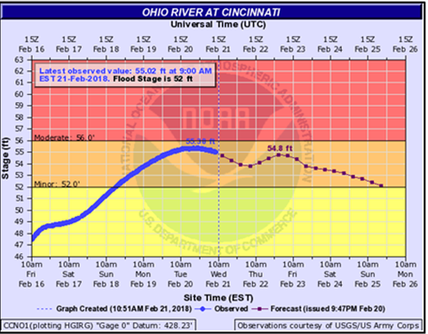
OHRFC River Forecast Process
Look Familiar???
This is the final product that is posted to the NWS page. Users (i.e. you) would use this information to aid in the decision making process.
While this line looks simple enough, there is an abundance of uncertainty that arises when a river forecast is put together.
So What's Included in the River Forecast?
Previous Rainfall (QC’d hourly, goes back over a month)
Forecast Rainfall (48-72 hours depending on confidence and validity)
Snowfall (if necessary, used during cases of snowmelt)

Slide 7
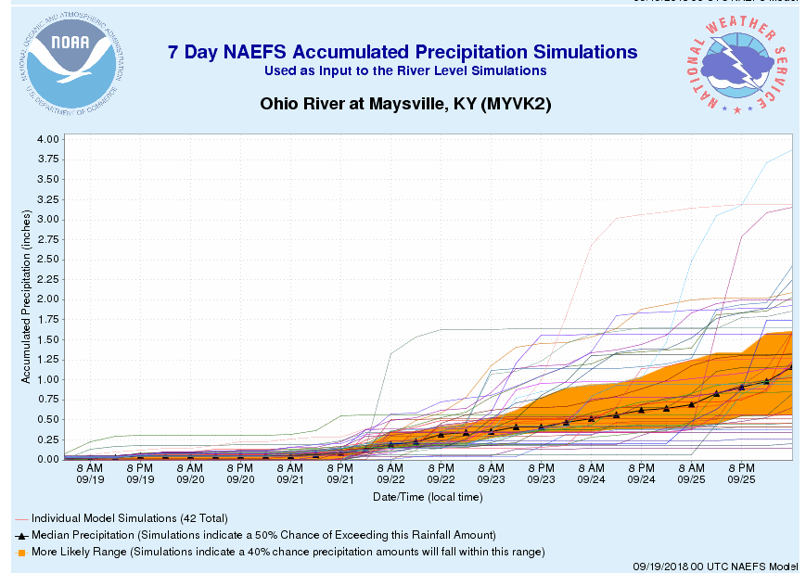
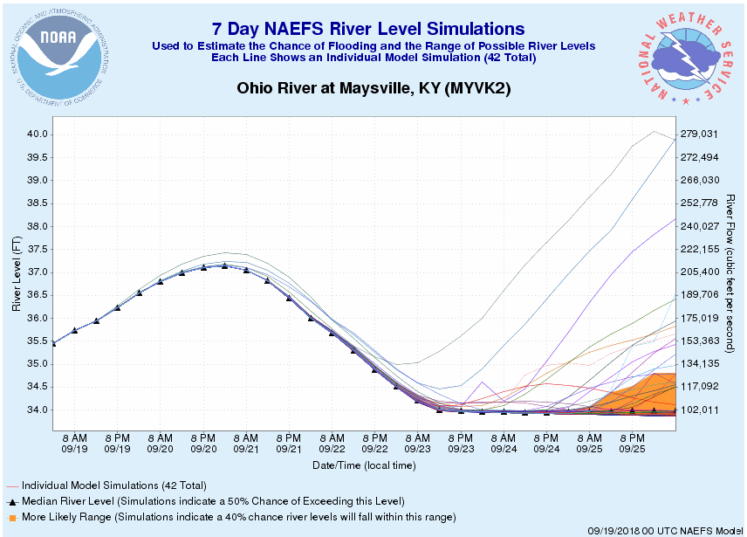
Lets Explore Ensembles
What is a Weather Model Ensemble?
- It is made up of many members (forecasts) to help address uncertainty in
forecasting. If slight changes are made in the initialization of the model,
what are the effects down the road?
So for Hydrologic Ensembles, we use the members to give expected rainfall (1)
These rainfall estimates are processed through the hydrologic model to get a
set of potential outcomes (2)
1.
2.

Slide 8
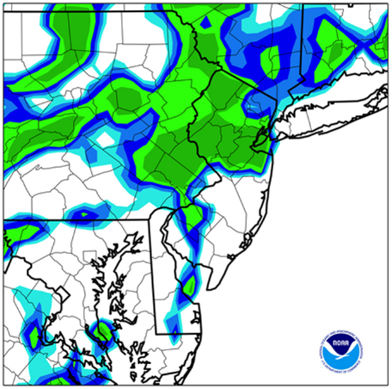
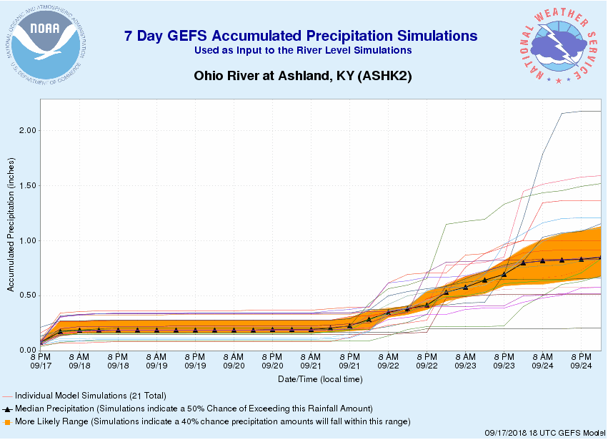
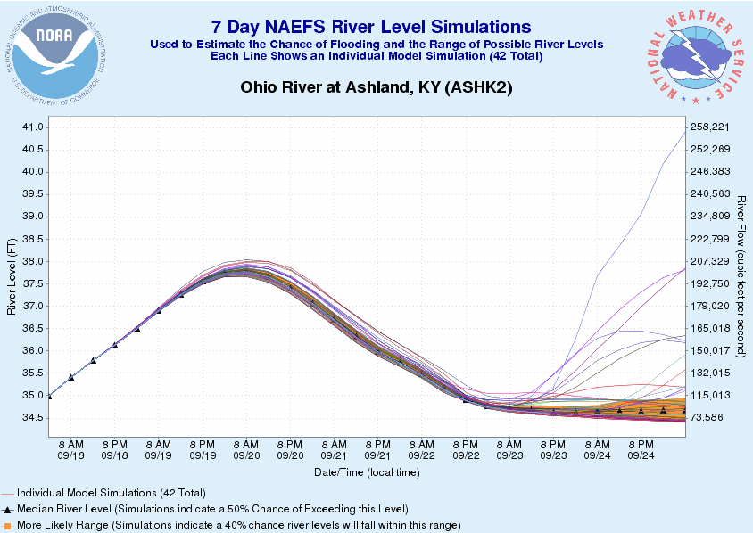
Ensemble Outlook Process
Rainfall Output
River Model
No Human Interaction
Weather Model
NAEFS North American Ensemble Forecast System (Canadian/American)
GEFS Global Ensemble Forecast System (American)
SREF Short Range Ensemble Forecast System (American)
Ensemble River
Outlooks

Slide 9
Forecast vs Outlook
Factor | Official Forecast | Ensemble Outlooks
Rainfall Used | 48-72 hours | 7 days (3 for SREF)
USACE Functions | Uses real time human generated operations | Uses model reservoir operations (not as useful in flood ops)
Past Rainfall | QC right before forecast issuance | QC may be outdated and not as precise
Human Interaction | Included (forecaster modifications before issuance) | Never Included
Cone of Uncertainty | Single forecast | Larger cone due to many members
Update Cycles | Updates completed as necessary | Updates only completed on scheduled times
Rainfall Resolution | Human incorporated rainfall forecast | Model only forecast with coarser resolution

Slide 10
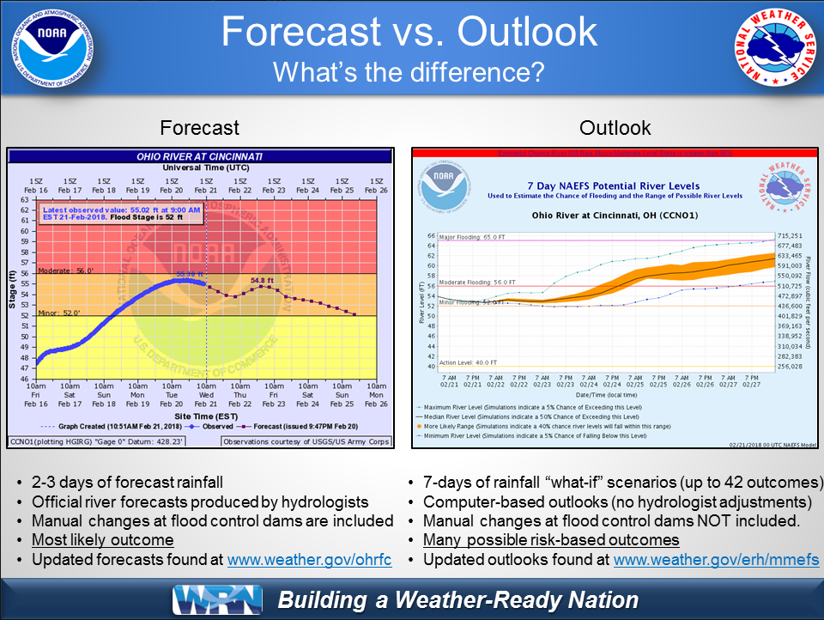
Communicating with Others
Outlooks use ensembles or multiple “what if” scenarios to arrive at a solution.
Forecasts give one solution based on many inputs and have human interaction.
Often users struggle to identify the differences.
From examining previous events, the public really struggles to understand the difference between the outlook and forecast.

Slide 11
Lets Give It A Try
I will present a scenario with outlooks similar to what you may see in a real
time event.
We will also put together a forecast given inputs from a hydrologic model and
a USGS rating curve.
We will then see how our forecast verified given this event.
At the end, we will discuss how various people
1) Used the information
2) Interpreted the information
3) What we (NWS/OHRFC) could do better in the future
Then we will have some time for final thoughts and comments at the end.

Slide 12
Loweville Rating Curve from USGS
Stage (ft) | Flow (cfs)
2 | 1286
3 | 4527
4 | 8845
5 | 12863
6 | 16462
7 | 20170
8 | 24003
9 | 27948
10 | 31996
11 | 36136
12 | 40363
13 | 44669
14 | 49051
15 | 53504
16 | 58023
17 | 63028
18 | 68580
19 | 74697
20 | 81448
21 | 88425
22 | 95624
23 | 103043
24 | 110677
25 | 118522
26 | 126577
27 | 134837
28 | 143301
29 | 151965
30 | 160826
31 | 169884
32 | 179134
33 | 188575
34 | 198206
35 | 208023
36 | 218024

Slide 13
Rating Curve Example
As an example, we will start with a flow of around 50,000cfs which was given from the Ohio River Forecast Center.
With a flow of 50,000cfs, this would yield a stage of ???
Start with a line across at 50,000cfs (red line).
Now take a vertical line where
it crosses the curve (blue line).
By reading where the blue line crosses the bottom axis (Stage), we see that 50,000cfs would correspond to 13ft at Loweville.
This is the procedure for using the rating curve for finding stage given flow.

Slide 14
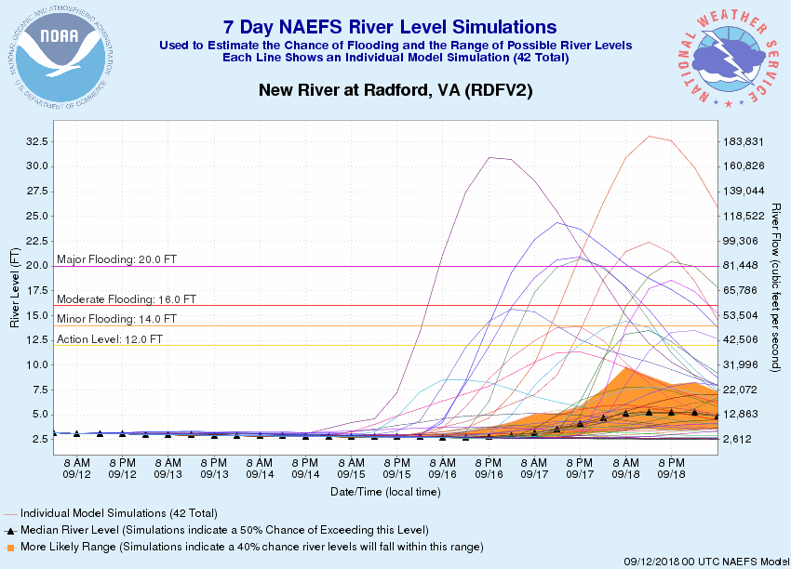
5 Day Outlook
42 Member North American Ensemble Forecast System (NAEFS)
United States and Canadian Weather Models
Several traces showing significant rises.
Traces range from no rise to 13 feet above major flood stage.
Lots of variability this far in advance.
Jot down your thoughts from seeing this.
High River at Loweville

Slide 15
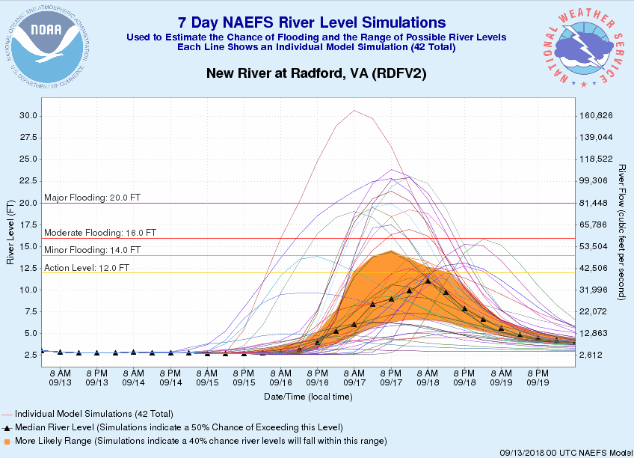
4 Day Outlook
42 Member North American Ensemble Forecast System (NAEFS)
United States and Canadian Weather Models
Several traces still showing significant rises.
Traces are starting to tighten up. More in the moderate and major category.
Still plenty of variability
Jot down your thoughts from seeing this.
High River at Loweville

Slide 16
OHRFC River Flows
Date | Flow (cfs) | Stage (ft)
9/13 @ 18Z | 2640
9/14 @ 00Z | 2950
9/14 @ 06Z | 2950
9/14 @ 12Z | 2950
9/14 @ 18Z | 2640
9/15 @ 00Z | 2640
9/15 @ 06Z | 2640
9/15 @ 12Z | 2640
9/15 @ 18Z | 2640
9/16 @ 00Z | 2640
9/16 @ 06Z | 2640
9/16 @ 12Z | 2640
9/16 @ 18Z | 2640
9/17 @ 00Z | 2640
9/17 @ 06Z | 2640
9/17 @ 12Z | 2640
Date | Flow (cfs) | Stage (ft)
9/17 @ 18Z | 2640
9/18 @ 00Z | 2640
9/18 @ 06Z | 2640
9/18 @ 12Z | 2640
These are the flows that were generated by the OHRFC.
We will then use the official rating curve from the US Geological Survey (USGS) to calculate the stages we can expect at our forecast point of Loweville.
00Z = 8pm EDT / 7pm EST
06Z = 2am EDT / 1am EST
12Z = 8am EDT / 7am EST
18Z = 2pm EDT / 1pm EST

Slide 17
OHRFC River Flows
Date | Flow (cfs) | Stage (ft)
9/13 @ 18Z | 2640 | 2.5
9/14 @ 00Z | 2950 | 2.6
9/14 @ 06Z | 2950 | 2.6
9/14 @ 12Z | 2950 | 2.6
9/14 @ 18Z | 2640 | 2.6
9/15 @ 00Z | 2640 | 2.5
9/15 @ 06Z | 2640 | 2.5
9/15 @ 12Z | 2640 | 2.5
9/15 @ 18Z | 2640 | 2.5
9/16 @ 00Z | 2640 | 2.5
9/16 @ 06Z | 2640 | 2.5
9/16 @ 12Z | 2640 | 2.5
9/16 @ 18Z | 2640 | 2.5
9/17 @ 00Z | 2640 | 2.5
9/17 @ 06Z | 2640 | 2.5
9/17 @ 12Z | 2640 | 2.5
Date | Flow (cfs) | Stage (ft)
9/17 @ 18Z | 2640 | 2.5
9/18 @ 00Z | 2640 | 2.5
9/18 @ 06Z | 2640 | 2.5
9/18 @ 12Z | 2640 | 2.5

Slide 18
OHRFC River Forecast
Official OHRFC Forecast issued for Loweville. This forecast is issued on September 13th, 2018. From the outlook, the peak is expected on September 17th at 8pm.
In the outlook, a crest of over 10 feet was expected.
This forecast only have around 2.6 feet, what gives?
What are you thoughts on this?
How could this be improved?

Slide 19
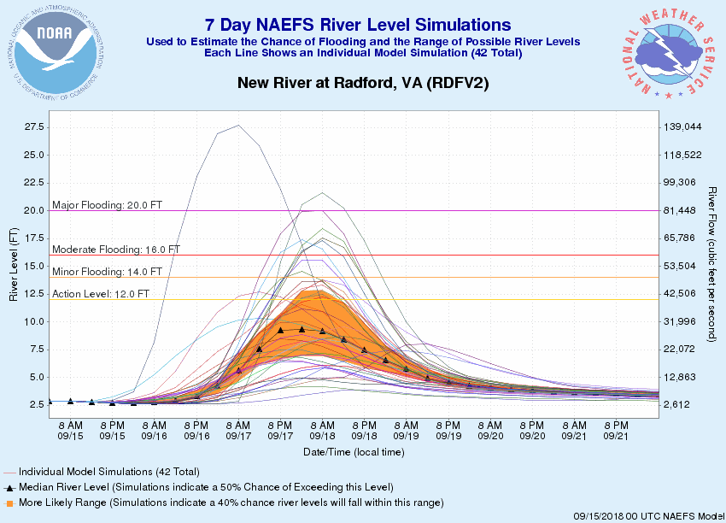
2 Day Outlook
42 Member North American Ensemble Forecast System (NAEFS)
United States and Canadian Weather Models
Overall median and orange range appears lower.
Still plenty of variability
What would we be passing along to our stakeholders?
Jot down your thoughts from seeing this.
High River at Loweville

Slide 20
OHRFC River Flows
Date | Flow (cfs) | Stage (ft)
9/15 @ 18Z | 3670
9/16 @ 00Z | 3300
9/16 @ 06Z | 3300
9/16 @ 12Z | 3670
9/16 @ 18Z | 4527
9/17 @ 00Z | 6500
9/17 @ 06Z | 12863
9/17 @ 12Z | 35300
9/17 @ 18Z | 65800
9/18 @ 00Z | 88425
9/18 @ 06Z | 99300
9/18 @ 12Z | 92000
9/18 @ 18Z | 81448
9/19 @ 00Z | 65800
9/19 @ 06Z | 43400
9/19 @ 12Z | 29000
Date | Flow (cfs) | Stage (ft)
9/19 @ 18Z | 20900
9/20 @ 00Z | 16462
9/20 @ 06Z | 13900
9/20 @ 12Z | 12150
Once again we will use the rating curve to calculate the stages we can expect at Loweville.
Flows on this run will be a bit higher.
00Z = 8pm EDT / 7pm EST
06Z = 2am EDT / 1am EST
12Z = 8am EDT / 7am EST
18Z = 2pm EDT / 1pm EST

Slide 21
OHRFC River Flows
Date | Flow (cfs) | Stage (ft)
9/15 @ 18Z | 3670 | 2.8
9/16 @ 00Z | 3300 | 2.7
9/16 @ 06Z | 3300 | 2.7
9/16 @ 12Z | 3670 | 2.8
9/16 @ 18Z | 4527 | 3
9/17 @ 00Z | 6500 | 3.5
9/17 @ 06Z | 12863 | 5
9/17 @ 12Z | 35300 | 10.8
9/17 @ 18Z | 65800 | 17.5
9/18 @ 00Z | 88425 | 21
9/18 @ 06Z | 99300 | 22.5
9/18 @ 12Z | 92000 | 21.5
9/18 @ 18Z | 81448 | 20
9/19 @ 00Z | 65800 | 17.5
9/19 @ 06Z | 43400 | 12.7
9/19 @ 12Z | 29000 | 9.3
Date | Flow (cfs) | Stage (ft)
9/19 @ 18Z | 20900 | 7.2
9/20 @ 00Z | 16462 | 6
9/20 @ 06Z | 13900 | 5.3
9/20 @ 12Z | 12150 | 4.8

Slide 22
OHRFC River Forecast
Official OHRFC Forecast issued for Loweville. This forecast is issued on September 15th, 2018. From the outlook, the peak is expected on September 18th at 2am.
In the outlook, a crest of over 10 feet remains valid.
Why is the forecast now showing a significant rise when the one from before didn’t?
What are you thoughts on this?
How could this be improved?
Major 20ft
Moderate 16ft
Flood 14ft
Action 12ft

Slide 23
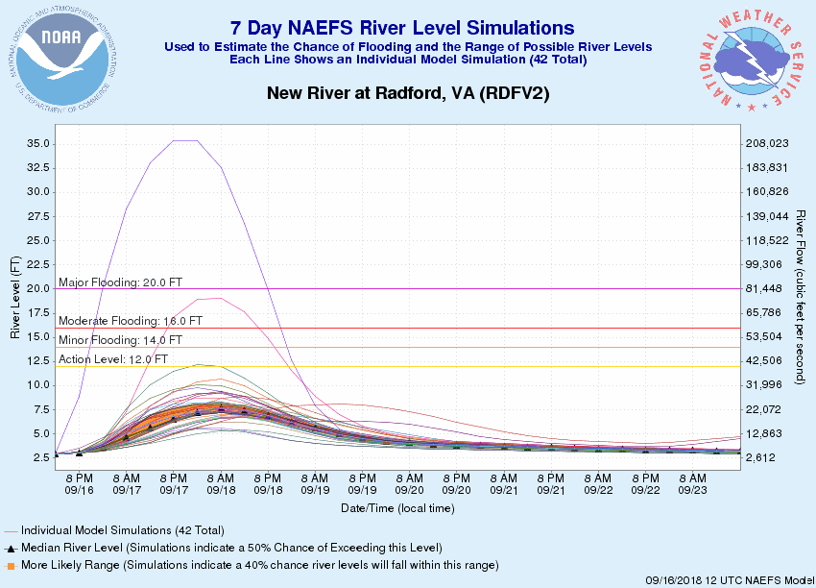
1 Day Outlook
42 Member North American Ensemble Forecast System (NAEFS)
United States and Canadian Weather Models
As we near the event, the outlooks decreased significantly.
Remember this is an outlook with no human interaction.
The human factor in this case still thought higher amounts of rainfall would be experienced.
High River at Loweville

Slide 24
OHRFC River Forecast
Official OHRFC Forecast issued for Loweville. This forecast is issued on September 15th, 2018. From the outlook, the peak is expected on September 18th at 2am.
From the outlook, the median stayed below Action Stage. The official forecast remains at Major Flood, what gives?
What are you thoughts on this?
Should we Yo-Yo or try to hold steady?
How could this be improved?
Major 20ft
Moderate 16ft
Flood 14ft
Action 12ft

Slide 25
What Actually Happened
So this scenario was based on an actual event that took place in the OHRFC area of responsibility.
The point was actually Radford on the New River in Virginia during Hurricane Florence rather than the High River at Loweville.
From this we can see the uncertainties that come in river forecasting.
Rainfall amounts were lower than forecast, leading to river levels not reaching as high as originally forecast.
Until we actually get the rainfall on the ground, a high degree of uncertainty will always exist.
Moderate 16ft
Flood 14ft
Action 12ft

Slide 26
Final Thoughts
Today we have identified many of the pieces that go into the river forecast process.
We identified the importance of the USGS Rating Curve.
We covered the difference between the outlook river guidance and the official NWS river forecast.
We have noted why we may see some of the bouncing around in the forecast with the variability in forecast rainfall.
Anything Else???

Slide 27
Question / Comments
Ryan Fliehman
Ryan.Fliehman@noaa.gov
NWS Ohio River Forecast Center
Wilmington, Ohio

