Slide 1
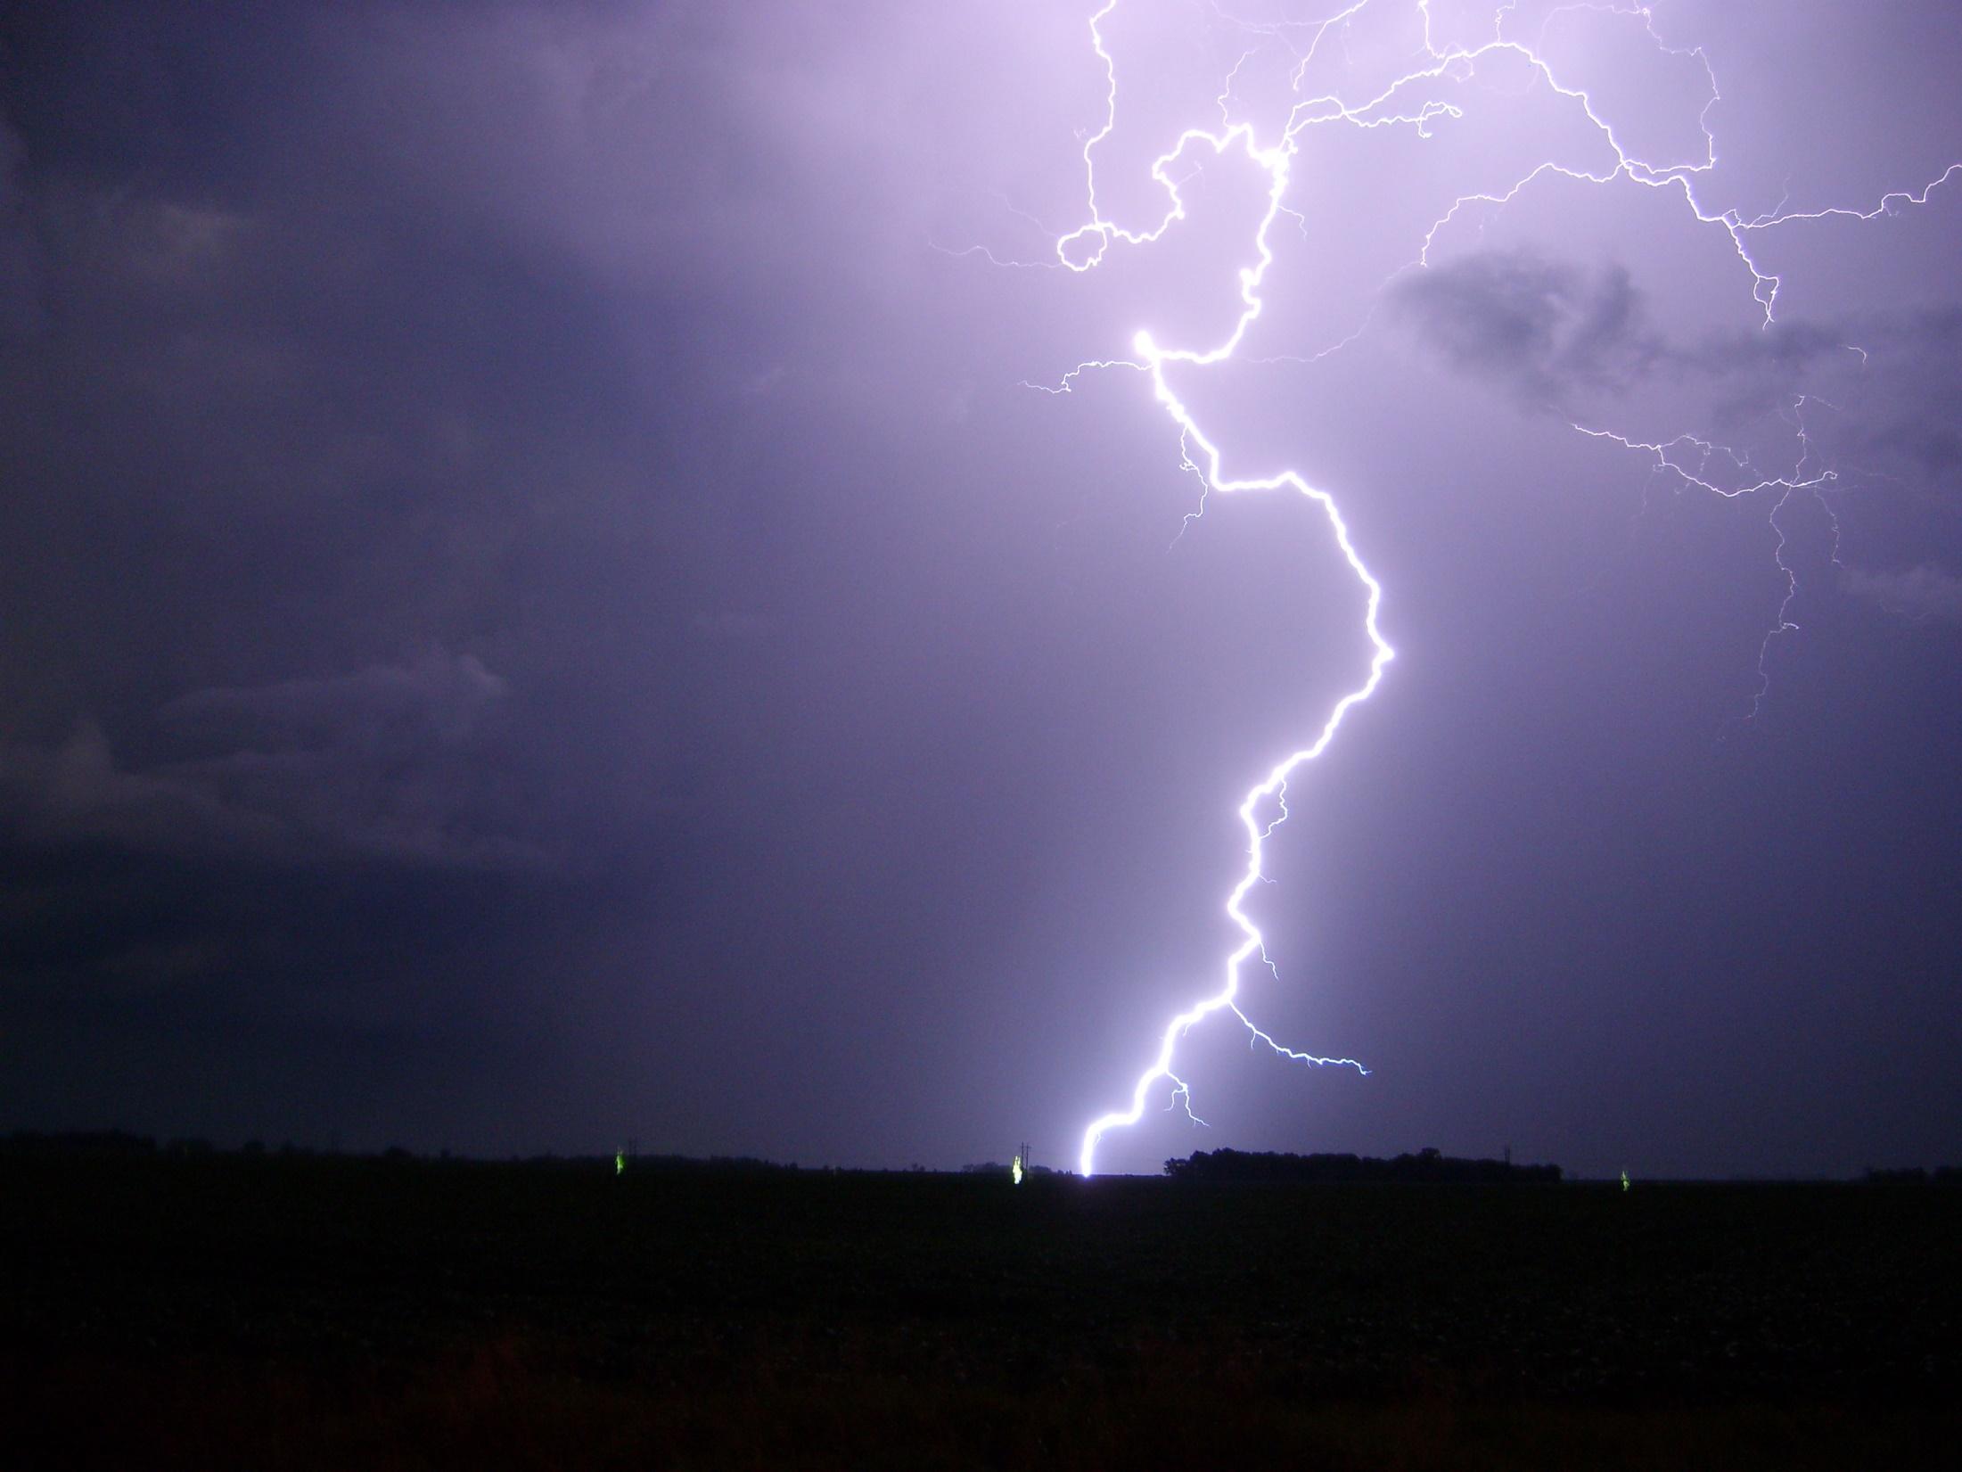
Tri-State Integrated Warning Team
Workshop
Ashland, KY
October 16, 2018
Welcome

Slide 2
Today’s Agenda
9 AM ................ Welcome/Introductions
9:30 AM ........... Round Table Discussion
            John Hunt (KYDPH/Prestonsburg EM)
            Darren Price (Ohio EMA)
            Brandon Butcher (WSAZ)
            Ben Gilmore (USCG)
            Eddie Jenkins (ARES Emergency Coordinator – Lawrence Co, OH)
10:30 AM ......... River Forecasts vs. Outlooks
11:30 PM ......... Lunch
12:30 PM ......... Tabletop Exercise
2:30 PM ........... Hotwash and Wrap-up

Slide 3
What is an IWT?
Anyone who works to protect people’s lives before, during and after hazardous weather events is part of the Integrated Warning Team.
Notes:
Everyone in the is room plays a role, that’s why you were invited to be here today. In order for an IWT to function, there has to be some knowledge of the other players, and what role their organization plays in the whole scheme of things.

Slide 4
Private Sector
INFO POOL
Volunteers
Media
DOH
NWS
EM
b i t s o f i n f o r m a t i o n
Notes:
An IWT is kind of like a puzzle. There are many pieces that play an intricate role. Each organization can be seen a piece of the puzzle, with its own strengths and limitation based on organizational goals, etc.

Slide 5
Goals For Today
Develop relationships
Discover common issues
Foster future collaboration
Learn, teach, have fun
Notes:
The goal is to produce a more cohesive and mutually beneficial relationship within the IWT that allows for a faster and more collaborative response to high-impact weather events. Public safety is the primary driver, not individual organization's goals.
To be successful:
Diverse group of stakeholders present
Everyone needs to participate
The workshop is a judgement free zone
Questions are encouraged
Make introductions to those you don’t know

