Slide 1
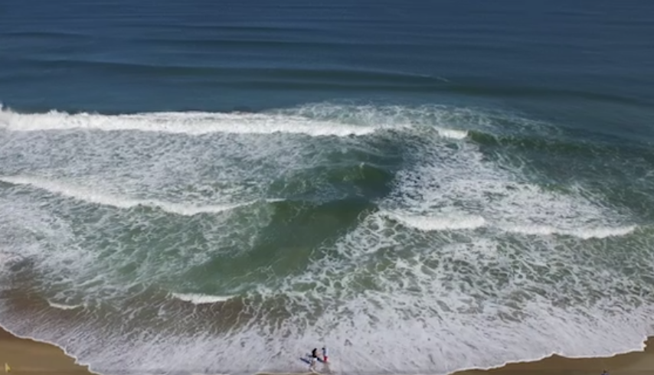
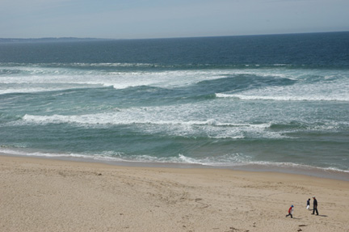
Do You Vacation At The Beach?
BEWARE RIP CURRENTS
What is a rip current?
Rip currents are fast flowing channels of water that extend from close to the shoreline through the surf and past the breaking waves
Strong rips can reach speeds faster than an Olympic swimmer
How do you spot a rip current?
Easiest to spot rip currents from an elevated position overlooking the beach
Rip currents may look darker, muddy, or choppier than surrounding areas
Look for areas where waves are not breaking
For more information visit - https://www.weather.gov/safety/ripcurrent

Slide 2
Do You Vacation At The Beach?
Learn How to Escape a Rip Current
Did you know… Most rip fatalities are people from inland areas
There are an estimated 100 rip current fatalities a year in the U.S.
Around 80% of all ocean rescues are rip related
Learn how to spot rips & Know Your Options for escaping them
For more information visit - https://www.weather.gov/safety/ripcurrent

