Slide 1
Information Extraction and verification of numerical weather prediction for severe weather forecasting
Israel Jirak, NOAA/Storm Prediction Center
Chris Melick, OU/Cooperative Institute for Mesoscale Meteorological Studies (CIMMS) and SPC
Harold Brooks, NOAA/National Severe Storms Laboratory
Matt Pyle, NOAA/Environmental Modeling Center

Slide 2
Project Overview
Collaborative effort among SPC, NSSL, and EMC to improve severe weather forecasting
Direct involvement with the Hazardous Weather Testbed (HWT) for testing and evaluation of products/techniques
Two primary components:
  Verification
    Explore and refine scale-appropriate metrics for convection-allowing model and ensemble forecasts relevant to severe convective weather
  Information Extraction
    Develop techniques/diagnostics to mine useful information embedded within convection-allowing models for severe weather forecasting

Slide 3
NGGPS Areas Addressed
Advances in convective/severe weather prediction through innovative scale-appropriate information extraction and verification methods on convective scales
Advances in ensemble development through evaluation of convection-allowing ensembles of opportunity to inform the design and configuration of future operational convection-allowing ensembles
Advances in post-processing by extracting relevant simulated storm processes and characteristics from convection-allowing models to identify the likelihood of severe weather

Slide 4
Project Summary: Verification
Identify the current accuracy and skill of convection-allowing models (CAMs) in predicting organized severe-wind-producing mesoscale convective systems (MCSs), including derechos
Evaluate the membership of the SPC storm-scale ensemble of opportunity (SSEO) to determine relative value of members
Explore new methods and techniques of verifying CAMs and SPC forecasts of severe-wind-producing MCSs

Slide 5
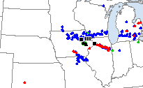
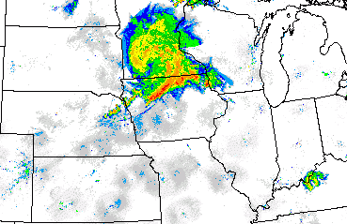
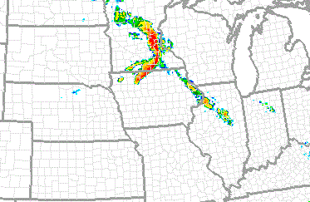
Project Summary: Verification
Identify the current accuracy and skill of convection-allowing models (CAMs) in predicting organized severe-wind-producing mesoscale convective systems (MCSs), including derechos
Organized, progressive MCSs are capable of producing widespread swaths of wind damage
How well do convection-allowing models forecast these types of events using existing output fields (e.g., 10-m winds)?
Preliminary Storm Reports
22 June 2015
1200 UTC Radar Image
22 June 2015
12-h NSSL-WRF Refl Fcst
Valid 12 UTC 22 June 2015

Slide 6
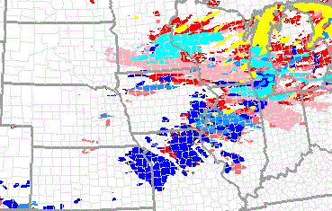

Project Summary: Verification
Evaluate the membership of the SPC storm-scale ensemble of opportunity (SSEO) to determine relative value of members
The SSEO is a 7-member multi-model (3 WRF-ARW, 3 NMMB, and 1 WRF-NMM) ensemble, including two time-lagged members
Ensemble performance will be evaluated as individual members are removed systematically to identify the relative value of each member
Preliminary Storm Reports
22 June 2015
SSEO 24-h 30-kt 10-m Wind Speed
Ending 12 UTC 23 June 2015

Slide 7
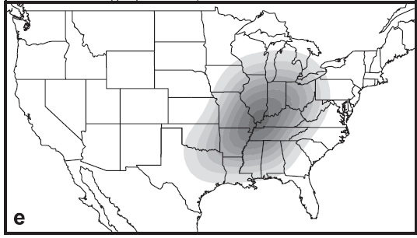
Project Summary: Verification
Explore new methods and techniques of verifying CAMs and SPC forecasts of severe-wind-producing MCSs
SPC probabilistic outlooks are valid within 25 miles of a point while CAMs are run at higher spatial resolution (~4-km grid spacing)
Can common verification methods/metrics (e.g., neighborhood approach) be applied to both forecasts?

Slide 8
Project Summary: Information Extraction
Develop and test model diagnostic variables for identifying organized MCSs with potential for producing damaging surface winds in CAMs
Incorporate diagnostic variables into operational CAMs for identifying severe-wind-producing MCSs

Slide 9
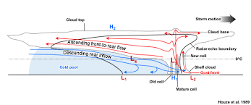
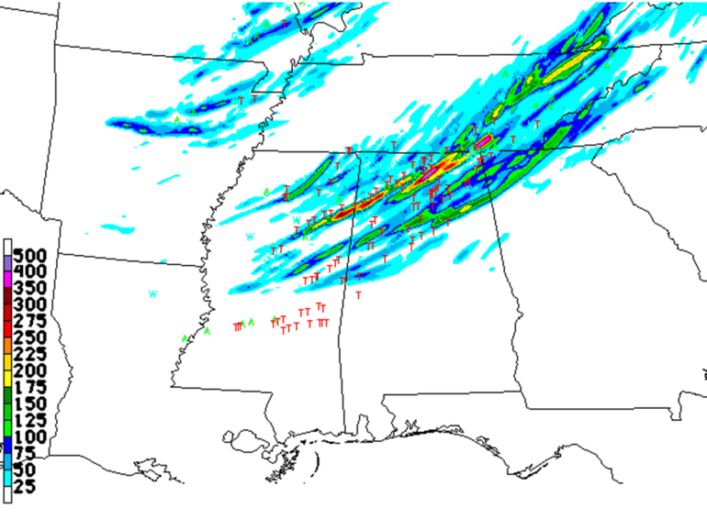
Project Summary: Information Extraction
Develop and test model diagnostic variables for identifying organized MCSs with potential for producing damaging surface winds in CAMs
Identify key dynamical features of an organized MCS in convection-allowing simulations (e.g., descending rear-inflow jet)
Produce diagnostics to quickly and efficiently identify these systems in CAMs (analogous to updraft helicity for supercells)
Vertical cross-section schematic of squall line

Slide 10
Project Summary: Information Extraction
Incorporate diagnostic variables into operational CAMs for identifying severe-wind-producing MCSs
Test and evaluate the newly developed diagnostic variables in the NSSL-WRF
Compare and verify these new diagnostics to existing and traditional model output in the HWT
Transition the diagnostics to operational CAMs

Slide 11
Project Status
OU graduate student, Jeff Milne, has begun work on this project:
  Developing a climatology of severe-wind-producing MCSs
  Assessing the current skill of CAMs in predicting these systems
Part-time research associate, Nathan Hitchens, also recently started:
  Scale-appropriate verification metrics for SPC outlooks and CAM forecasts
  Exploration of probabilistic verification approaches for convection-allowing ensembles
Full-time research associate, Robert Hepper, will be starting with CIMMS/SPC on July 31

Slide 12
Project Direction
Over the next year, the following tasks will be accomplished:
  Verification
    Complete climatology of severe-wind-producing MCSs
    Refine and/or develop scale-appropriate metrics for verifying CAM and SPC forecasts of severe wind
    Assess skill of CAMs and SSEO in predicting severe-wind-producing MCSs using existing model fields (e.g., 10-m wind speed)
  Information Extraction
    Identify and re-run MCS cases using the NSSL-WRF to examine 3-D structure of simulated systems
    Formulate diagnostic variables for identifying severe wind-producing MCSs in CAMs

