Slide 1
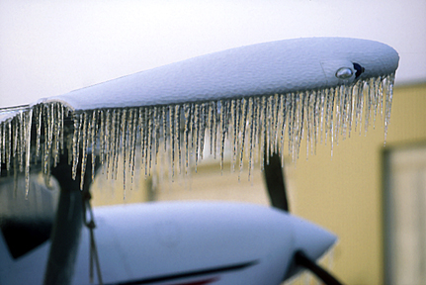


Aircraft Icing
Jim Vasilj, Meteorologist
Center Weather Service Unit
Auburn, Washington
NOAA/NWS Seattle Center Weather Service Unit (ZSE)
Notes:
This presentation, “Aircraft Icing”, was developed by Jim Vasilj, the acting Meteorologist in Charge at the National Weather Service, Center Weather Service Unit in Auburn, Washington. This presentation is intended for pilots, general aviation, and those with an interest in aviation and aircraft icing.

Slide 2
Review of Causes of Icing
NOT caused by ice in clouds.
Is caused by “super-cooled” liquid water droplets in clouds…
  That strike the leading edge of an airfoil and
  Freeze on impact
Aircraft must be in clouds or precipitation (visible water droplets) for icing to occur
NOAA/NWS Seattle Center Weather Service Unit (ZSE)
Notes:
Icing is not caused by ice in clouds. Rather, icing is caused by “super cooled liquid” water droplets in a cloud coming into contact with an aircraft. So an aircraft must be in a cloud or visible precipitation must be occurring for icing to occur on the aircraft. It is these super cooled liquid water droplets that impinge upon the leading edge of the airfoil and freeze on contact to produce icing.

Slide 3
Combined Effects
Pilot Action Recommendation: Watch your outside air temperature and try to stay out of visible moisture (precipitation or clouds) anytime the temperature is below 0°C. In some instances the moisture can almost be invisible. Remember…on a standard day you lose about 2°C per thousand feet.
NOAA/NWS Seattle Center Weather Service Unit (ZSE)

Slide 4
Icing Severity Factors
Liquid water content (LWC)
Temperature
Droplet size
Cloud type
Airfoil geometry
Airspeed
Duration of exposure
NOAA/NWS Seattle Center Weather Service Unit (ZSE)
Notes:
The severity of icing depends on several factors, which include: liquid water content (LWC), temperature, droplet size, cloud type, airfoil geometry, airspeed, and duration of exposure. Of these, the most important are LWC and temperature.

Slide 5
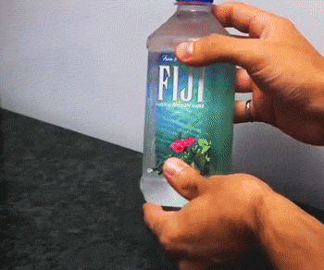
“Super-Cooled” Water Formation
Ice formation requires both water drops below freezing (0°C to -40°C) and a nucleation point.
This can be an impurity in the water (eg, dust or minerals) or ice crystals.
When the molecules align properly (this could be due to a jolt), ice will begin to form.
Source: www.gifbay.com via giphy.com
NOAA/NWS Seattle Center Weather Service Unit (ZSE)
Notes:
Super cooled water forms by starting with liquid water with the initial water temperature above or below freezing. The water is cooled rapidly, for example, by lifting of the air. Since the water was lifted rapidly, it remains liquid although the surrounding air temperature is below freezing.

Slide 6
Temperature
Most icing
occurs
between
0° and -20°C
http://www.casa.gov.au/fsa/2006/apr/26-33.pdf
NOAA/NWS Seattle Center Weather Service Unit (ZSE)
Notes:
The image shows icing typically occurs between 0 and -20C ( F) where there is an abundant supply of liquid water droplets. Below 0C (32F), the all droplets are warm and liquid, so no icing occurs. Above -20C ( F), icing is still possible with some liquid water droplets found, but the risk of icing decreases. Above -40C (-40F), all droplets are in the form of ice crystals due to the low temperatures, so icing is not a threat here.

Slide 7
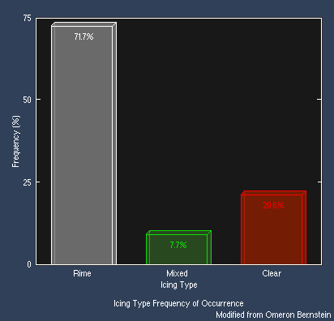
Types of Icing
Frequency of Occurrence
Clear
Mixed
Rime
Temperature Range
Clear | 0° to -10°C (32° to 14°F)
Mixed | -10° to -15°C (14° to 5°F)
Rime | -15° to -40°C (5° to -40°F)
NOAA/NWS Seattle Center Weather Service Unit (ZSE)
Notes:
There are 3 types of icing: clear, mixed, and rime. Clear – 0 to -10C (32 to 14F); mixed -10 to -15C (14 to 5F); and rime -15 to -40C (5 to -40F). Rime icing by far occurs more of the time (71.7%) with clear icing (20.6%) followed by mixed (7.7%).
Clear 0 to -10C 32 to 14F
Mixed -10 to -15C 14 to 5F
Rime -15 to -40C 5 to -40F

Slide 8
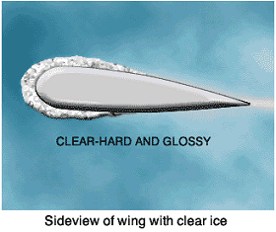
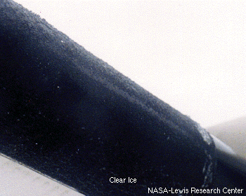
Clear Icing
Transparent, “Glossy”
Not easily seen at first
Can spread out on airfoil beyond “reach” of de-icing equipment
Hard, heavy, and tenacious
NOAA/NWS Seattle Center Weather Service Unit (ZSE)
Notes:
This clear coating of ice is transparent and has a glossy appearance, which can make it hard to detect. Clear icing is hard, heavy and tenacious. Since the water droplet spreads out, icing can reach surface areas of the aircraft that are difficult for deicing equipment to handle.

Slide 9
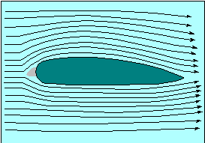
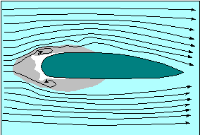
Clear Icing
Gray is region
where air is
stagnant.
Tends to form ‘Horns’ at leading edge of airfoil.
More difficult to remove with de-icing equipment.
Disrupts and makes airflow more turbulent
No Icing
NOAA/NWS Seattle Center Weather Service Unit (ZSE)
Notes:
Looking at the schematic of the airfoil, the center of the airfoil is a small area of stagnant air. As water droplets collide with the leading edge of the airfoil, “horns” form. The water droplets spread out beyond just the leading edge, but can also coat the airfoil surfaces. The build up of clear ice at the leading edge of the airfoil disrupts air flow and produces more turbulent flow. It is more difficult to remove with deicing equipment. The more water droplets forming ice on the airfoil, the less it conforms to the airfoil creating “horns” of ice.

Slide 10
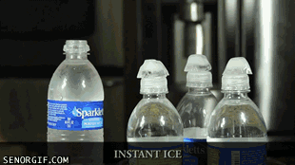
Icing Accretion Example
Source: www.gifbay.com via giphy.com
The super-cooled water is forming ice as it hits the already frozen ice cube, similar to Clear Icing.
NOAA/NWS Seattle Center Weather Service Unit (ZSE)
Notes:
An example of icing accretian is shown here. The super-cooled water forms ice as it hits the already frozen ice cube, similar to clear icing.

Slide 11
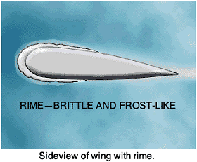
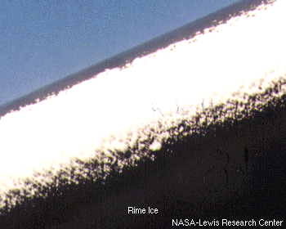
Rime Icing
Is opaque
Easily seen
Lighter than clear ice
However…shape and rough surface decrease aircraft aerodynamics
Easier to remove than clear ice
NOAA/NWS Seattle Center Weather Service Unit (ZSE)
Notes:
Rime ice is opaque and more easily detected. It is lighter than clear ice, though it produces a rougher surface than clear ice, decreasing the aircraft aerodynamics. Rime ice is easier to remove than clear ice.

Slide 12
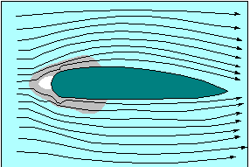
Rime Icing
Gray is region
where air is
stagnant.
Tends to form at leading edge of airfoil
Easier for deicing equipment to remove
Rime
Clear
Compare with ‘horns’
of clear icing.
NOAA/NWS Seattle Center Weather Service Unit (ZSE)
Notes:
The two images compare clear and rime icing. Rime ice forms along the leading edge of the airfoil, whereas clear ice spreads out and backward along the airfoil from the leading edge. Thus, rime ice is easier for deicing equipment to handle.

Slide 13
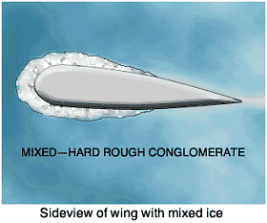
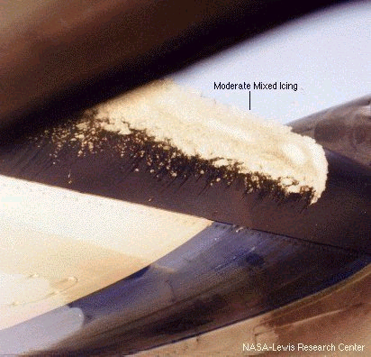
Mixed Icing
Mixture of Clear and Rime ice
Easily seen at first
Forms when water drops vary in size or when liquid drops are intermingled with snow and ice
Same hazards as Clear icing…
  Can spread out on airfoil beyond “reach” of de-icing equipment
NOAA/NWS Seattle Center Weather Service Unit (ZSE)
Notes:
Mixed icing is a mixture of clear and rime ice. This type of ice forms either when water droplets vary in size or when liquid water droplets are mixed with wet snow and ice. It is easily detected like rime ice, but is difficult for deicing equipment, since the ice can spread out from the leading edge of the airfoil like clear icing and out of reach of the deicing equipment.

Slide 14
Mixed Icing
Also tends to form ‘Horns’ at leading edge of airfoil.
More difficult to remove with de-icing equipment.
NOAA/NWS Seattle Center Weather Service Unit (ZSE)
Notes:
Mixed icing also tends to forms “horns” like clear icing.

Slide 15
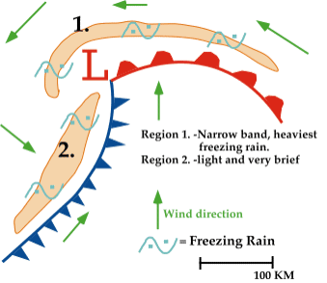
Freezing Rain
Warm, moist air over-running cold air
Precipitation begins as snow, changes to rain
  Then falls through Cold air
  Becomes “Super-Cooled Water”
  Freezes on impact
Heavy icing in a short period of time
Best maneuver may be to gain altitude
  Check with a weather briefer first!
NOAA/NWS Seattle Center Weather Service Unit (ZSE)
Notes:
Super cooled raindrops freeze on contact with any surface, not just the leading edge of the airfoil.

Slide 16
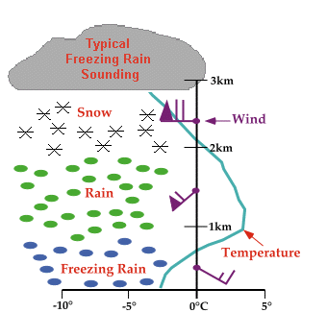
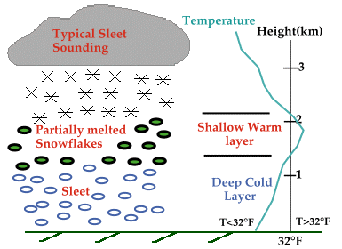
Typical Freezing Rain/Sleet Soundings
NOAA/NWS Seattle Center Weather Service Unit (ZSE)
Notes:
A layer of warm air above a layer of cold air near the surface is required for freezing rain or sleet.

Slide 17
American Eagle #4184
31 October 1994
An ATR-72 was scheduled to 4:10pm departure from IND to ORD
Entered holding pattern at 10,000ft
Flight Data Recorder recorded activation of Level III de-icing during decent to 10,000ft
NOAA/NWS Seattle Center Weather Service Unit (ZSE)
Notes:
American Eagle #4184, 31 October 1994

Slide 18
American Eagle #4184
Ridge of ice accreted beyond the deicing boots during freezing rain/drizzle in holding pattern
The airplane went into a roll, followed by a rapid decent due to the cumulative effects of clear ice.
68 people died near Roselawn IN.
NOAA/NWS Seattle Center Weather Service Unit (ZSE)
Notes:
American Eagle #4184, 31 October 1994

Slide 19
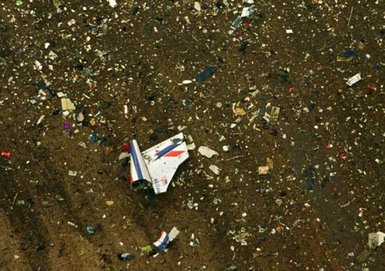
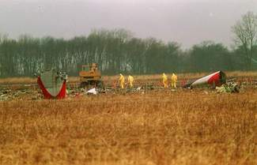
American Eagle #4184
Crash investigators search the site of the crash of American Eagle flight 4184 in a field near Roselawn, Ind. in the days after the Oct. 31, 1994 crash.
Associated Press file via Daily Herald
A field near Roselawn, Ind., was strewn with debris including a portion of the red, white and blue tail section of American Eagle Flight 4184, after it crashed on Oct. 31, 1994, killing all 68 people aboard. Wreckage of the 7-month-old twin-engine propjet was scattered across a muddy 40-acre soybean field in Northwest Indiana 30 miles south of Gary. (Photo: Charles Bennett / Associated Press) via Indianapolis Star
NOAA/NWS Seattle Center Weather Service Unit (ZSE)
Notes:
American Eagle #4184, 31 October 1994

Slide 20

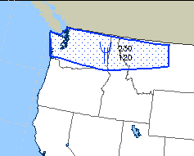
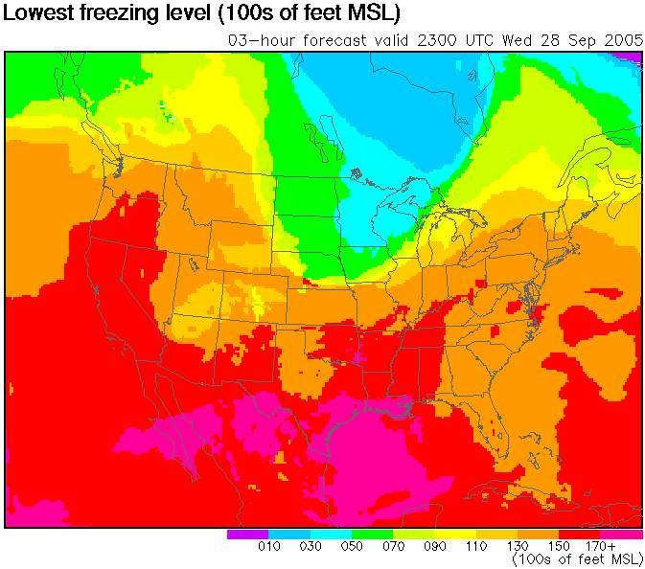
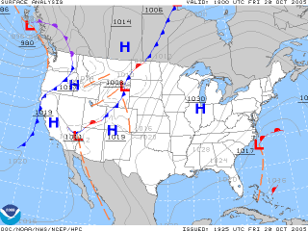
Situational Awareness
Keep current with the weather in your area
Know where the fronts are located
Keep current with freezing levels in your area
http://adds.aviationweather.gov/airmets/
NOAA/NWS Seattle Center Weather Service Unit (ZSE)
Notes:
When planning a flight, keeping current with the weather is extremely important. Developing good situational awareness beforehand can help in the planning process. Situational awareness is ability to identify, process, and comprehend the critical elements of information about what is happening, and using that knowledge to understand the future. Available tools can help build your awareness of the potential for icing. View current airmets. Examine surface maps to determine the location of frontal boundaries. Know the freezing level in your area. http://adds.aviationweather.gov/airmets/

Slide 21
Situational Awareness
Know the cloud bases.
Know the cloud tops…light, non-turbo aircraft may not be able to climb above 8,000 ft. Once on top…can they stay there?
Are clouds air mass or frontal? Frontal clouds cover larger areas…aircraft flying through frontal clouds may experience icing conditions for a longer period of time.
Are alternate routes available, ie, around fronts or around mountains?
NOAA/NWS Seattle Center Weather Service Unit (ZSE)

Slide 22
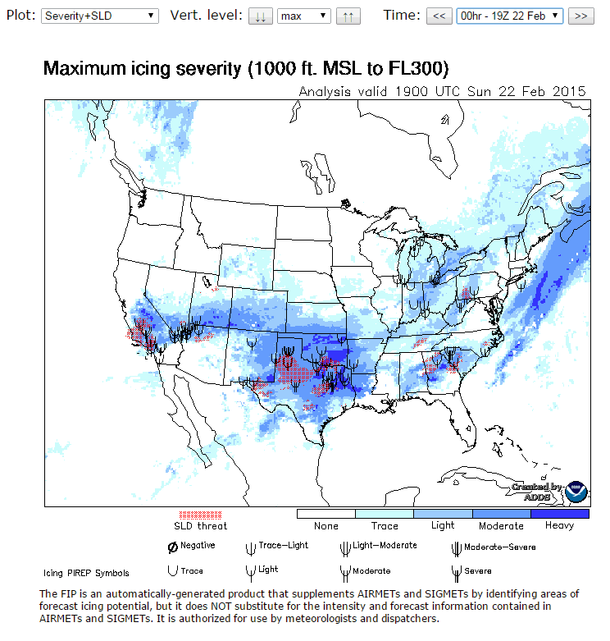
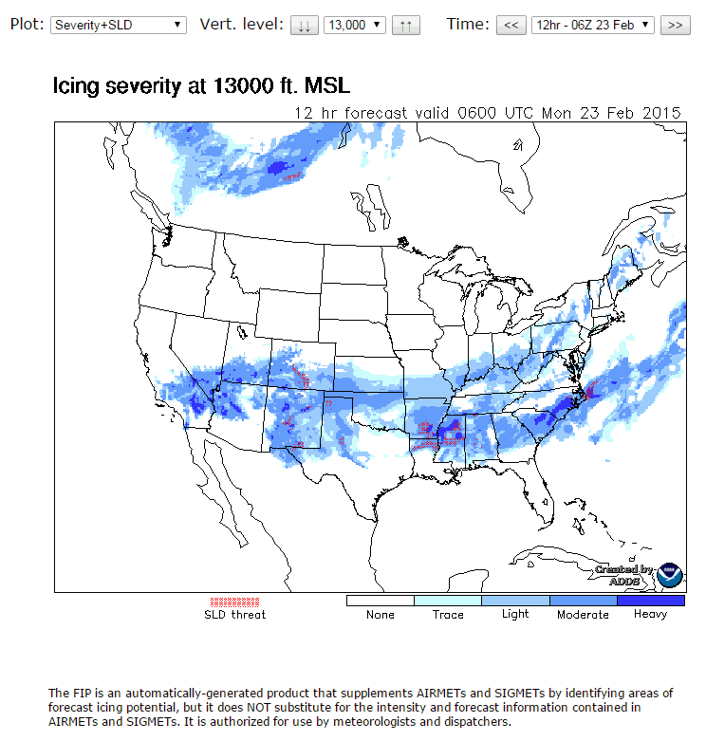
Situational Awareness
Know current and forecast icing potential
http://www.aviationweather.gov/icing/fip
Current ...FL030 to FL300 including SLD.
Forecast … 0 to 18 hours 010 to FL290
(SLD…Super-cooled Large Drops)
Delineates general areas of icing potential
NOAA/NWS Seattle Center Weather Service Unit (ZSE)

Slide 23
You Should Know
In most freezing rain episodes, a climb to warmer air aloft is in order.
Heavy accumulation of ice can occur in cumulus clouds. Get out of these clouds and into VFR conditions immediately.
In stratiform clouds, a change in altitude is in order to a flight level with above freezing temperatures, one where the temperature is colder than -10°C, or a level above and out of the clouds.
It is considered best to begin avoidance when icing is first detected.
NOAA/NWS Seattle Center Weather Service Unit (ZSE)

Slide 24
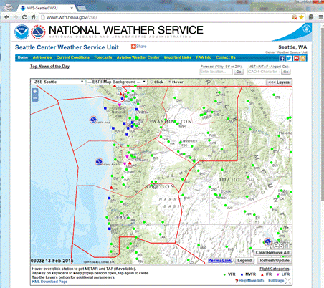
Seattle CWSU
http://www.wrh.noaa.gov/zse/
NOAA/NWS Seattle Center Weather Service Unit (ZSE)

Slide 25
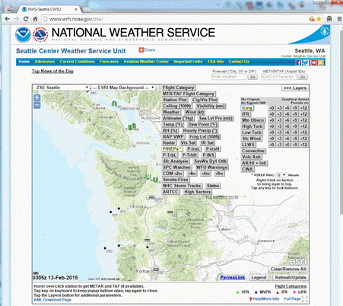
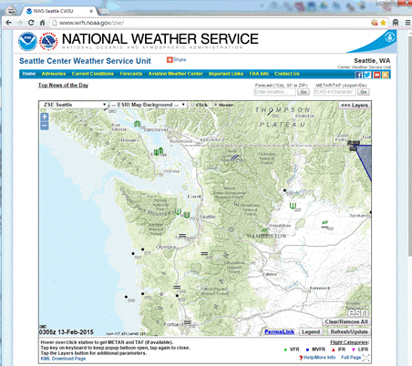
Seattle CWSU
http://www.wrh.noaa.gov/zse/
NOAA/NWS Seattle Center Weather Service Unit (ZSE)

Slide 26
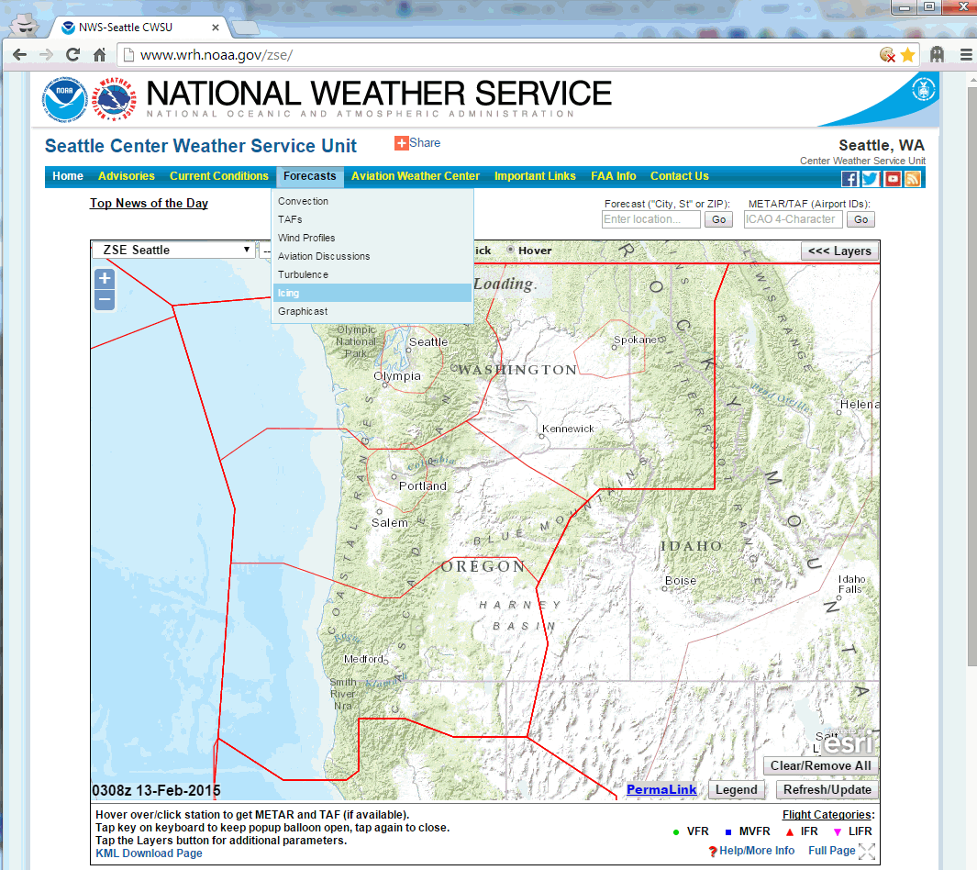
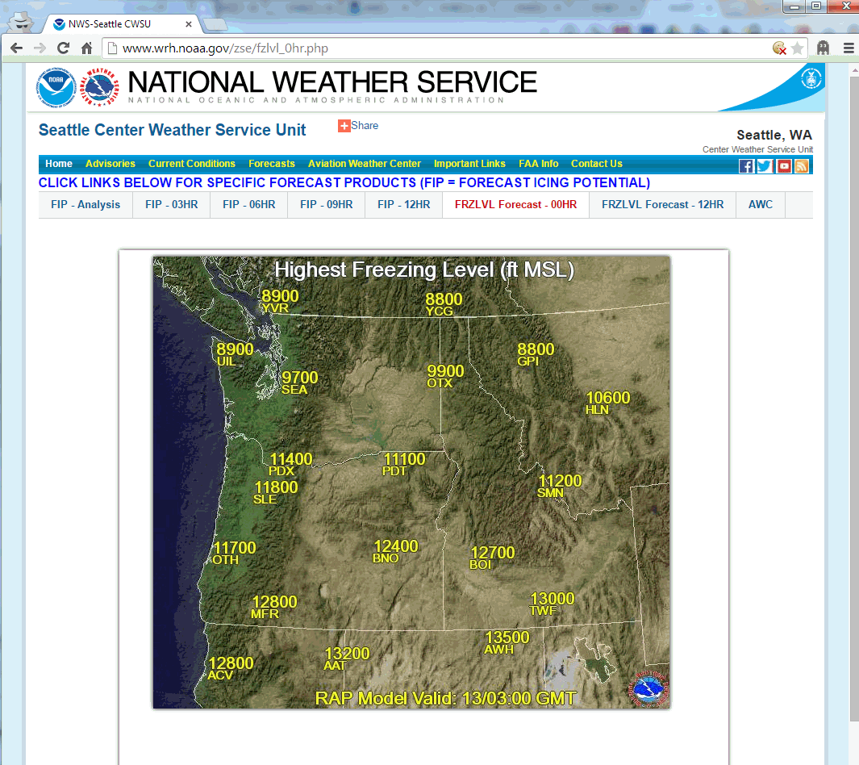
Seattle CWSU
http://www.wrh.noaa.gov/zse/icing_fcst.php
*
NOAA/NWS Seattle Center Weather Service Unit (ZSE)

Slide 27
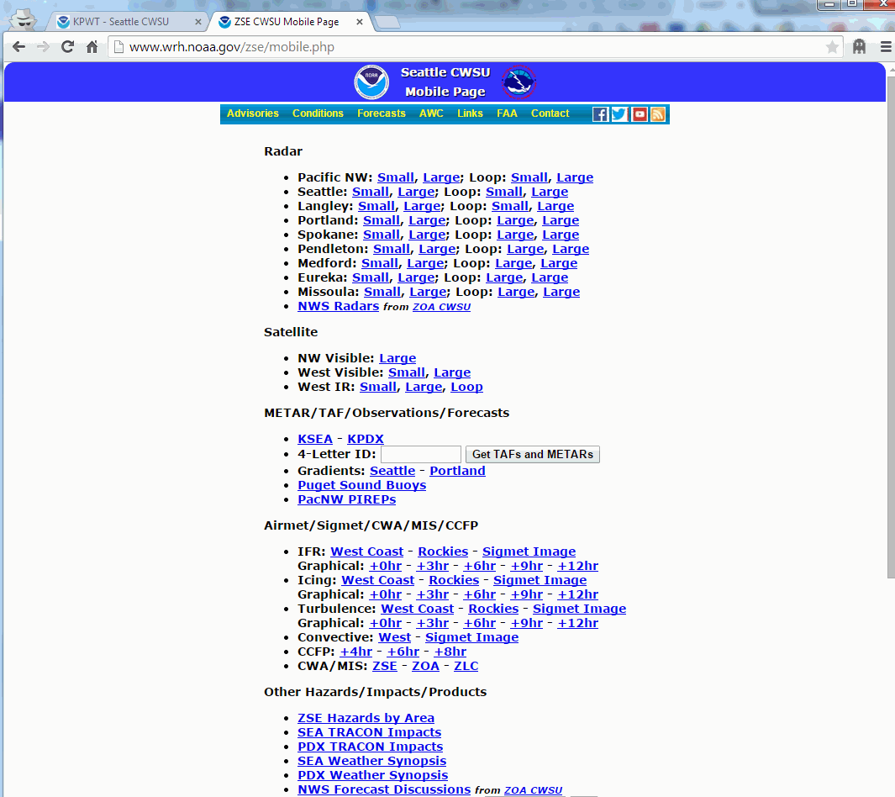
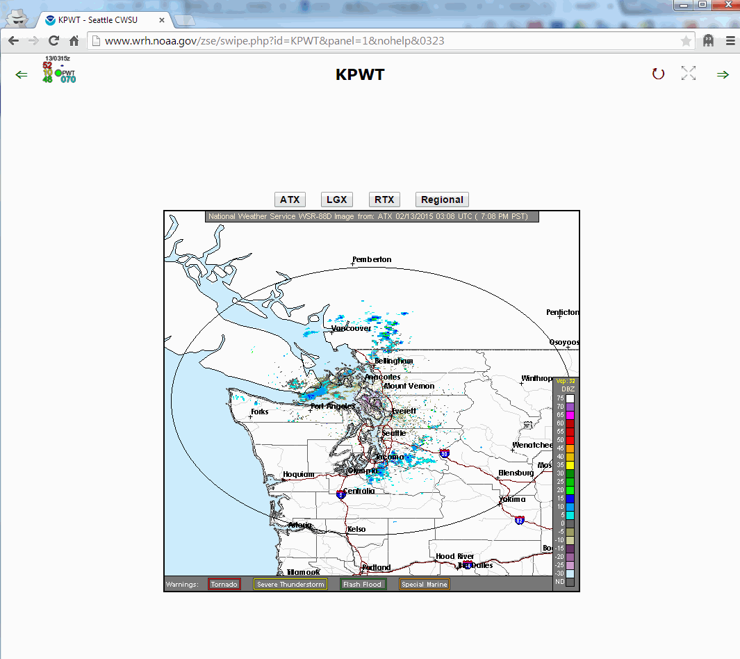
Seattle CWSU
http://www.wrh.noaa.gov/zse/mobile.php
http://www.wrh.noaa.gov/zse/swipe.php
*
NOAA/NWS Seattle Center Weather Service Unit (ZSE)

Slide 28
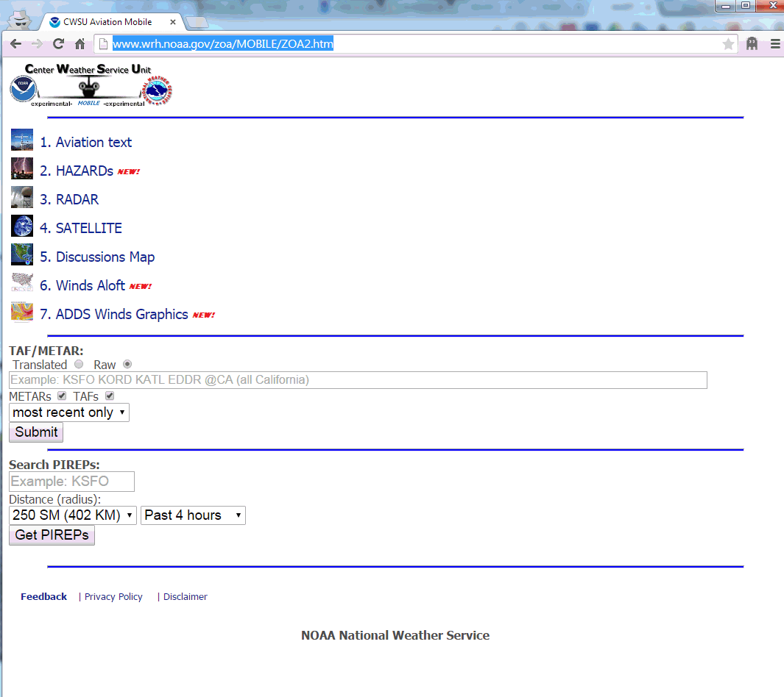
Oakland CWSU
http://www.wrh.noaa.gov/zoa/MOBILE/ZOA2.htm
*
NOAA/NWS Seattle Center Weather Service Unit (ZSE)

Slide 29
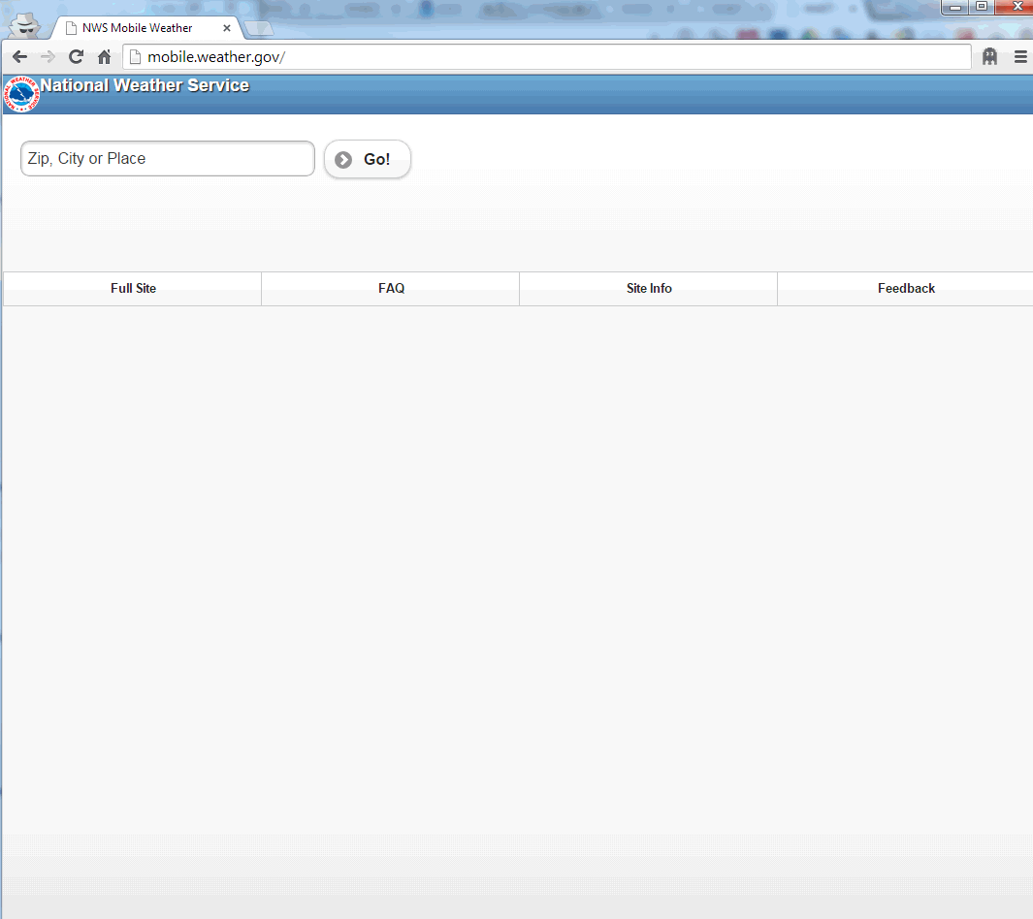
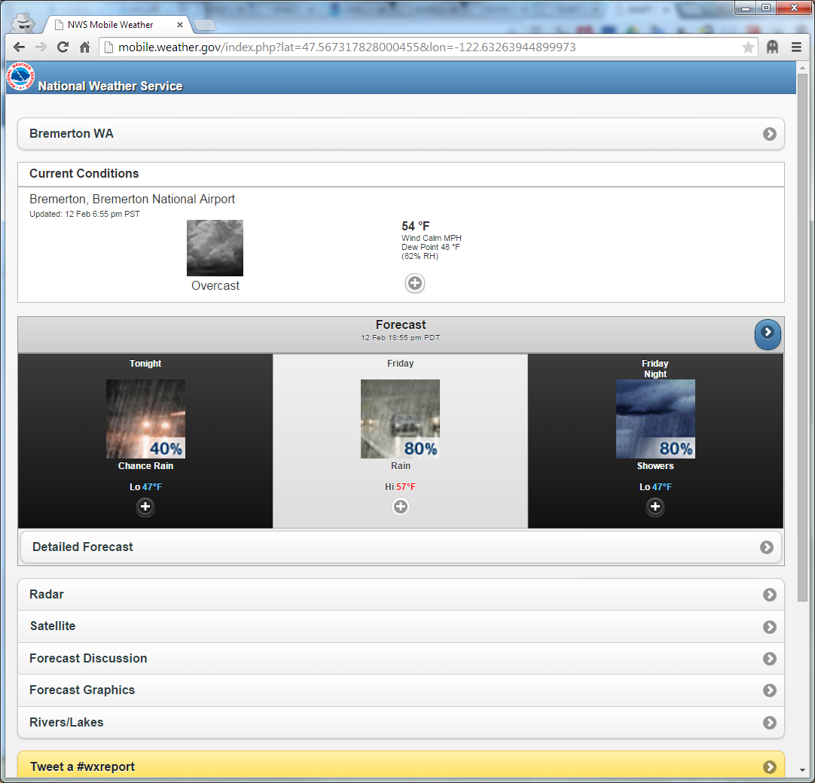
NWS Mobile Weather
http://mobile.weather.gov/
*
NOAA/NWS Seattle Center Weather Service Unit (ZSE)

Slide 30
NWS RAP/RUC Analyses/Forecasts
http://ruc.noaa.gov/soundings/
Red: Temperature (°C)
Blue: Dew Point Temp (°C)
Change forecast time
Altitude (ft)
Wind Speed (kt)
Fog/Clouds Likely
HQM had 2-3sm Visibility and
014-016 Ceiling Developing
In general, look for Temperature-Dew Point to be less than 6°C for clouds.
NOAA/NWS Seattle Center Weather Service Unit (ZSE)

Slide 31
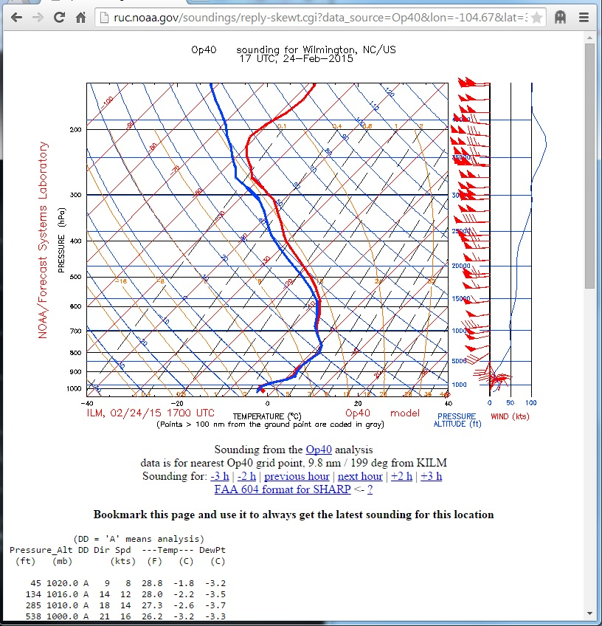
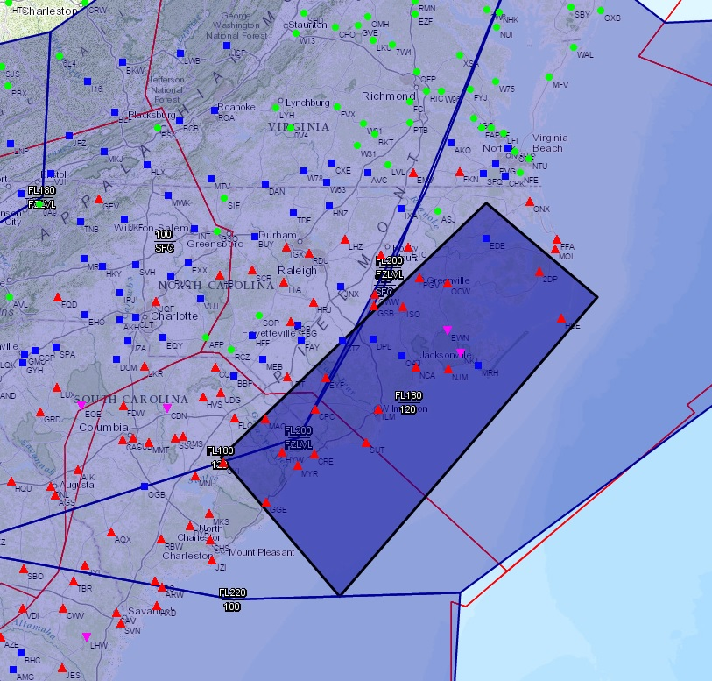
NWS RAP/RUC Analyses/Forecasts
http://ruc.noaa.gov/soundings/
Red: Temperature (°C)
Blue: Dew Point Temp (°C)
0°C
Altitude (ft)
Wind Speed (kt)
Icing SIGMET 120-FL180
Saturated below 15,000ft
KILM 241653Z 01008KT 5SM -FZRA BR OVC009 M02/M04 A3014 AO2 UPB46E49FZRAE46B49 SLP204 P0005 I1006 T10221039
WSUS02 KKCI 241629 WS2Y MIAY WS 241629 SIGMET YANKEE 1 VALID UNTIL 242029 NC SC AND CSTL WTRS FROM 20WNW ECG TO 70SE ECG TO 90ESE CHS TO 30SSW FLO TO 20WNW ECG OCNL SEV RIME/MXD ICGICIP BTN 120 AND FL180. CONDS CONTG BYD 2029Z.
*
NOAA/NWS Seattle Center Weather Service Unit (ZSE)

Slide 32
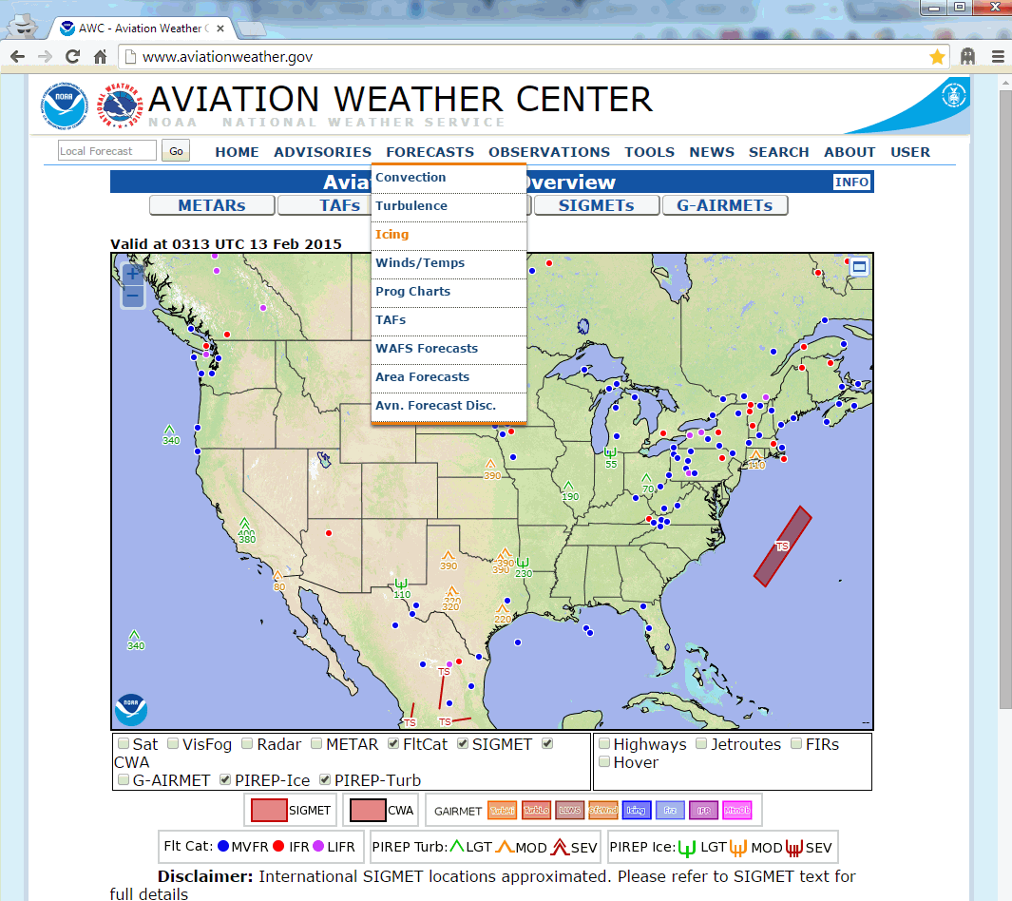
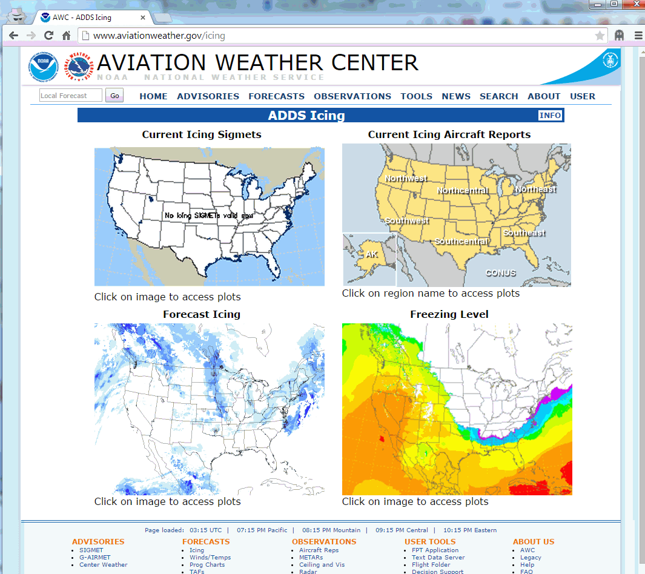
Aviation Weather Center
http://www.aviationweather.gov/icing
NOAA/NWS Seattle Center Weather Service Unit (ZSE)

Slide 33
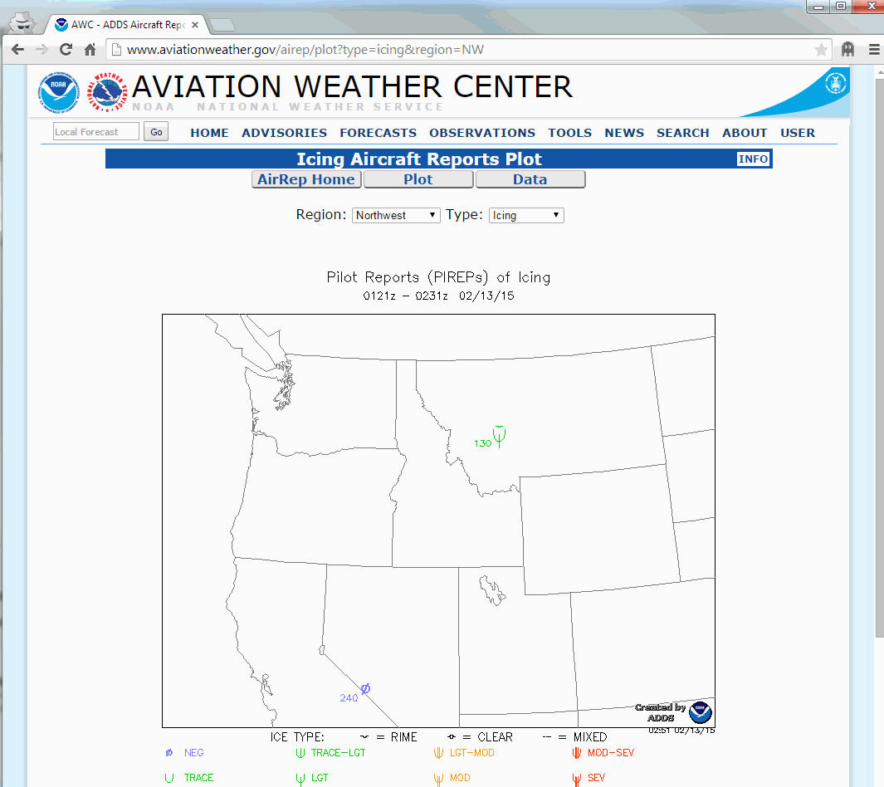
Aviation Weather Center
http://www.aviationweather.gov/
*
NOAA/NWS Seattle Center Weather Service Unit (ZSE)

Slide 34
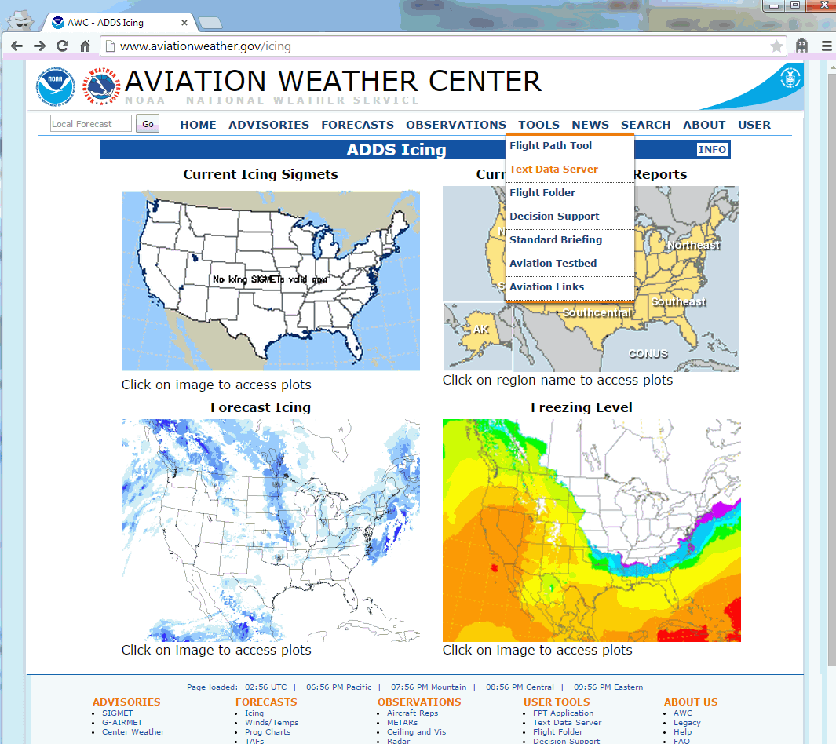
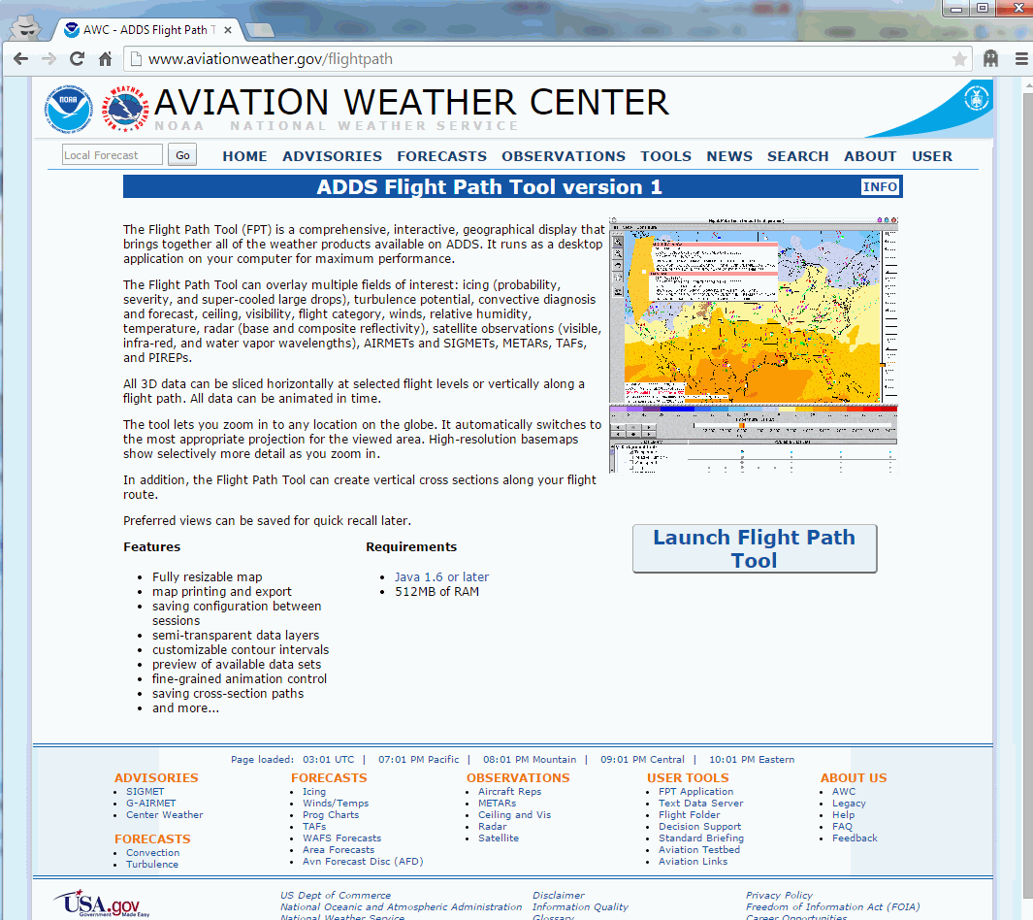
Aviation Weather Center
http://www.aviationweather.gov/flightpath
NOAA/NWS Seattle Center Weather Service Unit (ZSE)

Slide 35
Aviation Weather Center
http://www.aviationweather.gov/flightpath
Requires Java
  Therefore smartphones and most tablets will not work
Resizable map
Customizable contour intervals
NOAA/NWS Seattle Center Weather Service Unit (ZSE)

Slide 36
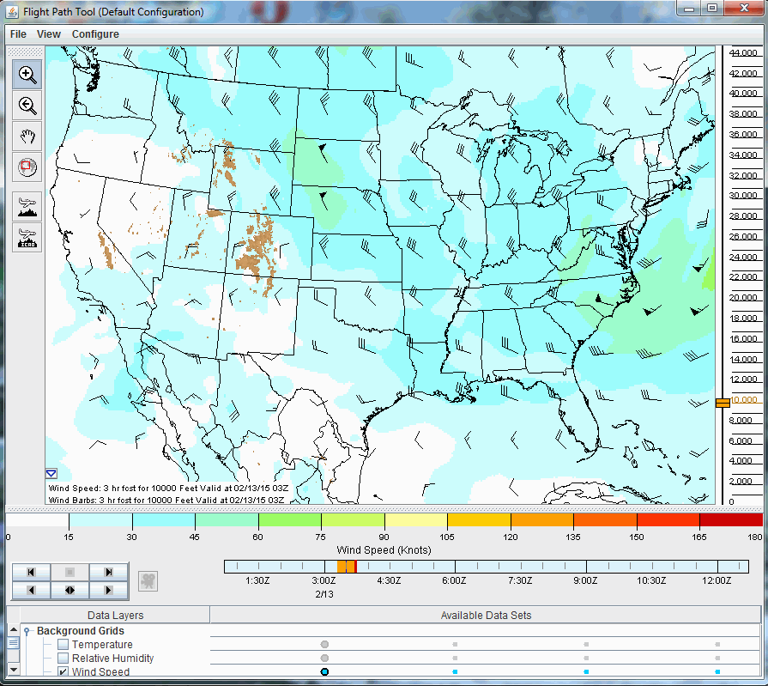
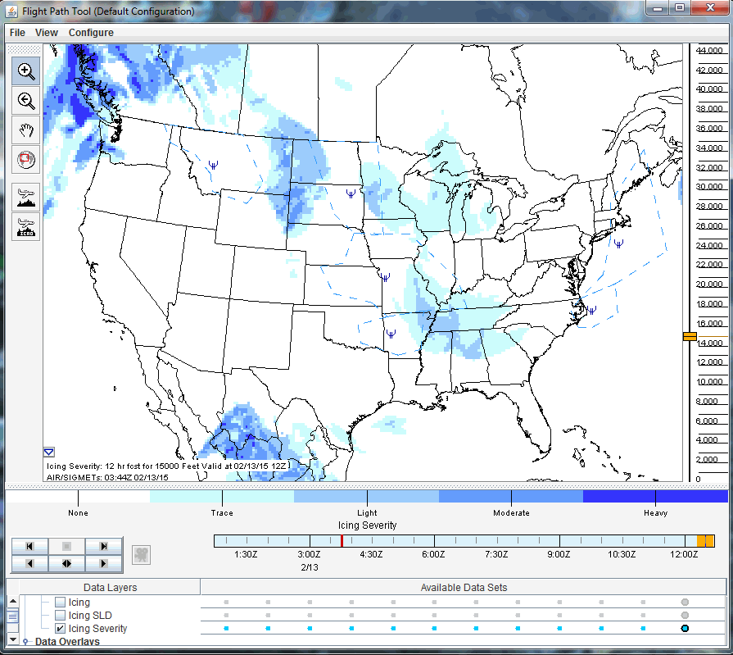
Aviation Weather Center
http://www.aviationweather.gov/flightpath
NOAA/NWS Seattle Center Weather Service Unit (ZSE)

Slide 37
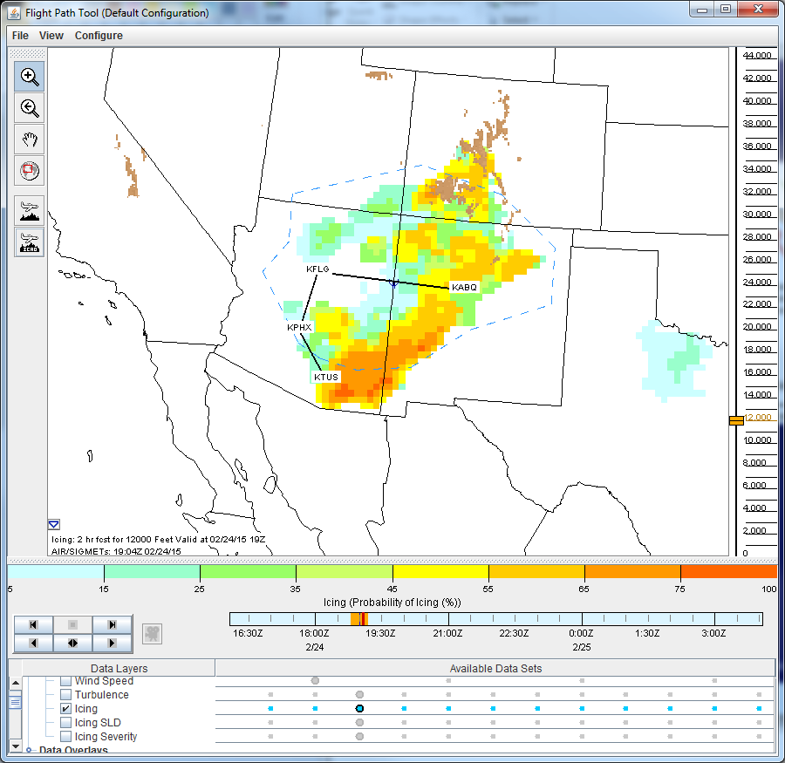
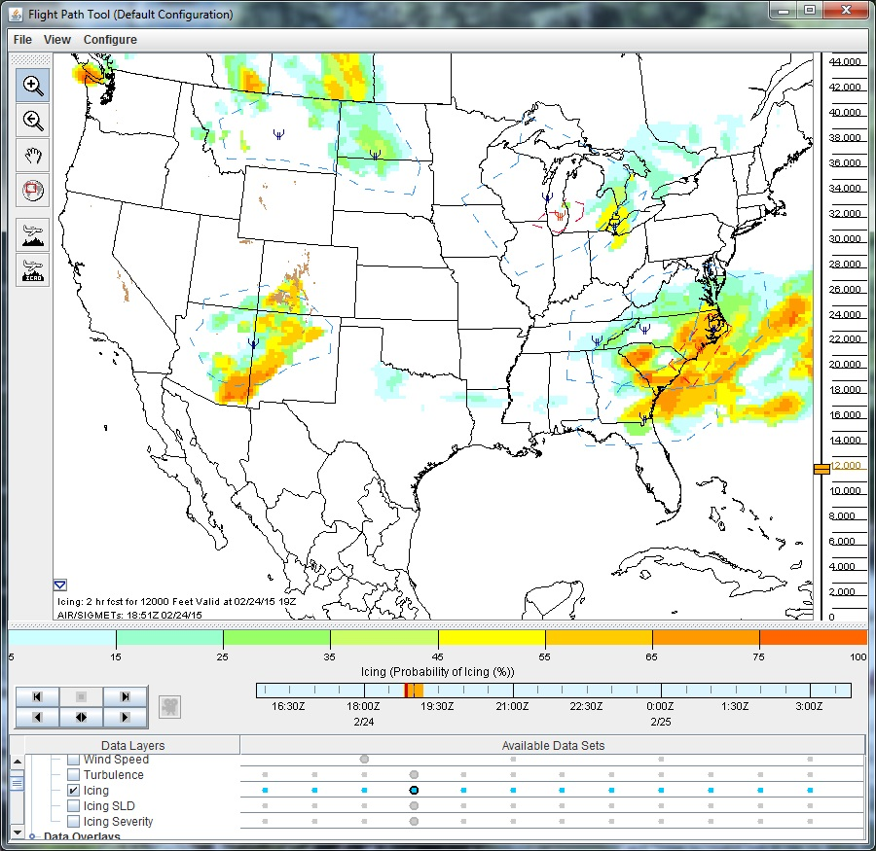
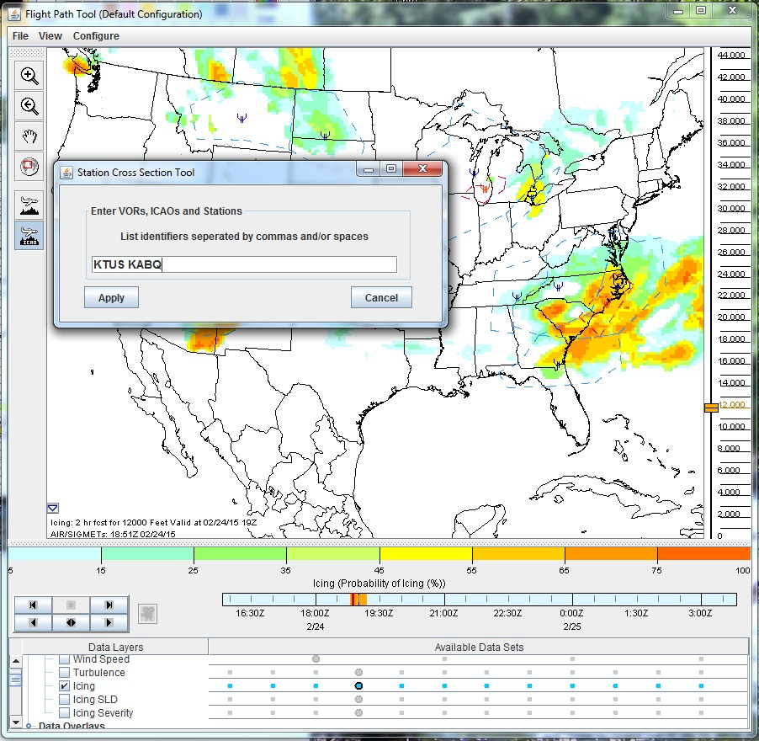
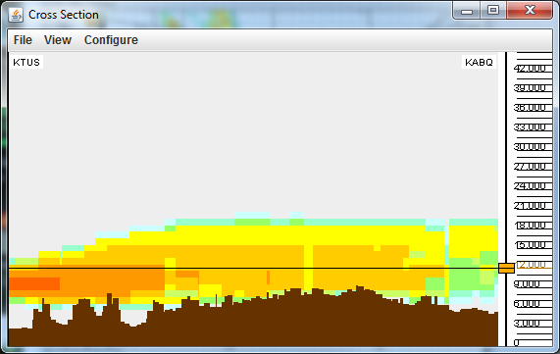
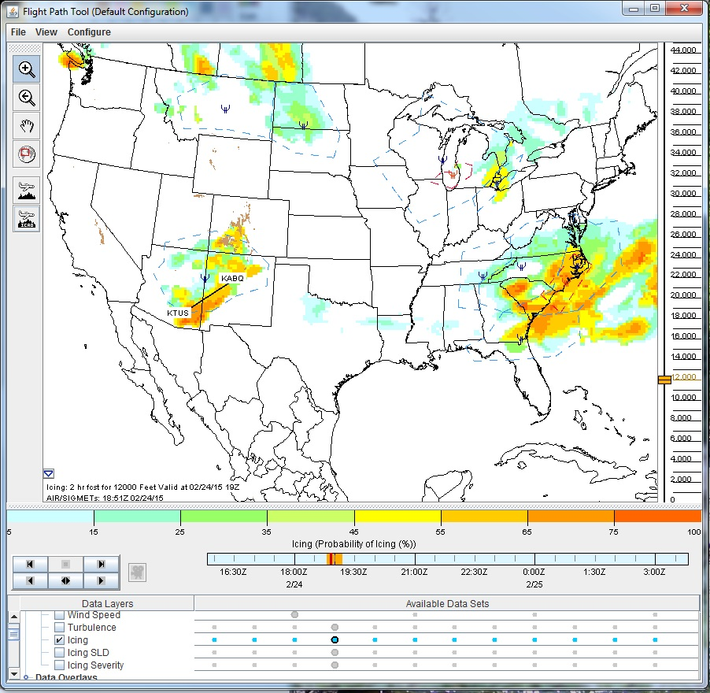
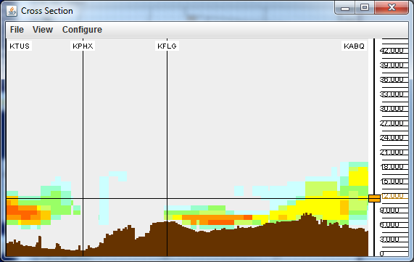
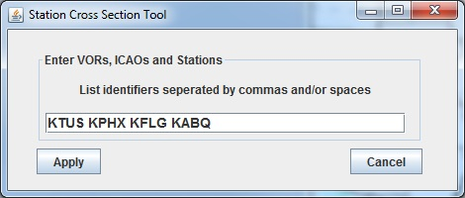
Aviation Weather Center
http://www.aviationweather.gov/flightpath
Example over AZ-NM from Tuesday, 24 February 2015.
The flight tool can help you avoid expected icing areas along your route.
*
NOAA/NWS Seattle Center Weather Service Unit (ZSE)

Slide 38
Links in the Presentation
http://www.aviationweather.gov/icing/fip Current/forecast icing from AWC (Aviation Weather Center)
http://www.wrh.noaa.gov/zse/ Seattle CWSU home page, includes customizable map where you can add pireps, AIRMETs, CWAs, highest freezing level, radar, satellite, etc
http://www.wrh.noaa.gov/zse/icing_fcst.php Icing page from the Seattle CWSU, includes current/forecast icing graphics, highest freezing level current/forecast, link to AWC icing page
http://www.wrh.noaa.gov/zse/mobile.php Seattle CWSU mobile page includes Pacific NW links for radar, satellite, TAF/METARs, PIREPs, AIRMETs/SIGMETs, CWA/MIS, area hazards, other images, links to other NWS mobile pages
http://www.wrh.noaa.gov/zse/swipe.php Seattle CWSU "swipe" page, optimized for mobile devices, shows local radar, satellite, TAF/METARs, Vertical Wind Profile, local forecast, AIRMETs/SIGMETs, sunrise/sunset, local station plot map, local model text data
http://www.wrh.noaa.gov/zoa/MOBILE/ZOA2.htm Oakland CWSU mobile page has links including aviation text, hazards, radar, satellite, discussions, winds aloft, ADDS wind graphics, TAF/METAR, PIREPs, etc
http://mobile.weather.gov/ The NWS mobile page for basic local forecasts, radar, discussions, forecast graphics, etc
http://ruc.noaa.gov/soundings/ RAP (formerly RUC) vertical analyses and forecasts. These are Skew-T log-P soundings meteorologists use which display vertical moisture, temperature, winds, etc over a desired location.
http://www.aviationweather.gov/icing AWC icing page, including Icing SIGMETs, forecast icing, freezing levels, icing PIREPs, etc
http://www.aviationweather.gov/flightpath AWC Flight Path tool (requires Java) which can help a pilot determine the best path to avoid icing. It is customizable (both zooming into areas and showing what is along a specific path and altitude).
NOAA/NWS Seattle Center Weather Service Unit (ZSE)

Slide 39
Thank you for
your participation!
Further questions can be directed to the Center Weather Service Unit in
Auburn, Washington
James.Vasilj@noaa.gov
NOAA/NWS Seattle Center Weather Service Unit (ZSE)
Notes:
Thank you for participating in this Aircraft Icing refresher. Further questions can be directed to the Center Weather Service Unit in Auburn, Washington: James.Vasilj@noaa.gov .

