Slide 1
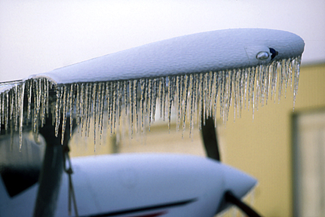


Aircraft Icing
Jim Vasilj, Meteorologist
Center Weather Service Unit
Auburn, Washington
NOAA/NWS Seattle Center Weather Service Unit (ZSE)
Notes:
This presentation, “Aircraft Icing”, was developed by Jim Vasilj, the acting Meteorologist in Charge at the National Weather Service, Center Weather Service Unit in Auburn, Washington. This presentation is intended for pilots, general aviation, and those with an interest in aviation and aircraft icing.

Slide 2
Objectives
Describe the effects of icing on aircraft performance
Explain what causes icing
Understand how ice forms and when and where it occurs
Define the 3 types of icing and their characteristics
Identify the potential type of icing based on cloud types
Explain how freezing precipitation produces aircraft icing
List strategies to maintain situational awareness for icing events
NOAA/NWS Seattle Center Weather Service Unit (ZSE)
Notes:
By the end of this presentation, you will be able to:
Describe the effects of icing on aircraft performance,
Explain what causes icing,
Understand how ice forms and when and where it occurs
Define the 3 different types of icing and the characteristics of each,
Identify the potential type of icing based on cloud types,
Explain how freezing rain produces aircraft icing, and
List strategies to maintain situational awareness for icing events

Slide 3
Effects of Aircraft Icing Are “Cumulative”
Decreases Lift
Decreases Thrust
Increases Weight
Increases Drag
Affects control surfaces
Affects engine performance
Increases stall speeds
Decreases Lift
Decreases
Thrust
Increases
Drag
Increases Weight
NOAA/NWS Seattle Center Weather Service Unit (ZSE)
Notes:
Icing affects aircraft performance in a number of ways. It decreases lift, decreases thrust, increases weight, increases drag, affects control surfaces and engine performance, and increase stall speeds
Very little ice accumulation can have major effects on an aircraft. Ice accumulation the thickness of coarse sandpaper can reduce the lift as much as 30%, and increase drag up to 40%. Larger accumulations can decrease lift and drag as much as 80% or more.

Slide 4
Combined Effects
Pilot Action Recommendation: Watch your outside air temperature and try to stay out of visible moisture (precipitation or clouds) anytime the temperature is below 0°C. In some instances the moisture can almost be invisible. Remember…on a standard day you lose about 2°C per thousand feet.
NOAA/NWS Seattle Center Weather Service Unit (ZSE)

Slide 5
The Cause of Icing
NOT caused by ice in clouds.
Is caused by “super-cooled” liquid water droplets in clouds…
  That strike the leading edge of an airfoil and
  Freeze on impact
Aircraft must be in clouds or precipitation (visible water droplets) for icing to occur
NOAA/NWS Seattle Center Weather Service Unit (ZSE)
Notes:
Icing is not caused by ice in clouds. Rather, icing is caused by “super cooled liquid” water droplets in a cloud coming into contact with an aircraft. So an aircraft must be in a cloud or visible precipitation must be occurring for icing to occur on the aircraft. It is these super cooled liquid water droplets that impinge upon the leading edge of the airfoil and freeze on contact to produce icing.

Slide 6
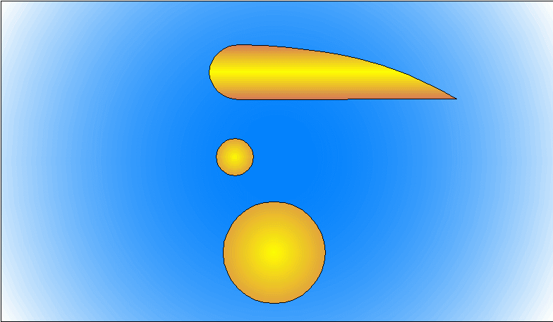
Where Ice Forms
On the leading edge of the airfoil
  Where the ‘Radius of Curvature’ is shortest
Shortest Radius
NOAA/NWS Seattle Center Weather Service Unit (ZSE)
Notes:
Ice forms on the leading edge of the airfoil. This is where the radius of curvature is smallest. Ice collects fastest along the leading edge, since it is first to encounter the super cooled water droplets.

Slide 7
Icing Severity Factors
Liquid water content (LWC)
Temperature
Droplet size
Cloud type
Airfoil geometry
Airspeed
Duration of exposure
NOAA/NWS Seattle Center Weather Service Unit (ZSE)
Notes:
The severity of icing depends on several factors, which include: liquid water content (LWC), temperature, droplet size, cloud type, airfoil geometry, airspeed, and duration of exposure. Of these, the most important are LWC and temperature.

Slide 8
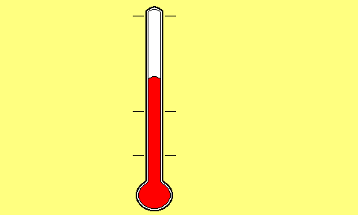
Liquid Water Can Exist at
Temperatures Below Freezing
100 C
212 F
Icing can occur
in this temperature
range
Icing can occur
in this temperature
range
0 C
32 F
- 40 C
- 40 F
Called “Super-Cooled Water”
NOAA/NWS Seattle Center Weather Service Unit (ZSE)
Notes:
One of the most important factors for icing to occur is the LWC of a cloud. Water can exist in liquid state below freezing. This is called “super cooled” water. Icing typically occurs from 32F to -40F, which is 0C to -40C.

Slide 9
“Super-Cooled” Water Formation
Begins with water in liquid form
Initial water temp can be above freezing
Water is cooled rapidly, usually by “lifting”
Water remains in liquid state at temps well below freezing
NOAA/NWS Seattle Center Weather Service Unit (ZSE)
Notes:
Super cooled water forms by starting with liquid water with the initial water temperature above or below freezing. The water is cooled rapidly, for example, by lifting of the air. Since the water was lifted rapidly, it remains liquid although the surrounding air temperature is below freezing.

Slide 10
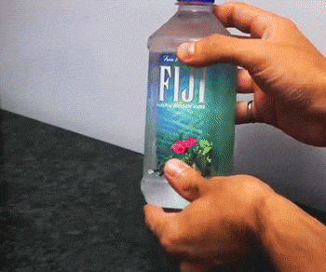
“Super-Cooled” Water Formation
Ice formation requires both water drops below freezing and a nucleation point.
This can be an impurity in the water (eg, dust or minerals) or ice crystals.
When the molecules align properly (this could be due to a jolt), ice will begin to form.
Source: www.gifbay.com via giphy.com
NOAA/NWS Seattle Center Weather Service Unit (ZSE)
Notes:
Super cooled water forms by starting with liquid water with the initial water temperature above or below freezing. The water is cooled rapidly, for example, by lifting of the air. Since the water was lifted rapidly, it remains liquid although the surrounding air temperature is below freezing.

Slide 11
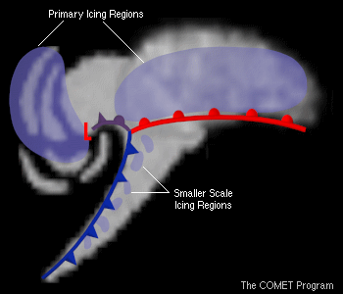
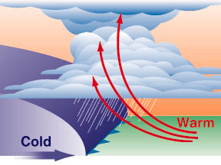
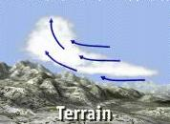
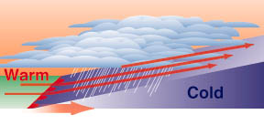
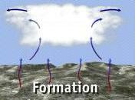
“Lift” Mechanisms
Icing
Icing
Weather fronts
Cyclones
Icing
Orographic lift
Convection
NOAA/NWS Seattle Center Weather Service Unit (ZSE)
Notes:
Air can be lifted in a number of ways, by weather fronts, convection, or orographic lift.

Slide 12
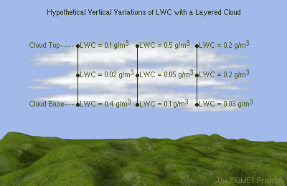
Liquid Water Content (LWC)
Amount of available cloud water
Varies from cloud to cloud
Varies within same cloud…both in the horizontal and vertical
NOAA/NWS Seattle Center Weather Service Unit (ZSE)
Notes:
The amount of liquid water in a cloud varies from cloud to cloud and can even vary within the same cloud, both horizontally and vertically. The greater the altitude, the less moisture and the colder the air, so there is less of a chance of liquid water being present. The LWC is lower. A cloud and its water droplets can be over different surfaces, for example, water or land, forest or urban, different soil types, etc. Land cover affects the amount of moisture in the air above the surface, hence influencing the LWC.

Slide 13
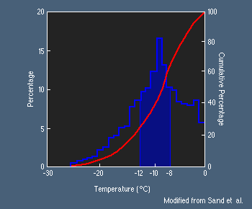
Temperature
Most icing occurs between 0°C and -22°C (FL190), however…
At -16°C (FL160), 95% of cloud droplets have changed to ice crystals, and
At -25°C (FL200), 99.9% of cloud droplets have changed to ice crystals
Occurrence of icing is scarce at elevations above FL200 or higher
Note…more than 50% of icing occurs at temps between -8°C (FL110) and -12°C (FL140)
NOAA/NWS Seattle Center Weather Service Unit (ZSE)
Notes:
Besides LWC, temperature has a substantial impact on icing. Most icing occurs between 0C and -22C (32 to -8F), which is about a flight level of 19,000 feet. The occurrence of ice above a flight level of 20,000 feet or higher is scarce, since any available moisture tends to be ice crystals. Research has shown, at -16C(3F), a flight level of 16,000 feet, 95% of liquid water droplets become ice crystals. At -25C(-13F), a flight level of 20,000 feet, 99.9% of cloud droplets are ice crystals.
50% of icing occurs between -8C and -12C(18 to 10F), flight levels 11,000-14,000 feet. As an aside, the flight levels refer to altitude in a standard atmosphere, and can vary with latitude. For example, at high latitudes FL160 will be at a lower altitude than the same flight level at a lower latitude.

Slide 14
Temperature
Most icing
occurs
between
0° and -20°C
http://www.casa.gov.au/fsa/2006/apr/26-33.pdf
NOAA/NWS Seattle Center Weather Service Unit (ZSE)
Notes:
The image shows icing typically occurs between 0 and -20C ( F) where there is an abundant supply of liquid water droplets. Below 0C (32F), the all droplets are warm and liquid, so no icing occurs. Above -20C ( F), icing is still possible with some liquid water droplets found, but the risk of icing decreases. Above -40C (-40F), all droplets are in the form of ice crystals due to the low temperatures, so icing is not a threat here.

Slide 15
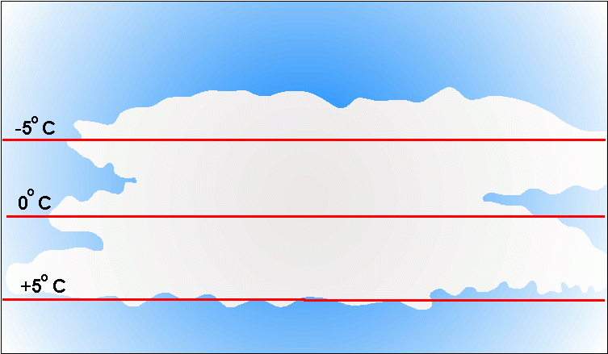
Temperature
“Cold Soaked" aircraft can be a cause
  Sustained flight in below freezing air
  Descends to warm air, but…
  The aircraft’s skin remains cold
NOAA/NWS Seattle Center Weather Service Unit (ZSE)
Notes:
Particularly true when fuel tanks are near the skin of the aircraft.
Not only is air temperature important to consider, but the temperature of the aircraft can also have an impact on whether or not ice forms on its surface. An aircraft can be “cold soaked”, that is due to long duration in below freezing air the aircraft’s skin is below freezing. Even if the aircraft then descends to an above freezing or warmer layer the aircraft’s skin may remain below freezing for some time. Thus, if flying through precipitation or clouds, liquid water droplets can potentially freeze onto the surface of the aircraft. This is similar to freezing rain at the ground.

Slide 16
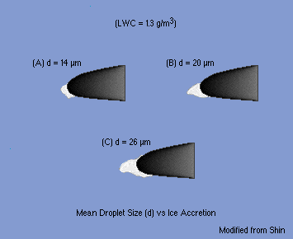
Water Droplet Size
Icing patterns change with droplet size, but in
relation to other
factors….
Droplet size not as important as…
  LWC and
  Temperature
NOAA/NWS Seattle Center Weather Service Unit (ZSE)
Notes:
Water droplet size is also notable for having an impact on icing patterns. A smaller droplet size produces less accretion on the leading edge of the airfoil. As droplet size increases, the greater the accretion on the airfoil is. Smaller droplets are swept around the wings impacting a greater area with ice. Keep in mind that although this is important, LWC and temperature are more important factors in icing.

Slide 17
Cloud Type and Droplet Size
Cumulus - Large drops
Stratus - Small drops
High clouds - Ice crystals
NOAA/NWS Seattle Center Weather Service Unit (ZSE)
Notes:
Droplet size varies with cloud type, which influences the type of icing likely to occur. Cumulus clouds have large droplets, while small droplets are found in stratus clouds. High clouds, like cirrus, contain only ice crystals

Slide 18
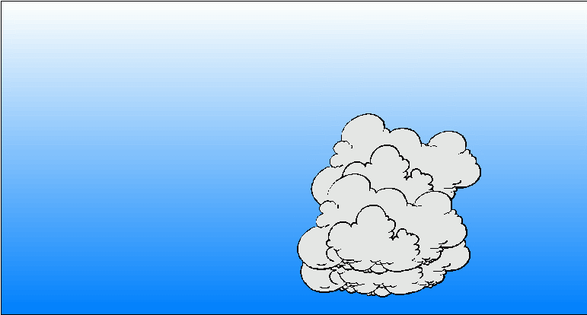

Airspeed and Duration
Aircraft type and speed affect icing occurrence
Same route & altitude
Wheee !
Whoaa !
No Ice
Loads of ice
NOAA/NWS Seattle Center Weather Service Unit (ZSE)
Notes:
Given the same route and altitude, the amount of time spent in the cloud determines the amount of icing. Greater air speed reduces the time spent in the cloud and little to no icing occurs. With a lower air speed, more time is spent in the cloud allowing more time for liquid water drops to collide and freeze onto the aircraft, significantly increasing the amount of icing, potentially creating a dangerous situation.

Slide 19
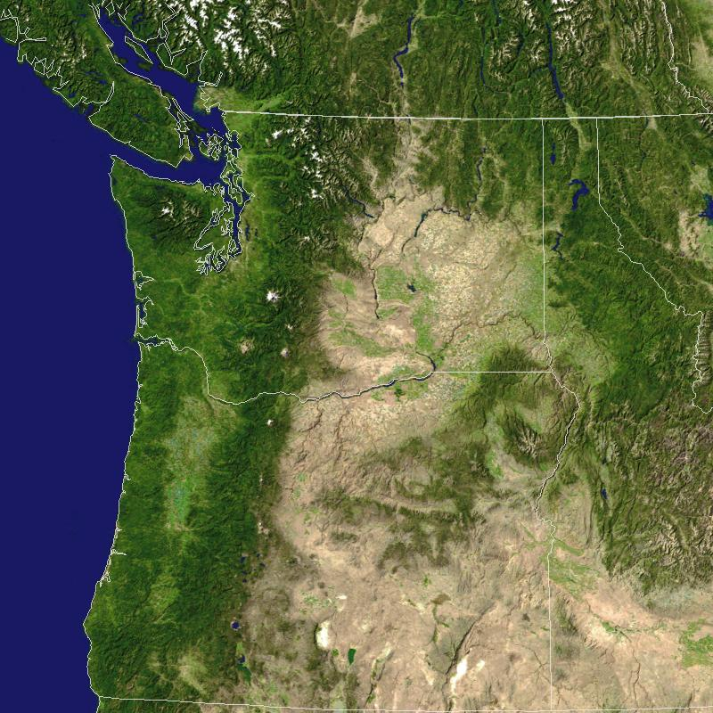
Pacific NW “Famous” for Icing
Pacific Ocean to our west for -
~ Source of Abundant Moisture
North-South mountain ranges with prevailing westerly wind flow for -
~ Sustained orographic, upslope flow
Sustained low level onshore flow
Low freezing levels fall, winter, and spring
NOAA/NWS Seattle Center Weather Service Unit (ZSE)
Notes:
The Pacific Northwest encounters a lot of icing conditions. The Pacific Ocean is a huge moisture source that provides abundant liquid water droplets to the atmosphere. With prevailing westerly wind flow and upslope flow (orographic lift) due to the north – south Cascade Mountains, the necessary moisture for icing is provided and lifted, cooling for icing to form. Likewise, the Pacific Northwest also receives sustained low level onshore flow, again enhancing the amount of moisture present in the atmosphere. Additionally, low freezing levels during fall, winter, and spring allow icing conditions to occur more frequently than other areas of the country and at lower elevations or altitudes.

Slide 20
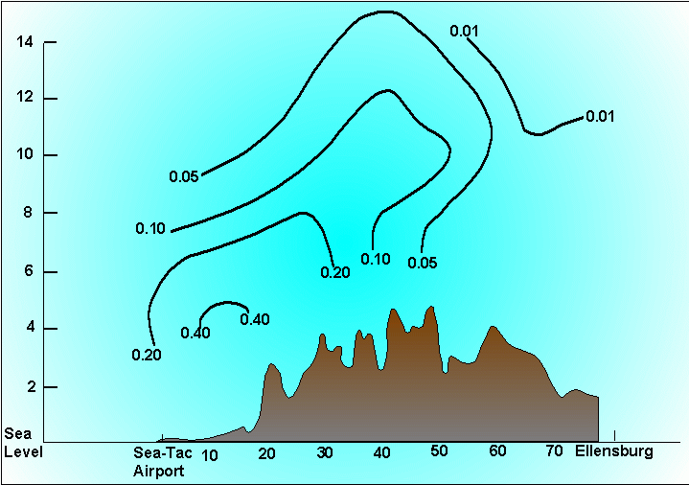
Icing Study by UW
Axis of
max LWC
is also
max icing
potential
and is
often same
as descent
from over
Cascades
(Note: Height and distance not to scale.)
NOAA/NWS Seattle Center Weather Service Unit (ZSE)
Notes:
Axis of maximum LWC is also maximum icing potential and is often the same as descent from the Cascades. Graph shows LWC in grams per cubic meter versus height. The maximum LWC, or potential for icing occurs between 3 and 10,000 feet.

Slide 21
Reportable Icing Intensities
Trace Perceptible, no significant accumulation
Deicing equipment may not be necessary
Light Significant accumulation for a prolonged flight (over 1 hour)
Occasional use of deicing equipment
Moderate Significant accumulation for short periods of flight
The use of deicing equipment or flight diversion is necessary
Severe Rapid, dangerous accumulations
Deicing equipment fails to reduce the hazard
Definitions used in all FAA, DOC, and DOD handbooks, manuals and publications
NOAA/NWS Seattle Center Weather Service Unit (ZSE)
Notes:
Reportable Icing Intensities range from Trace to Severe.

Slide 22
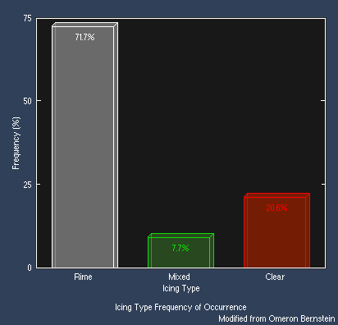
Types of Icing
Frequency of Occurrence
Clear
Mixed
Rime
Temperature Range
Clear | 0° to -10°C (32° to 14°F)
Mixed | -10° to -15°C (14° to 5°F)
Rime | -15° to -40°C (5° to -40°F)
NOAA/NWS Seattle Center Weather Service Unit (ZSE)
Notes:
There are 3 types of icing: clear, mixed, and rime. Clear – 0 to -10C (32 to 14F); mixed -10 to -15C (14 to 5F); and rime -15 to -40C (5 to -40F). Rime icing by far occurs more of the time (71.7%) with clear icing (20.6%) followed by mixed (7.7%).
Clear 0 to -10C 32 to 14F
Mixed -10 to -15C 14 to 5F
Rime -15 to -40C 5 to -40F

Slide 23

Clear Icing
Large drops
Leading
edge of
Wing
NOAA/NWS Seattle Center Weather Service Unit (ZSE)
Notes:
Clear icing starts with large liquid water drops in below freezing air that come in contact with the aircraft. When the water droplet collides with the aircraft the water spreads out in all directions before freezing forming a clear coating of ice on the aircraft.

Slide 24
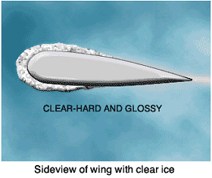
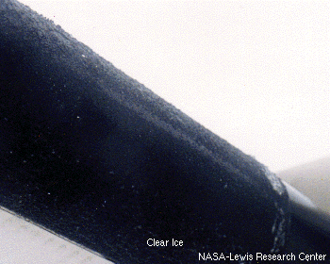
Clear Icing
Transparent, “Glossy”
Not easily seen at first
Can spread out on airfoil beyond “reach” of de-icing equipment
Hard, heavy, and tenacious
NOAA/NWS Seattle Center Weather Service Unit (ZSE)
Notes:
This clear coating of ice is transparent and has a glossy appearance, which can make it hard to detect. Clear icing is hard, heavy and tenacious. Since the water droplet spreads out, icing can reach surface areas of the aircraft that are difficult for deicing equipment to handle.

Slide 25
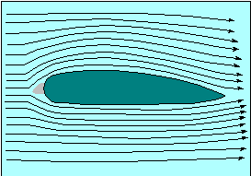
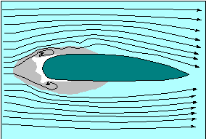
Clear Icing
Gray is region
where air is
stagnant.
Tends to form ‘Horns’ at leading edge of airfoil.
More difficult to remove with de-icing equipment.
Disrupts and makes airflow more turbulent
No Icing
NOAA/NWS Seattle Center Weather Service Unit (ZSE)
Notes:
Looking at the schematic of the airfoil, the center of the airfoil is a small area of stagnant air. As water droplets collide with the leading edge of the airfoil, “horns” form. The water droplets spread out beyond just the leading edge, but can also coat the airfoil surfaces. The build up of clear ice at the leading edge of the airfoil disrupts air flow and produces more turbulent flow. It is more difficult to remove with deicing equipment. The more water droplets forming ice on the airfoil, the less it conforms to the airfoil creating “horns” of ice.

Slide 26
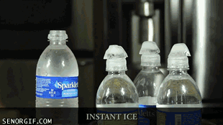
Icing Accretion Example
Source: www.gifbay.com via giphy.com
The super-cooled water is forming ice as it hits the already frozen ice cube, similar to Clear Icing.
NOAA/NWS Seattle Center Weather Service Unit (ZSE)
Notes:
An example of icing accretian is shown here. The super-cooled water forms ice as it hits the already frozen ice cube, similar to clear icing.

Slide 27

Rime Icing
Small drops
Trapped air
Leading
edge of
Wing
NOAA/NWS Seattle Center Weather Service Unit (ZSE)
Notes:
Rime ice is formed when small, fast-moving, super cooled water droplets hit the airfoil and freeze instantly. They do not spread out across the surface, but freeze where they hit. As these droplets hit the air frame, air is trapped in between them. This gives rime ice its milky appearance.

Slide 28
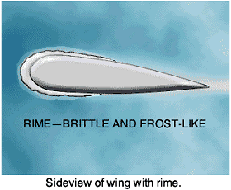
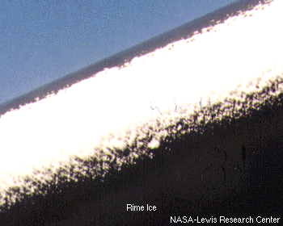
Rime Icing
Is opaque
Easily seen
Lighter than clear ice
However…shape and rough surface decrease aircraft aerodynamics
Easier to remove than clear ice
NOAA/NWS Seattle Center Weather Service Unit (ZSE)
Notes:
Rime ice is opaque and more easily detected. It is lighter than clear ice, though it produces a rougher surface than clear ice, decreasing the aircraft aerodynamics. Rime ice is easier to remove than clear ice.

Slide 29
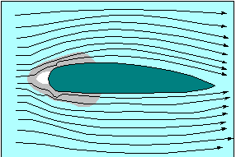
Rime Icing
Gray is region
where air is
stagnant.
Tends to form at leading edge of airfoil
Easier for deicing equipment to remove
Rime
Clear
Compare with ‘horns’
of clear icing.
NOAA/NWS Seattle Center Weather Service Unit (ZSE)
Notes:
The two images compare clear and rime icing. Rime ice forms along the leading edge of the airfoil, whereas clear ice spreads out and backward along the airfoil from the leading edge. Thus, rime ice is easier for deicing equipment to handle.

Slide 30
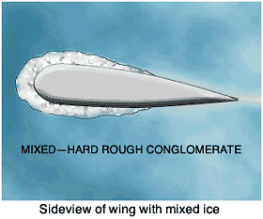
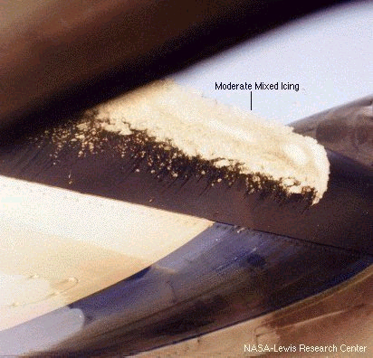
Mixed Icing
Mixture of Clear and Rime ice
Easily seen at first
Forms when water drops vary in size or when liquid drops are intermingled with snow and ice
Same hazards as Clear icing…
  Can spread out on airfoil beyond “reach” of de-icing equipment
NOAA/NWS Seattle Center Weather Service Unit (ZSE)
Notes:
Mixed icing is a mixture of clear and rime ice. This type of ice forms either when water droplets vary in size or when liquid water droplets are mixed with wet snow and ice. It is easily detected like rime ice, but is difficult for deicing equipment, since the ice can spread out from the leading edge of the airfoil like clear icing and out of reach of the deicing equipment.

Slide 31
Mixed Icing
Also tends to form ‘Horns’ at leading edge of airfoil.
More difficult to remove with de-icing equipment.
NOAA/NWS Seattle Center Weather Service Unit (ZSE)
Notes:
Mixed icing also tends to forms “horns” like clear icing.

Slide 32
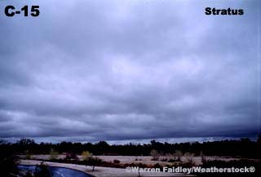
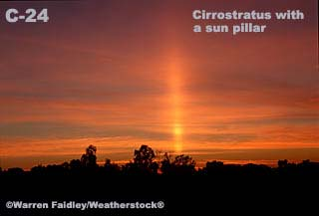
Icing vs Cloud Type
Stratiform Clouds
Small Cloud Droplets
Rime/Mixed most common
Usually confined to layer 3,000-4,000’ thick
Max values occur in upper part of cloud
Large horizontal extent
NOAA/NWS Seattle Center Weather Service Unit (ZSE)
Notes:
Stratiform clouds are sheet like clouds that can extend over large areas. Due to their large areal extent, icing conditions can be widespread over an area through stratus clouds. They most commonly produce rime or mixed icing in a 3000-4000 feet thick layer. The maximum icing reports occur in the upper most portion of the cloud layer.

Slide 33
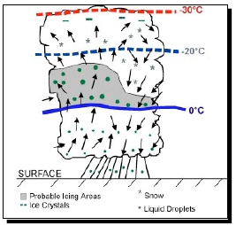
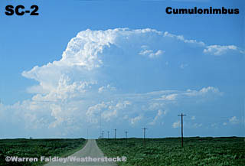
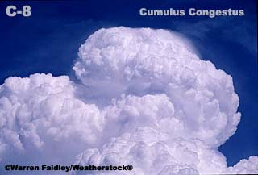
Icing versus Cloud Type
Cumuliform Clouds
Large Cloud Droplets
Heavy Clear Icing found in “updraft” portion of cloud
Heavy rime most frequently in cloud tops
Clear icing most likely in building Cu
Rime often found in fully developed TS
Relatively small
horizontal extent
NOAA/NWS Seattle Center Weather Service Unit (ZSE)
Notes:
Cumuliform clouds are the result of rapidly rising air and appear like cotton balls. Their areal horizontal extent tends to be small, but can extend thousands of feet vertically. Large cloud droplets ascend through the cloud and produce heavy clear icing in the updraft portion of the cloud. As the water droplet approaches the top of the cloud, heavy rime ice is more common. This is mainly due to the temperature structure of the cloud. The greater the ascent, the higher the cloud, and colder the air is. As large heavy water droplets are lifted to a high height rapidly and then freeze, rime results. Rime is found in fully developed thunderstorms. In building cumulus clouds, clear icing is expected, since cumulus clouds in the development stage are lower and warmer.

Slide 34
Icing versus Cloud Type
Previous statements “generally” true…
BUT research has found…
  Mixed-phase clouds of all types may harbor sufficient amounts of Super-Cooled water.
NOAA/NWS Seattle Center Weather Service Unit (ZSE)
Notes:
Research has found the mixed phase clouds of all types may harbor sufficient amounts of super cooled water. Mixed phase clouds contain both large and small super cooled water droplets, and as a result both clear and rime ice can form.

Slide 35
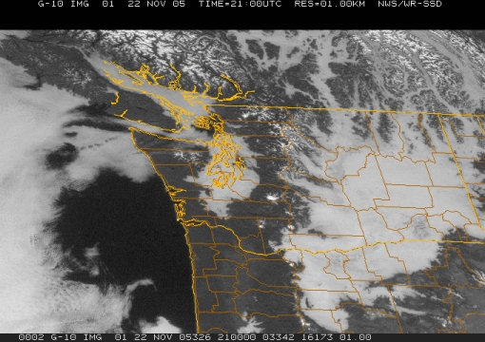
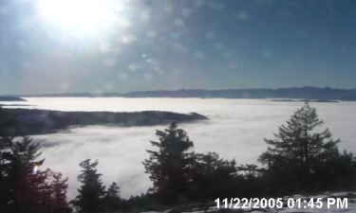
Typical Wintertime Rime Icing Event Eastern WA
Status fills Columbia Basin
Cloud tops FL040 – FL050
Cloud top temps 0° to -2°C
Light to moderate rime icing
* View from satellite *
* View from ridgetop *
No icing here …shallower cloud tops ~ FL015…temps above freezing
NOAA/NWS Seattle Center Weather Service Unit (ZSE)
Notes:
Satellite imagery can help forecast likely locations for icing to occur. However, the visible satellite image shows similar looking clouds over Puget Sound and the Columbia Basin. The clouds over the Puget Sound are low, cloud tops are 1,500 feet, and above freezing, so no icing is expected. In eastern Washington, stratus clouds cover the Columbia Basin at 4 to 5,000 feet, when in this case the top of the stratus cloud temperatures are in the 0 to -2C range. So light to moderate rime icing is expected. In stratus clouds, the water droplet size is larger, so even though the temperature is not in the typical range for rime to form, due to the large droplet size rime can form between 0 and -2C, as in this case.

Slide 36
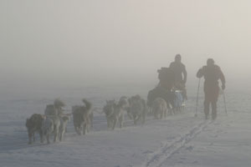
Fog at Below Freezing Temperatures
Freezing Fog
Fog is made of “Super-Cooled” water droplets
When Freezing Fog comes into contact with a surface below freezing, it will turn to ice
from Jackson KY NWS: http://www.crh.noaa.gov/jkl/?n=fog_types
NOAA/NWS Seattle Center Weather Service Unit (ZSE)
Notes:
Freezing fog is made of super-cooled water droplets. When these droplets come into contact with a surface below freezing, they will form ice.

Slide 37
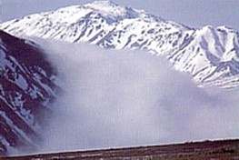
Fog at Below Freezing Temperatures
Ice Fog
Fog is made of tiny ice crystals that are suspended in the air
Only found in very cold air masses, with the temperature generally below -10°C (14°F)
from Jackson KY NWS: http://www.crh.noaa.gov/jkl/?n=fog_types
NOAA/NWS Seattle Center Weather Service Unit (ZSE)
Notes:
Ice fog is made of tiny ice crystals that are suspended in the air. It is found only in very cold air masses, such as in the arctic.

Slide 38
Freezing Rain
Occurs when warm, moist air is forced over cold (often dry) air.
Forcing can be done by
  Terrain (Mountains)
  Fronts
  Cold air outflow (Columbia River Gorge)
NOAA/NWS Seattle Center Weather Service Unit (ZSE)
Notes:
Freezing rain is a unique type of icing situation. Freezing rain occurs when warm, moist air is forced over cold, often dry air. Forcing results from mountains, fronts, or cold, outflow boundary, such as the Columbia River Gorge or thunderstorm outflow.

Slide 39
Freezing Rain
Warm air/moisture overrunning cold air
Precipitation begins as rain (or melted snow)
  falls through cold air
  becomes “Super-Cooled Water”
  freezes on impact
Quite common in the Pacific Northwest
Can result in heavy icing in a short period of time
NOAA/NWS Seattle Center Weather Service Unit (ZSE)
Notes:
Freezing rain results from warm moist air overrunning cold air. Precipitation begins as rain, falls through cold air and becomes “super cooled water”. When the super cooled water makes contact with a surface and it freezes on contact, assuming the surface is below freezing. If an aircraft is flying through freezing rain, this can lead to heavy icing in a short period of time.

Slide 40
Precipitation begins as rain
Warm, moist air
being forced aloft
Cold
Air
Becomes
freezing
rain
NOAA/NWS Seattle Center Weather Service Unit (ZSE)
Notes:
Super cooled raindrops freeze on contact with any surface, not just the leading edge of the airfoil.

Slide 41
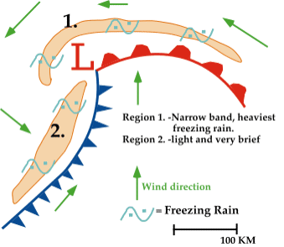
Freezing Rain
Warm, moist air over-running cold air
Precipitation begins as snow, changes to rain
  Then falls through Cold air
  Becomes “Super-Cooled Water”
  Freezes on impact
Heavy icing in a short period of time
Best maneuver may be to gain altitude
  Check with a weather briefer first!
NOAA/NWS Seattle Center Weather Service Unit (ZSE)
Notes:
Super cooled raindrops freeze on contact with any surface, not just the leading edge of the airfoil.

Slide 42
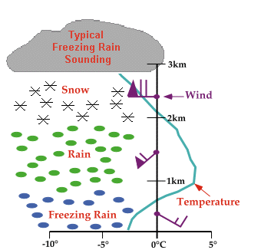
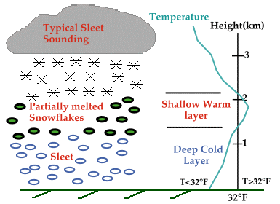
Typical
Freezing Rain / Sleet Soundings
NOAA/NWS Seattle Center Weather Service Unit (ZSE)
Notes:
A layer of warm air above a layer of cold air near the surface is required for freezing rain or sleet.

Slide 43
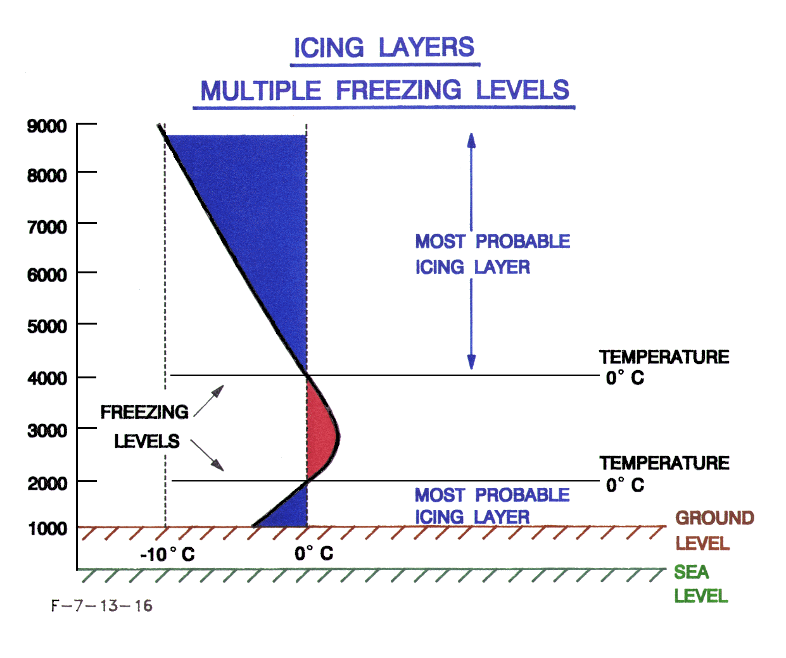
Typical Freezing Rain/Sleet Soundings
NOAA/NWS Seattle Center Weather Service Unit (ZSE)
Notes:
A layer of warm air above a layer of cold air near the surface is required for freezing rain or sleet.

Slide 44
American Eagle #4184
31 October 1994
An ATR-72 was scheduled to 4:10pm departure from IND to ORD
Entered holding pattern at 10,000ft
Flight Data Recorder recorded activation of Level III de-icing during decent to 10,000ft
NOAA/NWS Seattle Center Weather Service Unit (ZSE)
Notes:
American Eagle #4184, 31 October 1994

Slide 45
American Eagle #4184
Ridge of ice accreted beyond the deicing boots during freezing rain/drizzle in holding pattern
The airplane went into a roll, followed by a rapid decent due to the cumulative effects of clear ice.
68 people died near Roselawn IN.
NOAA/NWS Seattle Center Weather Service Unit (ZSE)
Notes:
American Eagle #4184, 31 October 1994

Slide 46
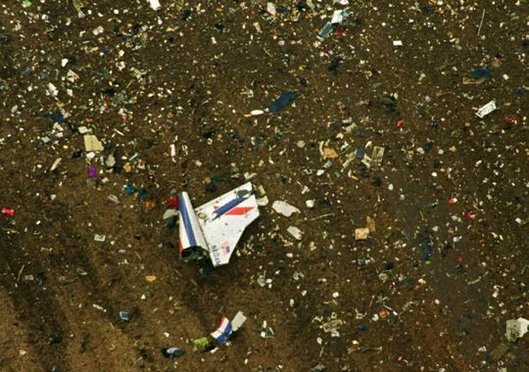
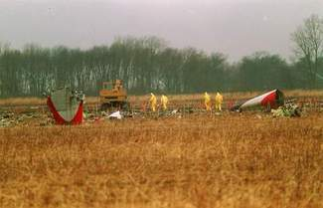
American Eagle #4184
Crash investigators search the site of the crash of American Eagle flight 4184 in a field near Roselawn, Ind. in the days after the Oct. 31, 1994 crash.
Associated Press file via Daily Herald
A field near Roselawn, Ind., was strewn with debris including a portion of the red, white and blue tail section of American Eagle Flight 4184, after it crashed on Oct. 31, 1994, killing all 68 people aboard. Wreckage of the 7-month-old twin-engine propjet was scattered across a muddy 40-acre soybean field in Northwest Indiana 30 miles south of Gary. (Photo: Charles Bennett / Associated Press) via Indianapolis Star
NOAA/NWS Seattle Center Weather Service Unit (ZSE)
Notes:
American Eagle #4184, 31 October 1994

Slide 47

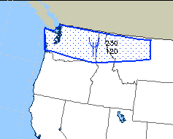
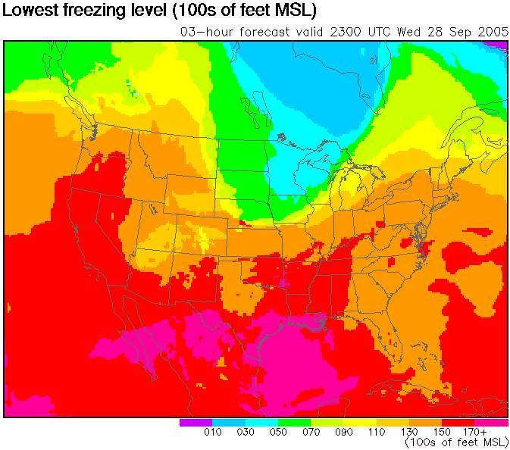
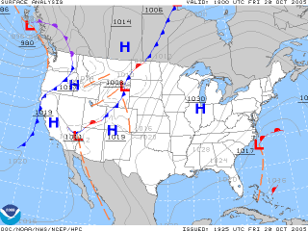
Situational Awareness
Keep current with the weather in your area
Know where the fronts are located
Keep current with freezing levels in your area
http://www.aviationweather.gov/gairmet
NOAA/NWS Seattle Center Weather Service Unit (ZSE)
Notes:
When planning a flight, keeping current with the weather is extremely important. Developing good situational awareness beforehand can help in the planning process. Situational awareness is ability to identify, process, and comprehend the critical elements of information about what is happening, and using that knowledge to understand the future. Available tools can help build your awareness of the potential for icing. View current airmets. Examine surface maps to determine the location of frontal boundaries. Know the freezing level in your area. http://adds.aviationweather.gov/airmets/

Slide 48
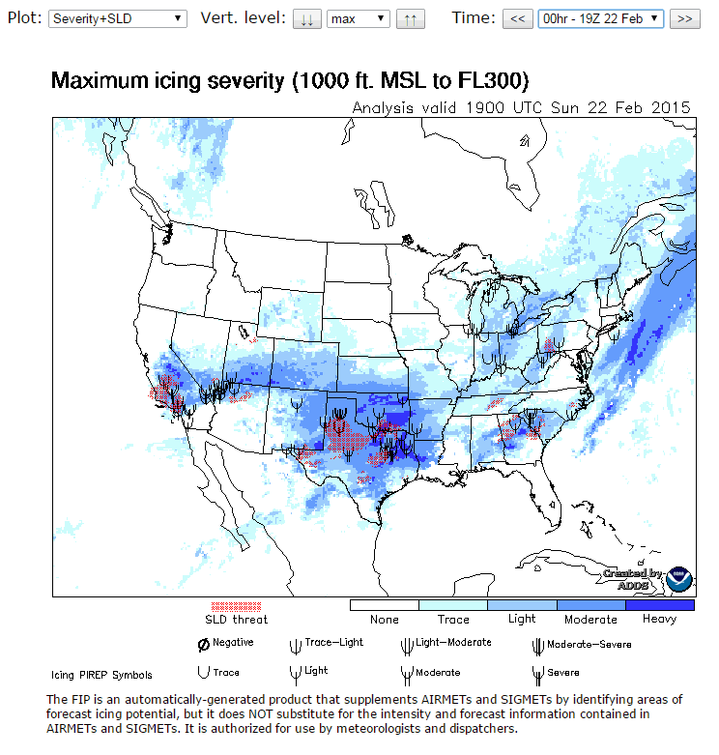
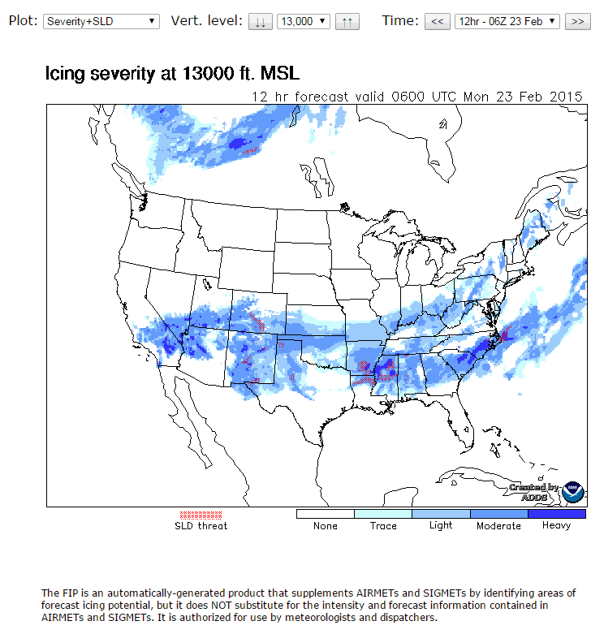
Situational Awareness
Know current and forecast icing potential
http://www.aviationweather.gov/icing/fip
Current ...FL030 to FL300 including SLD.
Forecast … 0 to 18 hours 010 to FL290
(SLD…Super-cooled Large Drops)
Delineates general areas of icing potential
NOAA/NWS Seattle Center Weather Service Unit (ZSE)
Notes:
Situational Awareness – Icing Potential Forecast

Slide 49
Situational Awareness
Know the cloud bases
Know the cloud tops…light, non-turbo aircraft may not be able to climb above 8,000 ft. Once on top…can they stay there?
Are clouds air mass or frontal? Frontal clouds cover larger areas…aircraft flying through frontal clouds may experience icing conditions for a longer period of time.
Are alternate routes available…around fronts or around mountains?
NOAA/NWS Seattle Center Weather Service Unit (ZSE)
Notes:
Know the cloud bases and tops. Most non-turbo prop aircraft can’t climb above 8000 feet. Can they stay on top? Are the clouds air mass or front? Frontal clouds cover large areas. Aircraft flying through frontal clouds can experience conditions for a longer period of time. Are alternative routes available?

Slide 50

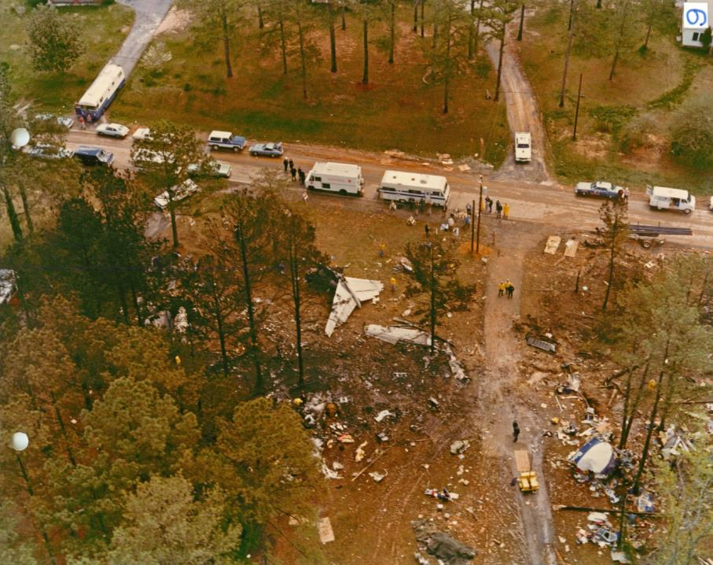
CWSUs - Why are we here?
The result of Southern Airways Flight 242 crash in New Hope, GA on April 4, 1977…72 souls lost
Total loss of thrust from both engines due to damage from ingest of water/hail while penetrating an area of severe thunderstorms
CWSUs established by FAA in 1978 as a result of NTSB recommendation A-77-068 to formulate procedures for the timely dissemination of all available severe weather information by controllers
Source: NTSB
“…limitations in the Federal Aviation Administration’s air traffic control system which precluded the timely dissemination of real-time hazardous weather information to the flight crew.” – NTSB-AAR-78-3, Jan 1978
NOAA/NWS Seattle Center Weather Service Unit (ZSE)
Notes:
CWSUs established by FAA in 1978 as a result of NTSB recommendation A-77-068 to formulate procedures for the timely dissemination of all available severe weather information by controllers

Slide 51
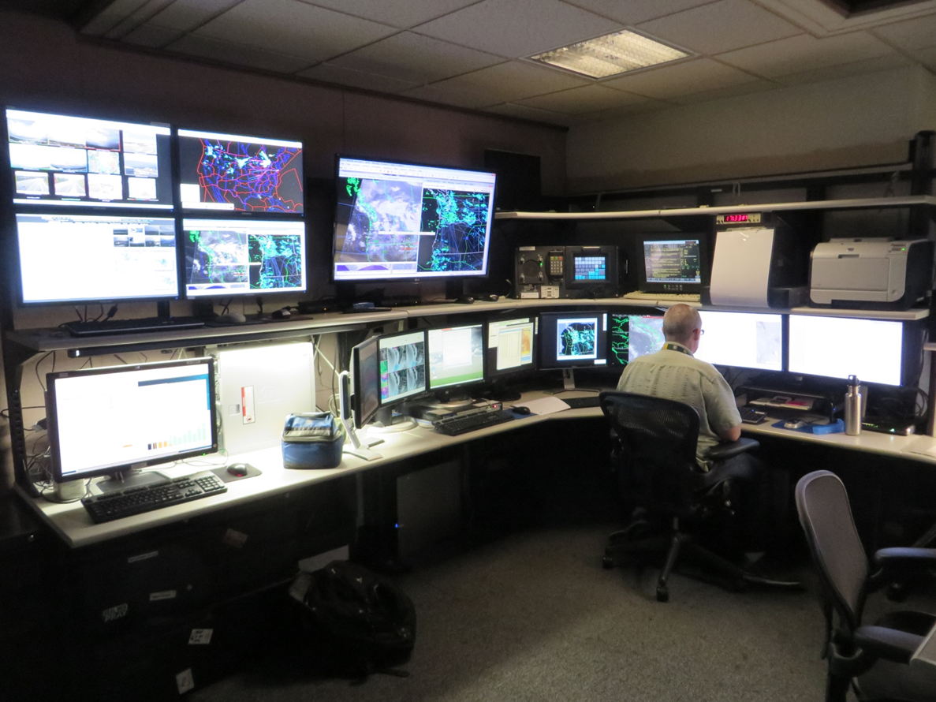
CWSU Operations
3 Meteorologists and 1 Manager
Open 5am – 9pm
Provide 2 stand-up briefings perday
Answer questions from TMU, OM, FLMs, TRACONs, towers, etc
Coordinate TAFs, SIGMETs, CWAs, etc with other NWS offices
Issue CWAs, keep web page updated, participate in conference calls
NOAA/NWS Seattle Center Weather Service Unit (ZSE)
Notes:
CWSU Operations

Slide 52
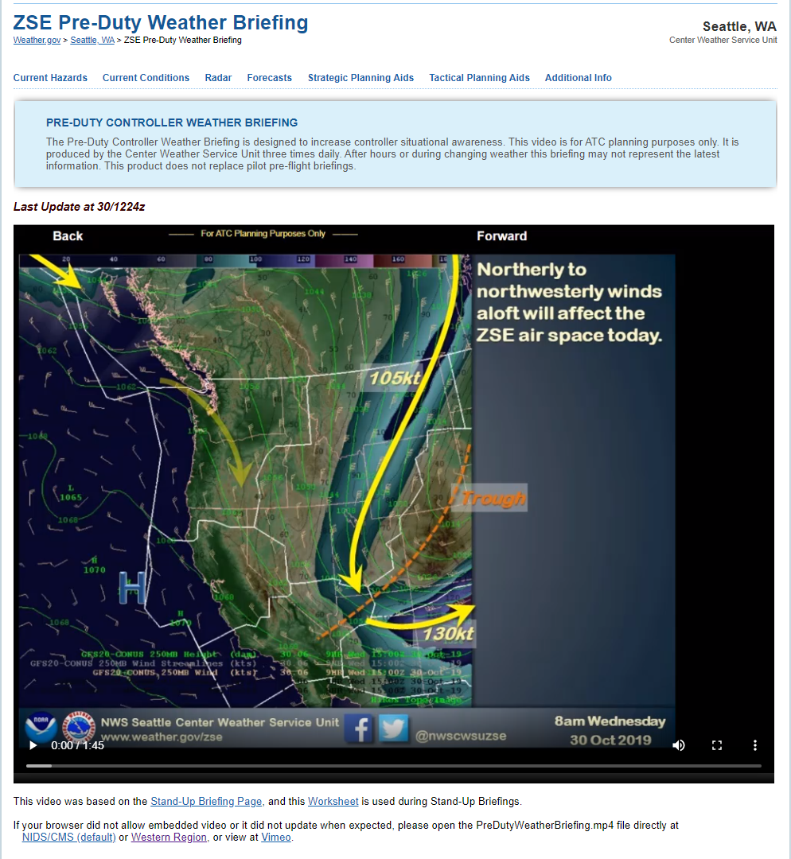





ZSE CWSU Web Page
Headlines and Weather Story
Drop-Down Menus
Updated by
5:45am
12:30pm
8:30pm
Interactive Map
https://www.weather.gov/zse
NOAA/NWS Seattle Center Weather Service Unit (ZSE)
Notes:
ZSE Web Page – Check out Headlines/Weather Stories, Products/Sites in Drop-Down Menus, and various plots/overlays in the Interactive Map.

Slide 53


Winter Forecast
https://www.cpc.ncep.noaa.gov/
Precipitation Probability (PacNW – Neutral)
Temperature Probability (PacNW – Above Average)
NOAA/NWS Seattle Center Weather Service Unit (ZSE)
Notes:
Situational Awareness – Icing Potential Forecast

Slide 54
Thank you for
your participation!
Please come to any of us (or call x3741) with questions you may have!
NOAA/NWS Seattle Center Weather Service Unit (ZSE)
Notes:
Thank you for participating in this Aircraft Icing refresher. Further questions can be directed to the Seattle Center Weather Service Unit.

