Slide 1
Aviation Weather Training
Adverse Winds
Jim Vasilj
Seattle Center Weather Service Unit
Notes:
◉ This lesson will teach you the characteristics of hazardous weather and their effects on aviation.
• The hazards covered in this lesson are:
− Adverse wind
− Instrument (IFR) weather
− Mountain obscuration
− Turbulence
− Density altitude
− Icing
− Thunderstorm
− Low level wind shear

Slide 2
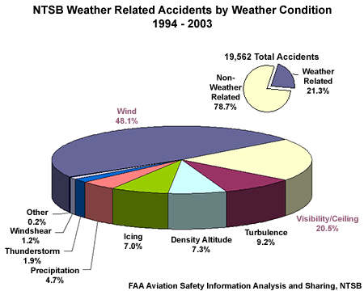
Motivation
Adverse Winds
Notes:
◉ Weather accounts for 21% of all U.S. aviation accidents.

Slide 3
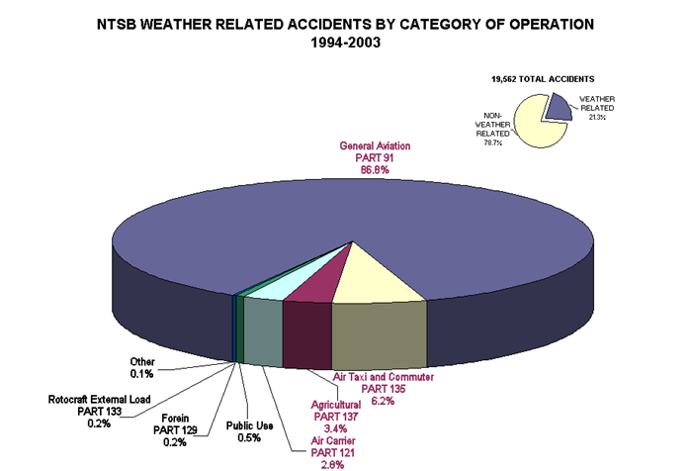
Motivation
Adverse Winds
Notes:
◉ General aviation (Part 91) is especially susceptible to weather.
• Accounts for 87% of all weather-related accidents.

Slide 4
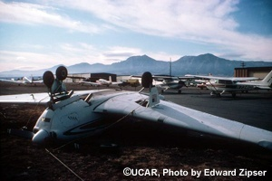
Adverse Wind
Responsible for most weather-related accidents
Often trigger air traffic management decisions that adversely impact traffic (runway configuration, arrival rates, etc)
Adverse Winds
Notes:
◉ Adverse wind is responsible for most weather-related accidents.
• Particularly general aviation (GA) pilots flying aircraft with lower crosswind and tailwind threshold values.
• Takeoff and landing are the most critical periods of any flight and are most susceptible to the adverse wind.
◉ Adverse winds often trigger air traffic management decisions that adversely impact traffic
• Change of runway configuration
− If there is only one runway, wind determines which direction planes will land or whether they can land at all.
• Reduced arrival rates
− This increases fuel consumption and therefore costs.
− Can cause a ripple throughout the National Airspace System

Slide 5
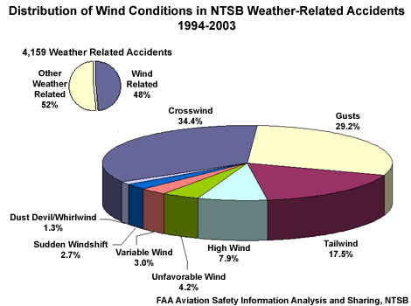
Adverse Wind Phenomena
Adverse Winds
Notes:
◉ Adverse winds are responsible for nearly half of all weather-related accidents.
• Crosswinds
• Gusts
• Tailwind
• Variable wind
• Sudden wind shift

Slide 6
Crosswind
 Crosswind - A wind that has a component directed perpendicularly to the heading of an aircraft. The drift produced by crosswind is critical to air navigation, being especially dangerous during takeoff and landing.
Adverse Winds
Notes:
 Crosswind – A wind that has a component directed perpendicularly to the heading of an aircraft. The drift produced by crosswind is critical to air navigation, being especially dangerous during takeoff and landing.
◉ Airplanes take off and land more efficiently when oriented into the wind.
• The aircraft’s groundspeed is minimized,
• Less runway is required to achieve liftoff, and
• The pilot has more time to make adjustments necessary for a smooth landing.
◉ As the wind turns more perpendicular to the runway to become a crosswind, airplane performance gradually degrades.
• If a pilot does not correctly compensate for the crosswind:
- The aircraft may drift off the side of the runway.
- Side load on landing gear might occur, leading to gear collapse.
◉ A crosswind en route can cause an aircraft to drift off its expected flight path, leading to navigation errors.

Slide 7
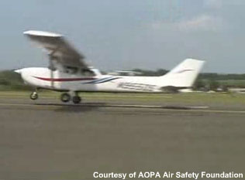
Gusts
 Gust – A sudden, brief increase in the speed of the wind.
Adverse Winds
Notes:
 Gust – A sudden, brief increase in the speed of the wind.
◉ Even if the airplane is oriented into the wind, gusts during takeoff and landing cause airspeed fluctuations which can cause problems for pilots.
• A gust increases airspeed, which increases lift, and may cause an aircraft to briefly balloon up.
• Once the gust ends, a sudden decrease of airspeed occurs, which decreases lift and causes the aircraft to sink.
- This can cause an airplane to bounce on the runway and possibly lead to a crash.

Slide 8
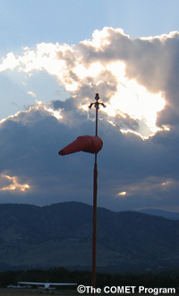
Tailwind
 Tailwind – A wind with a component of motion from behind the aircraft.
Adverse Winds
Notes:
 Tailwind – A wind that assists the intended progress of an aircraft. If an aircraft is airborne, a tailwind renders its groundspeed greater than its airspeed.
◉ A tailwind can be hazardous during both takeoff and landing.
• A longer takeoff roll is required.
− A higher ground speed is required to generate sufficient lift.
- The aircraft may roll off the end of the runway before liftoff.
• A smaller initial rate of climb occurs during takeoff.
− May be insufficient to clear obstacles at the end of the runway
• A longer landing roll is required.
− Aircraft must maintain a higher ground speed on landing.
-> Thus, the pilot has less time to make adjustments necessary for a smooth landing and may roll off the end of the runway.

Slide 9
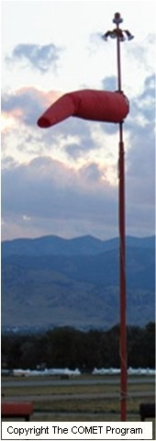
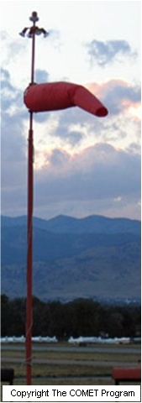
Variable Wind / Sudden Wind Shift
 Variable wind – Wind that changes direction frequently.
 Sudden wind shift – A line or narrow zone along which there is an abrupt change of wind direction.
Adverse Winds
Notes:
 Variable wind – Wind that changes direction frequently.
 Sudden wind-shift (also called wind-shift line) – A line or narrow zone along which there is an abrupt change of wind direction.
◉ Variable winds and sudden wind shifts, even at low speeds, can make takeoffs and landings difficult.
• A headwind can quickly become a crosswind or tailwind.

Slide 10
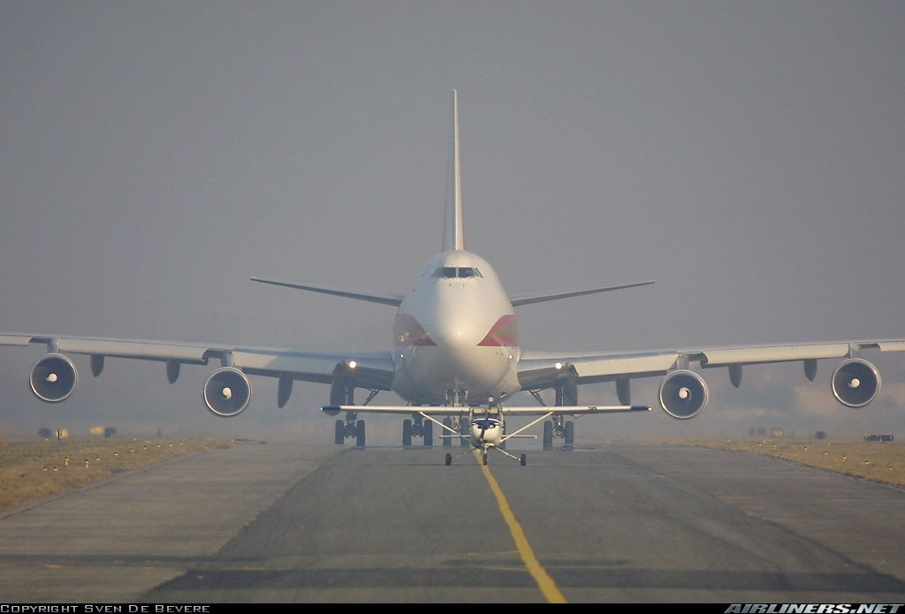
Effects of Approach Speed
◉ Airplanes with higher approach speeds are less affected by crosswinds and tailwinds
Adverse Winds
Notes:
◉ Airplanes with higher approach speeds are less affected by crosswinds and tailwinds.
• Larger airplanes generally have higher demonstrated crosswind and tailwind thresholds.
• The general aviation (GA) pilot is usually flying an aircraft that is less able to maintain directional control while landing in a strong crosswind or tailwind.
For example, a 20 kt crosswind on approach may require the Boeing 733 pilot to make only small adjustments to compensate, but the Piper Warrior (P28A)
would not be able to maintain directional control even with maximum pilot skill and effort.

Slide 11
Response Item
Even if an airplane is oriented into the wind, gusts during takeoff and landing may cause the aircraft to _______.
A. drift off the side of the runway
B. bounce on the runway
C. roll off the end of the runway
Adverse Winds
Notes:
NOTE: Click advance to reveal answer.

Slide 12
Response Item
A variable wind, even at low speeds, can be hazardous on takeoff and landing because it could _______.
A. cause engine failure
B. cause the plane to bounce on the runway
C. quickly become a crosswind or tailwind
Adverse Winds
Notes:
NOTE: Click advance to reveal answer.

Slide 13
Response Item
_______ perform better in adverse winds because most have demonstrated tailwind and crosswind thresholds that exceed FAA runway thresholds.
A. Larger airplanes
B. Smaller airplanes
C. Helicopters
Adverse Winds
Notes:
NOTE: Click advance to reveal answer.

Slide 14
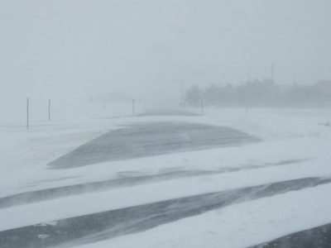
Blowing Snow
Light, dry, powder snow is most prone to being blown by the wind
Visibility will often be near zero/sky obscured when the particles are raised to great heights
  • Called a “whiteout”
  • Visibility improves rapidly when the wind subsides
Copyright Mike Hardiman, 2007
Adverse Winds
Notes:
 Blowing Snow – Snow lifted from the surface of the earth by the wind to a height of 6 feet (2 meters) or more above the ground and blow about in such quantities that the reported horizontal visibility is reduced to less than 7 statute miles (11 km).
NOTE: Teach from slide.

Slide 15
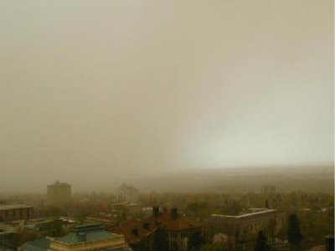
Duststorm
Originate over arid regions with fine-grained soils, rich in clay and silt
  Dry lake beds (playas)
  River flood plains
  Ocean sediments
  Glacial deposits
Soil is lofted airborne when exposed to strong wind
Adverse Winds
Notes:
 Duststorm – A severe weather condition characterized by strong winds and dust-filled air over an extensive area.
NOTE: Teach from slide.

Slide 16
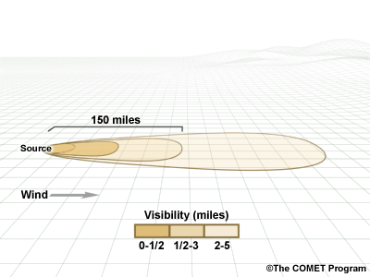
Typical Visibility Within a Duststorm
Adverse Winds
Notes:
◉ Most of the dust originates from a number of discrete point sources.
• Intense dust storms reduce visibility to near zero in and near source regions with visibility improving away from the source.
◉ The average height of a duststorm is 3,000 to 6,000 feet (~1 km).
• However, they can frequently extend up to 15,000 feet.
◉ Dust tends to settle of a rate of 1,000 feet per hour once winds die down.
• It can take many hours (or days) for the dust to settle.
• Precipitation will very effectively remove dust from the atmosphere.

Slide 17
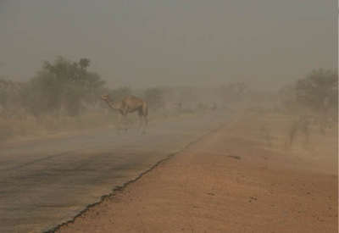
Sandstorm
Occurs in desert regions with loose sand, often in dunes
Similar to a duststorm, but on a localized scale
  Sand particles are larger and heavier than dust particles
Copyright George Kourounis, 2008
Adverse Winds
Notes:
 Sandstorm – Particles of sand carried aloft by a strong wind. The sand particles are mostly confined to the lowest 10 feet (3.5 m), and rarely rise more than fifty feet (15 m) above the ground.
NOTE: Teach from slide.

Slide 18
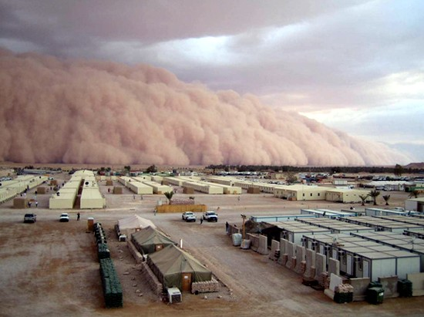
Haboob
 Haboob – A duststorm or sandstorm that forms as cold downdrafts from a thunderstorm turbulently lift dust and sand into the air.
Adverse Winds
Notes:
 Haboob – A duststorm or sandstorm that forms as cold downdrafts from a thunderstorm turbulently lift dust and sand into the air.
◉ Duststorms and sandstorms can also generated by thunderstorm outflows called “haboobs.”
• While haboobs are often shorter-lived, they can be quite intense.
• A haboob forms as cold downdrafts along the leading edge of a thunderstorm lift dust and/or sand into a huge, tumbling dark cloud sometimes called a dust wall.
- The dust wall may extend horizontally for over 60 miles (100 km) and rise vertically to the base of the thunderstorm.
• Spinning whirlwinds of dust frequently form along the turbulent cold air outflow, giving rise to huge dust/sand whirls.

Slide 19
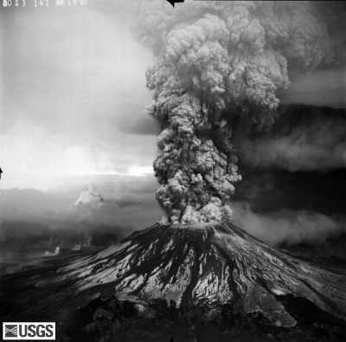
Volcanic Ash
Ash may not be visible, especially at night or in instrument conditions
  Difficult to distinguish visually between ash and ordinary cloud
  May not be detected by aircraft or ATC radar
Adverse Winds
Notes:
 Volcanic Ash – Fine particles of rock powder that originate from a volcano and that may remain suspended in the atmosphere for long periods.
NOTE: Teach from slide.

Slide 20
Response Item
During a duststorm, most of the dust originates from _______.
A. one point source
B. a number of discrete point sources
C. a large source region
Adverse Winds
Notes:
NOTE: Click advance to reveal answer.

Slide 21
Response Item
Which phenomenon can continue to restrict visibility, even after the wind subsides?
A. Blowing dust
B. Blowing sand
C. Blowing snow
Adverse Winds
Notes:
NOTE: Click advance to reveal answer.

Slide 22
Response Item
During a sandstorm, sand particles are mostly confined to the lowest ______ feet and rarely rise more than _______ feet above the ground.
A. 10; 50
B. 1,000; 3,000
C. 3,000; 6,000
Adverse Winds
Notes:
NOTE: Click advance to reveal answer.

Slide 23
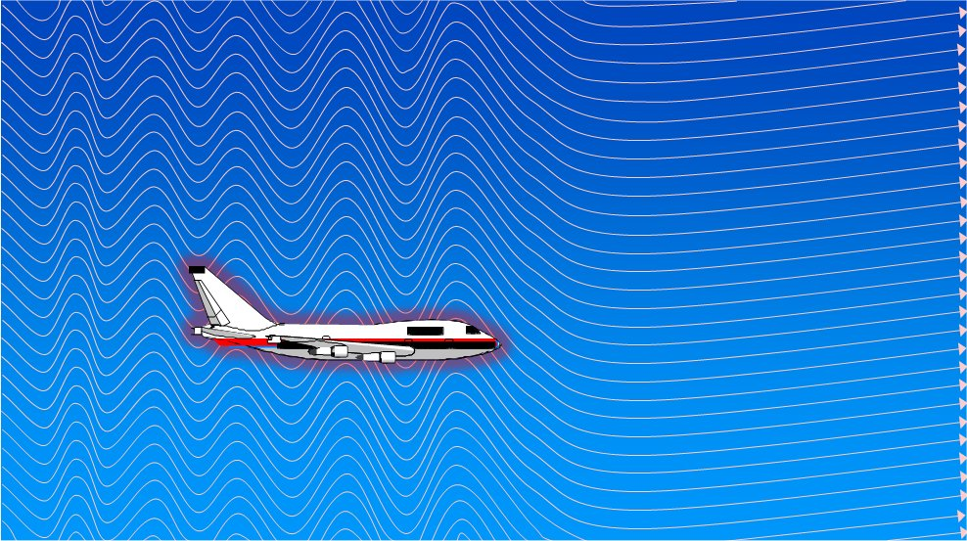
Turbulence Introduction
Turbulence ranges from annoying bumpiness to severe jolts which cause structural damage and/or injuries.
Adverse Winds
Notes:
 Aircraft Turbulence - Irregular motion of an aircraft in flight, especially when characterized by rapid up-and-down motion, caused by a rapid variation of atmospheric wind velocities.
NOTE: Teach from slide.

Slide 24
Turbulence Definitions
◉ a state of fluid flow in which the instantaneous velocities exhibit irregular and random fluctuations
◉ bumpiness in flight
◉ violent movements in the atmosphere caused in many different ways
◉ sudden changes in air movement causing aircraft to pitch, yaw and roll
Adverse Winds
Notes:
 Aircraft Turbulence - Irregular motion of an aircraft in flight, especially when characterized by rapid up-and-down motion, caused by a rapid variation of atmospheric wind velocities.
NOTE: Teach from slide.

Slide 25
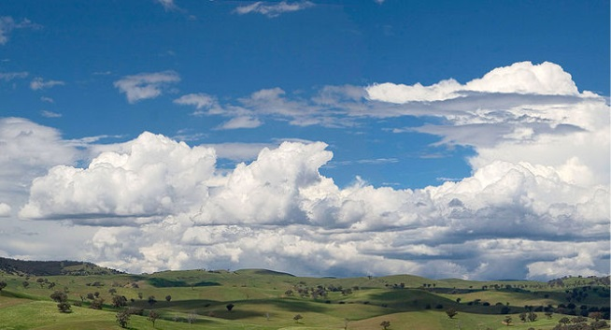
Causes of Turbulence
  • Convective currents
    Called convective turbulence
  • Obstructions to wind flow
    Called mechanical turbulence
  • Wind shear
SHEAR ZONE
Adverse Winds
Notes:
NOTE: Teach from slide.

Slide 26
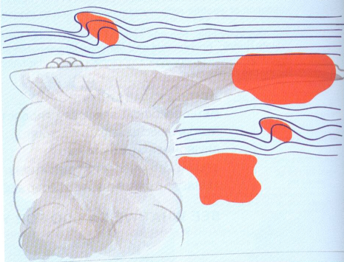
Convective Turbulence
FAA advises pilots to stay clear of TS by at least 20nm laterally
Known regions of turbulence around thunderstorms shaded in orange.
EDR-based turbulence measurements, combined with radar and satellite imagery have shown that the risk of severe turbulence is five times the background value at 10,000 ft above the cell and twice the background value at distances up to 40nm from the cell
CIT
CIT
CIT
CIT
Courtesy Wikipedia: WikiProject Aviation
CIT = Convectively Induced Turbulence
Adverse Winds
Notes:
 Convective Turbulence – Turbulent vertical motions that result from convective currents and the subsequent rising and sinking of air.
NOTE: Teach from slide.

Slide 27
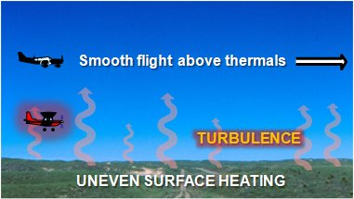
Thermals
Convective currents can still be active even when the air is too dry for cumuliform clouds
  • Called dry convection or “thermals”
  • A pilot has little indication of their presence until encountering turbulence
Copyright Robert A. Prentice, 2005
Adverse Winds
Notes:
NOTE: Teach from slide.

Slide 28
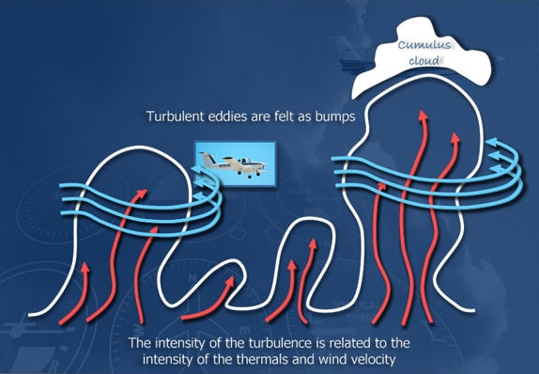
Thermals
Chris Smith (flight instructor) :
“Thermals are like flying through elevators of air - all moving at different speeds. It’s like flying across a series of speed bumps in the sky.”
Adverse Winds
Notes:
NOTE: Teach from slide.

Slide 29
Mechanical Turbulence
Obstructions to the wind flow disrupt the smooth flow of air.
  Aircraft flying through these areas experience mechanical turbulence
Turbulence intensity is directly related to:
  Wind speed
  Roughness of the obstructions
WIND
Adverse Winds
Notes:
 Mechanical Turbulence – Turbulent eddy motions caused by obstructions, such as trees, buildings, mountains, and so on.
NOTE: Teach from slide.

Slide 30
Mountain Wave
◉ Develop above and downwind of mountains
  • Waves remain stationary while wind blows through them
  May extend 600+ miles downwind
  Frequently produce severe to extreme turbulence
60
50
40
30
20
10
0
STRATOSPHERE
TROPOPAUSE
TROPOSPHERE
1000’s OF FEET
CCSL
ACSL
ACSL
CAP CLOUD
ROTOR
Adverse Winds
Notes:
 Mountain Wave – An atmospheric wave disturbance formed when stable air flow passes over a mountain or mountain barrier.
NOTE: Teach from slide.

Slide 31
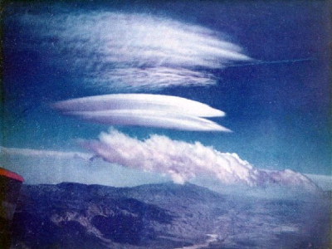
Mountain Wave Clouds
◉ When sufficient moisture is present, mountain waves are revealed by:
  • Cap clouds
  • Cirrocumulus standing lenticular (CCSL)
  • Altocumulus standing lenticular (ACSL)
  Rotor clouds
◉ Provide visual proof of a mountain wave
CCSL
ACSL
ROTOR
Adverse Winds
Notes:
Mountain Wave Cloud – A cloud that forms in the rising branches of mountain waves and occupies the crests of the waves.
The most distinctive are the sharp-edged, lens-, or almond-shaped lenticular clouds, but a variety of stratocumulus, altocumulus, and cirrocumulus forms appear.
NOTE: Teach from slide.

Slide 32
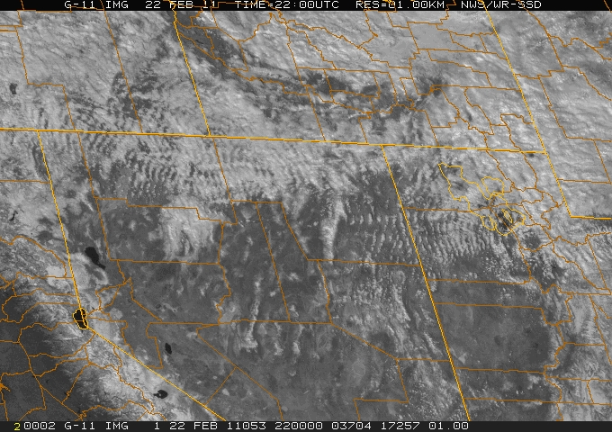
Mountain Wave Clouds
Adverse Winds
Notes:
Mountain Wave Cloud – A cloud that forms in the rising branches of mountain waves and occupies the crests of the waves.
The most distinctive are the sharp-edged, lens-, or almond-shaped lenticular clouds, but a variety of stratocumulus, altocumulus, and cirrocumulus forms appear.
NOTE: Teach from slide.

Slide 33
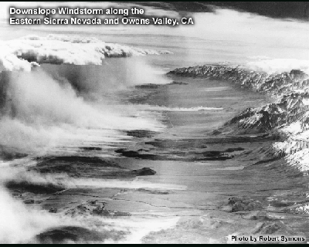
Downslope Windstorm
◉ Mountain waves can sometimes lead to strong and damaging windstorms (Foehn, Bora, etc) on the downwind-side of a mountain range
  • Winds can exceed 100 kt
  • Frequently lead to turbulence and wind shear at the surface
Adverse Winds
Notes:
 Foehn (also called Chinook) – A warm, dry, downslope wind descending the lee side of a mountain range a result of large-scale, cross-barrier flow over the mountain range.
 Bora – A fall wind with a source so cold that, when the air reaches the lowlands or coast, the dynamic warming is insufficient to raise the air temperature to the normal level for the region; hence it appears as a cold wind.
NOTE: Teach from slide.

Slide 34
Wind Shear
Wind shear generates turbulence between two wind currents of differing velocities
  May be associated with a wind shift or wind speed gradient at any level in the atmosphere
◉ Two types of special interest to aviation:
  Temperature inversion
  Clear air turbulence (CAT)
WIND
SHEAR ZONE
WIND
Adverse Winds
Notes:
 Wind shear – The rate of change of wind velocity (direction and/or speed) per unit distance; conventionally expressed as vertical or horizontal wind shear.
NOTE: Teach from slide.

Slide 35
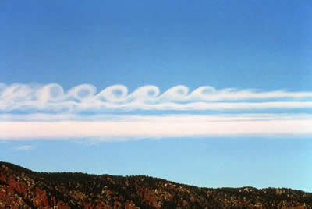
Wind Shear
If wind shear is large enough, the atmosphere can break down into turbulent eddies called Kelvin-Helmholtz waves
Looks and acts like ocean waves breaking on a beach as in the picture to the left
Plane rides through these areas can get bumpy…very bumpy!
Limited in vertical extent – so pilots test altitudes for smoother “rides”
Kelvin-Helmholtz clouds-visual indicators of high level turbulence
Adverse Winds
Notes:
 Wind shear – The rate of change of wind velocity (direction and/or speed) per unit distance; conventionally expressed as vertical or horizontal wind shear.
NOTE: Teach from slide.

Slide 36
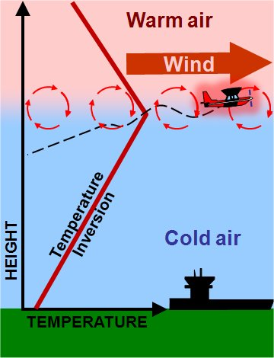
Temperature Inversion
◉ Inversions occur:
  Within lowest few thousand feet above ground due to nighttime radiational cooling
  Along frontal zones
  Within cold air trapped in a valley
◉ Strong wind shears often occur across temperature inversion layers which can generate turbulence
Adverse Winds
Notes:
 Temperature Inversion – A layer in which temperature increases with altitude. The principle characteristic of an inversion layer is its marked stability so that very little turbulence can occur within it. Strong wind shears often occur across inversion layers.
NOTE: Teach from slide.

Slide 37
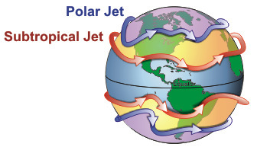
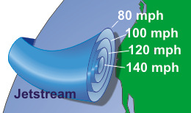
Clear Air Turbulence (CAT)
Location/intensity is directly related to wind shear
  Intensity is maximized during winter when jet streams are strongest
  Around sharply curved jet streams associated with rapidly intensifying pressure systems
◉ Jet stream CAT is usually confined to relatively thin, transient layers
  Best escaped by changing altitude
Courtesy NOAA/National Weather Service - Jetstream
Adverse Winds
Notes:
Jet stream – A quasi-horizontal stream of winds 50 knots or more concentrated within a narrow band embedded in the westerlies in the high troposphere.
Two jet streams are commonly distinguished; the polar jet and the sub-tropical jet.
Clear Air Turbulence (CAT) - A higher altitude (~20,000 to 50,000 ft or 6-15 km) turbulence phenomenon occurring in cloud-free regions, associated
with wind shear, particularly between the core of a jet stream and the surrounding air. It is most common near upper air fronts and the tropopause, and can
affect an aircraft without warning.
NOTE: Teach from slide.

Slide 38
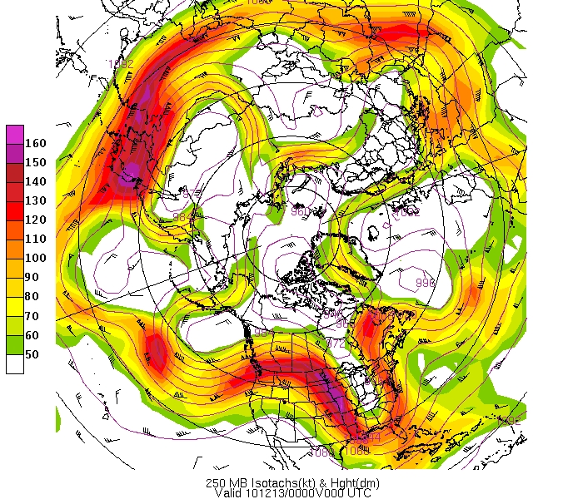
Jet Stream
Formed as the result of temperature gradients between polar and sub-tropical air masses
Strongest fall and winter
Shifts farther south in fall and winter
Flow predominately west to east but undulations in the flow pattern can result in components of north or south flow
Jet streams intensify and decay
Localized zones of extremely strong winds called jet streaks (>160kt) can form within jet streams
Can be several thousand miles long, a few hundred miles wide, and a few thousand feet in depth
Adverse Winds
Notes:
NOTE: Teach from slide.

Slide 39
Turbulence Intensity Classification
Intensity | Symbol | Aircraft Reaction | Reaction Inside Aircraft
Light |  | Momentarily causes slight, erratic changes in altitude and/or attitude (pitch, roll, yaw). | Occupants may feel a slight strain against seat belts or shoulder straps. Unsecured objects may be displaced slightly. Food service may be conducted and little or no difficulty is encountered in walking.
Moderate |  | Changes in altitude and/or attitude occur but the aircraft remains in positive control at all times. It usually causes variations in indicated airspeed. | Occupants feel definite strains against seat belts or shoulder straps. Unsecured objects are dislodged. Food service and walking are difficult.
Severe |  | Causes large, abrupt changes in altitude and/or attitude. It usually causes large variations in indicated airspeed. Aircraft may be momentarily out of control. | Occupants are forced violently against seat belts or shoulder straps. Unsecured objects are tossed about. Food Service and walking are impossible.
Extreme |  | Aircraft is violently tossed about and is practically impossible to control. It may cause structural damage.
Chop is a category of turbulence which causes rapid and somewhat rhythmic bumpiness without appreciable changes in altitude or attitude. May be reported as light chop or moderate chop.
Adverse Winds
Notes:
NOTE: Teach from slide.

Slide 40
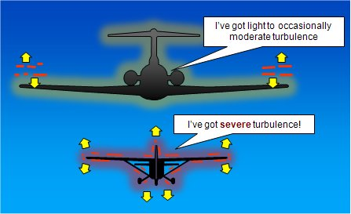
Aircraft Reaction to Turbulence
◉ Varies with aircraft:
  Size
    Larger is less bumpy
  Airspeed
    Slower is less bumpy
  Attitude
  Wing loading
◉ Smoother air is usually best found by changing altitude
Adverse Winds
Notes:
NOTE: Teach from slide.

Slide 41
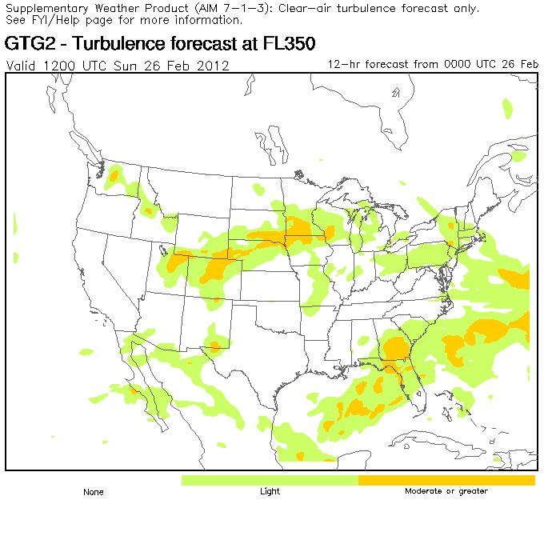
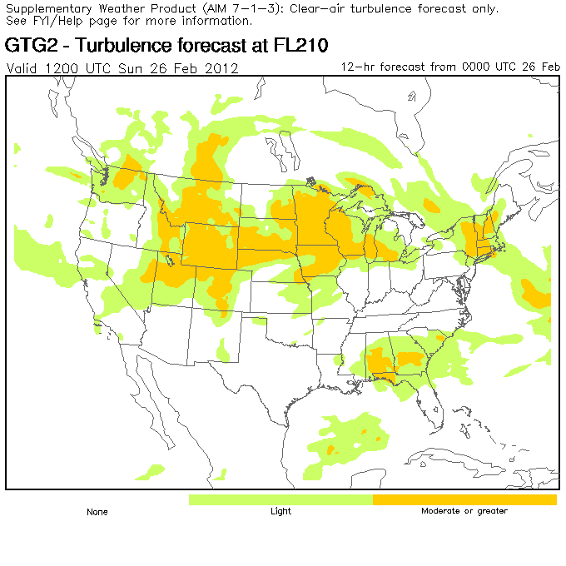
Graphical Turbulence Guidance
Aviation Weather Center
updated hourly / 12 hour forecasts / from 11,000 ft to FL450
http://aviationweather.gov/adds/turbulence/
Adverse Winds
Notes:
NOTE: Teach from slide.

Slide 42
Response Item
When the air is too dry for cumuliform clouds to form, _______ currents called thermals can still be active and cause turbulence.
A. wind shear
B. mechanical
C. convective
Adverse Winds
Notes:
NOTE: Click advance to reveal answer.

Slide 43
Response Item
Which of the following clouds would provide visual proof that a mountain wave exists?
A. Rotor cloud
B. Towering Cumulus (TCU)
C. Cumulonimbus (CB)
Adverse Winds
Notes:
NOTE: Click advance to reveal answer.

Slide 44
Response Item
_______ generates turbulent eddies between two wind currents of differing velocities.
A. Wind shear
B. Obstructions to the wind flow
C. Convective currents
Adverse Winds
Notes:
NOTE: Click advance to reveal answer.

Slide 45
Response Item
_______ turbulence momentarily causes slight erratic changes in altitude and/or attitude (pitch, roll, yaw).
A. Light
B. Moderate
C. Severe
Adverse Winds
Notes:
NOTE: Click advance to reveal answer.

Slide 46
Response Item
With _______ turbulence, the aircraft is violently tossed about and is practically impossible to control. It may cause structural damage.
A. moderate
B. severe
C. extreme
Adverse Winds
Notes:
NOTE: Click advance to reveal answer.

Slide 47
Response Item
Aircraft reaction to turbulence varies with aircraft _______.
A. altitude
B. size
C. navigational equipment
Adverse Winds
Notes:
NOTE: Click advance to reveal answer.

Slide 48
Downburst Lifecycle
FORMATION – Evaporation and precipitation drag forms downdraft
IMPACT – Downdraft quickly accelerates and strikes ground
DISSIPATION – Downdraft moves away from point of impact
Adverse Winds
Notes:
 Downburst – An area of strong, often damaging winds produced by a convective downdraft over an area from less than 0.6 to 6 miles (1 to 10 km) in horizontal dimensions.
 Microburst – A downburst that covers an area less than 2.5 miles (4 km) along a side with peak winds as high as 170 mph (150 kt) that lasts 2 to 5 minutes. The strong wind shears associated with a microburst can result in aircraft accidents.

Slide 49
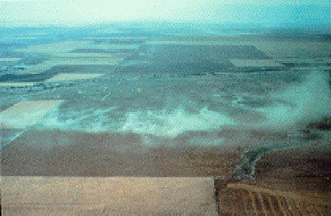
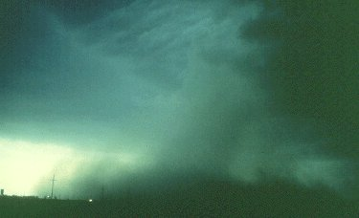
Microburst Types
A dry microburst is associated with virga
  Downdraft is driven by evaporative cooling of raindrops falling through dry, unsaturated air
A wet microburst is associated with a concentrated rain shaft
  Downdraft is driven by both evaporative cooling and precipitation drag of raindrops dragging air to the ground
Adverse Winds
Notes:
NOTE: Teach from slide.

Slide 50
Landing in a Microburst
X
Y
Z
Glideslope
At point X, the airplane enters the microburst zone where a headwind causes it to balloon above the normal glideslope.
At the center of the microburst, point Y, there is a downdraft which causes the airplane to sink.
At point Z, the airplane enters the most lethal zone where a sudden tailwind causes the airplane to lose airspeed.
Adverse Winds
Notes:
NOTE: Click forward to cue motion of aircraft between the points and reveal the associated text on the screen.
◉ A downburst is especially dangerous to airplanes when it is encountered when climbing from takeoff or approaching to land.
• During this phase, the aircraft is operating at relatively slow speeds.
- A major change of wind velocity can lead to a loss of lift and a crash.
◉ Pilots should be alert for a downburst early in the approach phase and be ready to initiate a missed approach at the first indication.
• However, it may be impossible to recover from a downburst encounter at low altitude.
PanAm 759: Encountered microburst on departure from MSY runway 10, crashing into Kenner LA
Delta 191: Encountered microburst on approach to DFW while flying through TSRA at north end of airport

Slide 51
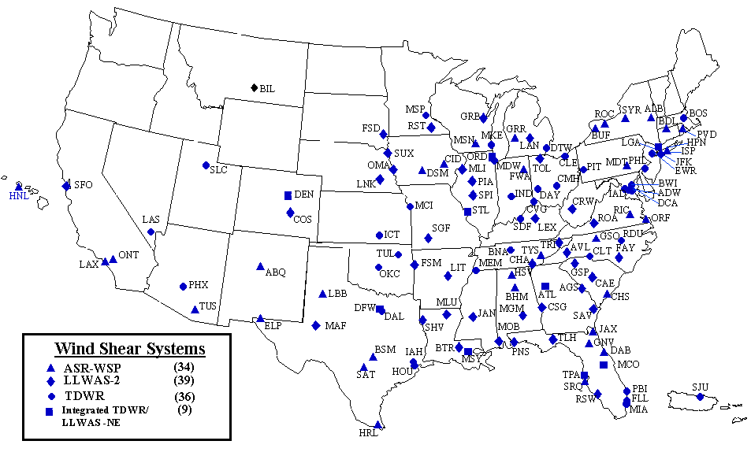
National Airspace System (NAS) Wind Shear Product Systems
Adverse Winds
Notes:
◉ The FAA has installed the following systems to warn terminal controllers and pilots of microbursts, wind shear, and gust fronts:
• Low-level wind shear alert system (LLWAS)
- Detects surface wind shear through the use of up to 32 remote wind sensors situated around an airport.
• Terminal Doppler weather radar (TDWR)
- Specialized weather radars used to detect microbursts, gust fronts, and convective storms along arrival and departure paths.
• Airport surveillance radar (ASR)-Weather system processor (WSP)
- An enhanced weather processor for the ASR-9 air traffic control radar that includes Doppler wind estimation for the detection of low-level wind shear.
◉ Tower controllers relay specific alerts from these systems to pilots via voice radio communication.

Slide 52
Response Item
It may be impossible to recover from _______ encountered at low altitude.
A. a headwind
B. a microburst
C. an outburst
Adverse Winds
Notes:
NOTE: Click advance to reveal answer.

Slide 53
Low-Level Wind Shear (LLWS)
 Low-level wind shear (LLWS) – A wind shear of 10 knots or more per 100 feet in a layer more than 200 feet thick which occurs within 2,000 feet of the surface.
Wind
Wind
Adverse Winds
Notes:
 Low-level wind shear (LLWS) – A wind shear of 10 knots or more per 100 feet in a layer more than 200 feet thick which occurs within 2,000 feet of the surface.

Slide 54
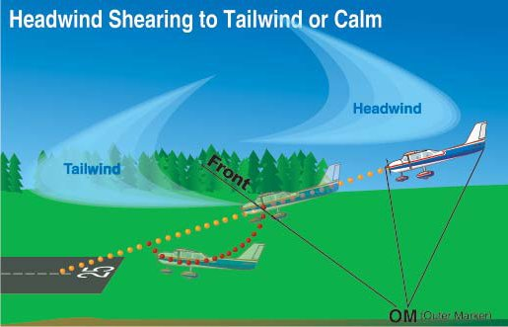
Wind Shear – Change From Headwind to Tailwind (or Calm) on Landing
Adverse Winds
Notes:
◉ While an aircraft is on approach, a shear from a headwind to a tailwind (or calm) causes:
• The airspeed to decrease
• The nose to pitch down
• The aircraft to drop below the glide slope
• If the pilot pulls the nose up to compensate, airspeed will be reduced even further.
- The pilot will typically compensate by increasing power, but if the engines don’t spool up fast enough, the airplane may land short, slow, and hard and could lead to a crash.

Slide 55
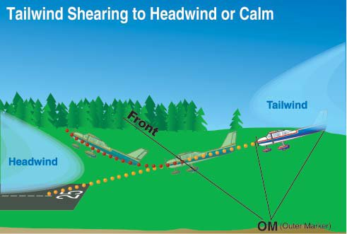
Wind Shear – Change from a Tailwind to a Headwind (or Calm) on Landing
Adverse Winds
Notes:
◉ Conversely, if the wind is calm, or there is a slight tailwind, and the flow shears into a headwind, this causes:
• The airspeed to increase
• The nose to pitch up
• The aircraft to balloon upward above the glide slope
• The airplane will land long and could run out of runway.
◉ Small, general aviation aircraft are much more prone to the effects of low-level wind shear than large commercial aircraft because:
• Their approach speeds are much closer to their stall speeds.

Slide 56
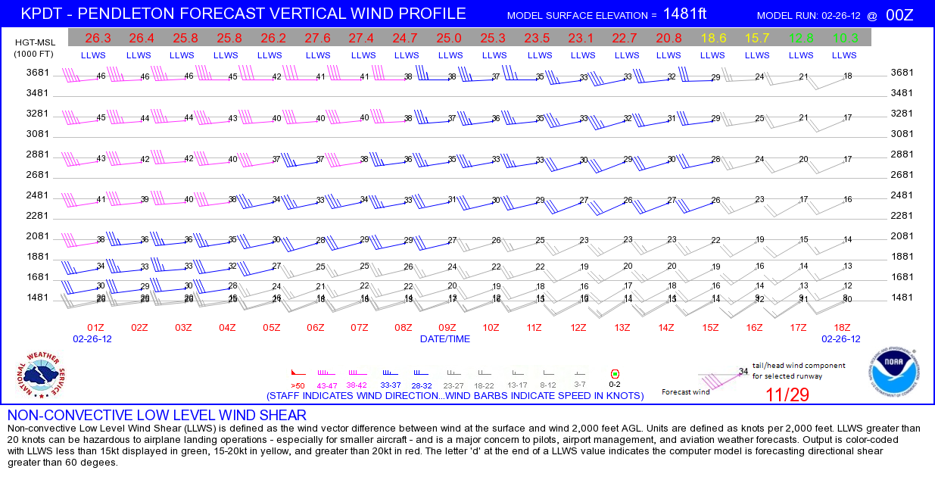
Vertical Wind Profiles from Seattle CWSU
most sites updated hourly / 18 hour forecasts / up to 2,000, 10,000, or 20,000 feet
http://www.wrh.noaa.gov/zse/WindProfiles.php
Adverse Winds
Notes:
NOTE: Teach from slide.

Slide 57
Response Item
Wind shear is especially dangerous when it is encountered _______.
A. during takeoff and landing
B. enroute
C. while in a holding pattern
Adverse Winds
Notes:
NOTE: Click advance to reveal answer.

Slide 58
Response Item
While an aircraft is on approach, a shear from a tailwind to a headwind causes airspeed to _______, the nose to pitch _______, and the aircraft to _______ the glide slope.
A. increase, up, balloon upward above
B. increase, up, drop below
C. decrease, down, drop below
Adverse Winds
Notes:
NOTE: Click advance to reveal answer.

Slide 59
What You Can Do
Report encounters with turbulence
Continue to report turbulence…even reports of no turbulence when it’s forecast. These will help other pilots, dispatchers, aviation forecasters, and ARTCC controllers do a better job in making sure you have a safe and comfortable ride!
Adverse Winds

Slide 60
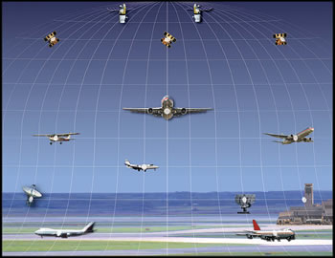
The End
Adverse Winds
Notes:
THE END

Slide 61
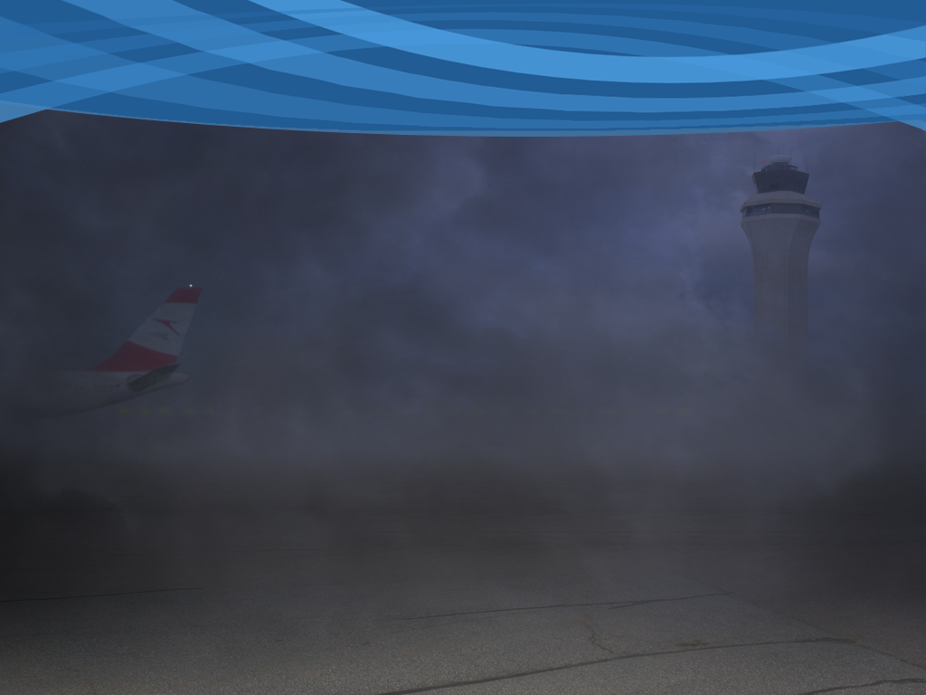

National Weather Service
Center Weather Service Units
Jim Vasilj
Meteorologist
Seattle Center Weather Service Unit
Seattle Air Route Traffic Control Center
Auburn, Washington

Slide 62
CWSU Background Info
CWSUs are NWS units
Contracted to the FAA
Located at every FAA ARTCC
Operate Every Day, 5am – 9pm
Staffing
  One MIC (Meteorologist in Charge)
  Three General Forecasters

Slide 63
CWSU Mission
Provide meteorological advice and consultation to Center operations personnel and other designated FAA air traffic control facilities (towers and TRACONS)
Emphasis on weather conditions that would be hazardous to aviation or would impeded the safe and efficient flow of air traffic, or cause ground and/or airborne delays

Slide 64
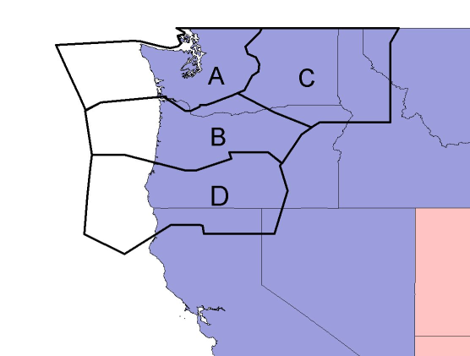
Seattle CWSU Forecast Area
(ZSE ARTCC CONTROL AREAS SHOWN IN BLACK)
ZSE’s area of responsibility covers all or parts of six, western states and adjacent offshore waters covering an area more than 300,000 square miles.
The area includes a range of climatic zones from marine, modified marine, arid, semi-arid, alpine and rain forest
OTX
SEW
●
●
●
MSO
●
●
PDT
PQR
●
BOI
MFR
Primary WFOs
SEA
PQR
MFR
EKA
OTX
PDT
Adjacent WFOs
MSO
BOI
RNO
STO
MTR
●
●
EKA
●
●
RNO
STO
●
MTR

Slide 65
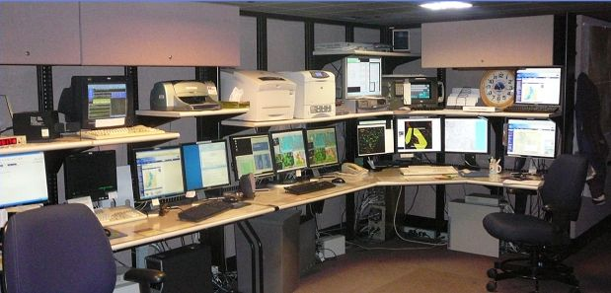
CWSU Work Area
Equipment is a mix of NWS and FAA supplied workstations and communications devices. We work in the Operations area next to the Traffic Management Unit (TMU).

Slide 66
CWSU Products and Services
Center Weather Advisory (CWA)
Meteorological Impact Statement (MIS)
Stand Up Briefings (8 am and 4 pm)
Provide weather refresher training for controllers and managers
Internet Briefing/Situational Awareness Pages including Social Media
Verbal Nowcasts/Forecasts provided to Centers, TRACONs, Towers, and FAA Command Center

Slide 67
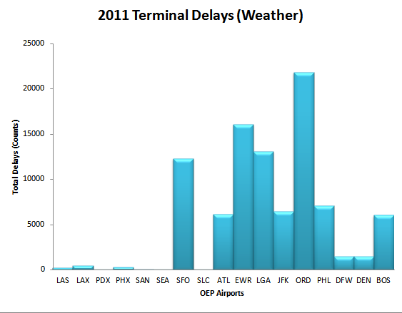
Reducing Airport Delays
Notes:
OEP: Operational Evolution Partnership (commercial US airports with significant activity)

Slide 68
Center Weather Advisory
An in-flight advisory product ...
  Issued when conditions meet SIGMET or AIRMET criteria, but none is in effect
  Issued to supplement (or update) an existing SIGMET, AIRMET, Convective SIGMET
  Issued for conditions that will adversely affect the safe flow of air traffic in ARTCC area
Center Weather Advisories are CWSU’s most important product
Notes:
AIRMET: Airmen’s Meteorological Information
SIGMET: Significant Meteorological Information

Slide 69
Example CWA
ZSE CWA 170014
ZSE CWA 101 VALID 170030-170200
FOR WRN WA...
FROM 40SE BLI TO 40NE PDX TO AST TO 40SE BLI
AREA STG LLWS RPTD BY NUMRS ACFT BLO 010. CONDS TO
CONTINUE TIL 170200. ZSE CWSU 170014

Slide 70
Meteorological Impact Statement
Unscheduled planning forecast of up to 12 hours for conditions that may impact flow of air traffic within the ARTCC.
  Thunderstorms, icing, turbulence, low IFR
  Freezing precipitation, wind greater than 30kt
  Dust, volcanic ash

Slide 71
Example MIS
ZSE MIS 161713
ZSE MIS 01 161730-162030
...FOR ATC PLANNING PURPOSES ONLY...
AT SEA AND PDX
SOUTHERLY WINDS 40-50 KTS WITHIN 020 AGL AND MVFR CIGS IN APPROACH AREAS OF BOTH AIRPORTS. EXPECT GROUND AND AIRBORNE DELAYS OF 20-30 MIN. ZSE CWSU 170014

Slide 72
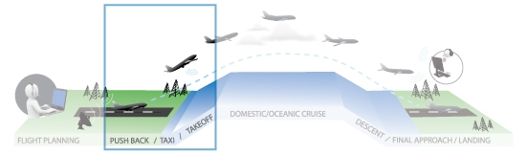
CWSUs are involved in all phases of flight
NAS - ARTCC TMU with FAA Command Center
Airport arrival and departure rates
Compression forecast (strong winds below 050 on approach)
TS forecasts (arrival and departure gates)
Assist TRACON/Tower in flow control (SEA north vs south, PDX east vs west or south vs north)

Slide 73
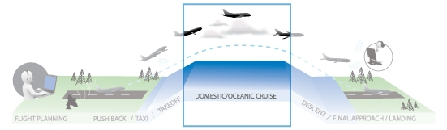
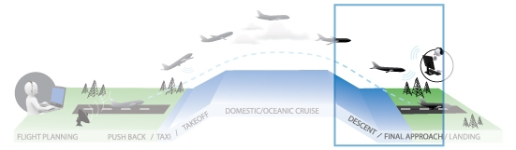
CWSUs are involved in all phases of flight
Icing
Turbulence
Tstms
CCFP
PIREPS
CWAs/MISs
AIRMETS
SIGMETS
Volcanic Ash plumes
Solar Wx
Assist TMUs and TRACONs with same issues as in the departure phase of flight

Slide 74
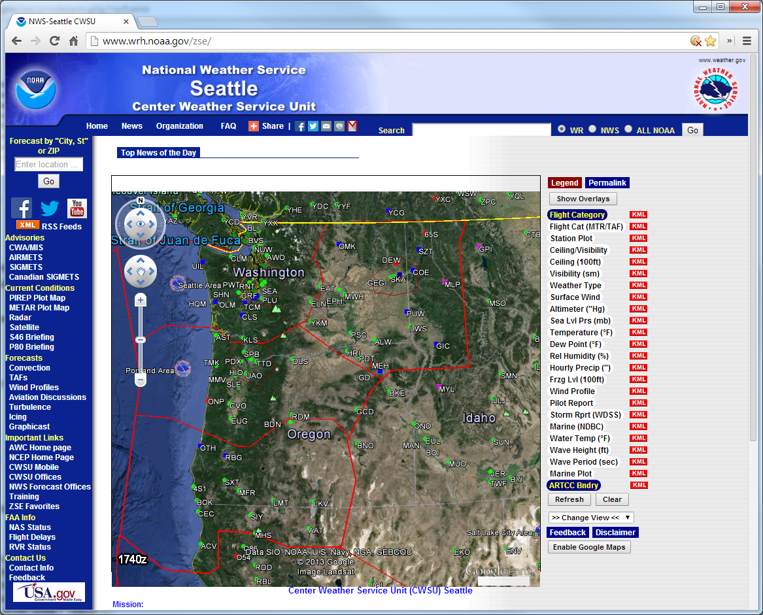
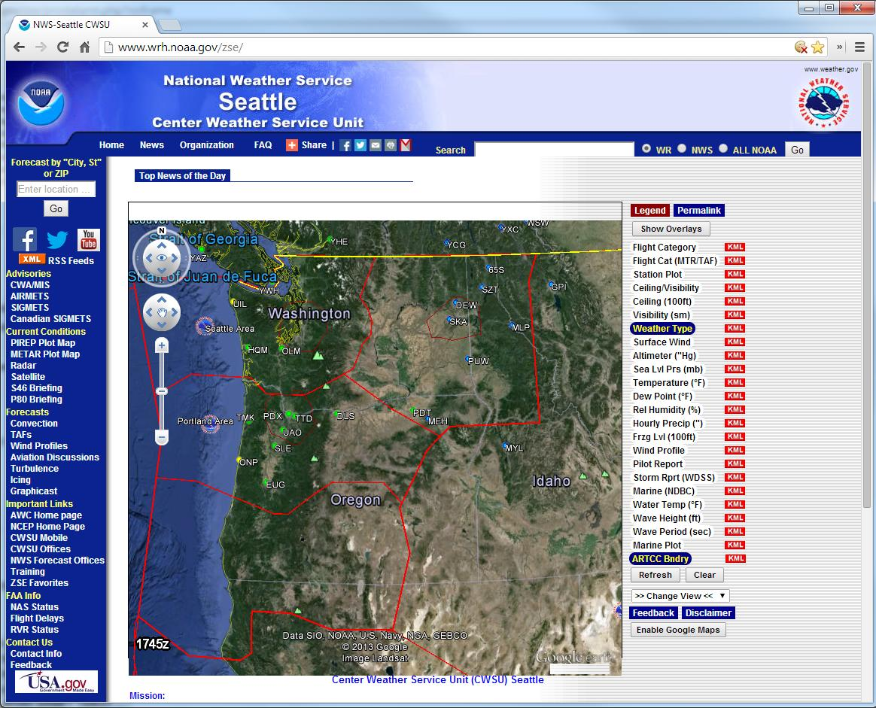
Seattle CWSU Web Pages
(Situational awareness and decision support tools)
Notes:
ZSE Home Page with Google Earth

Slide 75
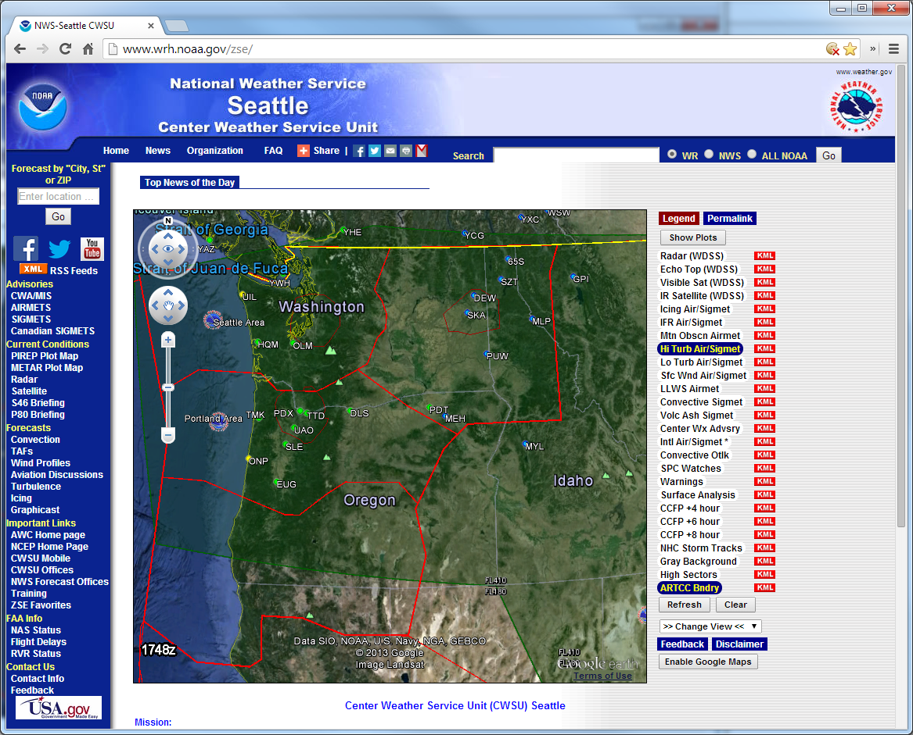
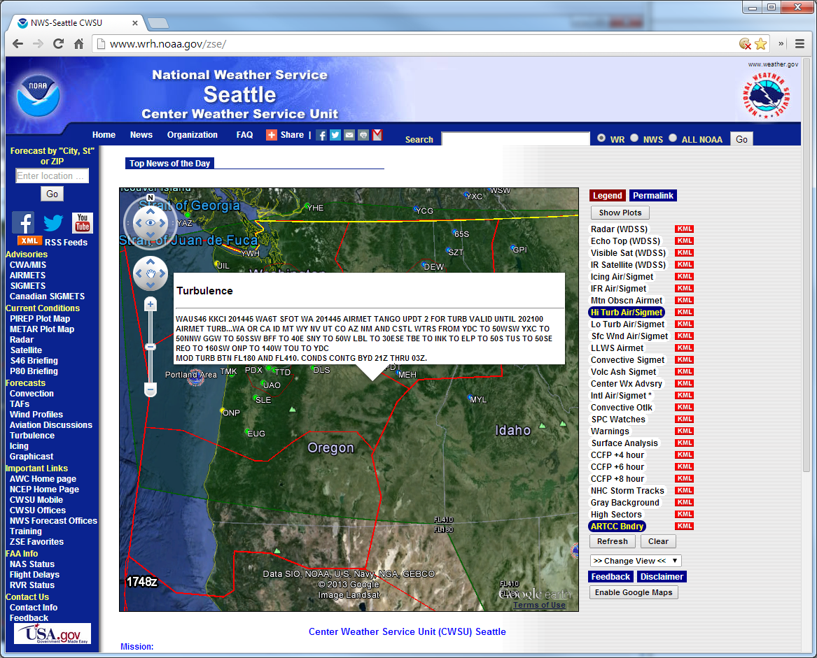
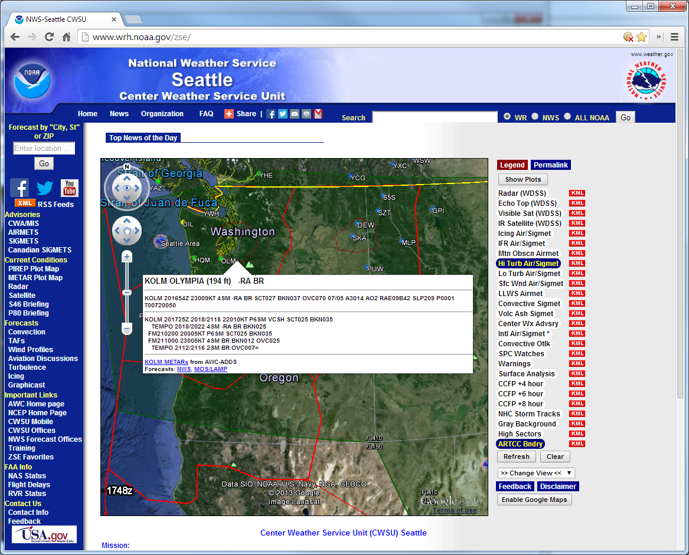
Seattle CWSU Web Pages
Notes:
ZSE Home Page with Google Earth
Turbulence AIRMETs and Weather Type

Slide 76


Seattle CWSU Web Pages
Notes:
ZSE Home Page with Google Earth
Radar/Visible Satellite and Weather Type

Slide 77


Seattle CWSU Web Pages
Notes:
ZSE Home Page with Google Earth
Radar and Convective SIGMET

Slide 78

Simple Google Maps Application
Available 24/7
Notes:
New Simple Google Maps Application (no Google Earth Plug In Required)
Radar and PIREPs

Slide 79

Seattle CWSU Web Pages
Notes:
Legend for Google Maps/Earth Pages

Slide 80


Seattle CWSU Web Pages
Vertical Wind Profiles
18 hour time vs height wind profiles for specific locations across the Pac NW
Displays tailwind/
headwind component
of forecast wind
Display 18 hour freezing level forecast
Updated hourly using the output from the RUC model
Selectable runway
Available as JPG image
Available 24/7

Slide 81



Weather Story
Link in “Top News of the Day” on Home Page
Notes:
Weather Story Examples

Slide 82


CWSU Mobile Website
http://www.wrh.noaa.gov/zoa/MOBILE/ZOA2.htm
81
Notes:
81
CWSU Mobile Page developed by the Oakland CWSU

Slide 83




Training…web audio presentations

Slide 84

Facebook
US.NationalWeatherService.SeattleCWSU.gov

Slide 85

Twitter
@NWSCWSUZSE

Slide 86


ZSE Newsletter…available in PDF format

Slide 87
Web Page URL
These and other images and text products can be found at:
http://www.wrh.noaa.gov/zse

Slide 88
The End
Questions, Suggestions, Comments, or Concerns?
Jim Vasilj
Seattle CWSU
3101 Auburn Way South
Auburn, WA 98092
Phone: 253-351-3741
Email: James.Vasilj@noaa.gov

Slide 89
The End

Slide 90
Back up

Slide 91

Notes:
The challenge coming from the resolution changes driven by NextGen will be how to keep our digital products representative of rapidly changing weather conditions, and at the same time maintaining internal meteorological consistency.
NextGen requirements suggest continuous updates to gridded information working at spatial and horizontal resolutions we are not accustomed to working with today
The FAA has clearly voiced their desire for more consistent aviation products starting today!
The CWSU business models address the consistency issues with the implementation of the Collaborative Weather Impact Product or (CWIP)
We must also work with metrics that measure performance of the operation of the NAS instead of the performance of a forecaster versus model output.

Slide 92

Overnight Briefing Sheet
Overnight briefing sheet used by OMs, FLMs, and TMU.
Available on ZSE’s web site 9 pm through 5 am.
91
Notes:
91
CWSUs -- don’t know how role of CWSU will change in the future because FAA air traffic management concepts are still evolving - want to insure safety of the flying public -- we’ll evolve as the mission and the science demands
We will evolve as the science and mission requirements dictate.

Slide 93

NWSChat Live…instant messaging

Slide 94
Web Stats…showing steady increase
Steady increase since 2008

Slide 95
CWSU Products and Services
Center Weather Advisory (CWA)
Meteorological Impact Statement (MIS)
Stand Up Briefings (8 am and 4 pm)
Various weather products to controllers (via WARP Briefing Terminals and Web Page)
Provide weather refresher training for controllers and FLMs
Internet Briefing/Situational Awareness Pages
Verbal Nowcasts/Forecasts provided to Centers, TRACONs, Towers, and FAA Command Center
  Wind, thunderstorm, snow, fog, RVR, ceiling, visibility, etc

Slide 96




Seattle CWSU Web Pages
Notes:
ZSE Home Page with Google Earth

Slide 97

Notes:
To expand on the last bullet:
Reduced requirement for government provided weather “products”
Weather information is translated into operational decision options for human/automated systems
Standalone Weather “Systems” become obsolete
Weather information sets become the government provided product in most cases
Opportunity for tailoring of private sector provided products significantly increase

